Slide 1

Version Control Systems: Mastering Git
This presentation explores the world of version control systems, specifically focusing on Git, a powerful tool for managing code and collaborating efficiently. We will cover the basics, benefits, and practical application of Git in real-world development scenarios.
by Kanishk Jain

Slide 2
What is Version Control?
Tracking Changes
Collaboration
Version control is a system that keeps track of changes made to files over time, allowing you to revert to previous versions or compare changes.
Version control allows teams to work on the same project simultaneously without overwriting each others' work, enabling seamless collaboration.

Slide 3

Benefits of Version Control
1
1. Undo Mistakes
2
2. Collaboration
Easily revert to previous versions of your code, undoing unwanted changes or fixing errors.
Work with teammates on the same codebase without conflicts, ensuring everyone is on the same page.
3
3. Project History
4
4. Code Recovery
Track the evolution of your project, understand who made what changes, and learn from past iterations.
Never lose your work again. Version control provides backups and allows you to recover lost or corrupted files.

Slide 4




Introduction to Git
Open Source
1
Developed and maintained by a global community of developers, promoting collaboration and innovation.
Distributed System
2
Each developer has a full copy of the project's history, allowing for offline work and independent development.
Command-Line Interface
3
Primarily controlled through commands, providing flexibility and advanced features.
Version Control
4
Tracks every change made to a project, allowing you to revert, compare, and understand the evolution of your code.

Slide 5
Git Fundamentals: Repositories, Commits, Branches
Repositories
Commits
Branches
A repository is a directory that holds all the files and history of a project, managed by Git.
A commit is a snapshot of the project at a specific point in time, recording changes and adding a message for context.
Branches allow you to work on different features or versions of a project simultaneously, isolating changes until ready to merge.

Slide 6
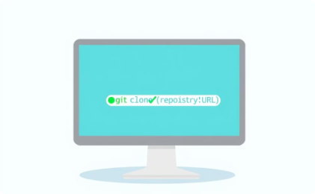
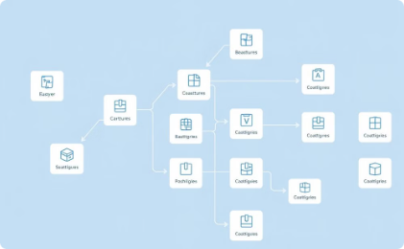
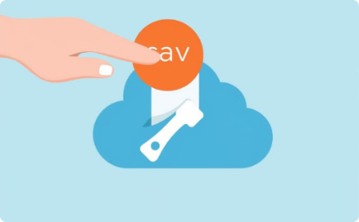



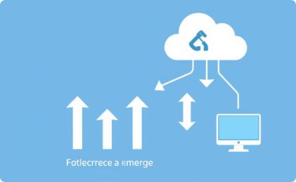
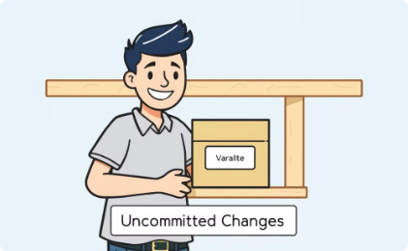
Git Workflow: Cloning, Branching, Merging, and More
Cloning
Branching
Committing
Merging
Create a local copy of a remote repository.
Create a new branch for each feature or bug fix to isolate changes.
Save your changes with a descriptive message.
Combine changes from one branch into another.
Pushing
Pulling
Fetching
Stashing
Upload your local commits to the remote repository for sharing.
Download the latest changes from the remote repository.
Download the latest changes from the remote repository without merging.
Temporarily set aside uncommitted changes when switching tasks.

Slide 7
Resolving Conflicts in Git
Identify Conflicts
1
Git will highlight areas of your code where changes from different branches have modified the same lines or sections. These areas are marked as conflicts, and Git will clearly indicate which changes came from which branch.
Manual Resolution
Carefully examine the conflicting code sections. Git usually provides a visual representation showing your changes, the changes from the other branch, and markers to help navigate. You can choose to keep either version, merge changes manually to combine parts of each version, or write a new solution that incorporates and synthesizes the elements from all conflicting sources.
2
Stage and Commit
Once you have resolved all conflicts, you'll need to stage the changed files using the `git add` command, confirming to Git that you've finished making changes. After staging, write a clear commit message explaining the conflict resolutions. This helps future developers understand the decisions made and prevents future problems. This is then committed with the `git commit` command.
3
Push Changes
Finally, push your changes to the remote repository using the `git push` command. This shares your resolved conflicts with your collaborators, ensuring everyone is working from a consistent version of the code. Be mindful of pushing often to avoid larger, more complex future merge conflicts.
4

Slide 8
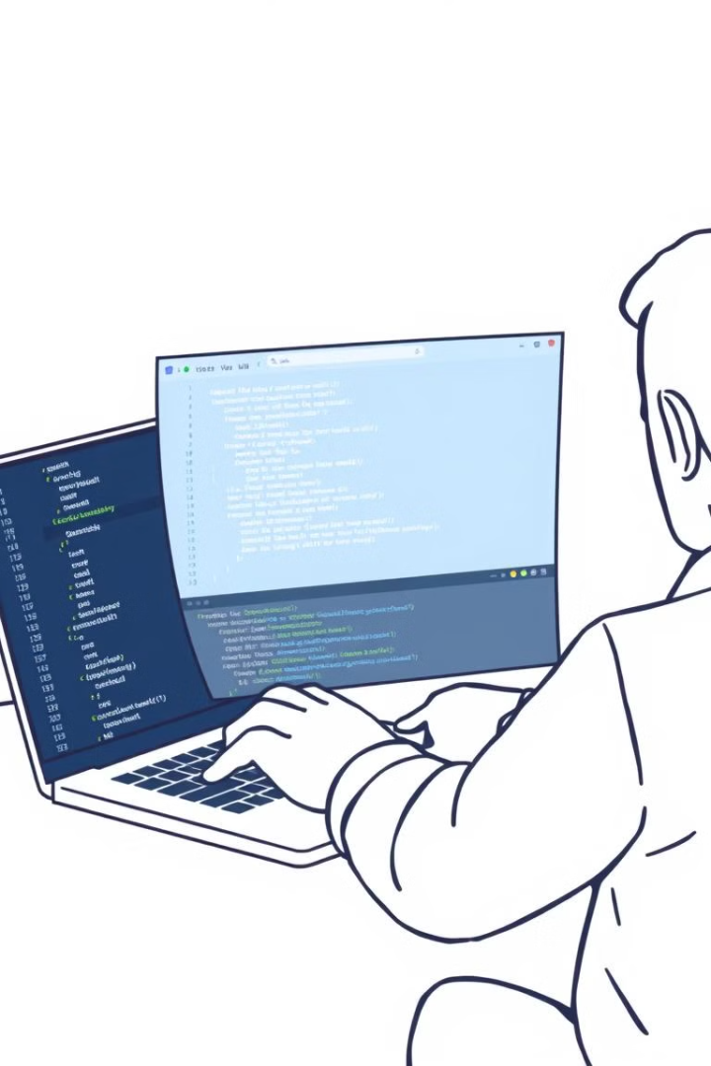
Git Tools and Workflows
GUI Clients
Command Line
GUI clients like GitHub Desktop simplify Git. They visualize branching and merging, making tasks like merging easier. Visual history helps avoid merge conflicts.
The command line offers precise Git control. Commands like `git add`, `git commit`, `git push`, and `git pull` manage repositories. It's best for complex tasks and resolving merge conflicts.
Workflows
Workflows like Gitflow and GitHub Flow organize branch management. Gitflow uses separate branches for different tasks, while GitHub Flow uses the main branch more frequently. The best workflow depends on your project.

Slide 9

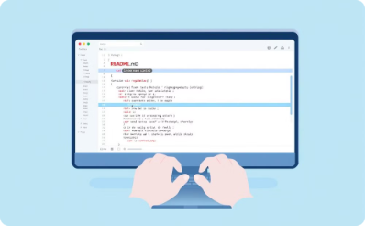
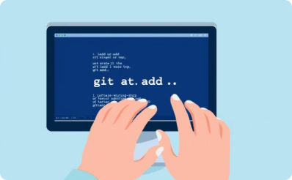
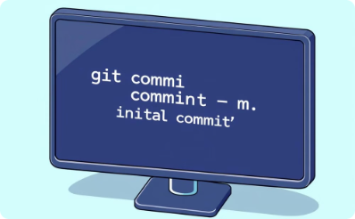
Small Example: Setting Up Git
Initializing a Repository
Create a README File
Stage Changes
Commit Changes
Use \`git add .\` to stage your changes. This tells Git which files you want to include in your next commit.
Finally, use \`git commit -m "Initial commit"\` to create the initial commit. This saves a snapshot of your project at this point in time.
The first step is creating a Git repository. The \`git init\` command sets up the repository in your project's folder.
Create a simple \`README.md\` file with basic project information. This file is useful for documenting your project.

Slide 10
Conclusion
1
Mastering Git
Version control is key for efficient collaboration.
2
Git's Power
Git's features streamline development.
3
Practice Makes Perfect
Regular practice builds Git proficiency.

