Slide 1
Programming exercise
iOS developer

Slide 2
Your mission is to create a new iOS app from scratch (in Swift). The app should contain one screen only, displaying a list of books and a header for the list.
To get the data your app should use this api:
https://api.storytel.net/search?query=harry

Slide 3
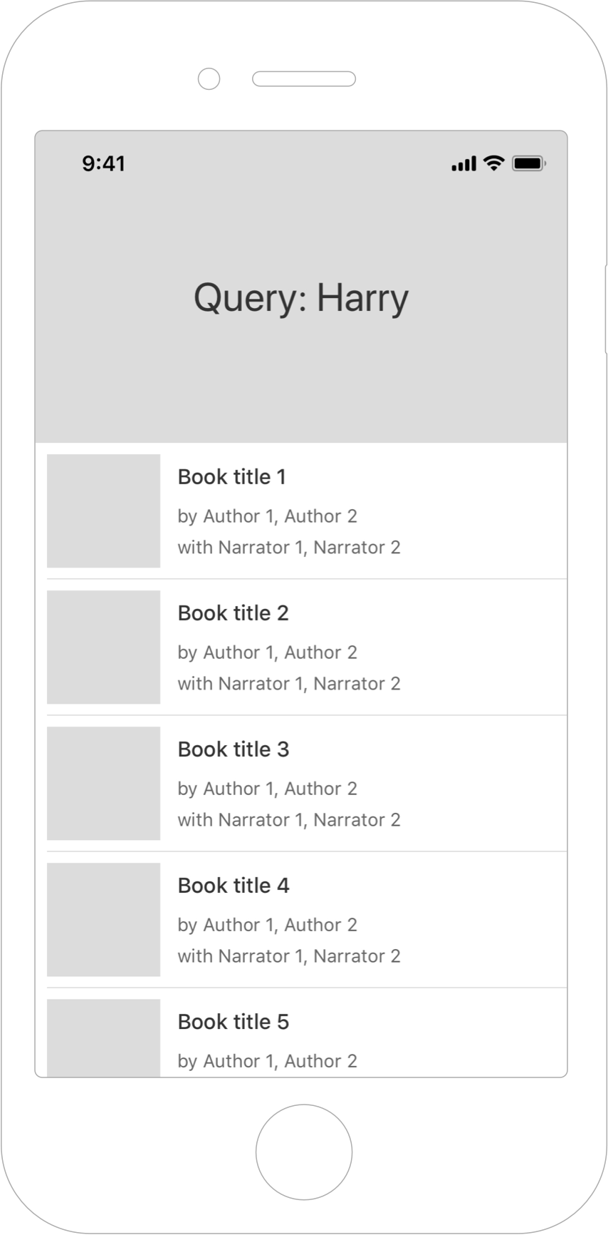
The JSON response from the api contains information to provide the list of books and the information header that you see in the image to the left.
Each book cell should contain a book cover image, a title, and two more labels.
One containing the list of author names, prepended with “By: “ and comma separated (if there are multiple) The second label should contain the list of narrator names, prepended with “With: ” and also comma separated. Each label should only use one row and truncate when the string becomes too long.

Slide 4
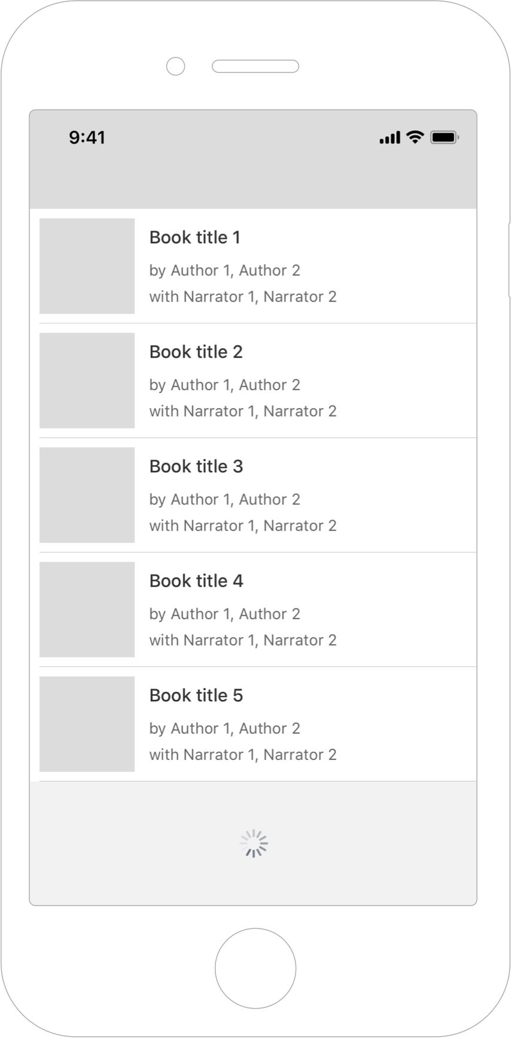
Scrolling down + pagination
When scrolling down, the query info area should just disappear with the rest of the page.
When reaching the bottom of the list, a new request should be sent to load more books to the current list. You should do that by appending a query parameter “&page=xxx” where “xxx” will be given to you in the api response (see root of json, look for the field called “nextPageToken”). So, if “nextPageToken” is “10”, the next request you send should be towards
https://api.storytel.net/search?query=harry&page=10.
While the request is loading you should show a spinner just below the last list cell.
When the response arrives, you should append the list of books to the list you already loaded.

Slide 5
What to consider
Write clean, readable and testable code. Also write unit tests where it makes sense.
Take the opportunity to showcase your coding style and use whatever design pattern you would normally use for this kind of task.
You are free to use whatever network library, dependency management, etc that you prefer (if any). But we ask you to limit the amount of libraries you use, and focus on showcasing your own skills. We kindly ask you not to use RxSwift or ReactiveSwift libraries.
Use Auto Layout
Minimum iOS target version should be 11. We suggest avoiding modern frameworks like SwiftUI and Combine.
We would like you to not create your view controller(s) using storyboard(s) or xibs but instead set those up programmatically in order for us to have an easier time reviewing your solution and assessing your skills.
It’s preferred that you use standard UI elements and follow HIG.

Slide 6
To send in your solution you should create a zip file containing the project and send that back to us, or send a link to a GitHub repository containing your solution.
Good luck!

