Slide 1

Talladega Nights: The Ballad of Concurrent Programming
Presenter: Ross Jennings

Slide 2

This is not me.
Edward Snowden

Slide 3

Clearly, very different people.
Ross Jennings

Slide 4
So who am I?
My name is Ross Jennings
I’m an architect here at Santander Consumer USA
I blog here: http://smugdeveloper.wordpress.com
(my friends in marketing will note the irony here since I fought so valiantly against using Wordpress in the enterprise)
My code (and these slides) goes here: http://github.com/staticvoidmain

Slide 5
Obligatory slides about Moore’s law
Not really a “law”, but it has become the de-facto standard for microprocessor manufacturers.
Named after Gordon E. Moore of (a co-founder of Intel) who described a steady trend in the number of transistors on a microprocessor.
Moore’s law essentially states that the number of transistors on a chip will double every 18 months.
Moore transistors means more performance. (See what I did there?)

Slide 6
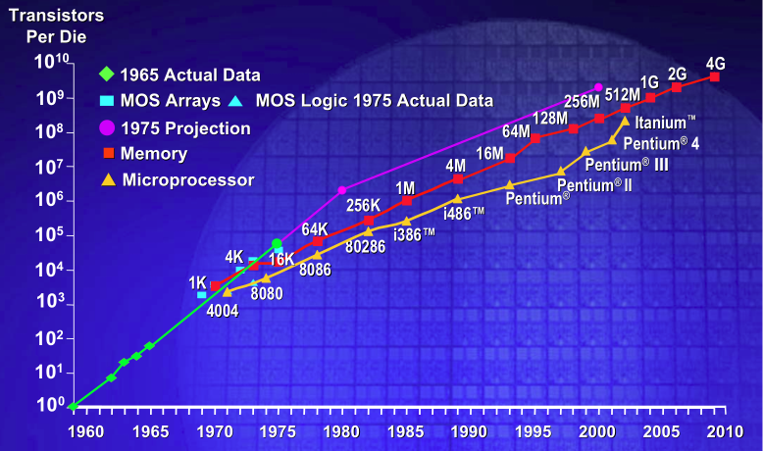
Obligatory picture illustrating Moore’s Law

Slide 7
No more free lunch
Much to the dismay of programmers everywhere, in 2003 the ability to add smaller and smaller transistors started to dry up. Due to something called “Physics”…
Specifically: Heat dispersion, power consumption, and quantum tunneling.
What’s better than one processor with lots of transistors? Lots of processors with lots of transistors. Moore’s law was saved! (Kinda)
We can no longer expect exponential speedups in our single-threaded software simply by improving hardware.
If we want peak performance, we have to start issuing work to more than one core.

Slide 8
Demo #1: Enter the Task
Microsoft has done a lot of research in this space and produced a number of libraries and compiler features which aim to make concurrent programming easier.
Starting in .Net 4.0 we’ve seen the introduction of “Parallel Extensions” to the base class library, which is comprised of the Task Parallel Library (TPL) and Parallel LINQ (PLINQ) to enhance support for parallel applications.
In .Net 4.5 Microsoft introduced the async and await keywords to C# to make writing asynchronous code less annoying.
Traditional async programming on .Net involved lots of Begin/End continuation passing code which was hard to follow. The async/await keywords allow you to write your code with normal control flow, and allow the compiler to rewrite the code to run asynchronously.

Slide 9
Danger Will Robinson, danger!
And now, a joke:
Some people, when presented with a problem think “I know! I’ll use threads”; now two they have problems.
Ha, ha it’s a race condition which causes the order of the words to get mixed up! Get it?
One of the biggest hazards when writing multi-threaded code is what is known as a race condition.
Code which is prone to race conditions can:
Cause your program to crash
Mutate shared variables in undefined ways
Report incorrect results
Be very difficult to debug, due to their non-deterministic nature.
Generally, crashing preferable to silent data corruption, but it doesn’t always happen that way.

Slide 10

I just thought this was hilarious and had to add it.

Slide 11
Demo #2: Who moved my cheese?
This demo illustrates some basic concurrency problems and how to mitigate them.
Synchronization primitives:
Locks (Mutex) – Mutual Exclusion primitive. Only one thread can own the block at any one time.
ReaderWriterLockSlim – Different locking levels based on intent. Readers won’t block other readers, but writers will block both readers and other writers.
SemaphoreSlim – Restricts the number of concurrent
SpinWait – Busy-wait instead of yielding a processor time-slice to another thread.
There are lots more, but these are the most common.

Slide 12
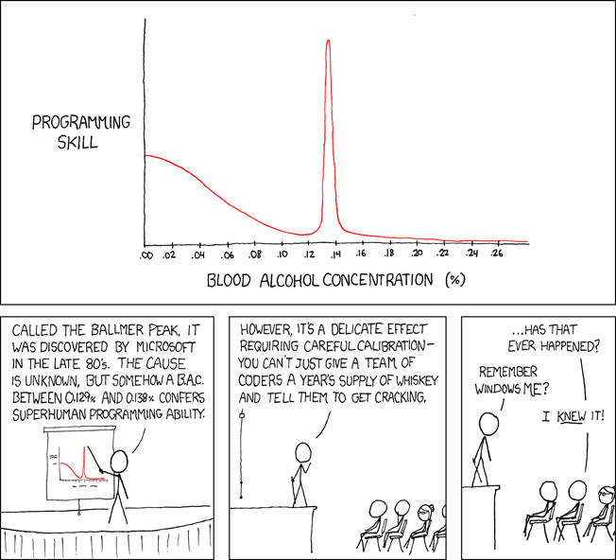
Demo #3: SPEEEEEEEED
Hopefully this demo doesn’t break. I threw it together in two days and I may have been trying to hit the Ballmer peak during most of it.

Slide 13
For further reading, check out the PFX team blog:
http://blogs.msdn.com/b/pfxteam/
Special thanks to Steve Youmans for writing so much slow code I decided to become a performance nerd!

