Slide 1
New World Ninja 2: NoSQL Jutsu
Presenter: Ross Jennings

Slide 2
Backstory
The mystic art of NoSQL is not a new style as some believe it to be.
Practitioners of NoSQL have been training in secret using the fighting manuals describing a technique called BerkelyDB since 1986.
The BerkelyDB fighting style does not involve relations, and thus can be employed freely and without restraint.
I don’t have enough time to carry on the ninja premise, so I’m just going to shoot some facts at you now.

Slide 3
What is NoSQL?
NoSQL is just as the name implies, any data-store which is not relational.
It has been perhaps overly-hyped by some to imply that it is the best thing since C++ and the only way to achieve “big scale”.
NoSQL Databases are deployed by some big technology companies, and it does tend to scale well, but it is not a magic bullet.
Google uses BigTable
Facebook uses Cassandra
Amazon uses DyanamoDb

Slide 4
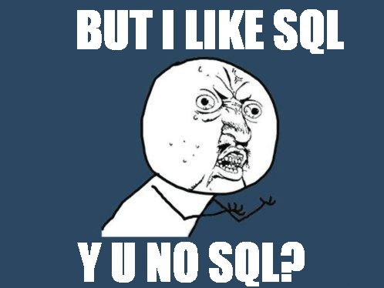
So what’s wrong with SQL?

Slide 5
So what’s wrong with SQL?
It’s not that NoSQL is a reaction to SQL being “broken”, but rather that there are some design goals which don’t map nicely to flat tables.
There is a concept called “the object-relational impedance mismatch”. (Try saying that five times fast)
Objects have structure, they have depth, they have weird a non-geometric shape.
Tables by comparison are flat rectangles of data.
Because of the impedance mismatch, we invent these things called Object Relational Mappers (ORMs) to do the translation between the flat world of the RDBMS to the hierarchical land of objects.
There is a cost to doing these mappings and it manifests as the dreaded SELECT N+1 <insert maniacal laughter>

Slide 6
Fetch all the things!
What is SELECT N+1?
foreach (Thing thing in FetchSomeThings()) // 1 select
{
// n more selects
thing.RelatedThing = FetchARelatedThing(thing.Id);
}
You might be saying to yourself: “So what Ross I do that every single day.”
Oh yeah? Well you’re doing it wrong. Each fetch incurs a separate TCP connection, parsing, execution, waiting on the result set from the network.
All these things take time. Precious, precious time.

Slide 8
For further reading, check out the PFX team blog:
http://blogs.msdn.com/b/pfxteam/
Thanks!

