Slide 1

New World Ninja 2: NoSQL Jutsu
Presenter: Ross Jennings

Slide 2
Backstory
The mystic art of NoSQL is not a new style as some believe it to be.
Practitioners of NoSQL have been training in secret using the fighting manuals describing a technique called BerkelyDB since 1986.
The BerkelyDB fighting style does not involve relations, and thus can be employed freely and without restraint.
I don’t have enough time to carry on with the ninja premise, so I’m just going to shoot some facts at you now.

Slide 3
What is NoSQL?
NoSQL is just as the name implies, any data-store which is not relational.
It has been perhaps overly-hyped by some to imply that it is the best thing since C++ and the only way to achieve “big scale”.
NoSQL Databases are deployed by some big technology companies, and it does tend to scale well, but it is not a magic bullet.
Google uses BigTable
Facebook uses Cassandra
Amazon uses DyanamoDb
No shortage NoSQL databases to choose from.

Slide 4
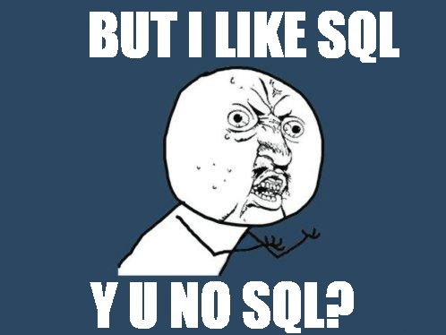
So what’s wrong with SQL?

Slide 5
So what’s wrong with SQL?
It’s not that NoSQL is a reaction to SQL being “broken”, but rather that there are some design goals which don’t map nicely to flat tables.
There is a concept called “the object-relational impedance mismatch”. (Try saying that five times fast)
Objects have structure, they have depth, they have weird a non-geometric shape.
Tables by comparison are flat rectangles of data.
Because of the impedance mismatch, we invent these things called Object Relational Mappers (ORMs) to do the translation between the flat world of the RDBMS to the hierarchical land of objects.
There is a cost to doing these mappings and it manifests as the dreaded SELECT N+1 <insert maniacal laughter>

Slide 6
Fetch all the things!
What is SELECT N+1?
foreach (Thing thing in FetchSomeThings()) // 1 select
{
// n more selects
thing.RelatedThing = FetchARelatedThing(thing.Id);
}
You might be saying to yourself: “So what Ross I do that every single day.”
Oh yeah? Well you’re doing it wrong. Each fetch incurs a separate TCP connection, parsing, execution, waiting on the result set from the network. Also, you didn’t specify how many things, so your result set could potentially be VERY large.
All these things take time. Precious, precious time…

Slide 7
What about that ORM thing?
An ORM is a workaround for the impedance mismatch but it is not a complete solution.
ORMs can do a better job at preventing SELECT N+1 but they are only as good as the developer writing the query.
For example, to properly fetch the referenced entities the following would be required in Entity Framework:
using (var db = new MyDbContext())
{
var accounts = db.Accounts
.Include("Customers.Contacts")
.Include("BillingDetails")
.Top(25);
// do stuff with accounts
}

Slide 8
What about that ORM thing? Part deux.
The problem with this approach is that it has the potential to be very inefficient.
From the MSDN documentation:
Using query paths can result in complex commands being executed against the data source from seemingly simple object queries. This occurs because one or more joins are required to return related objects in a single query, which results in redundant data for each related entities being returned from the data source.
So again, we’re stuck. Too many queries or one massive inefficient query.
RavenDB, take me awaaaayyyyyyy!

Slide 9


Raven DB
Developed by Hibernating Rhinos LTD, RavenDB is a native .Net database application with an emphasis on read performance and zero-cost indexing.
It was written by this man:
Actual name: Oren Eini
Alias: Ayende Rahien
He’s Israeli, and he means business. Don’t tell him Raven isn’t a “real” database or it might be very painful for you, physically and emotionally.

Slide 10
RavenDB Part 2
Some benefits:
Works with plain-old C# object (POCO) types.
No sql-specific decoration for column names.
No inline SQL ever.
Safe by default.
No unbounded results.
No frequent chatty requests back to the server for more data.
Asynchronous write support. No blocking!
DML? Nope.
All document updates happen in C#.
Queries?
Written entirely in C#
Indexes, surely indexes.
Nope, those are C# too.

Slide 11
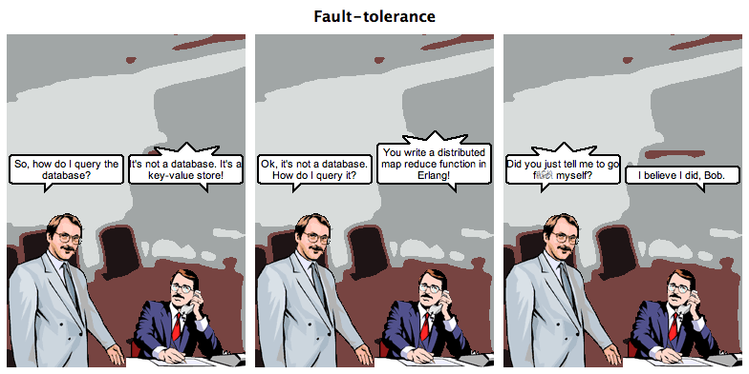
This is much funnier if you’ve seen Erlang: The Movie

Slide 12
For further reading, check out Ayende’s blog:
http://ayende.com/blog
Thanks!

