Slide 1
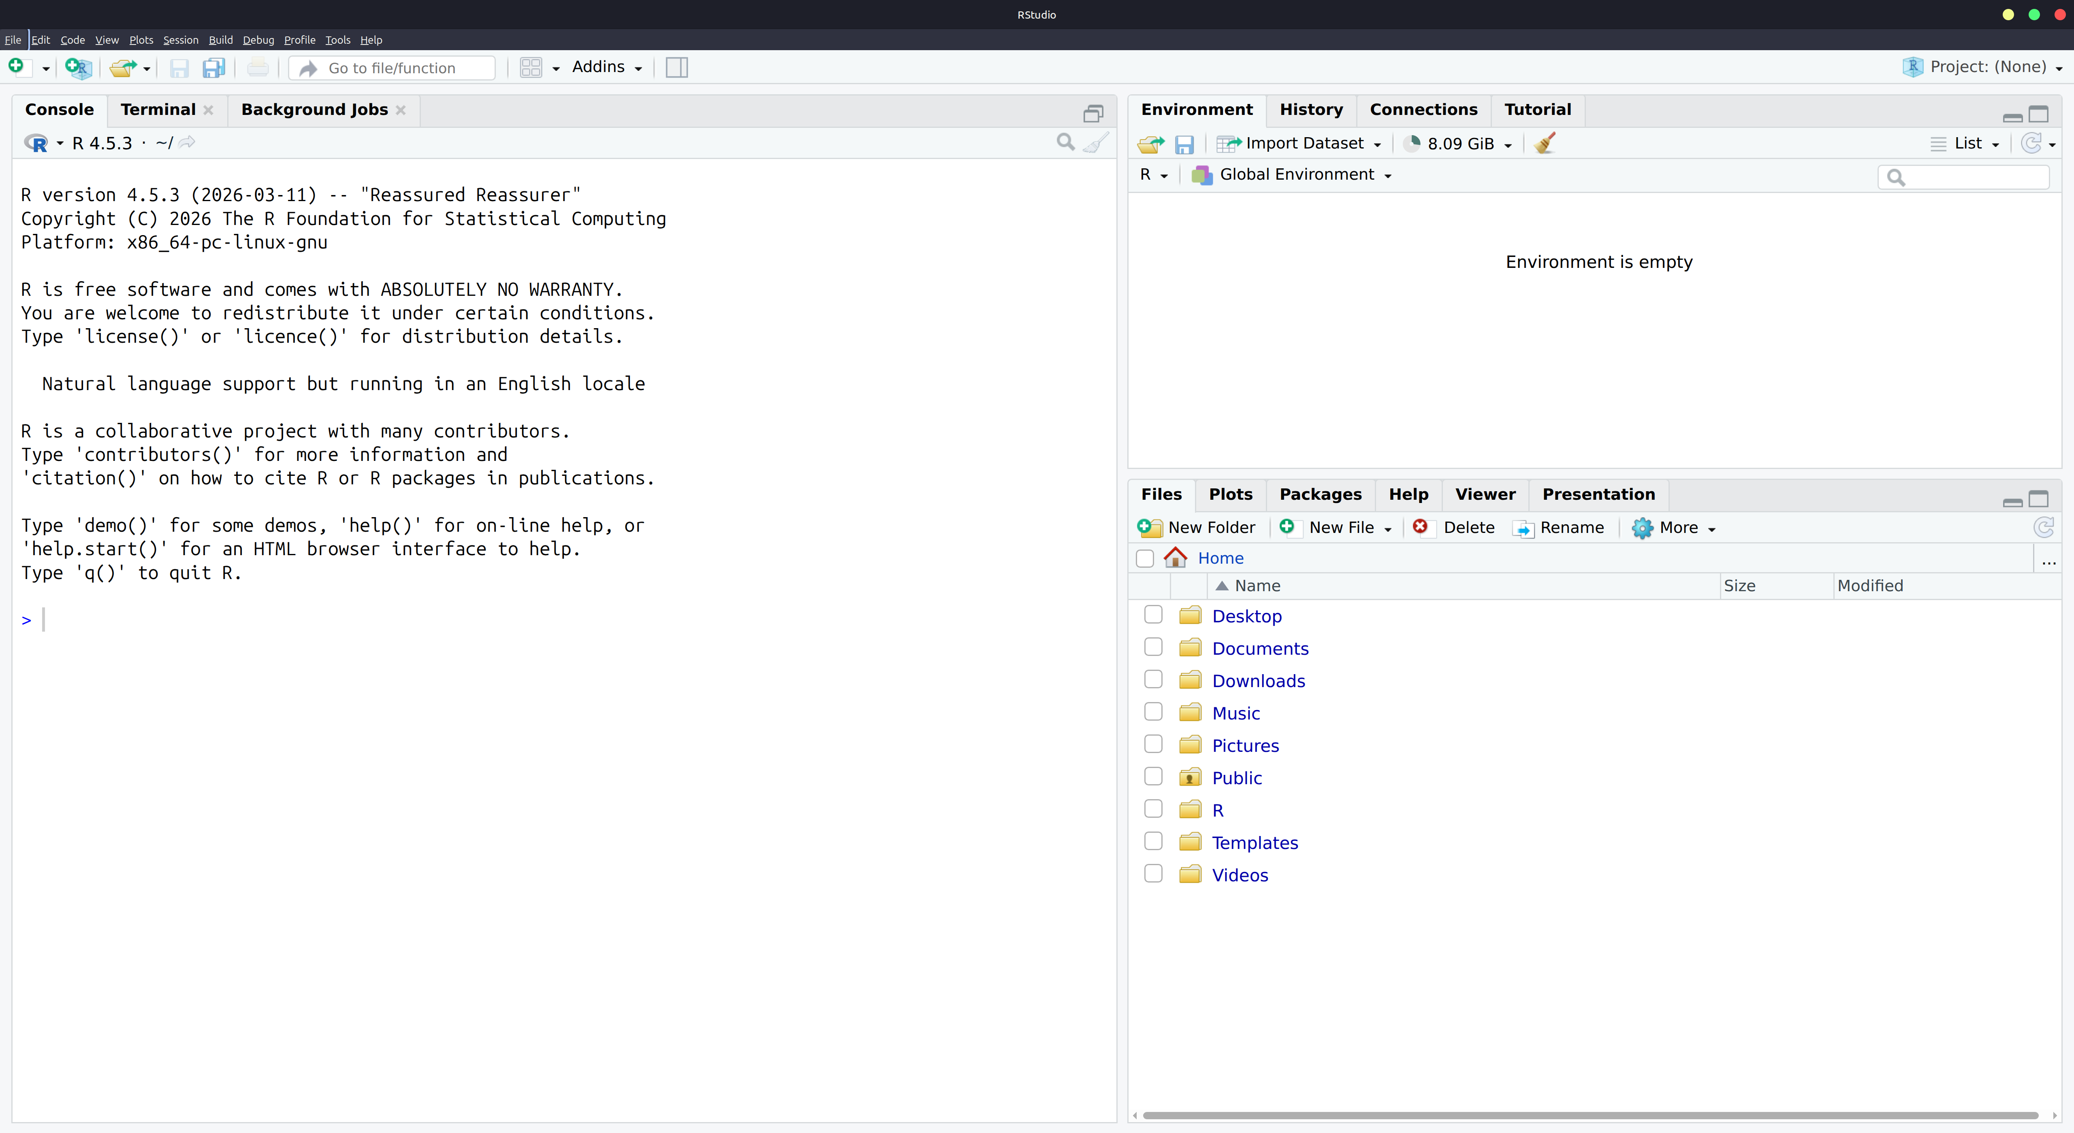
R Console
Command Line

