Slide 1

Containerization of microbial proteomics data processing pipelines
By: Timothy Bergström

Slide 2
Two-part project
Create a mass spectrometry proteomic processing pipeline
Analyse bacterial proteomic data with the pipeline created

Slide 3
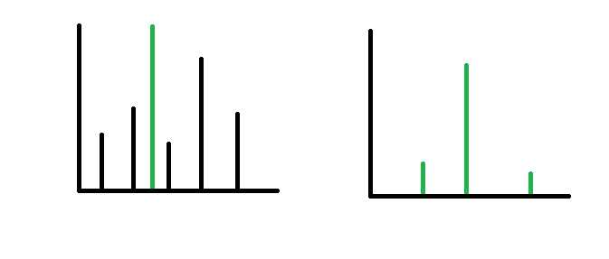
Mass spectrometry data
Input: Protein samples
Output: MS1 and MS2 spectra
Liquid chromatography (LC)
Electron spray
MS1
CID
MS2
MS1 spectra
MS2 spectra

Slide 4
Analysing proteomic data – A difficult task
PROBLEMS
Very large data sets
Takes a long time to set up a pipeline
Processing times for pipelines are long
Software needs many dependencies
Limited use on HPC clusters
Many are Windows OS based
Difficult to reproduce results
SOLUTIONS?

Slide 5
Containerization and workflow management

Slide 6




Containerization
OS
Distribute
Containerization
Image

Slide 7



Containerization
Software used: Singularity
Other software

Slide 8

Workflow management
Input
Software 1
Software 2
Software 3
Software 4
Output

Slide 9



Workflow management
Software used: Nextflow
Other software

Slide 10
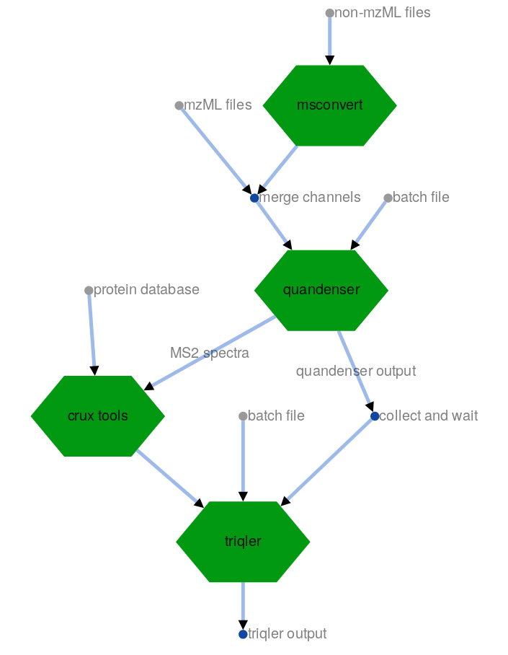
Quandenser-pipeline: Pipeline + Software

Slide 11
Quandenser-pipeline: Pipeline + Software
(Msconvert)
Converts MS files

Slide 12
Quandenser-pipeline: Pipeline + Software
(Quandenser)
Clusters MS1 and MS2 data without identification

Slide 13
Quandenser-pipeline: Pipeline + Software
(Crux)
Identifies proteins

Slide 14
Quandenser-pipeline: Pipeline + Software
(Triqler)
Probabilistic quantification

Slide 15
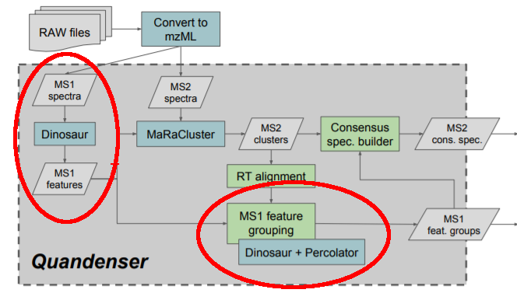

Quandenser parallelization

Slide 16
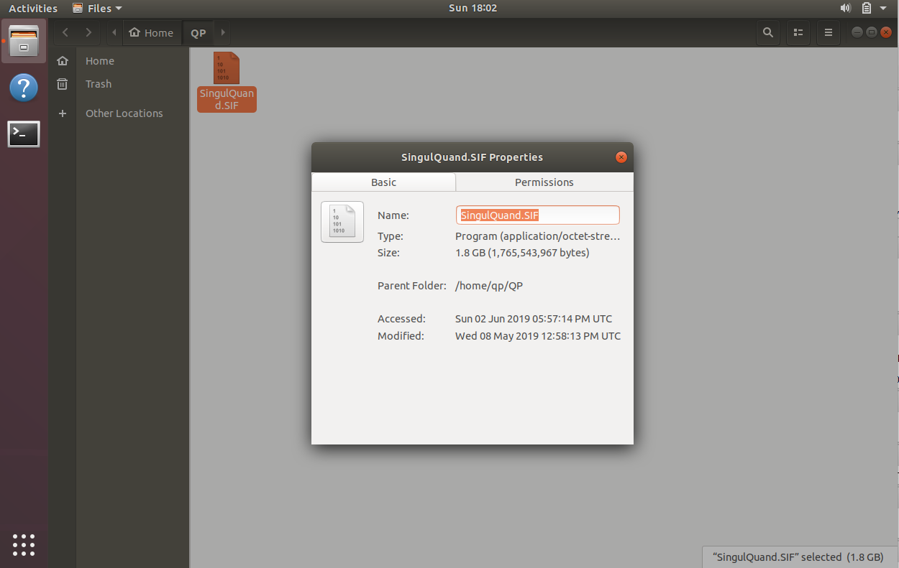
Quandenser-pipeline!
Done? Not yet…

Slide 17
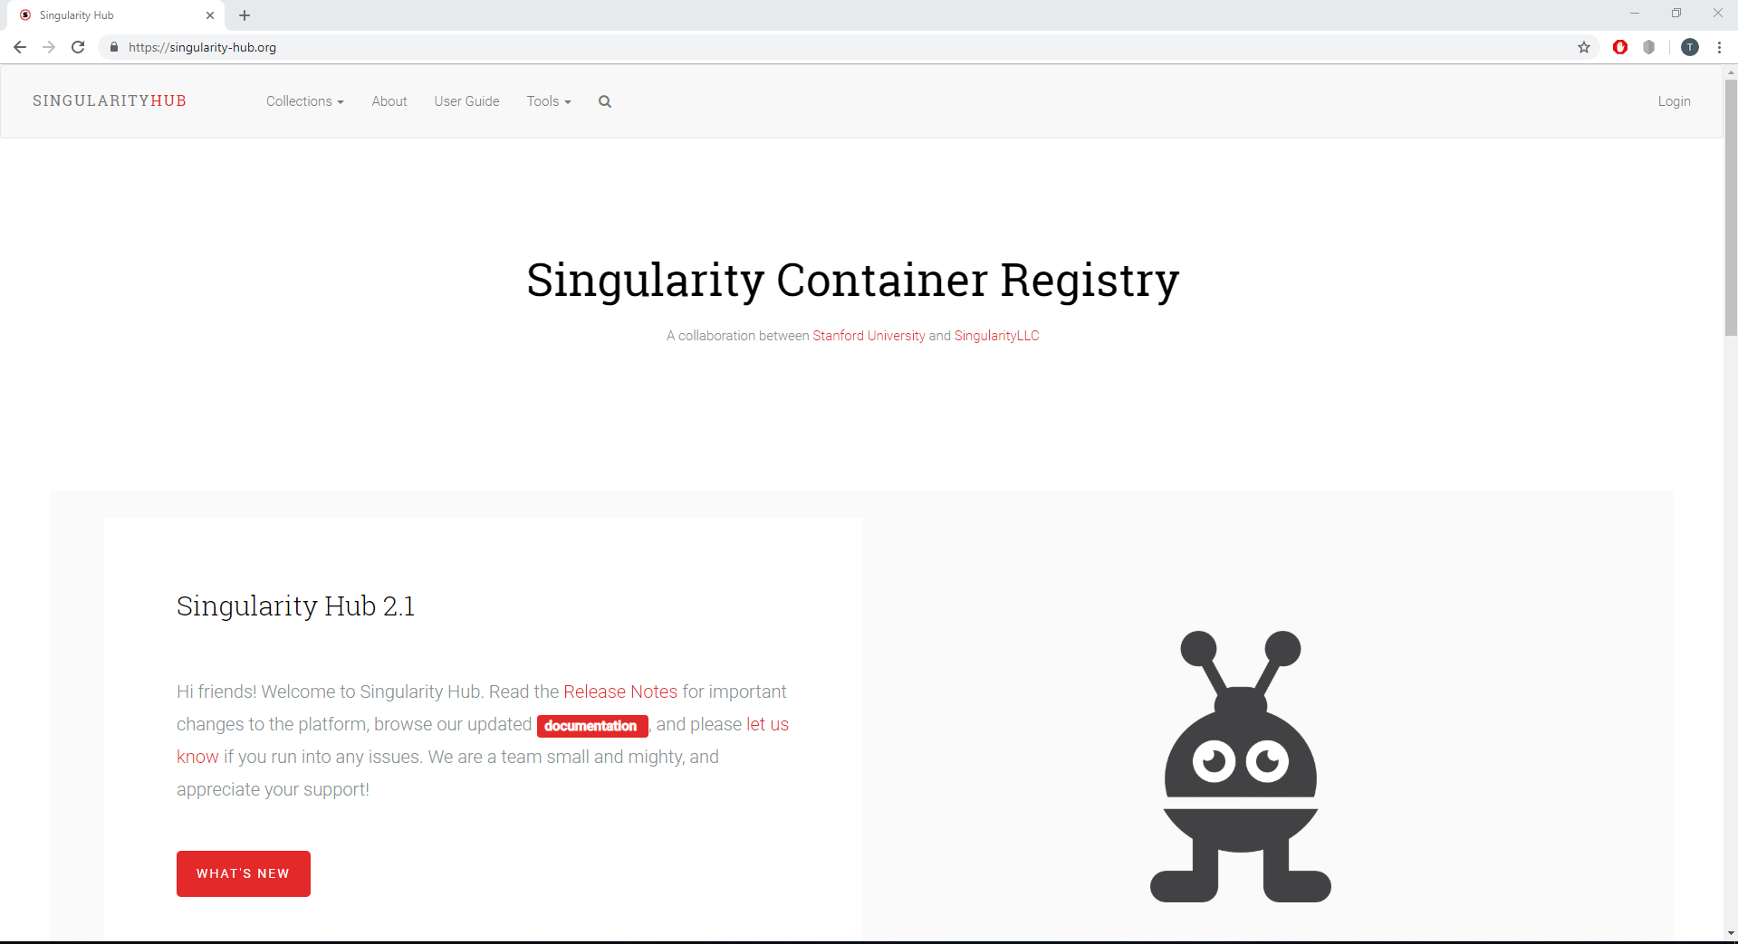
Singularity Hub

Slide 18
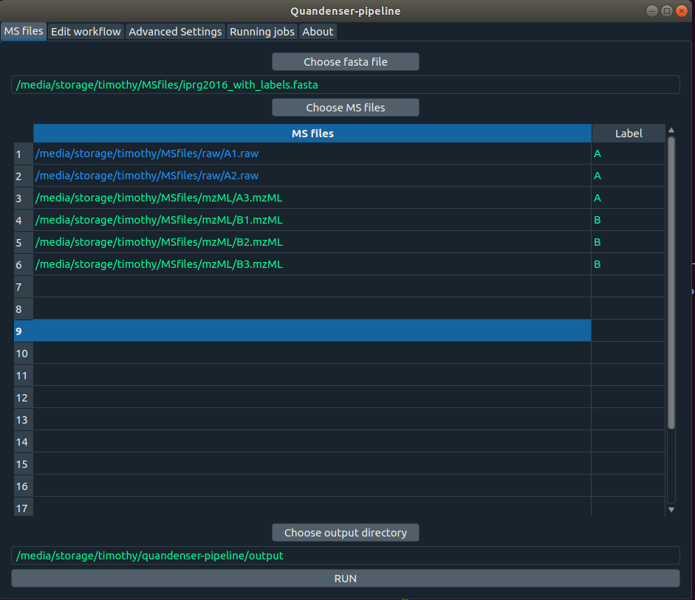

Graphical User Interface (GUI)

Slide 19
Shell file (.sh)
Installs Singularity on the computer
Downloads the image from singularity hub
Starts the GUI
Runs the pipeline

Slide 20
Pipeline finished!
Part 1 finished: Create a pipeline
Part 2 start: Analyze the data

Slide 21
The proteomic data
Cyanobacteria
A bacteria which utilizes photosynthesis
10 RAW files (about 0.8 Gb each)
Grown in a specialized batch bioreactor
Simulating light at different times of the day
Ralstonia bacteria
A gram-negative soil bacteria
20 RAW files (about 1.3 Gb each)
Grown in a chemostat
Limiting Formic Acid (carbon limitation) with growth rates set at different rates

Slide 22
The proteomic data
Groups | A | B | C | D | E
Cyano | Before sunrise (2 replicates) | After sunrise (2 replicates) | Noon (2 replicates) | Before sunset (2 replicates) | After sunset (2 replicates)
Ralstonia | μ = 0.25 (4 replicates) | μ = 0.20 (4 replicates) | μ = 0.15 (4 replicates) | μ = 0.10 (4 replicates) | μ = 0.05 (4 replicates)
μ = Growth rate

Slide 23
Results: Data sets
 | Ralstonia data set | Cyano data set
q-val < 0.05 unique | 267 proteins | 10 proteins

Slide 24
Results: Data sets
 | Ralstonia data set | Cyano data set
q-val < 0.05 unique | 267 proteins | 10 proteins

Slide 25
Results: Cyanobacteria
Protein | Function | PEP (Posterior error probability) | q-value
sll1214 | Magnesium-protoporphyrin IX monomethyl ester cyclase | 6.305e-16 | 0.007298
sll1184 | Heme oxygenase | 6.305e-16 | 0.00261
slr2032 | Hypothetical protein YCF23 | 4.568e-13 | 0.03241
sll1452 | Nitrate transport protein | 6.305e-16 | 0.01067
ssl2501 | Hypothetical protein | 6.305e-16 | 0.002183
ssr1480 | RNA-binding protein | 6.305e-16 | 0.04116
slr1739 | Photosystem II protein (PsbW) | 6.305e-16 | 0.04529
ssr3383 | Phycobilisome LC linker polypeptide | 6.305e-16 | 0.006643
slr0473 | Phytochrome Cph1 | 6.305e-16 | 0.02829
slr0083 | ATP-dependent RNA helicase | 6.305e-16 | 0.0164

Slide 26
Results: Cyanobacteria
Protein | Function | PEP (Posterior error probability) | q-value
sll1214 | Magnesium-protoporphyrin IX monomethyl ester cyclase | 6.305e-16 | 0.007298
sll1184 | Heme oxygenase | 6.305e-16 | 0.00261
slr2032 | Hypothetical protein YCF23 | 4.568e-13 | 0.03241
sll1452 | Nitrate transport protein | 6.305e-16 | 0.01067
ssl2501 | Hypothetical protein | 6.305e-16 | 0.002183
ssr1480 | RNA-binding protein | 6.305e-16 | 0.04116
slr1739 | Photosystem II protein (PsbW) | 6.305e-16 | 0.04529
ssr3383 | Phycobilisome LC linker polypeptide | 6.305e-16 | 0.006643
slr0473 | Phytochrome Cph1 | 6.305e-16 | 0.02829
slr0083 | ATP-dependent RNA helicase | 6.305e-16 | 0.0164

Slide 27
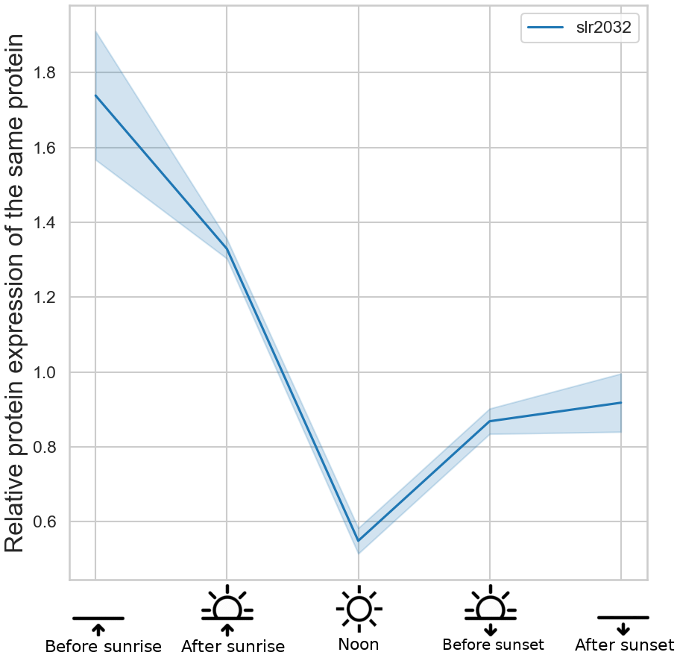
Results: Cyanobacteria

Slide 28
slr2032 – A ”hypothetical” protein
Previous studies
The thesis
Is a Phasin (PHA surface-coating protein)
PHA is a polyester energy/carbon storage for bacteria
Phasins stimulates synthesis or depolymerization (+ other stuff)
High expression before sunrise
Low at high light levels
Statistically significant result
slr2032 = depolymerization Phasin?

Slide 29


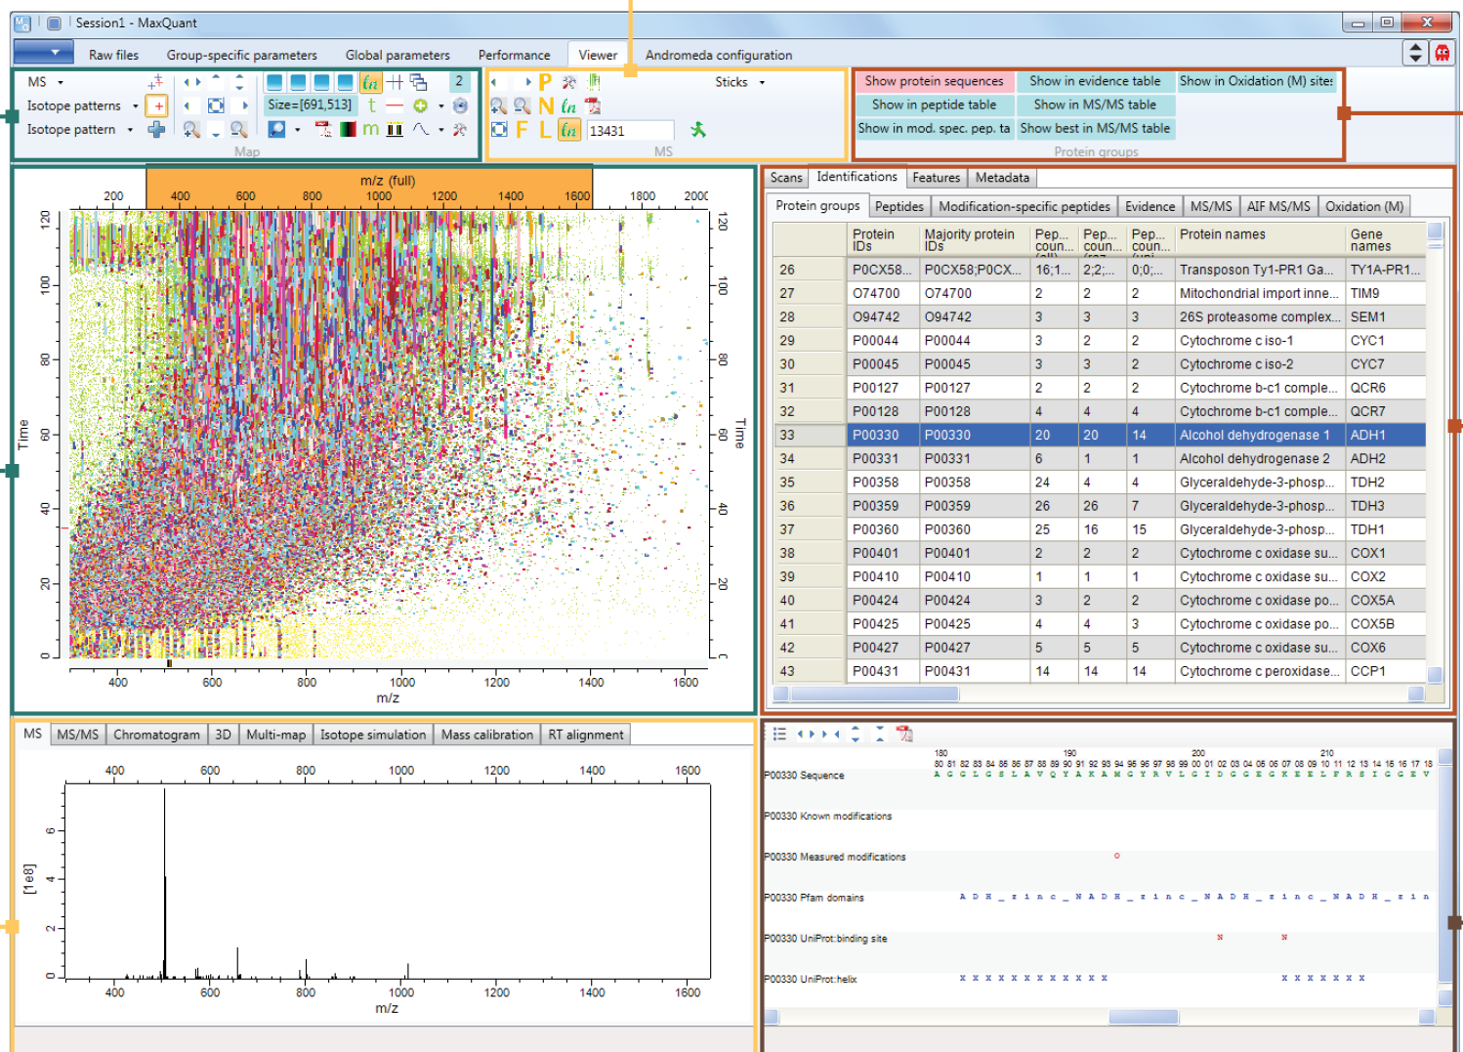
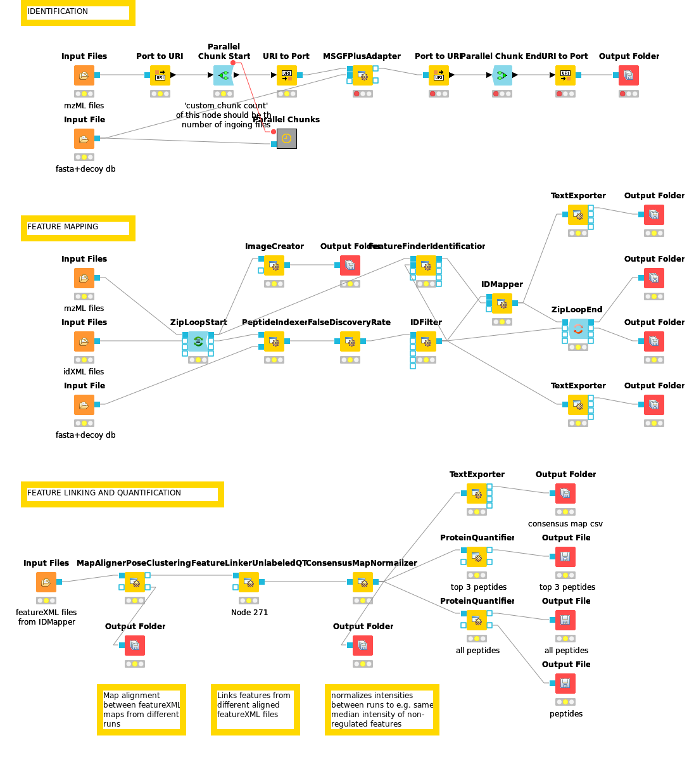
Other programs
MaxQuant 1.6.3.3
OpenMS + KNIME

Slide 30
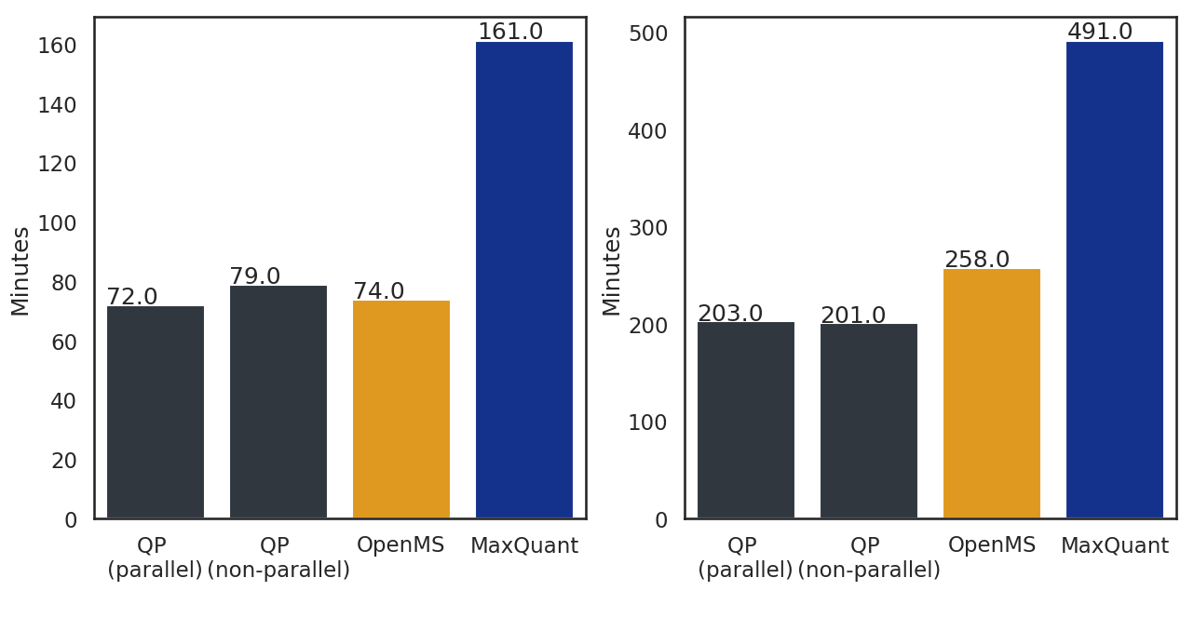
Results: Performances
Cyanobacteria data set (10 files)
Ralstonia bacteria data set (20 files)

Slide 31
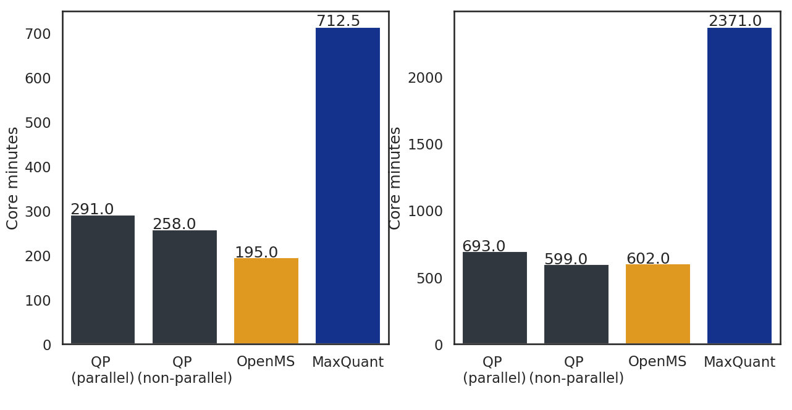
Results: Performances
Cyanobacteria data set (10 files)
Ralstonia bacteria data set (20 files)

Slide 32
Results: Performances
“Quandenser/Triqler outperformed the state-of-the-art method MaxQuant/Perseus, consistently reporting more differentially abundant proteins, even in a clinical dataset where none were discovered previously”
The M. and Käll L. (2018)

Slide 33
Conclusion
Quandenser-pipeline is fast
The image is easy to distribute
HPC clusters is an option
Possible function of one protein found

Slide 34
Future work
Improve the parallelization
Analysing a new data sets

Slide 35
Acknowledgements
Lukas Käll: The supervisor of the project, for helping me set up the programs used in the pipeline, providing a computer to work on and guidance during the project.
Michael Jahn: The secondary supervisor of the project, for helping me set up the OpenMS pipeline and for providing the data sets analyzed in the thesis.
Peter Savolainen: The examiner of the project, for taking me in as a thesis student and grading the project.
Matthew The: The author of several reports cited in the thesis, for creating the software Quandenser + Triqler alongside Lukas Käll.
Patrick Troung, Marcus Ekvall and Gus Jeuken: PhD students and research engineers working at Käll lab, for helping me with various programming issues and for testing the pipeline.
Questions?

