Slide 1
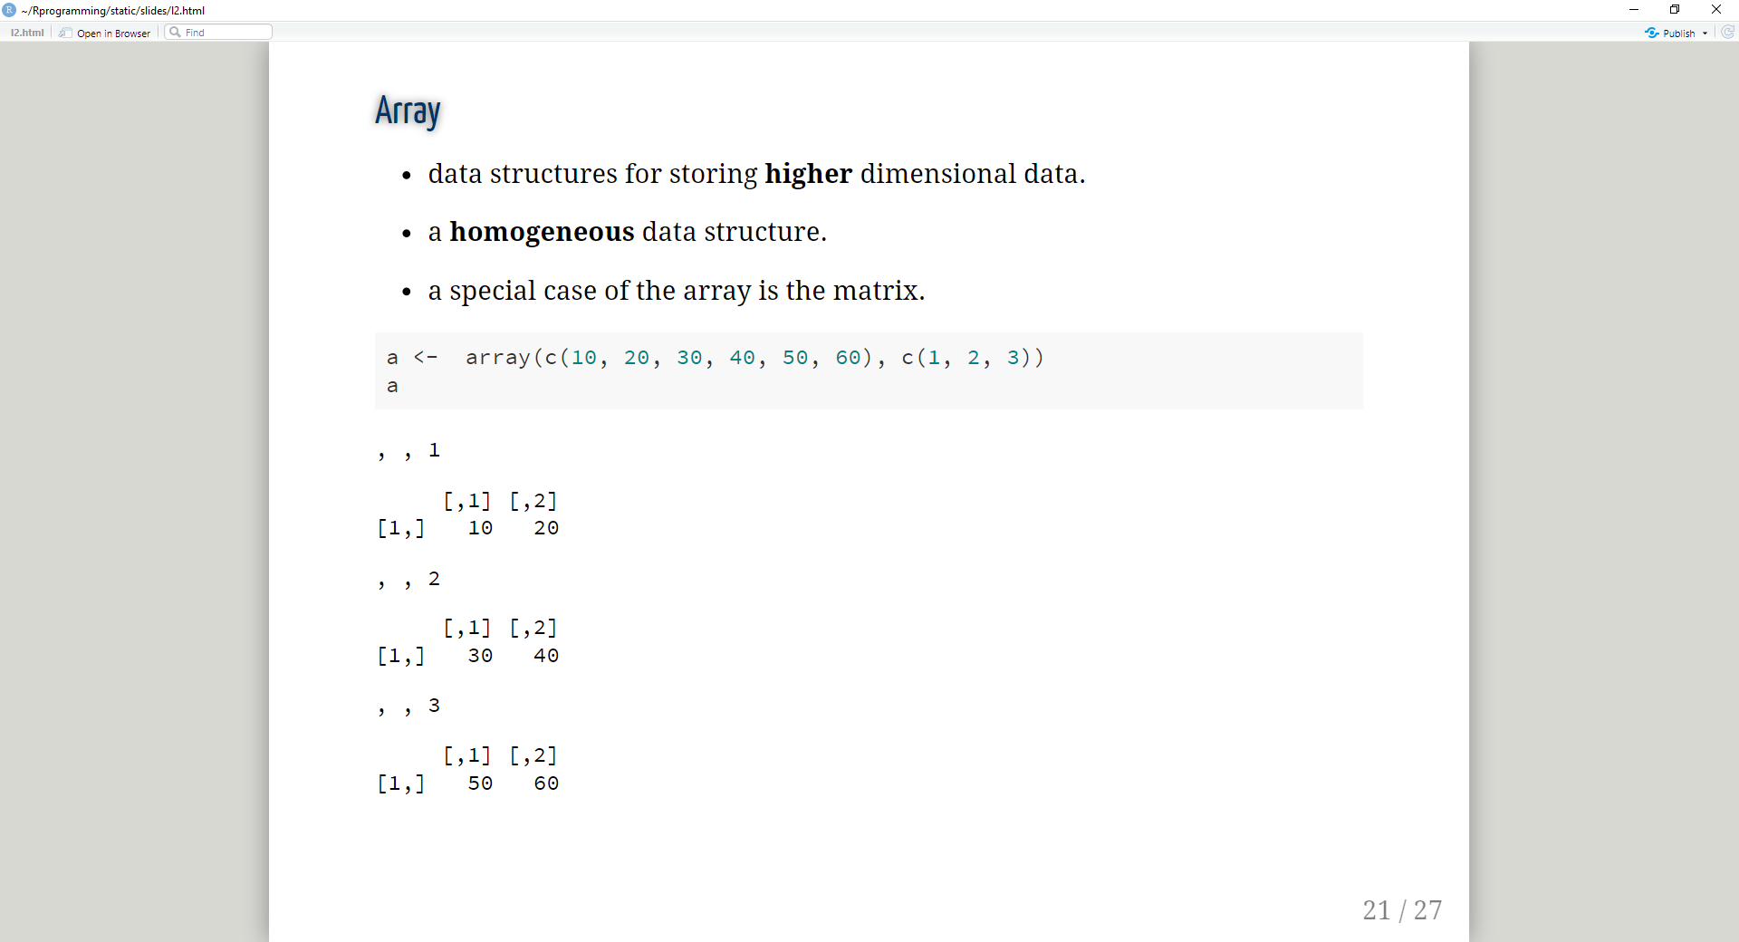
30 | 40
nrow
50 | 60
ncol
ndim = 3
10 | 20
ndim
30 | 40
50 | 60
nrow
50 | 60
ncol

