Slide 2
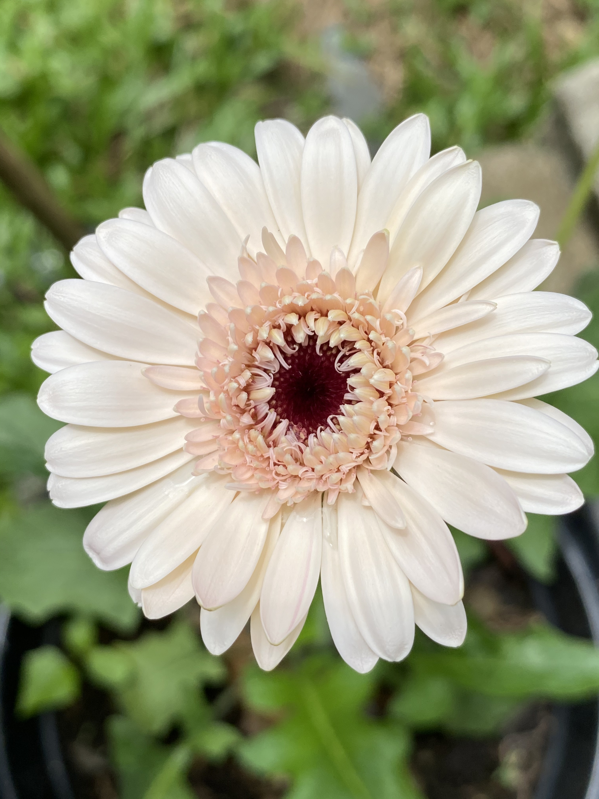
255
10
255
Pixel of an RGB image are formed from the corresponding pixel of the Red, Green and Blue components.

Slide 3
ame(

