Slide 1
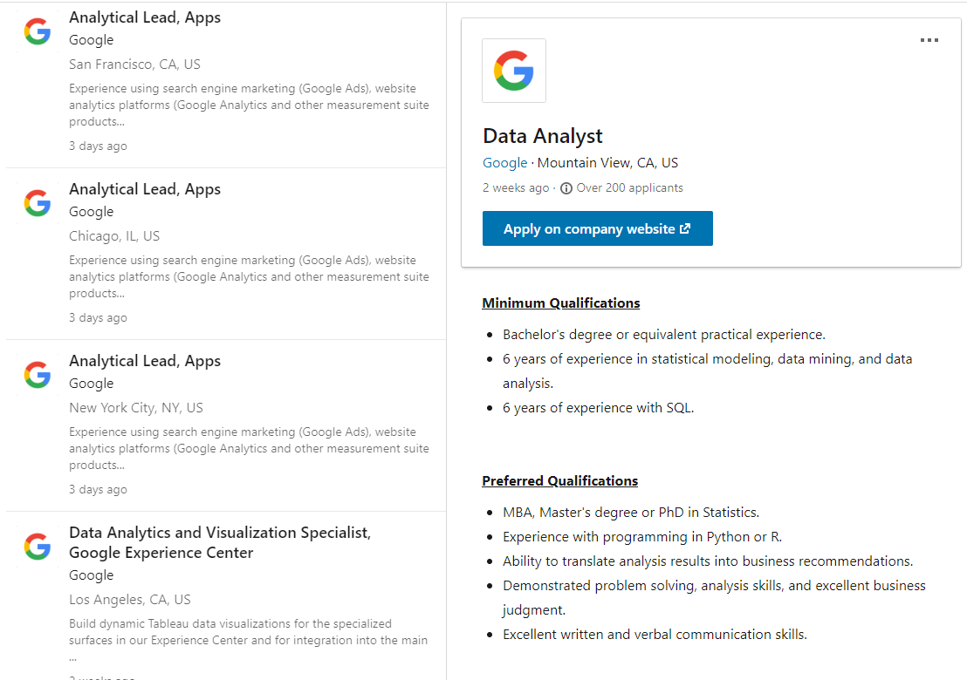

Slide 2
Experience with programming in Python or R.

