Slide 1
SDC Course Day 2
28.02.2024
Defining tables, suppression frequency tables

Slide 2
General information about the packages
GaussSuppression (and all of our packages) are written in «base R» with no internal use tidyverse or data.table
Mostly for robustness and compatibility with other packages(consistency in syntax)
tibble[,1] ≠ data.frame[,1]
data.table[1] ≠ data.frame[1]
Works with pipe operators (%>% eller |>), safest to use as.data.frame on the data set before sending in to the package’s functions

Slide 3
Agenda for today
Introduction to GaussSuppression function interface
Part 1: Get to know the interface
How to specify input and output
Use of dimVar and formula for defining tables
Part 2: Start suppressing frequency tables
Later: more advanced challenges with frequency tables

Slide 4


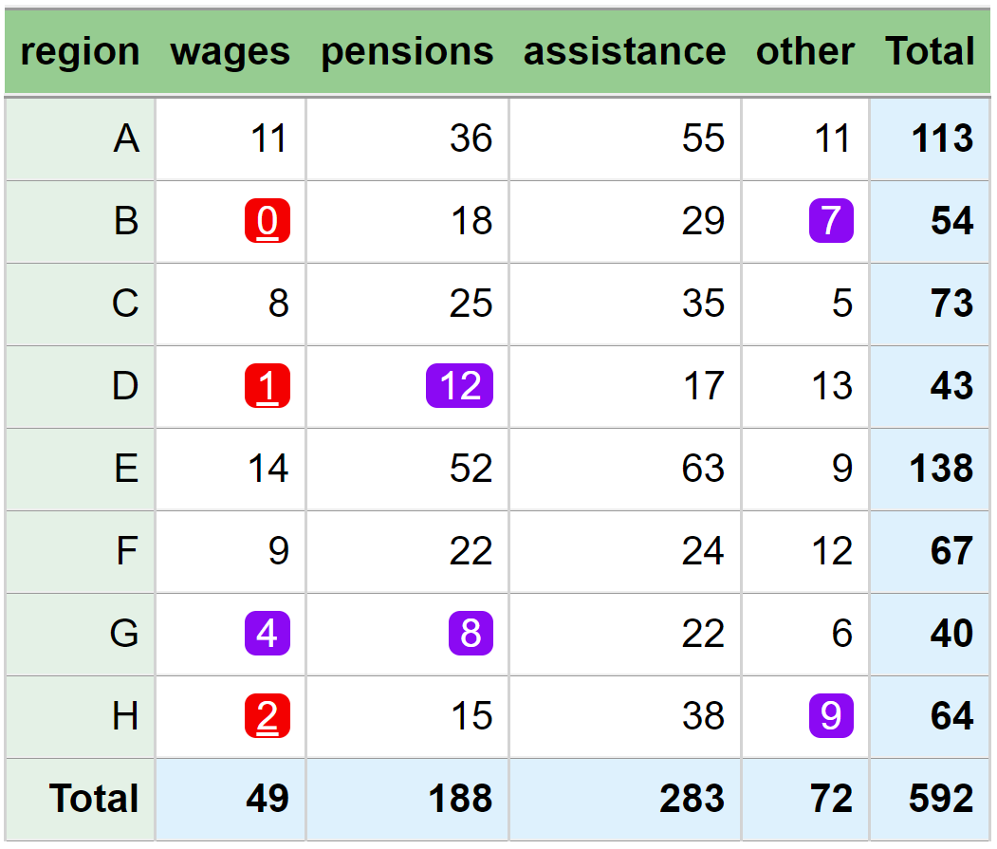
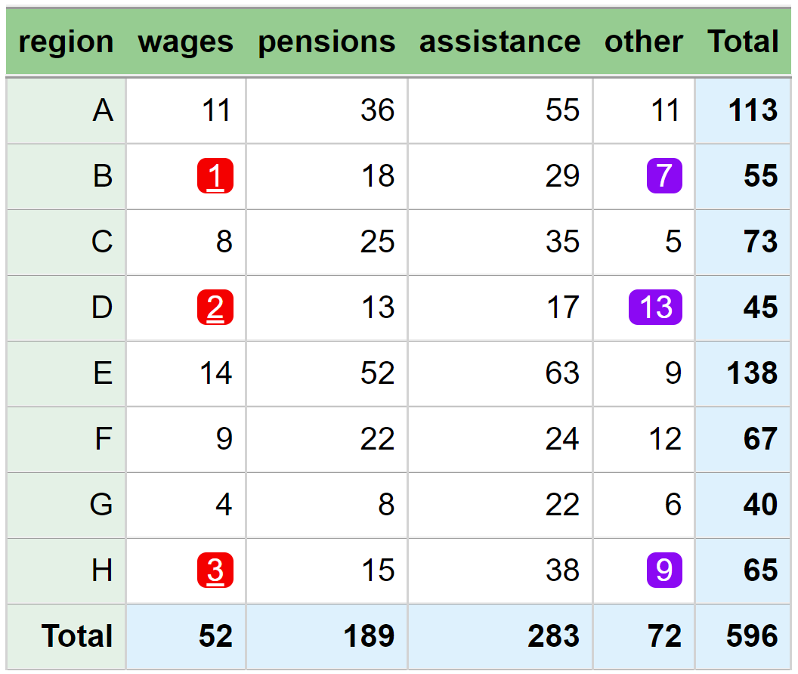
Simple table
simple method
optimal method

Slide 5


When does confidentiality come in?
confidentiality
Source
input data
prepared data
Tables/statistic
output data
data minimization
pseudonymization
recoding
reformatting
controls
calculations
editing
linking
aggregation
estimation
seasonal adjustment
confidentiality
NO!
microdata

Slide 6
Function interface
In theory: given prepared data, one function call that does it all
Primary suppressed cells
All suppressed cells
V1 | V2 | freq | num | primary | suppressed
Total | Total | 5 | 28 | FALSE | FALSE
Total | X | 3 | 17 | FALSE | TRUE
Total | Y | 2 | 11 | TRUE | TRUE
a | Total | 3 | 6 | FALSE | TRUE
b | Total | 2 | 22 | TRUE | TRUE
a | X | 2 | 5 | TRUE | TRUE
a | Y | 1 | 1 | TRUE | TRUE
b | X | 1 | 12 | TRUE | TRUE
b | Y | 1 | 10 | TRUE | TRUE
V1 | V2 | num
a | X | 2
a | X | 3
a | Y | 1
b | Y | 10
b | X | 12
SuppressSmallCounts
SuppressDominantCells
SuppressFewContributors
output

Slide 7
Function interface
In theory: given prepared data, one function call that does it all: aggregate data to a table, primary suppress, secondary suppress
SuppressSmallCounts(
data = …,
freqVar = …,
dimVar = …,
formula = …,
hierarchies = …,
maxN = …,
protectZeros = …,
…)
SuppressFewContributors(
data = …,
numVar = …,
dimVar = …,
formula = …,
hierarchies = …,
contributorVar = …
maxN = …,
…)
SuppressDominantCells(
data = …,
numVar = …,
dimVar = …,
formula = …,
hierarchies = …,
contributorVar = …,
n = …,
k = …,
…)
Input data
Table definitions
Magnitude tables
Frequency tables
Magnitude tables

Slide 8
Part 1: Defining tables

Slide 9
data = …
data = …,
freqVar = …,
numVar = …,
dimVar = …,
formula = …,
hierarchies = …
The underlying data, which should be published in an aggregated (potentially suppressed) format
For frequency tables this can be
microdata
(fully or partially) aggregated
For magnitude tables it must be microdata
All variables that should be included in
the output, should be in the input
V1 | V2
a | X
a | X
a | Y
b | Y
b | X
V1 | V2 | freq
a | X | 2
a | Y | 1
b | Y | 1
b | X | 1

Slide 10
freqVar = …
data = …,
freqVar = …,
numVar = …,
dimVar = …,
formula = …,
hierarchies = …
The input data can be a (partially aggregated) file
In this case, we must specity which variable contains the count information
V1 | V2 | freq
a | X | 2
a | Y | 1
b | Y | 1
b | X | 1
freqVar = “freq”

Slide 11
numVar = …
data = …,
freqVar = …,
numVar = …,
dimVar = …,
formula = …,
hierarchies = …
For magnitude tables, we wish to sum one or more numerical variables
In this case, we must specity which variable contains the numerical values
Can specify multiple variables
V1 | V2 | num1 | num2
a | X | 21 | 1.4
a | Y | 15 | 253.1
b | Y | 1 | 14
b | X | 12 | 6.2
numVar = “num1”
numVar = c(“num1”,“num2”)

Slide 12
dimVar = …
data = …,
freqVar = …,
numVar = …,
dimVar = …,
formula = …,
hierarchies = …
The first (and easiest) way to specify tables
The output table is all combinations of all specified variales, including all marginals/totals
dimVar = c(“V1”, “V2”)
Input data
V1 | V2 | freq
Total | Total | 5
Total | X | 3
Total | Y | 2
a | Total | 3
b | Total | 2
a | X | 2
a | Y | 1
b | X | 1
b | Y | 1
V1 | V2
a | X
a | X
a | Y
b | Y
b | X

Slide 13
dimVar = …
data = …,
freqVar = …,
numVar = …,
dimVar = …,
formula = …,
hierarchies = …
Hierarchical relationships are automatically detected in the background, without the need to specify explicitly
The output variable name is the variable with the highest level of detail
Input data
dimVar = (“NACE5”, “NACE2”)
NACE5 | NACE2
52.031 | 52
52.001 | 52
37.123 | 37
38.014 | 38
38.014 | 38
NACE5 | freq | primary | suppressed
Total | 5 | … | …
37 | 1 | … | …
38 | 2 | … | …
52 | 2 | … | …
37.123 | 2 | … | …
38.014 | 2 | … | …
52.001 | 1 | ... | …
52.031 | 1 | … | …
NACE2 are interpreted as marginals over NACE5

Slide 14
formula = …
data = …,
freqVar = …,
numVar = …,
dimVar = …,
formula = …,
hierarchies = …
A way of specifying more complex tables using model formulas
This lets us define precisely which combinations of variables our table should include

Slide 15
(Incomplete) crash course on formula
data = …,
freqVar = …,
numVar = …,
dimVar = …,
formula = …,
hierarchies = …
formula = ~ V1 * V2
formula = ~ V1 + V2 + V1 : V2
dimVar = c(“V1”, “V2”)
Main operations: + , * , :
Supports parentheses
formula =
~ V1
formula =
~ V1 + V2
formula =
~ V1 : V2
formula = ~ V1 * V2
Input data
V1 | V2
a | X
a | X
a | Y
b | Y
b | X
V1 | freq
Total | 5
a | 3
b | 2
V1 | V2 | freq
Total | Total | 5
Total | X | 3
Total | Y | 2
a | Total | 3
b | Total | 2
V1 | V2 | freq
Total | Total | 5
a | X | 2
a | Y | 1
b | X | 1
b | Y | 1
V1 | V2 | freq
Total | Total | 5
Total | X | 3
Total | Y | 2
a | Total | 3
b | Total | 2
a | X | 2
a | Y | 1
b | X | 1
b | Y | 1

Slide 16
(Incomplete) crash course on formula
data = …,
freqVar = …,
numVar = …,
dimVar = …,
formula = …,
hierarchies = …
Minus (-) also supported
~ A – B means «Build table A, then remove all rows that are in table B»
The population total («intercept») has a special status: always included, unless one explicitly removes it with -1
Input data
~ V1 * V2
~ V2
~ V1 * V2 – V2
~ V1 * V2 – V2 - 1
V1 | V2
a | X
a | X
a | Y
b | Y
b | X
V1 | V2 | freq
Total | Total | 5
Total | X | 3
Total | Y | 2
a | Total | 3
b | Total | 2
a | X | 2
a | Y | 1
b | X | 1
b | Y | 1
V1 | V2 | freq
Total | Total | 5
Total | X | 3
Total | Y | 2
V1 | V2 | freq
Total | Total | 5
a | Total | 3
b | Total | 2
a | X | 2
a | Y | 1
b | X | 1
b | Y | 1
V1 | V2 | freq
a | Total | 3
b | Total | 2
a | X | 2
a | Y | 1
b | X | 1
b | Y | 1

Slide 17
formula = …
data = …,
freqVar = …,
numVar = …,
dimVar = …,
formula = …,
hierarchies = …
This provides a nice tool for simultaneously building (and suppressing) linked tables!
Two tables:
Number of people per sex in municipality and region
~gender * (municipality + region)
Number per sex and main_income in region
~gender * main_income * region
These can be combined to a single formula, and thus a single function call!
~gender * (municipality +region) + gender * main_income *region

Slide 18
Why build/protect simultaneously?
data = …,
freqVar = …,
numVar = …,
dimVar = …,
formula = …,
hierarchies = …
Best practice: all tables built on the same input data are built and protected together.
 | CoV2 | Cold
k2 | 5 | 6
k3 | 8 | 5
k4 | 4 | 9
5 | 6
8 | 5
4 | 9
 | Hthy | CoV2 | Cold | Flu | Total
k1 | 6 | 1 | 7 | 4 | 18
k2 | 2 | 5 | 6 | 6 | 19
k3 | 3 | 8 | 5 | 2 | 18
k4 | 8 | 4 | 9 | 7 | 28
Total | 19 | 18 | 27 | 19 | 83
 | Hthy | CoV2 | Cold | Flu | Total
k1 | - | - | - | 4 | 18
k2 | - | 5 | - | 6 | 19
k3 | - | - | 5 | - | 18
k4 | 8 | - | 9 | - | 28
Total | 19 | 18 | 27 | 19 | 83
X
X
suppression
X

Slide 19
Why build/protect simultaneously?
data = …,
freqVar = …,
numVar = …,
dimVar = …,
formula = …,
hierarchies = …
Best practice: all tables built on the same input data are built and protected together.
 | CoV2 | Cold
k2 | 5 | 6
k3 | 8 | 5
k4 | 4 | 9
 | Hthy | CoV2 | Cold | Flu | Total
k1 | - | - | - | 4 | 18
k2 | - | 5 | - | 6 | 19
k3 | - | - | 5 | - | 18
k4 | 8 | - | 9 | - | 28
Total | 19 | 18 | 27 | 19 | 83
 | Hthy | CoV2 | Cold | Flu | Total
k1 | - | 1 | 7 | 4 | 18
k2 | 2 | 5 | 6 | 6 | 19
k3 | - | 8 | 5 | - | 18
k4 | 8 | 4 | 9 | - | 28
Total | 19 | 18 | 27 | 19 | 83
 | Hthy | CoV2 | Cold | Flu | Total
k1 | 6 | 1 | 7 | 4 | 18
k2 | 2 | 5 | 6 | 6 | 19
k3 | 3 | 8 | 5 | 2 | 18
k4 | 8 | 4 | 9 | 7 | 28
Total | 19 | 18 | 27 | 19 | 83
 | Hthy | CoV2 | Cold | Flu | Total
k1 | 6 | 1 | 7 | 4 | 18
k2 | 2 | 5 | 6 | 6 | 19
k3 | 3 | 8 | 5 | 2 | 18
k4 | 8 | 4 | 9 | 7 | 28
Total | 19 | 18 | 27 | 19 | 83
X
X
5 | 6
8 | 5
4 | 9
suppression
X

Slide 20
Exercises
R/dimVar.R
R/formula.R

Slide 21
Part 2: Suppressing frequency tables

Slide 22
Function interface
In theory: given prepared data, one function call that does it all: aggregate data to a table, primary suppress, secondary suppress
SuppressSmallCounts(
data = …,
freqVar = …,
dimVar = …,
formula = …,
hierarchies = …,
maxN = …,
protectZeros = …,
…)
SuppressFewContributors(
data = …,
numVar = …,
dimVar = …,
formula = …,
hierarchies = …,
contributorVar = …
maxN = …,
…)
SuppressDominantCells(
data = …,
numVar = …,
dimVar = …,
formula = …,
hierarchies = …,
contributorVar = …,
n = …,
k = …,
…)
How to suppress
Magnitude tables
Frequency tables
Magnitude tables

Slide 23
Function interface
In theory: given prepared data, one function call that does it all: aggregate data to a table, primary suppress, secondary suppress
SuppressSmallCounts(
data = …,
freqVar = …,
dimVar = …,
formula = …,
hierarchies = …,
maxN = …,
protectZeros = …,
…)
SuppressFewContributors(
data = …,
numVar = …,
dimVar = …,
formula = …,
hierarchies = …,
contributorVar = …
maxN = …,
…)
SuppressDominantCells(
data = …,
numVar = …,
dimVar = …,
formula = …,
hierarchies = …,
contributorVar = …,
n = …,
k = …,
…)
How to suppress
Frequency tables

Slide 24
Cell suppression
SuppressSmallCounts(data = …,
freqVar = …,
dimVar = …,
formula = …,
hierarchies = …,
maxN = …,
protectZeros = …,
…)
SuppressSmallCounts is a function that provides a simple interface for suppression of «small» frequencies
Simple use requies only setting the parameter maxN to a number
All frequencies less than or equal to maxN (including 0) will be primary suppressed

Slide 25
maxN = …
SuppressSmallCounts(data = …,
freqVar = …,
dimVar = …,
formula = …,
hierarchies = …,
maxN = …,
protectZeros = …,
…)
formula = ~ V1 * V2, maxN = 2
formula = ~ V1 * V2, maxN = 1
V1 | V2 | freq | primary
Total | Total | 5 | FALSE
Total | X | 3 | FALSE
Total | Y | 2 | TRUE
a | Total | 3 | FALSE
b | Total | 2 | TRUE
a | X | 2 | TRUE
a | Y | 1 | TRUE
b | X | 1 | TRUE
b | Y | 0 | TRUE
V1 | V2 | freq | primary
Total | Total | 5 | FALSE
Total | X | 3 | FALSE
Total | Y | 2 | FALSE
a | Total | 3 | FALSE
b | Total | 2 | FALSE
a | X | 2 | FALSE
a | Y | 1 | TRUE
b | X | 1 | TRUE
b | Y | 0 | TRUE

Slide 26
protectZeros = …
SuppressSmallCounts(data = …,
freqVar = …,
dimVar = …,
formula = …,
hierarchies = …,
maxN = …,
protectZeros = …,
…)
formula = ~ V1 * V2, maxN = 2,
protectZeros = TRUE
formula = ~ V1 * V2, maxN = 2,
protectZeros = FALSE
V1 | V2 | freq | primary
Total | Total | 5 | FALSE
Total | X | 3 | FALSE
Total | Y | 2 | TRUE
a | Total | 3 | FALSE
b | Total | 2 | TRUE
a | X | 2 | TRUE
a | Y | 1 | TRUE
b | X | 1 | TRUE
b | Y | 0 | TRUE
V1 | V2 | freq | primary
Total | Total | 5 | FALSE
Total | X | 3 | FALSE
Total | Y | 2 | TRUE
a | Total | 3 | FALSE
b | Total | 2 | TRUE
a | X | 2 | TRUE
a | Y | 1 | TRUE
b | X | 1 | TRUE
b | Y | 0 | FALSE

Slide 27
Exercises
R/freq_suppression.R

Slide 28
Thank you!

