Slide 1
SDC Course Day 6
summary and a little extra

Slide 2
Agenda
Course summary
Keep dominance and p% rules secret!
Did my suppression protect well enough?
Protect with already published tables
Estimating intervals for suppressed cells

Slide 3
This course
Introduction to cell suppression using GaussSuppression
Building (linked) tables
Frequency tables:
Small count primary suppression
Taking into consideration empty cells, structural zeros
Magnitude tables:
few contributor rule, dominance rules, p% rule
Contributor information (holding variable)
Handling public information
Brief intro to SmallCountRounding, and microdata

Slide 4
Keep dominance and p% rules secret!

Slide 5
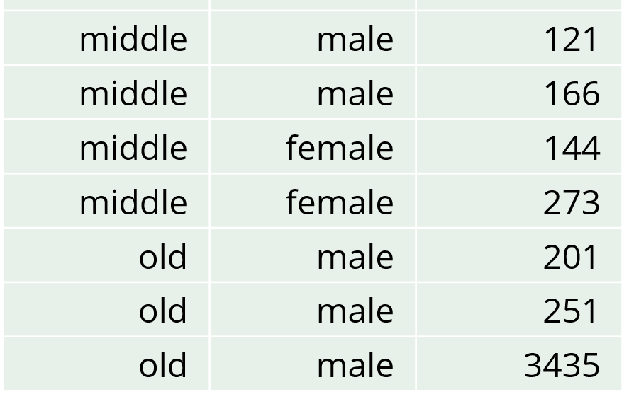
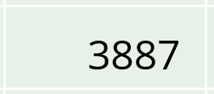
p% rule
Earlier Slide
A cell is considered sensitive if a contributor can estimate another contributor's contribution to that cell within p% of its true value.
To comply with the rule, we only need to assess how well the contributor with the second-largest value can estimate the largest value.
In our old-male cell:
Accuracy: (100*((3887-251)-3435)/3435)% = 5.8%
p=5
→ Not sensitive
p=6
→ Sensitive
As seen earlier
This rule is specifically designed to address the primary issue of accurate estimation.
Therefore, it can be considered better than dominance rules.

Slide 6
Estimate when p% rule is known Calculated by the contributor with the second-largest value
Without the rule
Initial estimate: 3887-251= 3636 (5.8% deviation)
With knowledge of the 5% rule
Given that the value is not suppressed, one can know that the initial estimate deviates from the actual value by at least 5%.
Corrected estimate: 3636/1.05= 3463 (0.81% deviation)
p=5
→ Not sensitive
Note: The contributor with the second-largest value cannot know that the estimate is this accurate

Slide 7
(n, k)-dominance rule
Earlier Slide
With n₁=1 and n₂=2
k₁=90 and k₂=95
→ Not sensitive
k₁=85 and k₂=95
→ Sensitive
k₁=90 and k₂=94
→ Sensitive
The sum of the n largest contributions cannot exceed k% of the cell value
Common practice to use two rules: n=1 and n=2
In our old-male cell:
Largest contribution: (100*3435/3887)% = 88.4% of the cell value
2 largest contributions: (100*(3435+251)/3887)% = 94.8% of the cell value

Slide 8
Estimate when (1, 90)- rule is known Calculated by anyone
With n₁=1 and n₂=2
k₁=90 and k₂=95
→ Not sensitive
Without the rule
Estimate: 3887 (13% deviation)
With knowledge of the (1, 90) rule
Given that the value is not suppressed, it is known that the largest contribution is at most 90% of the cell total
Improved estimate: 0.90*3887= 3498 (1.8% deviation)
Note: No one can know that the estimate is this accurate

Slide 9
Estimate when (2, 95)- rule is known Calculated by the contributor with the second-largest value
With n₁=1 and n₂=2
k₁=90 and k₂=95
→ Not sensitive
Without the rule
Estimate: 3887-251= 3636 (5.8% deviation)
With knowledge of the (2, 95) rule
Given that the value is not suppressed, it is known that the two largest contributions constitutes at most 95% of the cell total
Improved estimate: (0.95*3887)-251= 3442 (0.19% deviation)
Note: The contributor with the second-largest value cannot know that the estimate is this accurate

Slide 10
Conclusion: Threshold values used in the p% rule and in dominance rules should not be made public
The reason for this is that individual contributions can be estimated with greater precision when the limit values are known.
This has been demonstrated in our examples above.

Slide 11
Is the suppression good enough? Also: Handling already published tables

Slide 12
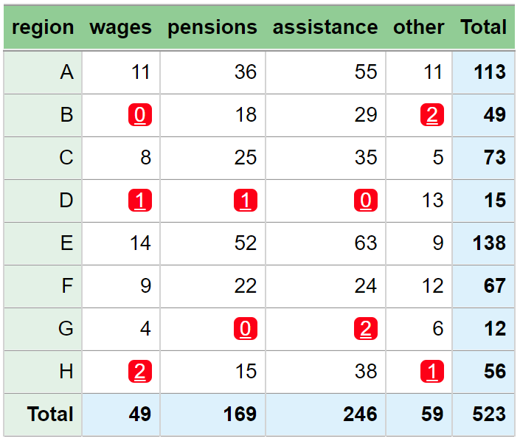
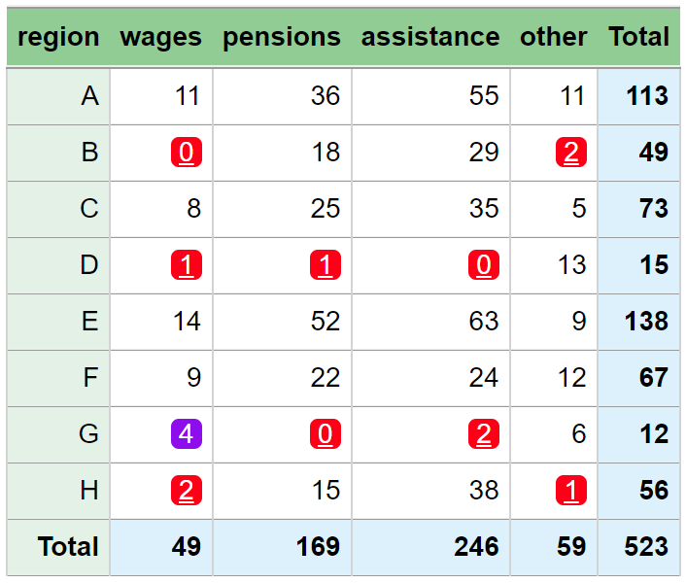
Is this good enough?
GaussSuppression functions can be used to check whether a suppression is good enough
But how?

Slide 13
Customizing suppressions
The GaussSuppression package and its functions have many advanced features, one of which is completely custom primary suppression
The primary parameter
Can also force publication using forced = …
primary = … and forced = … can be (1) integers, (2) a list of TRUE/FALSE, or (3) a function
primary and forced as functions is most powerful (and most used by us), but more complex and outside of the scope of this course

Slide 14
Customizing suppressions
SuppressSmallCounts(data = social,
formula = ~county*main_income,
maxN = 3,
primary = c(5,7))
SuppressSmallCounts(data = social,
formula = ~county*main_income,
maxN = 3,
primary = c(FALSE,FALSE,FALSE,FALSE,TRUE,FALSE,TRUE,FALSE,
FALSE,FALSE,FALSE,FALSE,FALSE,FALSE,FALSE))
primary = … as integers:
Indicates which rows in output table should be primary suppressed
primary = … as TRUE/FALSE:
Must be a vector of same length as output table, TRUE indicates primary suppressed cells.
county main_income freq primary suppressed
1 Total Total 771 FALSE FALSE
2 Trondelag Total 550 FALSE FALSE
3 Viken Total 221 FALSE FALSE
4 Total assistance 329 FALSE FALSE
5 Total other 88 TRUE TRUE
6 Total pensions 255 FALSE FALSE
7 Total wages 99 TRUE TRUE
8 Trondelag assistance 246 FALSE FALSE
9 Trondelag other 68 FALSE FALSE
10 Trondelag pensions 174 FALSE FALSE
11 Trondelag wages 62 FALSE FALSE
12 Viken assistance 83 FALSE FALSE
13 Viken other 20 FALSE TRUE
14 Viken pensions 81 FALSE FALSE
15 Viken wages 37 FALSE TRUE

Slide 15
Customizing suppressions
SuppressSmallCounts(data = social,
formula = ~county*main_income,
maxN = 3,
primary = c(5,7,11))
SuppressSmallCounts(data = social,
formula = ~county*main_income,
maxN = 3,
primary = c(FALSE,FALSE,FALSE,FALSE,TRUE,FALSE,TRUE,FALSE,
FALSE,FALSE,TRUE,FALSE,FALSE,FALSE,FALSE))
primary = … as integers:
Indicates which rows in output table should be primary suppressed
primary = … as TRUE/FALSE:
Must be a vector of same length as output table, TRUE indicates primary suppressed cells.
county main_income freq primary suppressed
1 Total Total 771 FALSE FALSE
2 Trondelag Total 550 FALSE FALSE
3 Viken Total 221 FALSE FALSE
4 Total assistance 329 FALSE FALSE
5 Total other 88 TRUE TRUE
6 Total pensions 255 FALSE FALSE
7 Total wages 99 TRUE TRUE
8 Trondelag assistance 246 FALSE FALSE
9 Trondelag other 68 FALSE TRUE
10 Trondelag pensions 174 FALSE FALSE
11 Trondelag wages 62 TRUE TRUE
12 Viken assistance 83 FALSE FALSE
13 Viken other 20 FALSE FALSE
14 Viken pensions 81 FALSE FALSE
15 Viken wages 37 FALSE FALSE

Slide 16
Customizing suppressions
SuppressSmallCounts(data = social,
formula = ~county*main_income,
maxN = 3,
primary = c(FALSE,FALSE,FALSE,FALSE,TRUE,FALSE,TRUE,FALSE,
FALSE,FALSE,TRUE,FALSE,FALSE,FALSE,FALSE),
forced = c(FALSE,FALSE,FALSE,FALSE,FALSE,FALSE,FALSE,FALSE,
TRUE,FALSE,FALSE,FALSE,FALSE,FALSE,FALSE))
SuppressSmallCounts(data = social,
formula = ~county*main_income,
maxN = 3,
primary = c(5,7,11),
forced = 9)
forced = … as integers:
Indicates which rows in output table must be published
forced = … as TRUE/FALSE:
Must be a vector of same length as output table, TRUE indicates that a cell must be published
county main_income freq primary forced unsafe suppressed
1 Total Total 771 FALSE FALSE FALSE FALSE
2 Trondelag Total 550 FALSE FALSE FALSE FALSE
3 Viken Total 221 FALSE FALSE FALSE FALSE
4 Total assistance 329 FALSE FALSE FALSE FALSE
5 Total other 88 TRUE FALSE FALSE TRUE
6 Total pensions 255 FALSE FALSE FALSE FALSE
7 Total wages 99 TRUE FALSE FALSE TRUE
8 Trondelag assistance 246 FALSE FALSE FALSE FALSE
9 Trondelag other 68 FALSE TRUE FALSE FALSE
10 Trondelag pensions 174 FALSE FALSE FALSE TRUE
11 Trondelag wages 62 TRUE FALSE FALSE TRUE
12 Viken assistance 83 FALSE FALSE FALSE FALSE
13 Viken other 20 FALSE FALSE FALSE TRUE
14 Viken pensions 81 FALSE FALSE FALSE TRUE
15 Viken wages 37 FALSE FALSE FALSE FALSE

Slide 17
Is this suppression good enough?
Set all the suppressed cells as primary using primary = …
If the algorithm does not suppress more cells, it was good enough
Set all the suppressions as primary
The suppression was not good enough!
But how?

Slide 18
Handling already published tables
How to suppress a table with respect to already published (and maybe protected tables):
Table we are trying to protect
Already published
All already published cells as
forced (bold)
 | Hthy | CoV2 | Cold | Flu | Total
k1 | 6 | 1 | 7 | 4 | 18
k2 | 2 | 5 | 6 | 6 | 19
k3 | 3 | 8 | 5 | 2 | 18
k4 | 8 | 4 | 9 | 7 | 28
Total | 19 | 18 | 27 | 19 | 83
 | CoV2 | Cold
k2 | 5 | 6
k3 | 8 | 5
k4 | - | 9
All suppressed cells as
primary (-)

Slide 19
Handling already published tables
How to suppress a table with respect to already published (and maybe protected tables):
Table we are trying to protect
Already published
All already published cells as
forced (bold)
 | Hthy | CoV2 | Cold | Flu | Total
k1 | 6 | 1 | 7 | 4 | 18
k2 | 2 | 5 | 6 | 6 | 19
k3 | 3 | 8 | 5 | 2 | 18
k4 | 8 | - | 9 | 7 | 28
Total | 19 | 18 | 27 | 19 | 83
 | CoV2 | Cold
k2 | 5 | 6
k3 | 8 | 5
k4 | - | 9
All suppressed cells as
primary (-)

Slide 20
Handling already published tables
How to suppress a table with respect to already published (and maybe protected tables):
Table we are trying to protect
Already published
All already published cells as
forced (bold)
 | Hthy | CoV2 | Cold | Flu | Total
k1 | 6 | + | 7 | + | 18
k2 | 2 | 5 | 6 | 6 | 19
k3 | 3 | 8 | 5 | 2 | 18
k4 | 8 | - | 9 | + | 28
Total | 19 | 18 | 27 | 19 | 83
 | CoV2 | Cold
k2 | 5 | 6
k3 | 8 | 5
k4 | - | 9
All suppressed cells as
primary (-)
Secondary suppressions (+)

Slide 21
Handling already published tables
Table we are trying to protect
Already published
All already published cells as
forced (bold)
 | Hthy | CoV2 | Cold | Flu | Total
k1 | 6 | + | 7 | + | 18
k2 | 2 | 5 | 6 | 6 | 19
k3 | 3 | 8 | 5 | 2 | 18
k4 | 8 | - | 9 | + | 28
Total | 19 | 18 | 27 | 19 | 83
 | CoV2 | Cold
k2 | 5 | 6
k3 | 8 | 5
k4 | - | 9
All suppressed cells as
primary (-)
If the already published table was generated with GaussSuppression, the function AdditionalSuppression automatically handles all of this

Slide 22
Estimating intervals for suppressed cells

Slide 23
Estimating intervals
 | Hthy | CoV2 | Cold | Flu | Total
k1 | 6 | - | 7 | - | 18
k2 | - | - | 6 | 6 | 19
k3 | - | 8 | 5 | - | 18
k4 | 0 | 0 | 0 | 7 | 7
Total | 11 | 14 | 18 | 19 | 62
Each suppressed cell value can be estimated using intervals
Involves solving linear optimization problems:
Maximize/minimize cell value, given suppressed table
The functions in GaussSuppression can calculate these intervals for you
Cell is minimum 0, maximum 7
Cell is minimum 0, maximum 5

Slide 24
Estimating intervals
 | Hthy | CoV2 | Cold | Flu | Total
k1 | 6 | - | 7 | - | 18
k2 | - | - | 6 | 6 | 19
k3 | - | 8 | 5 | - | 18
k4 | 0 | 0 | 0 | 7 | 7
Total | 11 | 14 | 18 | 19 | 62
Each suppressed cell value can be estimated using intervals
Involves solving linear optimization problems:
Maximize/minimize cell value, given suppressed table
The functions in GaussSuppression can calculate these intervals for you
Requires installing (at least) one of the following extra packages: lpSolve, Rsymphony, or Rglpk
Use the lpPackage parameter, and specify which package you wish to use
Cell is minimum 0, maximum 7
Cell is minimum 0, maximum 5

Slide 25
Estimating intervals
SuppressSmallCounts(data = social,
formula = ~county*main_income,
maxN = 3,
primary = c(5,7,11), lpPackage = “lpSolve”)
Each suppressed cell value can be estimated using intervals
Involves solving linear optimization problems:
Maximize/minimize cell value, given suppressed table
The functions in GaussSuppression can calculate these intervals for you
Requires installing (at least) one of the following extra packages: lpSolve, Rsymphony, or Rglpk.
Use the lpPackage parameter, and specify which package you wish to use
Specify which package to use
Upper bound for primary suppressed cells
county main_income freq lo up primary suppressed
1 Total Total 771 NA NA FALSE FALSE
2 Trondelag Total 550 NA NA FALSE FALSE
3 Viken Total 221 NA NA FALSE FALSE
4 Total assistance 329 NA NA FALSE FALSE
5 Total other 88 20 150 TRUE TRUE
6 Total pensions 255 NA NA FALSE FALSE
7 Total wages 99 37 167 TRUE TRUE
8 Trondelag assistance 246 NA NA FALSE FALSE
9 Trondelag other 68 NA NA FALSE TRUE
10 Trondelag pensions 174 NA NA FALSE FALSE
11 Trondelag wages 62 0 130 TRUE TRUE
12 Viken assistance 83 NA NA FALSE FALSE
13 Viken other 20 NA NA FALSE FALSE
14 Viken pensions 81 NA NA FALSE FALSE
15 Viken wages 37 NA NA FALSE FALSE
Lower bound for primary suppressed cells

