Slide 1
Statistical Disclosure Control (SDC) day 1, part 2
Introductory Course, 26.02.2024

Slide 2
Microdata
age | gender | income
young | male | 105
young | female | 102
young | female | 111
young | female | 115
middle | male | 108
middle | male | 121
middle | male | 166
middle | female | 144
middle | female | 273
old | male | 201
old | male | 251
old | male | 3435
A single person in each row
In other cases, a single company in each row
In general, a single statistical unit in each row

Slide 3
Microdata
Aggregated data
with a frequency variable
age | gender | income
young | male | 105
young | female | 102
young | female | 111
young | female | 115
middle | male | 108
middle | male | 121
middle | male | 166
middle | female | 144
middle | female | 273
old | male | 201
old | male | 251
old | male | 3435
age | gender | income | freq
young | female | 328 | 3
young | male | 105 | 1
middle | female | 417 | 2
middle | male | 395 | 3
old | male | 3887 | 3

Slide 4
Microdata
Aggregated data
with a frequency variable
and including a row of zeros
age | gender | income
young | male | 105
young | female | 102
young | female | 111
young | female | 115
middle | male | 108
middle | male | 121
middle | male | 166
middle | female | 144
middle | female | 273
old | male | 201
old | male | 251
old | male | 3435
age | gender | income | freq
young | female | 328 | 3
young | male | 105 | 1
middle | female | 417 | 2
middle | male | 395 | 3
old | female | 0 | 0
old | male | 3887 | 3

Slide 5
Frequency Table
age | gender | income | freq
young | female | 328 | 3
young | male | 105 | 1
middle | female | 417 | 2
middle | male | 395 | 3
old | female | 0 | 0
old | male | 3887 | 3
 | young | middle | old | Total
female | 3 | 2 | 0 | 5
male | 1 | 3 | 3 | 7
Total | 4 | 5 | 3 | 12
Each cell-value represents the number of statistical units

Slide 6
Magnitude Table
age | gender | income | freq
young | female | 328 | 3
young | male | 105 | 1
middle | female | 417 | 2
middle | male | 395 | 3
old | female | 0 | 0
old | male | 3887 | 3
 | young | middle | old | Total
female | 328 | 417 | 0 | 745
male | 105 | 395 | 3887 | 4387
Total | 433 | 812 | 3887 | 5132
Each cell value represents the sum of a continuous variable
Each statistical unit has contributed a value
which can be zero

Slide 7
Disclosure in a Magnitude Table

Slide 8
Disclosure in a Magnitude Table
age | gender | income | freq
young | female | 328 | 3
young | male | 105 | 1
middle | female | 417 | 2
middle | male | 395 | 3
old | female | 0 | 0
old | male | 3887 | 3
 | young | middle | old | Total
female | 328 | 417 | 0 | 745
male | 105 | 395 | 3887 | 4387
Total | 433 | 812 | 3887 | 5132
This value can be used to estimate …
We will prevent the disclosure of a statistical unit's value
especially if the value is considered sensitive
It should also not be possible to estimate the value with high accuracy
The value of a single unit is disclosed

Slide 9
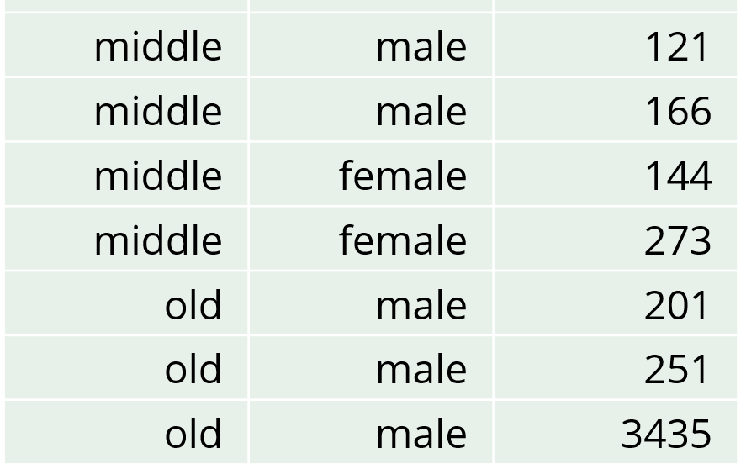
Estimate a value with high accuracy in a magnitude table
age | gender | income | freq
young | female | 328 | 3
young | male | 105 | 1
middle | female | 417 | 2
middle | male | 395 | 3
old | female | 0 | 0
old | male | 3887 | 3
 | young | middle | old | Total
female | 328 | 417 | 0 | 745
male | 105 | 395 | 3887 | 4387
Total | 433 | 812 | 3887 | 5132
This value can be used to estimate …
Suppose known that a person has a high income
The estimate, 3887, is only 13% higher than the person’s income
Acceptable?
The person with an income of 251 can subtract their own number
The estimate, 3887-251 = 3636, is only 5.8% higher than the person’s income
Acceptable?

Slide 10
Sensitive Cells in Magnitude Tables - These are cells that should be primary suppressed
 | young | middle | old | Total
female | 328 | 417 | 0 | 745
male | 105 | 395 | 3887 | 4387
Total | 433 | 812 | 3887 | 5132
Cells with a single contribution
The value can be directly disclosed
Cells with two contributions
One contributor may disclose the value of the other contributor
Other cells according to rules
Either due to dominance rules, p% rule or the few contributors rule.

Slide 11
Few Contributors Rule
 | young | middle | old | Total
female | 328 | 417 | 0 | 745
male | 105 | 395 | 3887 | 4387
Total | 433 | 812 | 3887 | 5132
 | young | middle | old | Total
female | 3 | 2 | 0 | 5
male | 1 | 3 | 3 | 7
Total | 4 | 5 | 3 | 12
Cells where the number of contributors is less than or equal to a certain threshold are primary suppressed
Choice of threshold:
1: Avoids the easiest form of direct disclosure
2: Prevents disclosure where a single unit could use information about itself
>2: Better safeguard against disclosure
However: This rule does not specifically target high-accuracy estimation
In our example, we focused on the specific old-male cell with three contributions that might be problematic, not every cell containing three contributions.

Slide 12
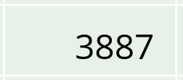
(n, k)-dominance rule
With n₁=1 and n₂=2
k₁=90 and k₂=95
→ Not sensitive
k₁=85 and k₂=95
→ Sensitive
k₁=90 and k₂=94
→ Sensitive
The sum of the n largest contributions cannot exceed k% of the cell value
Common practice to use two rules: n=1 and n=2
In our old-male cell:
Largest contribution: (100*3435/3887)% = 88.4% of the cell value
2 largest contributions: (100*(3435+251)/3887)% = 94.8% of the cell value

Slide 13
p% rule
A cell is considered sensitive if a contributor can estimate another contributor's contribution to that cell within p% of its true value.
To comply with the rule, we only need to assess how well the contributor with the second-largest value can estimate the largest value.
In our old-male cell:
Accuracy: (100*((3887-251)-3435)/3435)% = 5.8%
p=5
→ Not sensitive
p=6
→ Sensitive
As seen earlier
This rule is specifically designed to address the primary issue of accurate estimation.
Therefore, it can be considered better than dominance rules.

Slide 14
Disclosure in a Frequency Table

Slide 15
Disclosure in a Frequency Table
 | young | middle | old | Total
female | 3 | 2 | 0 | 5
male | 1 | 3 | 3 | 7
Total | 4 | 5 | 3 | 12
The cell values themselves are not sensitive
All contributions are 1, and this is common knowledge
Disclosure concerns whether categories within a spanning variable can be disclosed
Sensitive variables
Given that categories within other spanning variables are already known
Identifying variables
Variables can be both sensitive and identifying

Slide 16
Disclosure in a Frequency Table
 | young | middle | old | Total
female | 3 | 2 | 0 | 5
male | 1 | 3 | 3 | 7
Total | 4 | 5 | 3 | 12
Gender sensitive and age identifying
Given age is old → The gender is male
Disclosure is possible due to a cell value of 0
The individual who is young and male knows that all other young individuals are female
Disclosure is possible due to a cell value of 1
Age sensitive and gender identifying
Given gender is female → Age is not old
Negative disclosure is possible due to a cell value of 0
The individual who is young and male knows that no other male individuals are young
Negative disclosure is possible due to a cell value of 1

Slide 17
Any Sensitive Cells in Frequency Tables? - Which cells should be primary suppressed?
 | young | middle | old | Total
female | 3 | 2 | 0 | 5
male | 1 | 3 | 3 | 7
Total | 4 | 5 | 3 | 12
The cell values themselves are not sensitive
To prevent disclosure, it is common practice to primary suppress cells with small frequencies
Therefore, these cells are often labeled as sensitive
Consequently, zeros become sensitive

Slide 18
Primary Suppression of Small Counts in Frequency Tables
 | young | middle | old | Total
female | 3 | 2 | 0 | 5
male | 1 | 3 | 3 | 7
Total | 4 | 5 | 3 | 12
Cells with a frequency less than or equal to a certain threshold are primary suppressed
Choice of threshold:
0: Avoids the easiest form of disclosure
1: Prevents disclosure where a single unit could use information about itself
>1: Provides an even better safeguard against disclosure
This also prevents perceived disclosure, ensuring that individuals cannot identify themselves in the table.

