Slide 1
Suppression to meet SDMX standard using the R-package GaussSuppression
19.Nov 2025

Slide 2
Agenda
Disclaimer
What is the SDMX standard?
SDMX codes for confidentiality status
SDMX codes for confidentiality reasons
The R-package GaussSuppression
Example using GaussSuppression

Slide 3
Disclaimer!!
This presentation reflect our interpretation of the SDMX-standard
We have not used the standard in practice
We will focus on a subset of the SDMX code values for confidentiality
Information on SDMX is based on the code list CL_CONF_STATUS (Version 1.4 – 20/02/2025) from https://sdmx.org/sdmx_cdcl/

Slide 4
What is the SDMX Standard?
SDMX = Statistical Data and Metadata eXchange
An international standard for sharing statistical data and metadata
Sponsored by organizations like Eurostat, IMF, OECD, UN
Defines:
  Data formats (XML, JSON, CSV)
  Metadata structures (concepts, code lists)
  Web services and APIs

Slide 5
SDMX Code list for confidentiality status
The code list describes two distinct concepts:
  "Confidentiality status" (Confidential versus not confidential data)
  "Reasons for confidentiality" (e.g. dominance rule).
We will focus on a subset of the codes

Slide 6
Confidentiality status
Recommended code value | Description
F | Free for publication
C | Confidential statistical information Primary confidentiality
D | Secondary confidentiality (set by the sender)
Notes:
Omitted:
N Not for publication, restricted for internal use only
S Secondary confidentiality set and managed by the receiver, not for publication

Slide 7
Reasons for primary confidentiality
Recommended code value | Description: Primary confidentiality due to …
A | small count
O | dominance by one unit
T | dominance by two units
Notes:
Omitted:
G Primary confidentiality due to dominance by one or two unit
E Not for publication, restricted for internal use only

Slide 8


R-package GaussSuppression
A statistical disclosure control tool to protect tables by suppression (primary and secondary)
  Frequency tables (counts)
  Volume tables (sums)
Easy metadata extraction for SDMX confidentiality codes

Slide 9
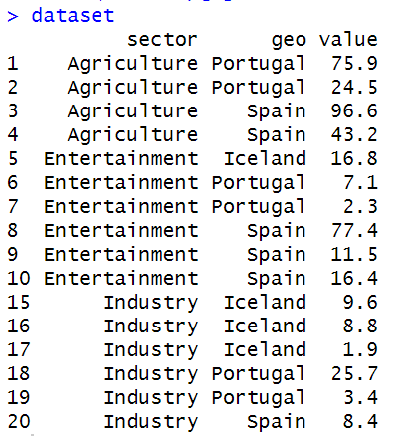
Example
Microdata
 | Portugal | Spain | Iceland
Agriculture | 75.9, 24.5 | 96.6, 43.2
Entertainment | 7.1, 2.3 | 77.4, 11.5, 16.4 | 16.8
Industry | 25.7, 3.4 | 8.4 | 9.6, 8.8, 1.9
Dimensions
Values to sum up
Notes:
We start by looking at microdata, where each row represent one sectors in countries. For each country and each sector, we may have multiple contributions.

Slide 10

Suppress cells with few contributors
Few <= 2
Microdata
 | Portugal | Spain | Iceland
Agriculture | 75.9, 24.5 | 96.6, 43.2
Entertainment | 7.1, 2.3 | 77.4, 11.5, 16.4 | 16.8
Industry | 25.7, 3.4 | 8.4 | 9.6, 8.8, 1.9
Dimensions
Values to sum up
Notes:
We start by looking at microdata, where each row represent one sectors in countries. For each country and each sector, we may have multiple contributions.

Slide 11
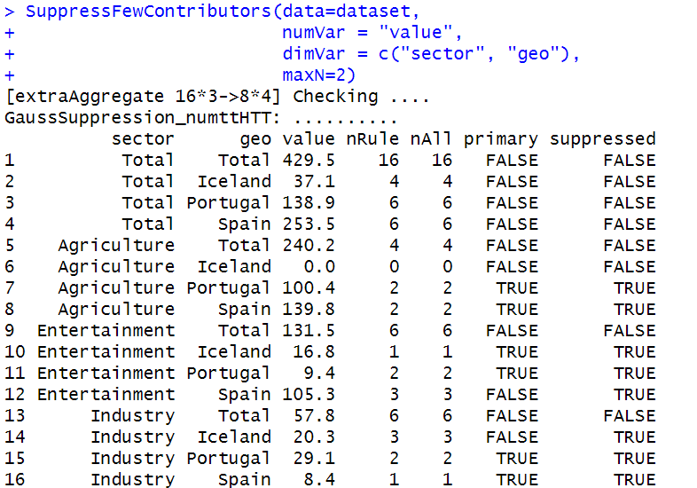
Suppress cells with few contributors
GaussSuppression
Microdata set
Value to sum up
Suppression threshold
Table dimensions

Slide 12
Suppress cells with few contributors

Slide 13
 | Portugal | Spain | Iceland | Total
Agriculture | 100.4 | 139.8 | 0 | 240.2
Entertain-ment | 9.4 | 105.3 | 16.8 | 131.5
Industry | 29.1 | 8.4 | 20.3 | 57.8
Total | 138.9 | 253.5 | 37.1 | 429.5
Notes:
This is no longer microdata, but aggregated values. Totals are added.

Slide 14
 | Portugal | Spain | Iceland | Total
Agriculture | 100.4 | 139.8 | 0 | 240.2
Entertain-ment | 9.4 | 105.3 | 16.8 | 131.5
Industry | 29.1 | 8.4 | 20.3 | 57.8
Total | 138.9 | 253.5 | 37.1 | 429.5
= Primary suppression
= Secondary suppression

Slide 15
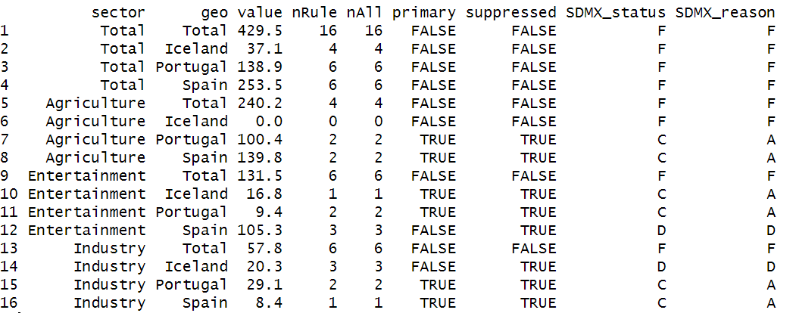
SDMX code
SDMX code:
F = Free

Slide 16
SDMX code
SDMX code:
F = Free

Slide 17
SDMX code
SDMX code:
F = Free

Slide 18
SDMX code
SDMX code:
F = Free
SDMX code:
F = Free
C = Primary
suppressed
A = Primary due to small count

Slide 19
SDMX code
Note: SDMX obtained using some R-code. Full code for the example can be found in the GitHub-page of the course
SDMX code:
F = Free
SDMX code:
F = Free
C = Primary
suppressed
A = Primary due to small count
D = Secondary suppressed

Slide 20
Example using dominance rules

Slide 21
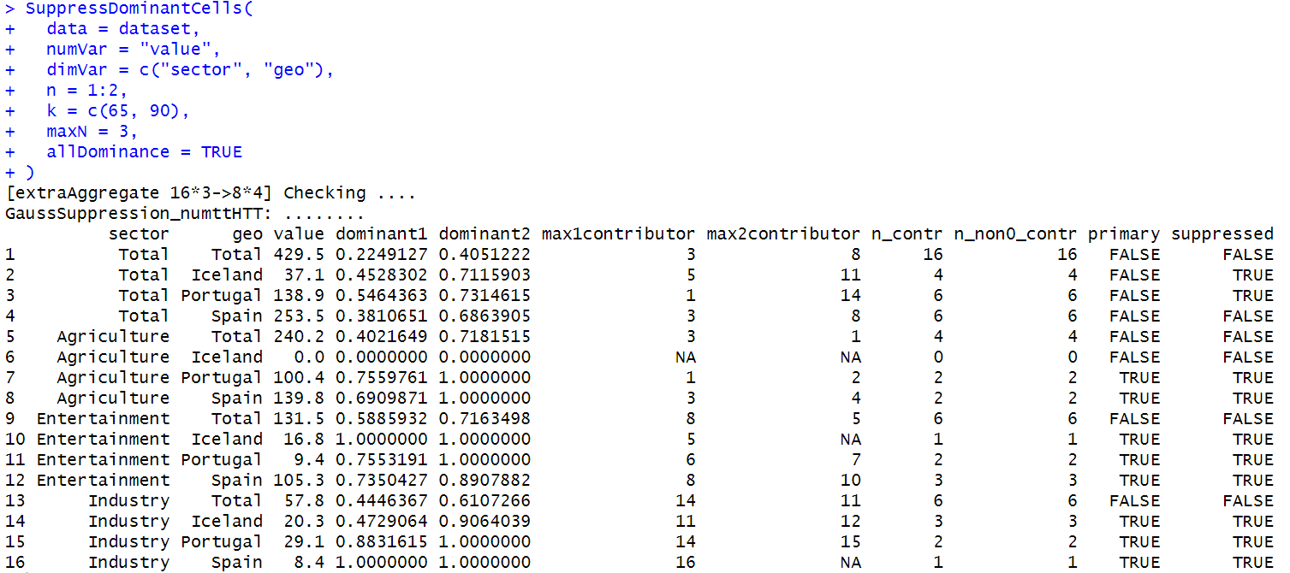
Example using dominance rules
GaussSuppression
Microdata set
Value to sum up
Table dimensions
Suppression threshold
Print extended output
Domninance rules:
1 unit can not contribute with more than 65% of the cell total
2 units can not contribute for more than 90% of the cell total

Slide 22
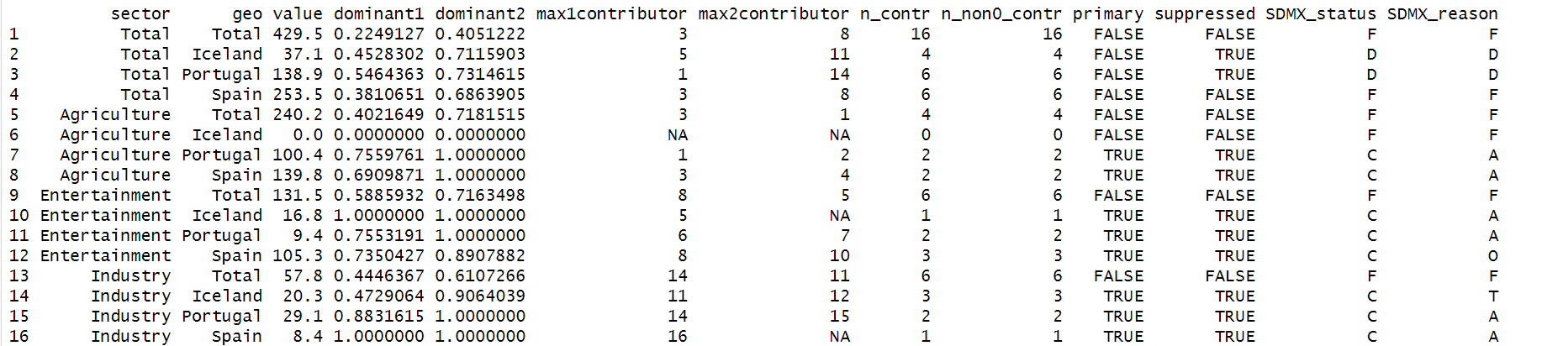
Example using dominance rules
Percentage of the total for the most dominant contribution
Percentage of the total for the two most dominant contributions
The number of (non-null) contributors to each aggregate
ID of largest contributor
ID of second largest contributor
Dimensions and value to sum up
Suppression status

Slide 23
Example using dominance rules
SDMX code:
F = Free
C = Primary suppressed
A = Primary due to small count
D = Secondary suppressed
O = Primary suppressed due
to one dominant unit
T = Primary suppressed due
to two dominant units
Percentage of the total for the most dominant contribution
Percentage of the total for the two most dominant contributions
ID of largest contributor
ID of second largest contributor

Slide 24
Example using dominance rules
SDMX code:
F = Free
C = Primary suppressed
A = Primary due to small count
D = Secondary suppressed
O = Primary suppressed due
to one dominant unit
T = Primary suppressed due
to two dominant units
Percentage of the total for the most dominant contribution
Percentage of the total for the two most dominant contributions
ID of largest contributor
ID of second largest contributor

Slide 25
Example using dominance rules
SDMX code:
F = Free
C = Primary suppressed
A = Primary due to small count
D = Secondary suppressed
O = Primary suppressed due
to one dominant unit
T = Primary suppressed due
to two dominant units
Percentage of the total for the most dominant contribution
Percentage of the total for the two most dominant contributions
ID of largest contributor
ID of second largest contributor

Slide 26
Code for the examples are available in the GitHub page
(ukraina_kode_sdmx_gauss.R)
https://github.com/statisticsnorway/kurs-metode-sdc-2025/tree/main/R

Slide 27
Thank you!

