Slide 1
Microdata Protection Using sdcMicro

Slide 2
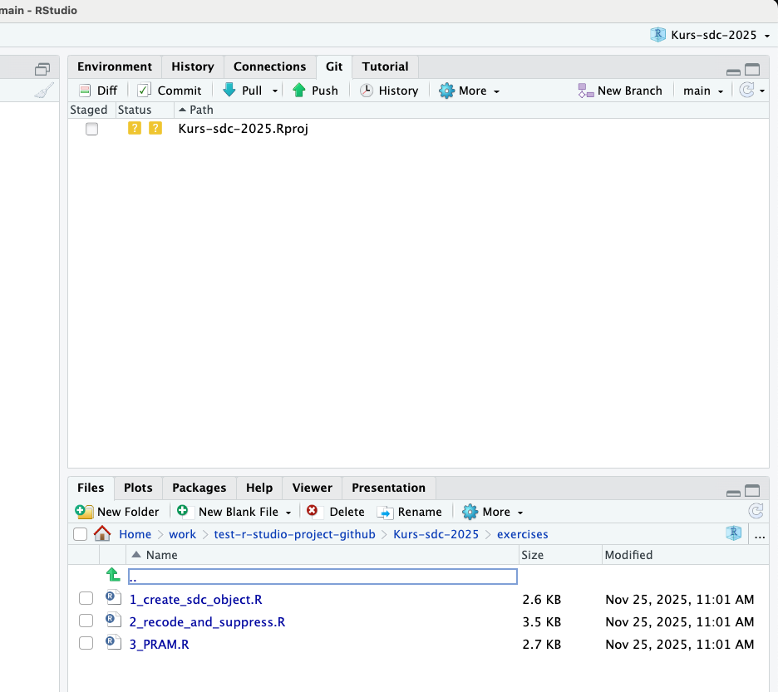
Exercises Added Today
Please update to find the files!
Rstudio: press the pull button
Terminal/other: ‘git pull’
Web access: https://github.com/statisticsnorway/kurs-metode-sdc-2025

Slide 3
Today’s Plan
Goal: everyone should be able to anonymize a dataset with sdcMicro:
  Recode, suppress, PRAM
  Calculate risk before and after the process
  Generate a report
Introduction to sdcMicro
Demonstration of sdcMicro
2-3 exercise sessions (20-30 min each)
GUI App of sdcMicro

Slide 4
sdcMicro — Introduction
sdcMicro is a free, open-source R-package to anonymize microdata
Main authors: M. Templ, B. Meindl, A. Kowarik, J. Gussenbauer
Version 1.0.0 was released on CRAN in 2007

Slide 5
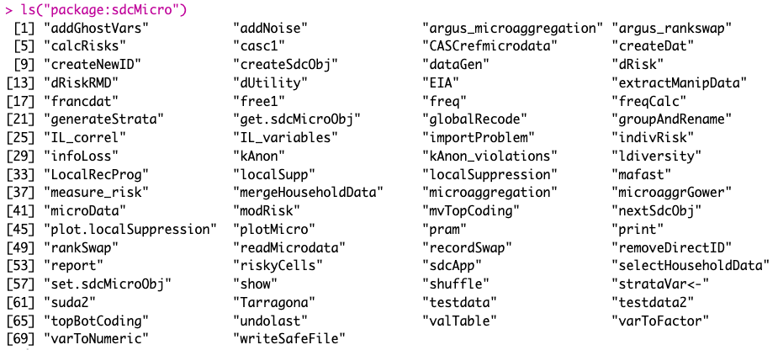
sdcMicro — Features
9 datasets
18 anonymization methods
12 risk assessment functions
4 utility evaluation functions

Slide 6
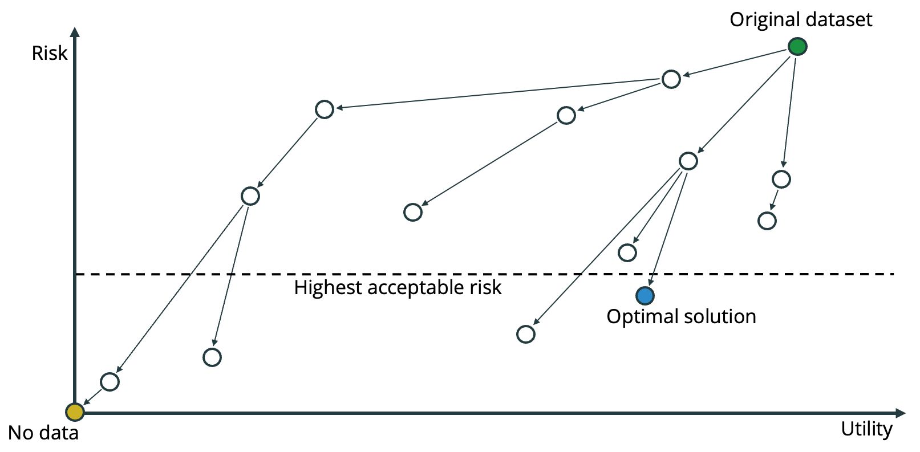
Create Initial sdcMicroObj
We always start by creating an sdcMicroObj
  Include the original dataset
  Include information about the variables in the dataset
    Key variables
    Sensitive variables
    Direct identifying variables
    Etc.
We make a new sdcMicroObj after each anonymization step
  scdMicroObj contains useful information about the current state of the dataset (e.g., risk)
  We can compare the risk before and after an anonymization method to see its effect

Slide 7
Create Initial sdcMicroObj
createSdcObj(
dat,
keyVars,
numVars = NULL,
pramVars = NULL,
ghostVars = NULL,
weightVar = NULL,
hhId = NULL,
strataVar = NULL,
sensibleVar = NULL,
excludeVars = NULL,
options = NULL,
seed = NULL,
randomizeRecords = FALSE,
alpha = 1
)
  dat: original dataset to anonymize
  keyVars: (categorical) key variables
  weigthVar: weight variable
  sensibleVar: sensitive variables
  excludeVars: variables to exclude from process and output

Slide 8
Persons Dataset
Key variables
(Quasi-identifiers)
Sensitive variable
Direct identifier
Weight variable
Person_id | Gender | Birth_year | Region | Income | Weight
1 | f | 1965 | A | 50000 | 10
2 | m | 1973 | A | 64000 | 20
3 | f | 1984 | A | 32000 | 30
4 | f | 1984 | A | 10000 | 15
… | … | … | … | … | …

Slide 9
Create Initial sdcMicroObj – Example
load(file = “data/persons.Rdata”)
sdc_0 <- createSdcObj(
dat = persons,
excludeVars = c("Person_id"),
keyVars = c("Gender", "Birth_year", ”Region"),
sensibleVar = c("Income"),
weightVar = ”Weight"
)

Slide 10
The sdcMicroObj – Slots
> slotNames(sdc_0)
"origData" "keyVars" "pramVars" "numVars" "ghostVars"
"weightVar" "hhId" "strataVar" "sensibleVar" "manipKeyVars"
"manipPramVars" "manipNumVars" "manipGhostVars" "manipStrataVar" "originalRisk"
"risk" "utility" "pram" "localSuppression" "options"
"additionalResults" "set" "prev" "deletedVars"
sdc_0@origData
sdc_0@deletedVars
sdc_0@risk

Slide 11
The Risk Slot – sdc_0@risk
$individual
risk fk Fk
[1,] 0.017144262 2 110.0
[2,] 0.022042326 2 84.5
[3,] 0.022042326 2 84.5
[4,] 0.177075834 1 17.0
[5,] 0.003581243 2 549.0
[6,] 0.003581243 2 549.0
[7,] 0.402359478 1 5.0
[8,] 0.017144262 2 110.0
$global
$global$risk
[1] 0.08312137
$global$risk_ER
[1] 0.664971
$global$risk_pct
[1] 8.312137
$global$threshold
[1] 0.003581243
$global$max_risk
[1] 0.01

Slide 12
Demonstration

Slide 13
Exercise 1:
1_create_sdc_object.R

Slide 14
Recoding
  obj: sdcMicroObj to apply local suppression on
  var: variable to recode
  before: list of values to recode from
  after: value to recode to
groupAndRename(
obj,
var,
before,
after,
addNA = FALSE
)

Slide 15
Local Suppression
  obj: sdcMicroObj to apply recoding on
  k: target level of anonymity
  importance: specify variable priority
  combs: use to specify subset size
localSuppression(
obj,
k = 2,
importance = NULL,
combs = NULL,
...
)

Slide 16
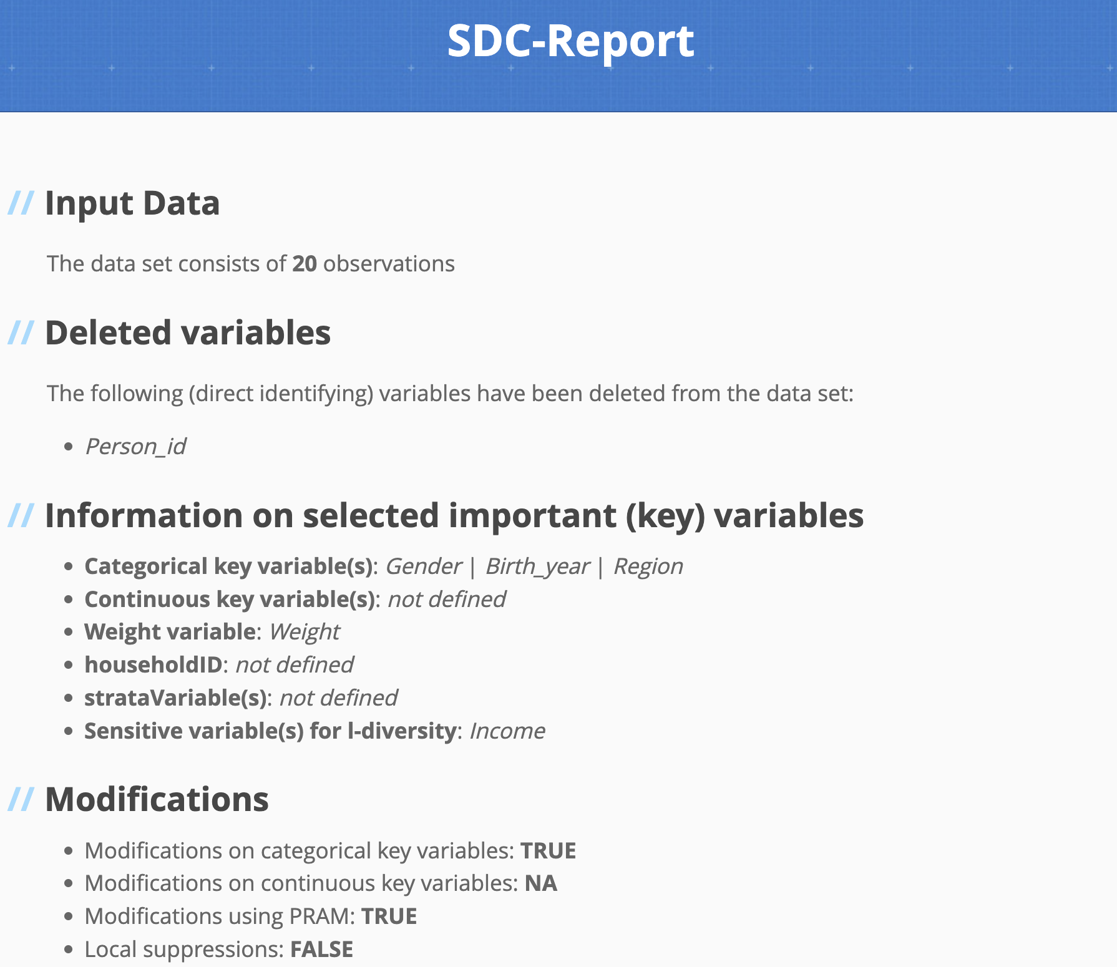
Generate Report
sdcMicro can generate a report about the whole anonymization process
report(sdc_0,
outdir = "reports",
filename = "demo_report.html”,
verbose = TRUE,
internal = TRUE
)

Slide 17
Extract Data with extractManipData
df_out <- extractManipData(sdc_5)

Slide 18
Exercise 2:
2_recode_and_suppress.R

Slide 19
Exercise 3:
3_PRAM.R

Slide 20
Thank you!

