Slide 1
Matplotlib Architecture
Backend
Deals with the rendering of plots to screen or files
In Jupyter notebooks we use the inline backend

Slide 2
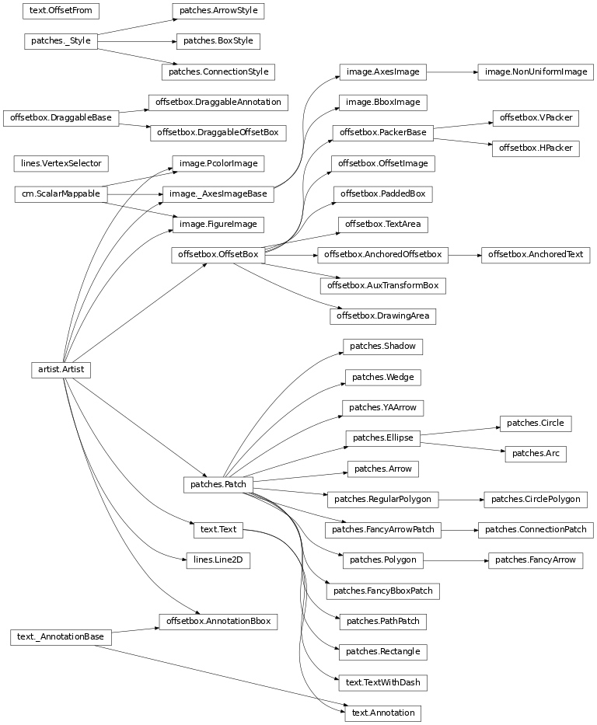
Notes:
The matplotlib architecture that shows the numerous kinds of artists available on the artist layer. The artists object has many child objects, some of which also have their own child objects. Patches.patch is one of the child objects of the artists object.
Source: http://matplotlib.org/api/artist_api.html

Slide 3
Matplotlib Architecture
Backend Layer
Deals with the rendering of plots to screen or files
In Jupyter notebooks we use the inline backend
Artist Layer
Contains containers such as Figure, Subplot, and Axes
Contains primitives, such as a Line2D and Rectangle, and collections, such as a PathCollection
Scripting Layer
Simplifies access to the Artist and Backend layers

Slide 4
Acknowledgements
Slide 2
Australian Transport Safety Bureau (2015). MH370 – Definition of Underwater Search Areas (Report). Retrieved February 17, 2017 from https://en.wikipedia.org/wiki/Heat_map#/media/File:MH370_location_probability_heat_map_per_DST_Group_analysis.jpg

