Slide 1
GAISE Recommendations for Intro Stat : Improving Understanding and Success Rates
Patti Frazer Lock, St. Lawrence University
Robin Lock, St. Lawrence University
MathFest 2026
Notes:
Dennis

Slide 2
GAISE Guidelines for Assessment and Instruction in Statistics Education
Two versions:
Pre-K-12 (NCTM - 2005) updated 2020
College (ASA – 2005) updated 2015
https://www.amstat.org/education/guidelines-for-assessment-and-instruction-in-statistics-education-(gaise)-reports

Slide 3

Update to GAISE College Report
https://amstat.quarto.pub/college-gaise/
Steering Committee:
Patti Frazer Lock, St. Lawrence University (co-chair)
Jamie Perrett, Brigham Young University (co-chair)
David Hunter, Penn State University
Lisa Kay, Eastern Kentucky University
Kate Kozak, Coconino Community College
Chris Malone, Winona State University
Maria Tackett, Duke University
Donna Lalonde, ASA Liaison

Slide 4
GAISE Recommendations
Recommendations for Statistics and Data Science
Teach statistics and data science as iterative processes of gleaning insights from data to inform evidence-based decisions.
Emphasize effective written and oral communication of results from data, with attention to the scope and limitations of conclusions.
Focus on conceptual understanding rather than algebraic manipulation and formulas.
Integrate real data with a context and purpose throughout the course. Select data that are meaningful and engaging to the students.
Encourage multivariable thinking.

Slide 5
GAISE Recommendations
Recommendations for Statistics and Data Science
Incorporate software/apps to explore concepts and work with data.
Emphasize responsible and ethical conduct in the collection and use of data and in their analysis.
Employ evidence-based pedagogies that actively engage students in the learning process.
Use a variety of formative and summative assessments to improve teaching and learning.
Implement a course design that uses inclusive strategies to foster a sense of belonging.

Slide 6
GAISE Recommendations
Recommendations for Statistics and Data Science
Teach statistics and data science as iterative processes of gleaning insights from data to inform evidence-based decisions.
Emphasize effective written and oral communication of results from data, with attention to the scope and limitations of conclusions.
Focus on conceptual understanding rather than algebraic manipulation and formulas.
Integrate real data with a context and purpose throughout the course. Select data that are meaningful and engaging to the students.
Encourage multivariable thinking.
TODAY

Slide 7
3. Focus on conceptual understanding rather than algebraic manipulation and formulas.
Example: Simulation-Based Inference (SBI)
Focus on key ideas of statistical inference, e.g.,
Use a p-value as evidence for a test
Construct a confidence interval for a parameter
Early in a course with minimal formulas, few distributional prerequisites, very little algebra, but lots of applicability to many situations.

Slide 8
Example #1: Beer & Mosquitoes
Question: Does consuming beer attract mosquitoes?
Experiment:
25 volunteers drank a liter of beer,
18 volunteers drank a liter of water
Randomly assigned!
Mosquitoes were caught in traps as they approached the volunteers.¹
¹ Lefvre, T., et. al., “Beer Consumption Increases Human Attractiveness to Malaria Mosquitoes, ” PLoS ONE, 2010; 5(3): e9546.

Slide 9
Beer and Mosquitoes
Number of Mosquitoes
Beer
27
20
21
26
27
31
24
19
23
24
28
19
24
29
20
17
31
20
25
28
21
27
21
18
20
Water
21
22
15
12
21
16
19
15
24
19
23
13
22
20
24
18
20
22
Beer mean = 23.6
Water mean
= 19.22
Beer mean – Water mean = 4.38
On average, the beer drinkers attracted 4.38 more mosquitoes than the water drinkers.
Is this a “significant” difference?

Slide 10
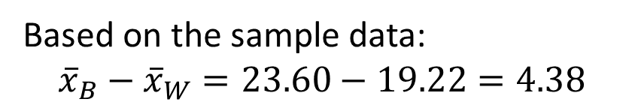
Randomization Approach
Number of Mosquitoes
Two possible explanations:
Beer attracts mosquitos
No difference; random chance
Beer
27
20
21
26
27
31
24
19
23
24
28
19
24
29
20
17
31
20
25
28
21
27
21
18
20
Water
21
22
15
12
21
16
19
15
24
19
23
13
22
20
24
18
20
22
What might happen just by random chance, if there is no difference??
µ = mean number of attracted mosquitoes
H₀: μ_{B} = μ_{W}
H_{a}: μ_{B} > μ_{W}
Based on the sample data:
$${\overline{x}}_{B}−{\overline{x}}_{W}=23.60−19.22=4.38$$

Slide 11
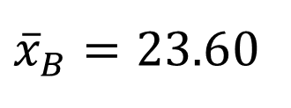


Randomization Approach
Number of Mosquitoes
To simulate samples under H₀ (no difference):
Re-randomize the values into Beer & Water groups
Beer
27
20
21
26
27
31
24
19
23
24
28
19
24
29
20
17
31
20
25
28
21
27
21
18
20
Water
21
22
15
12
21
16
19
15
24
19
23
13
22
20
24
18
20
22
27 19 21 24
20 24 18 19
21 29 20 23
26 20 21 13
27 27 22 22
31 31 15 20
24 20 12 24
19 25 21 18
23 28 16 20
24 21 19 22
28 27 15
${\overline{x}}_{B}=23.6$0
$${\overline{x}}_{W}=19.22$$
$${\overline{x}}_{B}−{\overline{x}}_{W}=4.38$$

Slide 12

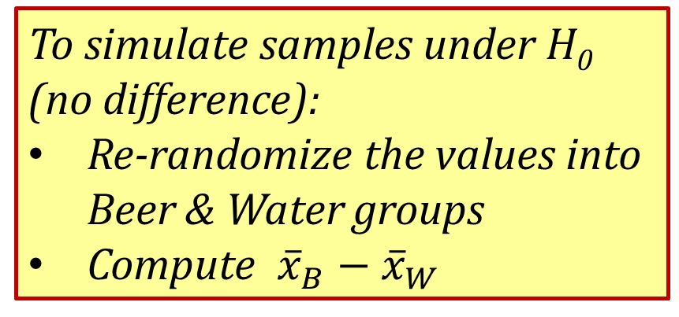


Randomization Approach
Number of Mosquitoes
To simulate samples under H₀ (no difference):
Re-randomize the values into Beer & Water groups
Compute ${\overline{x}}_{B}−{\overline{x}}_{W}$
Beer
Water
24
20 24 18 19
21 29 20 23
26 20 21 13
27 27 22 22
31 31 15 20
24 20 12 24
19 25 21 18
23 28 16 20
24 21 19 22
28 27 15
27
19
21
20
24
19
20
24
31
13
18
24
25
21
18
15
21
16
28
22
19
27
20
23
22
21
20
26
31
19
23
15
22
12
24
29
20
27
21
17
24
28
Repeat this process 1000’s of times to see how “unusual” the original difference of 4.38 is.
$${\overline{x}}_{B}=21.76$$
$${\overline{x}}_{W}=22.50$$
Time for Technology
$${\overline{x}}_{B}−{\overline{x}}_{W}=−0.84$$

Slide 13
StatKey
lock5stat.com/statkey
Freely available web apps with no login required
Runs in (almost) any browser (incl. smartphones/tablets)
Use standalone or supplement to existing technology
Notes:
Patti

Slide 14
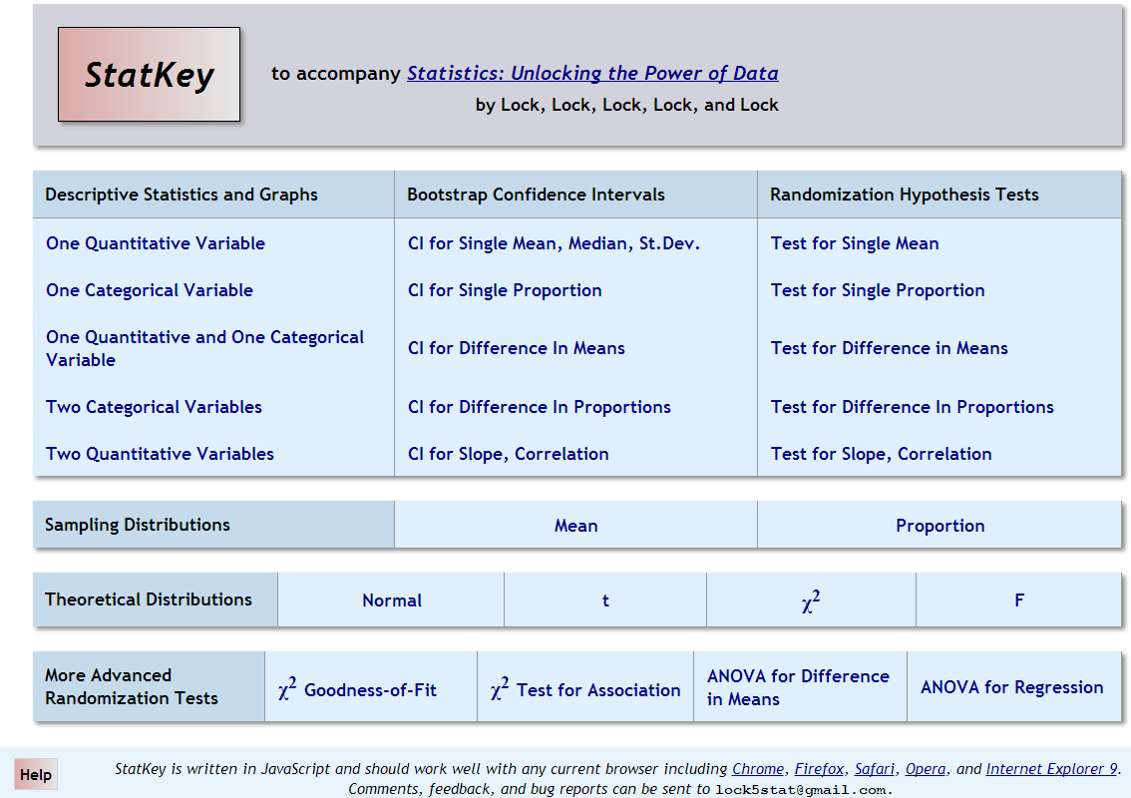
lock5stat.com/statkey

Slide 15
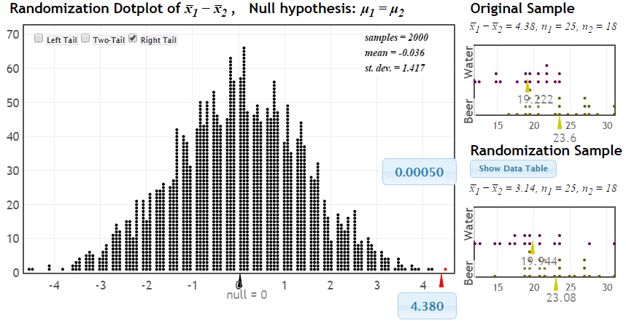
Randomization Test
p-value
Distribution of statistic if H₀ true
observed statistic
If there were no difference between beer and water, we would only see differences this extreme 0.05% of the time!

Slide 16
p-value: The chance of obtaining a statistic as extreme as that observed, just by random chance, if the null hypothesis is true
p-value: The chance of obtaining a statistic as extreme as that observed, just by random chance, if the null hypothesis is true
p-value: The chance of obtaining a statistic as extreme as that observed, just by random chance, if the null hypothesis is true
p-value: The chance of obtaining a statistic as extreme as that observed, just by random chance, if the null hypothesis is true
p-value: The chance of obtaining a statistic as extreme as that observed, just by random chance, if the null hypothesis is true

Slide 17
The difference of 4.38 is very unlikely to happen just by random chance.
We have strong evidence that drinking beer does attract mosquitoes!

Slide 18
Beer and Mosquitoes: Take 2
Number of Mosquitoes
Beer
27
20
21
26
27
31
24
19
23
24
28
19
24
29
20
17
31
20
25
28
21
27
21
18
20
Water
21
22
15
12
21
16
19
15
24
19
23
13
22
20
24
18
20
22
Does drinking beer actually attract mosquitoes, OR is the difference just due to random chance?
What about the traditional approach to this question?

Slide 19
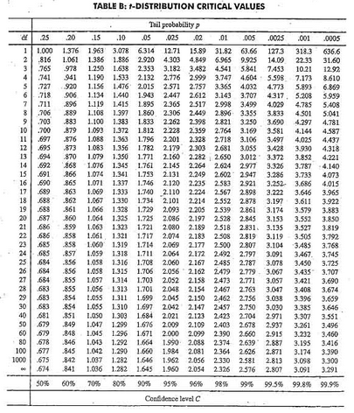

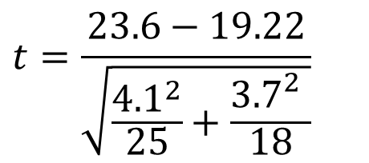
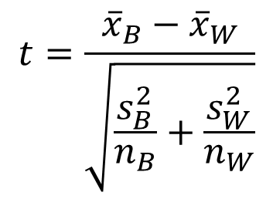
Traditional Inference
1. Check conditions
2. Which formula?
5. Which theoretical distribution?
$$t=\frac{{\overline{x}}_{B}−{\overline{x}}_{W}}{\sqrt{\frac{s_{B}^{2}}{n_{B}}+\frac{s_{W}^{2}}{n_{W}}}}$$
6. df?
7. Find p-value
8. Interpret a decision
3. Calculate numbers and plug into formula
$$t=\frac{23.6−19.22}{\sqrt{\frac{{4.1}^{2}}{25}+\frac{{3.7}_{}^{2}}{18}}}$$
4. Chug with calculator
$$t=3.68$$
0.0005 < p-value < 0.001

Slide 20
The conclusion is the same, but the method used to get there is very different.

Slide 21
Randomization Approach
Create a randomization distribution by simulating many samples from the original data, assuming H₀ is true, and calculating the sample statistic for each new sample.
Estimate p-value directly as the proportion of these randomization statistics that exceed the original sample statistic.
Small p-value ⇒ Strong evidence against H_{o}
Same general procedure works in lots of settings.

Slide 22

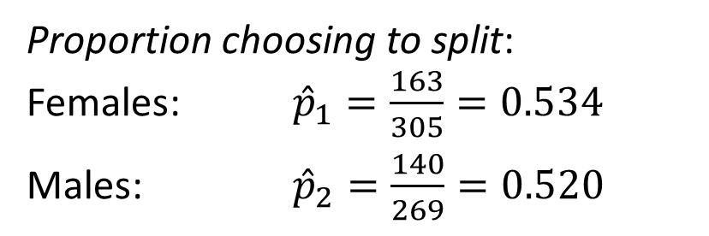
Example: Split or Steal?
https://econ.video/2017/08/24/golden-balls-split-or-steal/
 | Split | Steal | Total
Female | 163 | 142 | 305
Male | 140 | 129 | 269
Total | 303 | 271 | n=574
Proportion choosing to split:
Females: ${\hat{p}}_{1}=\frac{163}{305}=0.534$
Males: ${\hat{p}}_{2}=\frac{140}{269}=0.520$
Can we conclude from the information in this sample that females are more likely to split than males?
Van den Assem, M., Van Dolder, D., and Thaler, R., “Split or Steal? Cooperative Behavior When the Stakes Are Large,” 2/19/11.
Notes:
Watch the video… pause before the results, and ask students what they would do

Slide 23
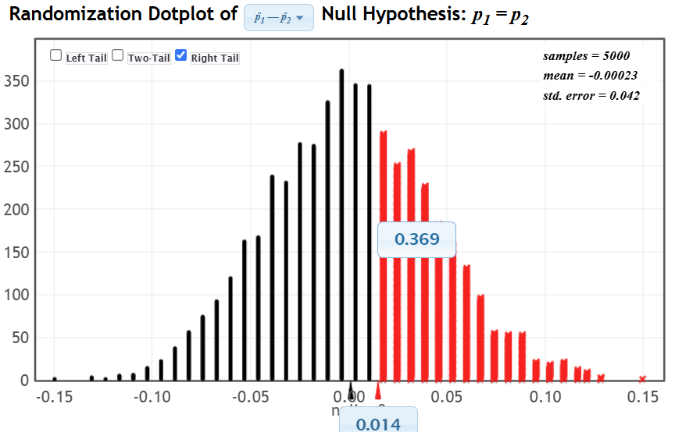
Example: Split or Steal?
This sample does not provide convincing evidence that females are more likely to split than males.

Slide 24
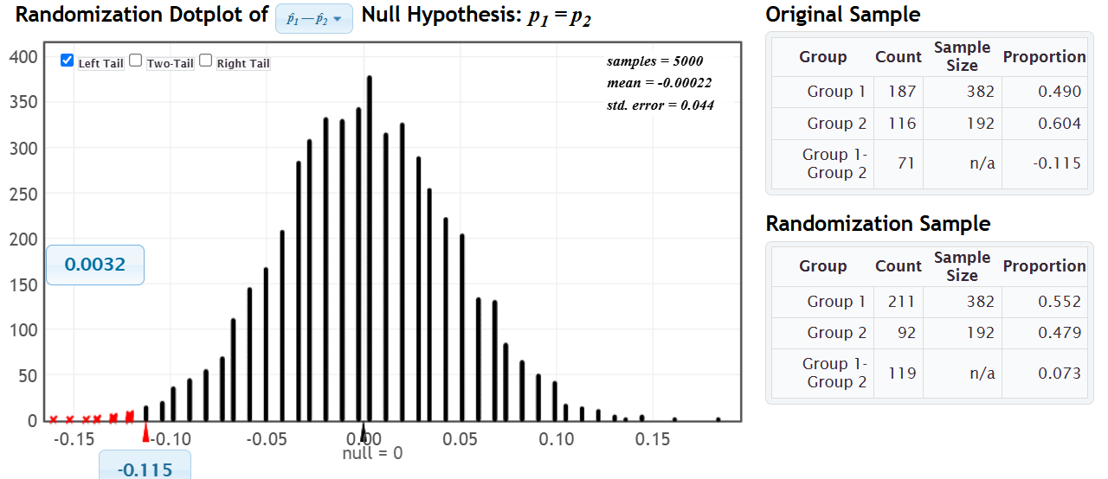
Example: Split or Steal?
We also have data on age. What do you think:
Are people younger than 40 less likely to split than people older than 40?
 | Split | Steal | Total
Under 40 | 187 | 195 | 382
Over 40 | 116 | 76 | 192
Total | 303 | 271 | n=574

Slide 25
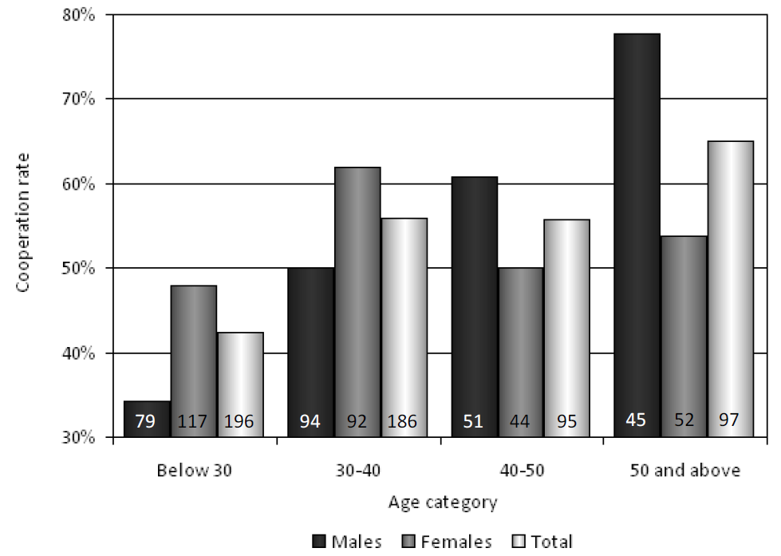
Example: Split or Steal?

Slide 26
Confidence Intervals
How can we estimate the variability (accuracy) of an estimator when we only have one sample?
Traditional: Assume a distribution and use a formula to compute a standard error.
SBI: Generate a distribution using simulation from the original sample.

Slide 27
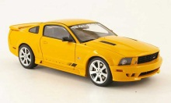
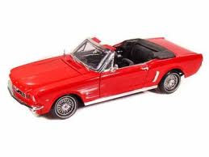
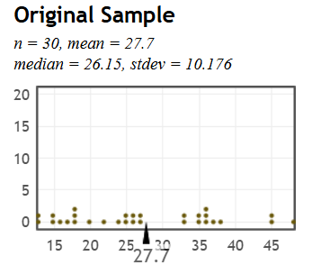
Example: Mustang Prices
What’s the mean price for used Mustang cars offered for sale online?
Data: Prices (in $1,000’s) for a random sample of n=30 Mustangs chosen at a website (like cars.com)
Best estimate for the mean price of used Mustangs is $27,700, but how accurate is that estimate?
Goal: Find an interval that is likely to contain the mean price for all Mustangs
Key concept: How much can we expect means for samples of size 30 to vary just by random chance?

Slide 28

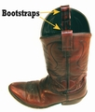
Bootstrapping
Brad Efron
Stanford University
How can we measure the variability of a sample statistic using ONLY the data in that one sample?
What is our best guess at the population, given just the sample data?
The sample itself! (or many copies of the sample)
Key idea: Draw new samples of the same sample size repeatedly from the sample data (with replacement!)
(bootstrap samples)

Slide 29
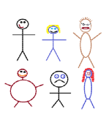
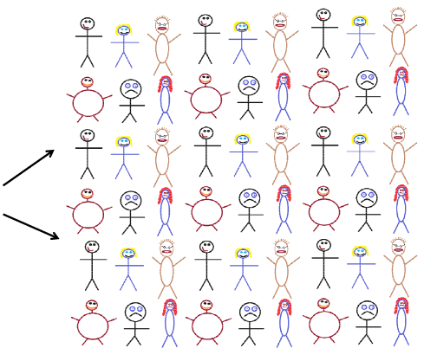




Finding a Bootstrap Sample
Original Sample (n=6)
A simulated “population” to sample from
Bootstrap Sample: (sample with replacement from the original sample)
Notes:
Patti

Slide 30
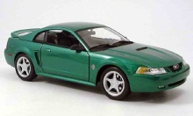
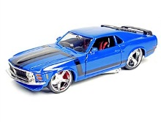
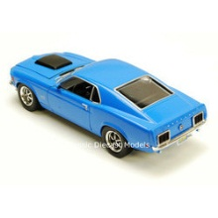
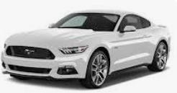
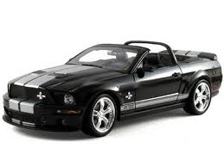
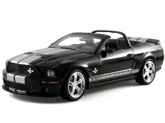
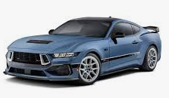
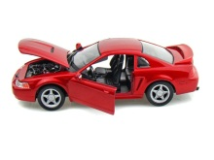
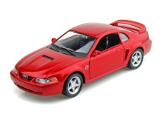

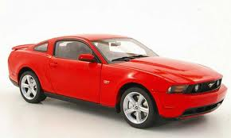
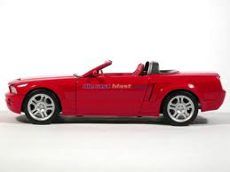

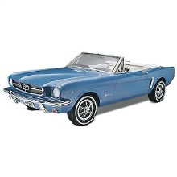
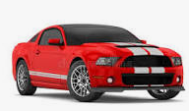
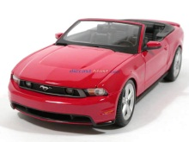
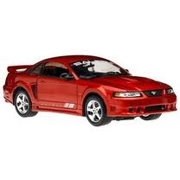
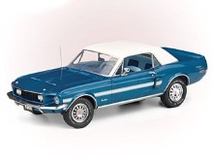
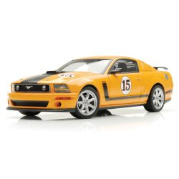
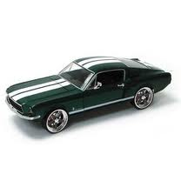
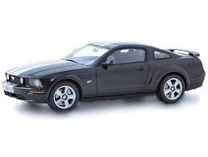
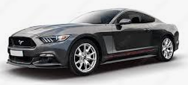
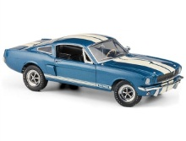
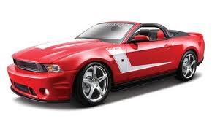
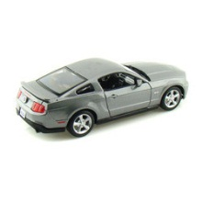
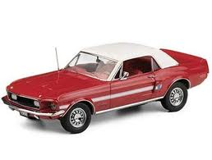
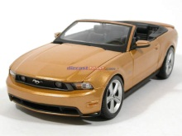
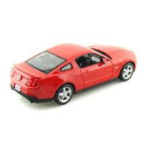
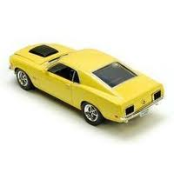


Original Sample
Bootstrap Sample
Repeat 1,000’s of times!
$$\overline{x}=27.70$$
$$\overline{x}=26.87$$
Notes:
Robin

Slide 31

BootstrapSample
Bootstrap Statistic
BootstrapSample
Bootstrap Statistic
Original Sample
Bootstrap Distribution
●
●
●
●
●
●
Sample Statistic
BootstrapSample
Bootstrap Statistic

Slide 32
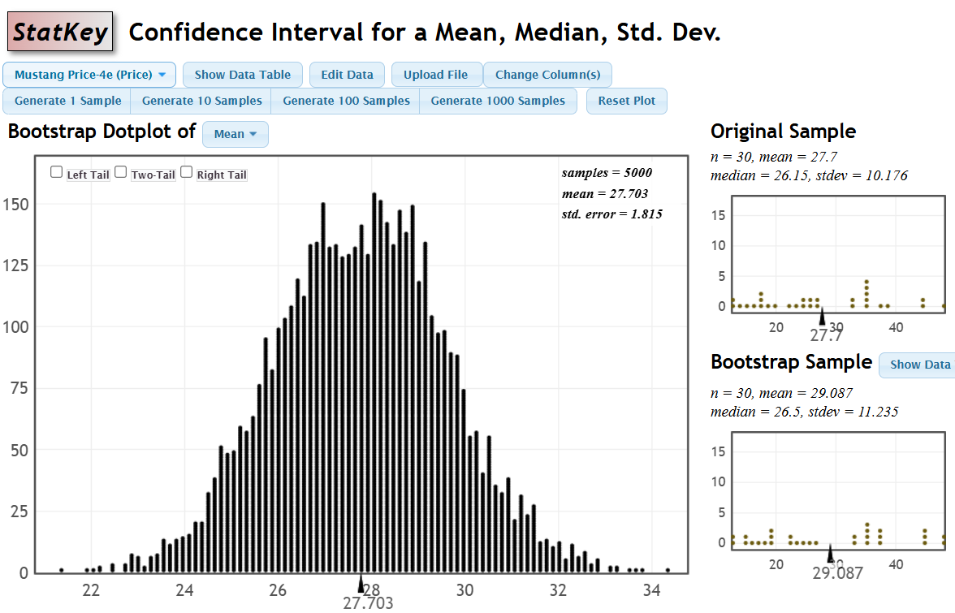
How do we find a confidence interval from th bootstrap distribution?
Notes:
Robin

Slide 33
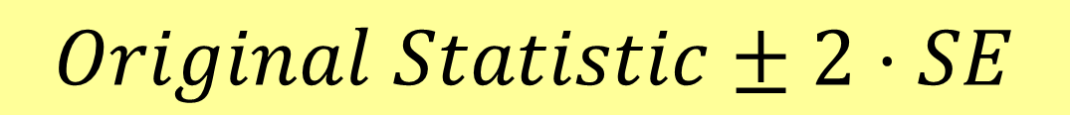
How do we get a CI from the bootstrap distribution?
Method #1: Standard Error
Find the standard error (SE) as the standard deviation of the bootstrap statistics
Find an interval with
$$Original Statistic±2⋅SE$$

Slide 34
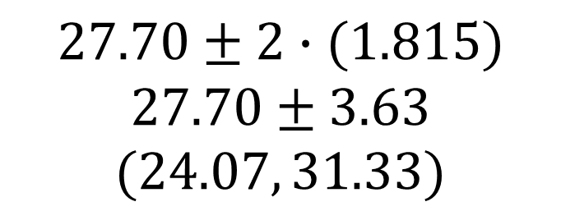
$$27.70±2∙(1.815)$$
$$27.70±3.63$$
$$(24.07, 31.33)$$
We are 95% sure that the average Mustang price is between $24,070 and $31,330
Notes:
Robin

Slide 35
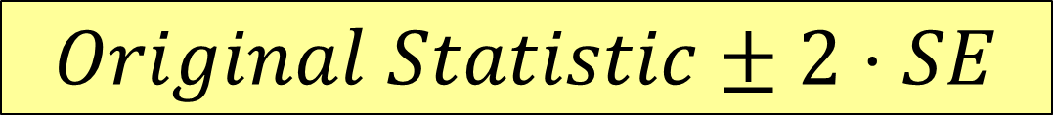
How do we get a CI from the bootstrap distribution?
Method #1: Standard Error
Find the standard error (SE) as the standard deviation of the bootstrap statistics
Find an interval with
$$Original Statistic±2⋅SE$$
Method #2: Percentile Interval
For a 95% interval, find the endpoints that cut off 2.5% of the bootstrap means from each tail, leaving 95% in the middle

Slide 36
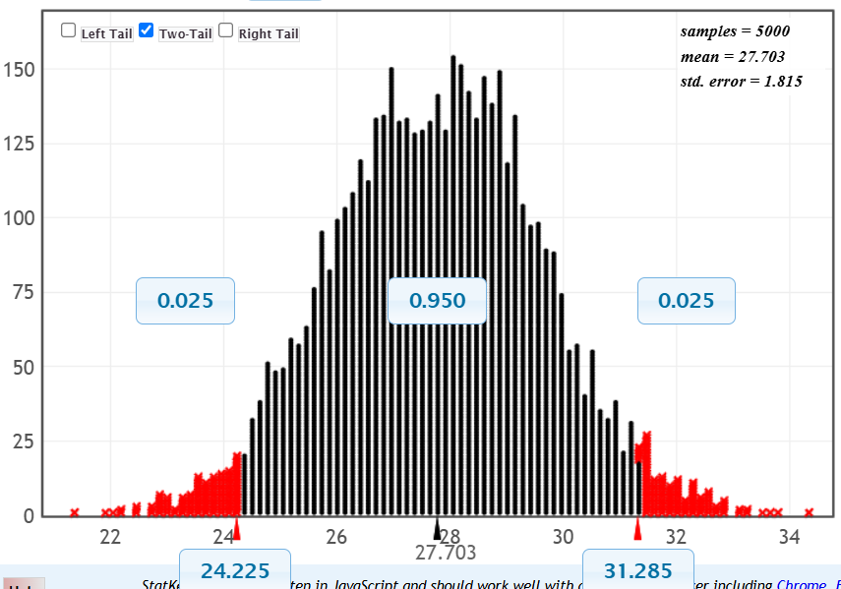
95% CI via Percentiles
Easily adjust to other confidence levels
Chop 2.5% in each tail
Keep 95% in middle
Chop 2.5% in each tail
We are 95% sure that the average online price for used Mustangs is between $24,225 and $31,285.

Slide 37
Bootstrap Confidence Intervals
Version 1 (Statistic ± 2 SE):
Great preparation for moving to
traditional methods
Version 2 (Percentiles):
Great at building understanding of
confidence level
Same process works for different parameters

Slide 38






Example: Teen TikTok Users
Find a 95% CI for the proportion of US teens who have used TikTok
$$\hat{p}=0.67$$
$$n =1316$$
# TikTok users$=1316\left(0.67\right)=882$
https://www.pewresearch.org/internet/2022/08/10/teens-social-media-and-technology-2022/

Slide 39


Example: Teen TikTok Users
We are 95% sure that the proportion of US teens who have used TikTok is between 0.644 and 0.696
$$0.67±2\left(0.013\right)=(0.644, 0.696)$$

Slide 40
Why
does the bootstrap work?

Slide 41
Sampling Distribution
Population
BUT, in practice we don’t see the “tree” or all of the “seeds” – we only have ONE seed
µ

Slide 42


Using only the Sample Data
What can we do with just one seed?
“Simulated
Population”
Estimate the distribution and variability (SE) of $\overline{x}$’s from this new distribution
Grow a NEW tree!
$$\overline{x}$$
µ

Slide 43
Want More About Bootstrapping?
What Teachers Should Know About the Bootstrap: Resampling in the Undergraduate Statistics Curriculum
Tim Hesterberg in December 2015 American Statistician
Or find another version at
https://arxiv.org/abs/1411.5279

Slide 44

SBI Inference
Visual!
Intuitive!
Easily incorporates active learning!
Ties directly to key concepts of random variation and strength of evidence!
(Note: No theoretical distributions. No complicated formulas. No algebra. Same process for all parameters.)

Slide 45

What about Traditional Inference?
Use formula for SE
Approximate the bootstrap/randomization distribution with a theoretical curve (CLT is easy!)
Notes:
M Lock

Slide 46


Moving to Traditional: Intervals
Bootstrap CI: $Statistic ±2∙SE$
Standard distribution with confidence level
(conditions)
Formula for SE
Traditional CI: $\overline{x} ±t^{∗}∙\frac{s}{\sqrt{n}}$
This is quick and easy since the basic understanding and interpretation of CI’s is already done!
Notes:
M Lock

Slide 47

Moving to Traditional: Tests
Standardized test statistic:
$$z=\frac{Statistic−Null}{SE}$$
Need:
Formula for SE for each parameter
Standard distribution (z or t) for p-value
This is quick and easy since the students already know how to state hypotheses and interpret a p-value!
Notes:
M Lock

Slide 48

Beer & Mosquitoes (Traditional)
H₀: μ_{B} = μ_{W}
H_{a}: μ_{B} > μ_{W}
$$t=\frac{23.6−19.22}{\sqrt{\frac{{4.1}^{2}}{25}+\frac{{3.7}_{}^{2}}{18}}}=\frac{4.38}{1.20}=3.66$$
$$t_{17}$$
Same “tail” process as randomization to find p-value
Notes:
M Lock

Slide 49
4. Integrate real data with a context and purpose throughout the course. Select data that are meaningful and engaging to the students.
Aspects of “real” data:
Authenticity: Collected for actual research or decision-making purposes.
Relevance: Tied to topics meaningful and engaging to students.
Complexity: Includes real-world features like outliers or missing data.
Context: Comes with background information to support interpretation and application.

Slide 50
Where to Find Real Data?
Online repositories
Textbook datasets
Class generated activities
Faculty colleagues
Community engagement
Government agencies
R packages
Web sources

Slide 51

Examples of Data Sources
https://myslu.stlawu.edu/~rlock/DataSources.html

Slide 52

Dataset and Story Library https://dasl.datadescription.com

Slide 53

SCORE Data Repository https://data.scorenetwork.org/

Slide 54
Your Assignment!
Find a dataset for one of these projects:
Project #1: Describe the variables and relationships in a dataset that has
3 to 5 variables
At least one categorical and two quantitative
At least 30 cases
Project #3: Build regression models to predict a quantitative response variable
Have 3 to 5 potential predictors in the data
At least 30 cases

Slide 55
Quick Survey
What would you like to hear more about on Saturday?
plock@stlawu.edu rlock@stlawu.edu

