Slide 1
GAISE Recommendations for Intro Stat : Improving Understanding and Success Rates
Patti Frazer Lock, St. Lawrence University
Robin Lock, St. Lawrence University
MathFest 2026
https://statmanrobin.github.io/MathFestMini2026/
Notes:
Dennis

Slide 2

What About AI?
Challenge:
Write an outside-class assignment that is AI proof.

Slide 3
Solution Ideas?
Oral exams/assessments
More in-class graded assessments
Increased explicit focus on learning
“You don’t take a fork-lift to the gym.”

Slide 4
GAISE Guidelines for Assessment and Instruction in Statistics Education
Written in 2005
Revised in 2016
Revised in 2026
Robin Lock on the writing team
Robin Lock on the writing team
Patti Frazer Lock on the writing team

Slide 5

2026 College GAISE
www.asacollegegaise.org
Recommendations for Statistics and Data Science
Learning Outcomes for Intro Stats
Current Landscape in Data Science
Assessment Items
And more…

Slide 6
2026 College GAISE Recommendations
Recommendations for Statistics and Data Science
Teach statistics and data science as processes of gleaning insights from data to inform evidence-based decisions.
Emphasize effective written and oral communication of results from data, with attention to the scope and limitations of conclusions.
Focus on conceptual understanding rather than algebraic manipulation and formulas.
Integrate real data with a context and purpose throughout the course. Select data that are meaningful and engaging to the students.
Encourage multivariable thinking.
Incorporate software/apps to explore concepts and work with data.
Emphasize responsible and ethical conduct in the collection and use of data and in their analysis.
Employ evidence-based pedagogies that actively engage students in the learning process.
Use a variety of formative and summative assessments to improve teaching and learning.
Implement a course design that uses inclusive strategies to foster a sense of belonging.

Slide 7
1. Teach statistics and data science as processes of gleaning insights from data to inform evidence-based decisions.
Data helps us understand the world better!
Build stronger insights!
Make better decisions!
Across almost ALL fields!
We want the examples we give and the data we use to be so engaging that students WANT to engage and want to learn.

Slide 8
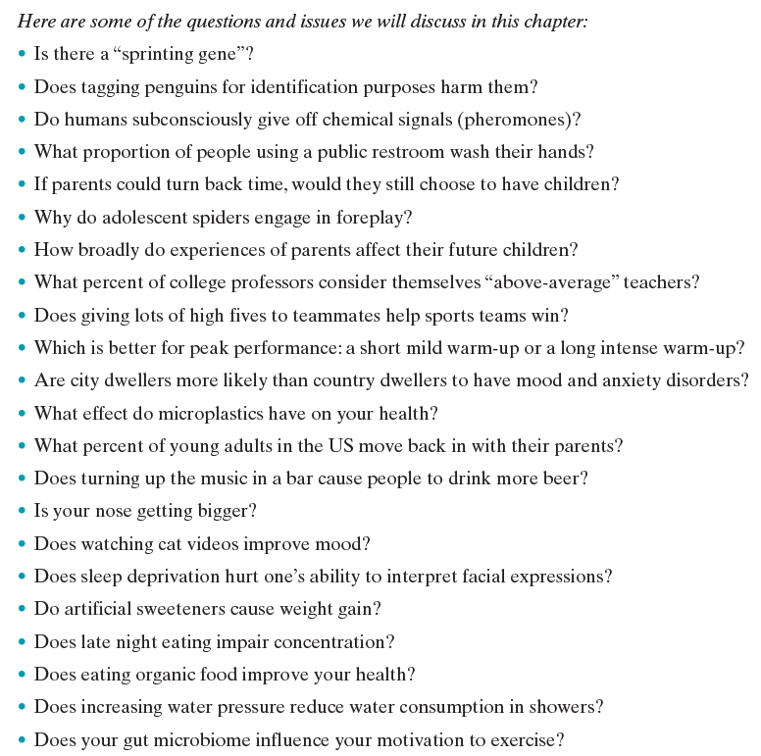
Insights from Data

Slide 9
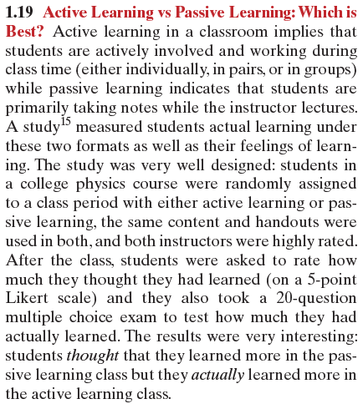
Insights from Data
Students randomly assigned
One group had active learning
One group had passive learning
How much did they think they learned?
How much did they actually learn?
“Students thought they learned more in the passive learning class but they actually learned more in the active learning class.”
Strongly significant in both cases.

Slide 10
2. Emphasize effective written and oral communication of results from data, with attention to the scope and limitations of conclusions.
Interpret! Interpret! Interpret!
What conclusions can we draw from these data?
Interpret the results in context.
“Data Storytelling” can be a key part of every IS and IDS course.
Wide variety of possible assessments!

Slide 11
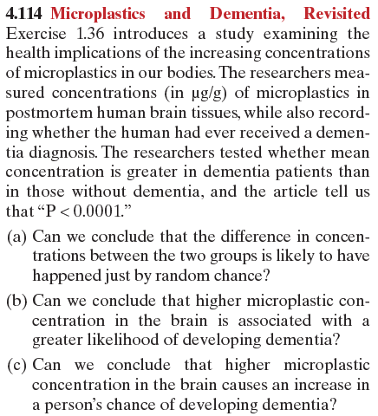
Effective Communication
One group had dementia.
One group didn’t.
Compared mean concentration of microplastics in
postmortem brain tissue.
Article: “P < 0.0001”
What can we conclude?

Slide 12
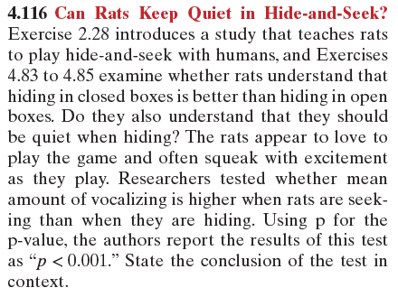
Effective Communication
Rats love to play hide-and-seek!
They squeak with excitement when playing!
Do they understand the game?
Compared mean amount of vocalizing between when rats are seeking vs when rats are hiding.
Article: “p < 0.001”
What can we conclude?

Slide 13
3. Focus on conceptual understanding rather than algebraic manipulation and formulas.
Simulation-Based Inference!!
Conceptual understanding!
Reduced focus on formulas/algebra!

Slide 14
4. Integrate real data with a context and purpose throughout the course. Select data that are meaningful and engaging to the students.
So important!!
Also can be really hard!
In our textbook writing, we think it is the most important thing we do.

Slide 15
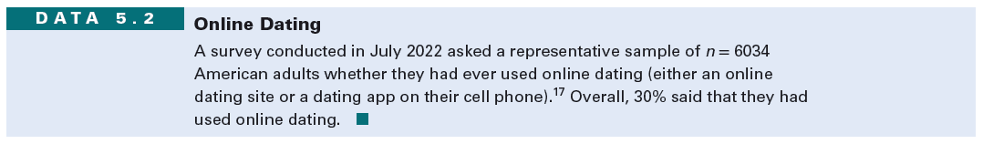
Real Data: Online Dating
Pew Research large survey
Have you ever used online dating?
30% said yes.
Standard confidence interval for a proportion

Slide 16
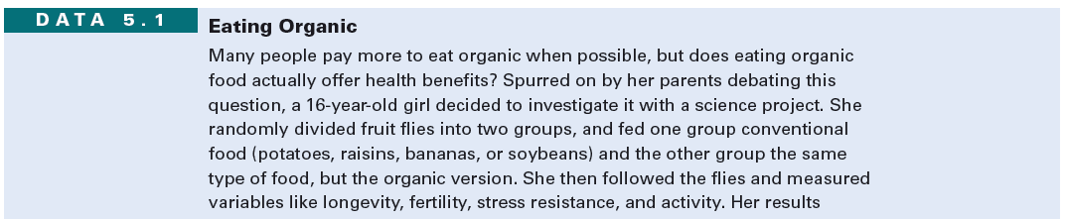

Real Data: Eating Organic
Fruit flies randomly divided.
500 fed organic potatoes; 500 regular potatoes.
After 13 days:
Organic: 318 of 500 still alive
Not-organic: 285 of 500 still alive
Standard difference in proportions hypothesis test

Slide 17
5. Encourage multivariable thinking.
www.gapminder.org
Notes:
Go live to gapminder after this.

Slide 18
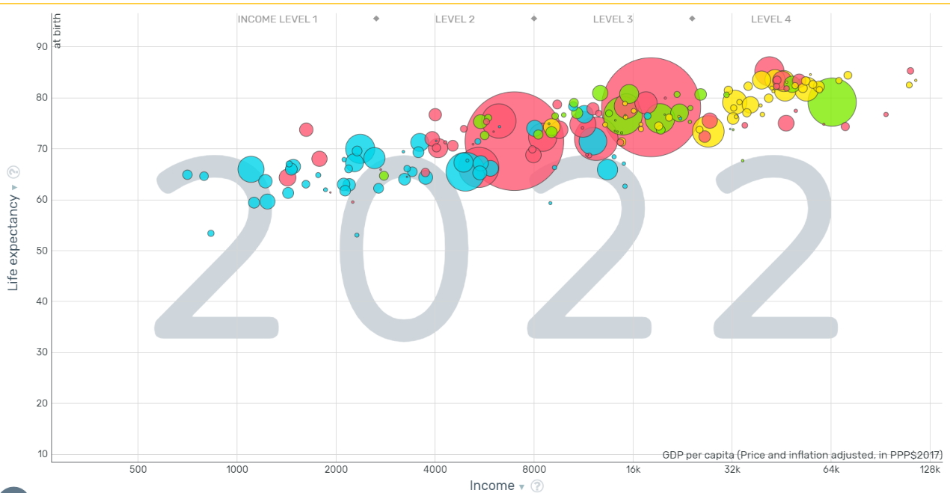
Multivariable Thinking: Gapminder
No Algebra!
But lots of thinking about and understanding data!
www.gapminder.org/tools

Slide 19
5. Encourage multivariable thinking.
Can introduce multivariable thinking with confounding variables very early.
Can have students discussing/interpreting Data Visualizations with enhanced scatterplots and online apps like www.gapminder.org, also early in a course.
More advanced topics such as a soft introduction to Multiple Regression or creating their own data visualizations may or may not be included.
Notes:
Go live to gapminder after this.

Slide 20
6. Incorporate software/apps to explore concepts and work with data.
StatKey!!!
Or any other statistical software or app!
Technology should change what and how we teach.
The recommendation is to use technology for all graphs and summary statistics rather than drawing or computing by hand.

Slide 21
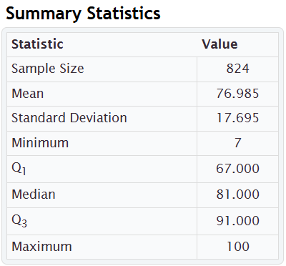
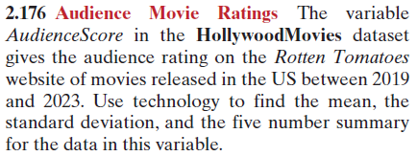
Technology: Audience Score for Hollywood Movies
For offline assessments:
Give summary statistics or graphs.
Emphasis is on interpreting,
not calculating or creating by hand.
Students can discuss what the summary statistics show,
Or lots of specific questions can be asked.

Slide 22
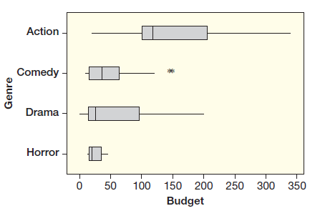
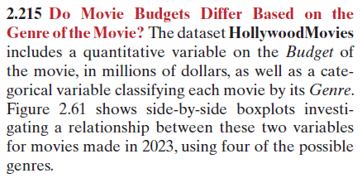
Technology: Budget for Hollywood Movies, by Genre
For offline assessments:
Give summary statistics or graphs.
Emphasis is on interpreting,
not calculating or creating by hand.
Students can discuss what the graph shows,
Or lots of specific questions can be asked.

Slide 23
Technology: Understanding Correlation
www.istics.net
=> Stat.istics.net
=> Guessing Correlations

Slide 24
7. Emphasize responsible and ethical conduct in the collection and use of data and in their analysis.
Particularly in a World of AI, discussions of ethics become essential.
Particularly in a World of Data, discussions of ethics become essential.
Focus throughout on where data came from, how it is being used, the scope of inference.

Slide 25
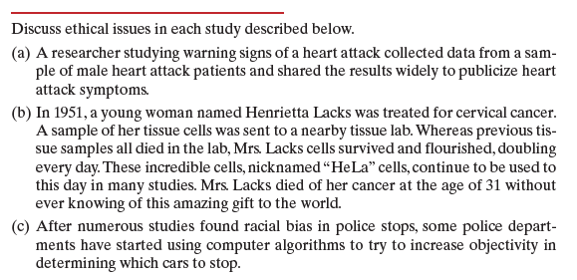
Ethical Conduct
Warning signs of a heart attack:
Sample only included males
HeLa cells from Henrietta Lacks, used without her consent or knowledge.
Racial bias in police stops:
Do computer algorithms help?

Slide 26
8. Employ evidence-based pedagogies that actively engage students in the learning process.
In-class discussions!
In-class group work!
In-class graded group work!
Open-ended questions!
Projects!

Slide 27
9. Use a variety of formative and summative assessments to improve teaching and learning.
Creative assessments are even more important now in the age of AI.
Need a variety of types and levels of assessment!
Short easy questions
Online homework questions that are engaging
Medium questions for quiz/exam
More involved questions for group/class discussions
Projects!

Slide 28
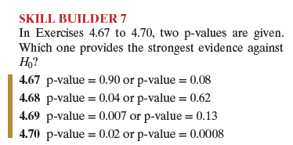
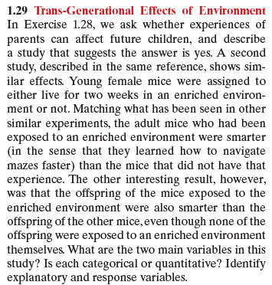
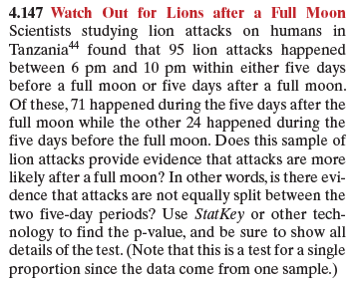
Variety of Assessments
“Skill Builders”
Short easy questions to build foundational understanding and build confidence.
Also good for quick oral assessments
Trans-Generational Effects of Environment
Trans-Generation Effects of Diet
Are There Human Pheromones?
Do Crows Hold a Grudge?
Do Pigeons Remember a Face?
Are Fast Food Diets and Depression related?
Group work/Full-Class Discussions
Hypothesis Test
Watch Out for Lions after a Full Moon!

Slide 29
10. Implement a course design that uses inclusive strategies to foster a sense of belonging.
Back to AI:
We want students to WANT to learn.
We want them to know we care.
We want them to know that these ideas about data will be relevant in their lives!
We want them ALL to feel welcomed and included.
One suggestion: Student Hours!
Another: Combat student loneliness!

Slide 30
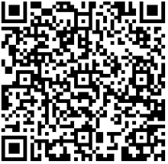
Questions, Comments, Suggestions
Patti Frazer Lock Robin H. Lock
plock@stlawu.edu rlock@stlawu.edu
Evaluation
www.asacollegegaise.org

Slide 31
2026 College GAISE Recommendations
Recommendations for Statistics and Data Science
Teach statistics and data science as processes of gleaning insights from data to inform evidence-based decisions.
Emphasize effective written and oral communication of results from data, with attention to the scope and limitations of conclusions.
Focus on conceptual understanding rather than algebraic manipulation and formulas.
Integrate real data with a context and purpose throughout the course. Select data that are meaningful and engaging to the students.
Encourage multivariable thinking.
Incorporate software/apps to explore concepts and work with data.
Emphasize responsible and ethical conduct in the collection and use of data and in their analysis.
Employ evidence-based pedagogies that actively engage students in the learning process.
Use a variety of formative and summative assessments to improve teaching and learning.
Implement a course design that uses inclusive strategies to foster a sense of belonging.

