Slide 1

Lab 4: Visualizing Read Mapping
Matthew Huff

Slide 2

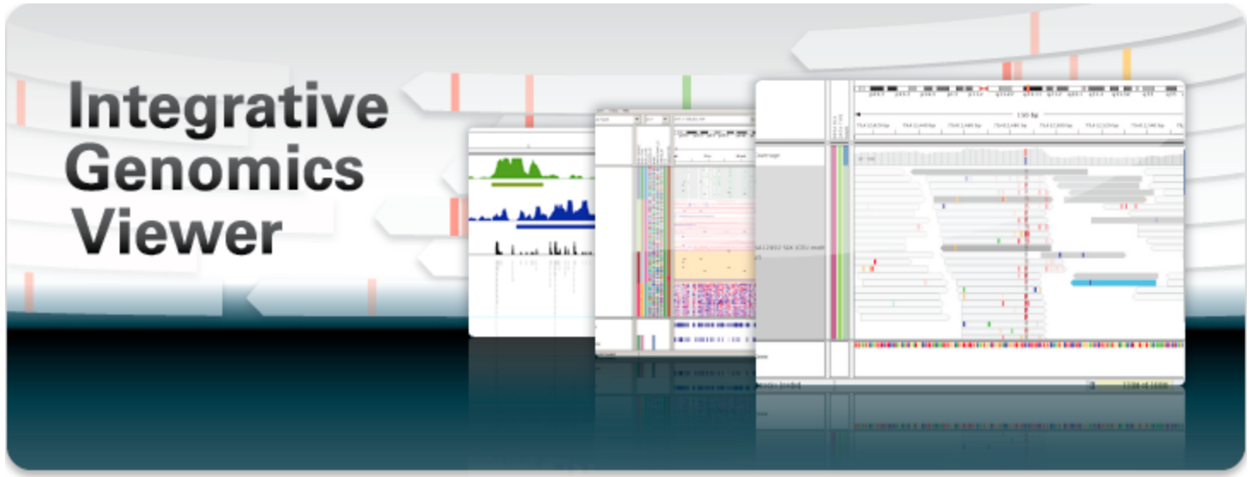
Integrative Genomics Viewer (IGV) – Visualizing Read Mapping
After performing read alignment, you may be interested in contextualizing your results with your genome of interest.
IGV is a popular tool to visualize alignments.
Available as a Java-based desktop application, a web application, and a JavaScript component to be integrated into web pages.
Made to view large, integrated genomics datasets.
Supports a wide range of data types, including the output of STAR.

Slide 3

IGV and STAR Results
IGV recommends using the BAM format when uploading Sequence Alignment Maps.
Any BAM files uploaded to IGV must meet the following requirements:
The BAM file must be sorted.
The BAM file must be indexed.
You have already produced sorted BAM files after running STAR, so your BAM files already meet one of these requirements.

Slide 4
Step 1: Indexing a BAM file
A BAM Index file is a companion file to the original BAM file.
Think of an Index file as an external Table of Contents for the original BAM file.
All Index files will share their name with their source file, suffixed with ‘.bai.’
Sequence Alignment Map (SAM)
samtools view, samtools sort
Sorted Binary SAM (BAM)
samtools index
Sorted Binary SAM (BAM)
Output of STAR, not ready for IGV
Sorted by left-most coordinates
Complementary file containing genome coordinates

Slide 5
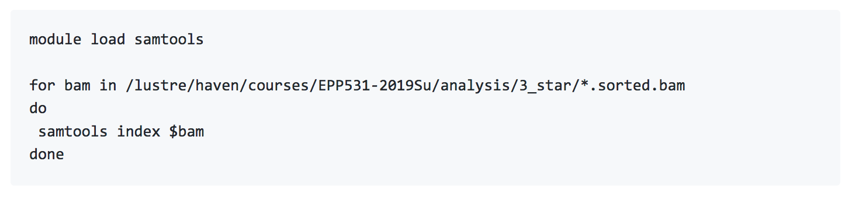
Step 1: Indexing a BAM file
In the directory where you previously ran STAR, create a shell script containing the following commands:

Slide 6

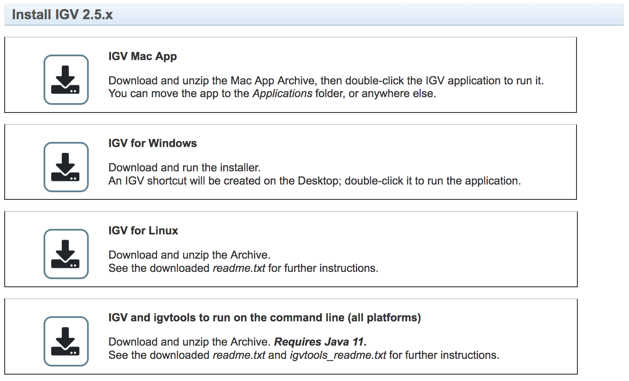
Step 2: Downloading IGV
Go to https://software.broadinstitute.org/software/igv/download
Select the app corresponding to your computer’s OS.

Slide 7
Step 3: Downloading files from the ACF to your personal computer
As IGV is a desktop-based program, you will need to download these files from the ACF to your computer.
There are several options available to obtain the files:
Secure Copy Protocol (scp) – A version of the “cp” command based on ”ssh” that allows a user to copy from one server to another.
Rsync – utility for transferring and synchronizing files between two servers. It is more advanced than scp, can allow for one-way transfers, and can resume a transfer/synch even if the connection is interrupted.
Globus – An online visual file manager that can connect to NICS’s Data Transfer nodes to both upload data to and download data from the ACF.
Notes:
For the purpose of this class, we will be using the scp command; however, rsync and Globus have a multitude of benefits that allow them to

Slide 8
Step 3: Secure Copy
scp username@acf-login.nics.utk.edu:/lustre/haven/courses/EPP531-2019Su/analysis/3_star/Ppersica_v2.0_chr1.fa ~/Downloads/IGV_files
Open a new terminal window, but do not log into the ACF. Instead, you will run the scp command:
Notes:
`cd ~/Downloads` takes you to your computer’s root directory, and then to your “Downloads” folder. I always use this directory for a few reasons:
I know how to access this location using both the command line and the Finder application.
I know it is a directory that I can safely download files to.
Breaking down the command:
scp – the command itself works very similarly to the “cp” command, in which the first item is the file to be copied, and the second item is the destination directory. What scp allows you to do is specify a server for one or both of these items, meaning you can copy items from your personal computer to a remote server, copy items from a remote server to your personal computer, and copy items from one remote server to another.
Username – You need your username to gain access to the server.
“@” – Ties your username to the server you are about to provide.
“acf-login.nics.utk.edu” - The SSH access server.
“:” - Directs the path you are about to type to the server information you have already provided. You need this for scp to understand that this directory is in the server, and not your computer.
“/path/to/target/file.fa” – The path to the file you are copying. In this code, the target file is within the ACF.
“/path/to/destination/directory” – The path to where you want the file to be copied to. In this case, you do not need to define a server location, as you our copying the file to your personal computer.

Slide 9
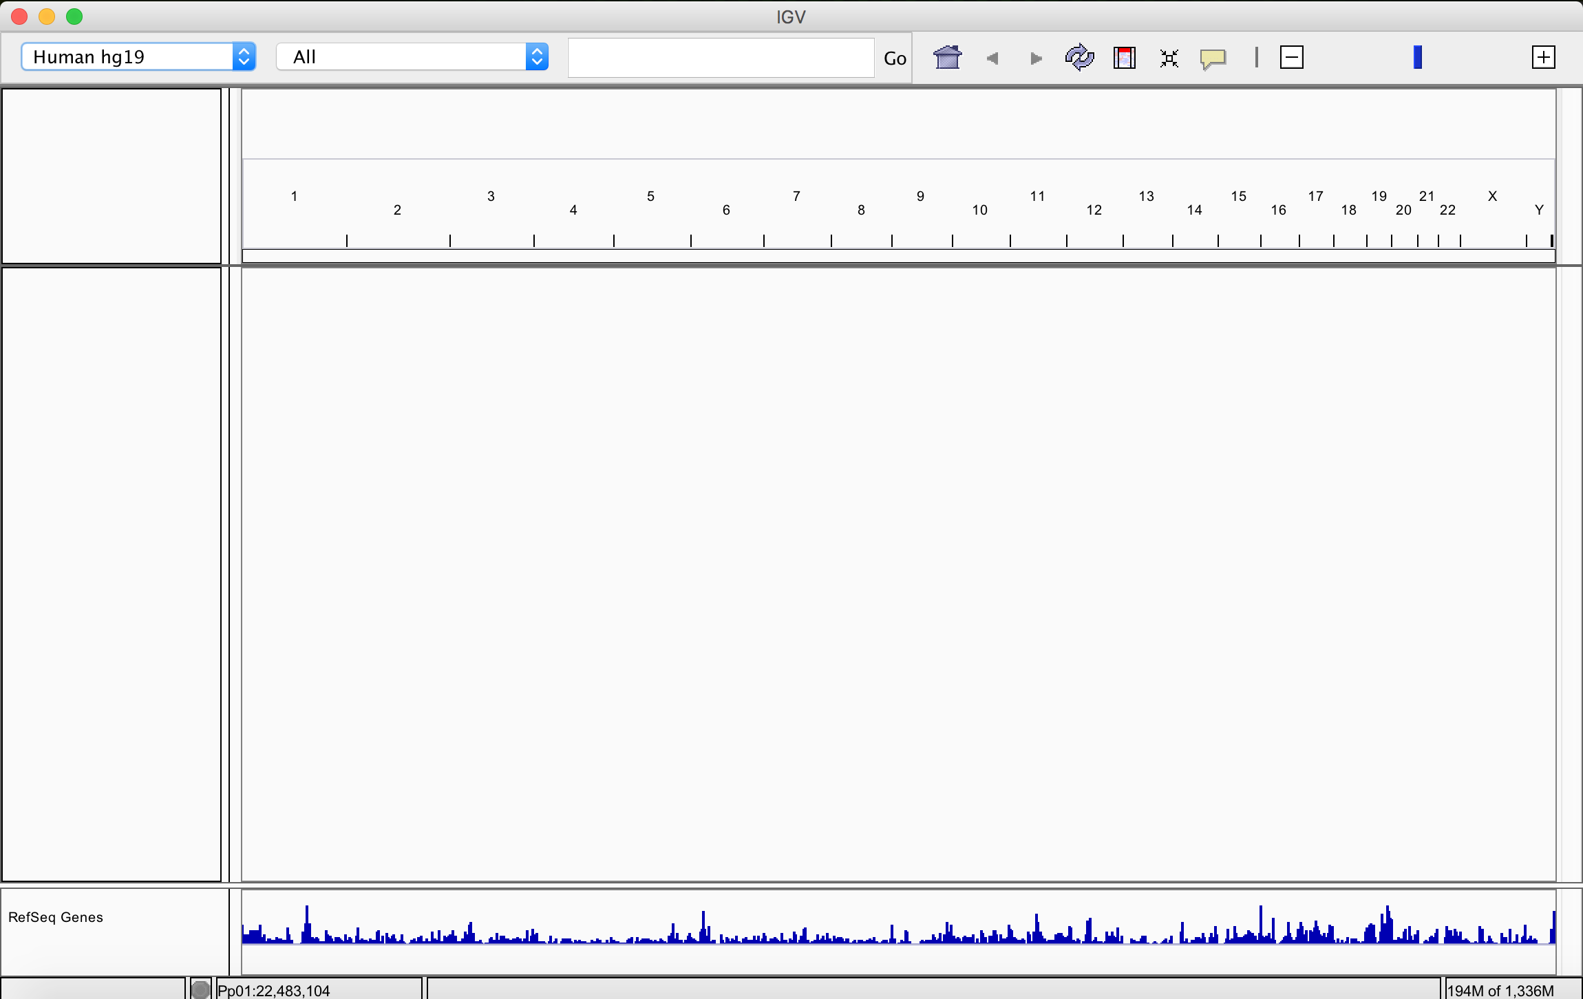
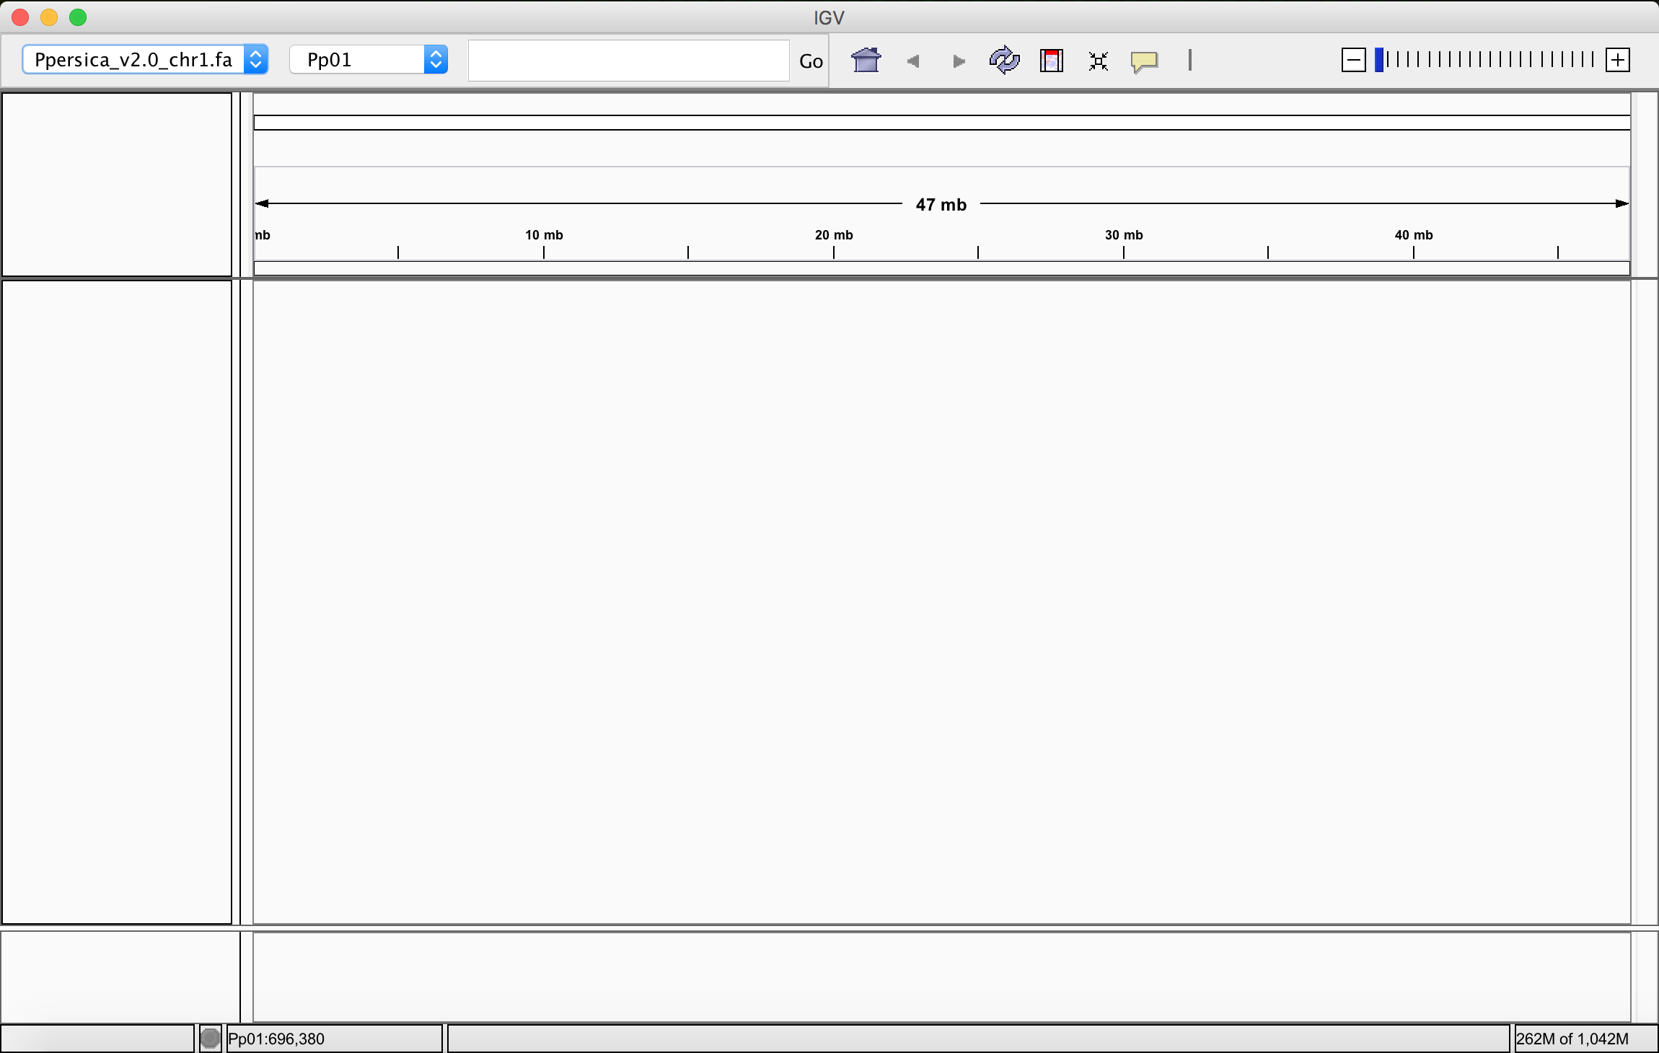
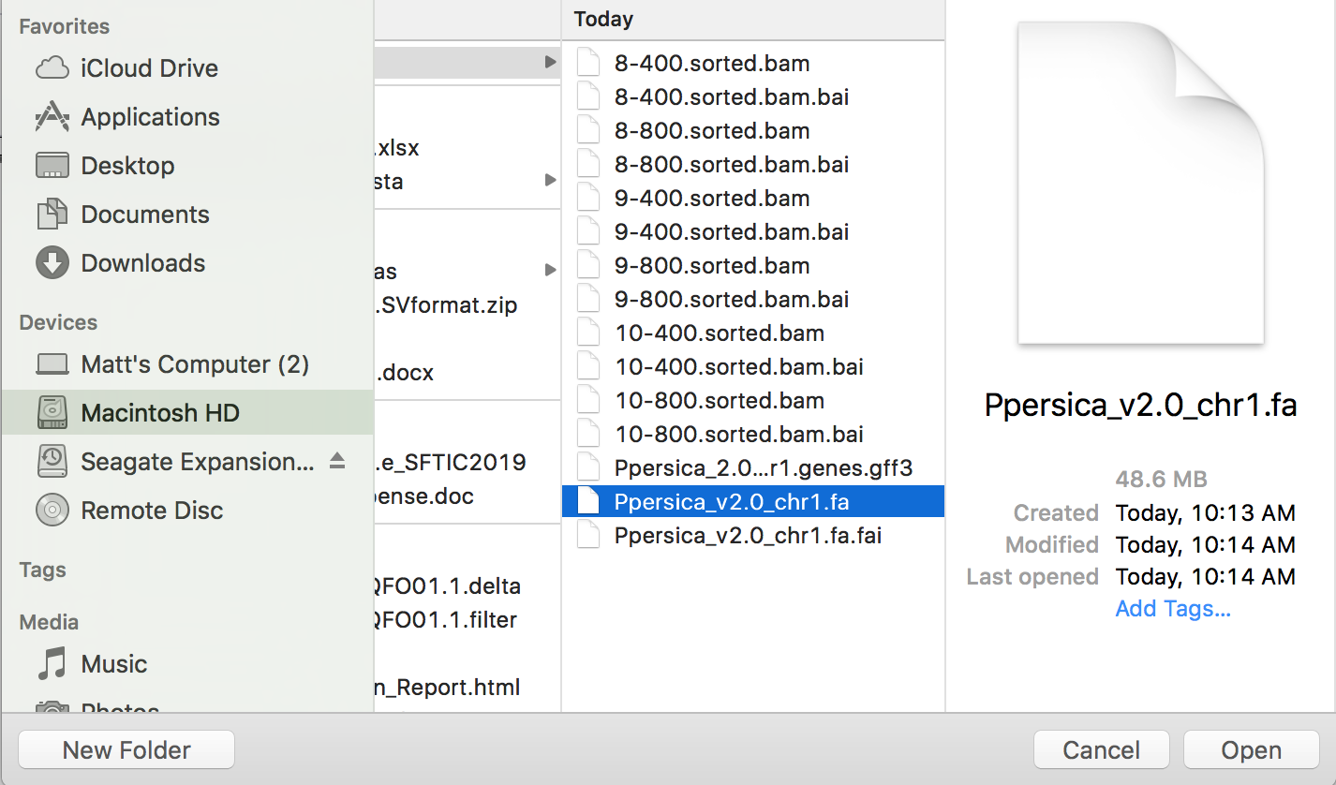
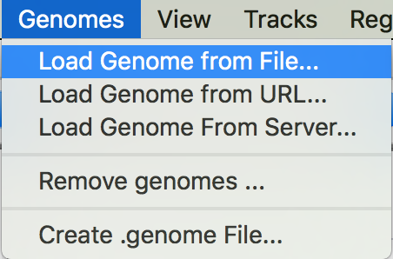
Step 4: Load Data to IGV
By default, IGV has the human genome preloaded. To load the peach genome...
Go to the Genomes Menu Bar and select “Load Genome from File...”
Select the Peach genome fasta file...
And IGV will now use the Peach Genome!
Notes:
After loading your genome for the first time, you can now select the genome from the first drop-down box in the top left corner.

Slide 10
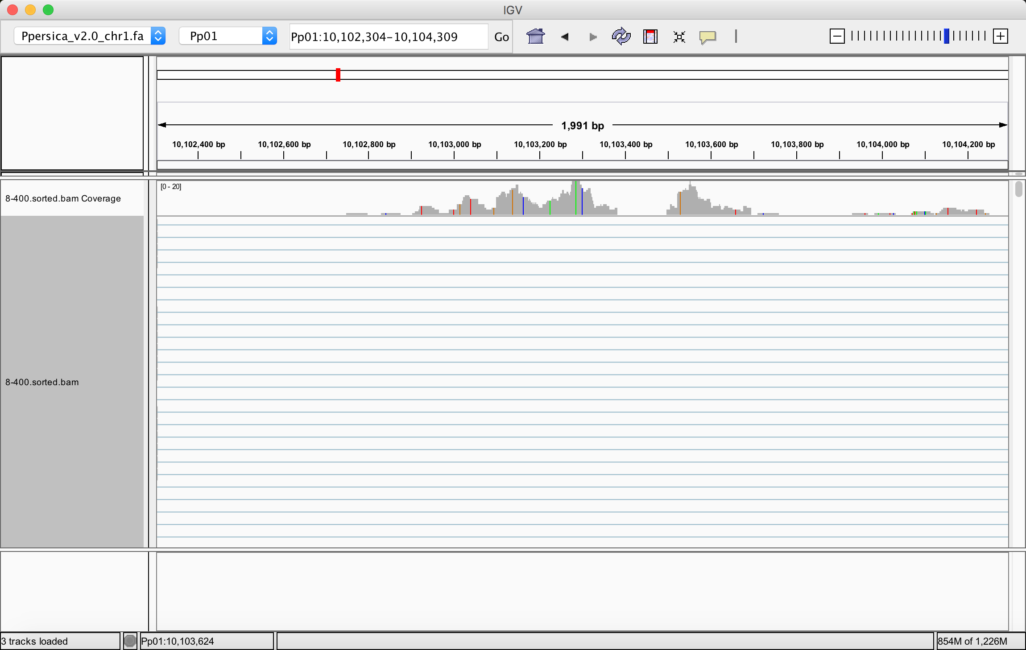
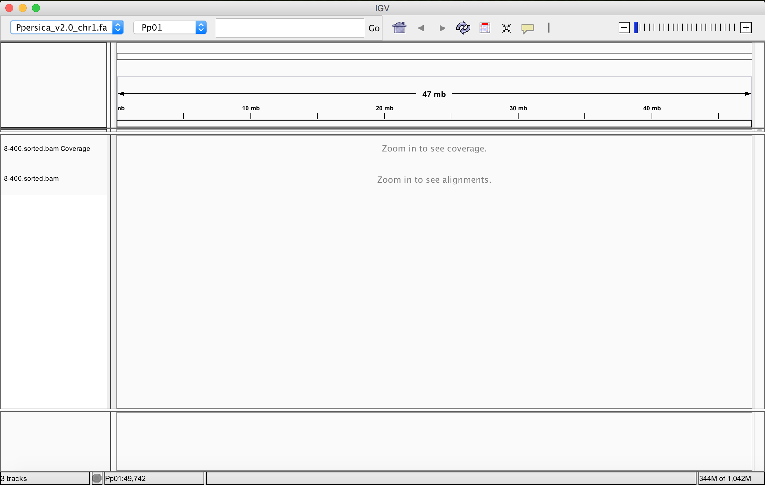
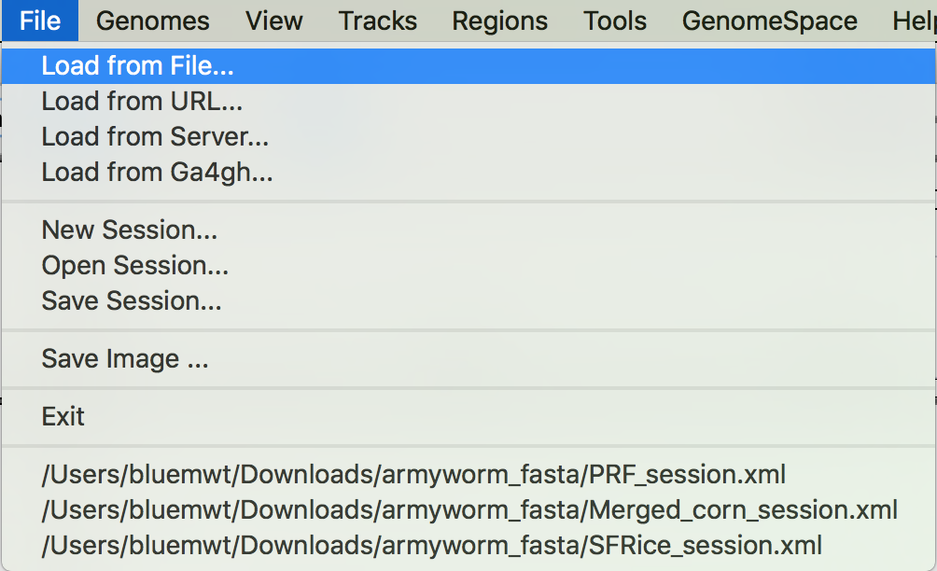
Step 4: Load Data to IGV
Now that you have the genome loaded, add your BAM files...
...Using the “Load from File...” option from the “File” menu.
This adds two ”Tracks” to the window; the “Alignments” track shows where the reads align to the genome, and the “Coverage” track illustrates how many reads align to a given region of the genome
Zoom in using the slider in the top right corner.
Notes:
You can also zoom in by clicking and dragging underneath the base pair count, right before the Coverage track begins.

Slide 11
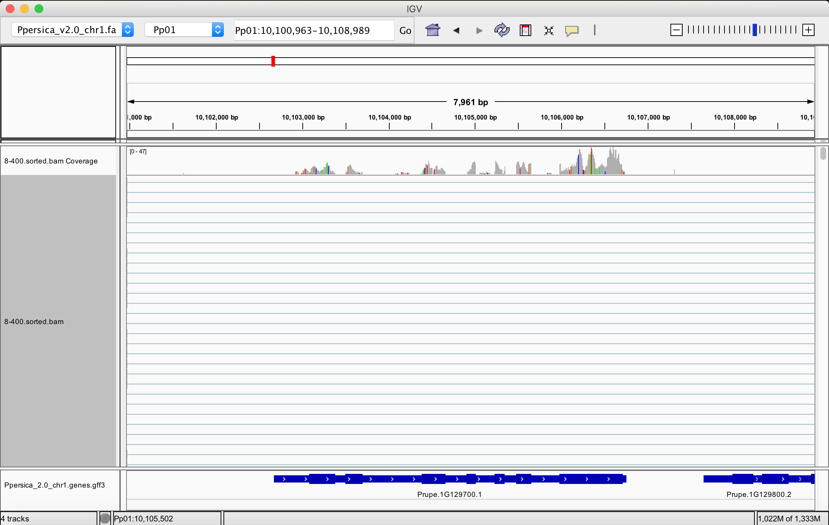
Step 4: Load Data to IGV
Loading the GFF file works the same way; however, while all BAM tracks will be grouped with one another, GFF files will be grouped in a separate set of tracks.

Slide 12
Step 5: Understanding IGV – Coverage Tracks
The Coverage Track is a bar graph illustrating how many reads overlap with the reference genome.
Grey bars indicate that all overlapping reads match with the reference genome.
Any other color indicates a SNP:
Blue = C
Orange = G
Green = A
Red = T
If you see two of the above colors in one bar, it generally indicates heterozygosity; one of the colors corresponds to the reference genome.

Slide 13
Step 5: Understanding IGV – Alignment Tracks
Each read that aligns to the genome is represented by a gray track.
Alignments with a white fill and gray border are considered low quality.
Any SNPs are color coded – using the same criteria as seen in the coverage tracks.
Any Insertions are indicated with a purple ”I”, and any Deletions are indicated with black dash.
Each mismatched base is assigned a transparency value, proportional to its read quality; this de-emphasizes any low quality reads.
If you see a black rectangle just under the coverage track, this indicates Downsampling, a memory-reducing measure used by IGV that reduces the number of reads represented in the Alignment Track.
Notes:
For Downsampled reads, the total number of reads before Downsampling is used for the coverage track. However, the alignment track uses a select number of these reads in deep coverage areas to save memory.

Slide 14

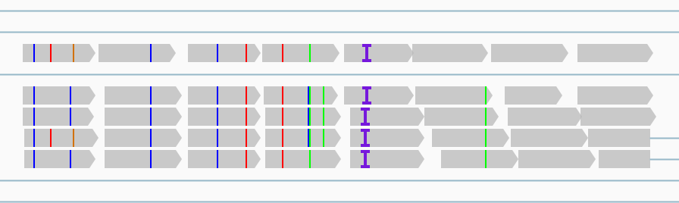
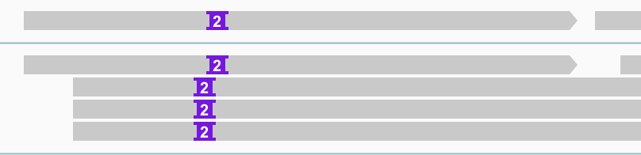
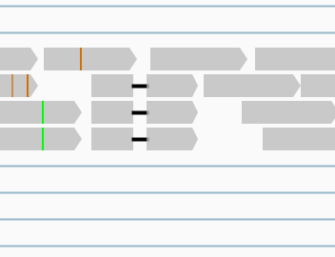
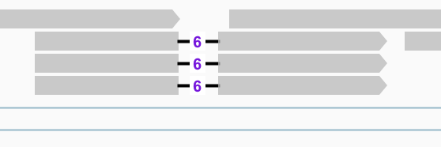
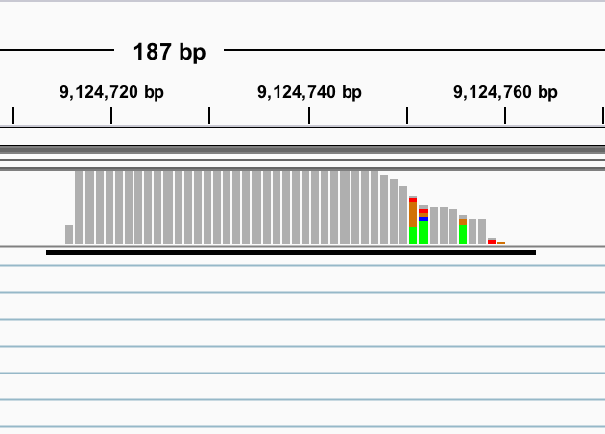
Step 5: Understanding IGV – Alignment Tracks
Insertions
Low Quality Reads
Deletions
Downsampling – 1,846 reads removed in this area.
Notes:
You can see how many reads are removed by downsampling by hovering over the black rectangle. The total number of reads in each alignment can be ascertained by hovering over their respective bar in the coverage track.
Zooming in on the alignment track will give more information on an insertion or a deletion, including how many bases are added/removed.

Slide 15
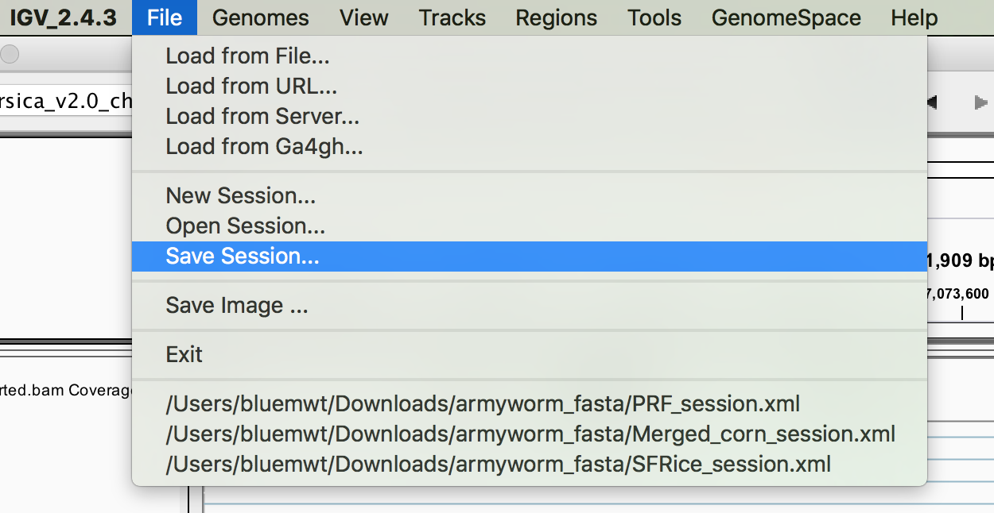
Step 6: Saving and Reloading a Session
Rather than loading everything again after restarting IGV, you can save your current session and reopen it at a later date.
The session is saved in Extensible Markup Language (XML) format, and will automatically reload every genome, alignment, and feature track that was loaded in the session.

Slide 16
Summary
IGV is a tool used to visualize genome alignments.
You have indexed your bam files, downloaded your files to your personal computer, and loaded the genome, alignment, and protein files onto IGV.
Using this, you are able to view what reads cover the majority of the genome, what bases are different from your reference genome, and contextualize the areas of high coverage with genome annotation.

Slide 17
Any Questions?

