Slide 1
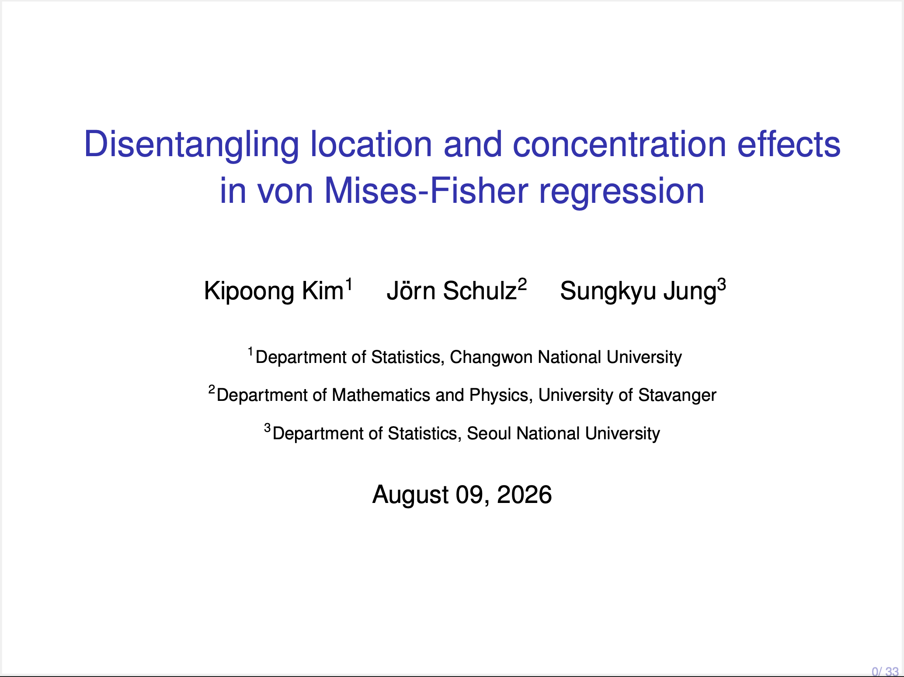

Slide 2
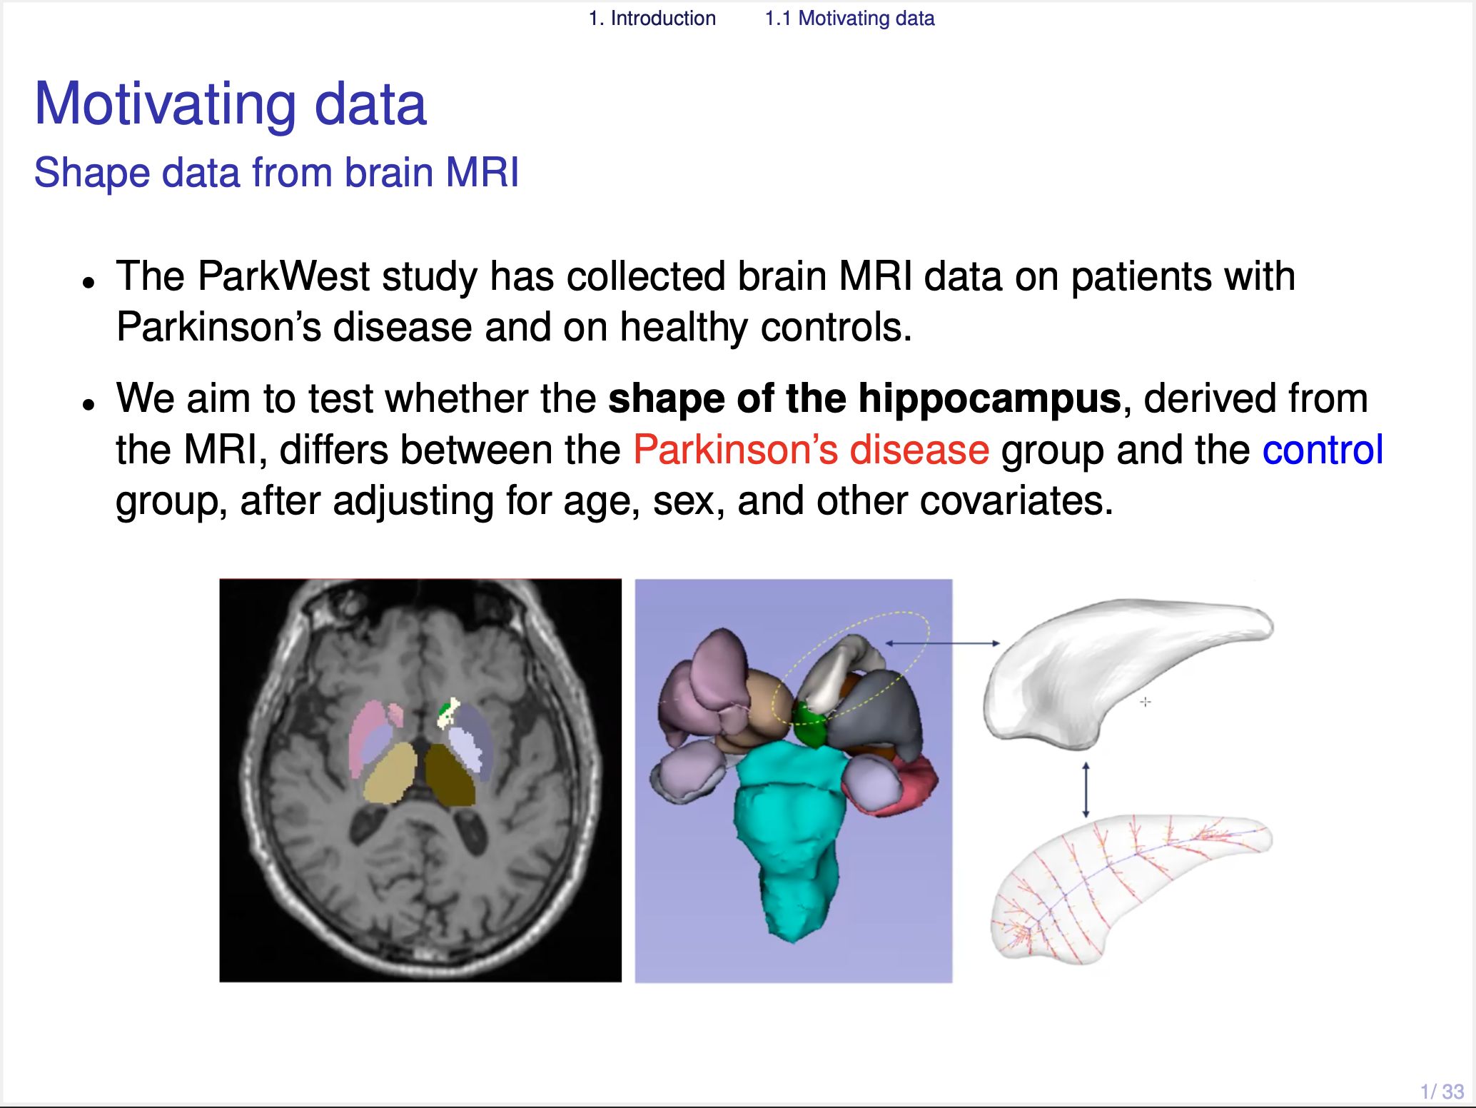
Notes:
Let me start from our motivating data. This is hippocampus shape data from the ParkWest study of Parkinson's disease.
Our question is a simple one. We want to know whether the shape of the hippocampus differs between the patient group and the control group.
So the question is about the shape. And the first thing we need is a way to write a shape in a mathematical form.

Slide 3
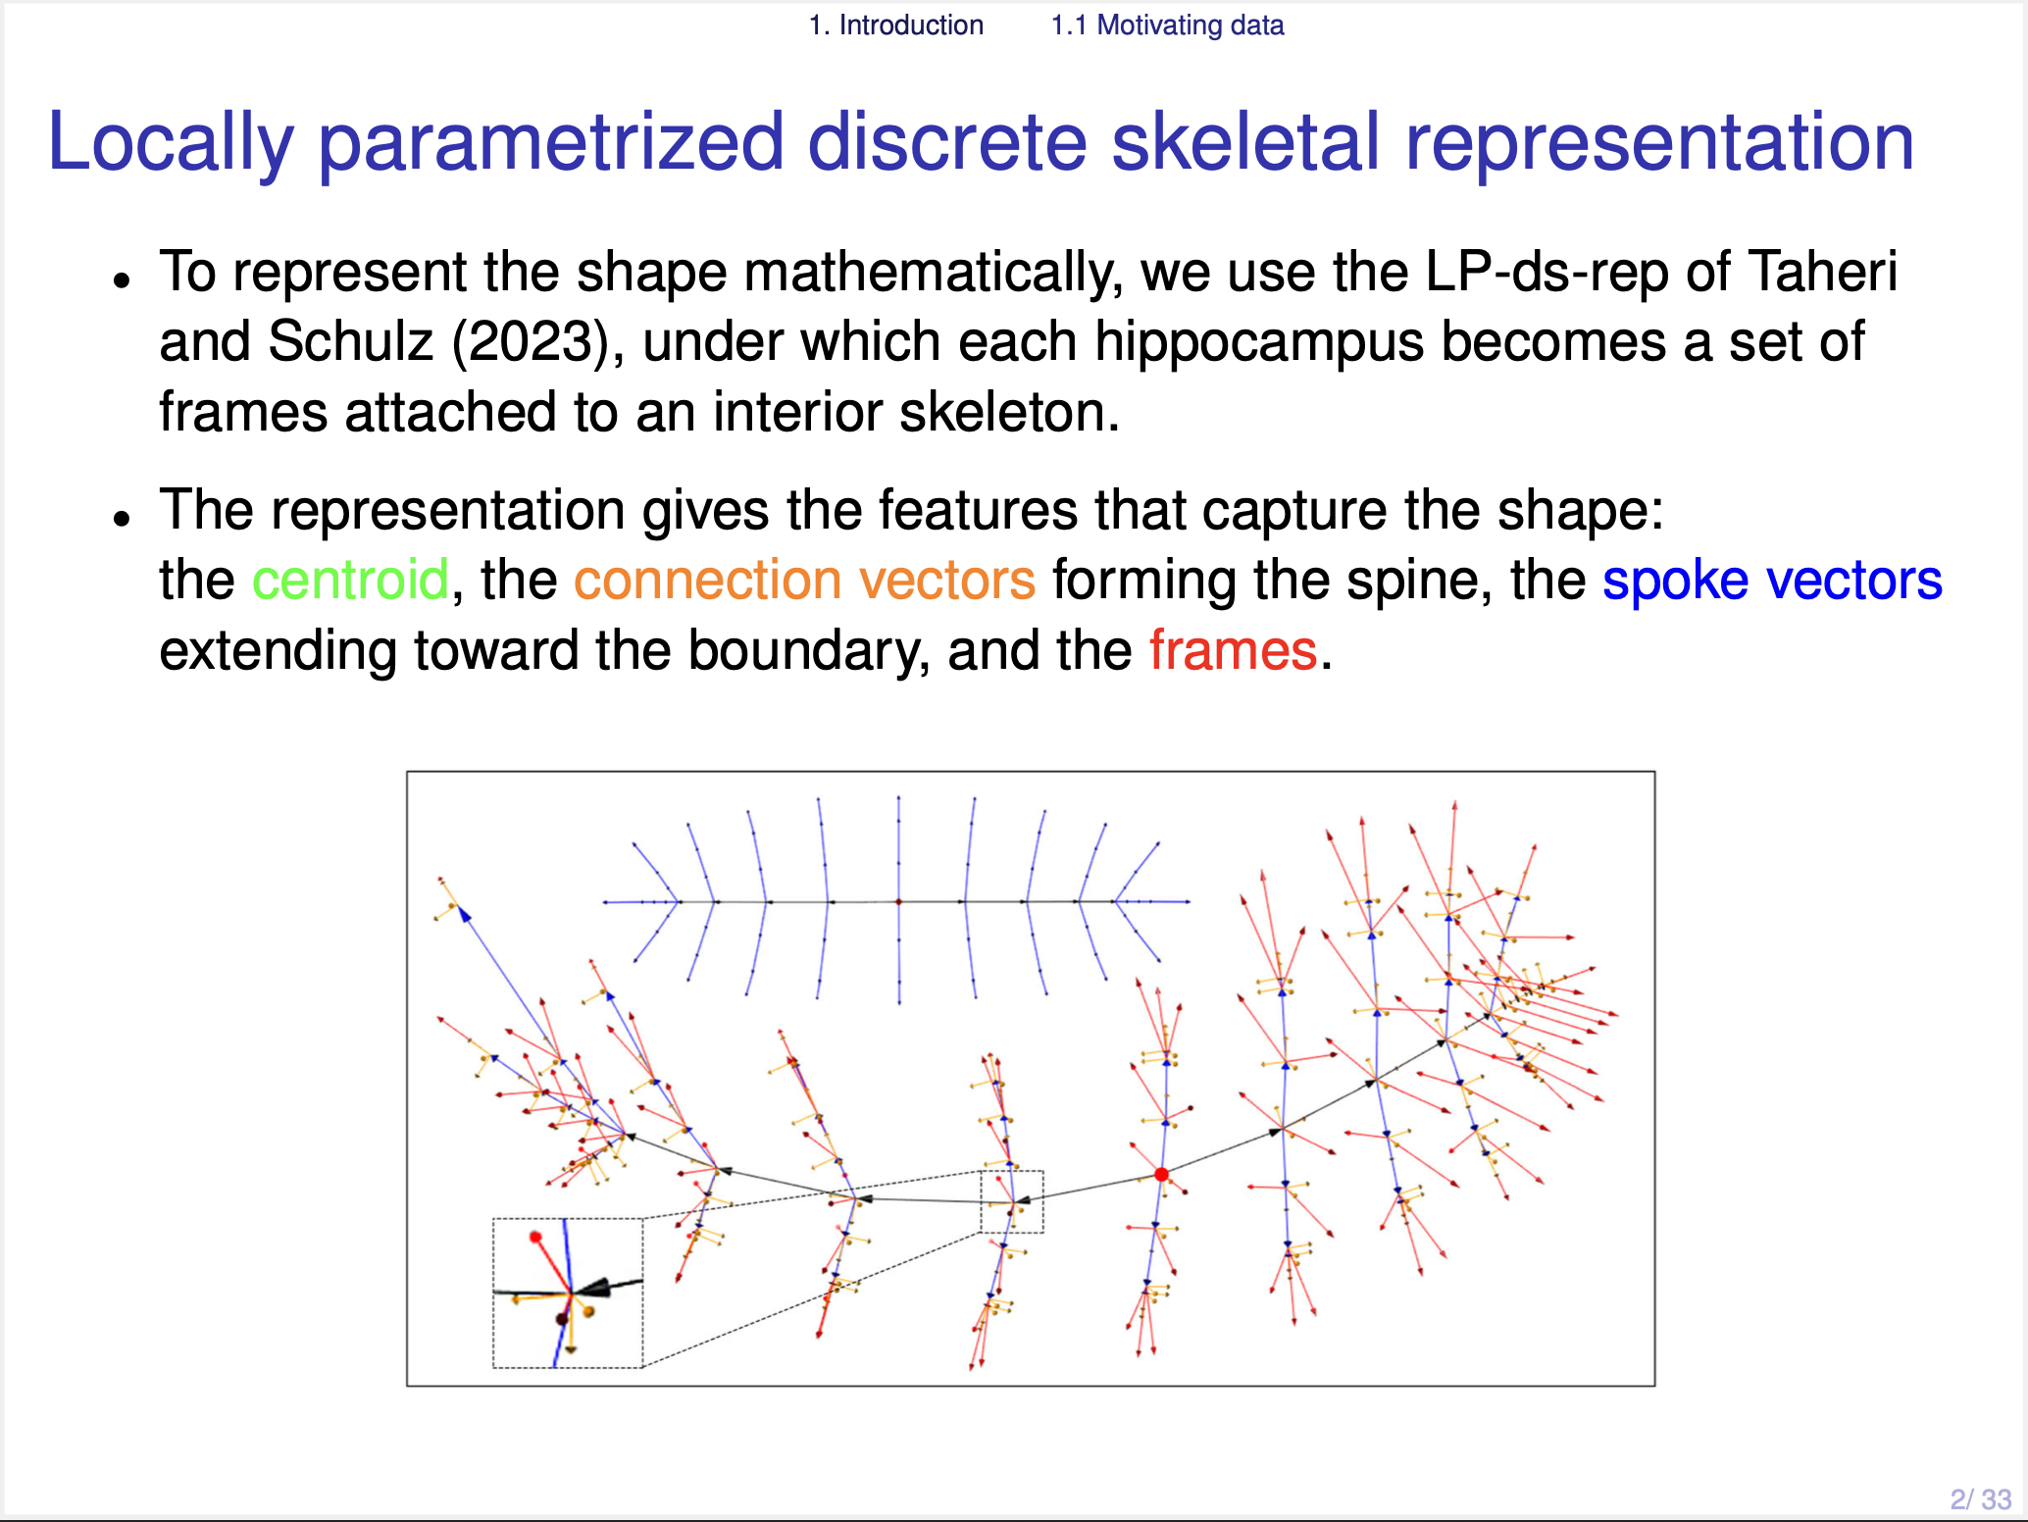
Notes:
For this purpose, we use the skeletal representation, especially the LP-ds-rep of Taheri and Schulz. Under this representation, each hippocampus becomes a set of vectors and frames attached to an interior skeleton. If you look at the figure. We have the centroid, the connection vectors forming the spine, the spoke vectors pointing to the boundary, and the frames.

Slide 4
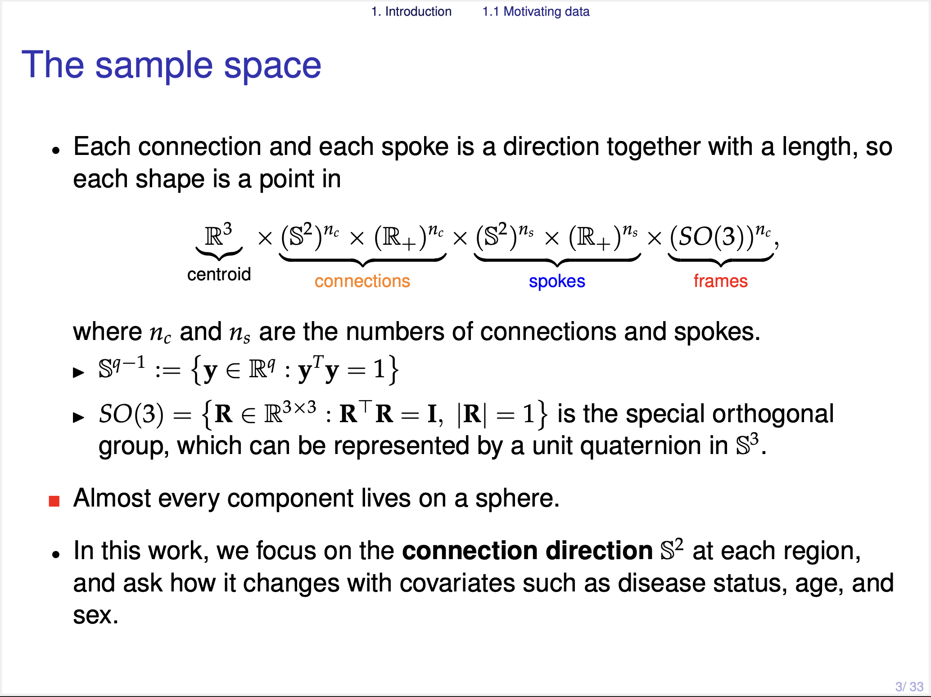
Notes:
[P11]
So a data point lies in this product space. The centroid is in R three. The connection directions and the spoke directions are two dimensional sphere $S^2$, together with their lengths in $R^1$. And the frames are in SO(3), which can be written as a unit quaternion, that is, a point on $S^3$.
So in this product space, every important component lies on a sphere. This is why we focus on a sphere.
In this work we focus on a single connection direction so that each data point is in $S^2$, and we ask how it changes with covariates such as disease status, age, and sex.

Slide 5
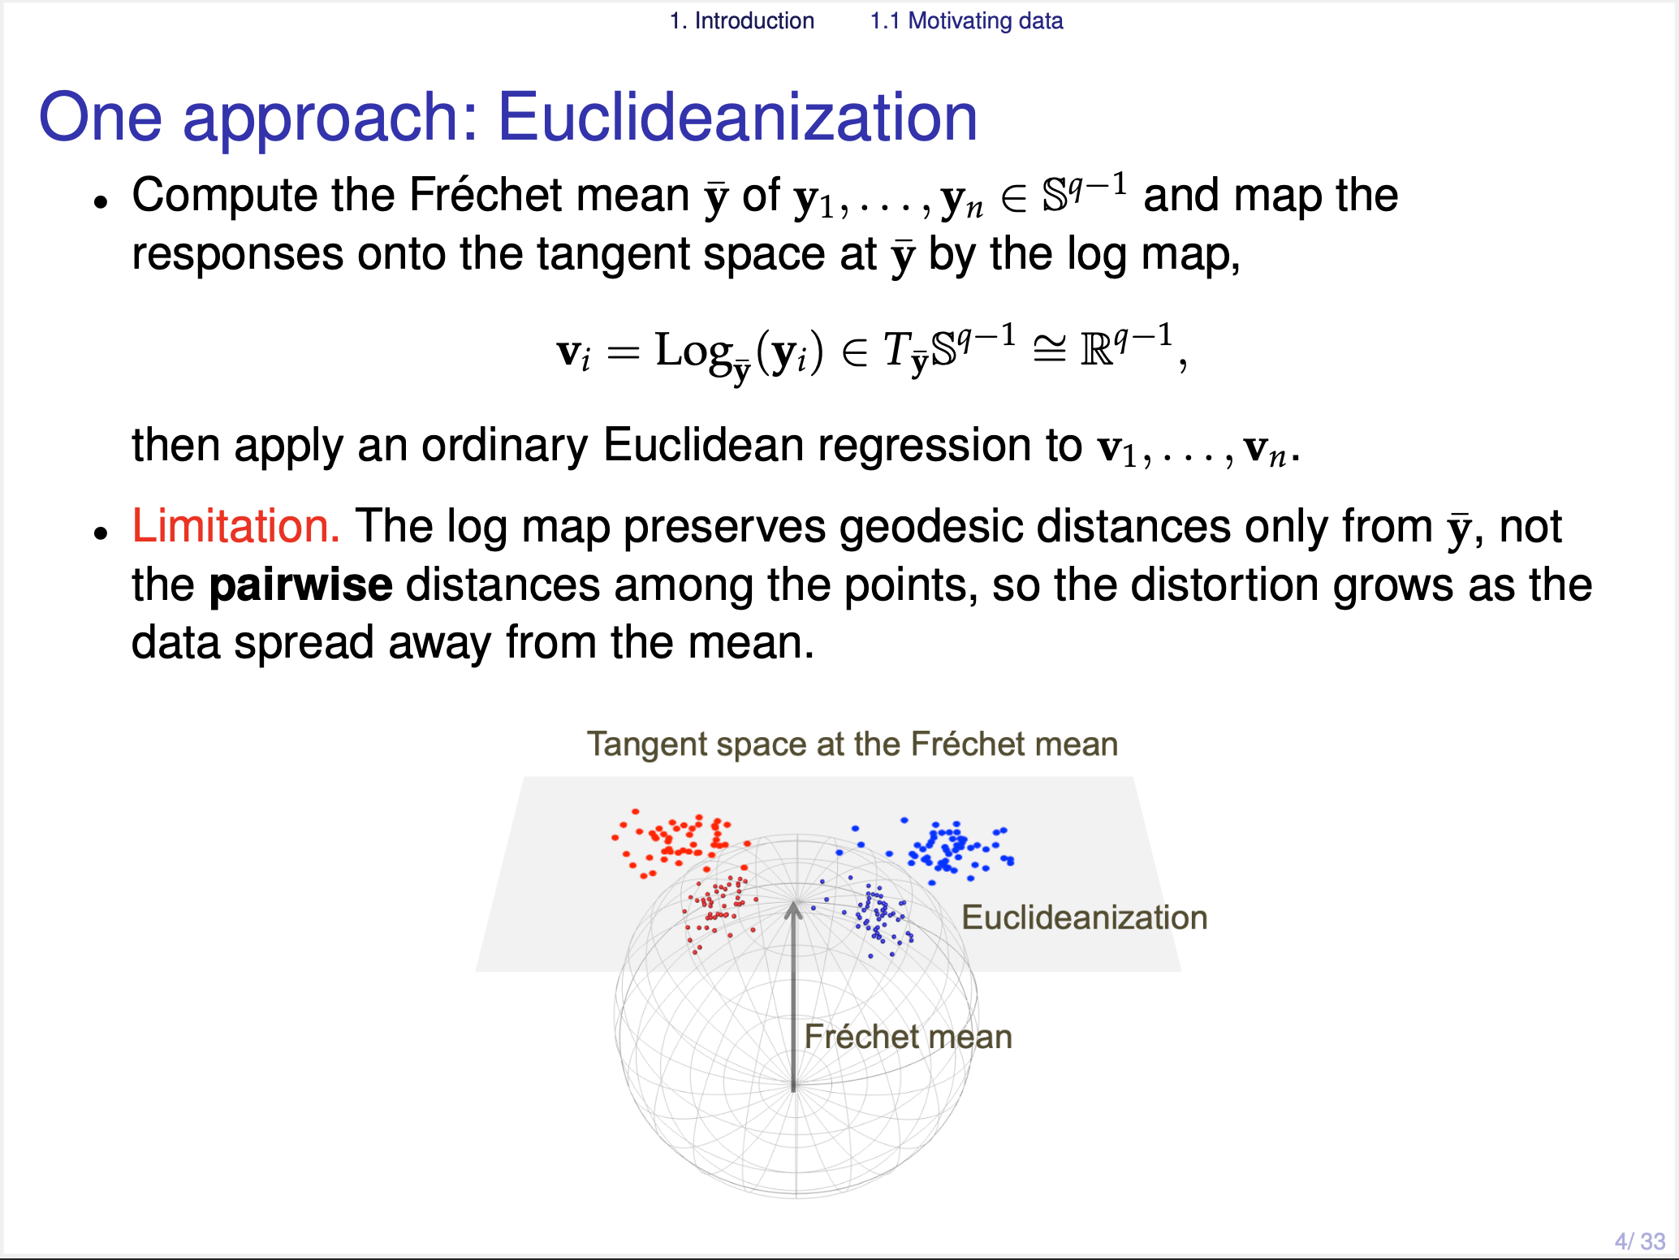
Notes:
To analyze this kind of spherical data, one familiar approach is Euclideanization, which calculate the Frechet mean and the Tangent Space. Then, each data point can be mapped onto the tangent space by the log map, and then we can apply ordinary Euclidean regression in this flat tangent space.
But there is a limitation. The log map keeps only the geodesic distance from the Frechet mean. It does not keep the pairwise distances among all points. So when the data are located far from the Frechet mean, the distortion becomes larger.
This is the main reason we want a model directly on the sphere.

Slide 6
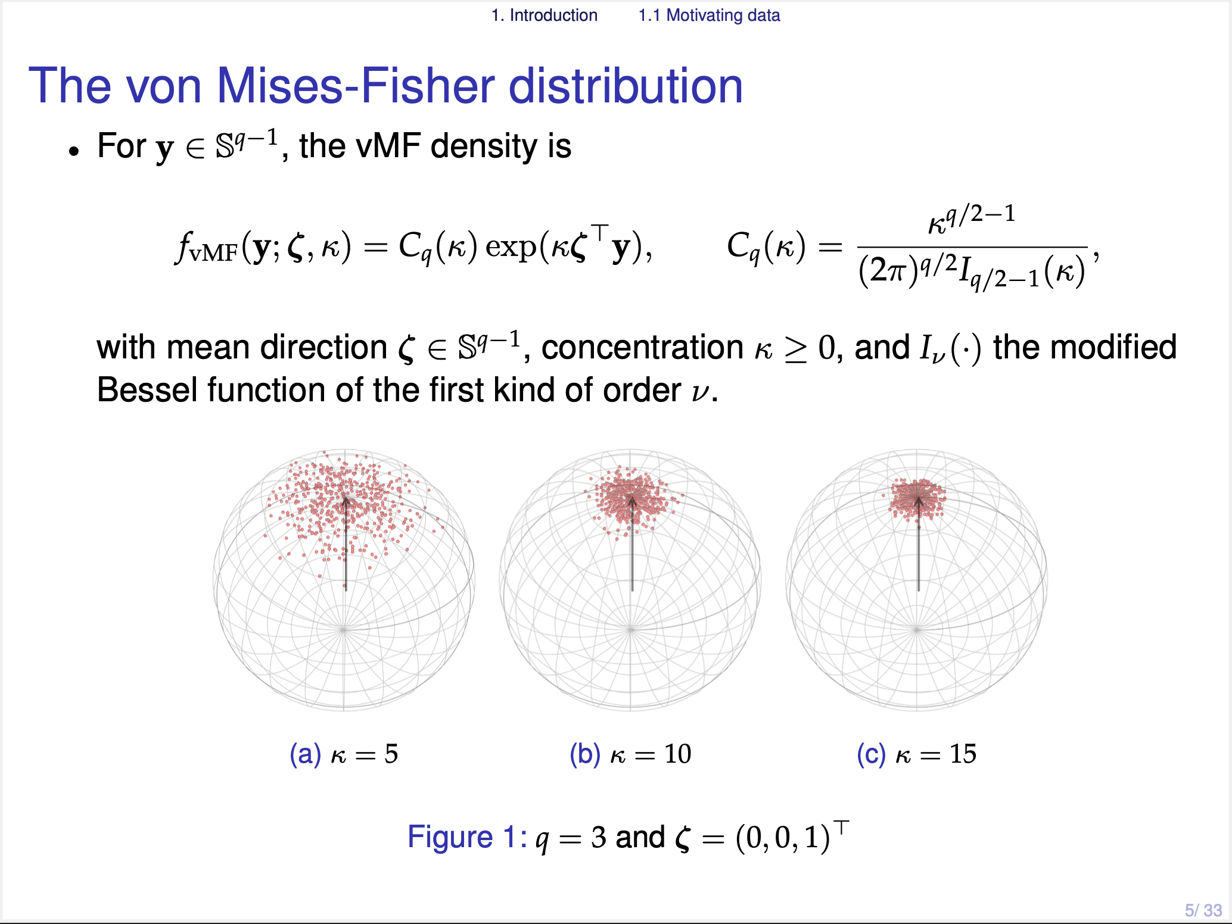
Notes:
For the spherical response y, we consider the von Mises-Fisher distribution.
The density has two parameters: Kappa and Zeta. Kappa is the concentration parameter, and zeta is the mean direction parameter.

Slide 7
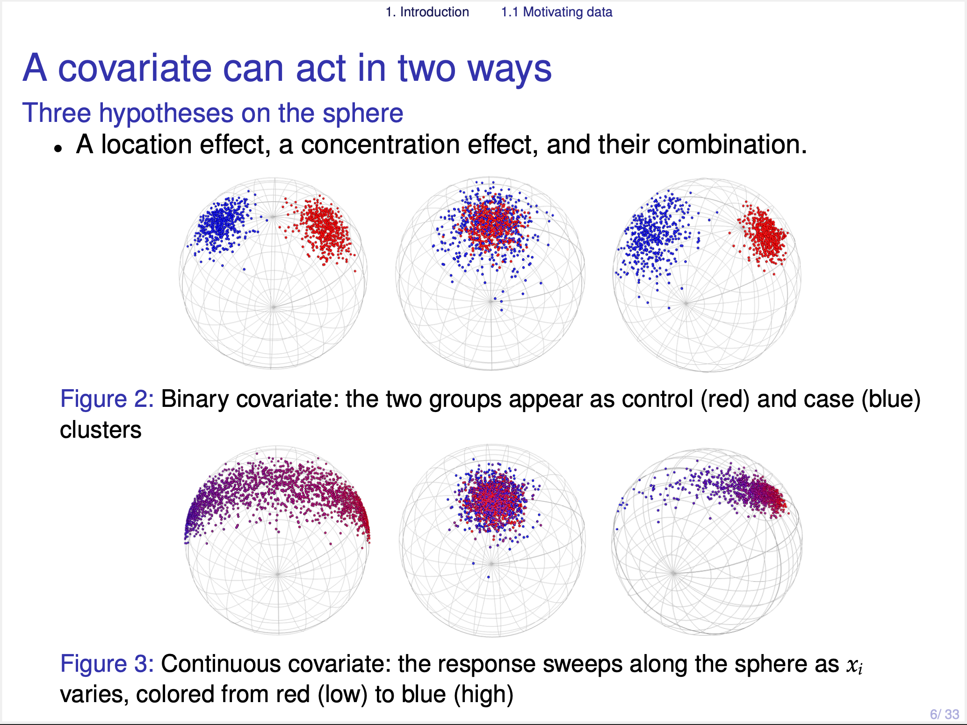
Notes:
Then, we can think that a covariate can act in two ways: rotate the mean direction, or change the concentration, or it can do both at the same time.

Slide 8
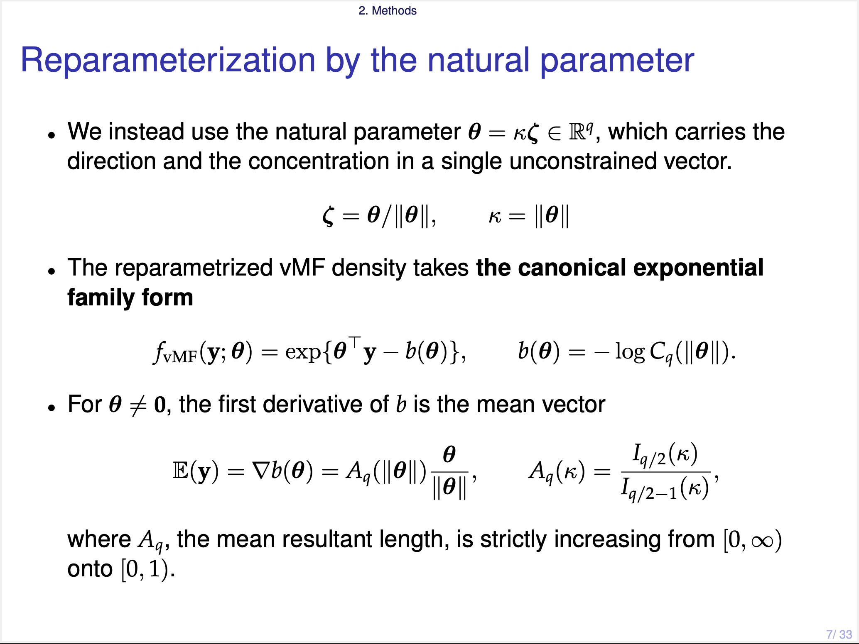
Notes:
Our solution is the natural parameter theta, equal to kappa times zeta, as one single vector.
In this way, the direction and the concentration are carried by one unconstrained vector. The direction of theta is zeta, and the length of theta is kappa.
The reparametrized vMF density is exactly a canonical exponential family. This canonical form is what makes the standard likelihood theory work.
And the first derivative of the function b is the mean vector. One thing to note here is that the mean vector E(y) is located within a unit ball, but the natural parameter theta lies in a $R^q$ space.

Slide 9
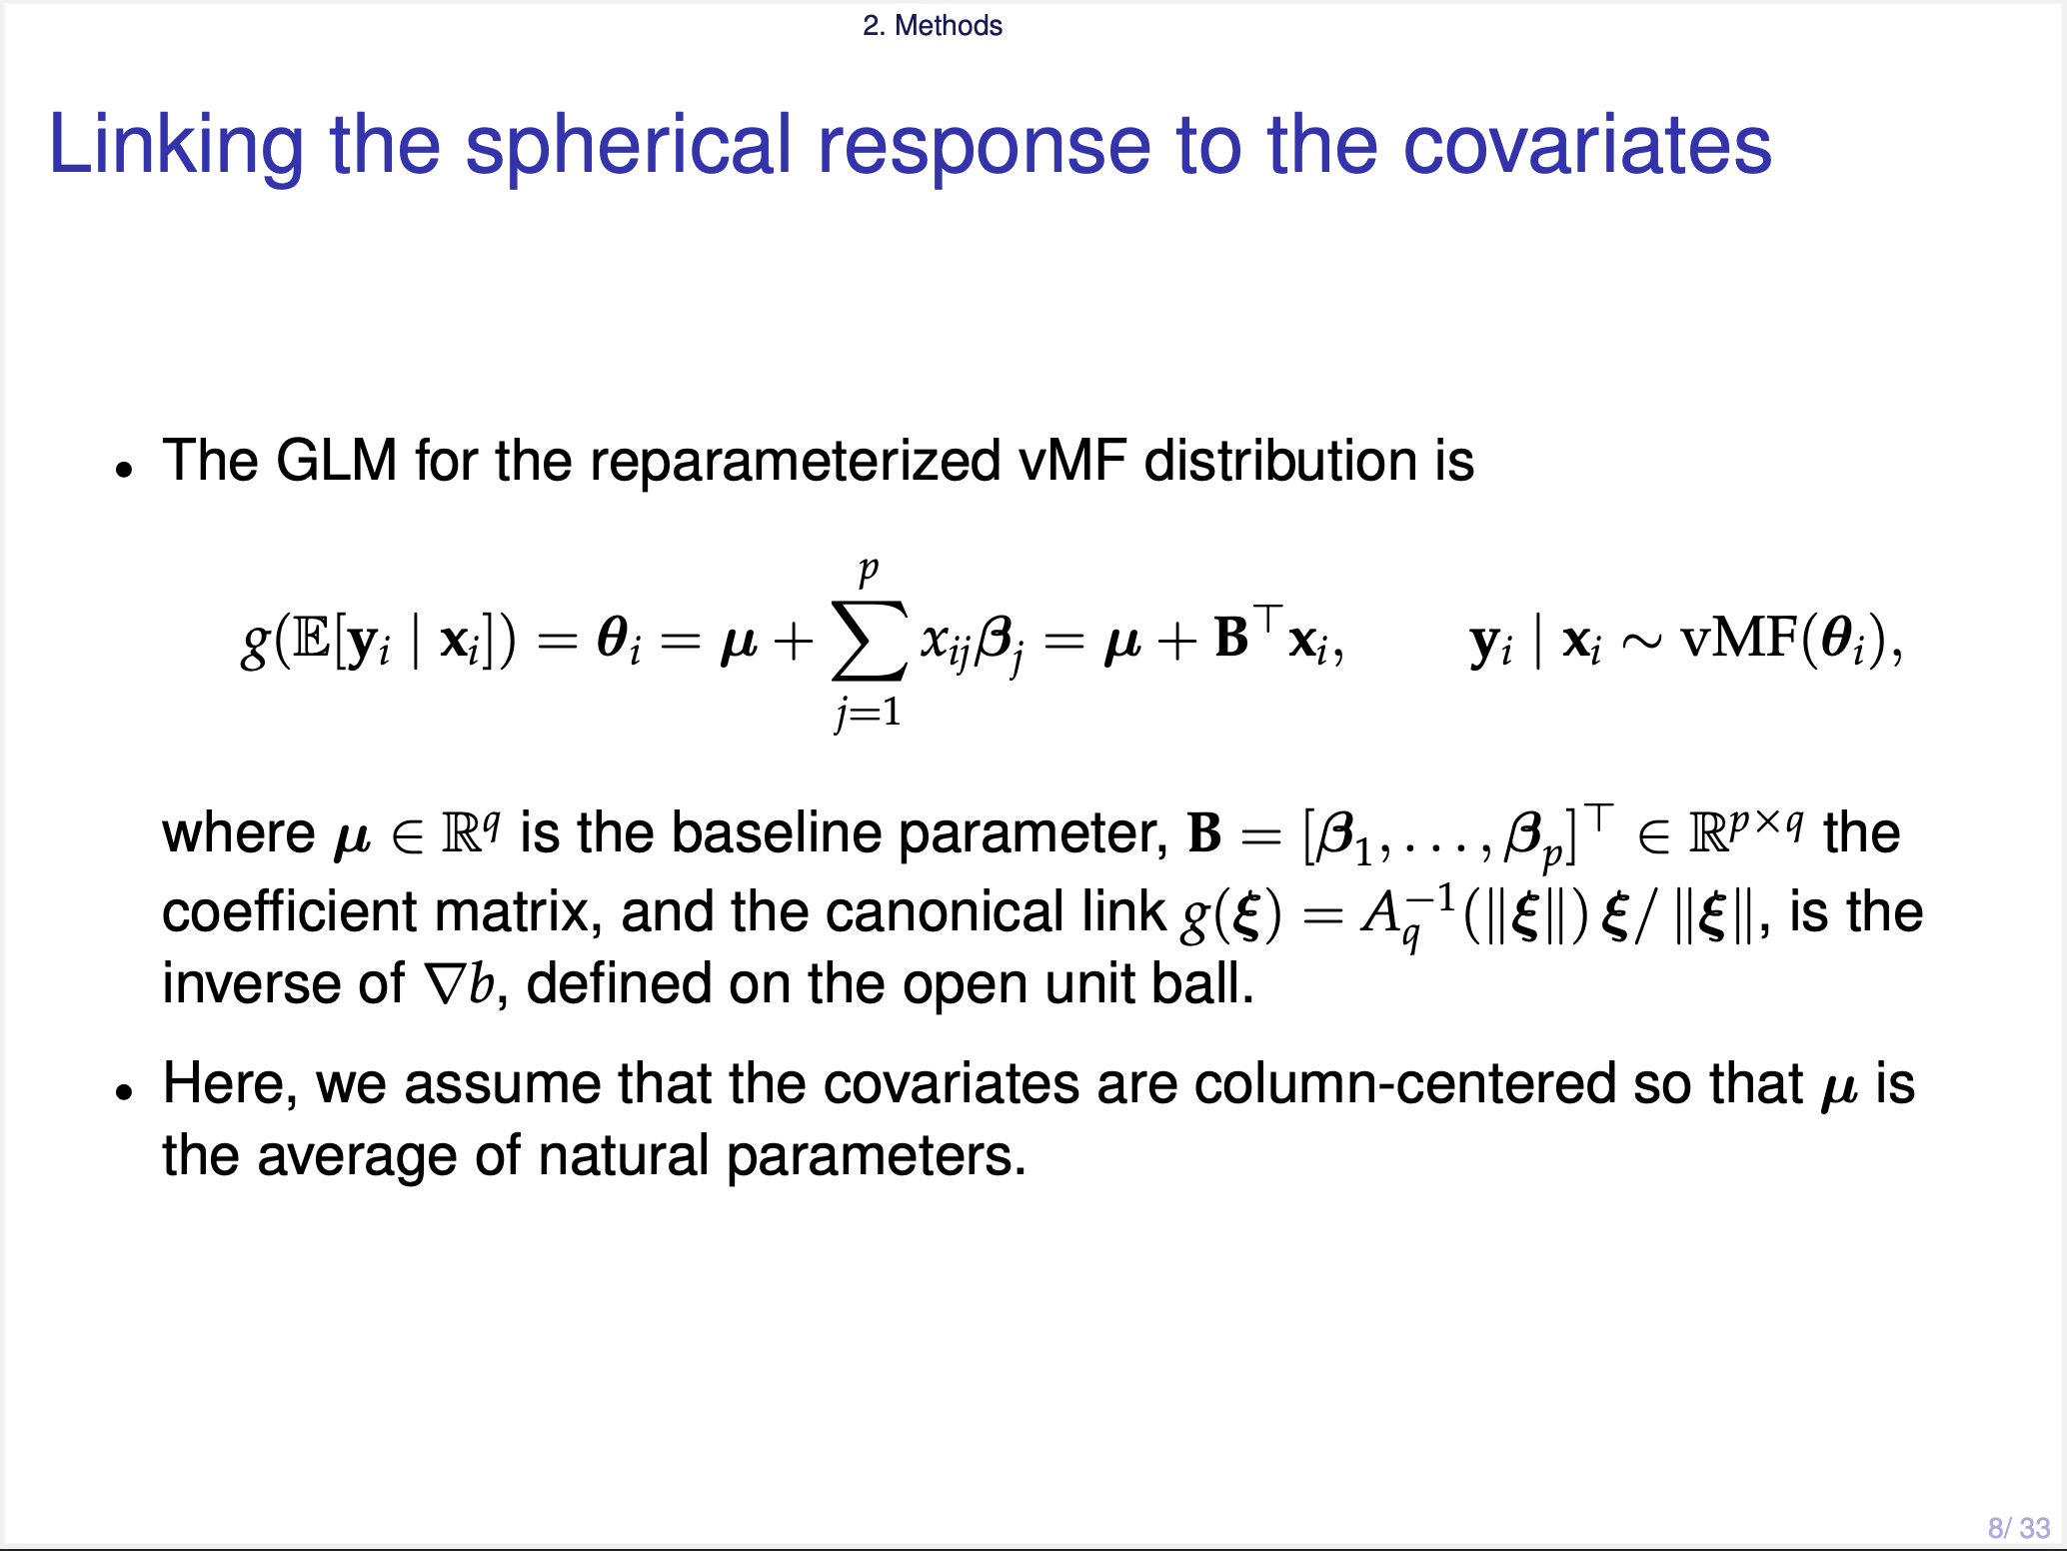
Notes:
By using this relationship, we can link the conditional expectation linearly to the covariates, through this way. Here, g is the inverse function of the first derivative of b, defined on the open unit ball.
Here, we assume that the covariates are column-centered so that mu becomes the natural parameter at the average covariate value.

Slide 10
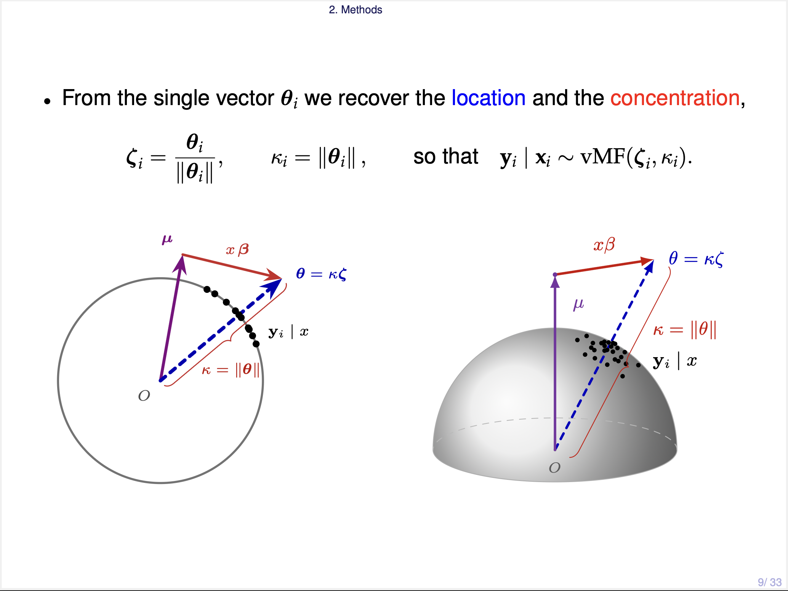
Notes:
These two pictures show the sampling process. The purple arrow is the baseline vector mu. The red arrow is x beta. And their sum is theta, the dashed blue arrow. The direction of theta is zeta, and its length is kappa. The black dots are the responses drawn around zeta.
The important point is that, as x changes, theta can move. And when theta moves, the direction and the concentration change at the same time. So the two effects are coupled by construction. And this is exactly what our inference has to separate.

Slide 11
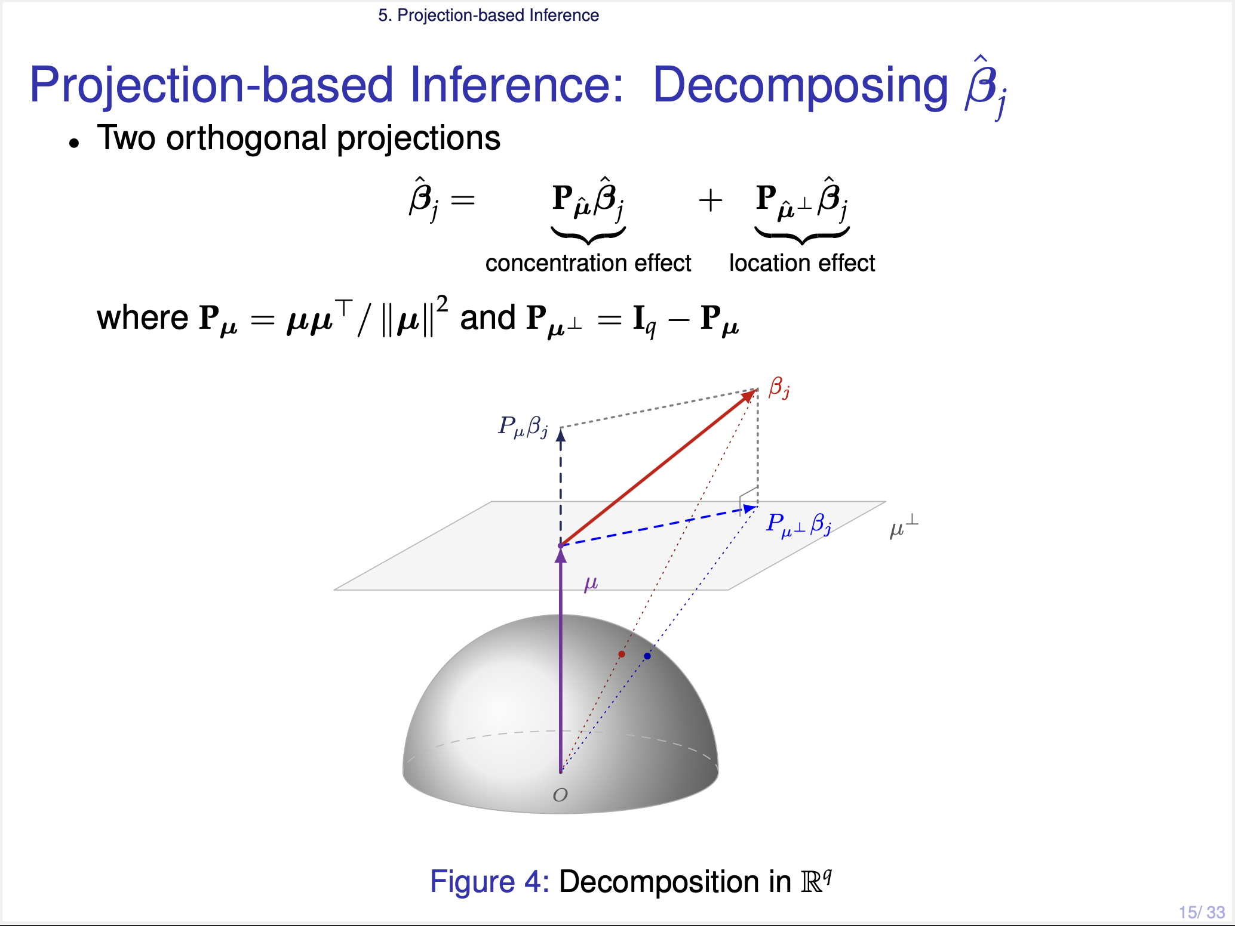
Notes:
From here, our idea is simple. We decompose beta-j-hat into two orthogonal projections. One onto the mu-hat direction, and one onto the orthogonal complement of mu-hat.
The interpretation is as follows. If beta is parallel to mu, the direction never changes, and only the length changes. So the parallel part is the concentration effect. And if beta is orthogonal to mu, the direction rotates. So the orthogonal part can be thought of as the location effect.

Slide 12
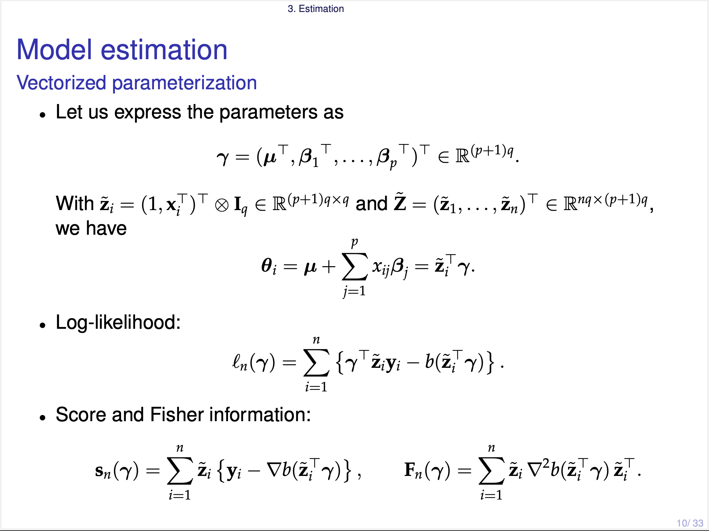
Notes:
For the estimation, we stack the intercept mu and all the coefficient vectors into a single parameter gamma, and we rewrite the covariates by a Kronecker product. Then the log-likelihood, the score, and the Fisher information all take the usual GLM form.

Slide 13
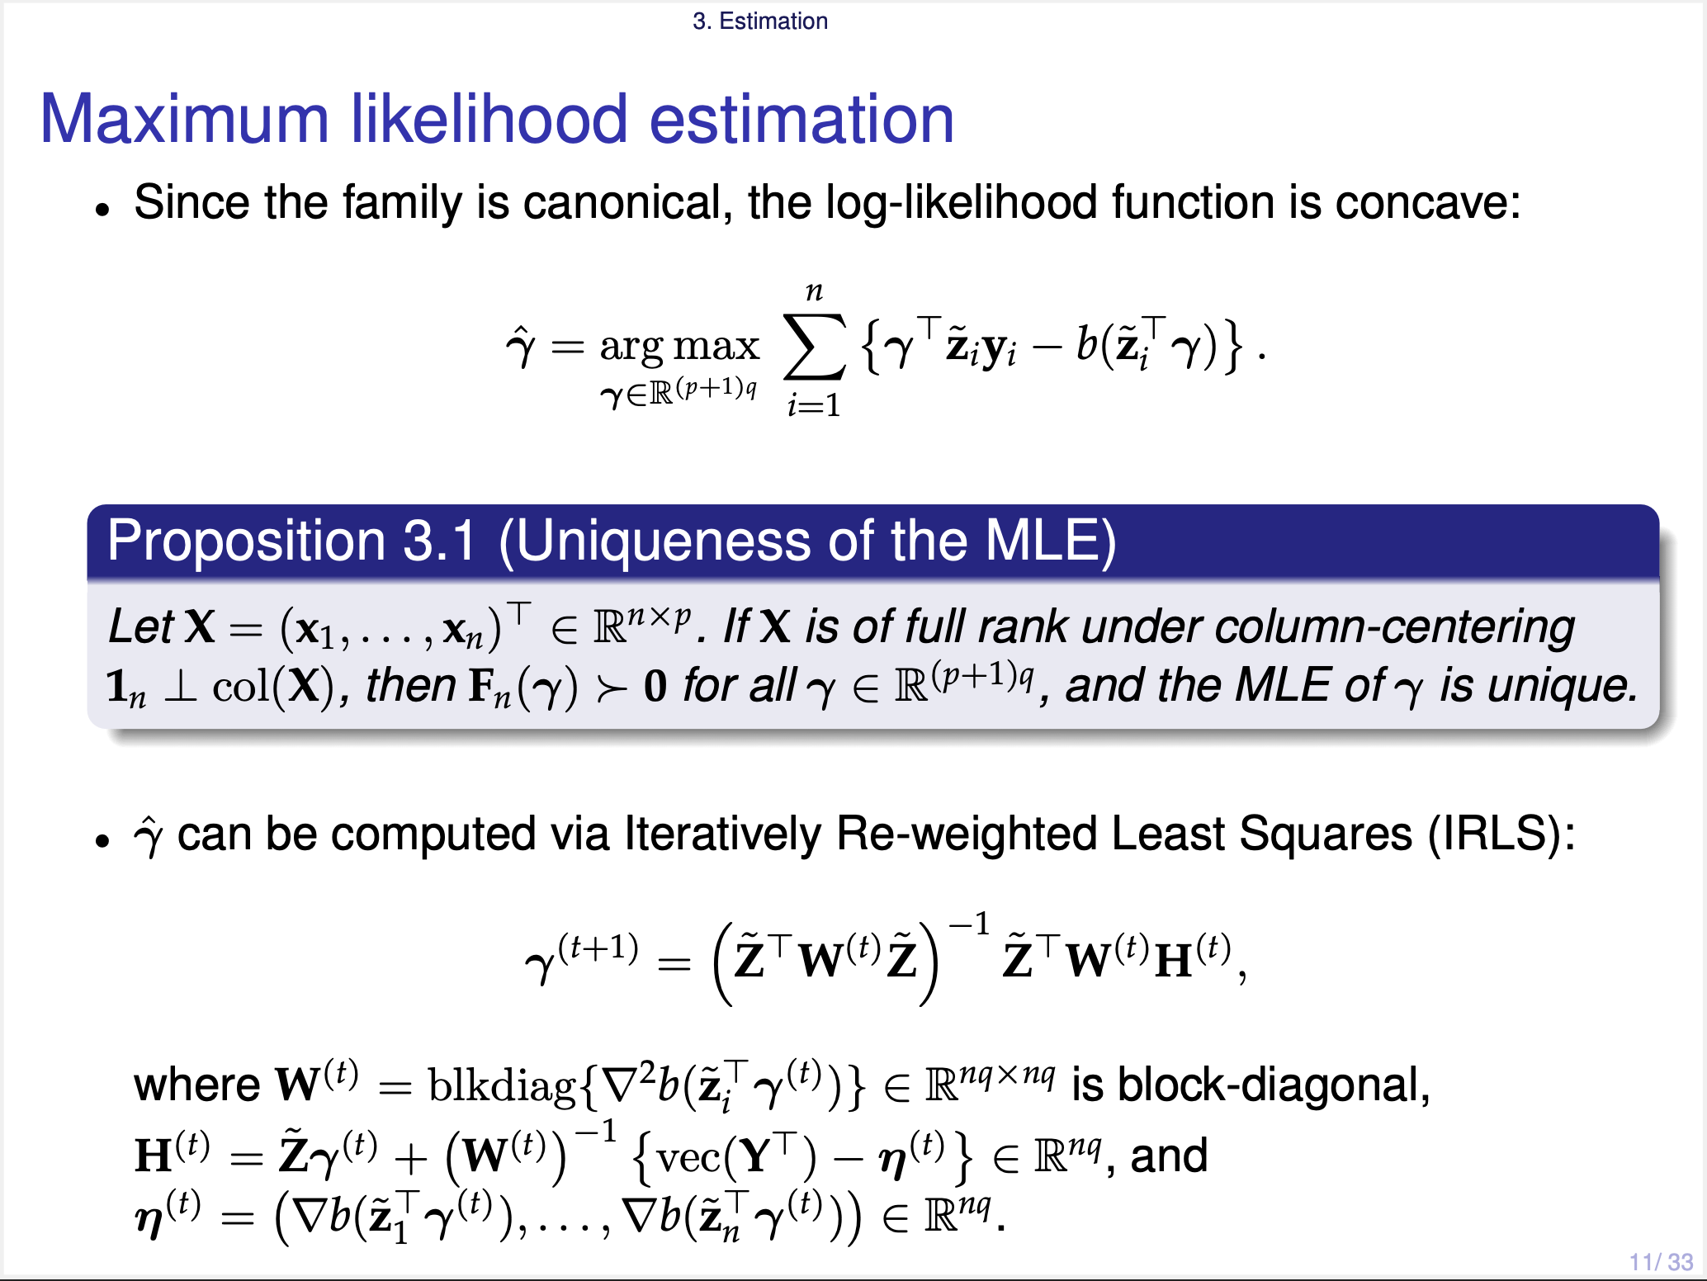
Notes:
Because the family is canonical, the log-likelihood is concave. So this proposition gives the uniqueness of MLE. If the centered design matrix has full column rank, then the Fisher information is positive definite for all gamma, and the MLE is unique whenever it exists. The existence fails only in a degenerate case.
And we can compute the MLE by the usual IRLS algorithm.

Slide 14
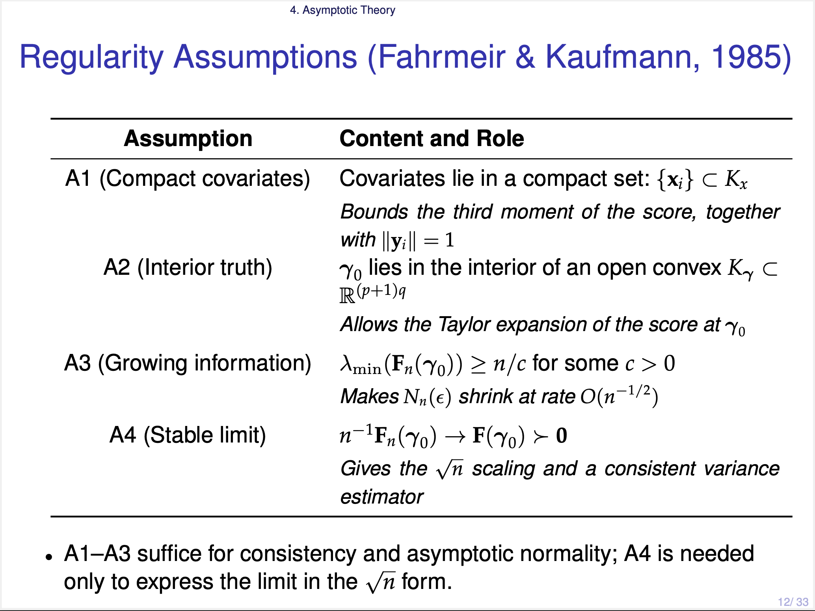
Notes:
Now let us move to the asymptotic theory. Our theory is built on the canonical-link GLM framework of Fahrmeir and Kaufmann (파어마이어 and 카우프만). There are four assumptions.
> A1 says compact covariates;
> A2 says the true parameter lies in the interior of an open convex set;
> A3 says the smallest eigenvalue of the Fisher information is at least of order n.
> A4 says the normalized information converges to a positive definite limit.

Slide 15
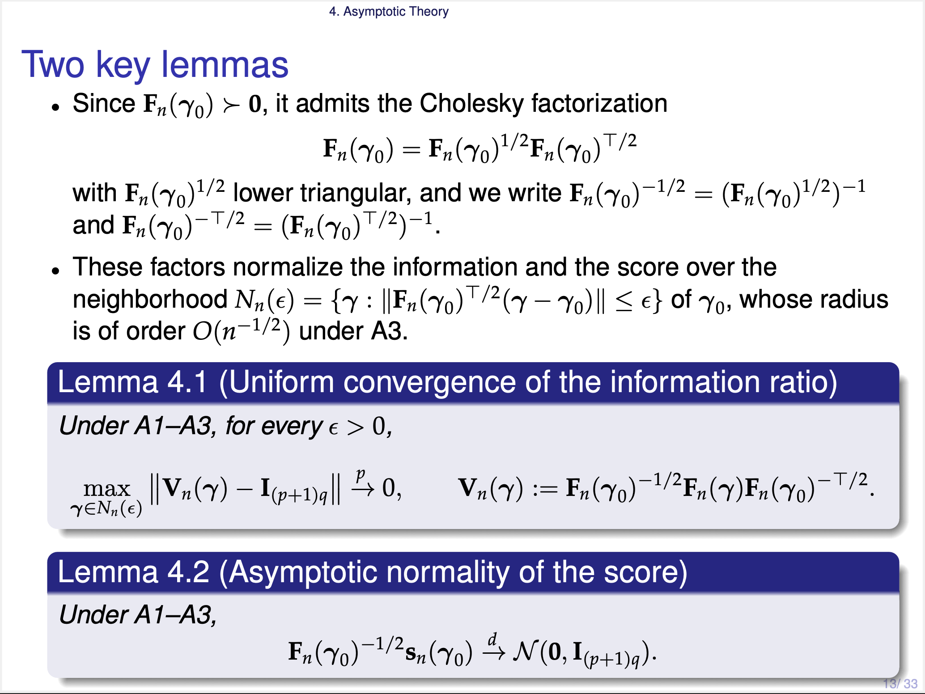
Notes:
Under these assumptions, we have two lemmas.
> The first lemma says that the information ratio goes uniformly to the identity, over this shrinking neighborhood. What this means is that the log-likelihood is locally concave around true parameter gamma-zero.
> The second lemma says that the standardized score goes to a standard normal. But it is not identically distributed, so this follows from the Lindeberg-Feller central limit theorem.

Slide 16
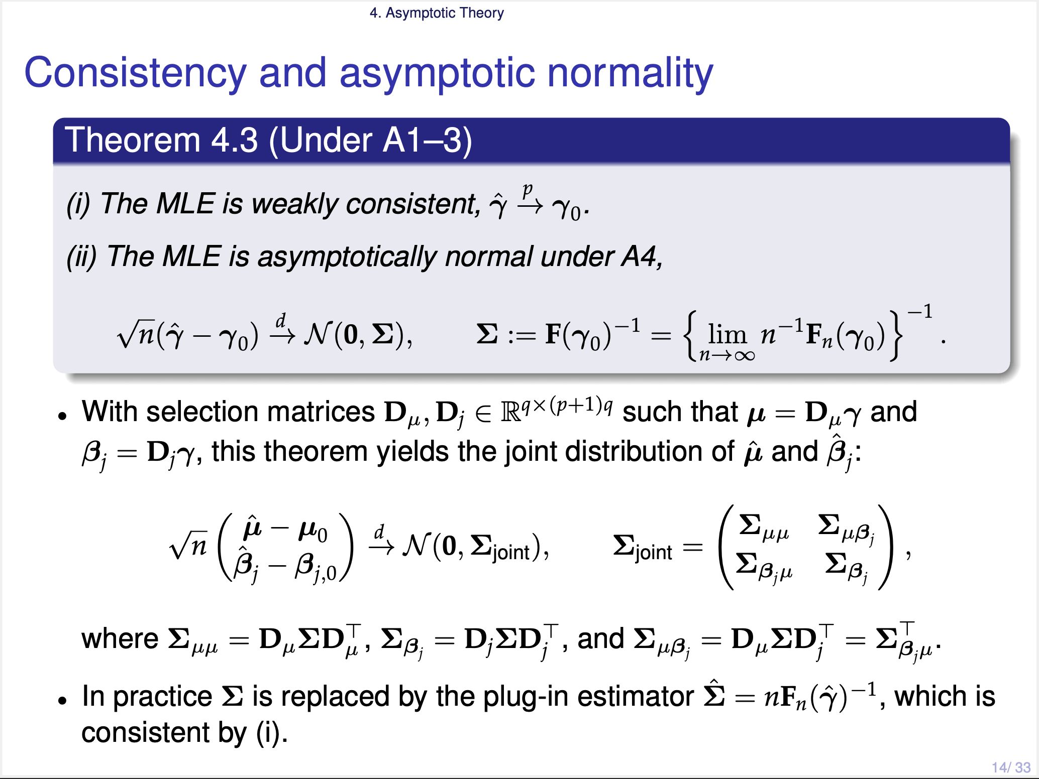
Notes:
The conclusion is standard. The MLE is consistent. And root n times this difference goes to a normal with covariance Sigma.
In this situation, we need the joint distribution of mu-hat and beta-j-hat, so we use selection matrices, which just pick out the mu block and the beta-j block.
Since mu-hat and beta-j-hat are simply linear transformations of gamma-hat, we can easily obtain their joint normal distribution.
In practice, Sigma is replaced by the plug-in estimator, because it is consistent estimator by this theorem.

Slide 17
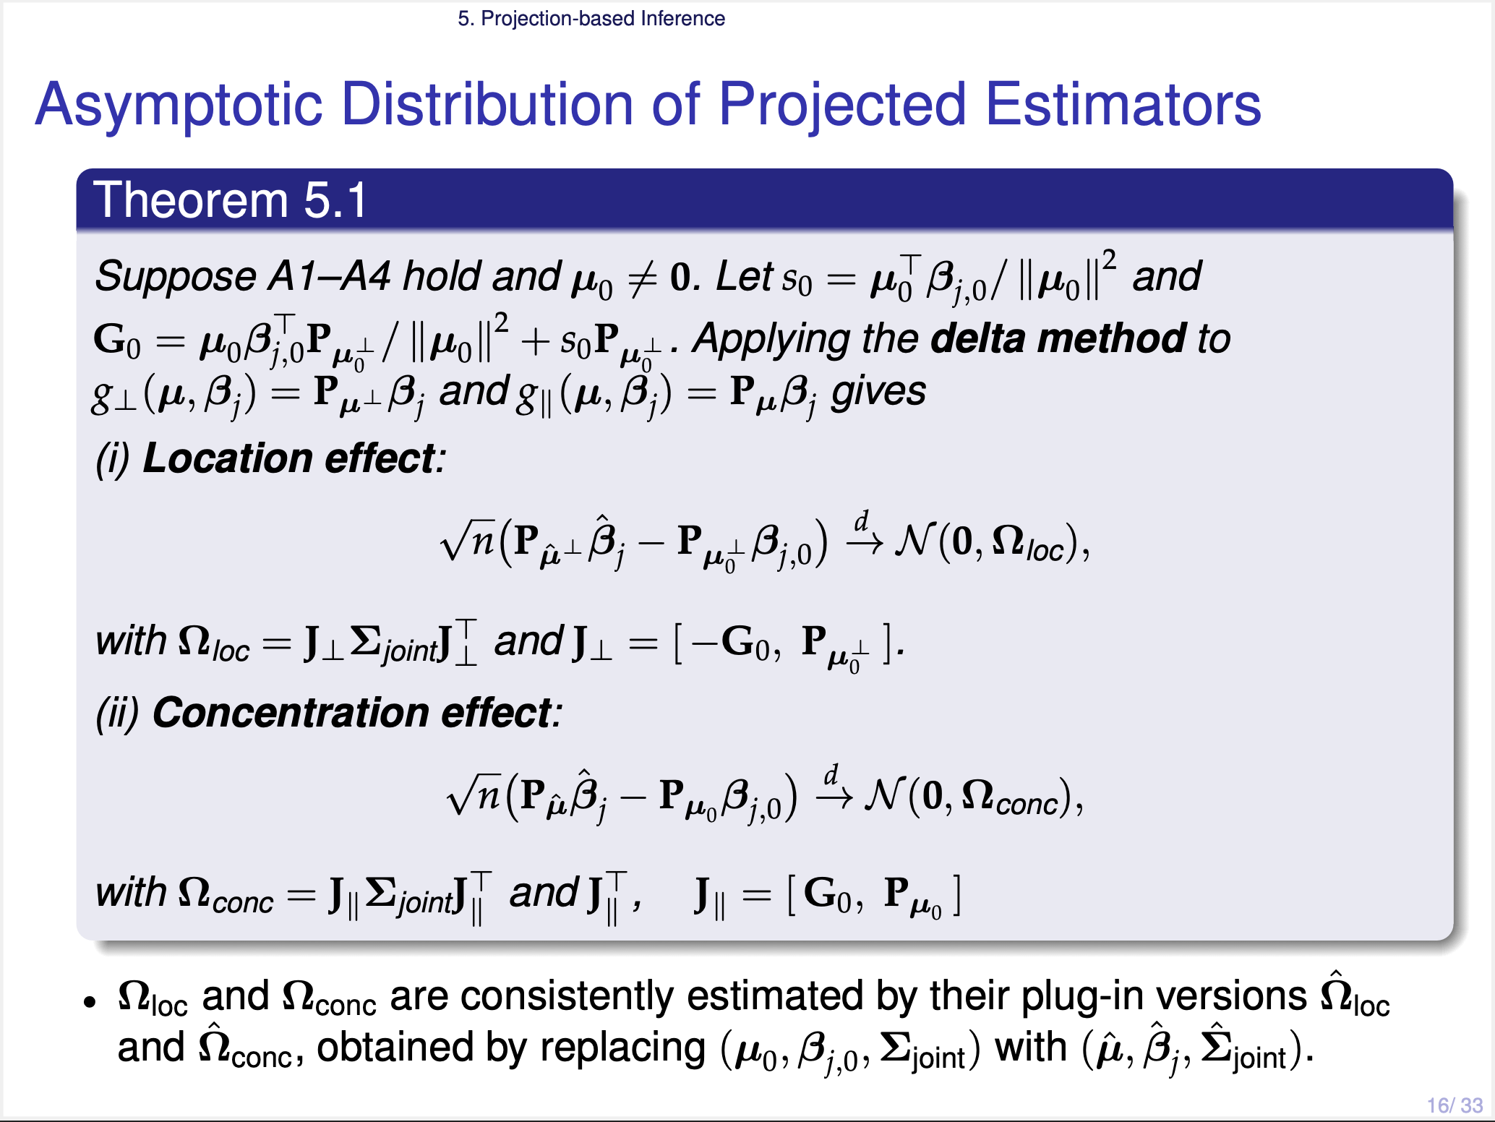
Notes:
Both projections use mu-hat, which is random. So we apply the delta method to the joint distribution of mu-hat and beta-j-hat. Then we obtain these two results:
the estimators for the location effect and concentration effect, both follow the asymptotic normal distribution, with covariances Omega-loc and Omega-conc from their own Jacobians, respectively.
One thing to note is that each Jacobian has two blocks.
> The right block carries the uncertainty of beta-j-hat onto the corresponding subspace.
> The left block, which is minus G-zero or plus G-zero, carries the extra uncertainty from estimating mu-hat.

Slide 18
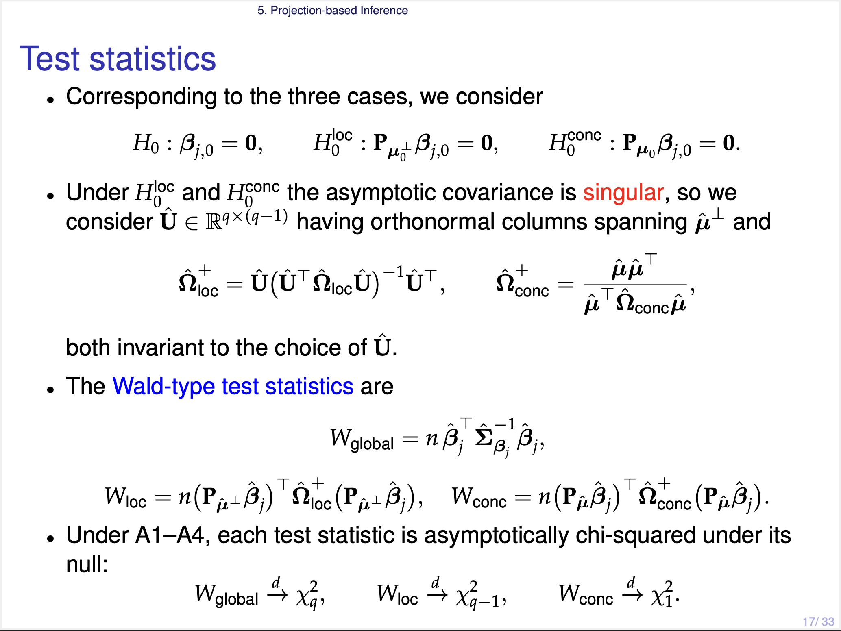
Notes:
Now we can define the test statistics, for the three hypotheses we saw before: The global null, the location null, and the concentration null.
Here one thing to note is that under the two projected nulls, location and concentration, the asymptotic covariance becomes singular.
< 왜? >
To avoid this, we take U-hat, whose columns are orthonormal bases of the asymptotic covariance. Then, we can use the ordinary inverse operator. And the outer U-hat brings it back to the original q coordinates.
Then, under its own null hypothesis, our test statistic W-global, W-loc, W-conc, all go to chi-squared distributions with q, q-1, 1 degrees of freedoms.

Slide 19
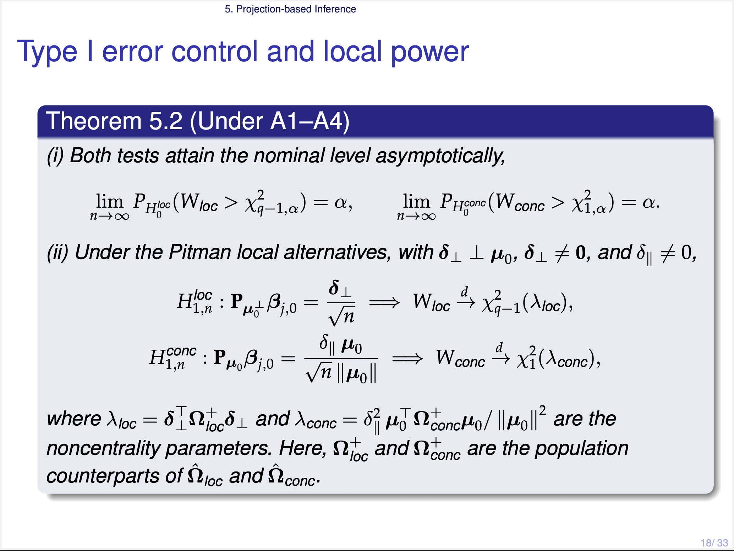
Notes:
This theorem gives results about the type I error rate control and the statistical power under Pitman local alternative.
Let me skip this slide

Slide 20
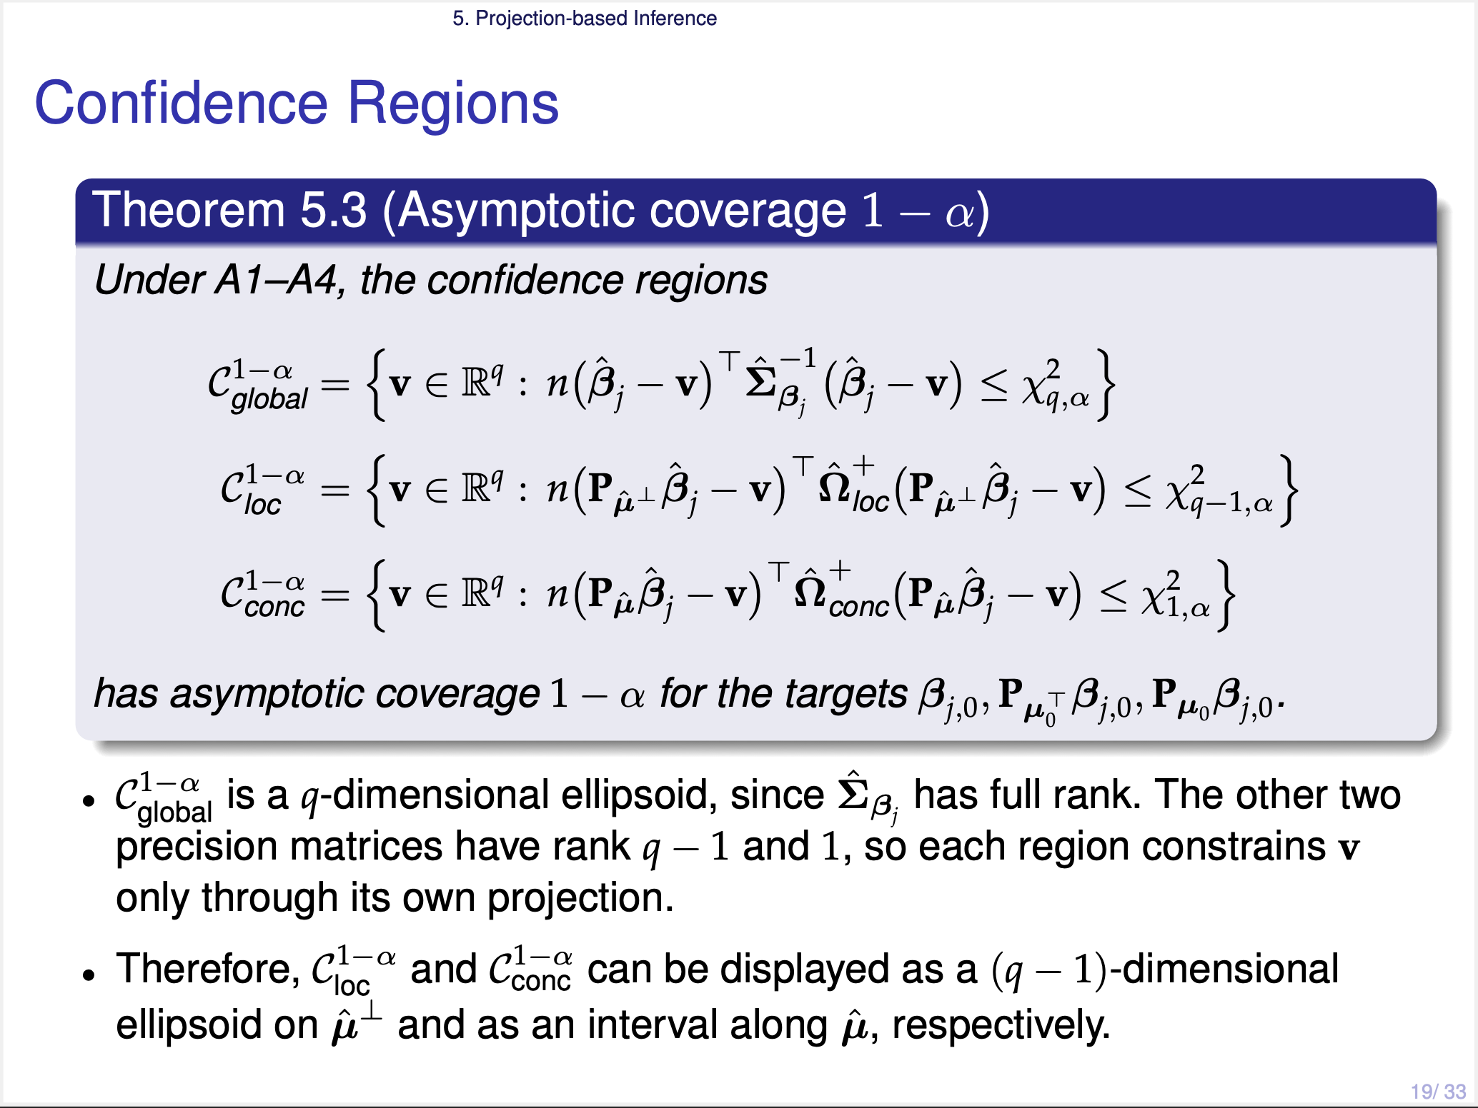
Notes:
We can obtain confidence regions like these forms.
The three precision matrices have rank q, q minus one, and one. So we can display each region on its own subspace. The location region is an (q-1) dimensional ellipsoid on the mu-hat-perp, and the concentration region is an one dimensional interval along mu-hat.

Slide 21
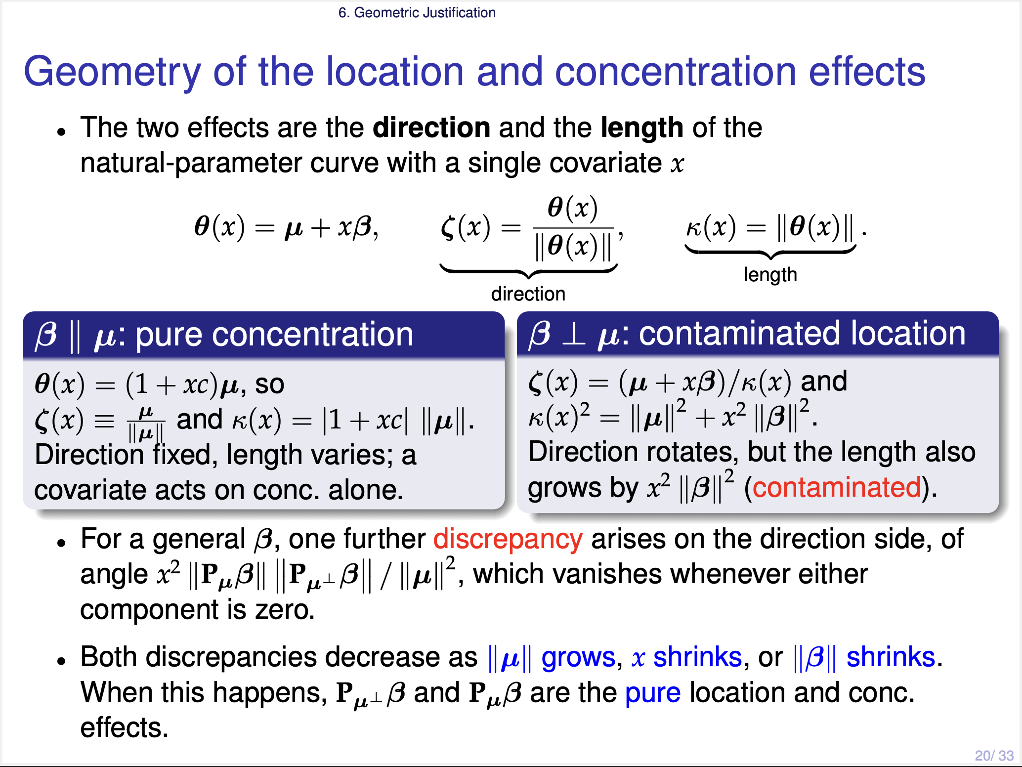
Notes:
Now let us look at the geometry once more. We first consider the natural parameter theta as a function of x. Then we can check how the direction and the concentration change as x changes.
Let me start from some cases.
> If beta is parallel to mu, then the direction is fixed at mu, and only the length changes. This beta is a pure concentration effect, because it affects the concentration only.
> However, if beta is orthogonal to mu, then the direction rotates. But the length also grows, by x squared times the norm of beta squared. So in this case the location effect is contaminated by the length. And for a general beta, there is one more gap, **this one**.
Now the important thing is that these two gaps are of second order of x beta, relative to the baseline bmu. So they become small when the norm of mu grows, or when x beta is small. When this happens, the two projections are the pure location and the pure concentration effects.

Slide 22
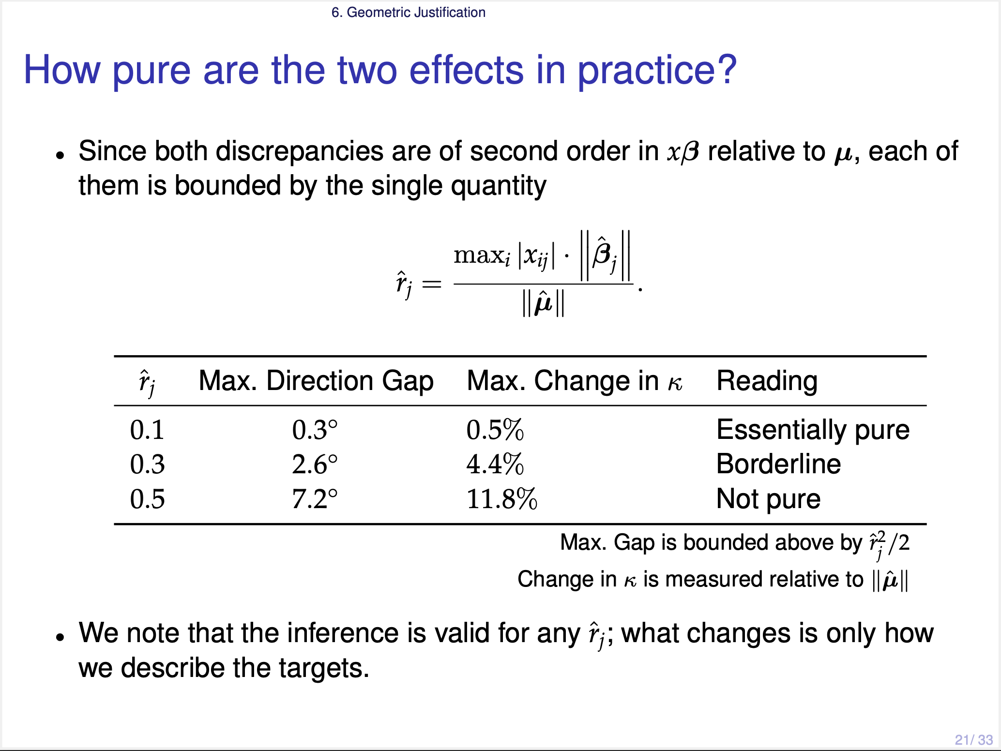
Notes:
In practice, we can check it by one single quantity r-hat, this form.
> If r-hat is about 0.1, the direction gap is less than one degree. So the two projections are essentially pure.
> If r-hat is about one half, the gap becomes 7 degrees. In that case we should not call them pure effects.

Slide 23
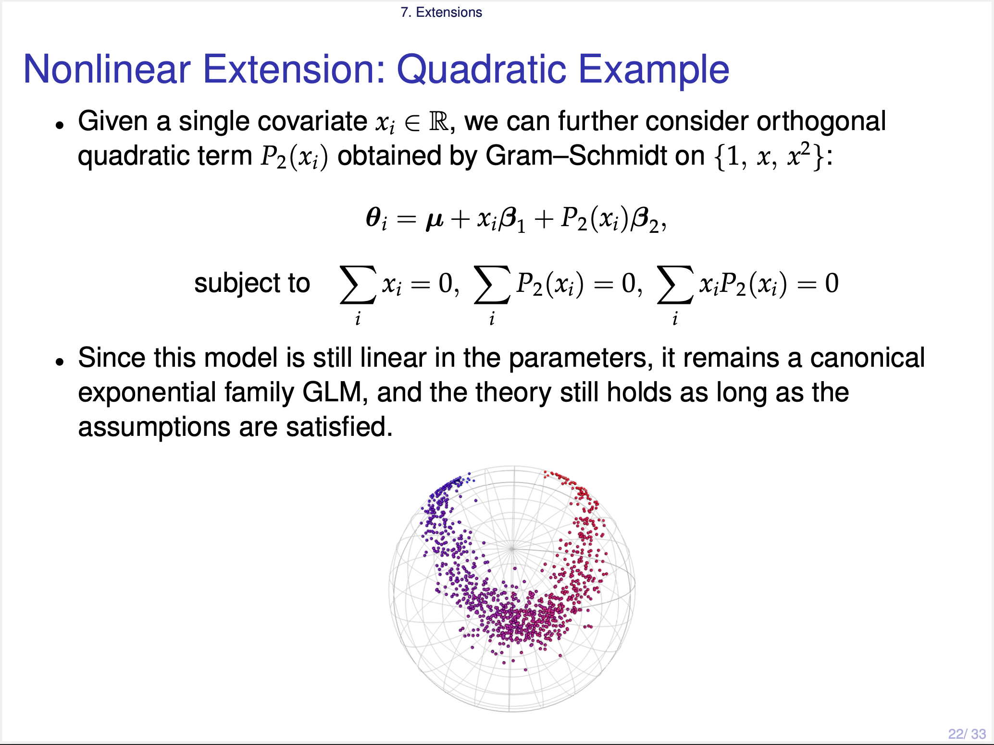
Notes:
Also we can consider the nonlinear extension,
but let me skip this slide.

Slide 24
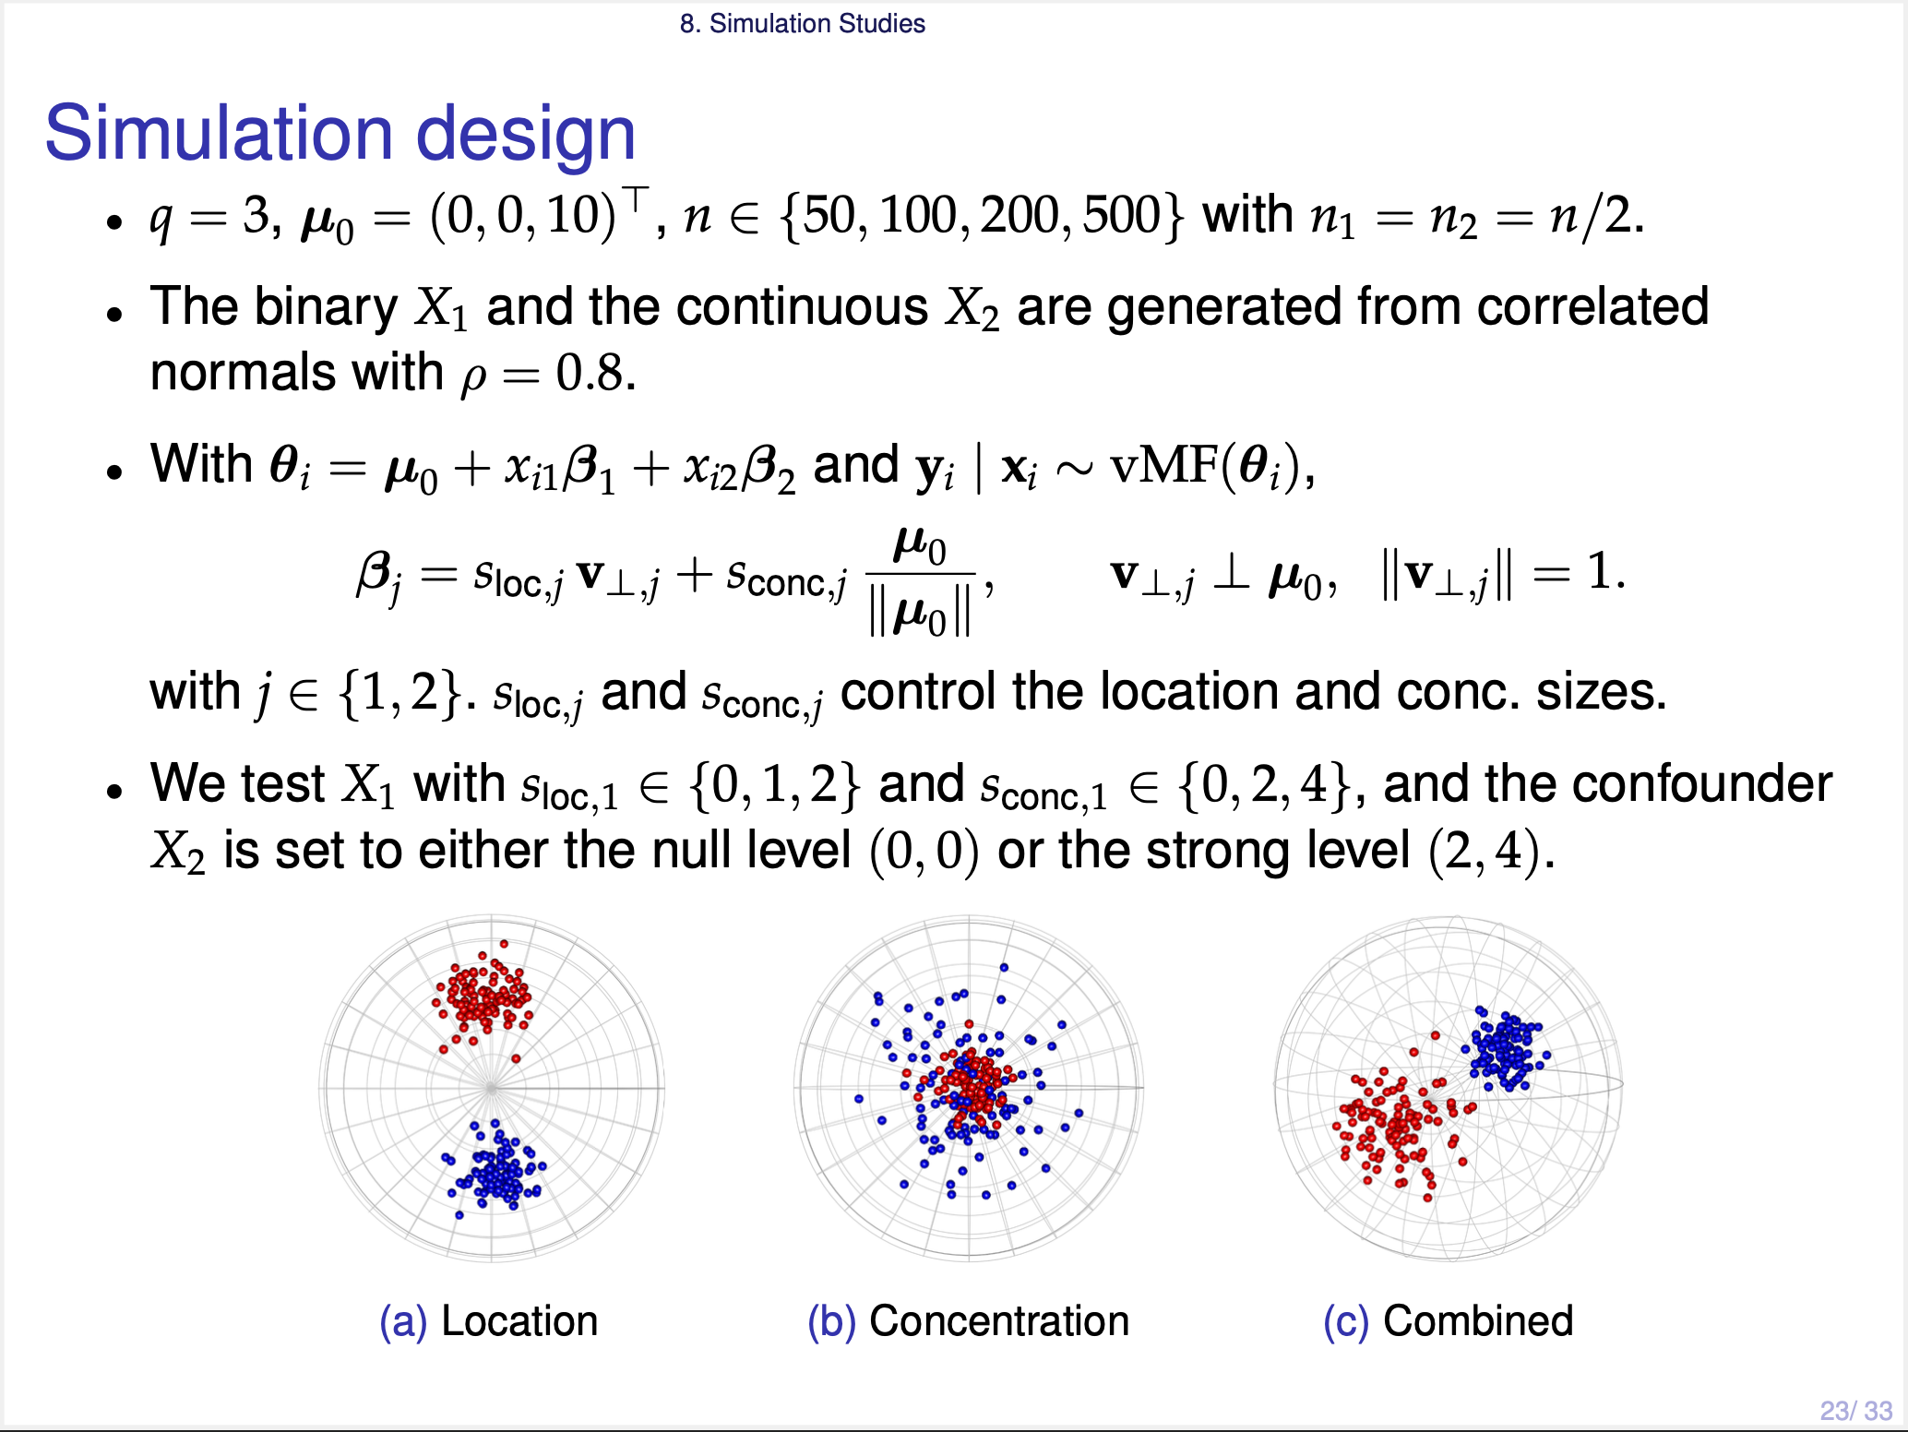
Notes:
Let me describe the simulation setup. We consider the two dimensional sphere, with mu-zero equal to (zero, zero, ten), and these four sample sizes.
We have a binary covariate X1, and a continuous confounder X2, with strong correlation zero point eight.
And the true coefficient is written in this form, so that s-loc and s-conc control the two effect sizes. When either one is zero, the corresponding null hypothesis holds.

Slide 25
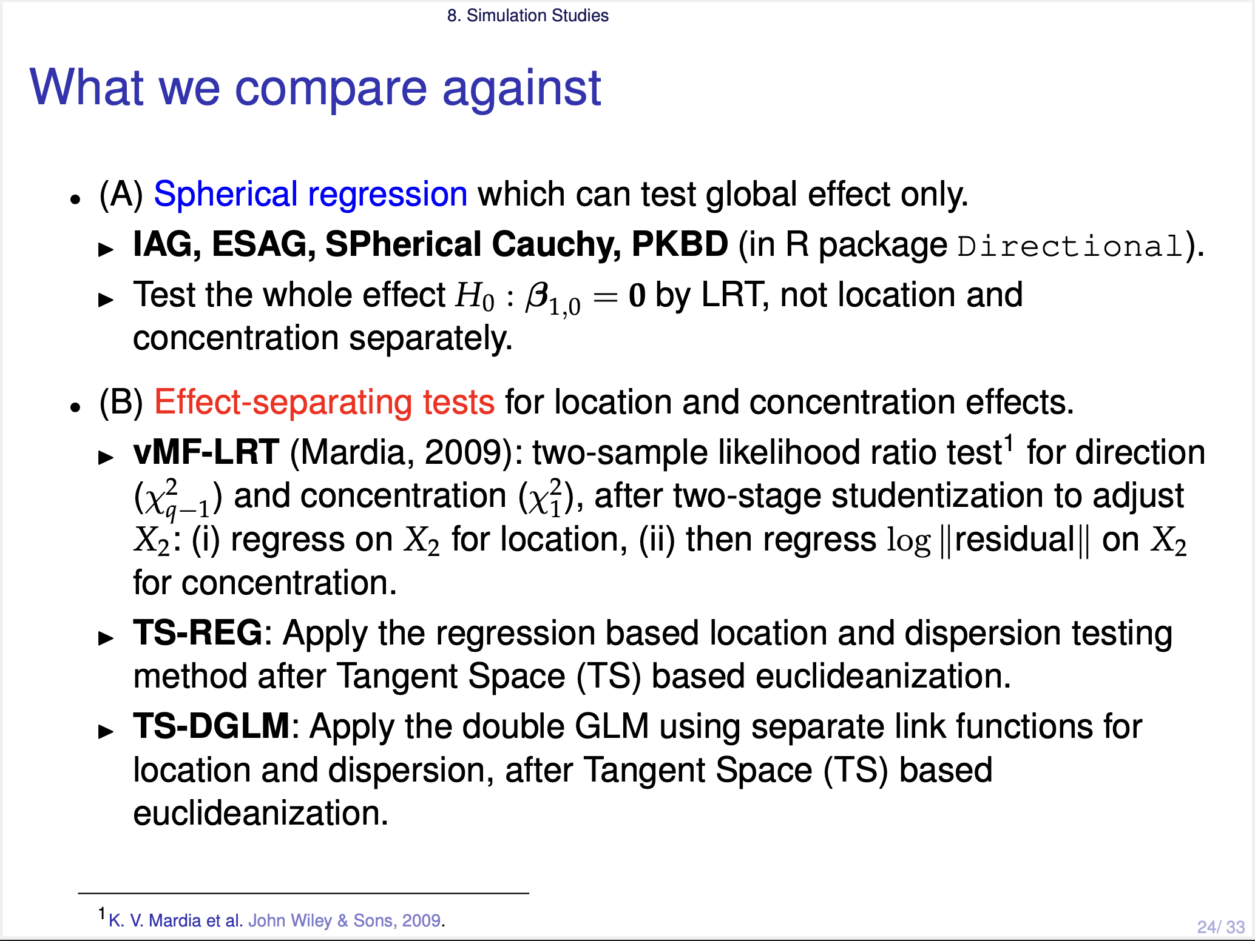
Notes:
We have two groups of competing methods.
Group A is the spherical regressions. They assume a different error distribution, and they cannot separate the two effects. So we compare them with our global test only.
Group B is the effect-separating methods: von Mises-Fisher based two-sample likelihood ratio test, and Tangent-Space based regression methods.

Slide 26
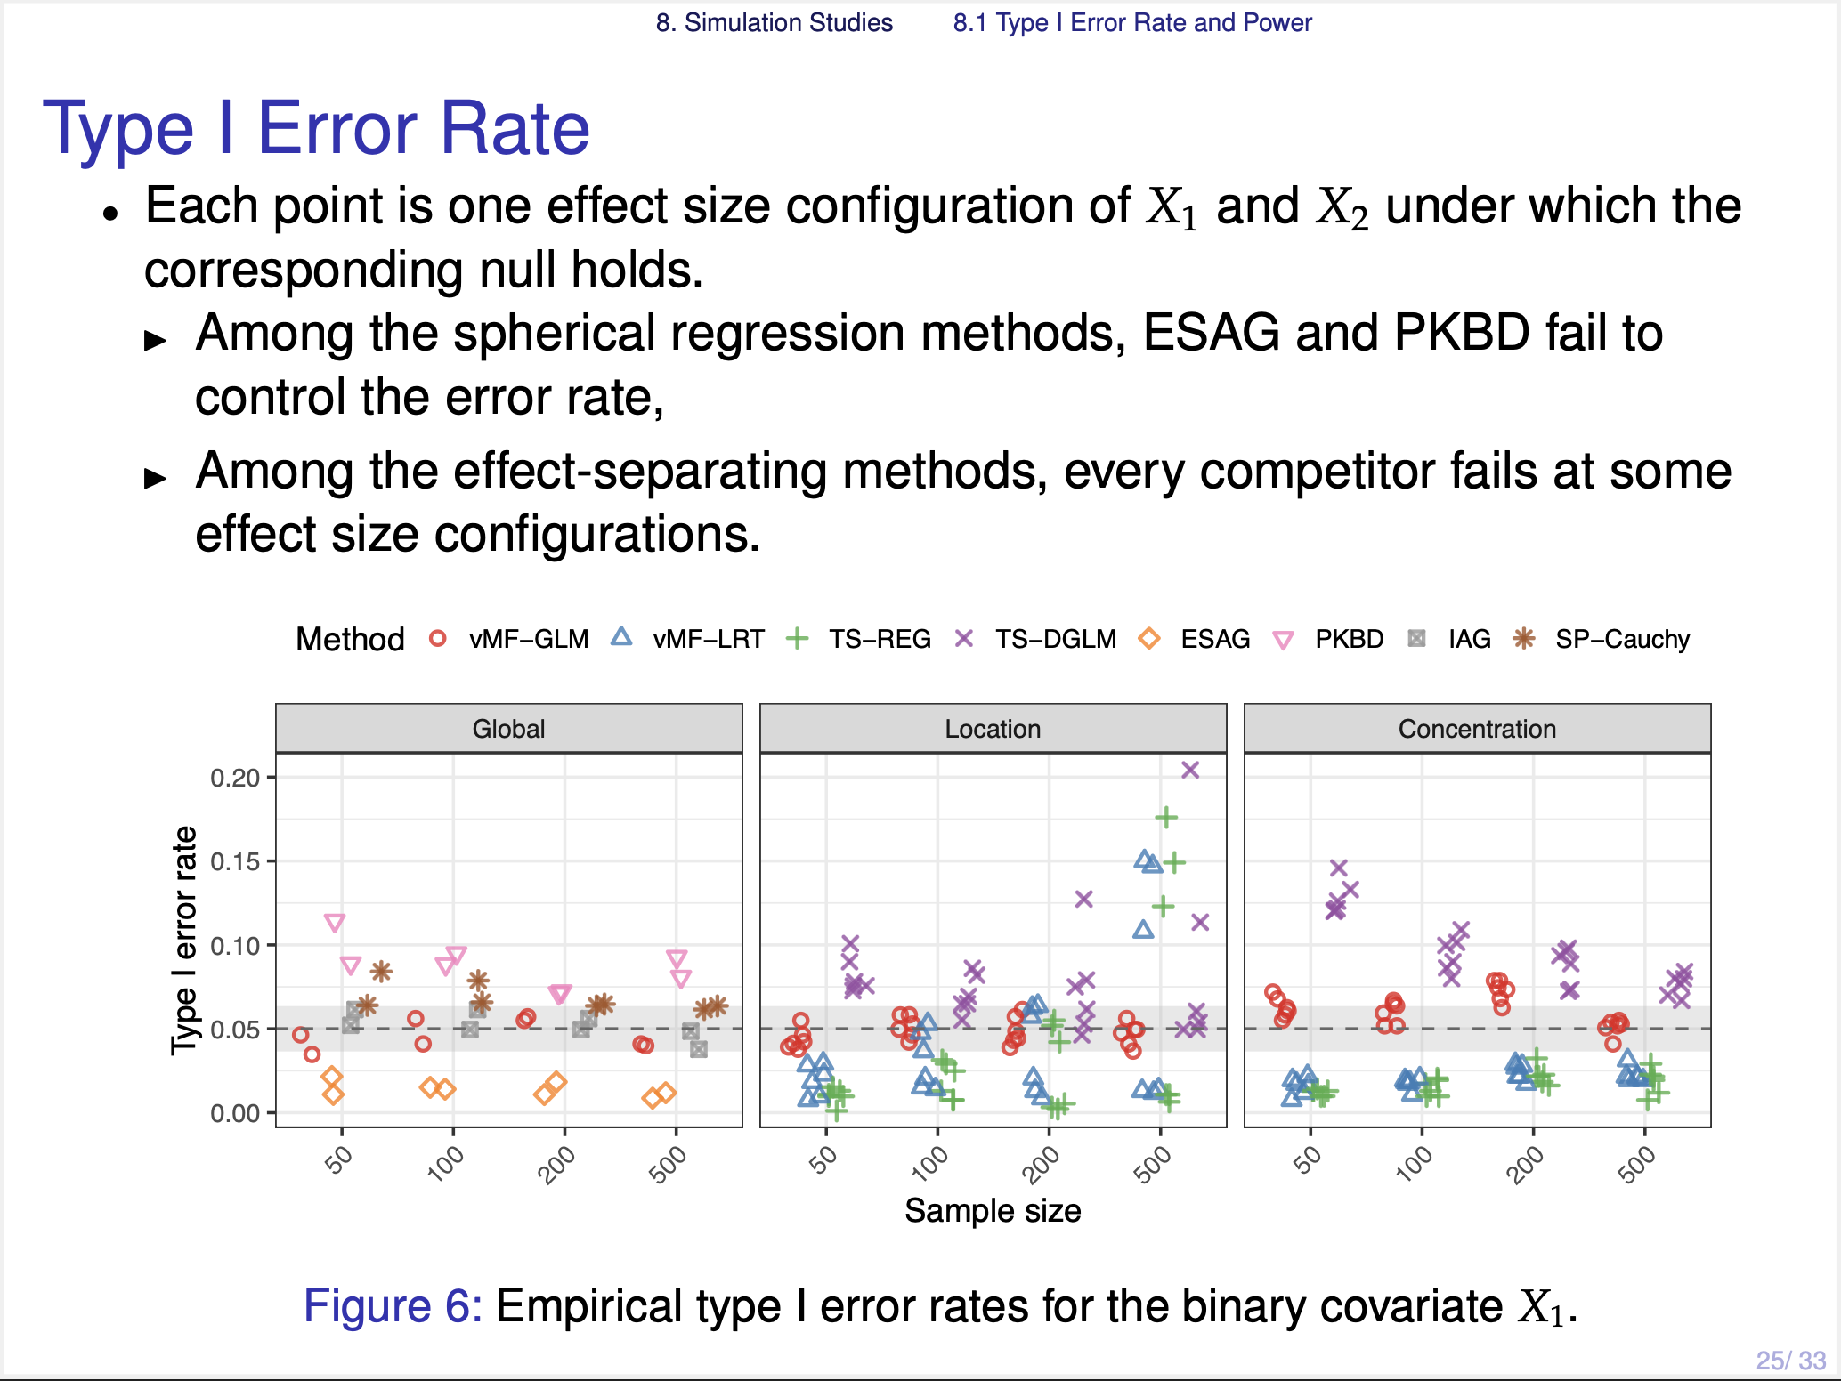
Notes:
This figure shows the empirical Type I error rates. The three panels are the global, the location, and the concentration test.
As you can see, our method, the red one, can control the error rate asymptotically along this axis, with increasing sample size, for all cases. Among the comparing methods, only IAG and SP-Cauchy control the error rate.

Slide 27
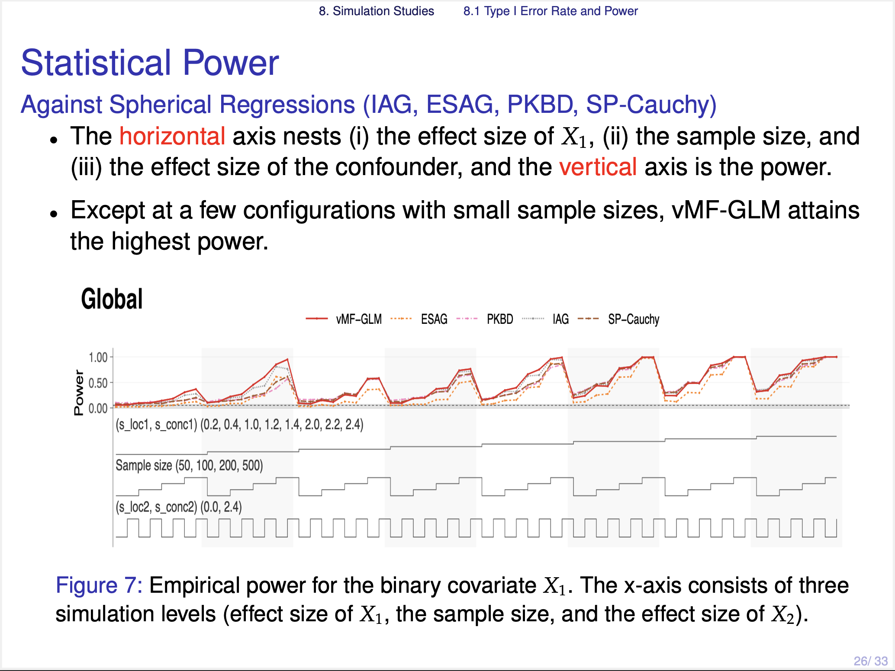
Notes:
Next is the power. The x-axis indicates all combinations of the simulation settings, and the figure is small, but the pattern is clear.
Against the spherical regressions, our method has the highest power in most cases.

Slide 28
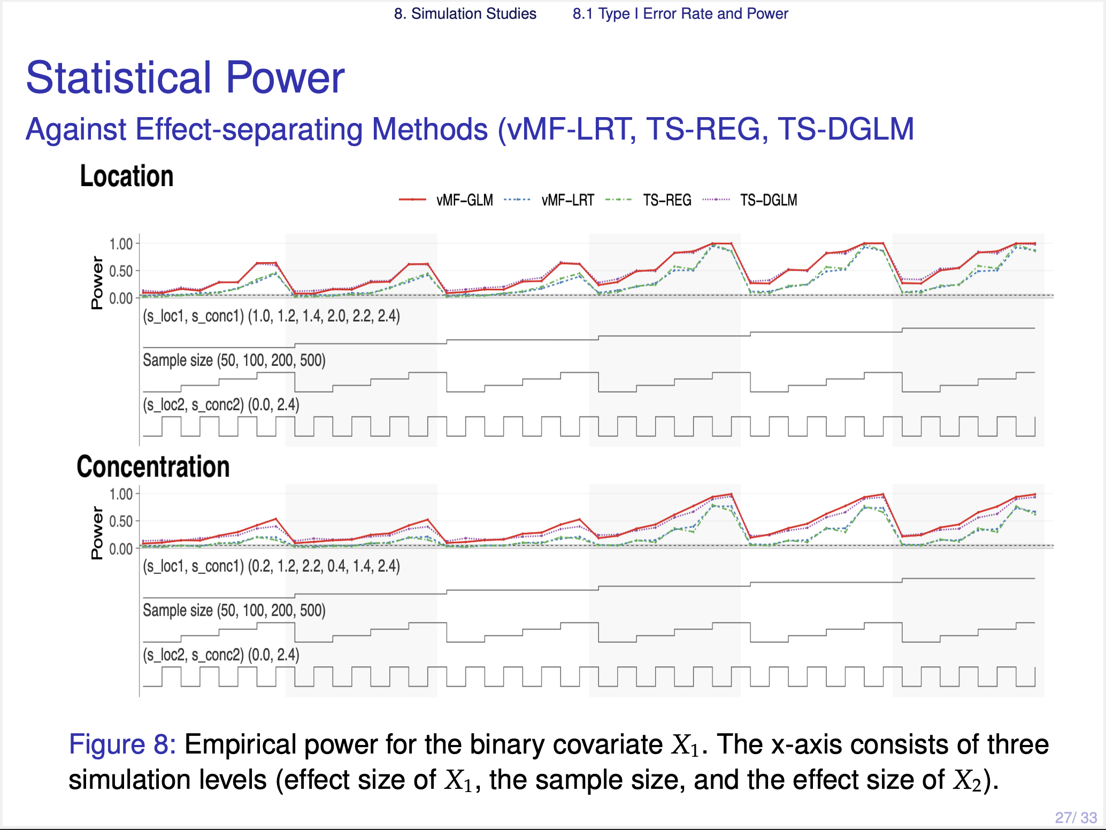
Notes:
Against the effect-separating methods, our method and TS-DGLM have the highest power in the location test. In the concentration test, our method is the highest, followed by TS-DGLM.
But the power of TS-DGLM is not directly comparable, because it does not control the Type I error rate.
Therefore, among the methods that control the error rate, our method has the highest power in most cases.

Slide 29
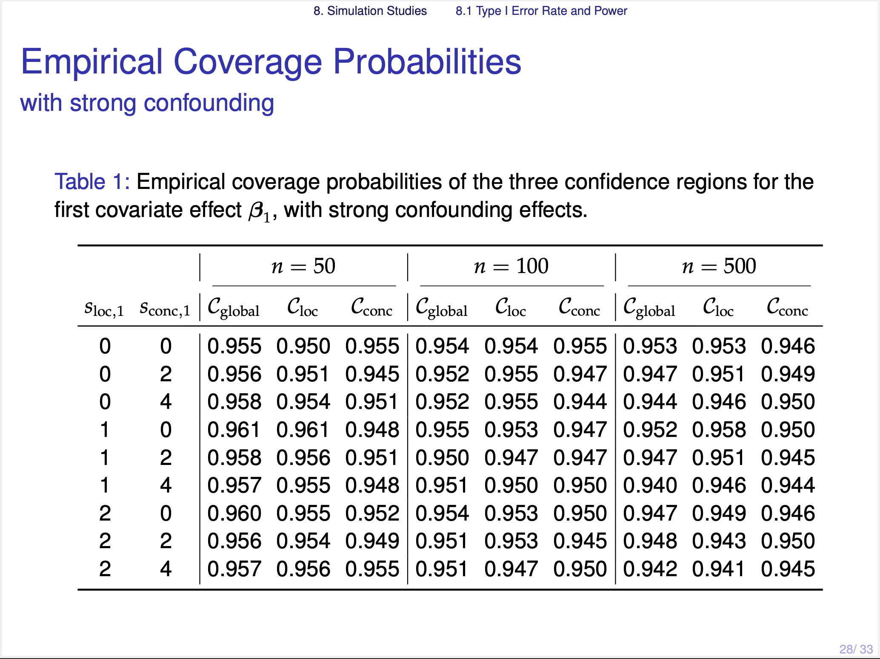
Notes:
This table shows the empirical coverage of our three confidence regions, but I will skip these slides

Slide 30
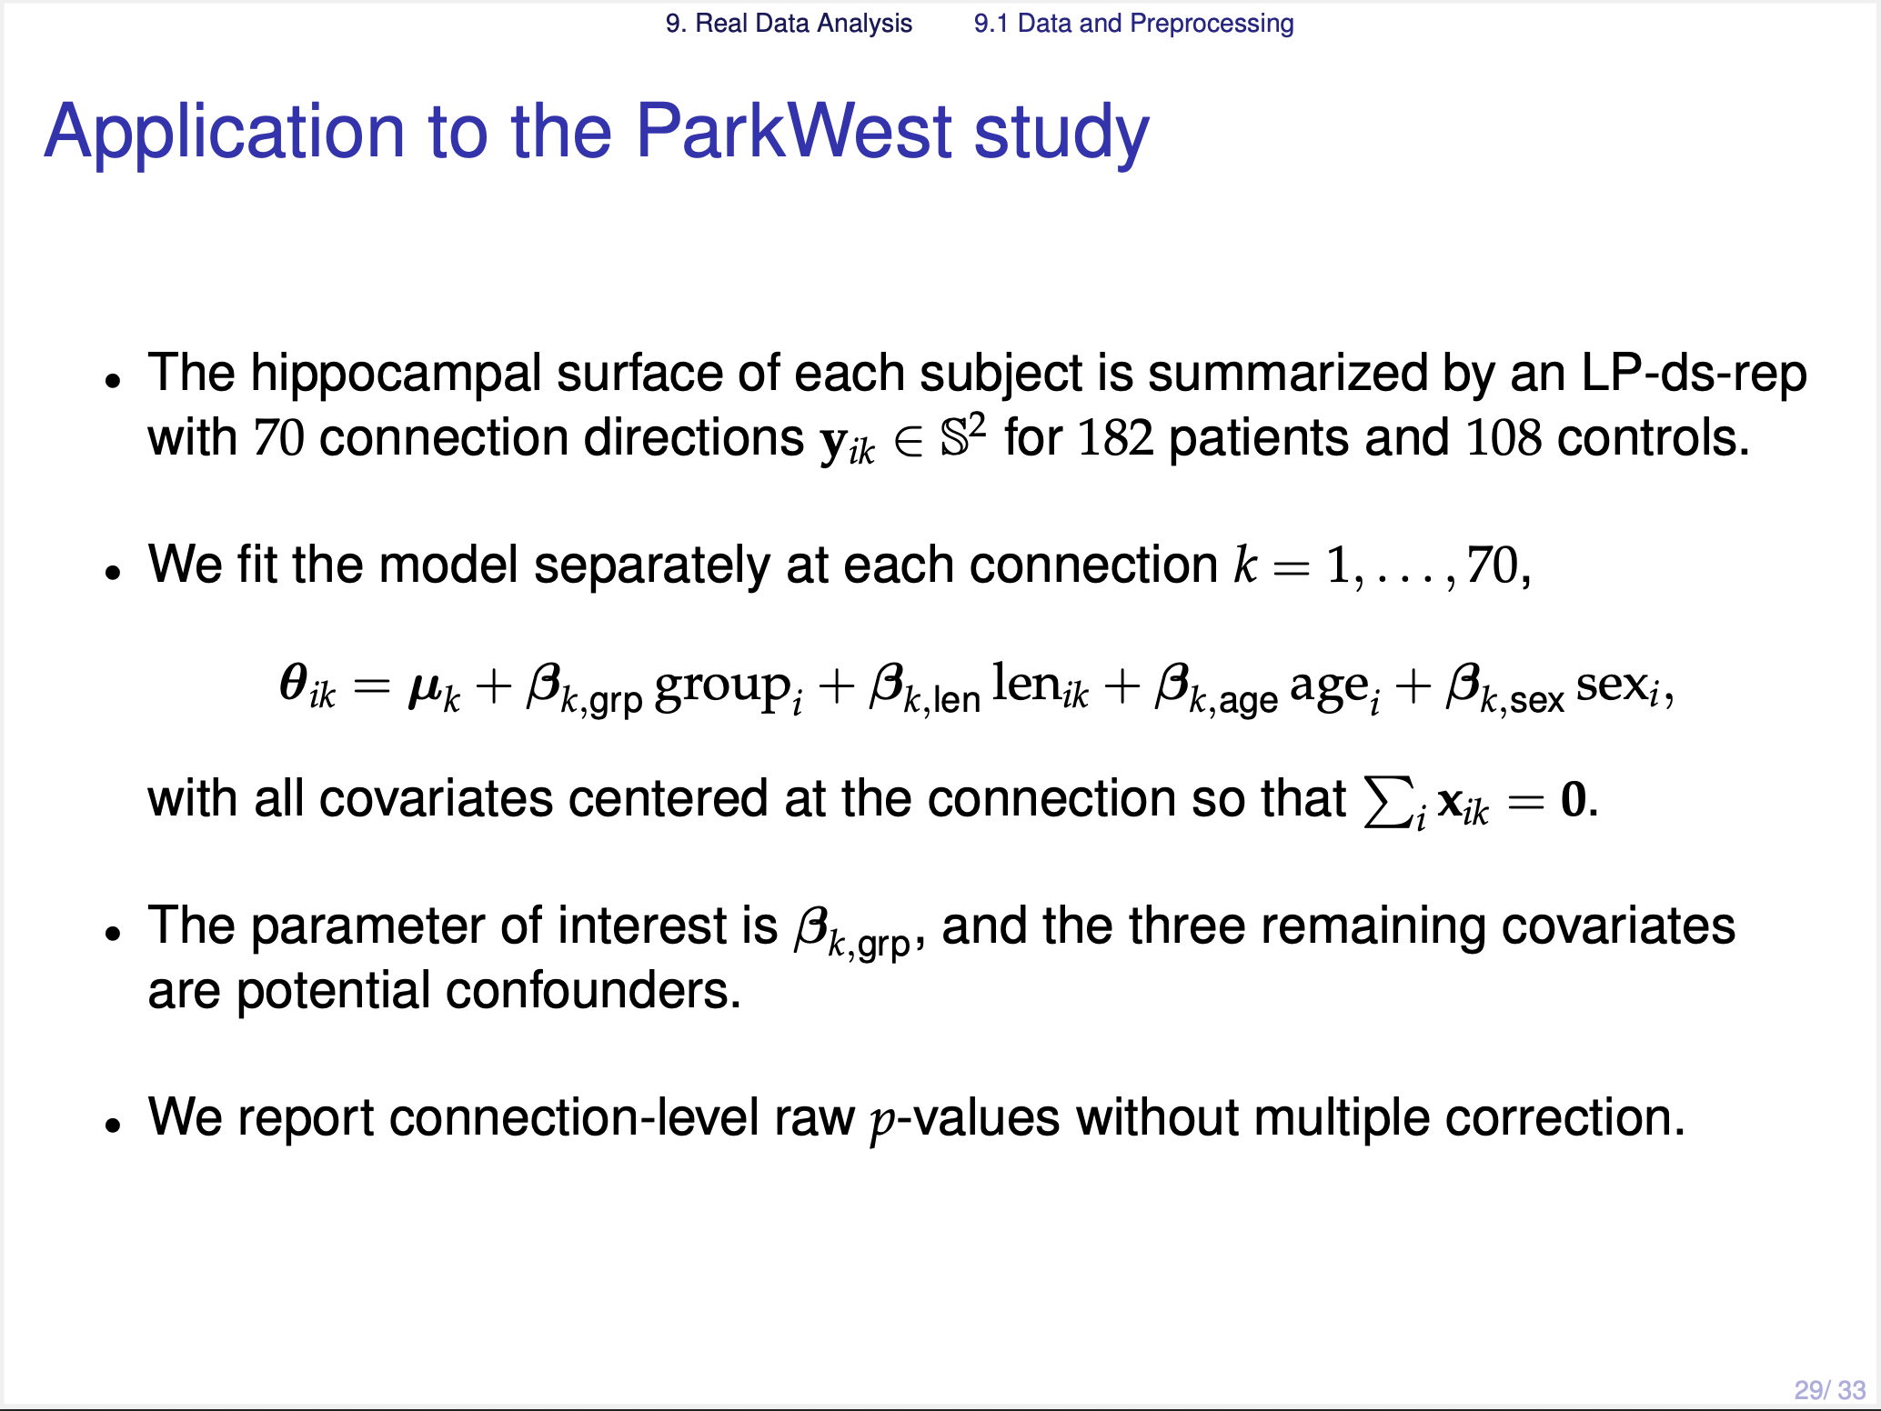
Notes:
Now let me apply the proposed vMF-GLM to the real data.
Each hippocampus shape was represented by the LP-ds-rep, with seventy connection directions so each of them is our response variable.
We fit **this model** at each connection, including several covariates with Parkinson's disease status and the connection length, age, and gender. Here our main interest is coefficients for the disease status at each connection.

Slide 31
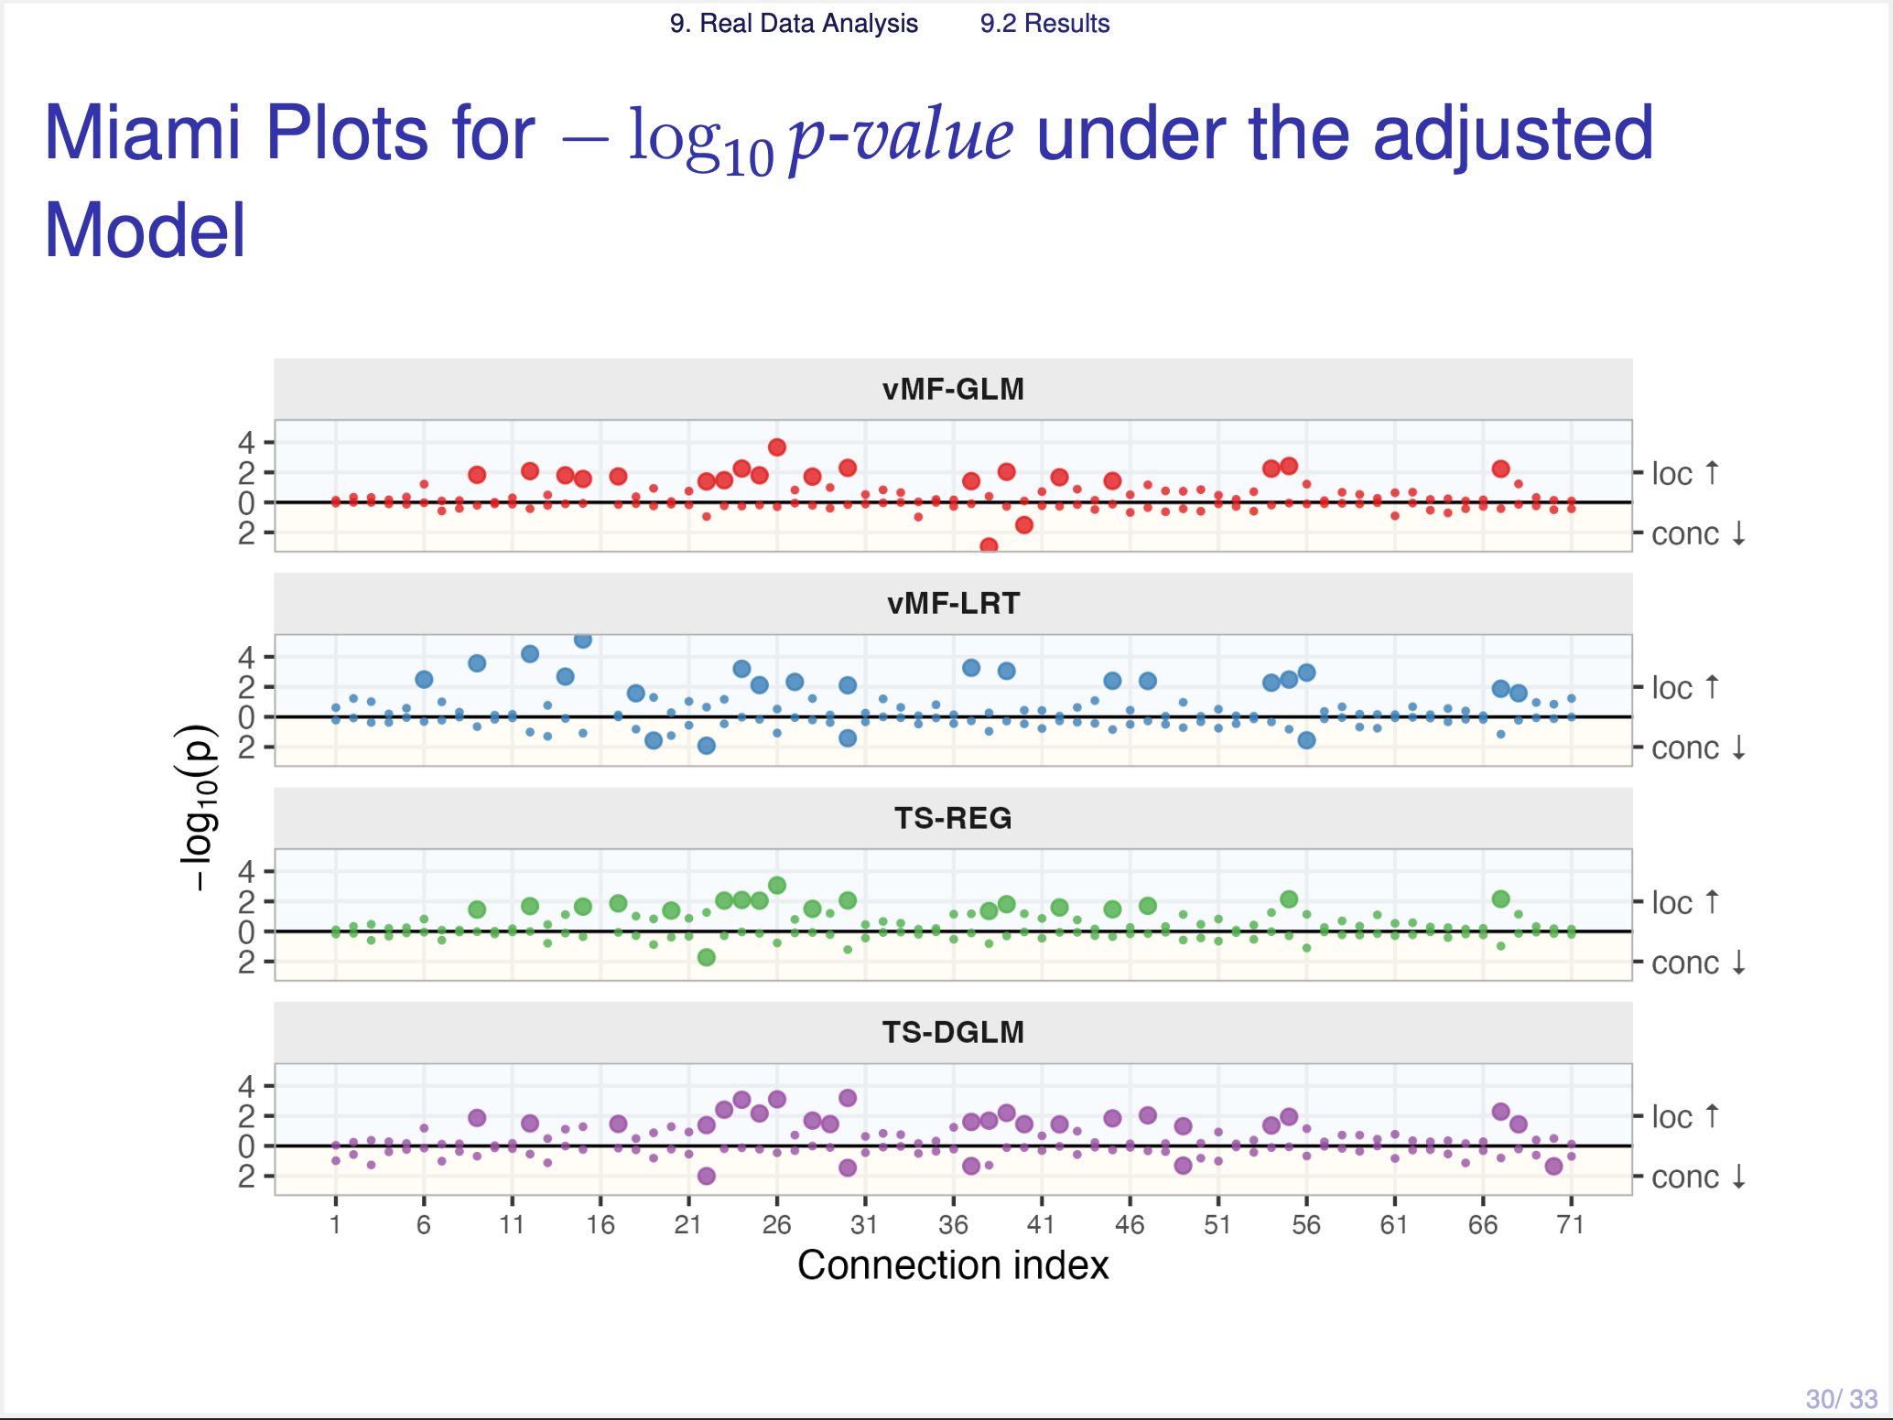
Notes:
This is the Miami plot which shows the -log10 p-values on the y-axis, and the index of connection on the x-axis.
Here we compared our method with the three effect-separating methods.
In each panel, the upper region is a result for the location test, and the lower region is the concentration. And the bigger points are the significant ones.
So you can see that there are many bigger points on the upper panel than the lower panel, in all methods.

Slide 32
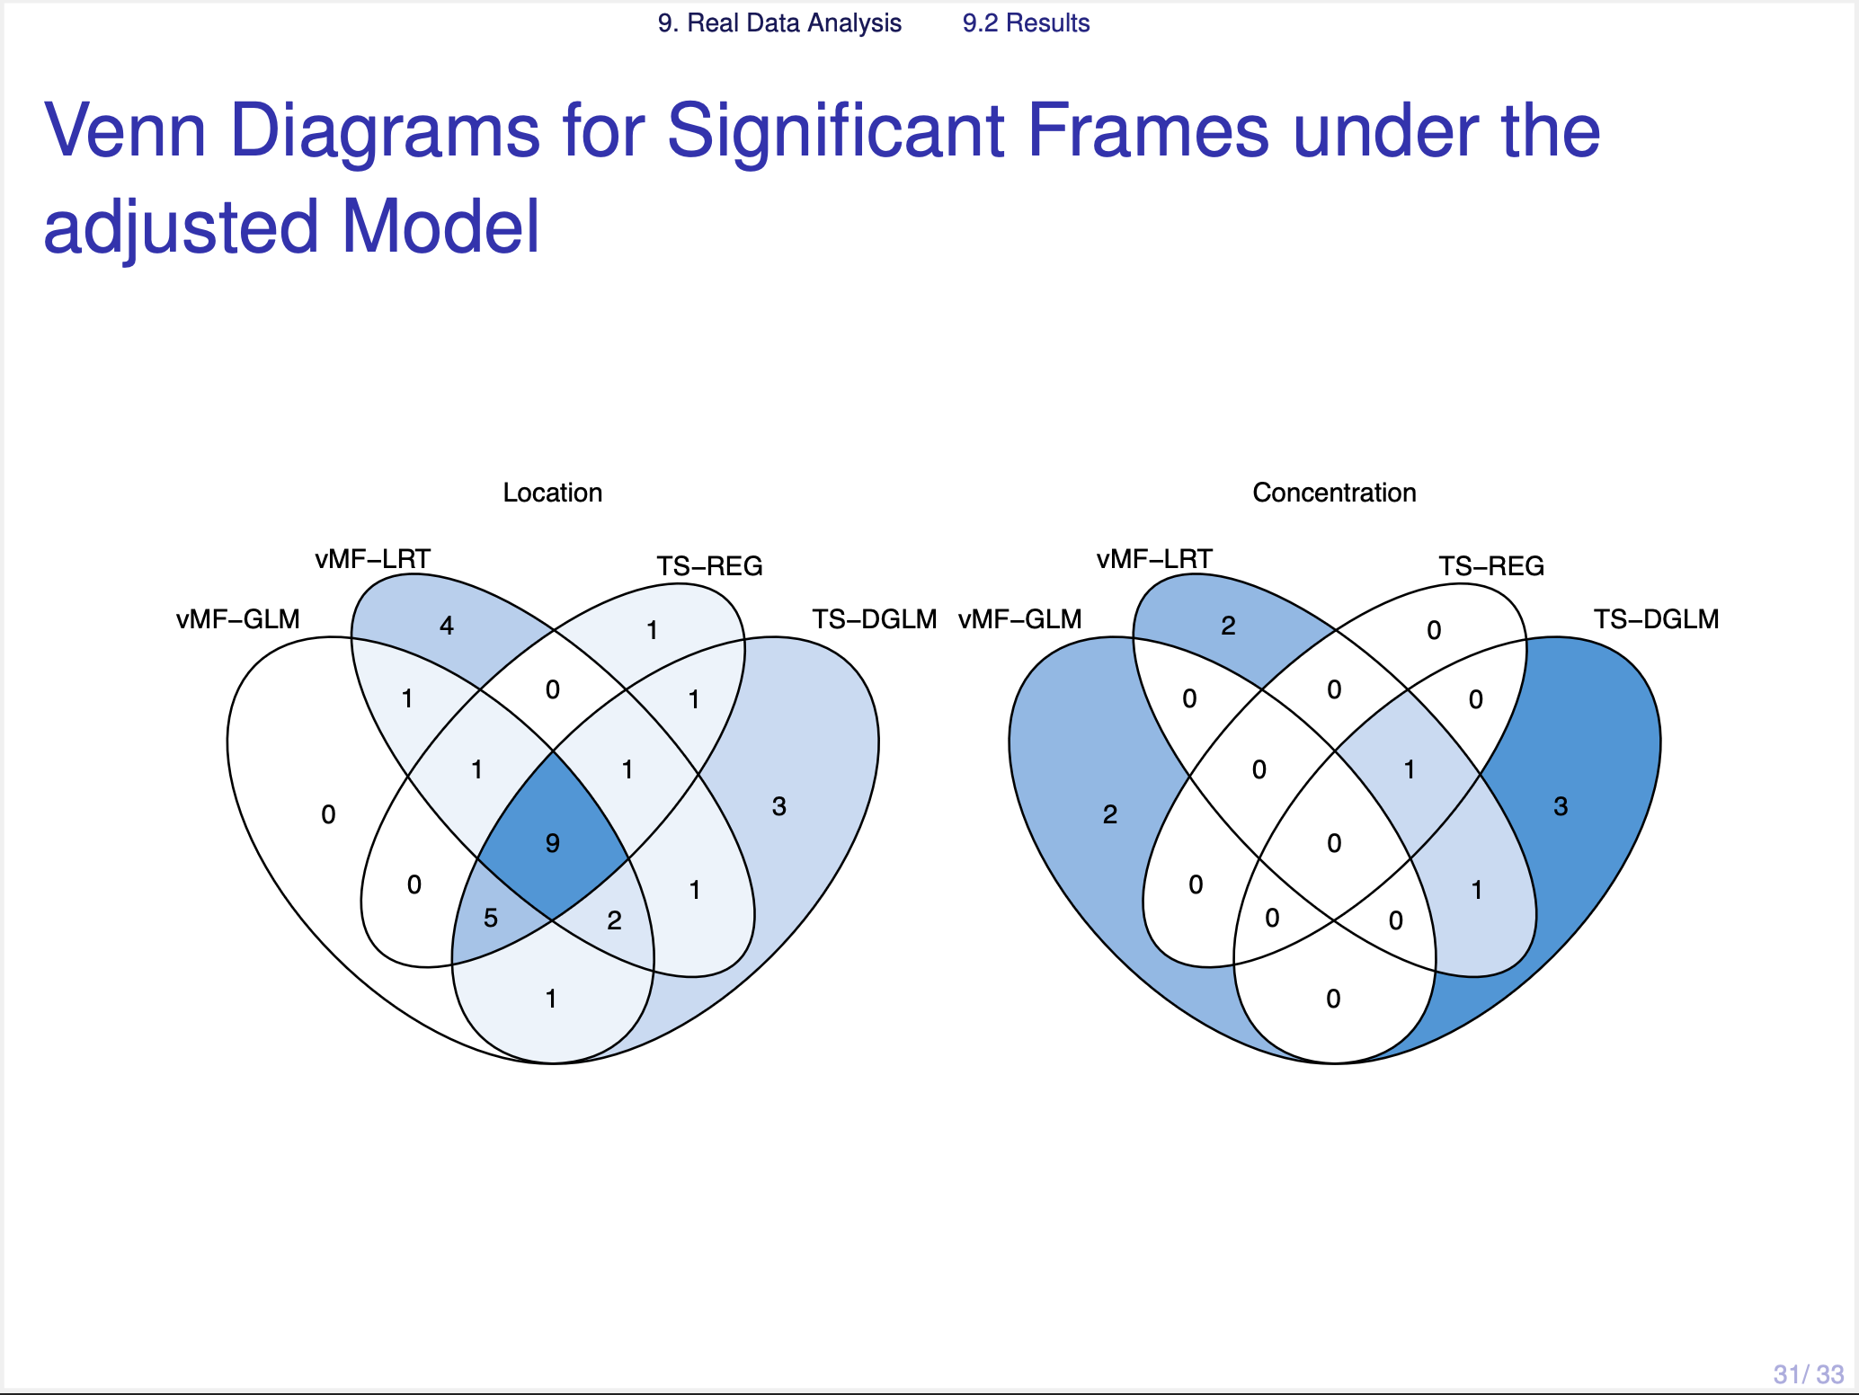
Notes:
Now, this Venn diagram shows how much the four methods agree. The left one is the location, and the right one is the concentration.
For the location test, the four methods agree well. Nine connections are significantly identified by all methods.
For the concentration test, no connection is found by all methods. Most of them are found by only one method.
So these data do not have a strong concentration signal. And since the competing methods failed to control the Type I error rate in our simulation, some of these may be false positives.

Slide 33
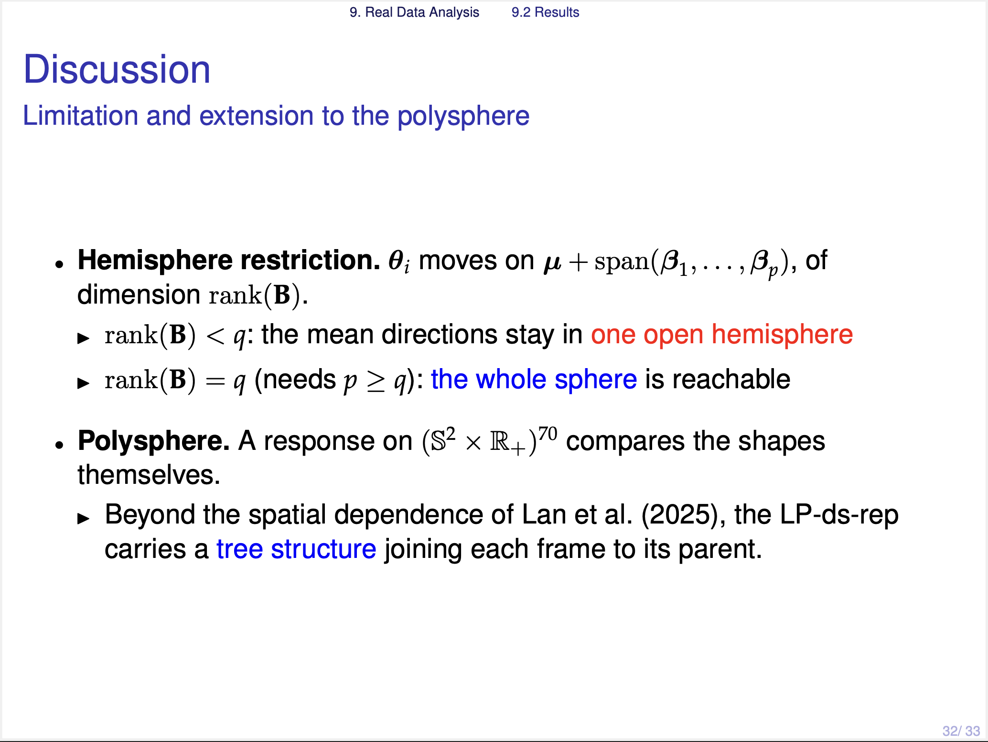
Notes:
Let me close with two remarks.
First one is about the hemisphere restriction. In our model, the natural parameter moves on an affine subspace, whose dimension is the rank of coefficients matrix B.
> If this rank is less than q, then the conditional mean directions stay within an open hemisphere.
> If it is full-rank, then the restriction disappears.
Second one is about the extension to a polyspherical response. In this work we fitted the seventy connections separately, and treated the connection length as a covariate. But the ultimate direction would be to take the directions and the lengths of all connections together, as one response on this product space. This could be an interesting topic for the future work.
This is the end of my talk.
Thank you very much for your attention.

Slide 34
