Slide 1
Global Terrorism
Group Members
James Willson
Sean Kugele (Team Lead)

Slide 2
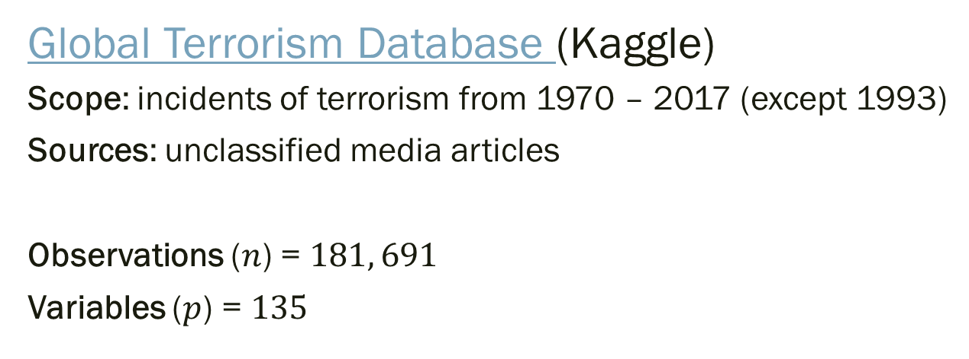
Data Set
Global Terrorism Database (Kaggle)
Scope: incidents of terrorism from 1970 – 2017 (except 1993)
Sources: unclassified media articles
Observations ($n$) = $181, 691$
Variables ($p$) = $135$
prior to data cleansing!
Terrorism (definition) "The threatened or actual use of illegal force and violence by a non-state actor to attain a political, economic, religious, or social goal through fear, coercion, or intimidation."

Slide 3
Variables (Summary)
Date Variables (Year, Month, Day, etc.)
Geospatial/Geopolitical Variables (Lat/Long, Region, Country, City, Province, etc.)
Incident Descriptive Variables (Attack Type, Duration of Incident, Success/Failure, Weapons Used, Targets, etc.)
Perpetrator Descriptive Variables (Terrorist group membership, # Perpetrators, etc.)
Casualty and Damage Variables (# Fatalities, # Injured, etc.)

Slide 4
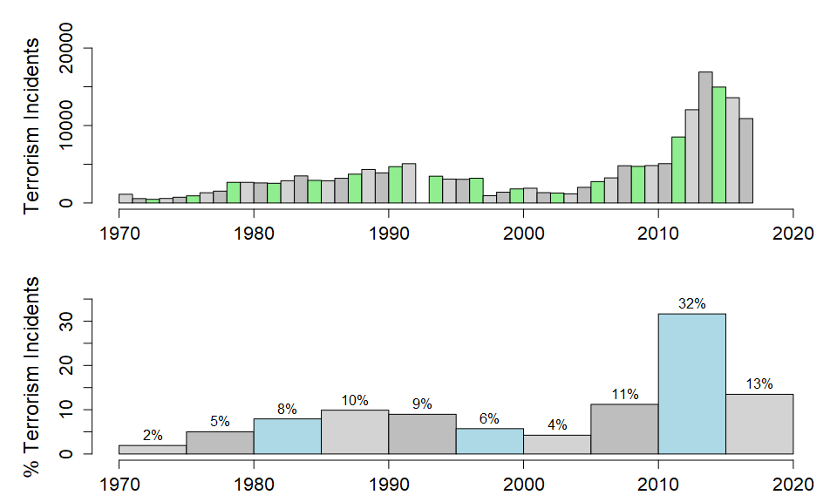
Observations (Summary)
Incidents by Time

Slide 5
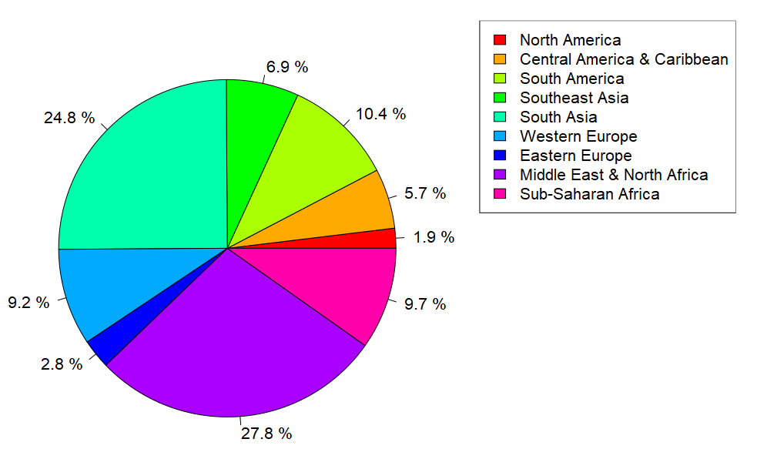
Observations (Summary)
Incidents by Region

Slide 6
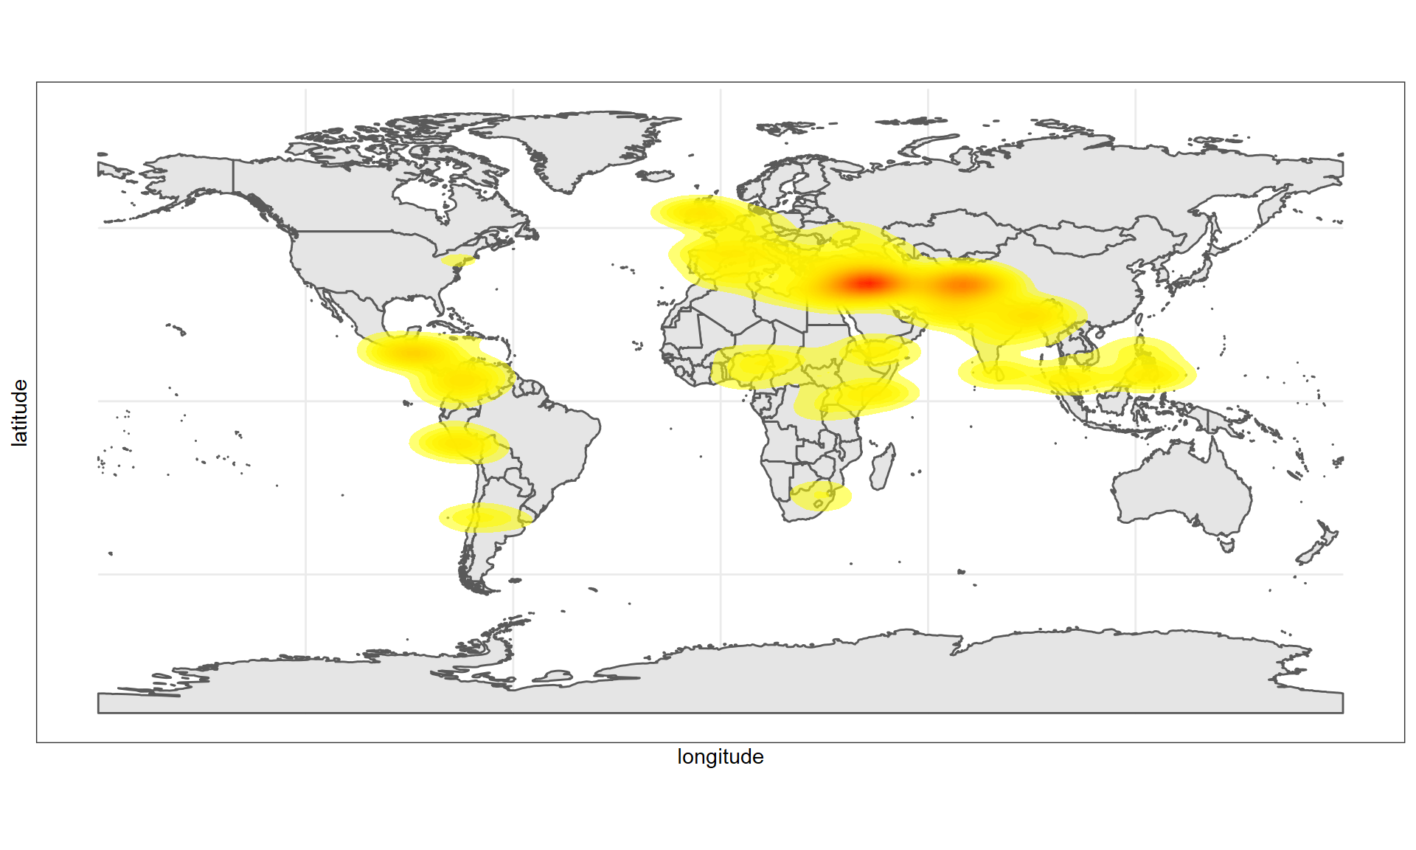
Observations (Summary)
Terrorism Incidents (Density Plot)
Notes:
Densities based on random plot of 20,000 incidents

Slide 7
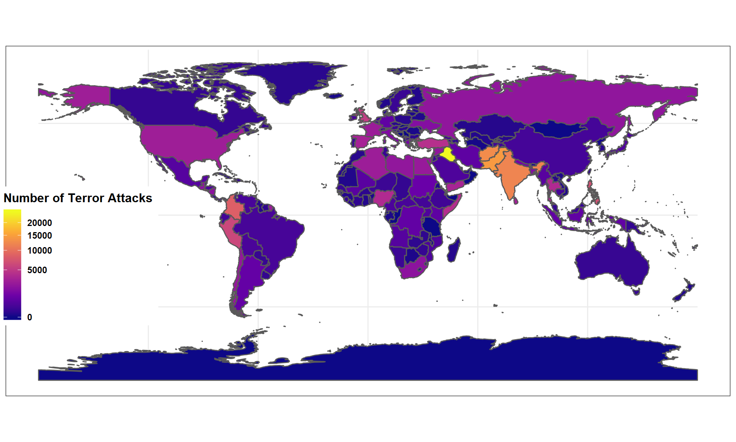
Observations (Summary)
Number of Terrorist Incidents by Country
Notes:
1
Iraq
24636
2
Pakistan
14368
3
Afghanistan
12731
4
India
11960
5
Colombia
8306
6
Philippines
6908
7
Peru
6096
8
El Salvador
5320
9
United Kingdom
5235
10
Turkey
4292

Slide 8
Data Quality and Characteristics
41 variables contain free-form textual descriptions (unusable)
Most variables contain large percentage of NA values
additional 44 variables have over 90% values as NA
na.omit results in zero observations!
Most variables are categorical (not numerical)
“unknown” common as a category value
some contain too many category values (for example, targsubtype1 has 107 distinct categories)
Large (Problem Specific) Data Cleansing Effort Needed!

Slide 9
Research Questions and Assignments
James Willson (Data Scientist)
Predict if an attack will be successful based on a variety of different factors.
Estimate the number of casualties in a successful terrorist attack
Sean Kugele (Data Scientist / Team Lead)
Predict the terrorist group responsible for perpetrating a terrorist attack
Estimate risk of an attack based on temporal and geo-spatial variables

Slide 10
Predicting successful Terrorist attacks
Data Scientist: James Willson

Slide 11
Data Cleansing
Large amount of NAs; All columns removed with > 1000 missing values.
Most of these values were either redundant (e.g. “targtype2”, “natlty2”, etc.)
Or didn’t match the goals for the model (e.g. “nkill”, “nwound”, etc.)
One Hot Encoding
After encoding final data had 85 variables

Slide 12
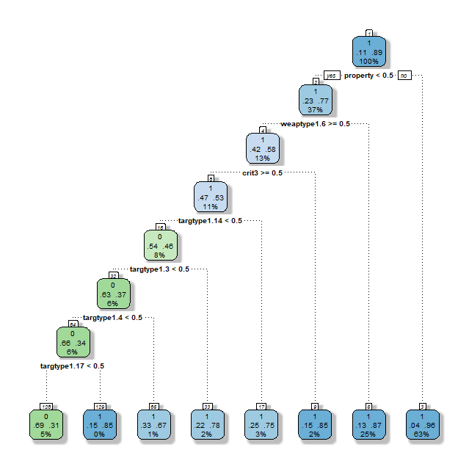
The First Attempt (Trees)
Recall: 0.3369
Precision: 0.6855
Problem! Almost everything is predicted “success”

Slide 13
Highly Unbalanced Data
20059 / 181691 = 11% of data is not a success
Solution: Oversampling
“Perfectly balanced as all things should be”

Slide 14
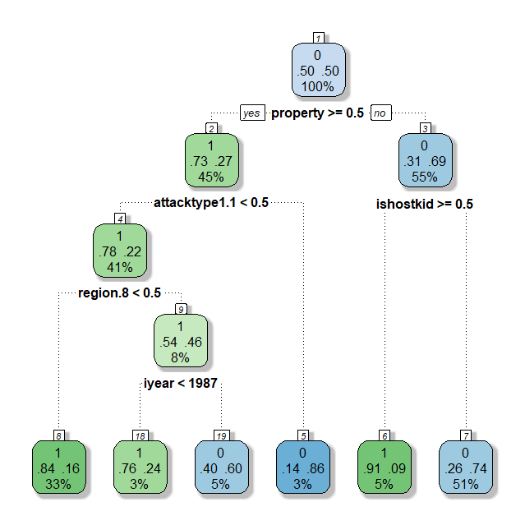
Oversampled Tree
Recall: 0.8641
Precision: 0.2130
The problem persists!

Slide 15
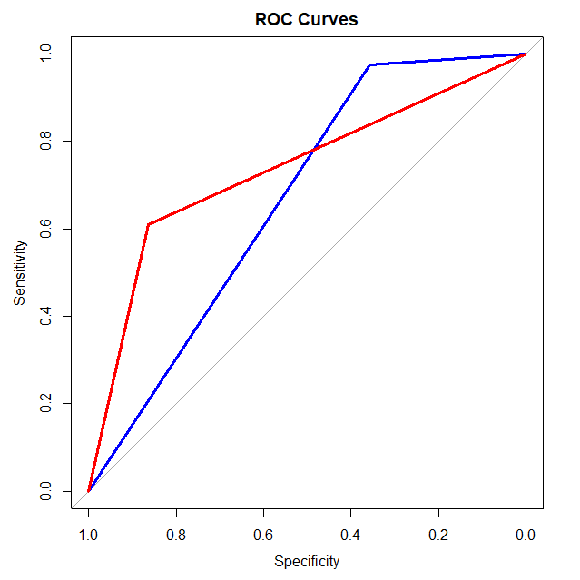
Model Comparison
AUC
First: 0.667
Second: 0.7367
The second model seems a bit better.

Slide 16
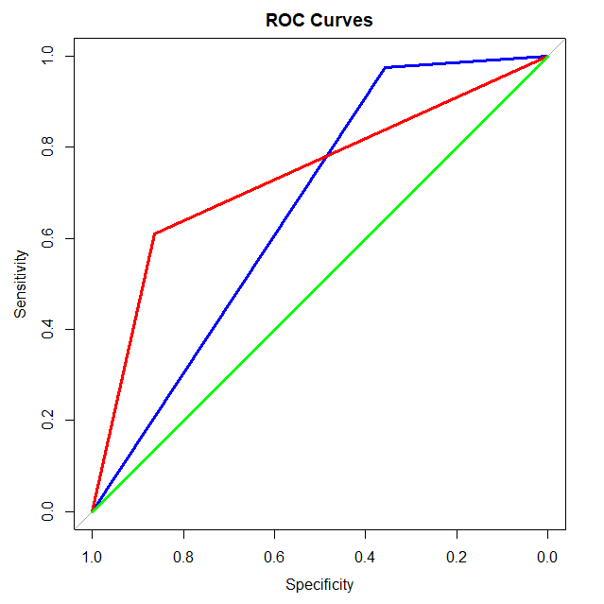
The Failed Experiment

Slide 17
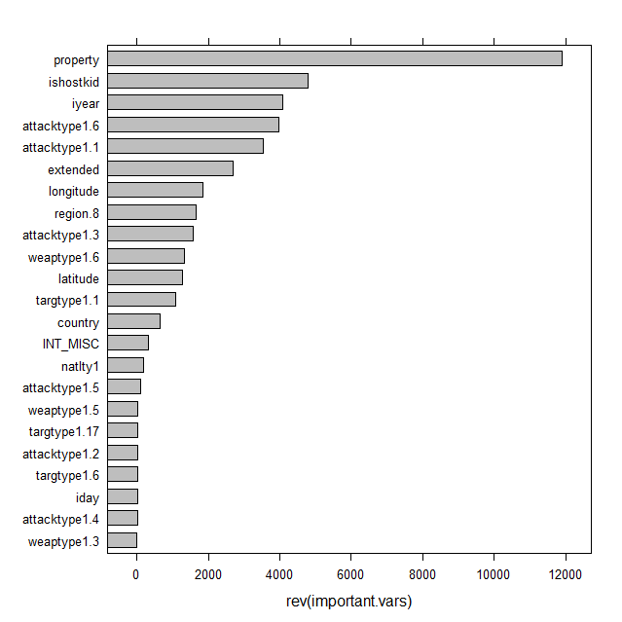
Back to Trees
“property” is the most important, but how helpful is it actually?
Similar problem for “ishostkid”
Feature importance

Slide 18
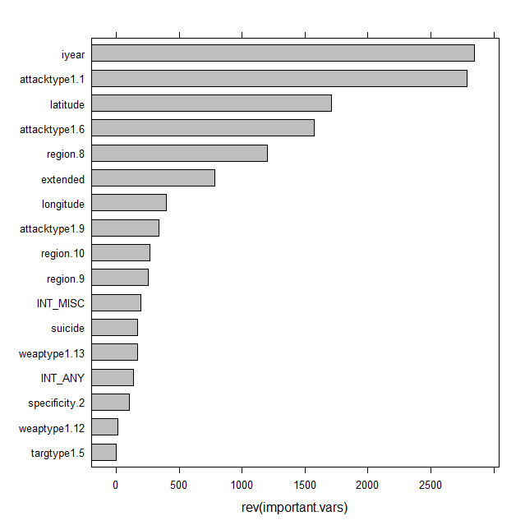
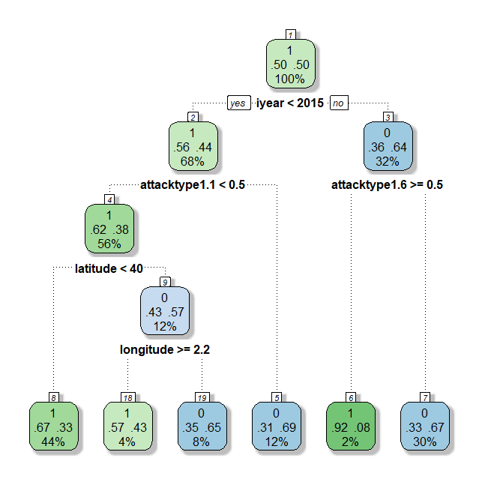
Back to Trees
Is using “iyear” valid?
How helpful is the longitude and latitude?

Slide 19
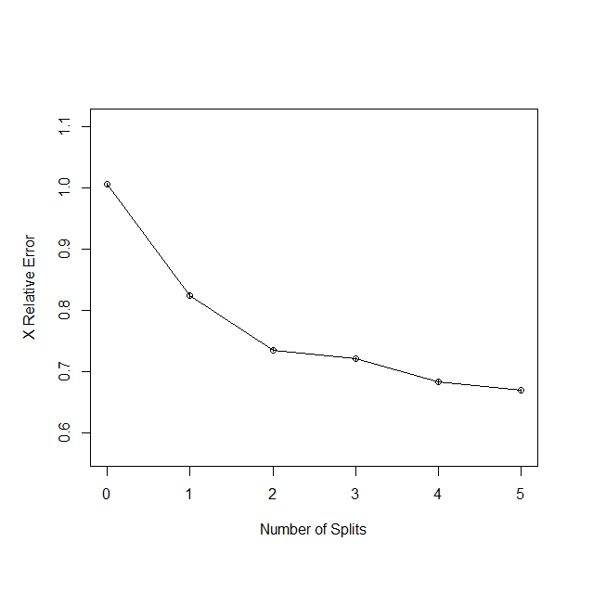
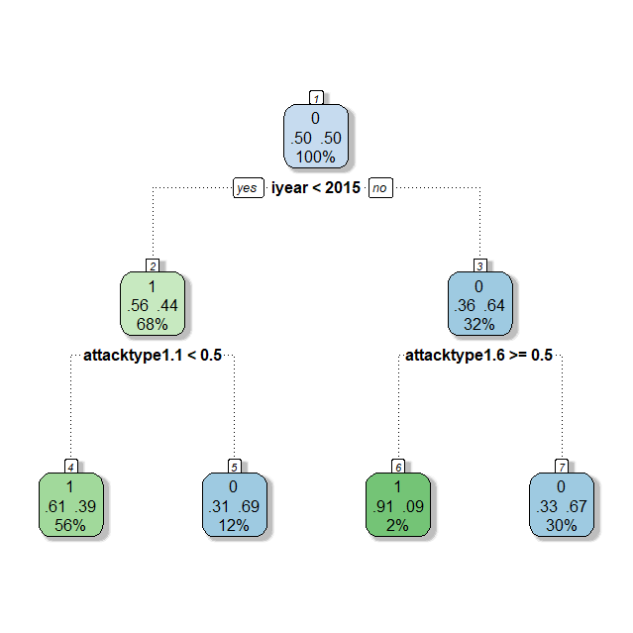
Pruning
2 – 3 splits seems best
Similar results to unpruned model.

Slide 20
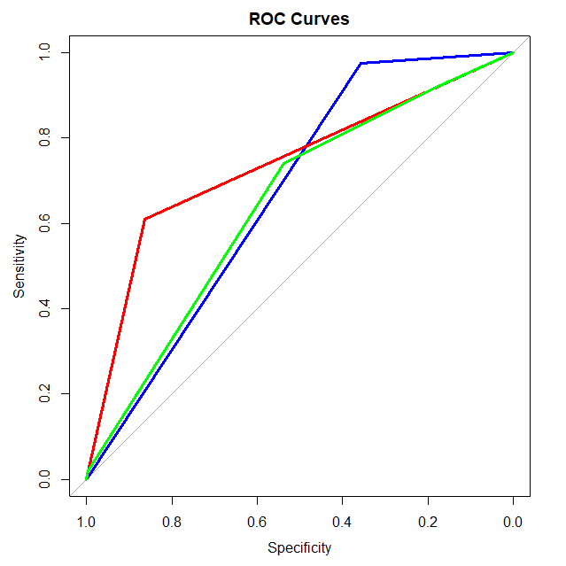
The Final Comparison
AUC
First: 0.667
Second: 0.7367
Third: 0.6443

Slide 21
So What Did We Learn?

Slide 22
Predicting Casualties from Terrorist attacks
Data Scientist: James Willson

Slide 23
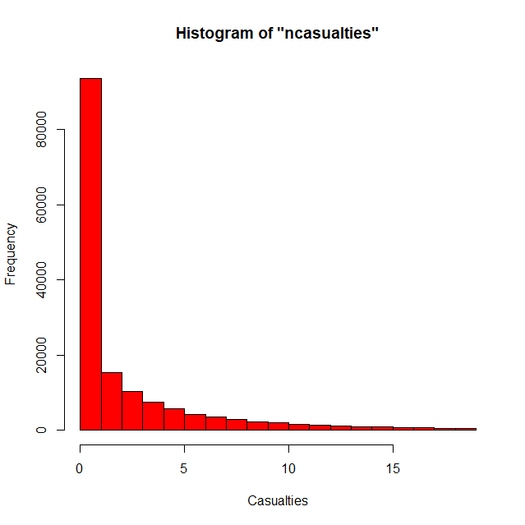
Goal
Build statistical models that predict the likely number of casualties based the variables available.
Casualties are defined as the sum of the fatalities and injuries (i.e. “nkill” + “nwound”)
All entries without casualty data were removed
Casualty data is heavily scewed

Slide 24
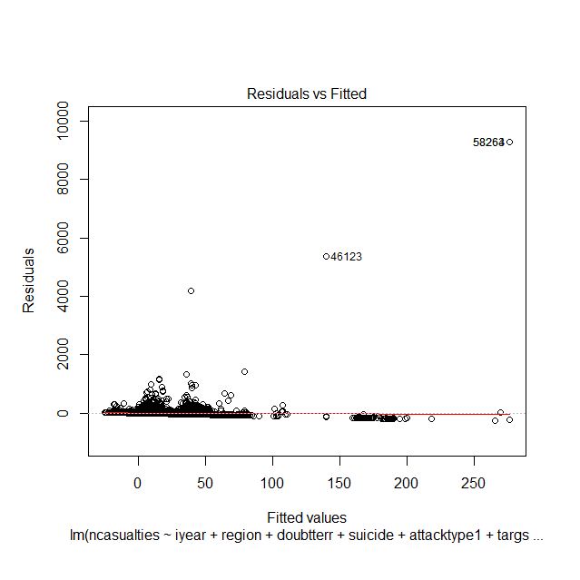
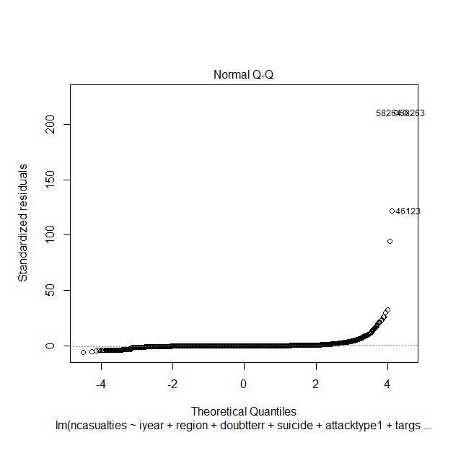
Linear Regression
R-squared = 0.04402
Some outliers seem a bit extreme
Only 12 out of >100,000 are greater than 1000
New R-squared = 0.0909

Slide 25
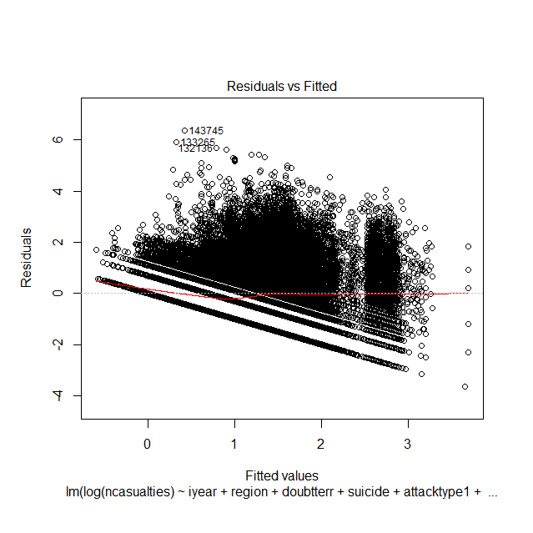
Linear Regression (Cont’d)
Log transformation used on y.
Clearly error isn’t random.
Perhaps a linear model isn’t the best

Slide 26
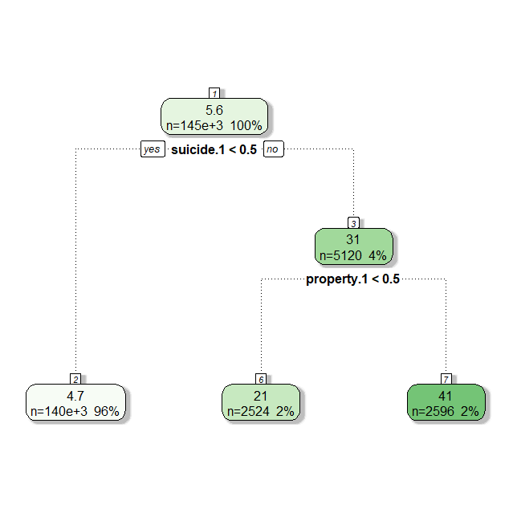
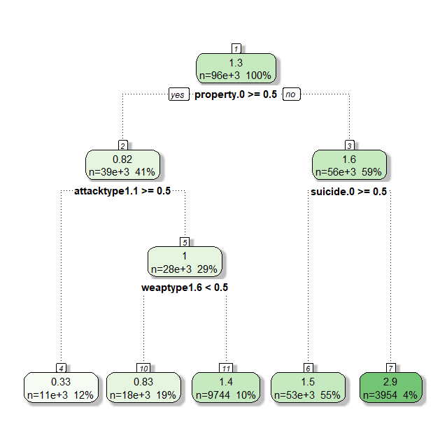
Trees
First Tree (untransformed y)
R-squared is very low: 0.08106
Unbalanced: 96% of data goes in one category.
Second Tree (log(y))
R-squared is better (but we can’t compare)
Takes more variables into account

Slide 27
SVMs
Took 5+ hours to converge!
C = 100 seems to be the best model. C = 1000 overfits the data.
None of them perform very well.
Still the best we’ve found so far...

Slide 28
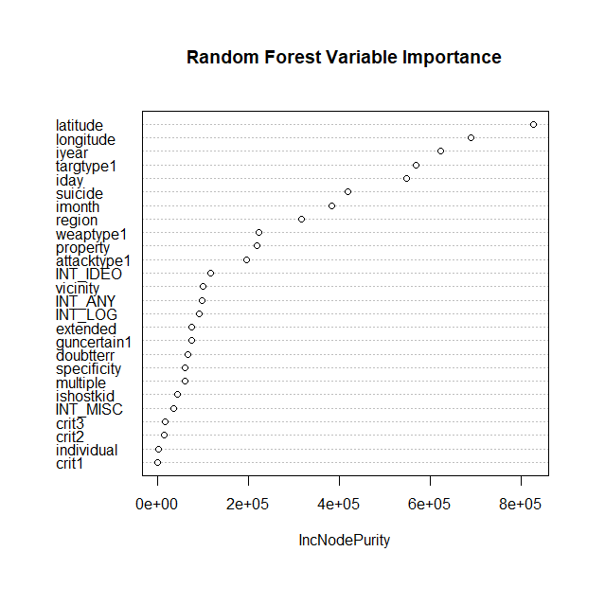
Random Forest
Highest R-squared
0.23279 on testing data
Finds very different variables important

Slide 29
Predicting Responsible Terrorist Groups
Data Scientist: Sean Kugele

Slide 30
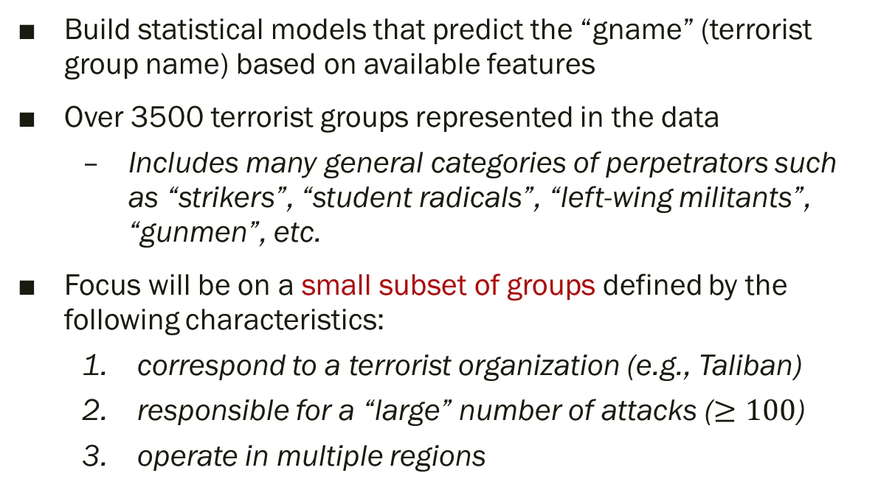
Goal
Build statistical models that predict the “gname” (terrorist group name) based on available features
Over 3500 terrorist groups represented in the data
Includes many general categories of perpetrators such as “strikers”, “student radicals”, “left-wing militants”, “gunmen”, etc.
Focus will be on a small subset of groups defined by the following characteristics:
correspond to a terrorist organization (e.g., Taliban)
responsible for a “large” number of attacks ($≥100$)
operate in multiple regions

Slide 31
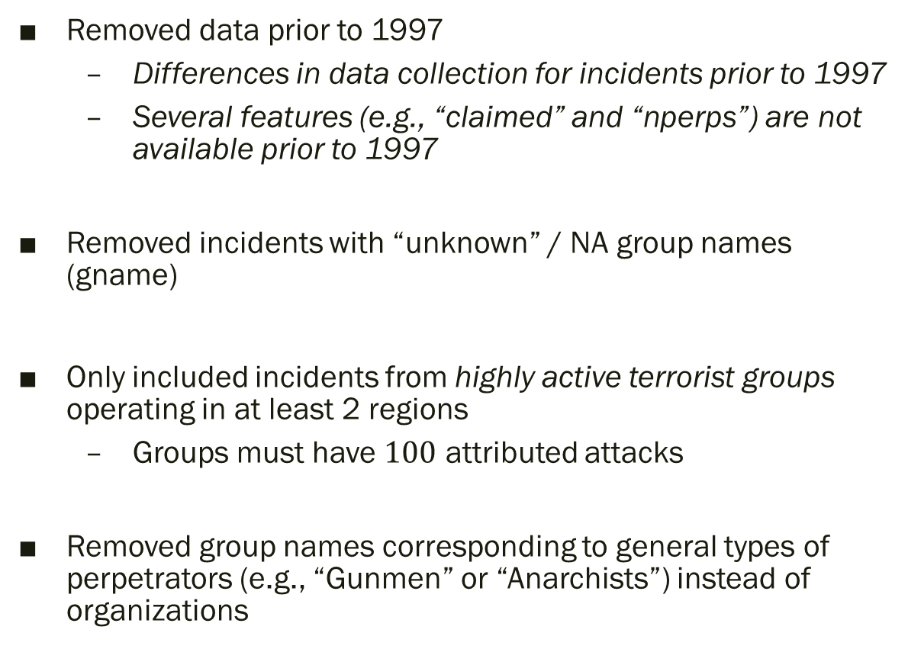
Data Cleansing (Observations)
Removed data prior to 1997
Differences in data collection for incidents prior to 1997
Several features (e.g., “claimed” and “nperps”) are not available prior to 1997
Removed incidents with “unknown” / NA group names (gname)
Only included incidents from highly active terrorist groups operating in at least 2 regions
Groups must have $100$ attributed attacks
Removed group names corresponding to general types of perpetrators (e.g., “Gunmen” or “Anarchists”) instead of organizations

Slide 32
Terrorist Groups
Terrorist Group | # of Attacks
Al-Qaida in Iraq | 606 | 3.35%
Al-Qaida in the Arabian Peninsula (AQAP) | 877 | 4.84%
Al-Qaida in the Islamic Maghreb (AQIM) | 225 | 1.24%
Hamas (Islamic Resistance Movement) | 297 | 1.64%
Hezbollah | 107 | 0.59%
Islamic State of Iraq and the Levant (ISIL) | 4,274 | 23.61%
Kurdistan Workers' Party (PKK) | 1,074 | 5.93%
Liberation Tigers of Tamil Eelam (LTTE) | 614 | 3.39%
New People's Army (NPA) | 1,573 | 8.69%
Revolutionary Armed Forces of Colombia (FARC) | 1,121 | 6.19%
Salafist Group for Preaching and Fighting (GSPC) | 182 | 1.01%
Taliban | 5,912 | 32.66%
Tehrik-i-Taliban Pakistan (TTP) | 1,240 | 6.85%
Highly Unbalanced Data!

Slide 33
Terrorist Groups (after oversampling)
Terrorist Group | # of Attacks
Al-Qaida in Iraq | 4,770 | 7.69%
Al-Qaida in the Arabian Peninsula (AQAP) | 4,770 | 7.69%
Al-Qaida in the Islamic Maghreb (AQIM) | 4,770 | 7.69%
Hamas (Islamic Resistance Movement) | 4,770 | 7.69%
Hezbollah | 4,770 | 7.69%
Islamic State of Iraq and the Levant (ISIL) | 4,770 | 7.69%
Kurdistan Workers' Party (PKK) | 4,770 | 7.69%
Liberation Tigers of Tamil Eelam (LTTE) | 4,770 | 7.69%
New People's Army (NPA) | 4,770 | 7.69%
Revolutionary Armed Forces of Colombia (FARC) | 4,770 | 7.69%
Salafist Group for Preaching and Fighting (GSPC) | 4,770 | 7.69%
Taliban | 4,770 | 7.69%
Tehrik-i-Taliban Pakistan (TTP) | 4,770 | 7.69%

Slide 34

Training / Testing Data Set
Training Set $→$ 62,010 observations
Testing Set $→$ 3,621 observations

Slide 35
Feature Selection (Model Set 1)
Feature Name | Data Type | Feature Name | Data Type
latitude | numerical | nwounded | numerical
longitude | numerical | nkill | numerical
region | categorical (12) | property | categorical (2*)
iyear | numerical
iday | numerical | success | categorical (2)
imonth | numerical | nkillter | numerical
 |  | claimed | categorical (2*)
nperps | numerical
attacktype1 | categorical (9)
targtype1 | categorical (22)
weaptype1 | categorical (12)
suicide | categorical (2)
multiple | categorical (2*)
extended | categorical (2)
Notes:
19 Variables

Slide 36
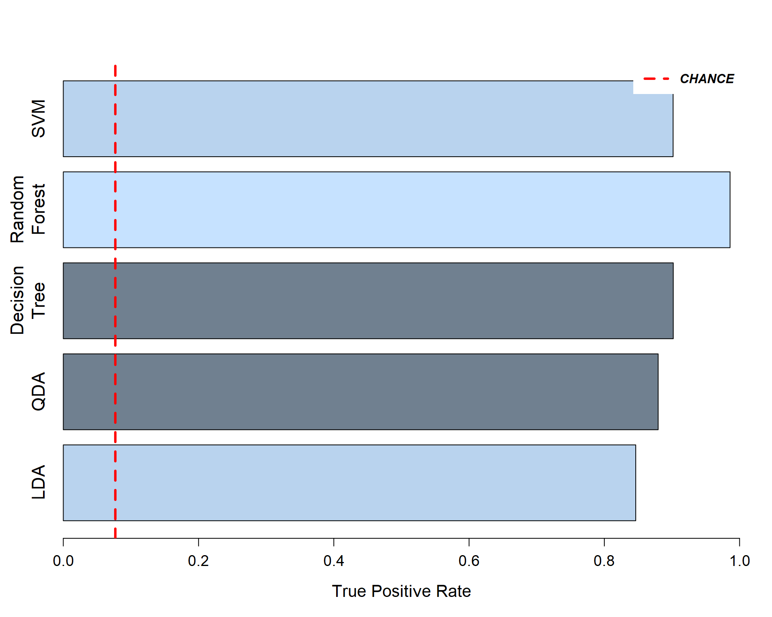
Model Set 1 Results (on test data)

Slide 37
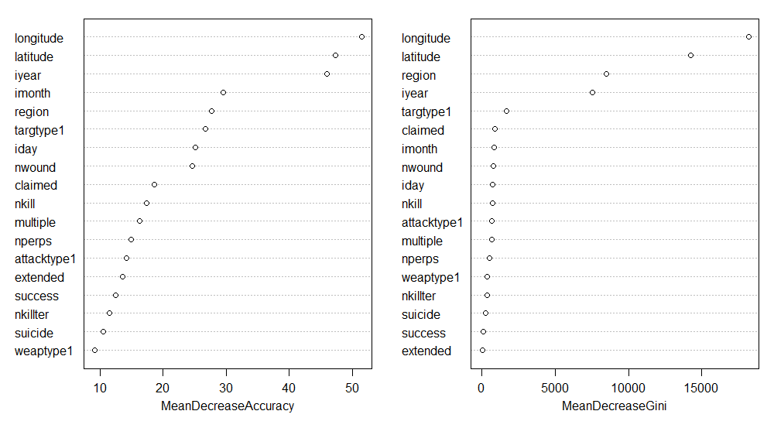
Importance Plot (Random Forest) - Model Set 1

Slide 38
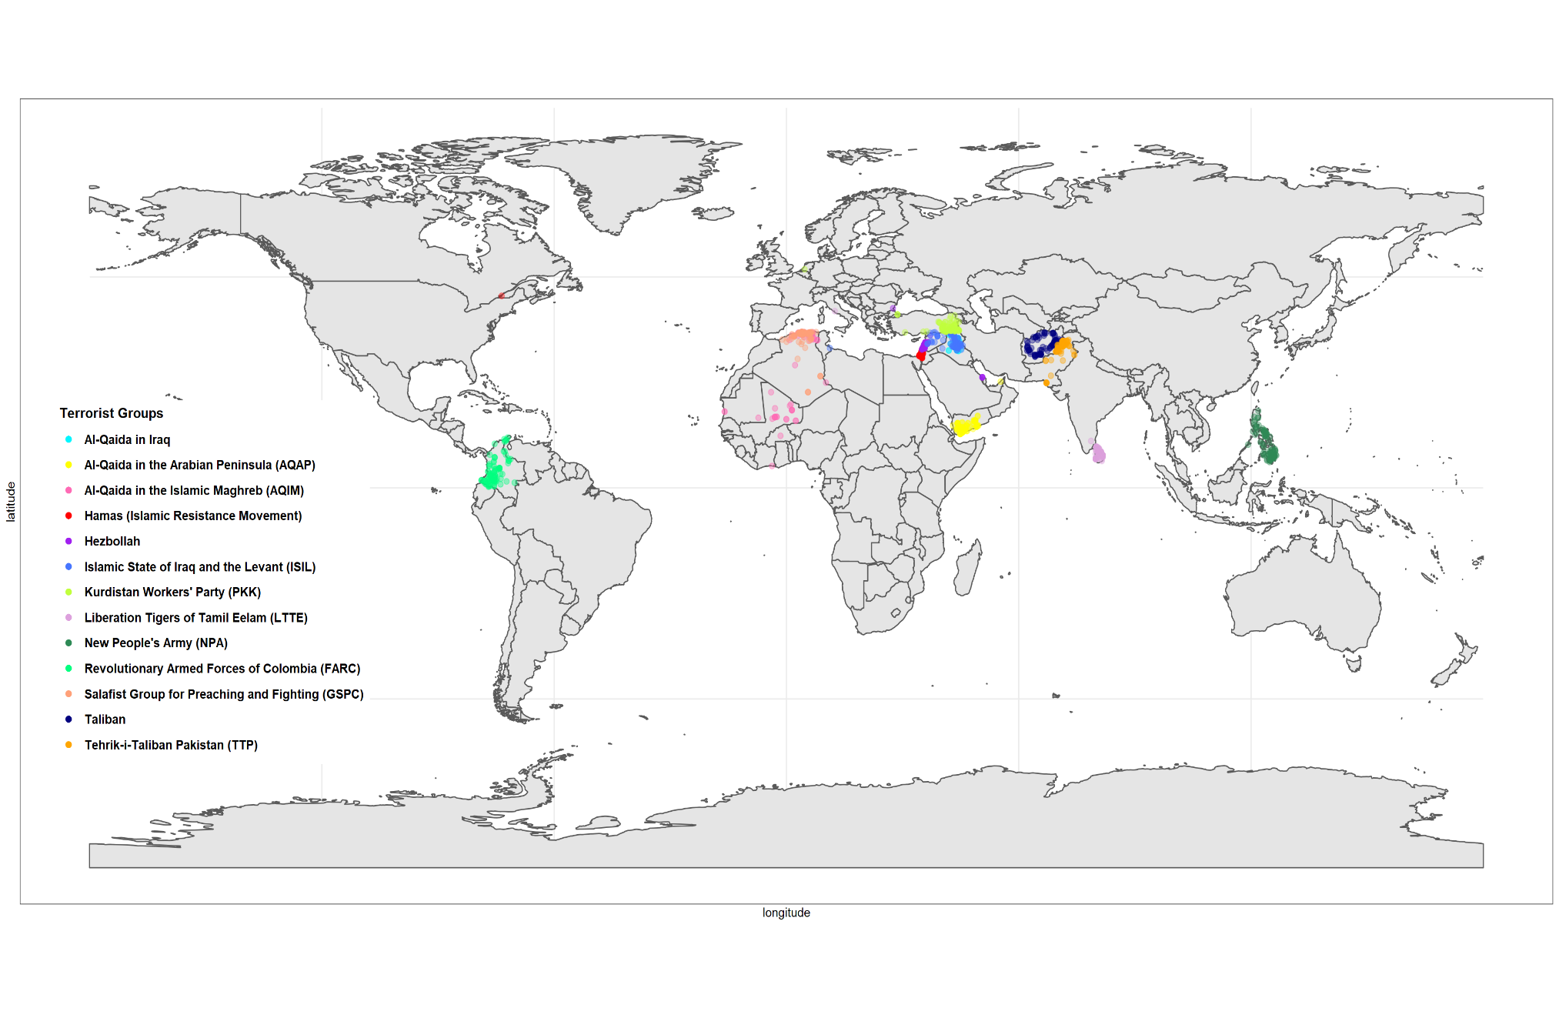
Terrorist Attacks by Group

Slide 39
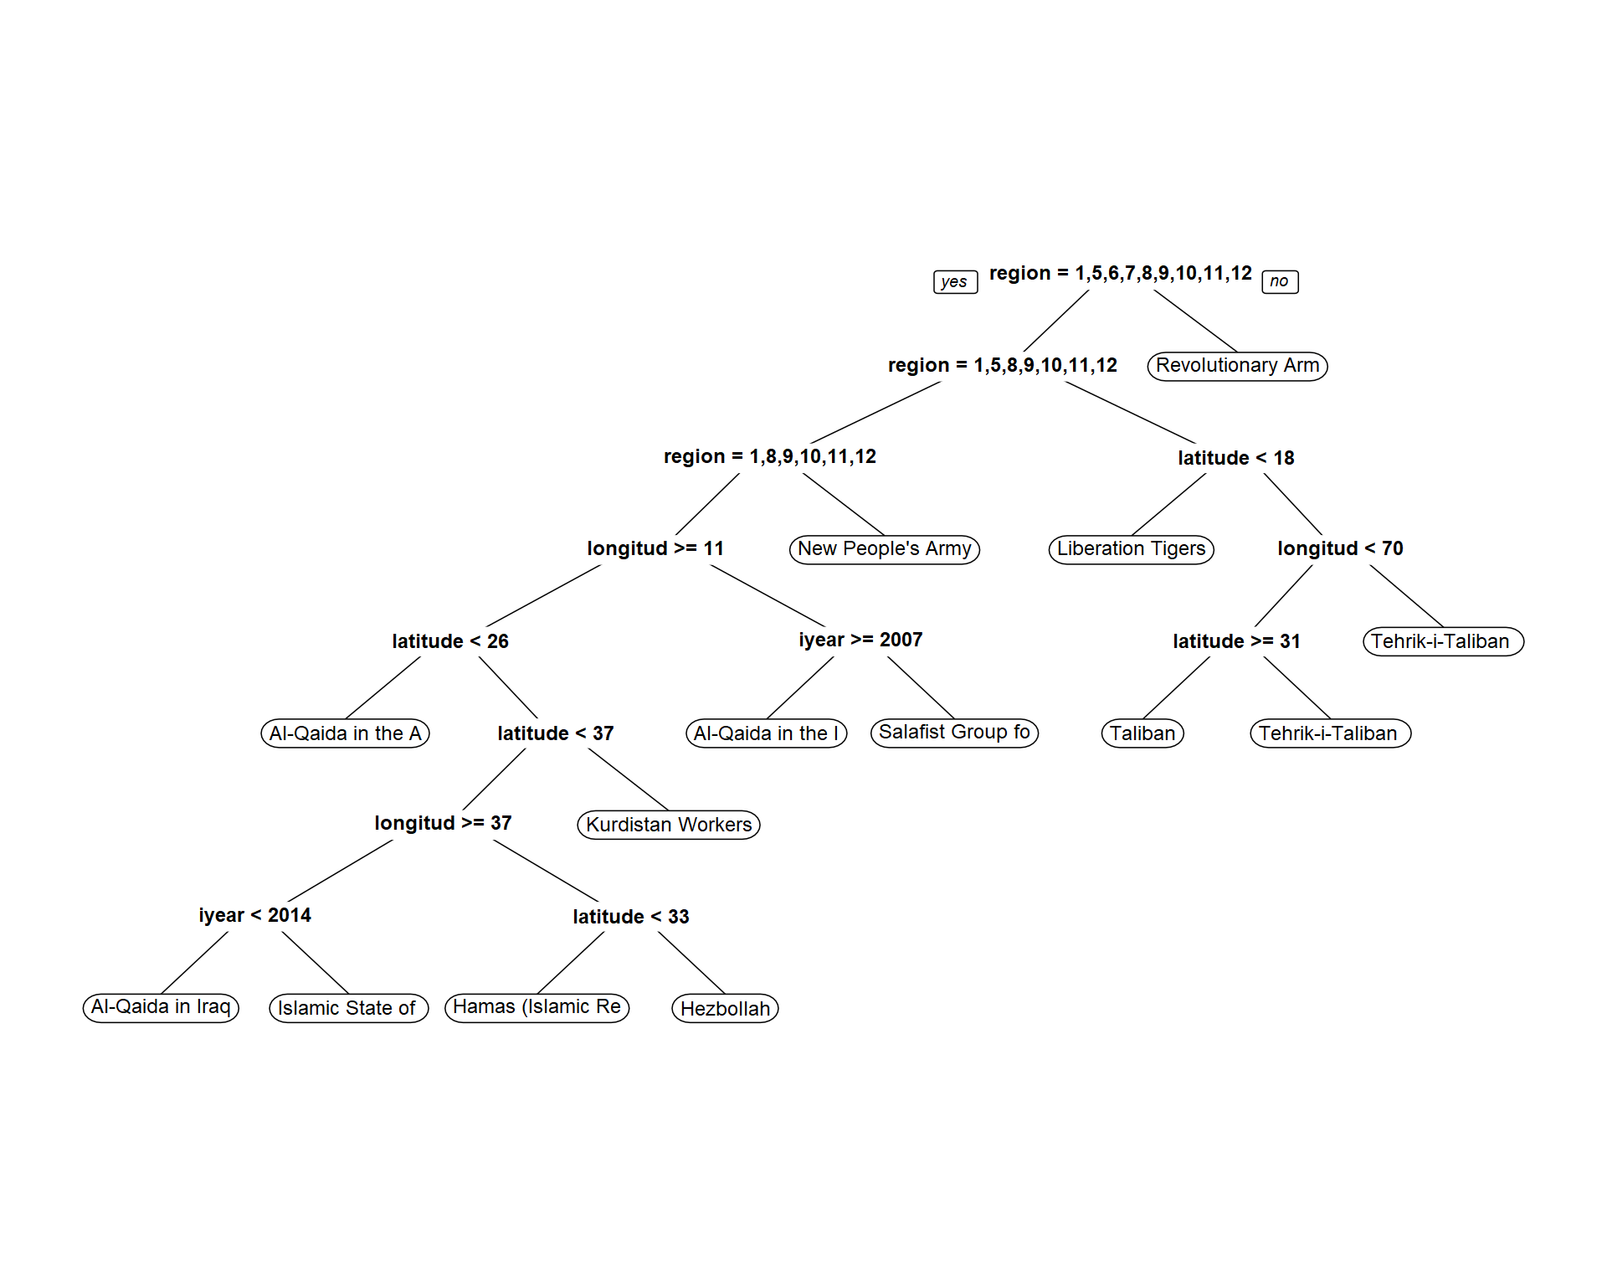
Visualization (Decision Tree) - Model Set 1

Slide 40
Feature Selection (Model Set 2)
Feature Name | Data Type | Feature Name | Data Type
latitude | numerical | nwounded | numerical
longitude | numerical | nkill | numerical
region | categorical | property | categorical
iyear | numerical
iday | numerical | success | categorical
imonth | numerical | nkillter | numerical
 |  | claimed | categorical
nperps | numerical
attacktype1 | categorical
targtype1 | categorical
weaptype1 | categorical
suicide | categorical
multiple | categorical
extended | categorical
Notes:
19 Variables

Slide 41
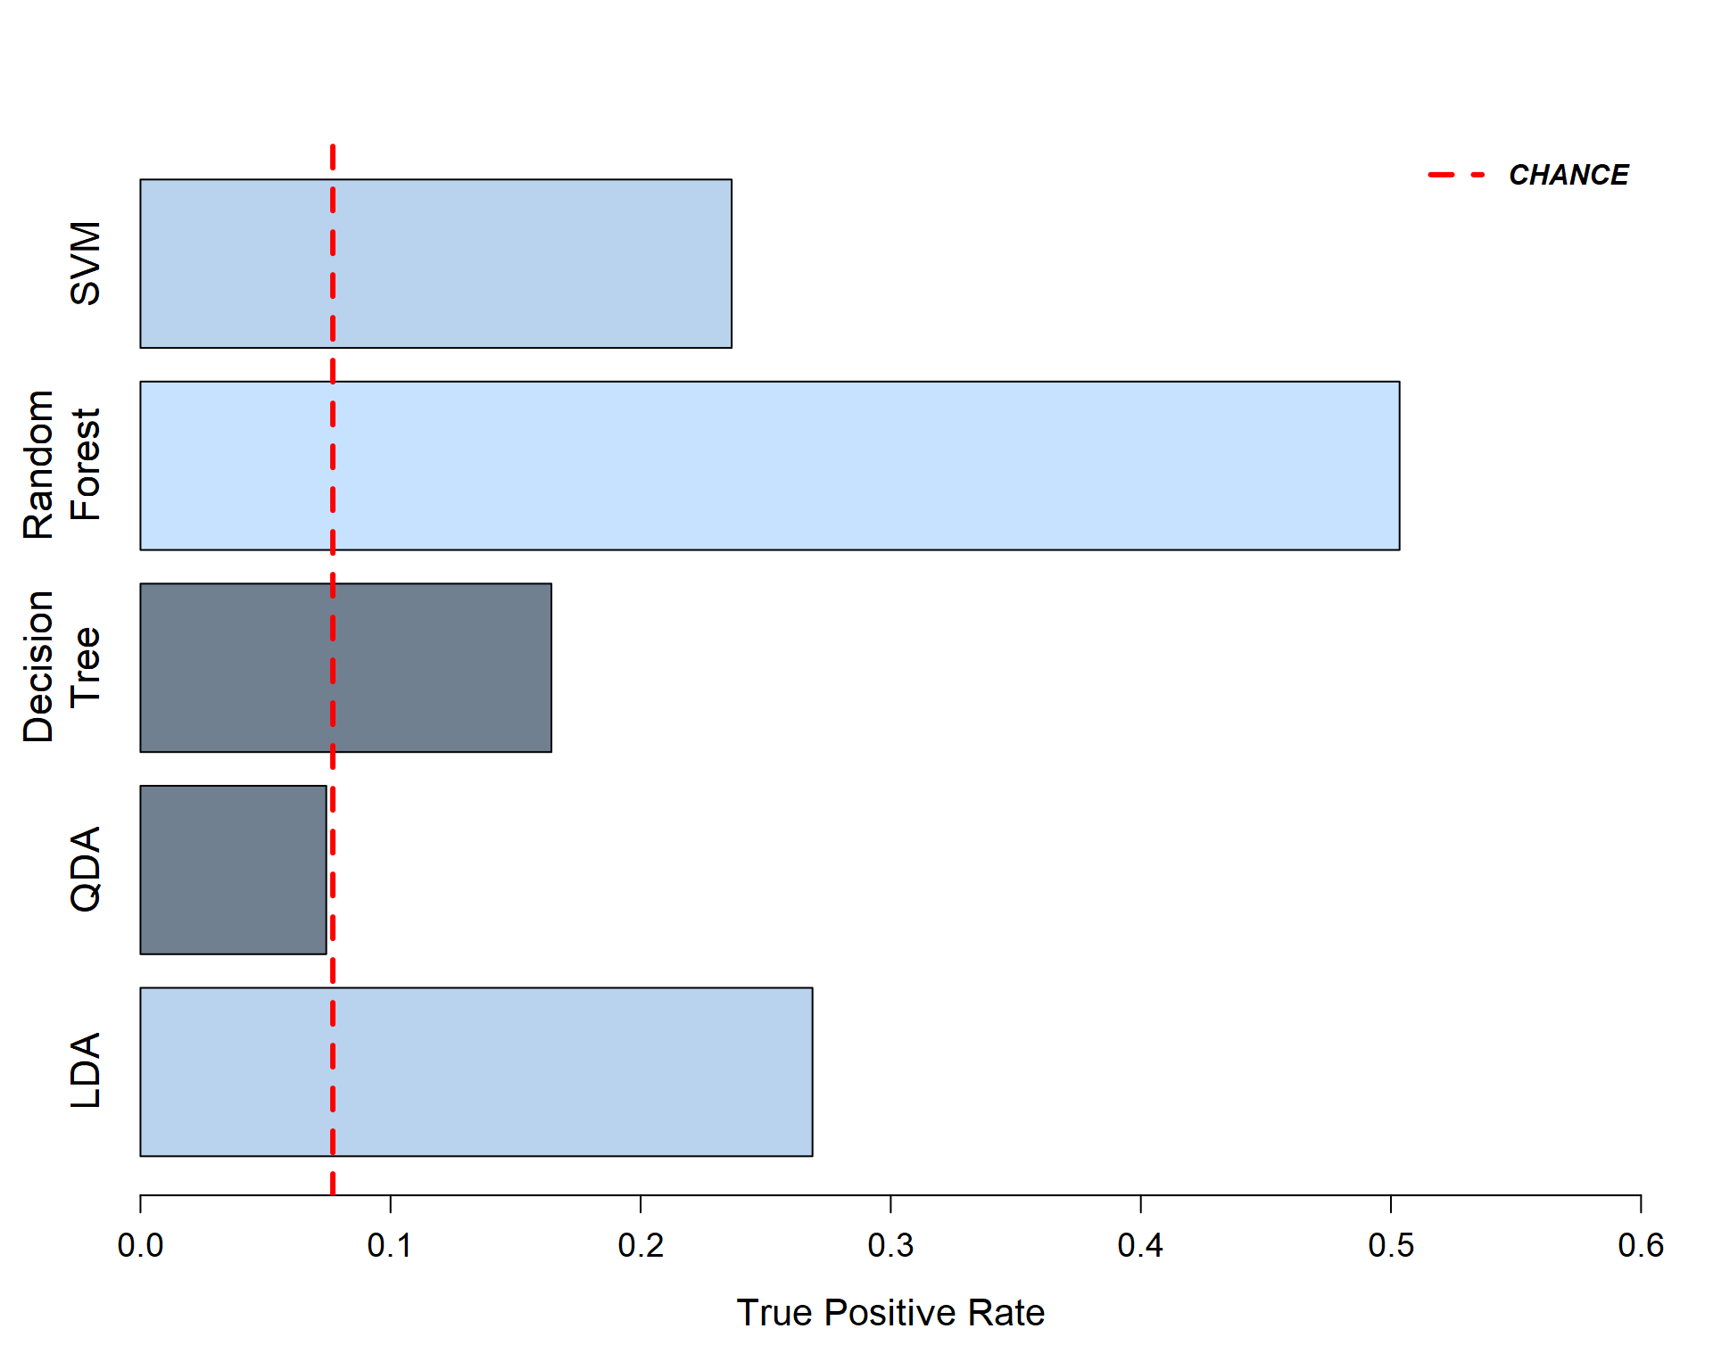
Model Set 2 Results (on test data)
Notes:
TPRs: 0.27 (LDA) 0.12 0.37 0.28

Slide 42
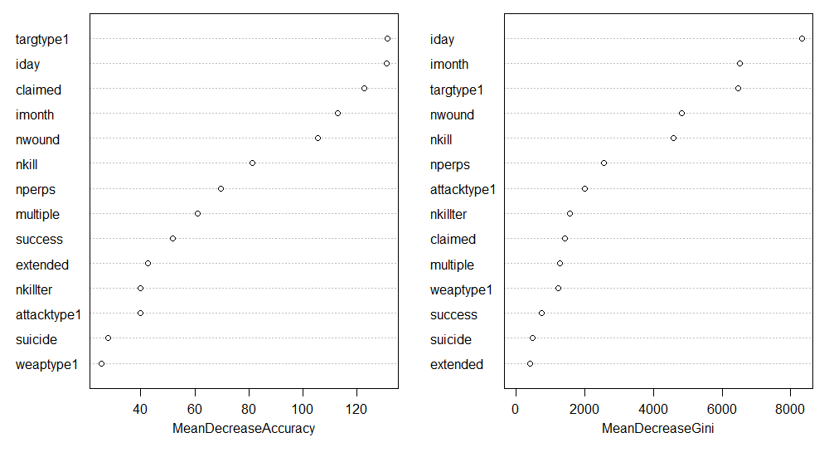
Importance Plot (Random Forest) - Model Set 2

Slide 43
Confusion Matrix (Random Forest) - Model Set 2
 |  | Predicted Terrorist Group
 |  | A | B | C | D | E | F | G | H | I | J | K | L | M
Actual Terrorist Group | A | 77 | 5 | 1 | 2 | 0 | 7 | 3 | 6 | 1 | 2 | 1 | 12 | 6
 | B | 3 | 58 | 3 | 2 | 5 | 20 | 14 | 16 | 14 | 14 | 6 | 23 | 9
 | C | 2 | 3 | 4 | 1 | 1 | 0 | 3 | 2 | 4 | 3 | 0 | 8 | 5
 | D | 0 | 3 | 1 | 26 | 3 | 9 | 1 | 1 | 1 | 1 | 1 | 9 | 3
 | E | 1 | 2 | 0 | 1 | 9 | 2 | 2 | 1 | 0 | 1 | 0 | 2 | 2
 | F | 34 | 31 | 8 | 27 | 12 | 513 | 16 | 21 | 16 | 25 | 8 | 115 | 37
 | G | 2 | 9 | 1 | 0 | 6 | 2 | 85 | 14 | 20 | 27 | 12 | 16 | 8
 | H | 2 | 8 | 4 | 1 | 2 | 9 | 21 | 36 | 9 | 19 | 8 | 21 | 1
 | I | 6 | 19 | 5 | 2 | 9 | 3 | 30 | 10 | 195 | 18 | 8 | 28 | 5
 | J | 1 | 12 | 1 | 1 | 2 | 7 | 28 | 15 | 22 | 100 | 11 | 20 | 5
 | K | 1 | 2 | 0 | 0 | 0 | 1 | 5 | 4 | 8 | 4 | 7 | 9 | 2
 | L | 17 | 27 | 13 | 29 | 24 | 105 | 71 | 63 | 41 | 36 | 15 | 632 | 69
 | M | 8 | 13 | 2 | 6 | 3 | 17 | 3 | 13 | 19 | 11 | 2 | 61 | 81
# FP |  | 77 | 134 | 39 | 72 | 67 | 182 | 197 | 166 | 155 | 161 | 72 | 324 | 152
FPR |  | 50.0% | 69.8% | 90.7% | 73.5% | 88.2% | 26.2% | 69.9% | 82.2% | 44.3% | 61.7% | 91.1% | 33.9% | 65.2%
Notes:
A Al-Qaida in Iraq
B Al-Qaida in the Arabian Peninsula (AQAP)
C Al-Qaida in the Islamic Maghreb (AQIM)
D Hamas (Islamic Resistance Movement)
E Hezbollah
F Islamic State of Iraq and the Levant (ISIL)
G Kurdistan Workers' Party (PKK)
H Liberation Tigers of Tamil Eelam (LTTE)
I New People's Army (NPA)
J Revolutionary Armed Forces of Colombia (FARC)
K Salafist Group for Preaching and Fighting (GSPC)
L Taliban M Tehrik-i-Taliban Pakistan (TTP)

Slide 44
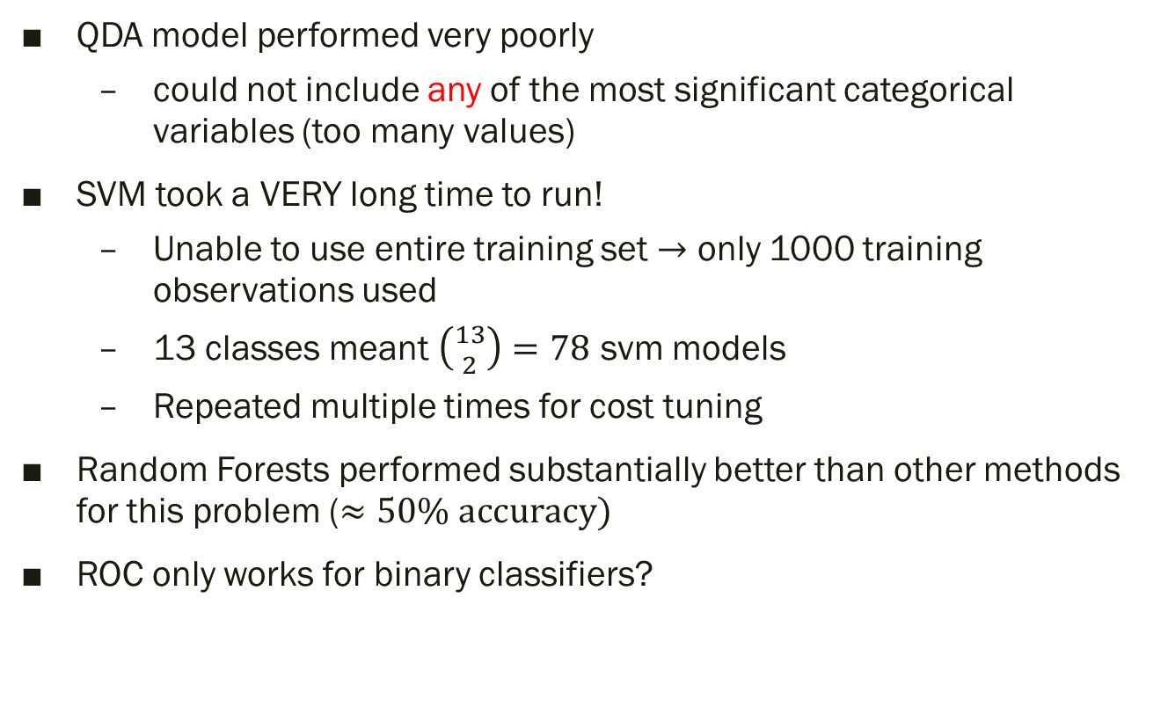
Discussion / Summary
QDA model performed very poorly
could not include any of the most significant categorical variables (too many values)
SVM took a VERY long time to run!
Unable to use entire training set $→$ only 1000 training observations used
13 classes meant $\left({13 \atop 2}\right)=78$ svm models
Repeated multiple times for cost tuning
Random Forests performed substantially better than other methods for this problem ($≈50\% \text{accuracy})$
ROC only works for binary classifiers?

Slide 45
Predicting risk of attack from GEOPolitical and TEMPORAL Variables
Data Scientist: Sean Kugele

Slide 46
Goal
Build statistical models that predict whether the risk of attack is “low” or “high” based on geospatial and temporal variables

Slide 47
Variables
Variable Name | Role | Data Type | Comments
iday | feature | numerical | day of month (1-31)
imonth | feature | numerical | month of year (1-12)
latitude* | support | numerical
longitude* | support | numerical
cluster_id | feature | categorical (32) | derived from latitude and longitude
n_attacks* | support | numerical
risk_level | response | categorical(2) | derived from n_attacks -- grouping by iday, imonth, cluster_id
event_group_id | support | numerical | unique identifier
Not Used
region | N/A | categorical (12) | too coarse grained
country | N/A | categorical | over 200 values (too many) geopolitical boundaries change over time (e.g., Soviet Union)
city | N/A | categorical | too many values
iyear | N/A | numerical
Notes:
19 Variables

Slide 48
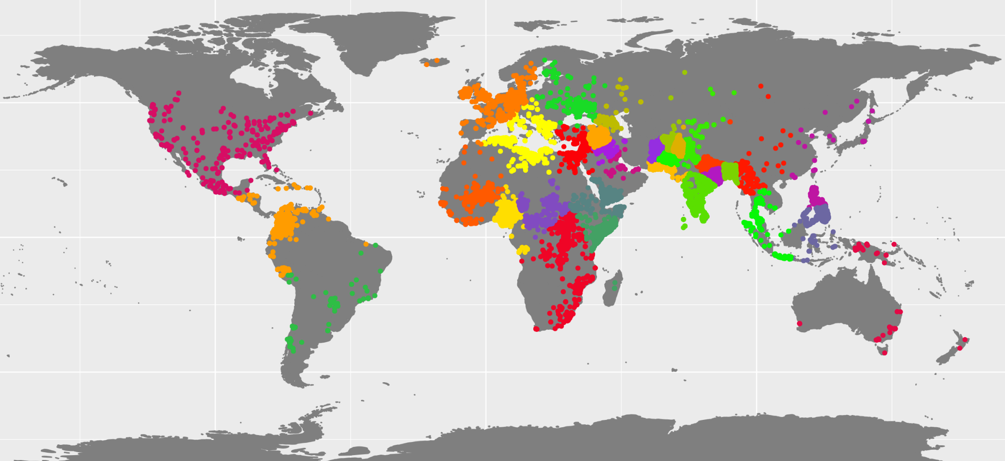
Clustering Geocoordinates via kmeans (cluster_id)

Slide 49
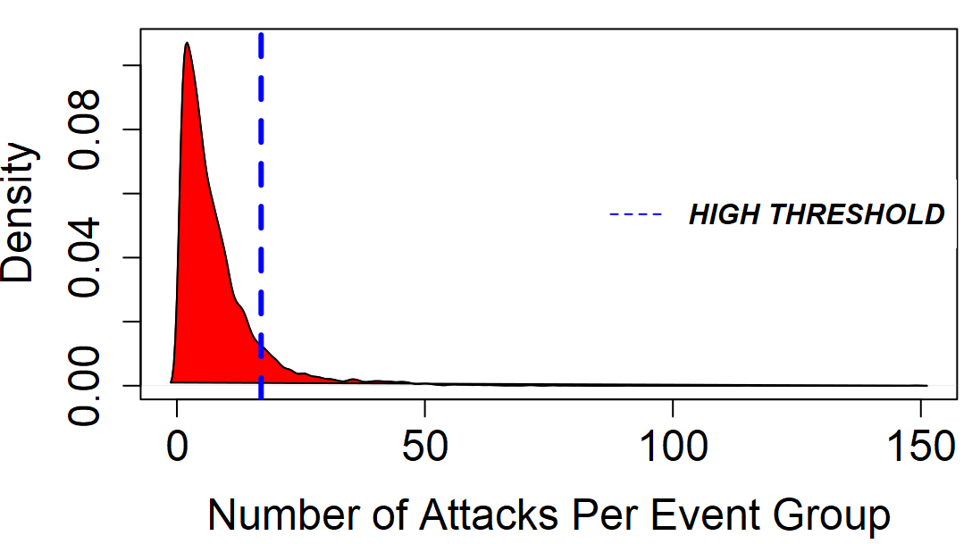
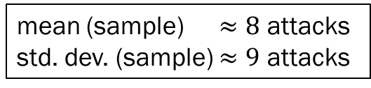
Response Variable (risk_level)
Risk Level (risk_level) | # Event Groups
low | 9,385 (89%)
high | 1,166 (11%)
10,551
event groups
$$≈89\% \text{(10,551 / 11,904) }\text{of} \text{possible} \text{event} \text{groups} \text{represented} \text{in} \text{data}$$
mean (sample) $≈8$ attacks
std. dev. (sample) $≈9$ attacks

Slide 50

Training / Testing Data Set
after balancing
Training Set $→$ 14,999 observations
Testing Set $→$ 2,111 observations
low: | 7,522
high: | 7,477

Slide 51
Methods Attempted:
LDA
QDA
Decision Tree
Random Forest
SVM (Linear, Radial, Sigmoid)

Slide 52
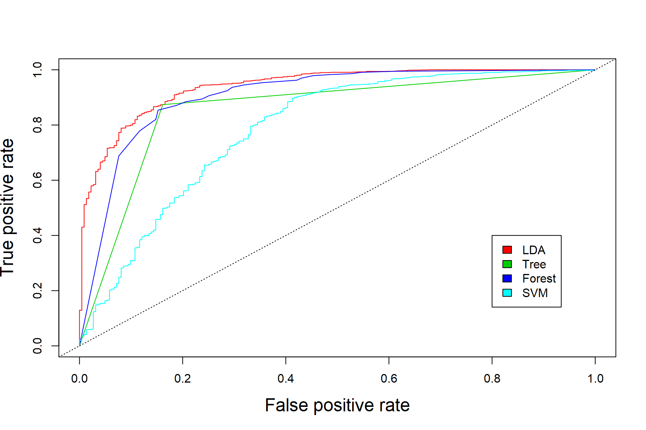
ROC Curves / AUC

Slide 53
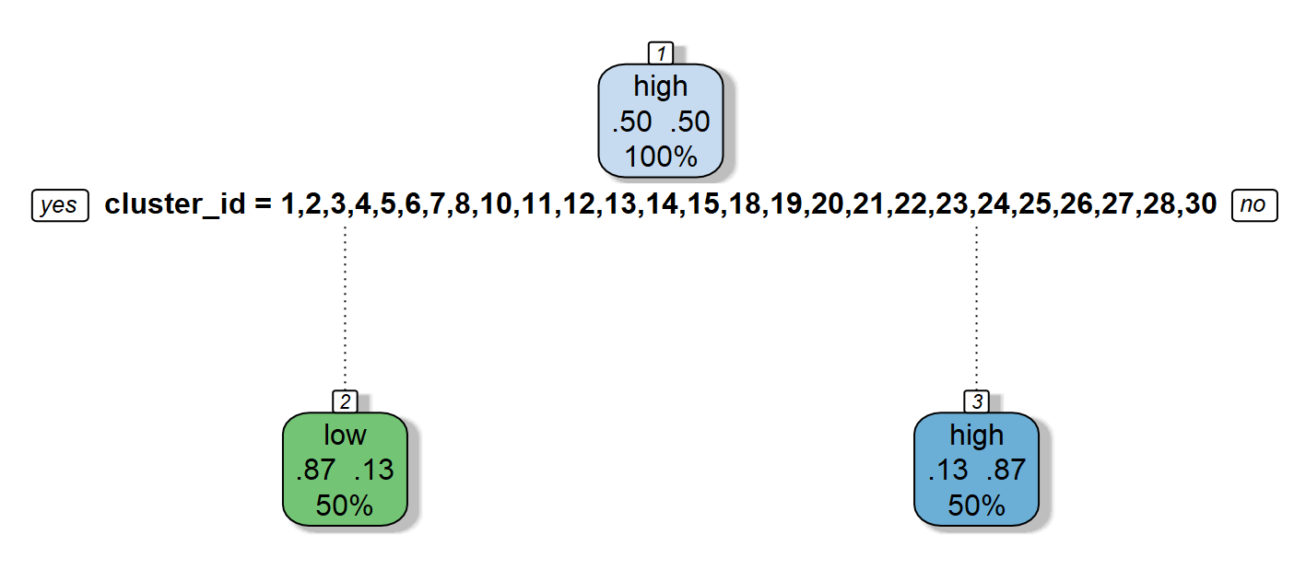
Decision Tree
Yuck!

Slide 54
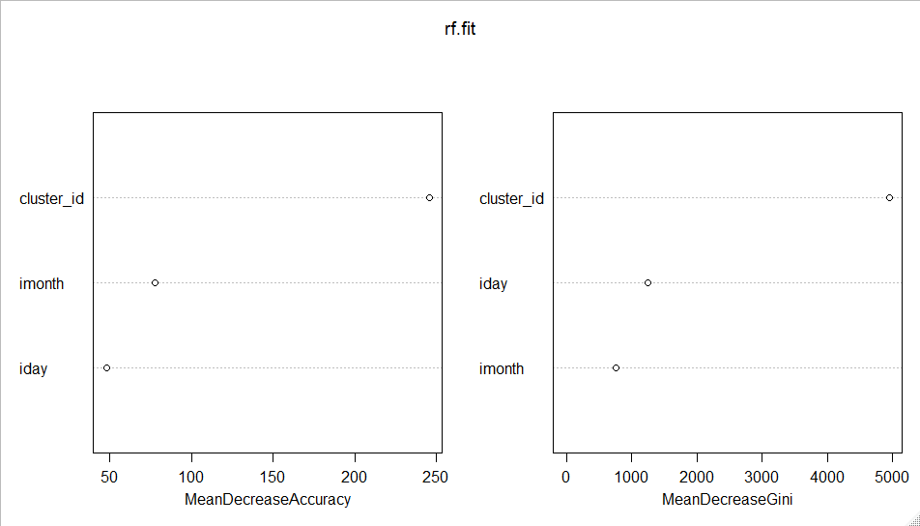
Random Forest (importance)

Slide 55
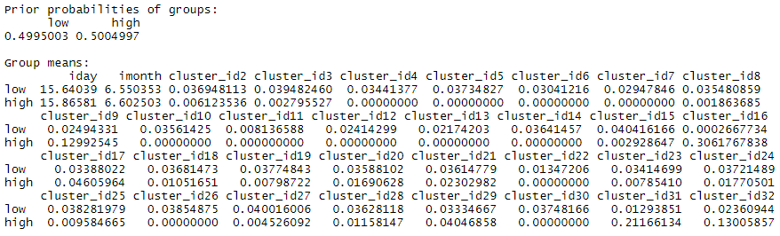
LDA Results

Slide 56

Discussion / Summary
QDA failed with “rank deficiency” error
SVM with radial basis kernel had very good performance
Unable to use entire training set $→$ only 1000 training observations used
SVM with linear/sigmoid kernels had very poor performance

Slide 58
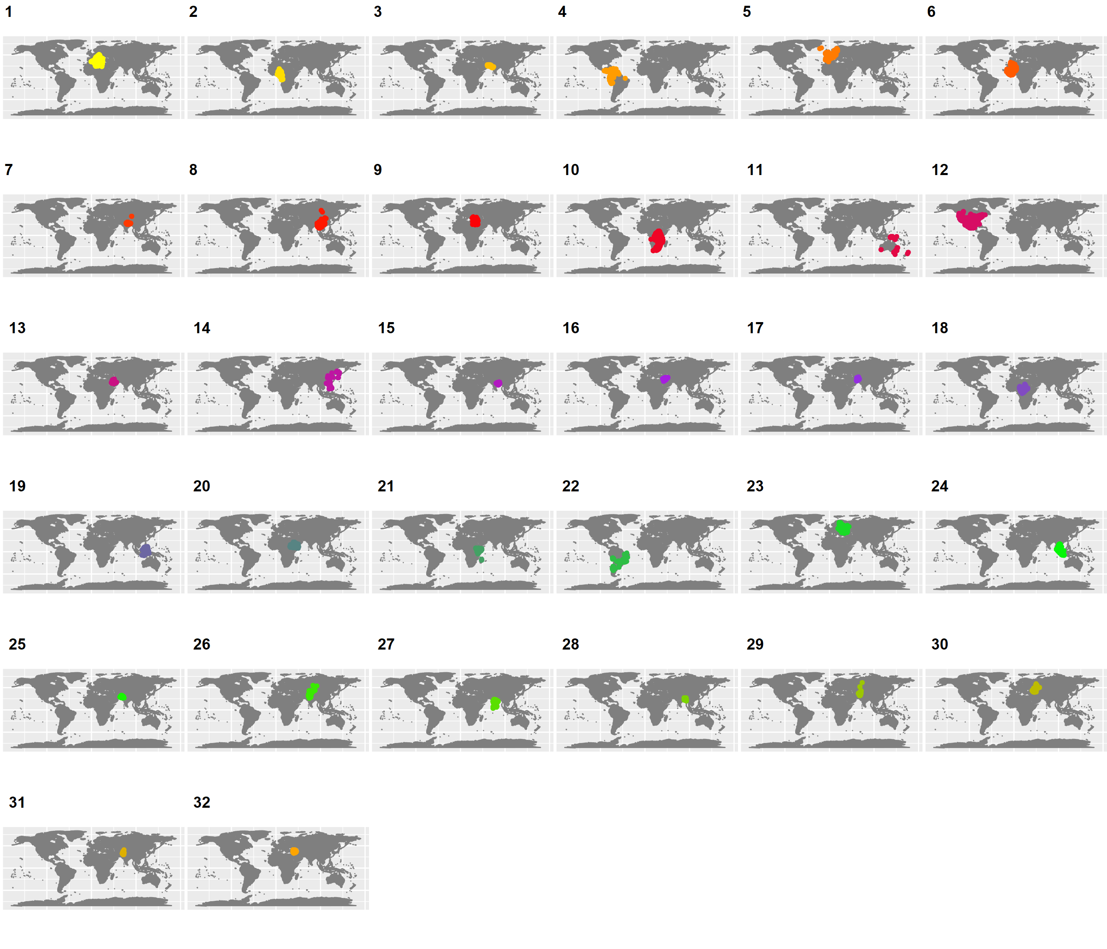
Clusters Used for Sean’s Q2

