Slide 1
Global Terrorism
Group Members
James Willson
Sean Kugele (Team Lead)

Slide 2
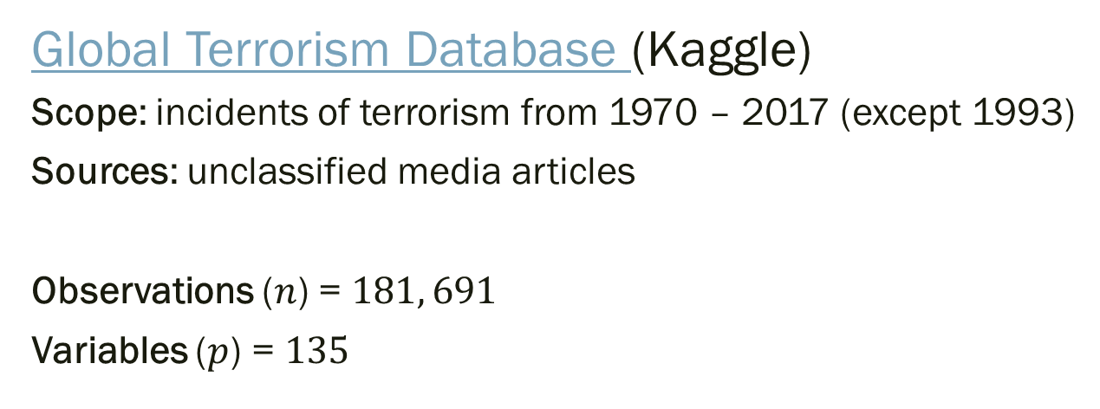
Data Set
Global Terrorism Database (Kaggle)
Scope: incidents of terrorism from 1970 – 2017 (except 1993)
Sources: unclassified media articles
Observations ($n$) = $181, 691$
Variables ($p$) = $135$
prior to data cleansing!
Terrorism (definition) "The threatened or actual use of illegal force and violence by a non-state actor to attain a political, economic, religious, or social goal through fear, coercion, or intimidation."

Slide 3
Variables (Summary)
Date Variables (Year, Month, Day, etc.)
Geospatial/Geopolitical Variables (Lat/Long, Region, Country, City, Province, etc.)
Incident Descriptive Variables (Attack Type, Duration of Incident, Success/Failure, Weapons Used, Targets, etc.)
Perpetrator Descriptive Variables (Terrorist group membership, # Perpetrators, etc.)
Casualty and Damage Variables (# Fatalities, # Injured, etc.)

Slide 4
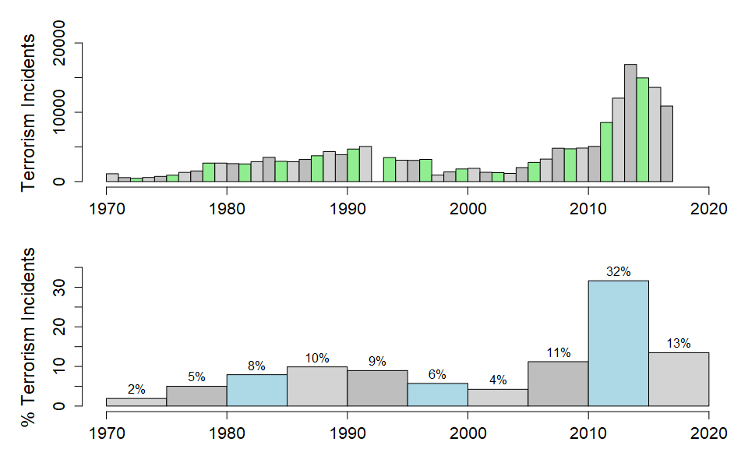
Observations (Summary)
Incidents by Time

Slide 5
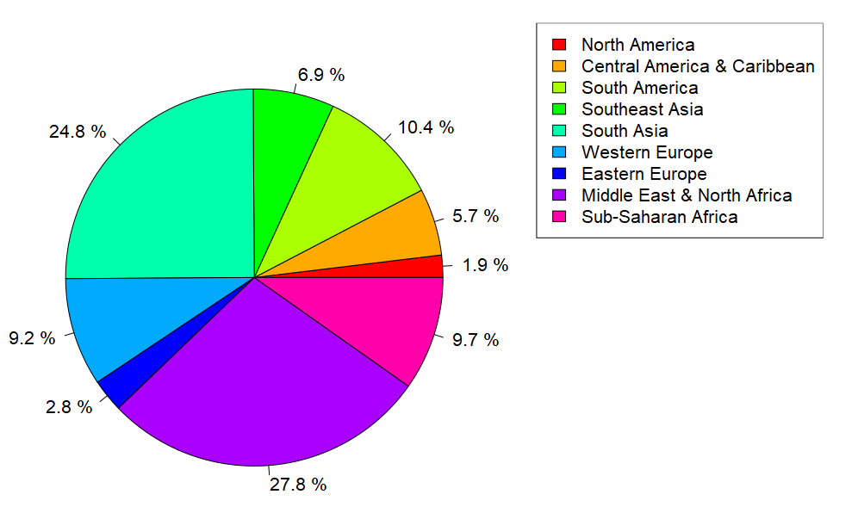
Observations (Summary)
Incidents by Region

Slide 6
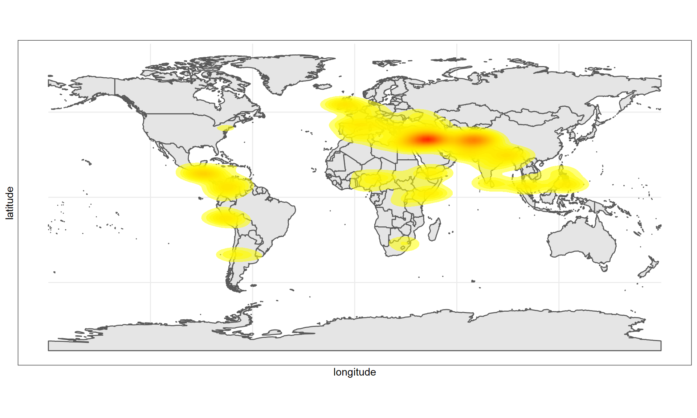
Observations (Summary)
Terrorism Incidents (Density Plot)
Notes:
Densities based on random plot of 20,000 incidents

Slide 7
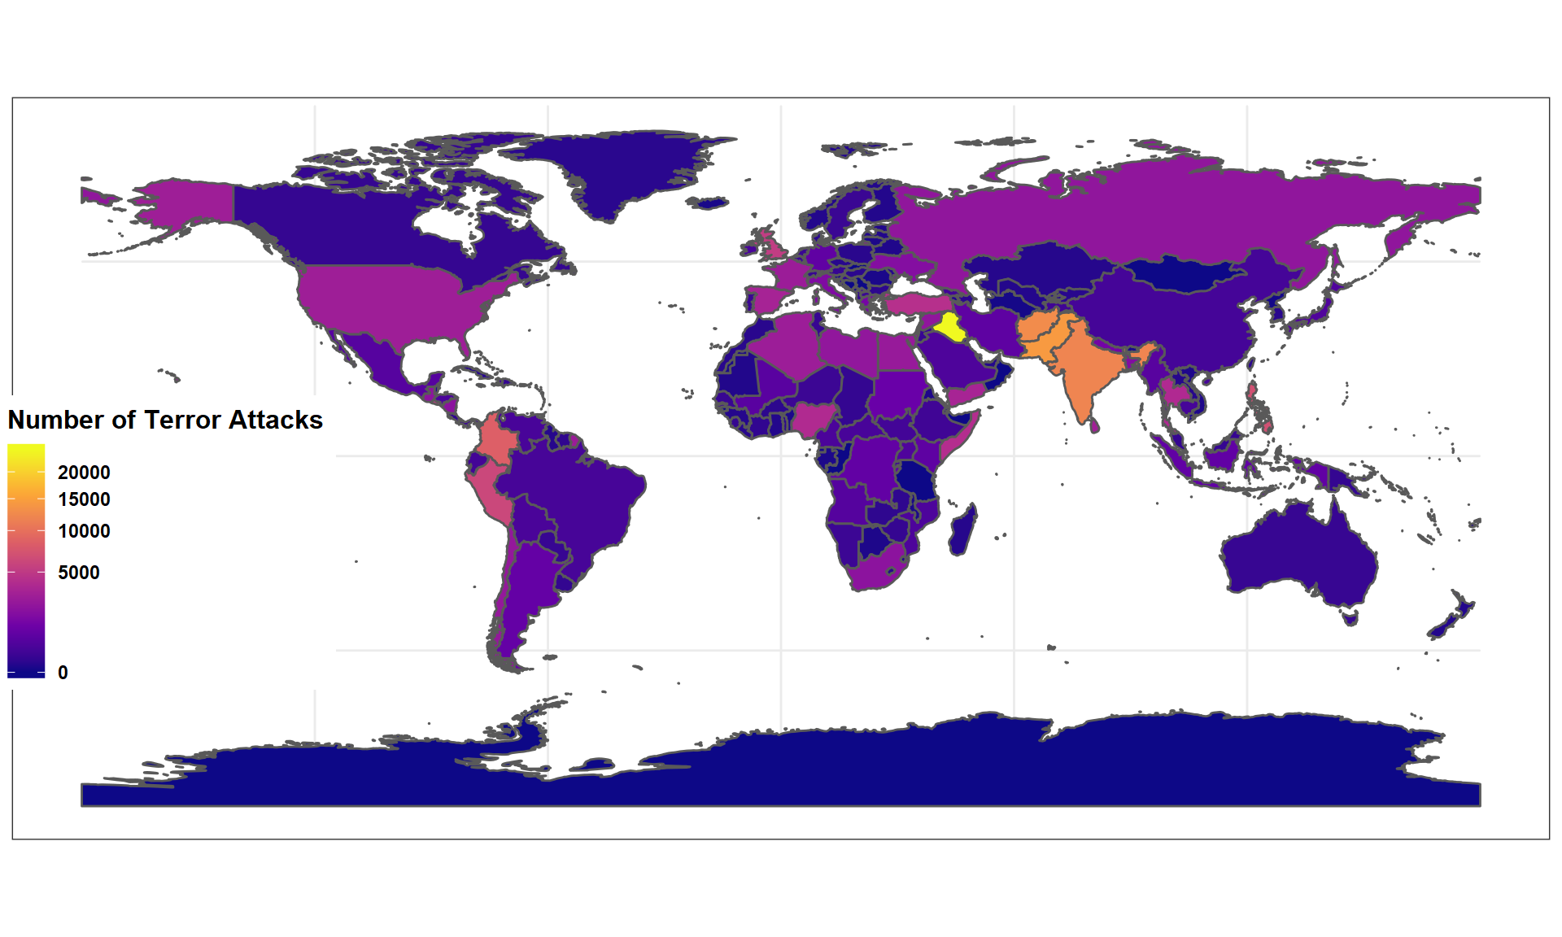
Observations (Summary)
Number of Terrorist Incidents by Country
Notes:
1
Iraq
24636
2
Pakistan
14368
3
Afghanistan
12731
4
India
11960
5
Colombia
8306
6
Philippines
6908
7
Peru
6096
8
El Salvador
5320
9
United Kingdom
5235
10
Turkey
4292

Slide 8
Data Quality and Characteristics
41 variables contain free-form textual descriptions (unusable)
Most variables contain large percentage of NA values
additional 44 variables have over 90% values as NA
na.omit results in zero observations!
Most variables are categorical (not numerical)
“unknown” common as a category value
some contain too many category values (for example, targsubtype1 has 107 distinct categories)
Large (Problem Specific) Data Cleansing Effort Needed!

Slide 9
Research Questions and Assignments
James Willson (Data Scientist)
Predict if an attack will be successful based on a variety of different factors.
Estimate the number of casualties in a successful terrorist attack
Sean Kugele (Data Scientist / Team Lead)
Predict the terrorist group responsible for perpetrating a terrorist attack
Estimate the probability of an attack based on temporal and geo-spatial variables

Slide 11
Predicting Responsible Terrorist Groups
Data Scientist: Sean Kugele

Slide 12
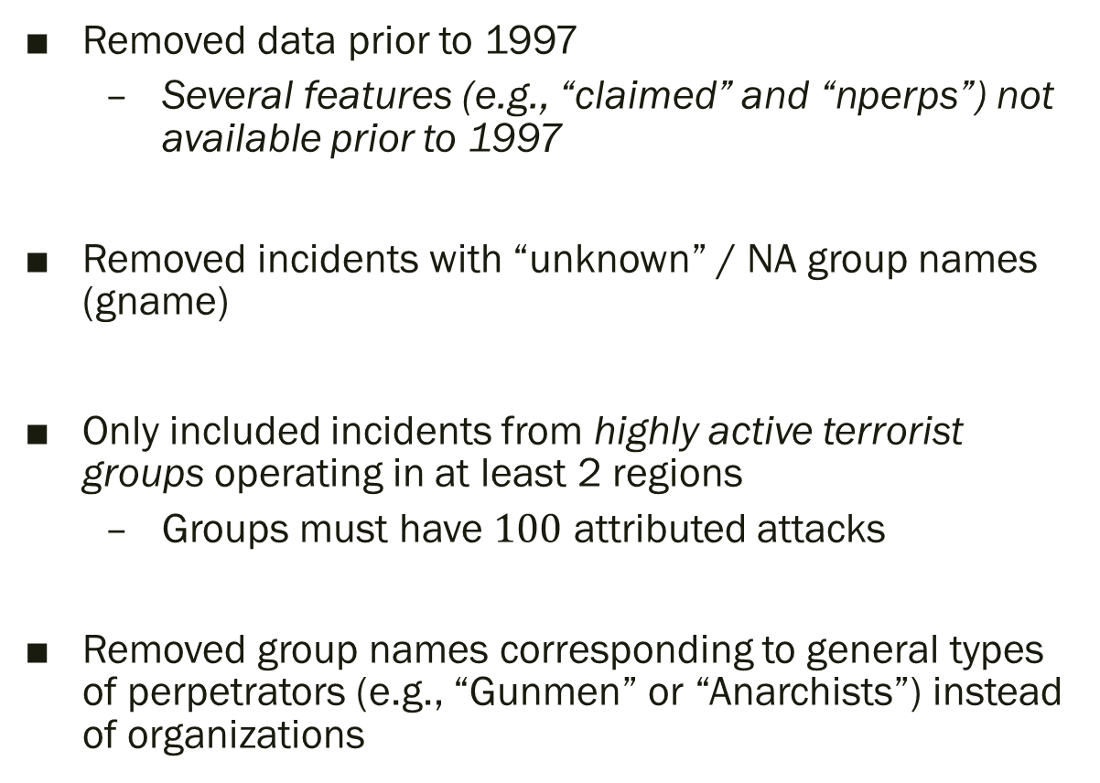
Data Cleansing (Observations)
Removed data prior to 1997
Several features (e.g., “claimed” and “nperps”) not available prior to 1997
Removed incidents with “unknown” / NA group names (gname)
Only included incidents from highly active terrorist groups operating in at least 2 regions
Groups must have $100$ attributed attacks
Removed group names corresponding to general types of perpetrators (e.g., “Gunmen” or “Anarchists”) instead of organizations

Slide 13
Terrorist Groups
Terrorist Group | # of Attacks
Al-Qaida in Iraq | 606 | 3.35%
Al-Qaida in the Arabian Peninsula (AQAP) | 877 | 4.84%
Al-Qaida in the Islamic Maghreb (AQIM) | 225 | 1.24%
Hamas (Islamic Resistance Movement) | 297 | 1.64%
Hezbollah | 107 | 0.59%
Islamic State of Iraq and the Levant (ISIL) | 4,274 | 23.61%
Kurdistan Workers' Party (PKK) | 1,074 | 5.93%
Liberation Tigers of Tamil Eelam (LTTE) | 614 | 3.39%
New People's Army (NPA) | 1,573 | 8.69%
Revolutionary Armed Forces of Colombia (FARC) | 1,121 | 6.19%
Salafist Group for Preaching and Fighting (GSPC) | 182 | 1.01%
Taliban | 5,912 | 32.66%
Tehrik-i-Taliban Pakistan (TTP) | 1,240 | 6.85%
Highly Unbalanced Data!

Slide 14
Terrorist Groups (after oversampling)
Terrorist Group | # of Attacks
Al-Qaida in Iraq | 4,770 | 7.69%
Al-Qaida in the Arabian Peninsula (AQAP) | 4,770 | 7.69%
Al-Qaida in the Islamic Maghreb (AQIM) | 4,770 | 7.69%
Hamas (Islamic Resistance Movement) | 4,770 | 7.69%
Hezbollah | 4,770 | 7.69%
Islamic State of Iraq and the Levant (ISIL) | 4,770 | 7.69%
Kurdistan Workers' Party (PKK) | 4,770 | 7.69%
Liberation Tigers of Tamil Eelam (LTTE) | 4,770 | 7.69%
New People's Army (NPA) | 4,770 | 7.69%
Revolutionary Armed Forces of Colombia (FARC) | 4,770 | 7.69%
Salafist Group for Preaching and Fighting (GSPC) | 4,770 | 7.69%
Taliban | 4,770 | 7.69%
Tehrik-i-Taliban Pakistan (TTP) | 4,770 | 7.69%

Slide 15

Training / Testing Data Set
Training Set $→$ 62,010 observations
Testing Set $→$ 3,621 observations

Slide 16
Feature Selection
Feature Name | Data Type | Feature Name | Data Type
latitude | numerical | nwounded | numerical
longitude | numerical | nkill | numerical
region | categorical | property | categorical
iyear | numerical
iday | numerical | success | categorical
imonth | numerical | nkillter | numerical
 |  | claimed | categorical
nperps | numerical
attacktype1 | categorical
targtype1 | categorical
weaptype1 | categorical
suicide | categorical
multiple | categorical
extended | categorical
Notes:
19 Variables

Slide 17
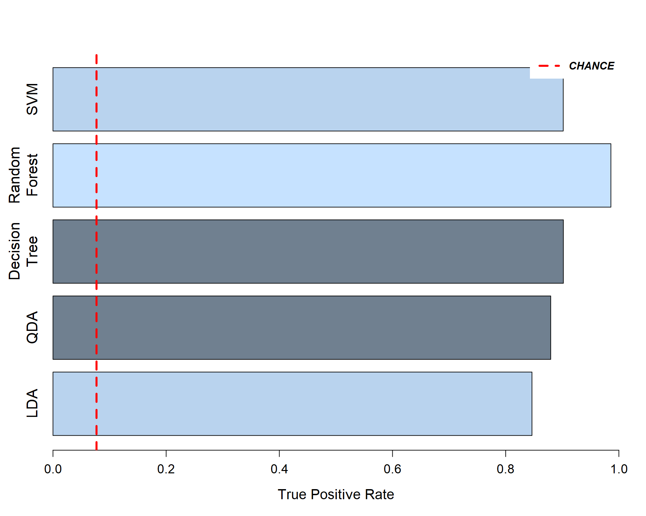
Initial Model Results - All Features

Slide 18
Confusion Matrix (Random Forest) - All Features
 |  | Predicted Terrorist Group
 |  | A | B | C | D | E | F | G | H | I | J | K | L | M
Actual Terrorist Group | A | 120 | 0 | 0 | 0 | 0 | 3 | 0 | 0 | 0 | 0 | 0 | 0 | 0
 | B | 1 | 184 | 1 | 0 | 0 | 0 | 0 | 0 | 0 | 0 | 0 | 0 | 1
 | C | 0 | 0 | 36 | 0 | 0 | 0 | 0 | 0 | 0 | 0 | 0 | 0 | 0
 | D | 0 | 0 | 0 | 59 | 0 | 0 | 0 | 0 | 0 | 0 | 0 | 0 | 0
 | E | 0 | 0 | 0 | 0 | 21 | 2 | 0 | 0 | 0 | 0 | 0 | 0 | 0
 | F | 1 | 0 | 0 | 4 | 0 | 844 | 10 | 0 | 4 | 0 | 0 | 0 | 0
 | G | 1 | 0 | 0 | 0 | 0 | 3 | 198 | 0 | 0 | 0 | 0 | 0 | 0
 | H | 0 | 0 | 0 | 0 | 0 | 0 | 0 | 140 | 1 | 0 | 0 | 0 | 0
 | I | 0 | 0 | 0 | 0 | 0 | 0 | 0 | 0 | 338 | 0 | 0 | 0 | 0
 | J | 0 | 0 | 0 | 0 | 0 | 0 | 0 | 0 | 0 | 225 | 0 | 0 | 0
 | K | 0 | 0 | 1 | 0 | 0 | 0 | 0 | 0 | 0 | 0 | 42 | 0 | 0
 | L | 0 | 0 | 0 | 0 | 0 | 0 | 0 | 0 | 0 | 0 | 0 | 1136 | 6
 | M | 0 | 0 | 0 | 0 | 0 | 0 | 0 | 0 | 0 | 0 | 0 | 12 | 227
# FP |  | 3 | 0 | 2 | 4 | 0 | 8 | 10 | 0 | 5 | 0 | 0 | 12 | 7
FPR |  | 2.4% | 0.0% | 5.3% | 6.3% | 0.0% | 0.9% | 4.8% | 0.0% | 1.5% | 0.0% | 0.0% | 1.0% | 3.0%

Slide 19
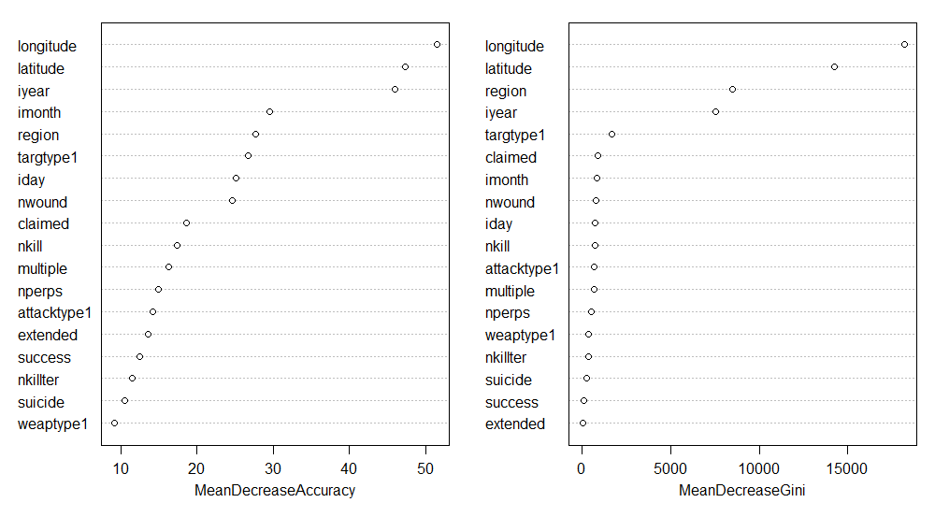
Importance Plot (Random Forest) - All Features

Slide 20
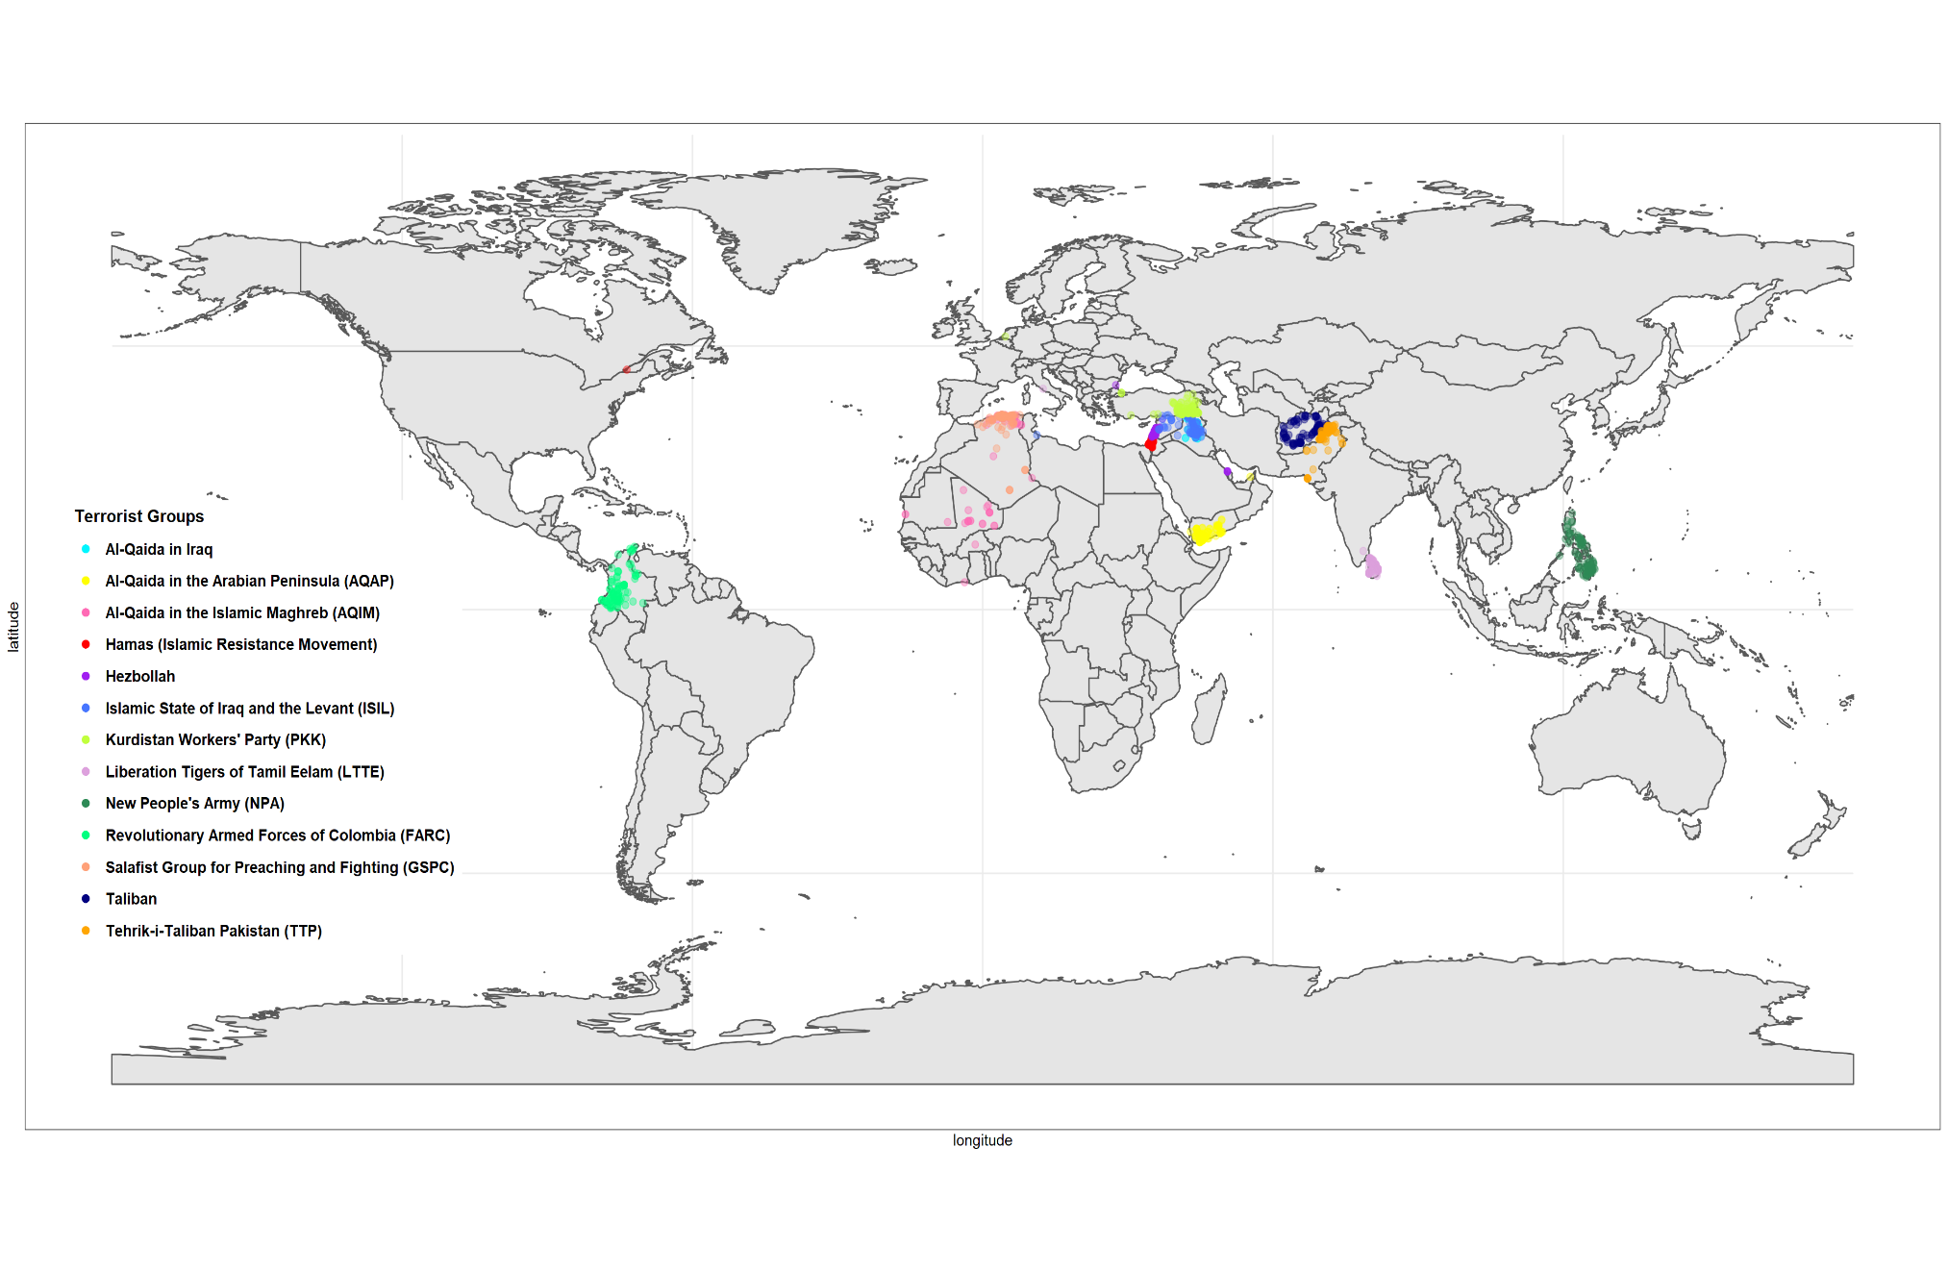
Terrorist Attacks by Group

Slide 21
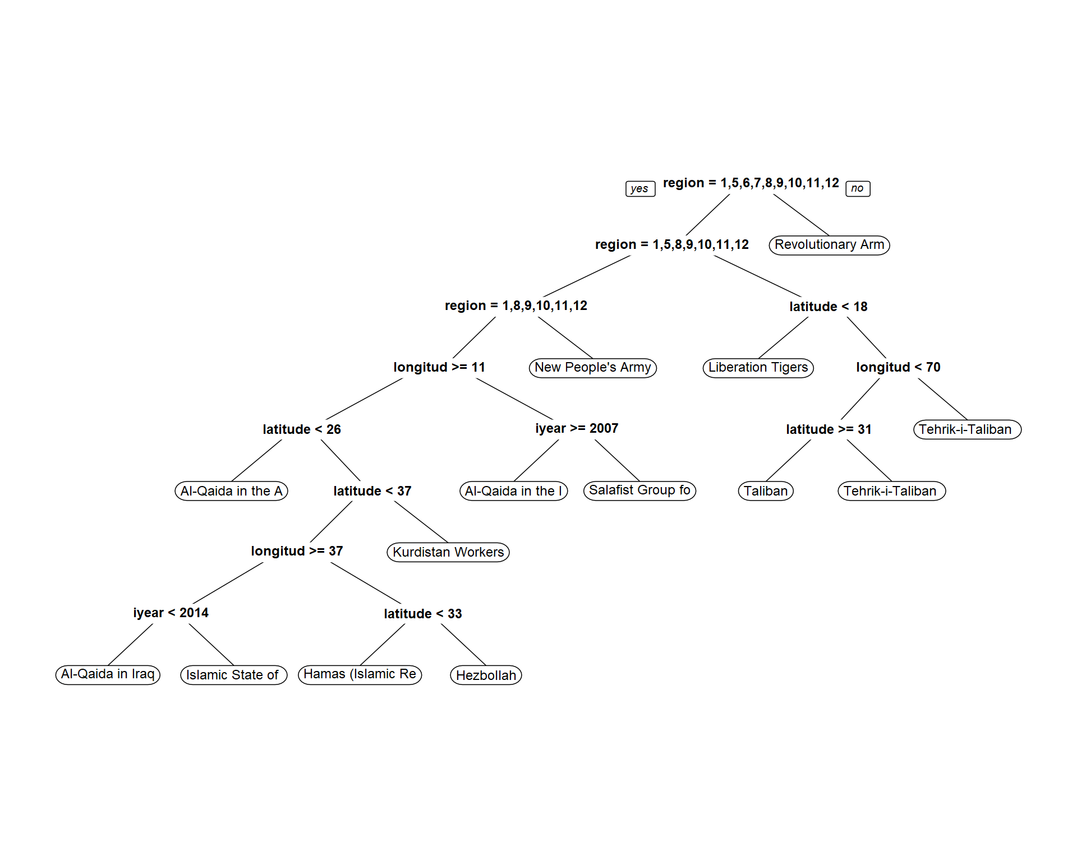
Decision Tree - All Features

Slide 22
Feature Selection (Revisited)
Feature Name | Data Type | Feature Name | Data Type
latitude | numerical | nwounded | numerical
longitude | numerical | nkill | numerical
region | categorical | property | categorical
iyear | numerical
iday | numerical | success | categorical
imonth | numerical | nkillter | numerical
 |  | claimed | categorical
nperps | numerical
attacktype1 | categorical
targtype1 | categorical
weaptype1 | categorical
suicide | categorical
multiple | categorical
extended | categorical
Notes:
19 Variables

Slide 23
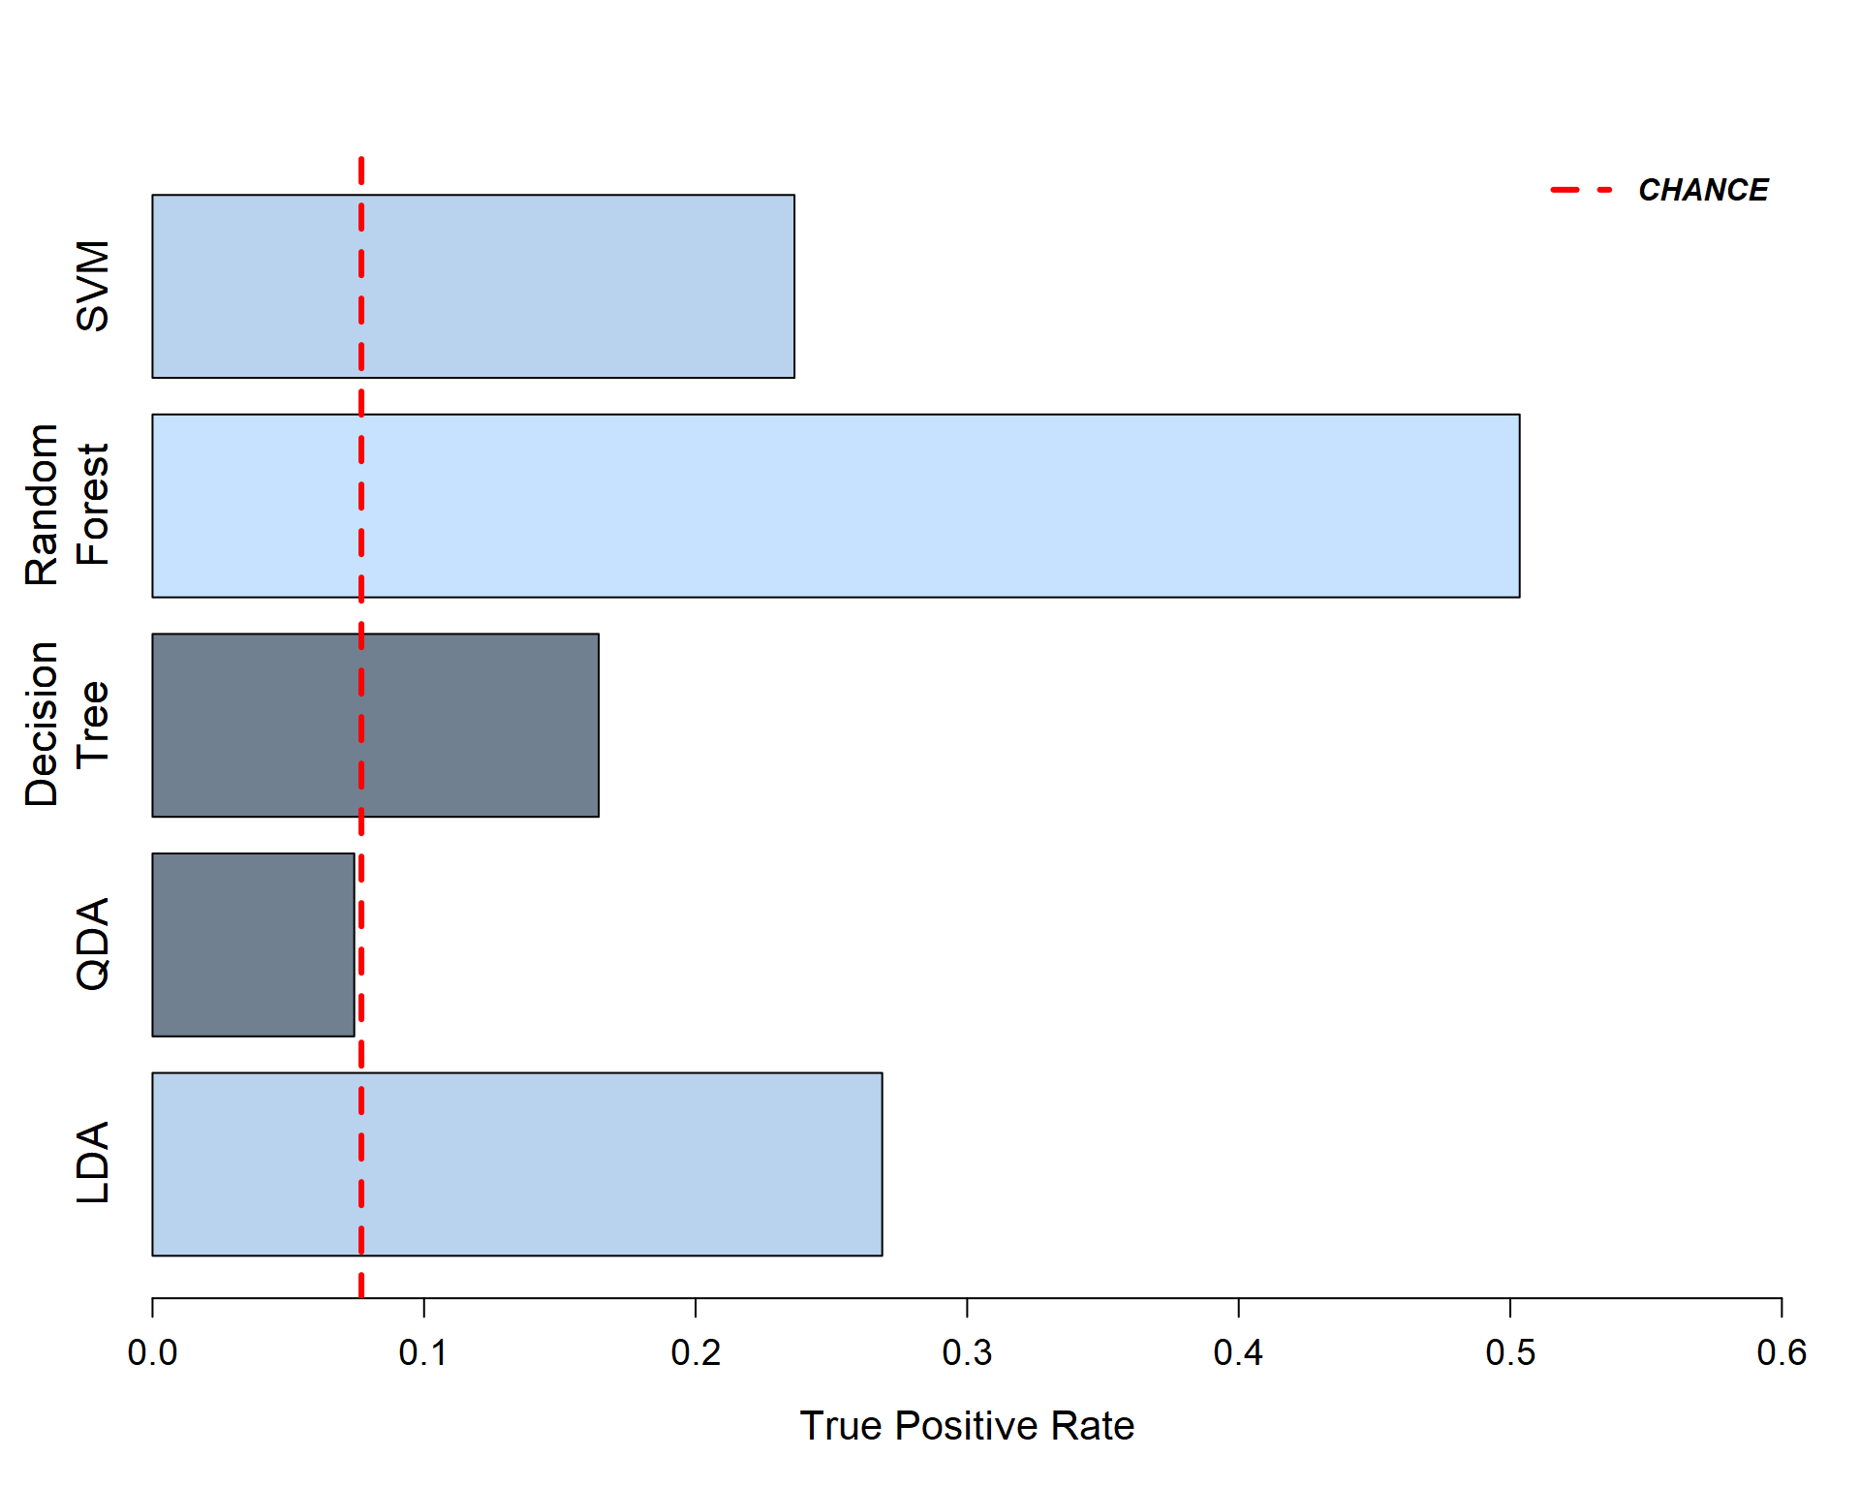
Model Performance - No Geospatial / No Year
Notes:
TPRs: 0.27 (LDA) 0.12 0.37 0.28

Slide 24
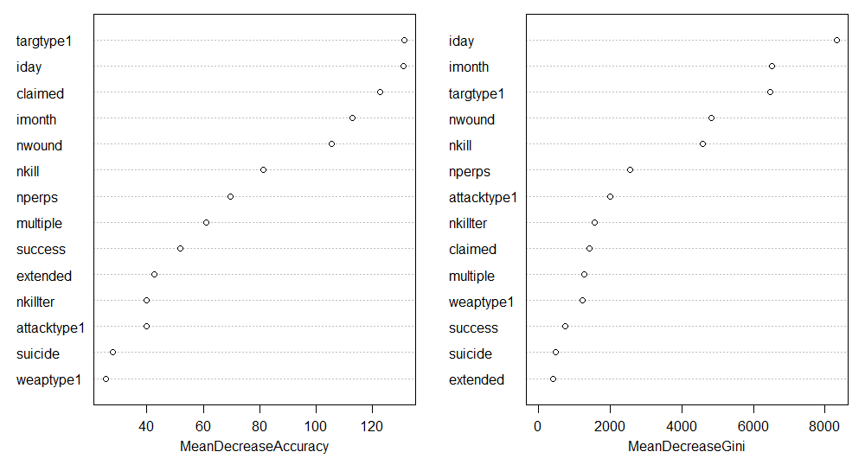
Importance Plot (Random Forest)

Slide 25
Confusion Matrix (Random Forest)
 |  | Predicted Terrorist Group
 |  | A | B | C | D | E | F | G | H | I | J | K | L | M
Actual Terrorist Group | A | 77 | 5 | 1 | 2 | 0 | 7 | 3 | 6 | 1 | 2 | 1 | 12 | 6
 | B | 3 | 58 | 3 | 2 | 5 | 20 | 14 | 16 | 14 | 14 | 6 | 23 | 9
 | C | 2 | 3 | 4 | 1 | 1 | 0 | 3 | 2 | 4 | 3 | 0 | 8 | 5
 | D | 0 | 3 | 1 | 26 | 3 | 9 | 1 | 1 | 1 | 1 | 1 | 9 | 3
 | E | 1 | 2 | 0 | 1 | 9 | 2 | 2 | 1 | 0 | 1 | 0 | 2 | 2
 | F | 34 | 31 | 8 | 27 | 12 | 513 | 16 | 21 | 16 | 25 | 8 | 115 | 37
 | G | 2 | 9 | 1 | 0 | 6 | 2 | 85 | 14 | 20 | 27 | 12 | 16 | 8
 | H | 2 | 8 | 4 | 1 | 2 | 9 | 21 | 36 | 9 | 19 | 8 | 21 | 1
 | I | 6 | 19 | 5 | 2 | 9 | 3 | 30 | 10 | 195 | 18 | 8 | 28 | 5
 | J | 1 | 12 | 1 | 1 | 2 | 7 | 28 | 15 | 22 | 100 | 11 | 20 | 5
 | K | 1 | 2 | 0 | 0 | 0 | 1 | 5 | 4 | 8 | 4 | 7 | 9 | 2
 | L | 17 | 27 | 13 | 29 | 24 | 105 | 71 | 63 | 41 | 36 | 15 | 632 | 69
 | M | 8 | 13 | 2 | 6 | 3 | 17 | 3 | 13 | 19 | 11 | 2 | 61 | 81
# FP |  | 77 | 134 | 39 | 72 | 67 | 182 | 197 | 166 | 155 | 161 | 72 | 324 | 152
FPR |  | 50.0% | 69.8% | 90.7% | 73.5% | 88.2% | 26.2% | 69.9% | 82.2% | 44.3% | 61.7% | 91.1% | 33.9% | 65.2%
Notes:
A Al-Qaida in Iraq
B Al-Qaida in the Arabian Peninsula (AQAP)
C Al-Qaida in the Islamic Maghreb (AQIM)
D Hamas (Islamic Resistance Movement)
E Hezbollah
F Islamic State of Iraq and the Levant (ISIL)
G Kurdistan Workers' Party (PKK)
H Liberation Tigers of Tamil Eelam (LTTE)
I New People's Army (NPA)
J Revolutionary Armed Forces of Colombia (FARC)
K Salafist Group for Preaching and Fighting (GSPC)
L Taliban M Tehrik-i-Taliban Pakistan (TTP)

Slide 26
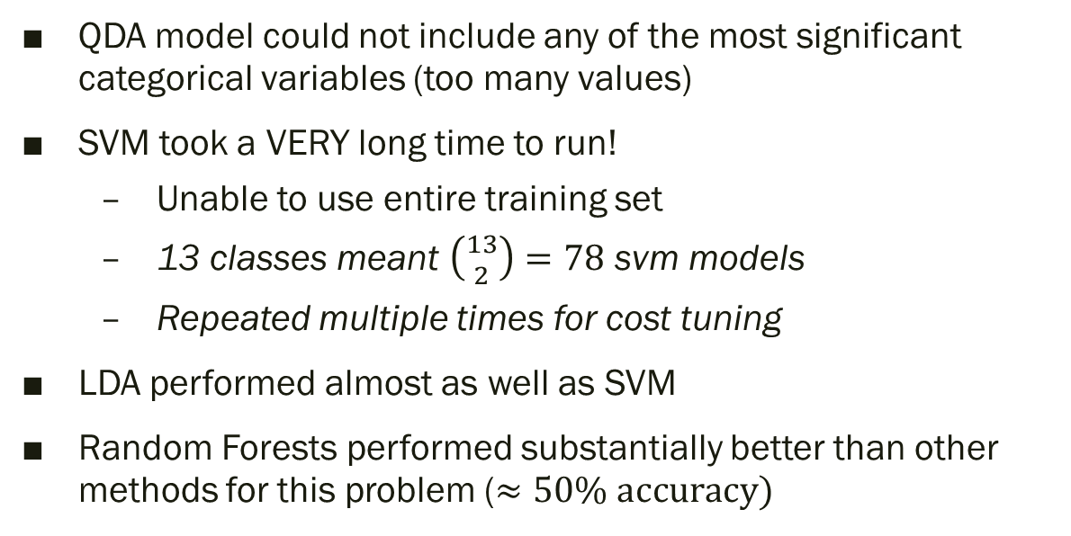
Discussion / Summary
QDA model could not include any of the most significant categorical variables (too many values)
SVM took a VERY long time to run!
Unable to use entire training set
13 classes meant $\left({13 \atop 2}\right)=78$ svm models
Repeated multiple times for cost tuning
LDA performed almost as well as SVM
Random Forests performed substantially better than other methods for this problem ($≈50\% \text{accuracy})$
TODO: Add something about model interpretation and variable analysis

