Slide 1
Global Terrorism
Group Members
James Willson
Kun Li
Sean Kugele (Team Lead)

Slide 2
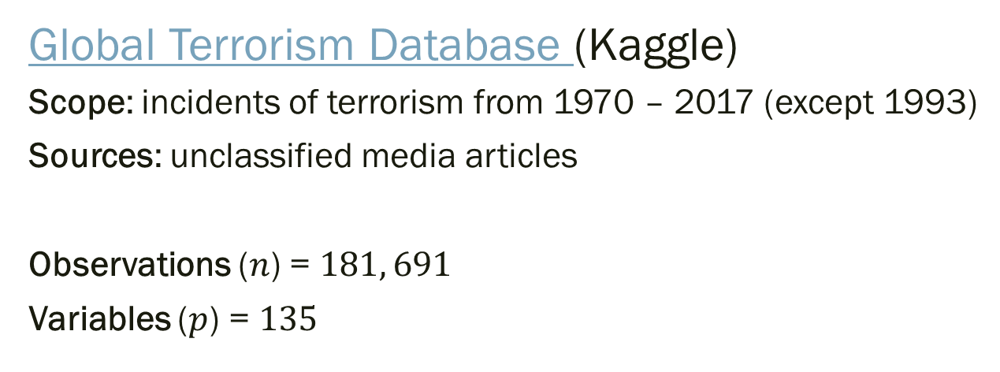
Data Set
Global Terrorism Database (Kaggle)
Scope: incidents of terrorism from 1970 – 2017 (except 1993)
Sources: unclassified media articles
Observations ($n$) = $181, 691$
Variables ($p$) = $135$
Terrorism (definition) "The threatened or actual use of illegal force and violence by a non-state actor to attain a political, economic, religious, or social goal through fear, coercion, or intimidation."

Slide 3
Variables (Summary)
Date Variables (Year, Month, Day, etc.)
Geospatial/Geopolitical Variables (Lat/Long, Region, Country, City, Province, etc.)
Incident Descriptive Variables (Attack Type, Duration of Incident, Success/Failure, Weapons Used, Targets, etc.)
Perpetrator Descriptive Variables (Terrorist group membership, # Perpetrators, etc.)
Casualty and Damage Variables (# Fatalities, # Injured, etc.)

Slide 4
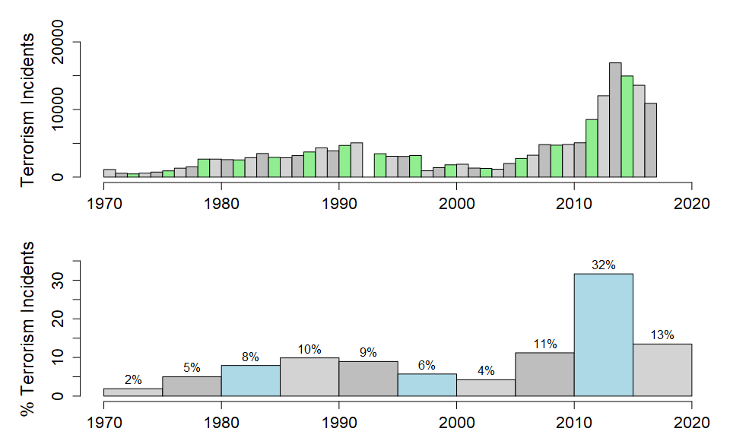
Observations (Summary)
Incidents by Time

Slide 5
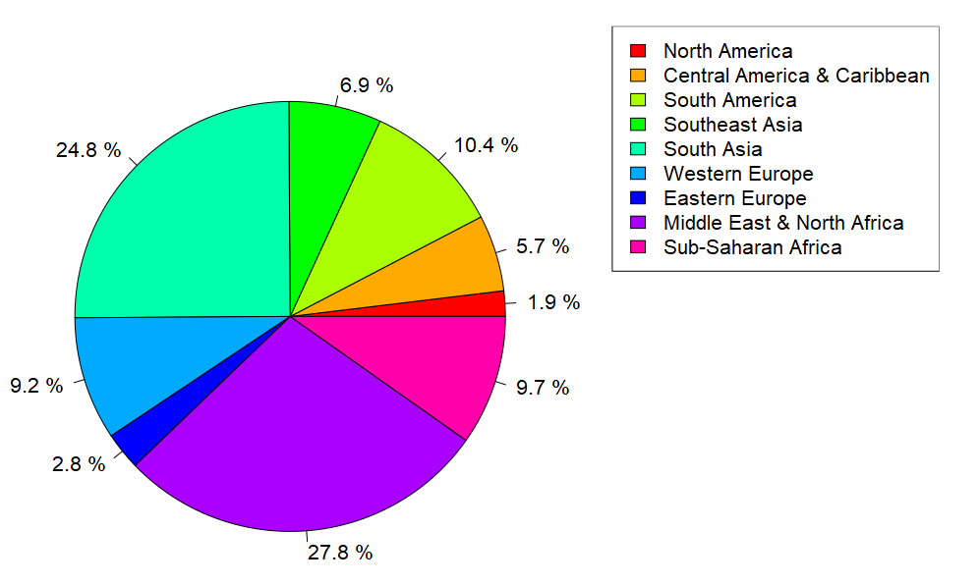
Observations (Summary)
Incidents by Region

Slide 6
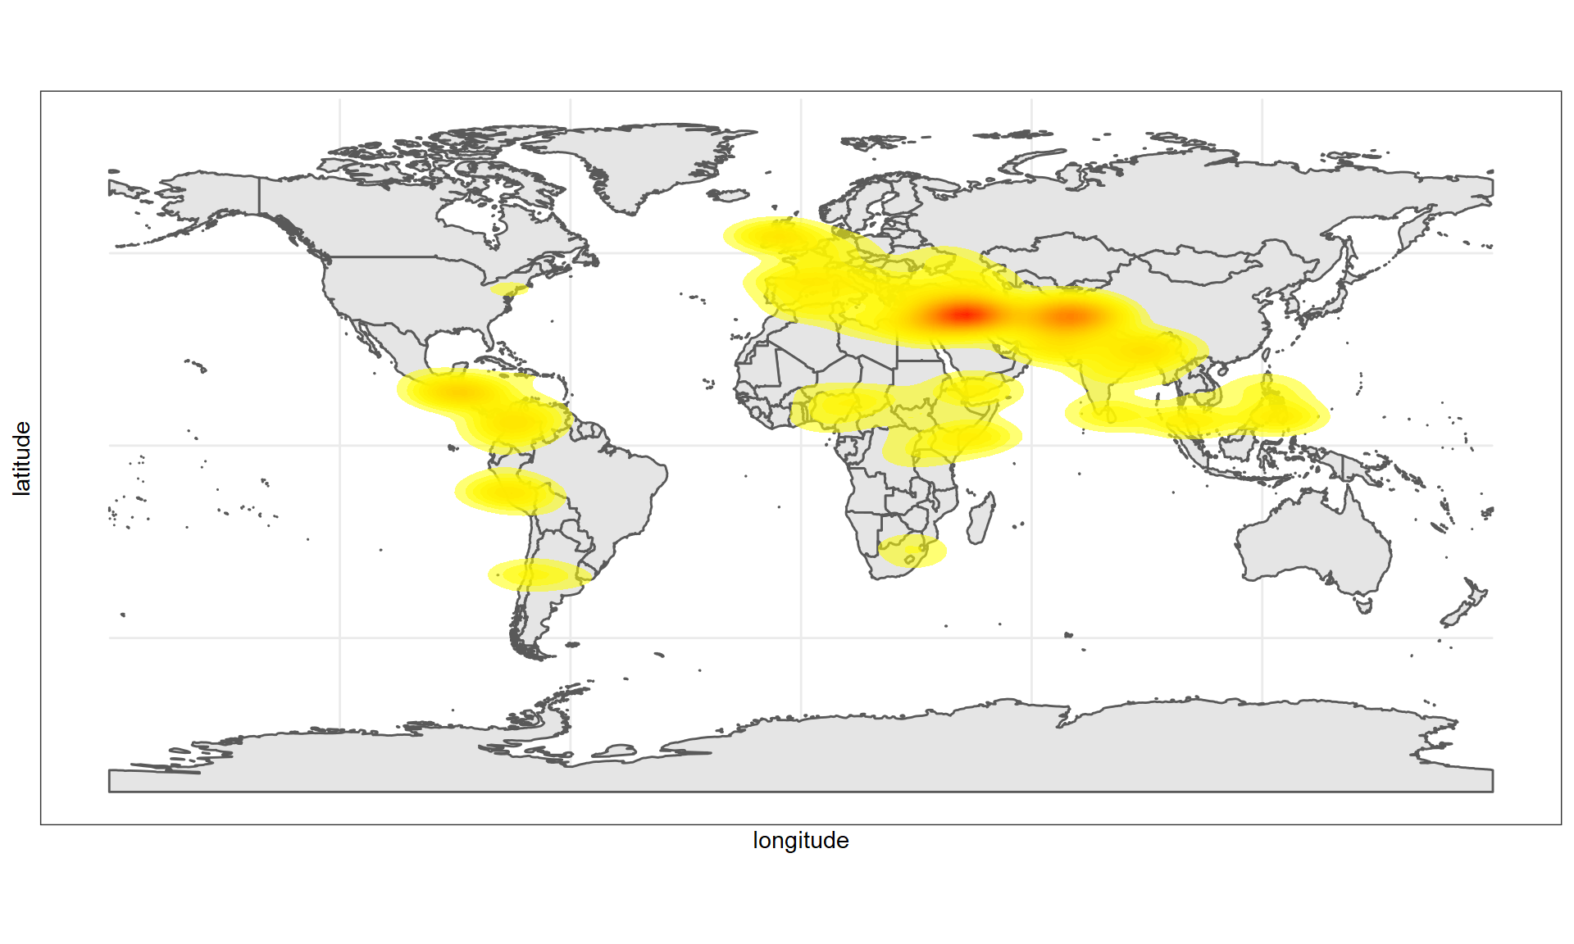
Observations (Summary)
Terrorism Incidents (Density Plot)
Notes:
Densities based on random plot of 20,000 incidents

Slide 7
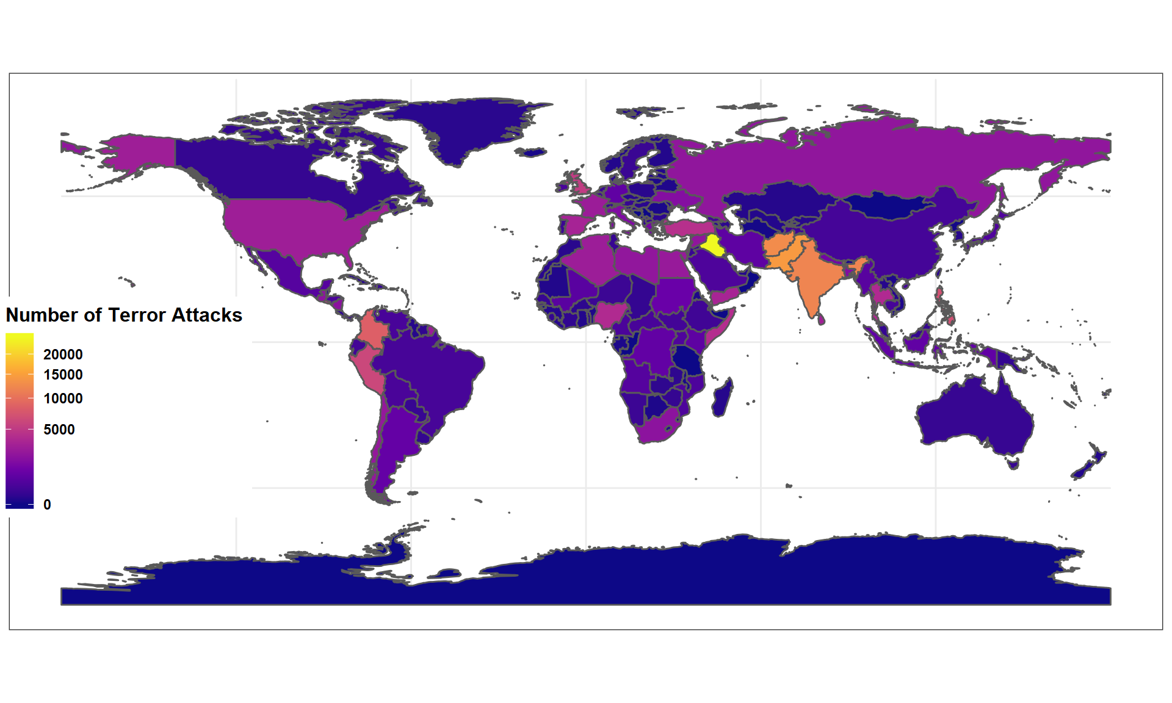
Observations (Summary)
Number of Terrorist Incidents by Country
Notes:
1
Iraq
24636
2
Pakistan
14368
3
Afghanistan
12731
4
India
11960
5
Colombia
8306
6
Philippines
6908
7
Peru
6096
8
El Salvador
5320
9
United Kingdom
5235
10
Turkey
4292

Slide 8
Data Quality and Characteristics
All columns NA values
na.omit results in zero observations!
Most variables are categorical (not numerical)
“unknown” common as a category value
Many redundant “description” variables
for example, textual translations of categorical variables
Large Data Cleansing Effort Needed!

Slide 9
Research Questions and Assignments
James Willson (Data Scientist)
Predict if an attack will be successful based on a variety of different factors.
Estimate the number of casualties in a successful terrorist attack
Kun Li (Data Scientist)
Predict the extent/dollar-amount of property damage from any given attack
Identify factors that could predict the target/victim type in an attack
Sean Kugele (Data Scientist / Team Lead)
Predict the terrorist group responsible for perpetrating a terrorist attack
Estimate the probability of an attack based on temporal and geo-spatial variables

Slide 12
Terrorist Groups
Terrorist Group | Number of Known Attacks
Al-Qaida in Iraq | 599
Al-Qaida in the Arabian Peninsula (AQAP) | 883
Al-Qaida in the Islamic Maghreb (AQIM) | 232
Hamas (Islamic Resistance Movement) | 291
Hezbollah | 111
Islamic State of Iraq and the Levant (ISIL) | 4,286
Kurdistan Workers' Party (PKK) | 1,080
Liberation Tigers of Tamil Eelam (LTTE) | 591
New People's Army (NPA) | 1,560
Revolutionary Armed Forces of Colombia (FARC) | 1124
Salafist Group for Preaching and Fighting (GSPC) | 182
Taliban | 5,877
Tehrik-i-Taliban Pakistan (TTP) | 1239

Slide 13
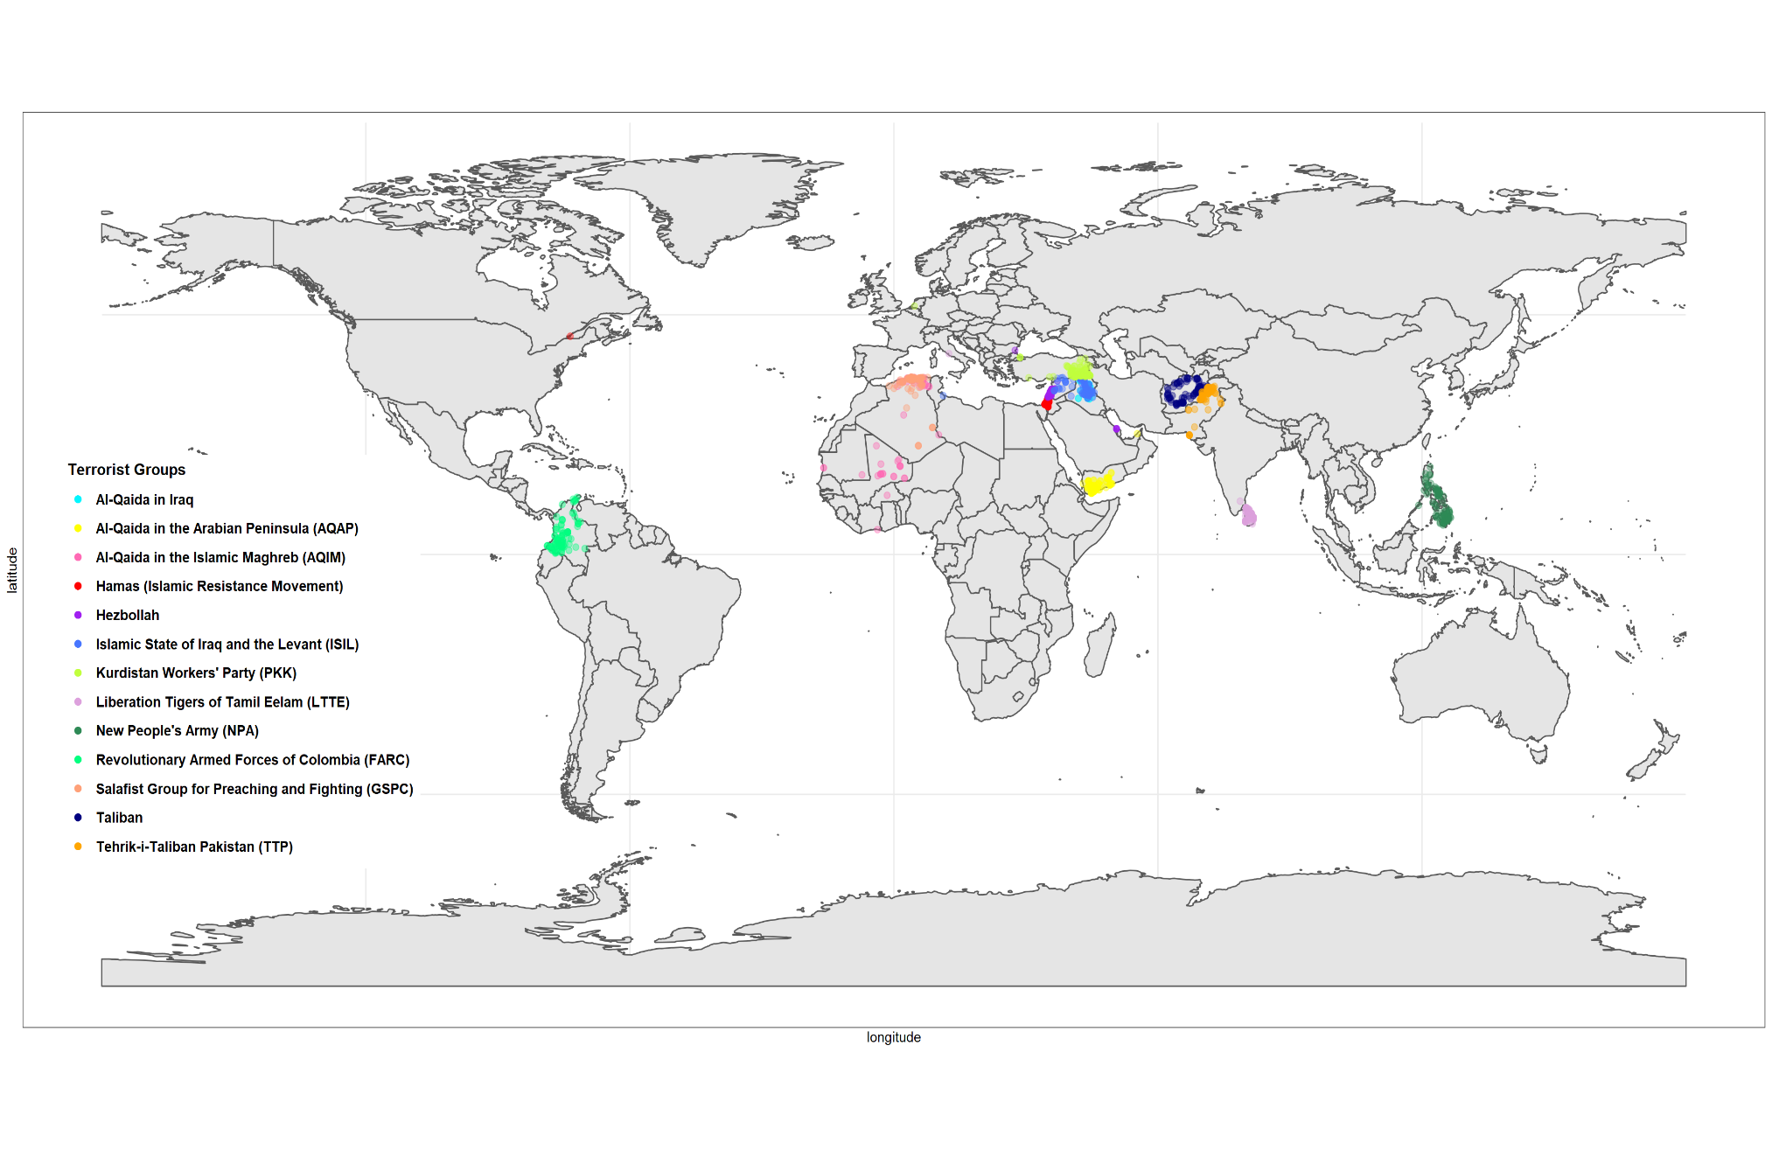
Terrorist Attacks by Group

