Slide 1








Slide 2


Slide 3
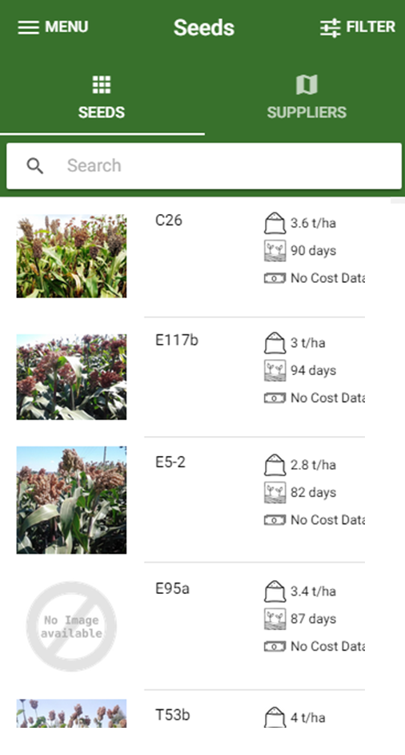
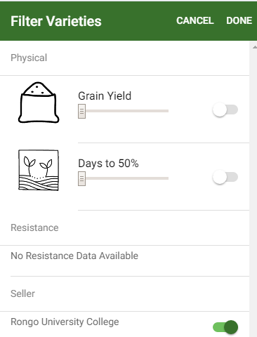

Slide 4
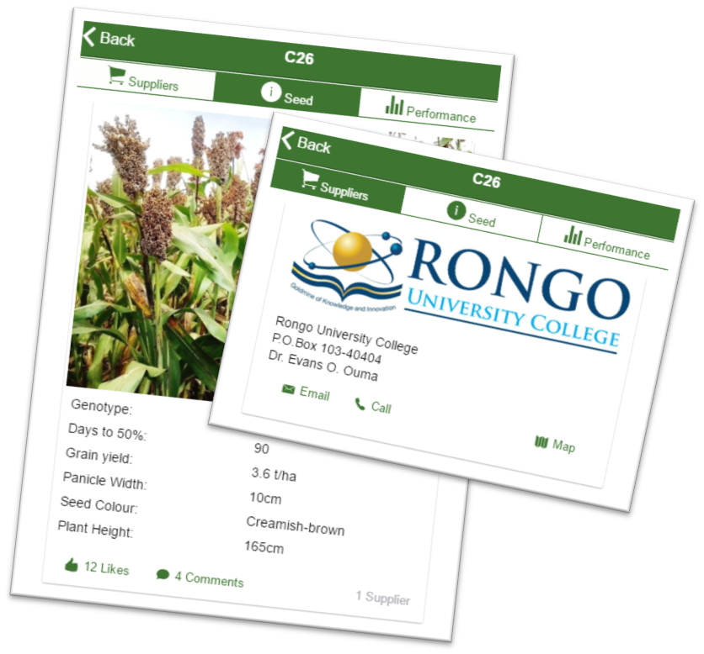
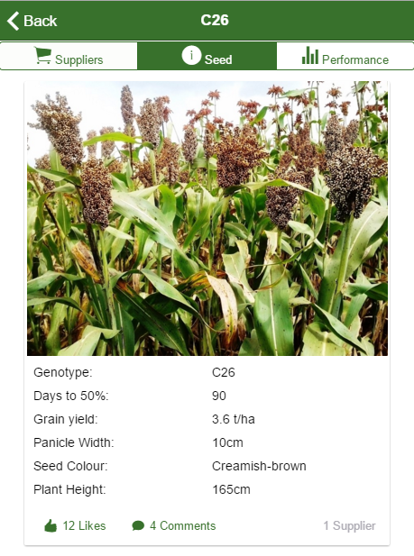
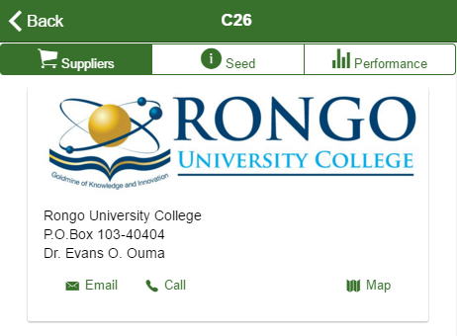

Slide 5




Data for demonstration app kindly provided by Dr. Evans O. Ouma, Rongo University College
App developed by the Statistical Services Centre, University of Reading. Source code available on GitHub

Slide 6
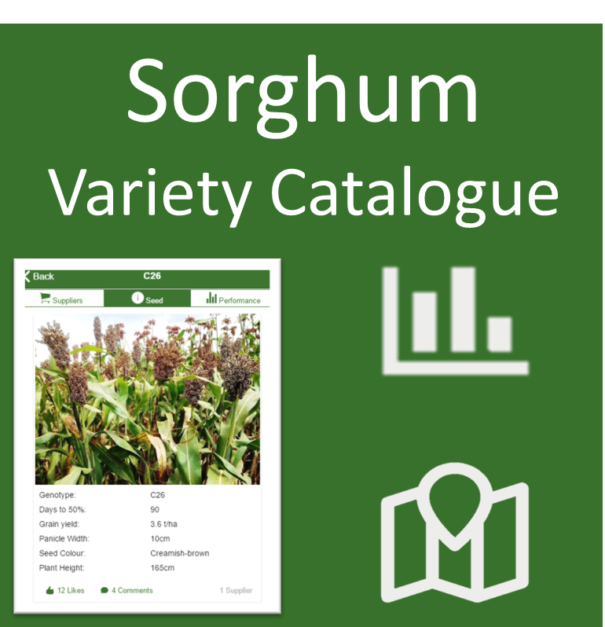



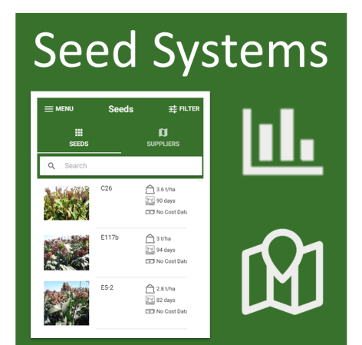
Sorghum Variety Catalogue

