Slide 1
Lecture 8: Summary of hockey stats

Slide 2
Goals
Overview of hockey stats
Shot based metrics
Score adjustments
PDO
Expected goals
Tools
Bivariate tools: scatter plots, r
Heat maps

Slide 3


Overview
-Grantland, 2014
-Rolling Stone, 2014

Slide 4
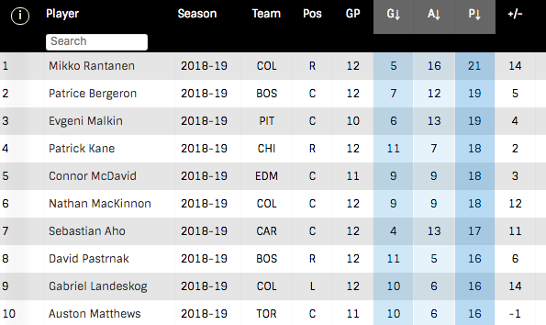
Traditional metrics

Slide 5
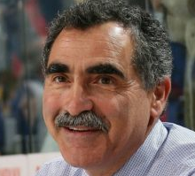

Shot based metrics
“in order to shoot the puck, you have to possess the puck”
Corsi: shots on goal + missed shots + blocked shots
Fenwick: shots on goal + missed shots

Slide 6
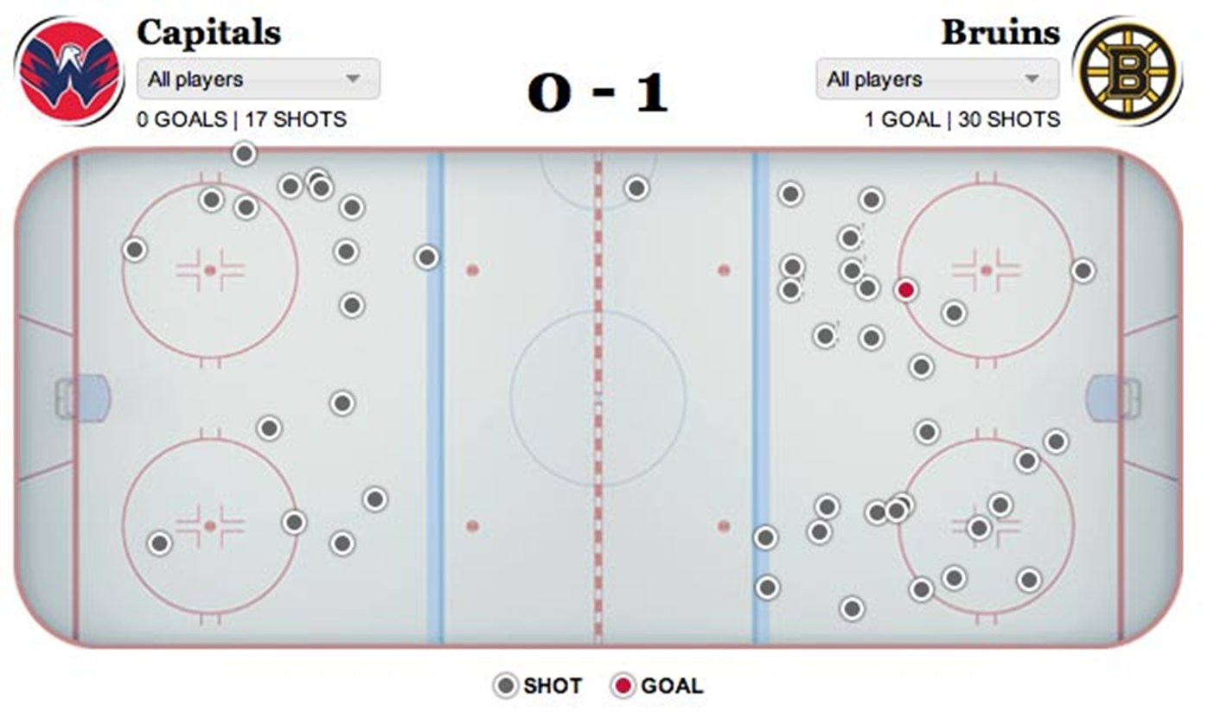
Shot based metrics
Corsi: shots on goal + missed shots + blocked shots

Slide 7
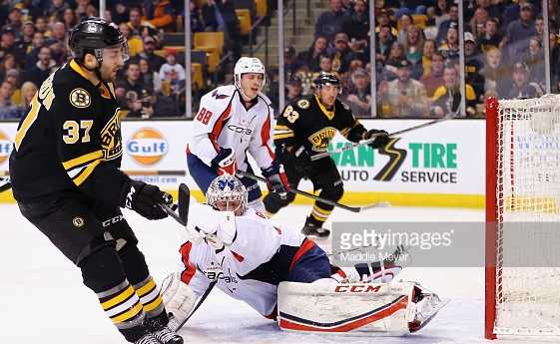
Shot based metrics
Corsi: shots on goal + missed shots + blocked shots (SAs)
Example: Patrice Bergeron
-On ice for 15 Boston SAs (CF = 15)
-On ice for 8 Washington SAs (CA = 8)
-Bergeron is a +7 for game (Corsi)
-Bergeron has a 65.2% CF%
How to interpret +7? How to interpret 65.2%?

Slide 8
Shot based metrics
Corsi: shots on goal + missed shots + blocked shots (SAs)
Example: Patrice Bergeron
Why Corsi?
-Strong correlation with future success
-Repeatable
Why not Corsi?

Slide 9
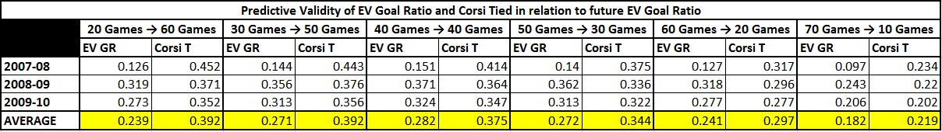
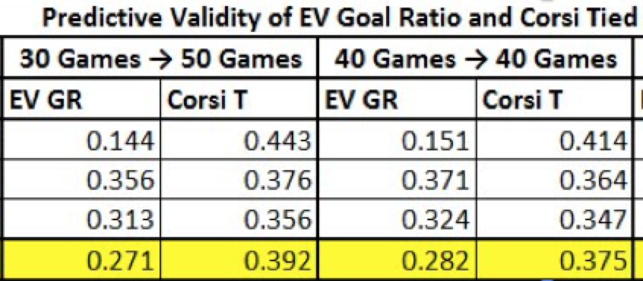
Shot based metrics
Corsi: shots on goal + missed shots + blocked shots (SAs)
Correlation to winning

Slide 10
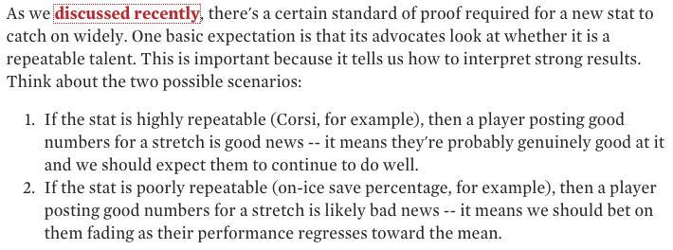
Shot based metrics
Corsi: shots on goal + missed shots + blocked shots (SAs)
Via Erik Tulsky:

Slide 11
Shot based metrics
Corsi: shots on goal + missed shots + blocked shots (SAs)
Example: Patrice Bergeron
CF60 = Corsi x 60/Time-on-ice
CorsiOff = Teammates number when player is off ice
CorsiRel = CF60 - CorsiOff
Bergeron’s 2016 CorsiRel = 7.97: Roughly 8 more shots per 60 even strength minutes were directed at opponents net while he was on the ice versus when he was off the ice

Slide 12
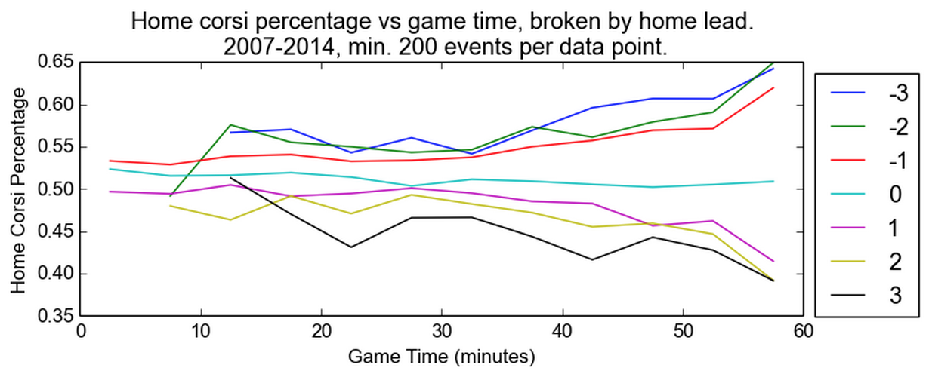
Shot based metrics
Corsi: shots on goal + missed shots + blocked shots (SAs)
Additional tweak: Score adjustments
-Adjust for relative score differential (-2, -1, 0, etc) and shot differential during each game (weighted by time)
https://hockey-graphs.com/2014/11/13/adjusted-possession-measures/

Slide 13
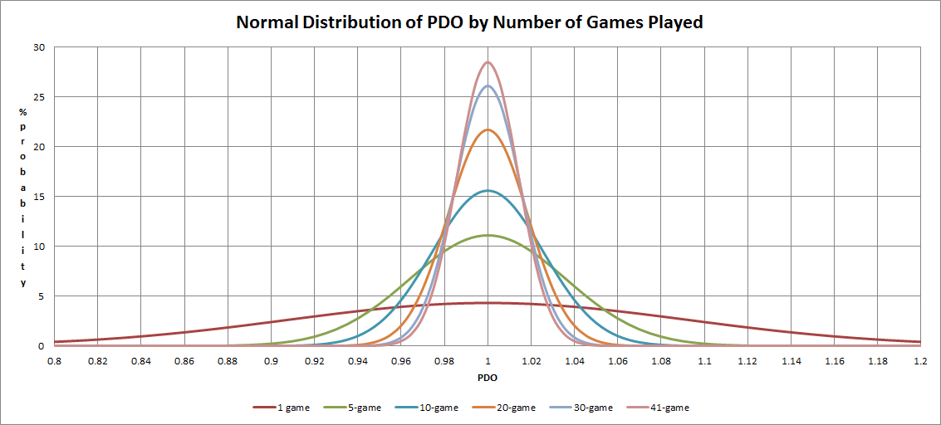
PDO
PDO: 5v5 shooting percentage + 5v5 save percentage
Creator: Vic Ferrari

Slide 14
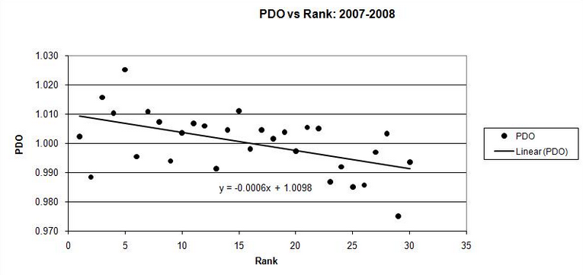
PDO
PDO: 5v5 shooting percentage + 5v5 save percentage
Ties to team performance

Slide 15
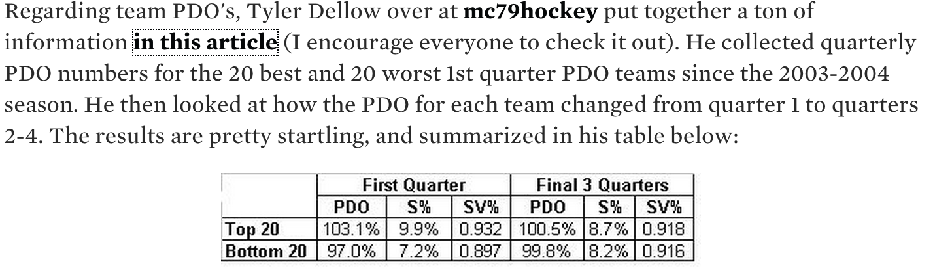
PDO
PDO: 5v5 shooting percentage + 5v5 save percentage
Less repeatable?
http://www.pensburgh.com/2010/6/23/1531707/pdo-and-what-it-means

Slide 16
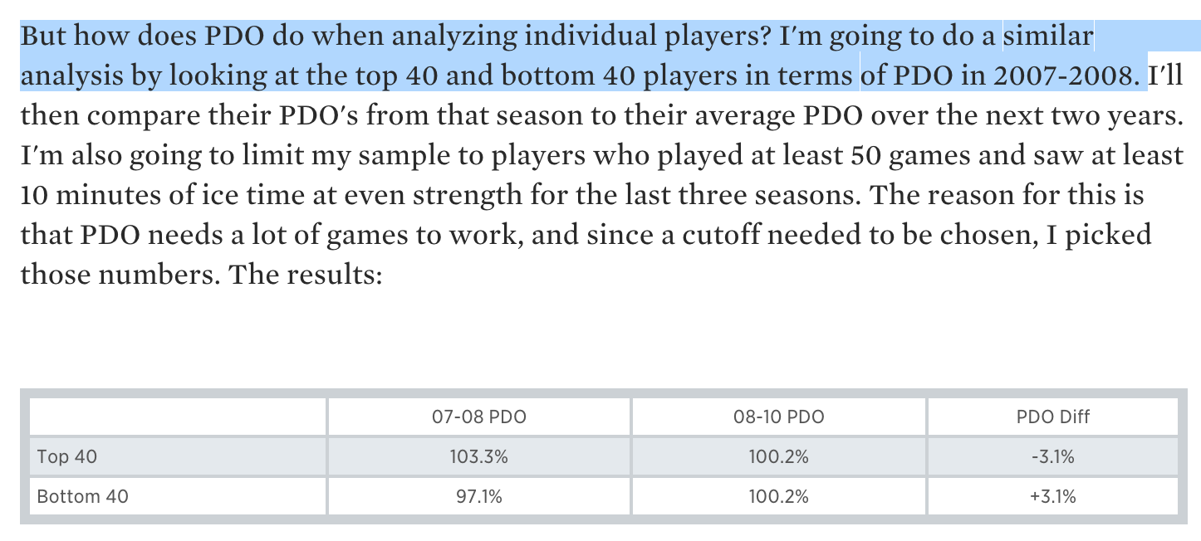
PDO
PDO: 5v5 shooting percentage + 5v5 save percentage
Less repeatable?
http://www.pensburgh.com/2010/6/23/1531707/pdo-and-what-it-means

Slide 17
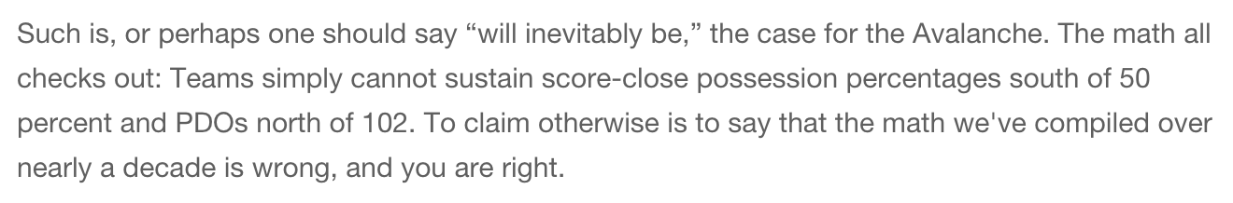
PDO
PDO: 5v5 shooting percentage + 5v5 save percentage
How can PDO predict the future?

Slide 18
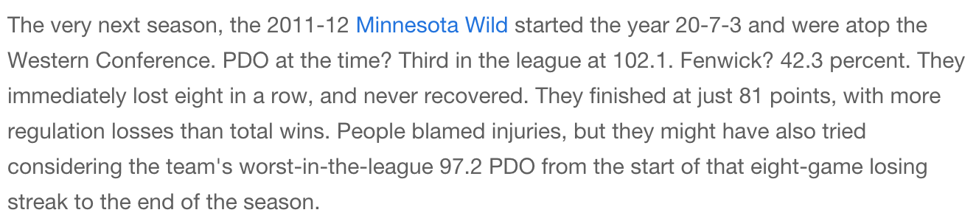
PDO
PDO: 5v5 shooting percentage + 5v5 save percentage
How can PDO predict the future?

Slide 19
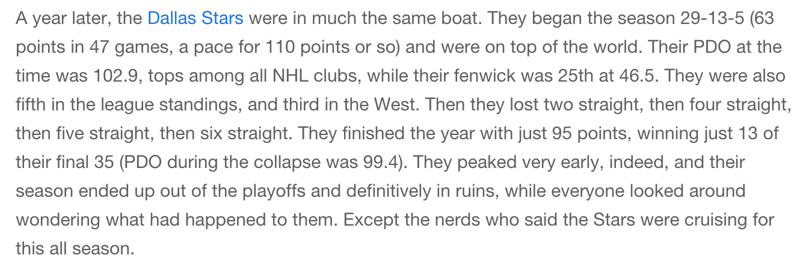
PDO
PDO: 5v5 shooting percentage + 5v5 save percentage
How can PDO predict the future?

Slide 20
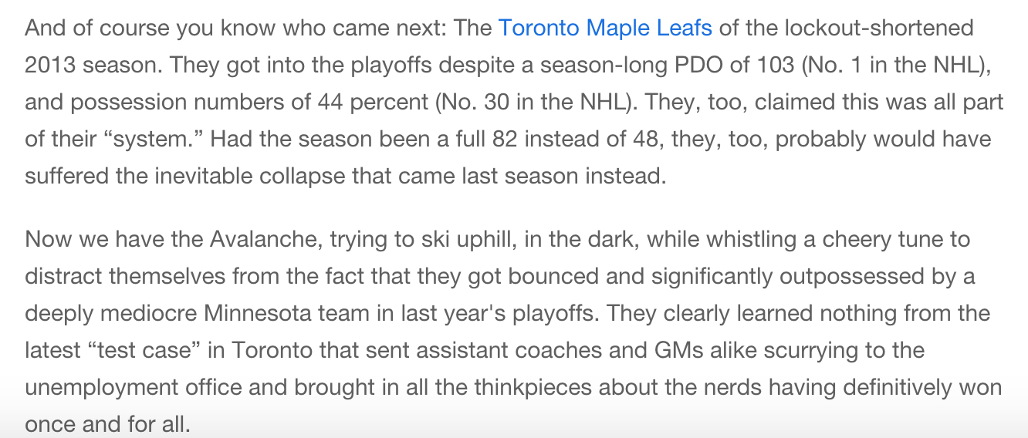
PDO
PDO: 5v5 shooting percentage + 5v5 save percentage
How can PDO predict the future?

Slide 21
PDO
No Goals
Good Luck
Bad Luck
Goals For Everyone
League Averages*
Shooting %: 7.35% Save % : 92.6%
Avg 5v5 (2016)
95%
Save %
(Sv%)
90%
Shooting %
(Sh%)
5%
10%

Slide 22
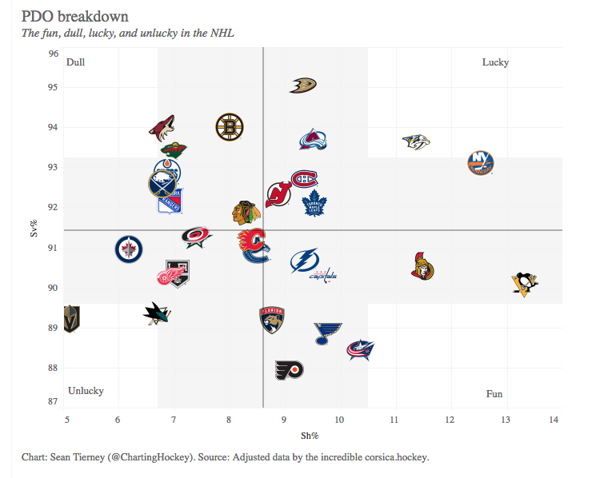
PDO (2018)
https://public.tableau.com/profile/sean.tierney#!/

Slide 23
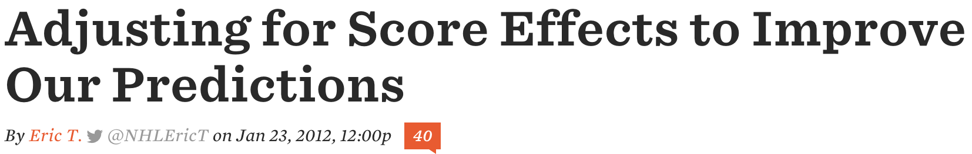
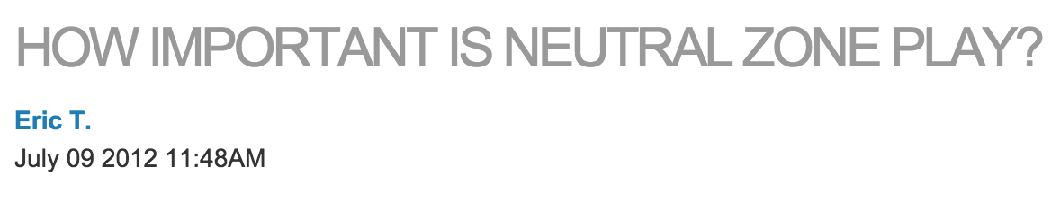
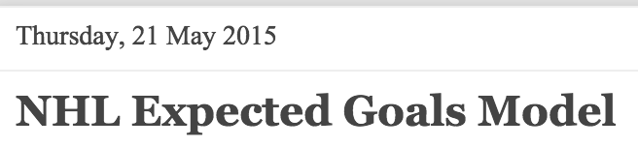
Articles for related discussion
http://www.broadstreethockey.com/2012/1/23/2722089/score-adjusted-fenwick
http://nhlnumbers.com/2012/7/9/how-important-is-neutral-zone-play
http://donttellmeaboutheart.blogspot.com/2015/05/nhl-expected-goals-model.html

