Slide 1
Lecture 5: Methods for categorical outcomes

Slide 2
Goals
How to analyze shot outcomes?
Tools
Expected value
Visualizations

Slide 3
Variables impacting FG %

Slide 4
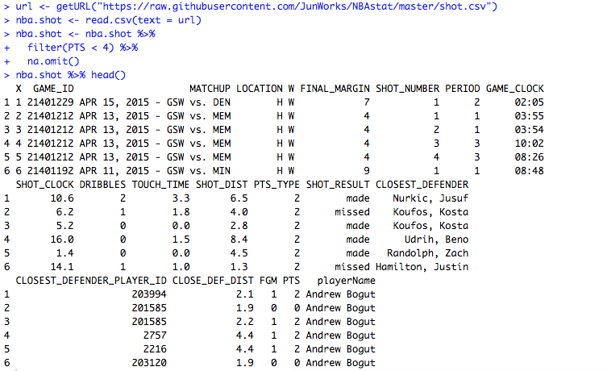
Variables impacting FG %

Slide 5
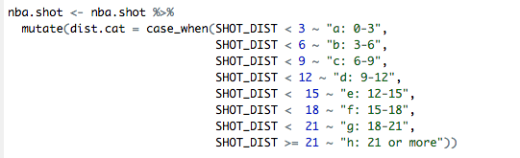
Variables impacting FG %

Slide 6
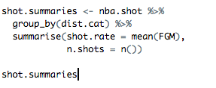
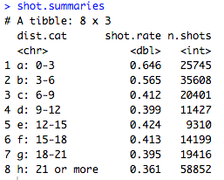
Variables impacting FG %

Slide 7

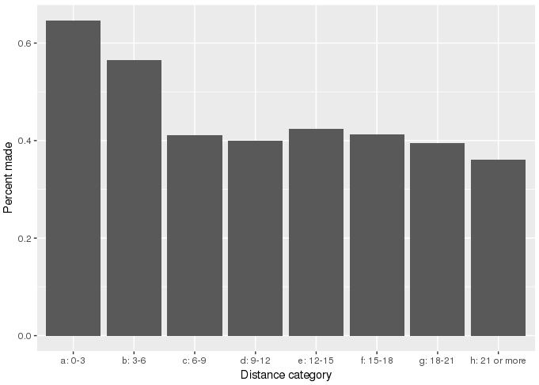
Variables impacting FG %

Slide 8
Expected value Formula: Calculate the expected value for each of the shot distances below

Slide 9

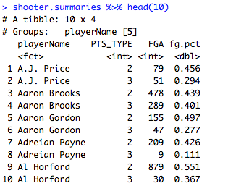
Expected value, players

Slide 10
Expected value, players

Slide 11
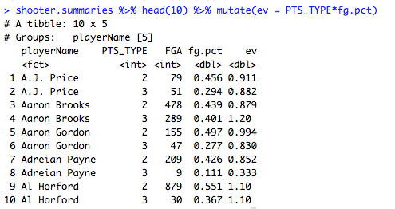
Expected value, players

Slide 12
Considerations besides expected value

Slide 13

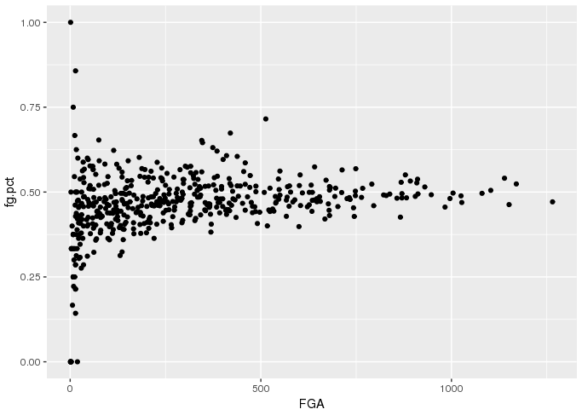
How accurate are field goal percentages?

Slide 14

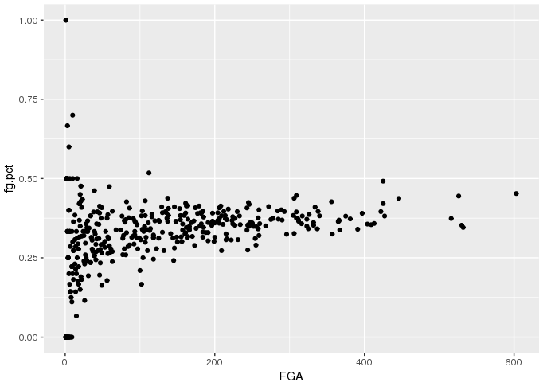
How accurate are field goal percentages?

Slide 15
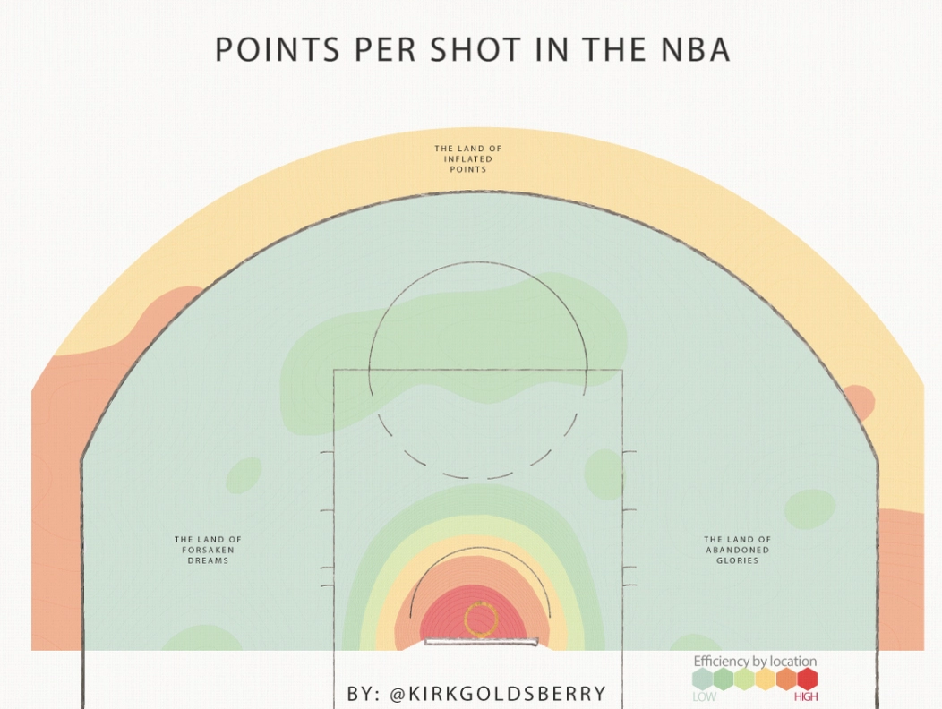
The three pointer
http://grantland.com/the-triangle/is-it-time-to-move-the-nba-3-point-line-back/

Slide 16
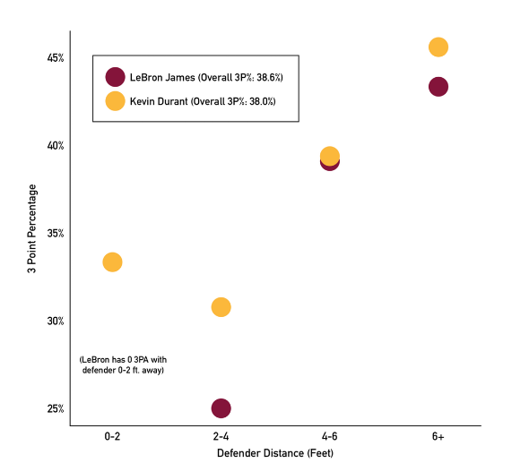
Simpson’s Paradox

Slide 17
Simpson’s Paradox

