Slide 1
Lecture 6: NFL, expected points, game theory

Slide 2
Goals
Expected points
NFL decision-making
Tools
Expected value
Tools for handling several categorical variables

Slide 3
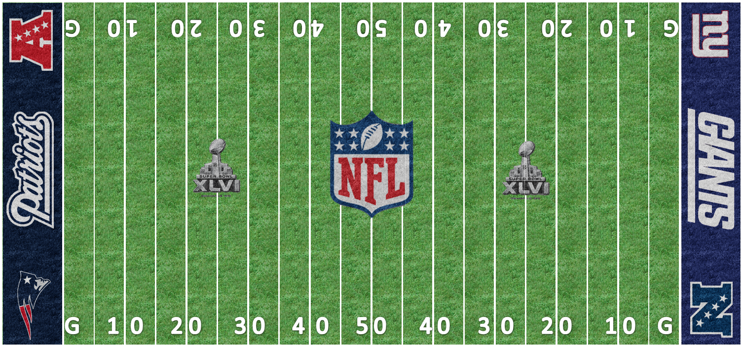
Formal definition: expected points
“Given any combination of down, yards to go, and distance from the end zone, the expected value of the points from that position are equal to the average of every next score from that position.” - Causey
Function of 3 play-specific characteristics: down, distance, yard line.

Slide 4
Some probability:
Expectation of random variable

Slide 5
Expected value calculations
Point totals fixed – stated in terms of offense
-8, -7, -6, -3, -2, 0, 2, 3, 6, 7, 8
Probabilities are the probability that each point total is the next one scored
Conditional on down, distance, yard line

Slide 6
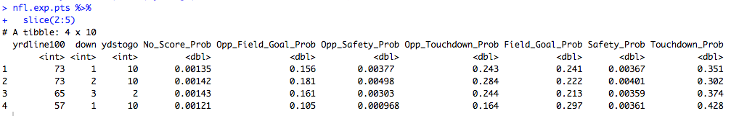
Some probability:

Slide 7
Expected value calculations
Ex: First and 10, 73 yards till the goalline
E(X) =

Slide 8
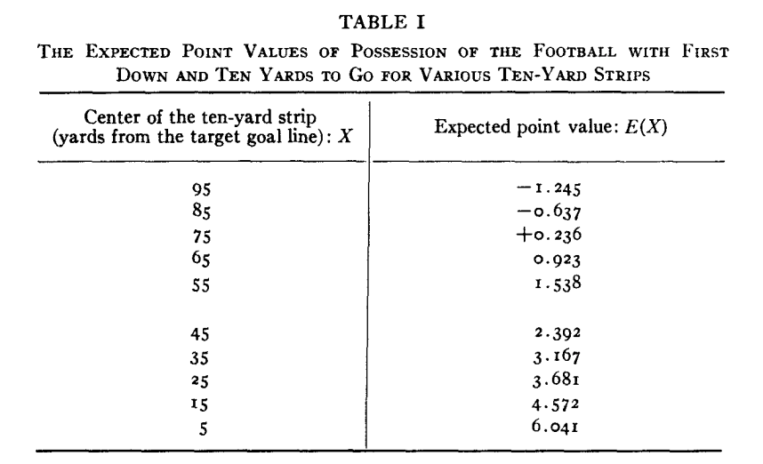
Expected value estimates
-Carter/Machol, 1971

Slide 9
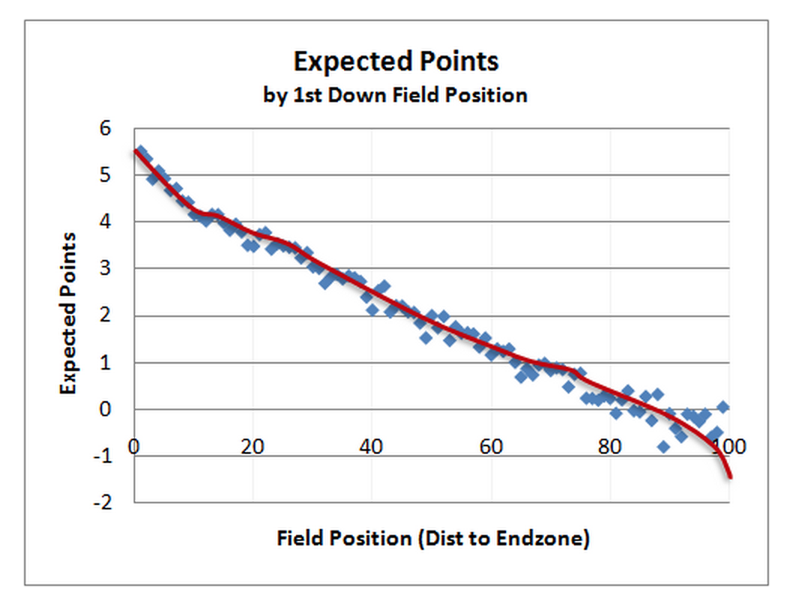
Expected value estimates
-Burke, 2010

Slide 10
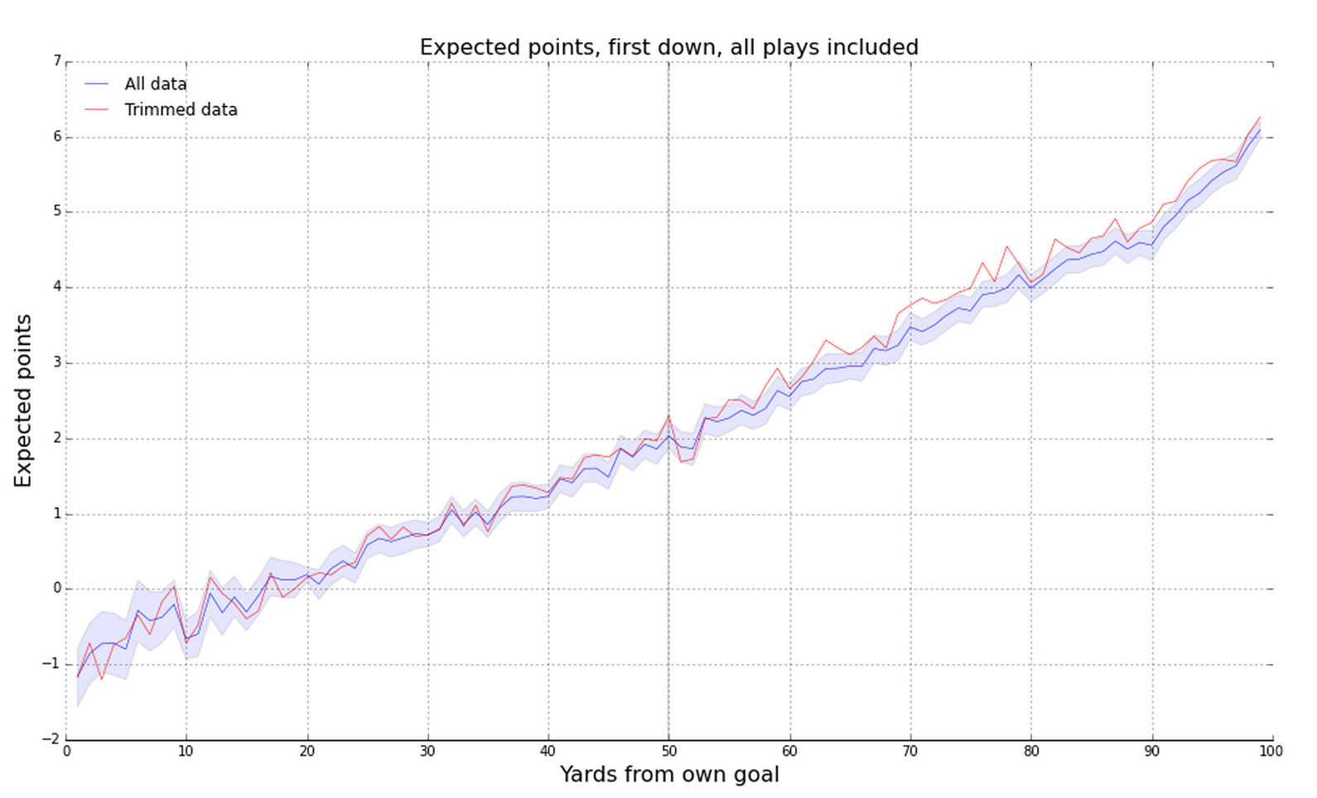
Expected value estimates
-Trey Causey, 2015

Slide 11
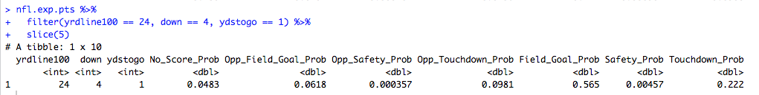
Expected points and NFL decisions
Example:
4th - 2 from opponents 23-yard line
E(X) =

Slide 12
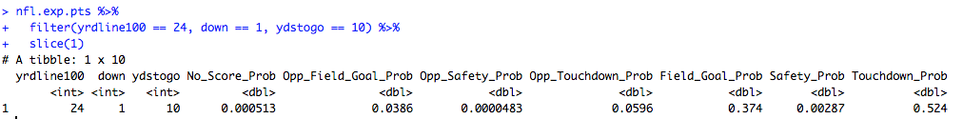
Expected points and NFL decisions
Example:
4th - 2 from opponents 23-yard line
Expected points, field goal:
Expected points, go for it, make it

Slide 13
Expected points and NFL decisions
Example:
4th - 2 from opponents 23-yard line
Issues with estimated E(X)

Slide 14
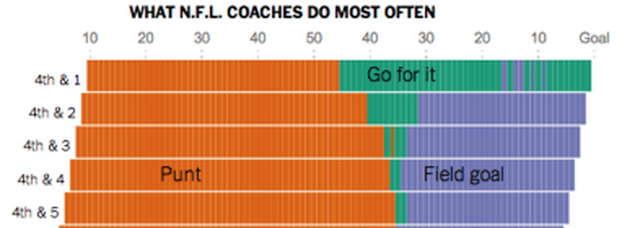
Expected points and NFL decisions
How do coaches behave?

Slide 15
Expected points and NFL decisions
Details
Quarters 1/3 & closer games receive priority
Extensions: Expected points added
- Ex 1: Kicker value
- Ex 2: Play value
- Ex 3: Play choice
Weaknesses: Not all points created equally

Slide 16
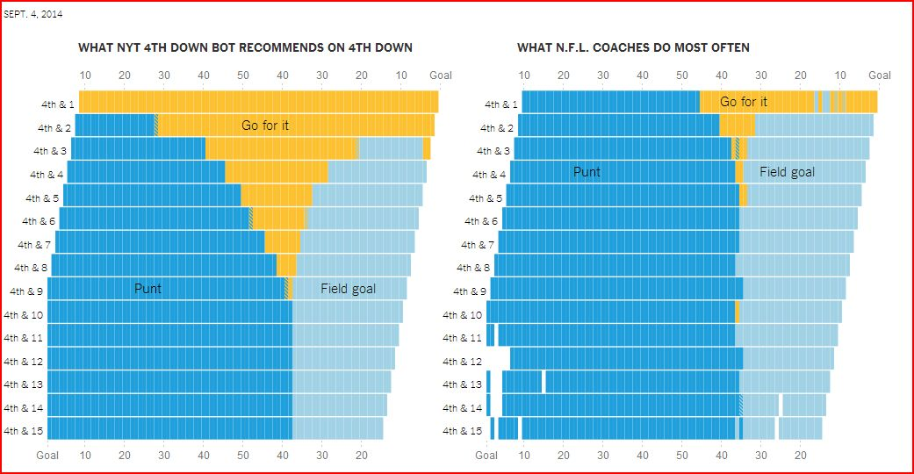
NFL Decisions

Slide 17
NFL Decisions
Reasons for passive strategy
Minimax
Prospect theory
Risk aversion

Slide 18
NFL Decisions: Minimax
Minimax: decision that minimizes possible loss in worst case scenario
Ex: 4th and 2 from opponents 23

Slide 19
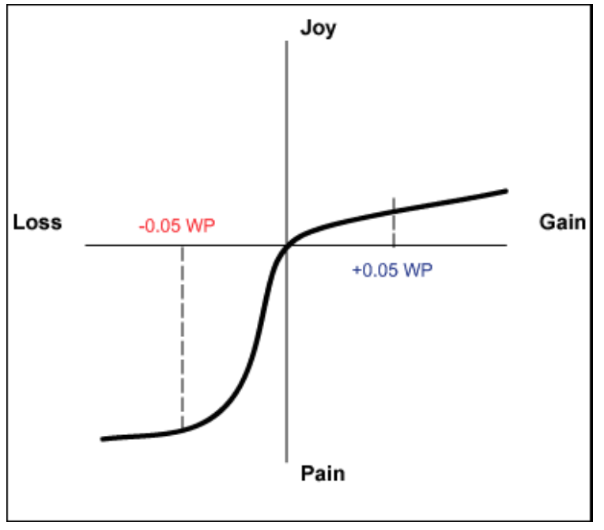
NFL Decisions: Prospect Theory
Prospect theory: humans make decisions based on value of losses and gains, and not on final outcome – and fear of losses outweighs equivalent gains.
Ex: Run versus pass

Slide 20
NFL Decisions: Risk aversion
Risk adverse: reluctance to accept bargain in favor of decision with more certain – but possibly lower - payoff
"Had we done that [gone for it] after what we had done to get down there and [not scored a touchdown], I can imagine what the critique would have been today about the play call.” – Brian Billick
“You guys might very well be right that we’re calling something too conservative in that situation. But what you guys don’t understand is that if I make a call that’s viewed to be controversial by the fans and the owner, and I fall, I lose my job” – Marvin Lewis
What was Mike Smith thinking

Slide 21
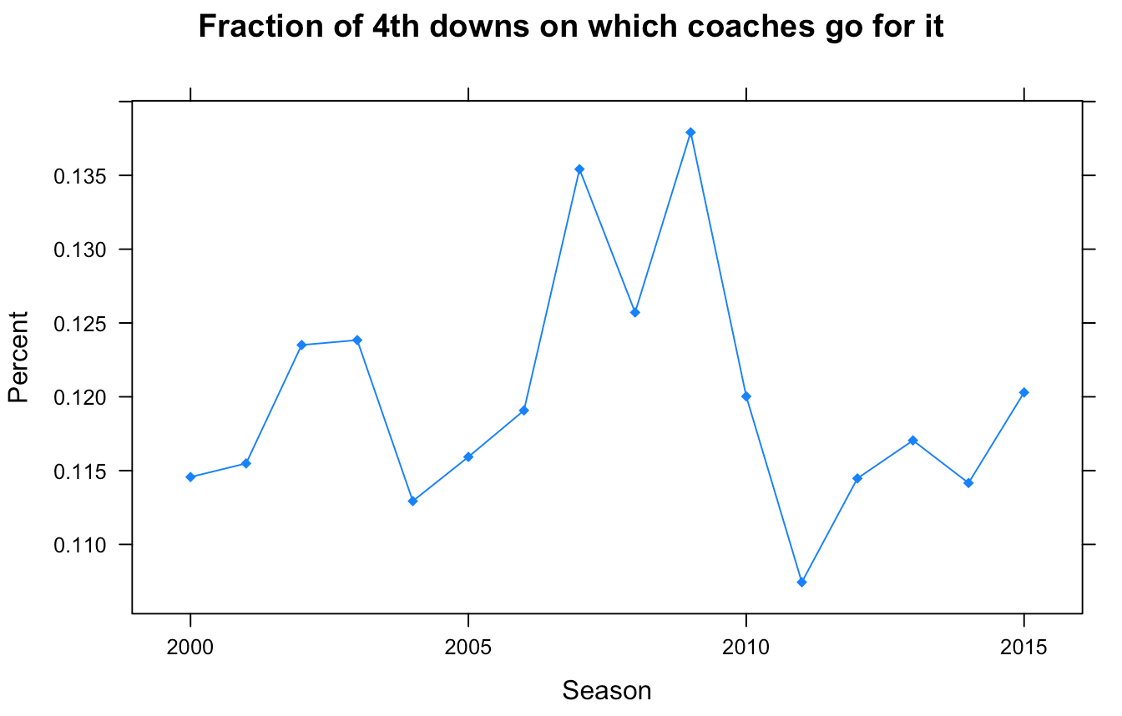
NFL Decisions:

Slide 22
NFL Decisions: Famous instances
(i) Does article deal with expected points?
(ii) Does statistics back up the coaches’ decision or not?
(iii) Explain how statistics is or could be used in this scenario
(iv) Describe play (down, distance, time) and game (playoffs?) characteristics
(v) Identify possible heuristics at work

