Slide 1
Statistics Jeopardy
Normal | Graphs | Grab Bag | Hypothesis | Trivia
$100 | $100 | $100 | $100 | $100
$200 | $200 | $200 | $200 | $200
$300 | $300 | $300 | $300 | $300
$400 | $400 | $400 | $400 | $400

Slide 2
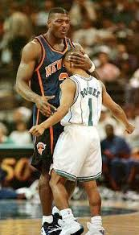
Normal for $100
NBA player heights are normally distributed with mean 78 inches and standard deviation 4.5 inches. What is the probability of someone being as short as 63 inches (Mugsy Bogues)?

Slide 3
Normal for $100
NBA player heights are normally distributed with mean 78 inches and standard deviation 4.5 inches. What is the probability of someone being as short as 63 inches (Mugsy Bogues)?
  z-score = -3.33, pnorm(-3.33) = 0.0004

Slide 4
Normal for $200
A battery life is normally distributed with mean 30 hours and standard deviation 4 hours. What percent of batteries last between 29 and 32 hours?

Slide 5
Normal for $200
A battery life is normally distributed with mean 30 hours and standard deviation 4 hours. What percent of batteries last between 29 and 32 hours?
z₂₉ = -0.25, pnorm(-0.25) = 0.40
z₃₂ = 0.50, pnorm(-0.25) = 0.69
0.69 – 0.40 = 0.29

Slide 6
Normal for $300
Jack scored a 520 on his Math SAT (overall mean 500, sd 100). He also found out that his SAT percentile was the same as on his ACT percentile (mean 21, sd 5). What score did he receive on the ACT?

Slide 7
Normal for $300
Jack scored a 520 on his Math SAT (overall mean 500, sd 100). He also found out that his percentile was the same as on his ACT (mean 21, sd 5). What score did he receive on the ACT?
1) SAT: z-score = 0.2
2) x = 0.2*5+21 = 22

Slide 8
Normal for $400
In 2013, the Pew Research Foundation reported that 45% of U.S. adults report that they live with one or more chronic conditions. However, this value was based on a sample – the study reported a standard error of about 1.2%, and a normal model may reasonably be used in this setting. Create a 99% confidence interval for the proportion of U.S. adults who live with one or more chronic conditions

Slide 9
Normal for $400
In 2013, the Pew Research Foundation reported that 45% of U.S. adults report that they live with one or more chronic conditions. However, this value was based on a sample – the study reported a standard error of about 1.2%, and a normal model may reasonably be used in this setting. Create a 99% confidence interval for the proportion of U.S. adults who live with one or more chronic conditions.
  0.45+/- 2.58(0.012) = (41.9, 48.1)

Slide 10
Graphs for $100
Name two measures of centrality or spread that are resistant/robust to outliers?

Slide 11
Graphs for $100
Name two measures of centrality or spread that are resistant/robust to outliers?
IQR, median, mode

Slide 12
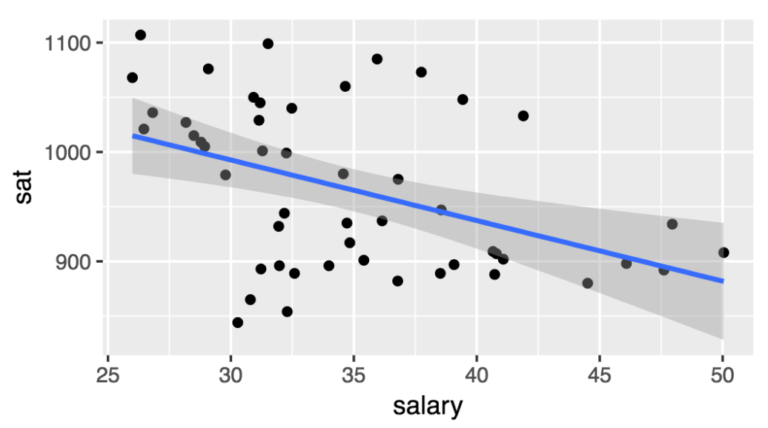
Graphs for $200
Estimate the residual for New York, a state that pays teachers 44k a year and has an average SAT score of 878

Slide 13
Graphs for $200
Estimate the residual for New York, a state that pays teachers 44k a year and has an average SAT score of 878

Slide 14
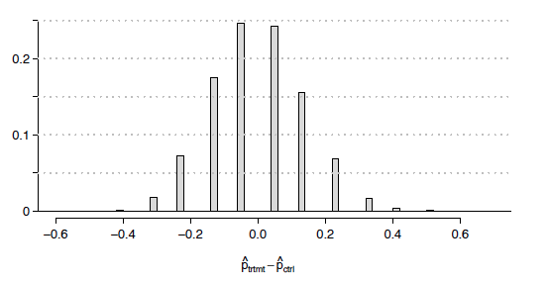
Graphs for $300
In the histogram below, what percent of simulations yielded a estimated difference less than -0.20?

Slide 15
Graphs for $300
In the histogram below, what percent of simulations yielded a estimated difference less than -0.20?
0.08+ 0.02 is approximately 0.10

Slide 16
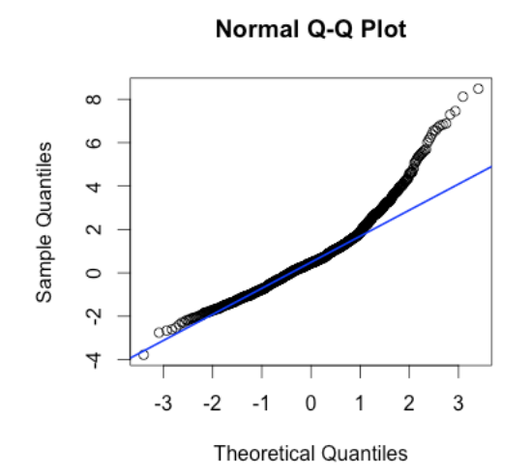
Graphs for $400
Describe the shape of distribution that would yield the following QQ-plot

Slide 17
Graphs for $400
Describe the shape of distribution that would yield the following QQ-plot
Skew right

Slide 18
Grab Bag for $100
True or False: The lower the p-value, the lower the probability that the null hypothesis is true

Slide 19
Grab Bag for $100
True or False: The lower the p-value, the lower the probability that the null hypothesis is true
FALSE

Slide 20
Grab Bag for $200
What percent of the standard normal curve is found in the region?
  P(-2 < z < 1)

Slide 21
Grab Bag for $200
What percent of the standard normal curve is found in the region?
  P(-2 < z < 1)
  P(z < -2) = 0.025
  P(z < 1 ) = 0.84
  P(z < -2) – P(z < 1) = 0.815

Slide 22
Grab Bag for $300
True or False: The null and alternative hypotheses are stated in terms of a population parameter

Slide 23
Grab Bag for $300
True or False: The null and alternative hypotheses are stated in terms of a population parameter
TRUE:
Example
H₀: p = 0.20
H_{a}: p > 0.20

Slide 24
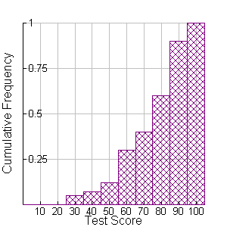
Grab Bag for $400
What is the median of this distribution and what % scored above 70?

Slide 25
Grab Bag for $400
What is the median of this distribution and what % scored above 70?
Median: a little below 80
About 60% above 70

Slide 26
Hypothesis for $100
What type of error will yield students to needlessly carry an umbrella around?
H_{o}: Sunny weather
H_{a}: Rainy weather

Slide 27
Hypothesis for $100
What type of error will yield students to needlessly carry an umbrella around?
H_{o}: Sunny weather
H_{a}: Rainy weather
      Type I: Predicting rain when it’s actually sunny

Slide 28
Hypothesis for $200
Define p-value

Slide 29
Hypothesis for $200
Define p-value
Probability of observing data as extreme as the given sample under the null hypothesis

Slide 30
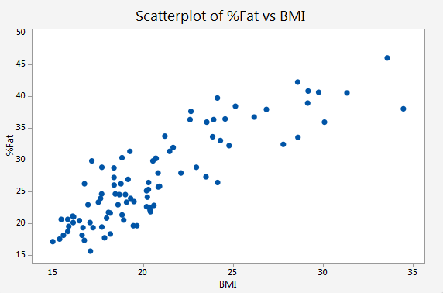
Hypothesis for $300
Estimate the correlation coefficient and the slope in the following graph of percent body fat versus BMI

Slide 31
Hypothesis for $300
Estimate the correlation coefficient and the slope in the following graph of percent body fat versus BMI
Correlation: roughly 0.85
Slope: roughly 2

Slide 32
Hypothesis for $400
In a study of heart disease, 90 of 100 patients receiving the treatment pill survived, compared to 80 of 100 receiving the placebo. Identify the point estimate for the difference in survival rates, and state the null and alternative hypothesis.

Slide 33
Hypothesis for $400
In a study of heart disease, 90 of 100 patients receiving the treatment pill survived, compared to 80 of 100 receiving the placebo. Identify the point estimate for the difference in survival rates, and state the null and alternative hypothesis.
Test statistic: 0.10, H₀:p_{t}=p_{c}, H_{a:} p_{t} ≠ p_{c}

Slide 34
Trivia for $100
What is the capital of Canada?

Slide 35
Trivia for $100
What is the capital of Canada?
  Ottawa

Slide 36
Trivia for $200
What four states have banned the use of billboards?

Slide 37
Trivia for $200
What four states have banned the use of billboards?
Maine, Vermont, Alaska, Hawaii

Slide 38
Trivia for $300
Name the four presidents who have state capitals named after them.

Slide 39
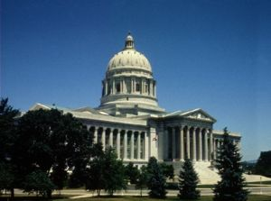
Trivia for $300
Name the four presidents who have state capitals named after them.
Madison, Lincoln, Jefferson City,
Jackson

Slide 40
Trivia for $400
Name the five presidents with four-letter last names.

Slide 41
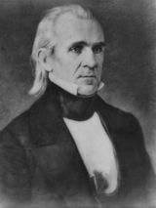
Trivia for $400
Name the five presidents with four-letter last names.
GW Bush, GHW Bush, Ford, Taft, Polk

