Slide 1


Causal inference in healthcare studies with multiple treatments
Michael J. Lopez
(joint work with Roee Gutman)
April, 2016
New England Statistics Symposium

Slide 2







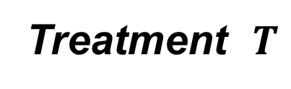
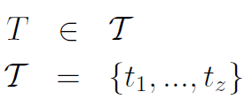

Study population, Z treatments

Slide 3
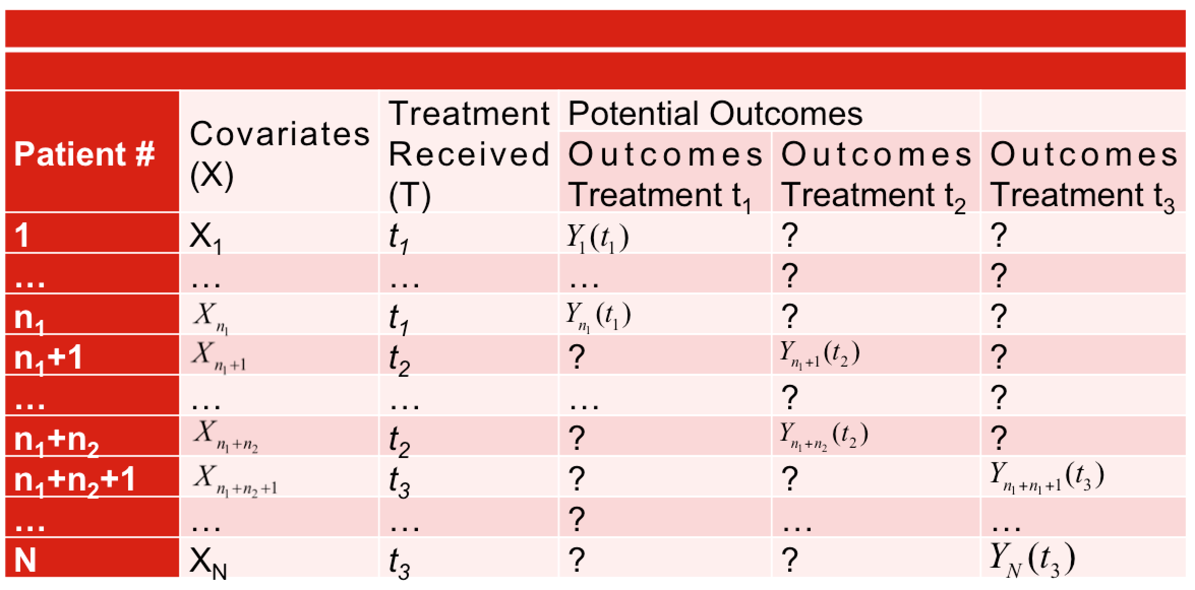
Study Population, In a table (Z =3)

Slide 4











Randomized Design, Z = 3 treatments

Slide 5
Randomized Design, Z = 3 treatments
Issues:
-Expensive
-Unethical
-Restricted population

Slide 6
What’s the problem with observational data?

Slide 7
Problem #1
Subjects choose treatment
Treatment selection bias
Propensity score (PS) for binary treatment (Rosenbaum & Rubin, 1983)
e(X) = P(T = t₁|X)
Limited extensions of PS tools for multiple treatments
R(X) = (P(T = t₁|X), …, P(T = t_{Z}|X))

Slide 8
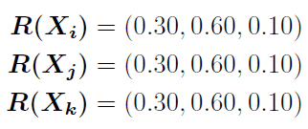
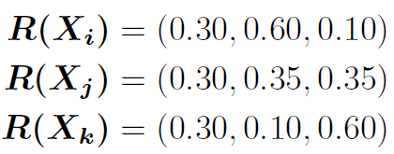
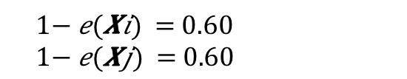
Problem #1
Multidimensional nature of treatment assignment
Binary treatment:
e(X_{i}) = 0.30 1 - e(X_{i}) = 0.70
e(X_{j}) = 0.30 1 - e(X_{j}) = 0.70
Multiple treatments (Z = 3)

Slide 9
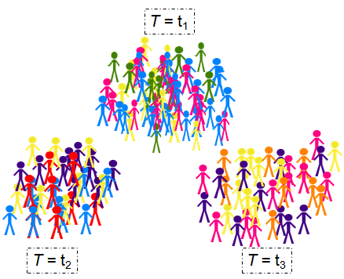
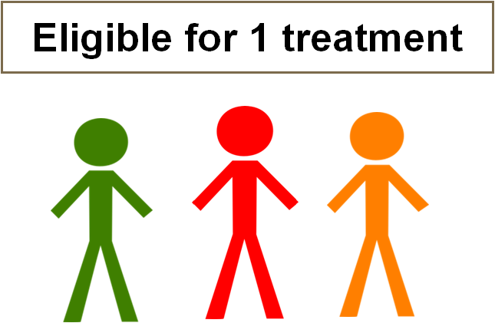
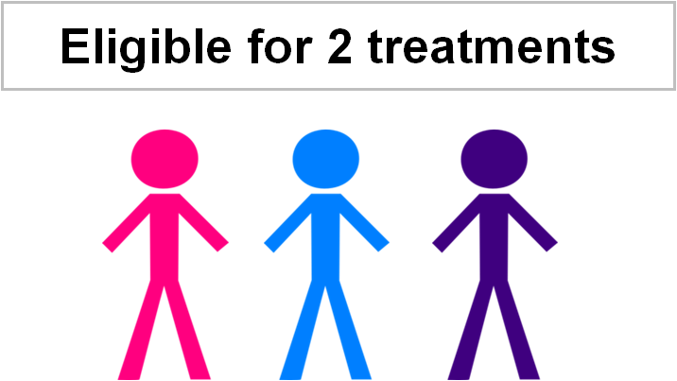
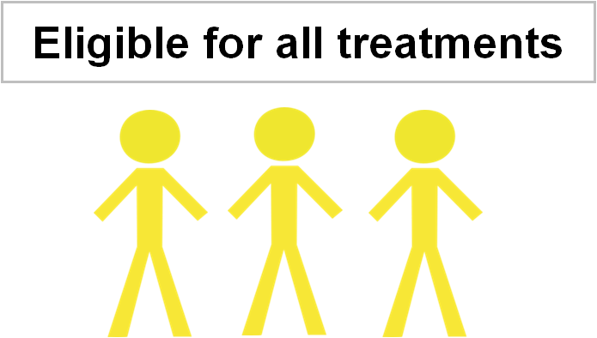
Problem #2
Different populations of interest
Subjects eligible for one treatment? two? three?
Estimates impacted by our population choice

Slide 10
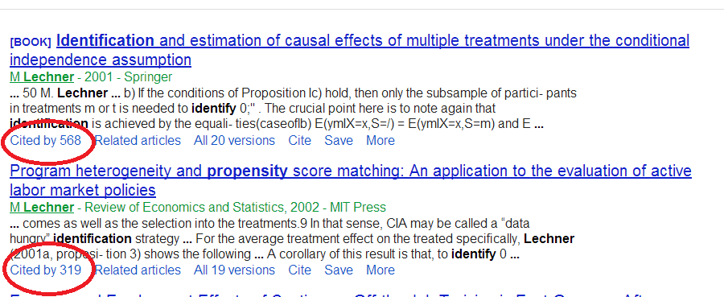
Problem #3
Binary approach
Lechner (2001, 2002)

Slide 11
Aims:
1. Unifying terminology, specify estimand of interest
2 Issues with binary approaches
Method for matching on R(X)
Simulations to judge success

Slide 12
The assignment mechanism
P(T=t|Y(t₁),…,Y(t_{Z}), X)
Individualistic
Safe to assume in a random sample
Probabilistic
Probability of treatment assignment to unit is exactly between 0 and 1
Unconfounded
P(T=t|Y(t₁),…,Y(t_{Z}), X) =P(T=t|X)

Slide 13
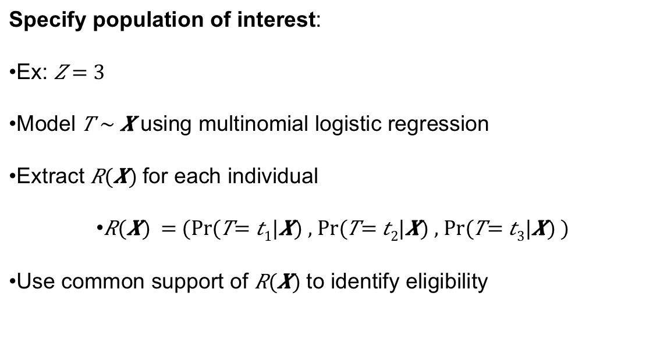
Specify population, estimand of interest
Specify population of interest:
Ex:
Model using multinomial logistic regression
Extract for each individual
Use common support of to identify eligibility

Slide 14
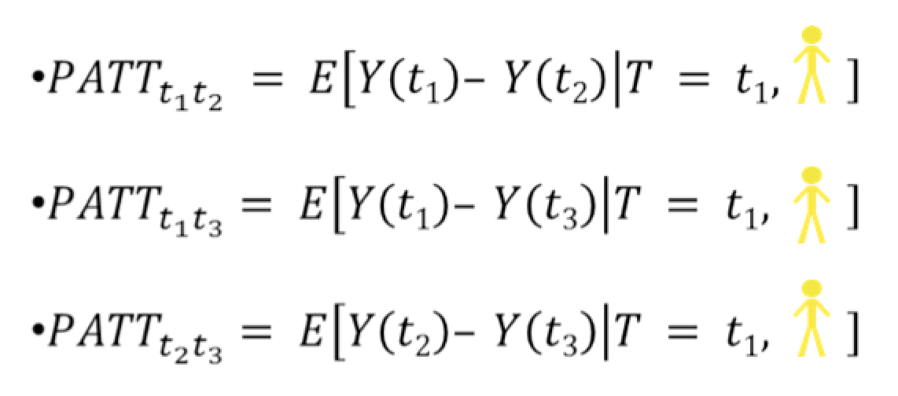
Specify population, estimand of interest

Slide 15
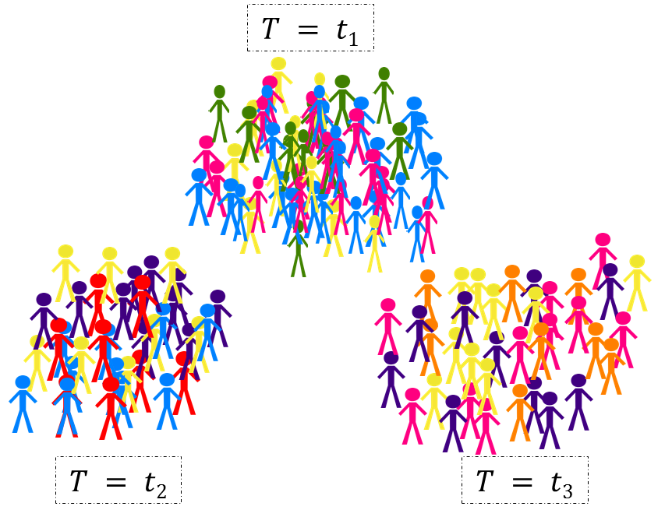
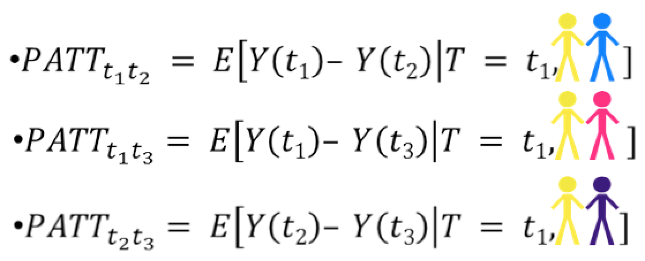
Binary applications to multiple treatments
Lechner (2001, 2002)

Slide 16
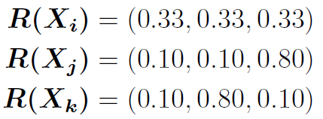
Binary applications to multiple treatments
Problem I
Transitivity
Policy implications
Problem II
Poor matches

Slide 17
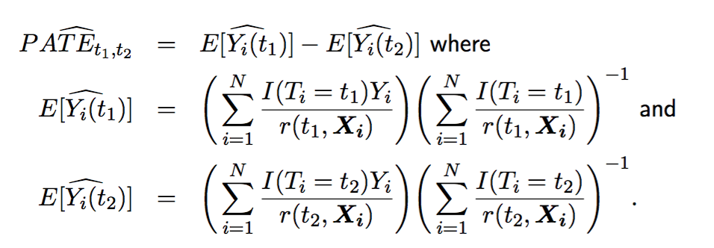
Other common approach
Inverse Probability Weighting (IPW)
Where do weights come from?
Multinomial logistic regression/multinomial probit
Generalized boosted models (McCaffrey, 2013)

Slide 18
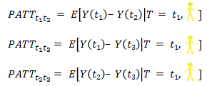
Proposed method: vector matching
Benefits
Transitivity
Policy implications
So how do we match on a vector?

Slide 19
Proposed method: vector matching
Stratify on $R(X)$, match within strata (“Vector Matching”)

Slide 20
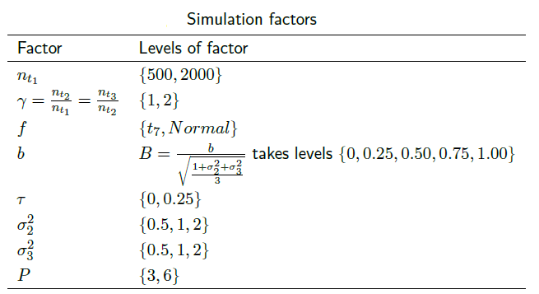

Simulations
How does VM compare to other approaches for multiple treatments
Binary methods (CRM), weighting (IPW)
Given $X$, how similar are subjects that are matched?
Measured by standardized bias
What percent of eligible subjects are matched?

Slide 21
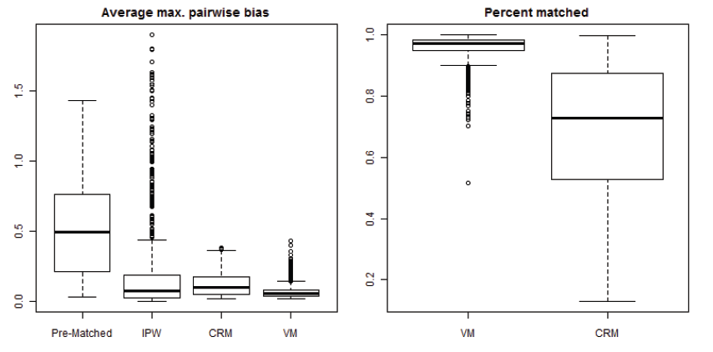
Simulations
Each point represents average of 200 simulations (1080 configurations)

Slide 22
Conclusions
Importance of defining a causal estimand
Issues with binary matching application
Low bias, high % matched using Vector Matching

Slide 23
Thank you!!
See statsbylopez.com/research to read the paper

Slide 24
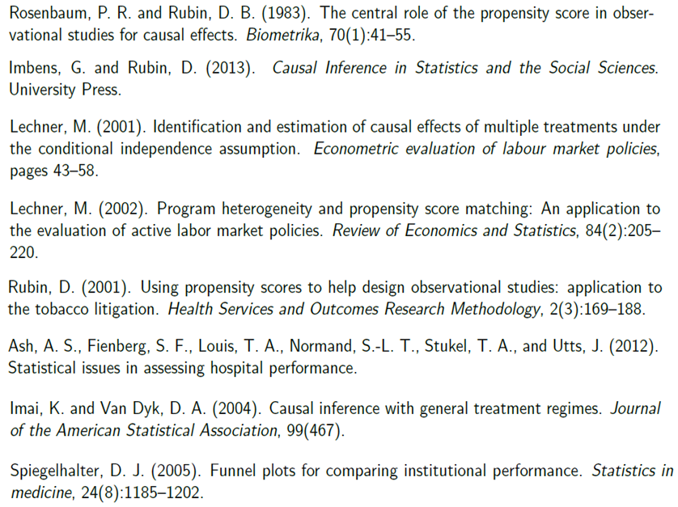
Citations

Slide 25
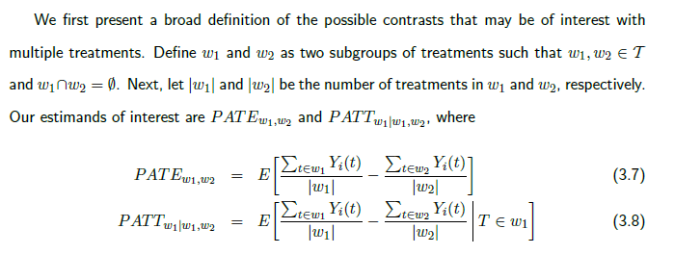

Slide 26
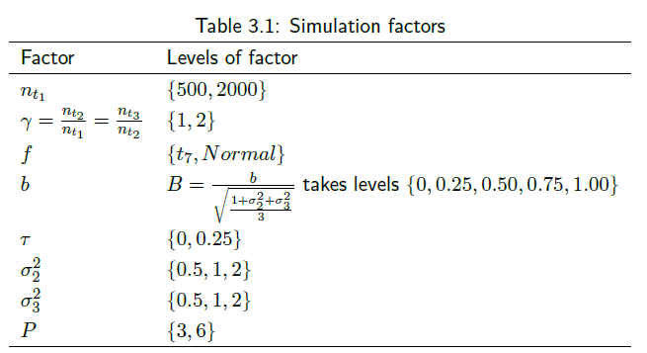

Slide 27
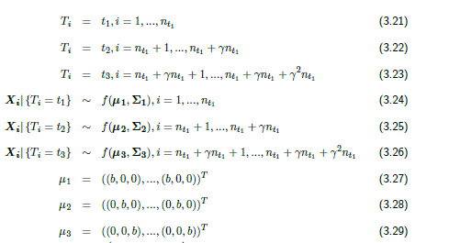
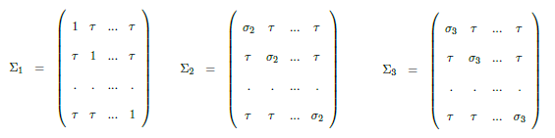

Slide 28
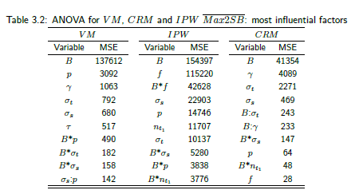

Slide 29
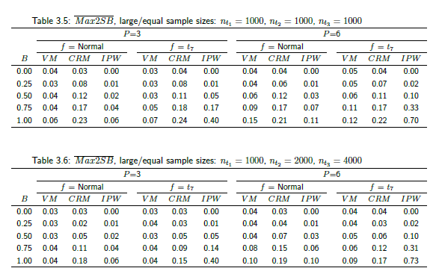

Slide 30
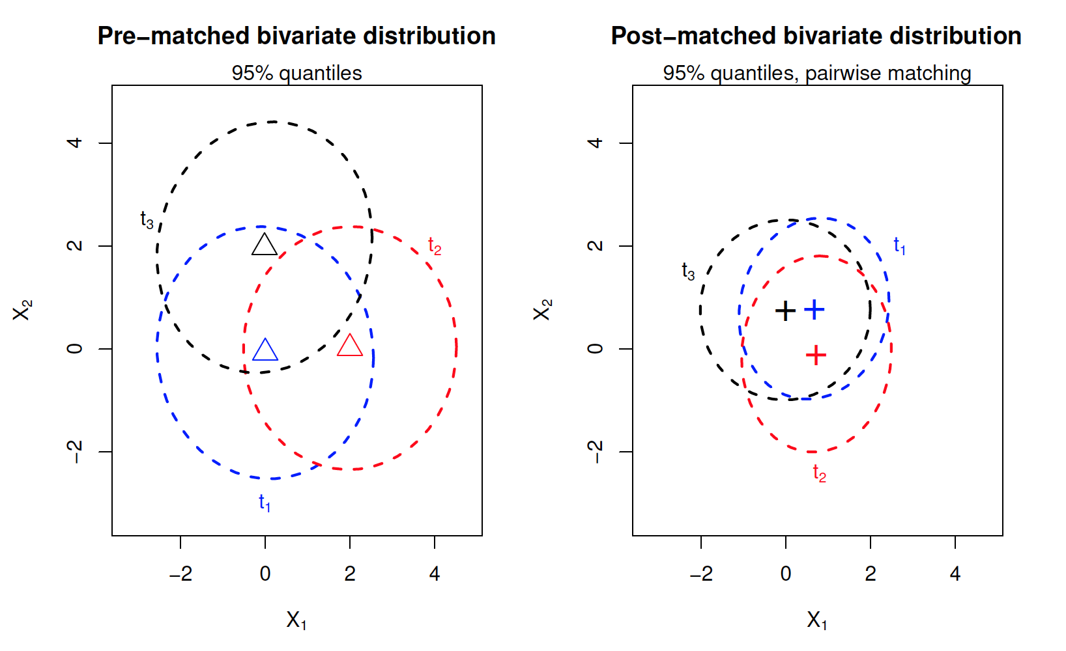

Slide 31
