Slide 1

Welcome!
T. ARNOLD

Slide 2
Introduction to Data Science
Today we are going to get all of the administrative details dealt with. Here is a quick outline:
– give a brief overview of the course material
– go through the syllabus
– tell you a bit about myself
– install software
– answer any additional questions
T. ARNOLD

Slide 3
Data Science?
Data science is an interdisciplinary field concerned with drawing knowledge from data and communicating those results to various audiences.
Unlike many other fields that you may be familiar with, data science focused on the creation and application of methods, rather than theoretical or foundational questions.
This semester we will learn and practice a series of methods for organizing, collecting, visualizing, manipulating, and exploring different kinds of data.
T. ARNOLD

Slide 4
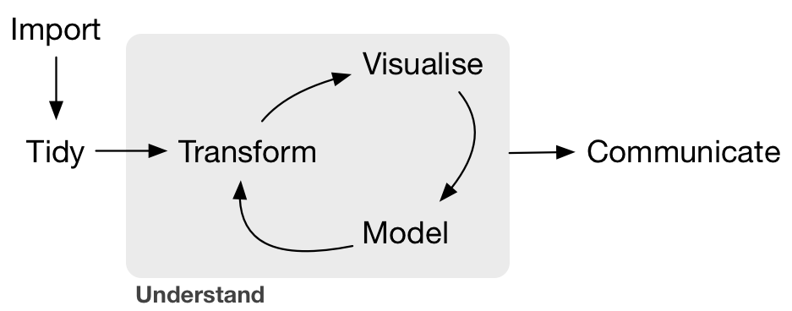
Data Science Pipeline
Grolemund & Wickham R4DS Illustration
T. ARNOLD

Slide 5
Perspectives
Most students really enjoy this course. We learn skills that are important to doing technical work in almost any field while playing around with a variety of interesting datasets in a relatively low-stress setting.
The most important thing is to have an open mind about what we will be covering this semester. Note that:
– this is NOT a mathematics class, despite the name of the course
– the topics covered are very different from those in an introductory
statistics course
– it often resembles a computer science course, but keep in mind that
different techniques are needed for data science scripting than you may
have learned in other CS courses
T. ARNOLD

Slide 6


Programming
There are several different programming languages for data science. By far the two most popular are R and Python.
We will be using R this semester but will learn a version that is easily adapted to other languages such as Python.
In the last week I will demo the use of Python and JavaScript based on the the class material.
T. ARNOLD

Slide 7
Grading
There are three elements that you will get graded on this semester:
– Exams: four take-home, home-book exams
– Homework: readings posted on website; graded on
self-reported completion using course form
– Engagement: short essay due on last day of class reflecting
on effort/participation/engagement
Your final grade is determined by averaging together these six grades. More details and the specific grading scales used to convert between number and letter grades are given in the syllabus.
T. ARNOLD

Slide 8
Class Structure
Most course meetings are organized as follows:
— homework I: carefully read any posted notes on the website and
formulate questions for the next class (30-90 minutes)
— course form: fill out at the start of class (< 1 minute)
— discussion / slides: review readings or previous notebooks, discuss any
questions, perhaps start classwork together (15-30 minutes)
— classwork: work individually or in small groups to answer questions in
the form of programming notebooks (45-60 minutes)
— homework II: finish classwork or review posted solutions (0-60 minutes)
All materials can be found on the course website.
T. ARNOLD

Slide 9
Attendance
It is important to attend class as much as possible, though it is also important to stay home if you are feeling ill. The class form will ask, when you are absent, to give an explanation. Just a few words will suffice (i.e., "feeling ill", "job interview", "needed a personal day").
If absences are relatively rare and/or justified,† they will not affect your grade. When I feel that they are excessive, I will reach out to individuals before taking any punitive action.
† A specific cut-off is hard to define. As a guideline, 2-3 absences for any reason is fine. A few more in the case of illness are also okay. Beyond that we will likely have to talk.
T. ARNOLD

Slide 10
Questions & Office Hours
We will usually have a lot of time in class to answer any questions you have about the course material. I am usually around before and after class for additional questions.
Please also feel free to send questions by email. I typically respond within 24 hours.
Finally, I am of course happy to schedule an office hours meeting for extended questions or personal concerns. Just send me an email with your availability at least 1 day before you'd like to meet.
T. ARNOLD

Slide 11

Coffee chat?
I get a lot of requests for longer discussions about graduate school, careers in data science, or research projects.
I love having these conversations with students. Just send me an email or ask after class and we can find a time to grab coffee/tea/whatever and answer any questions you have.
T. ARNOLD

Slide 12
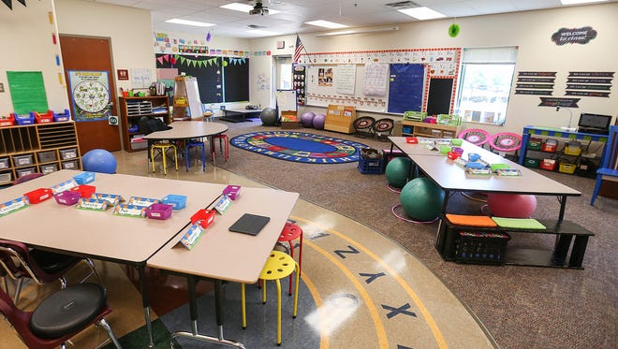
Masks and Such
As I mentioned in my first email to the class, policies regarding COVID-19 are constantly changing. In fact, they already have!
Following the UR guidelines, for the first three weeks we will wear masks while in class. We can re-assess the situation after that point.
Faculty are also asked to create a seating chart (kindergarten-style, see image). Think about where and with whom you would like to sit. I will use whatever configuration we have in class on Thursday.
T. ARNOLD

Slide 13
Course Sequence
This course assumes you have some experience using code to manipulate data. It makes no assumptions about your knowledge of any specific programing language or knowledge of statistical inference.
MATH 289
MATH 389
The class is designed as a year-long sequence paired with MATH 389; I strongly suggest taking both during the same academic year if possible.
T. ARNOLD

Slide 14
Data Science Pipeline
Focus of MATH 289
Grolemund & Wickham R4DS Illustration
T. ARNOLD

Slide 15
Data Science Pipeline
Grolemund & Wickham R4DS Illustration
Focus of MATH 389
T. ARNOLD

Slide 16
Course Topics
See tentative topics posted on the course website.
T. ARNOLD

Slide 17







About Me
- From New England: born in Maine, school in MA, ME, CT
- Moved to Richmond in 2016
- Research on large text and image datasets in linguistics and cultural studies
T. ARNOLD

Slide 18





About Me
- Lots of industry experience in DS:
- IBM (Healthcare)
- Travelers (Insurance)
- DARPA (social media)
- AT&T (location analytics)
- Telperian (pharmaceuticals)
T. ARNOLD

Slide 19
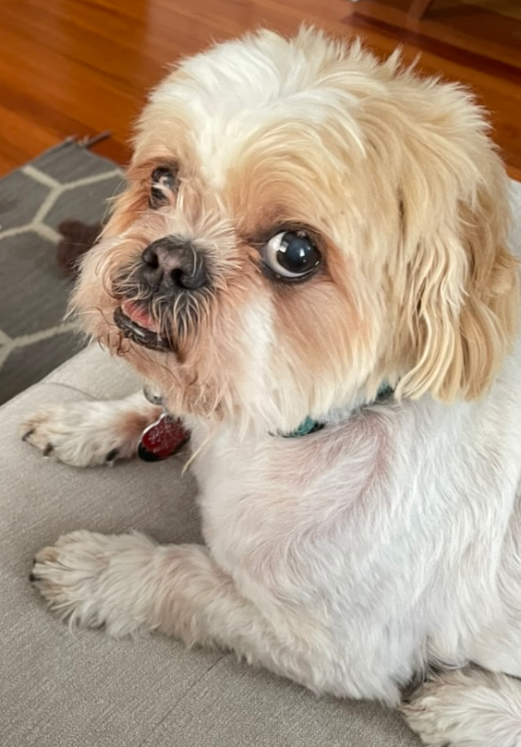
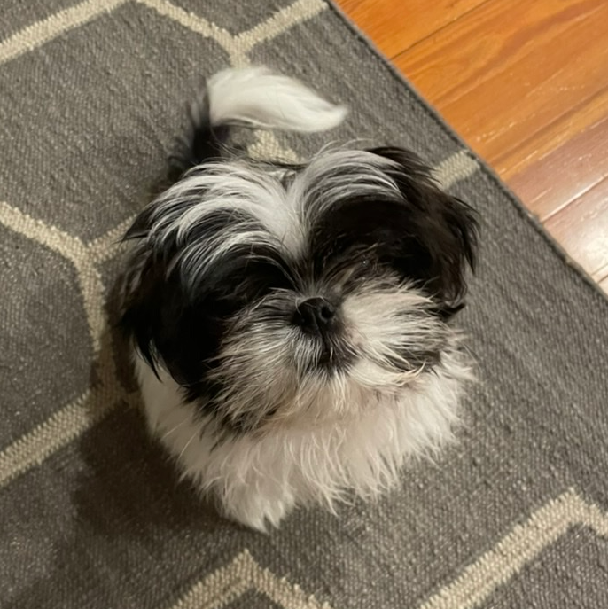
About Me
- I have two Shih-Tzus: Roux and Sargent
- Roux is often in my office; please come say hello
T. ARNOLD

