Slide 1

Introduction to Data Science
Welcome!
Note: I have been asked to have a fixed seating chart for the semester. So, pick your seat today carefully!
T. ARNOLD

Slide 2
Introduction to Data Science
Today we are going to get all of the administrative details dealt with. Here is a quick outline:
1. syllabus
2. course content
3. introductions
4. install course materials
There should be plenty of time for questions throughout the class.
T. ARNOLD

Slide 3
1. Syllabus
T. ARNOLD

Slide 4
Questions & Office Hours
We will usually have a lot of time in class to answer any questions you have about the course material. I am usually around before and after class for additional questions.
Please also feel free to send questions by email. I typically respond within 24 hours.
Finally, I am of course happy to schedule an office hours meeting for extended questions or personal concerns. Just send me an email with your availability at least 1 day before you'd like to meet.
T. ARNOLD

Slide 5

Coffee chat?
I get a lot of requests for longer discussions about graduate school, careers in data science, or research projects.
I love having these conversations with students. Just send me an email or ask after class and we can find a time to grab coffee/tea/whatever and answer any questions you have.
T. ARNOLD

Slide 6
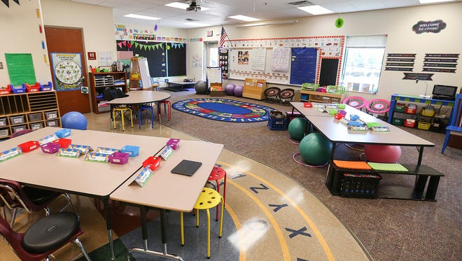
Masks and Such
As I mentioned in my first email to the class, policies regarding COVID-19 are constantly changing. In fact, they already have!
Following the UR guidelines, for the first three weeks we will wear masks while in class. We can re-assess the situation after that point.
Faculty are also asked to create a seating chart (kindergarten-style, see image), which we will do right now.
T. ARNOLD

Slide 7
2. Course Content
T. ARNOLD

Slide 8
Data Science?
This semester we will learn and practice a series of methods for organizing, collecting, visualizing, manipulating, and exploring different kinds of data. We are focused on the creation and application of methods, rather than theoretical or foundational questions.
This is not a mathematics course, nor will it resemble a traditional introductory statistics class. We will spend the entire semester writing code to apply data science concepts.
T. ARNOLD

Slide 9


Programming
There are several different programming languages for data science. By far the two most popular are R and Python.
We will be using R this semester but will learn a version that is easily adapted to other languages such as Python.
No specific experience with R or Python is expected!
T. ARNOLD

Slide 10
An Example
If you are not familiar with the kinds of tasks that are common in data science and exploratory data analysis, an example can be very helpful.
Here is a slightly dated but still the best concise example I know of:
https://www.youtube.com/watch?v=Z8t4k0Q8e8Y
T. ARNOLD

Slide 11
3. Introductions
T. ARNOLD

Slide 12







About Me
- From New England: born in Maine, school in MA, ME, CT
- Moved to Richmond in 2016
- Research on large text and image datasets in linguistics and cultural studies
T. ARNOLD

Slide 13





About Me
- Lots of industry experience in DS:
- IBM (Healthcare)
- Travelers (Insurance)
- DARPA (social media)
- AT&T (location analytics)
- Telperian (pharmaceuticals)
T. ARNOLD

Slide 14
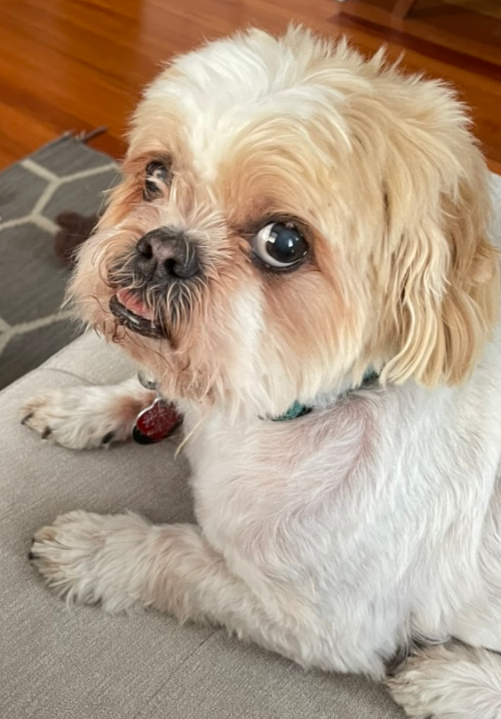

About Me
- I have two Shih-Tzus: Roux and Sargent
- Roux is often in my office; please come say hello
T. ARNOLD

Slide 15
4. Course Setup
[see other slides]
T. ARNOLD

