Slide 1

How to Organize Data
Learning how to organize a dataset is one of the most important skills you should leave this class with. The notes you read for today focused on the mechanics of doing data entry.
Here we will look at some of the higher-level concepts related to collecting data.
The central concept for understanding how to organize data is to know the unit of observation, the thing that one particular observation represents.
T. ARNOLD

Slide 2
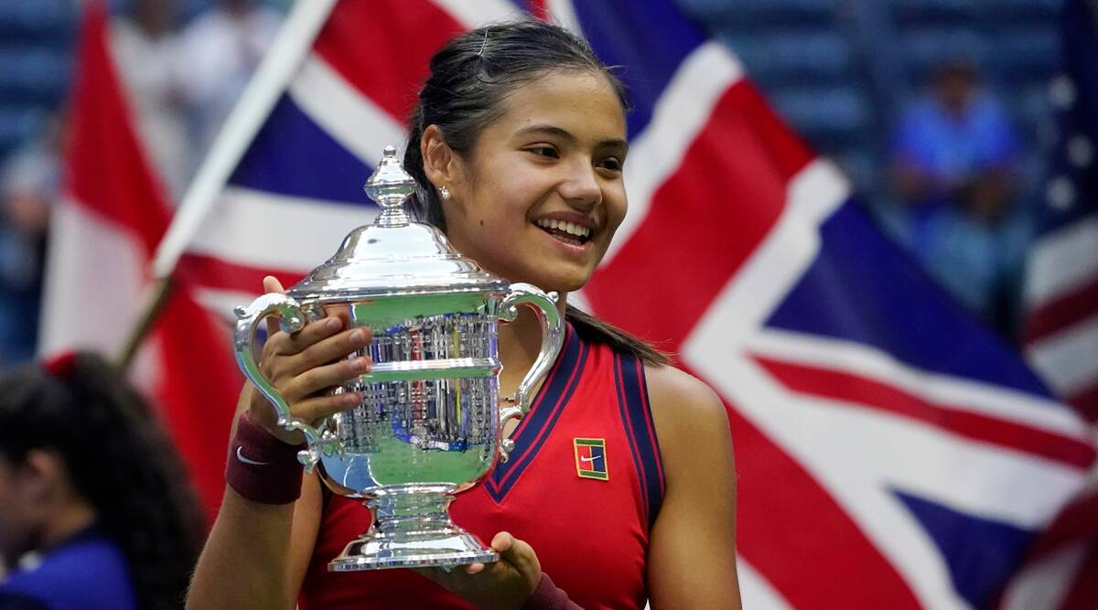
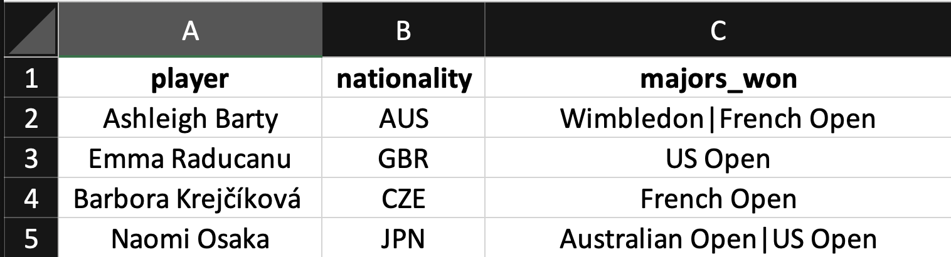
An Example
Consider the following dataset showing four female tennis players. Notice that the last column is trying to put multiple pieces of information in one value.
unit of observation: Player
T. ARNOLD

Slide 3
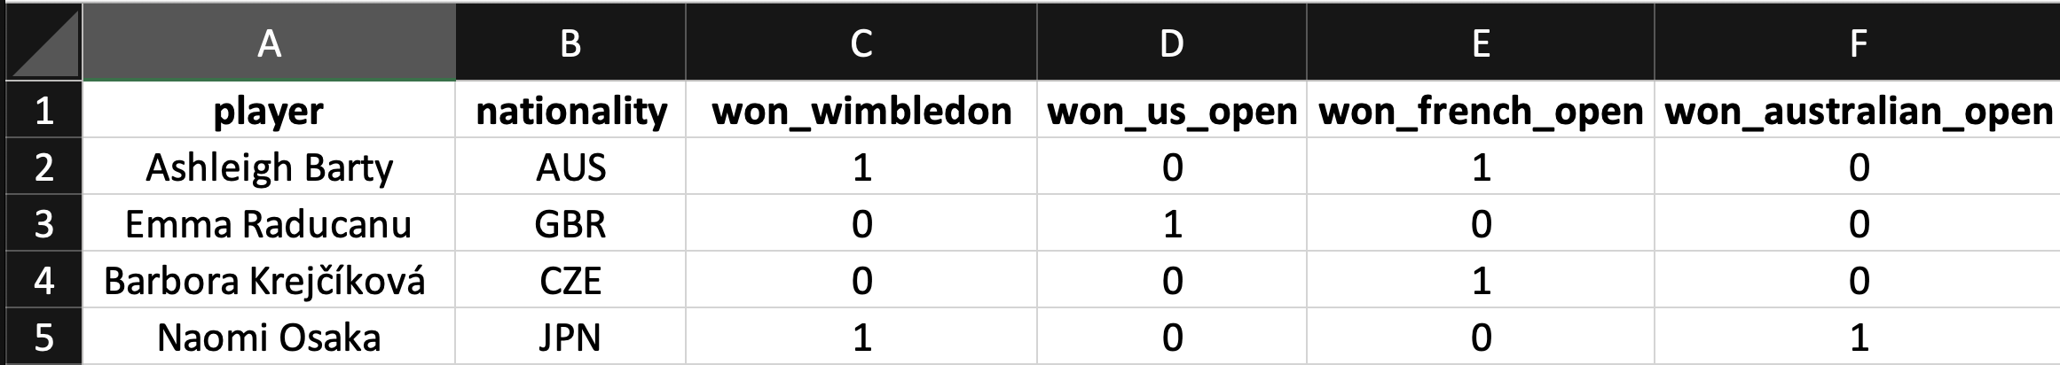
First Normal Form (1NF)
Here is an alternative that only has one piece of information in each cell. This table is said to be in the First Normal Form (1NF).
1NF requires that the data be in a tabular format with only one individual pieces of information in each cell.
unit of observation: Player
T. ARNOLD

Slide 4

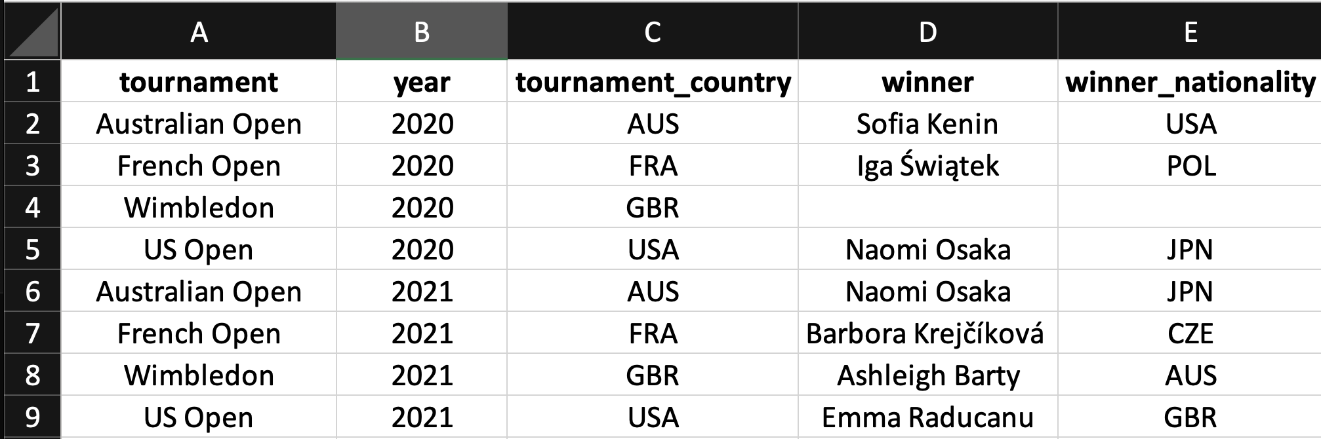
Another Example
Here is another example of a similar dataset. This one gives information about each Grand Slam itself. It is in 1NF but notice that it duplicates information.
unit of observation: tournament x year
T. ARNOLD

Slide 5
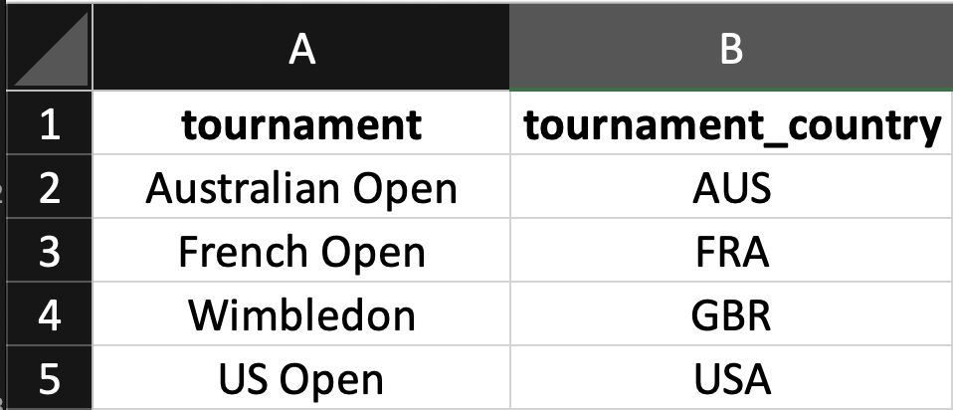
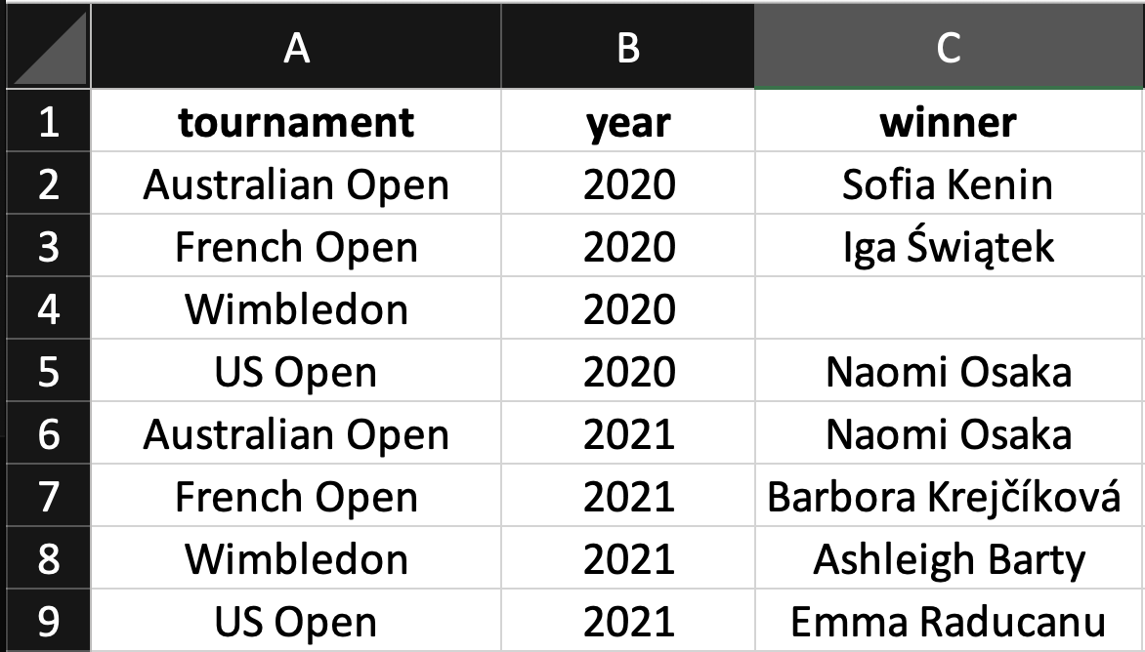
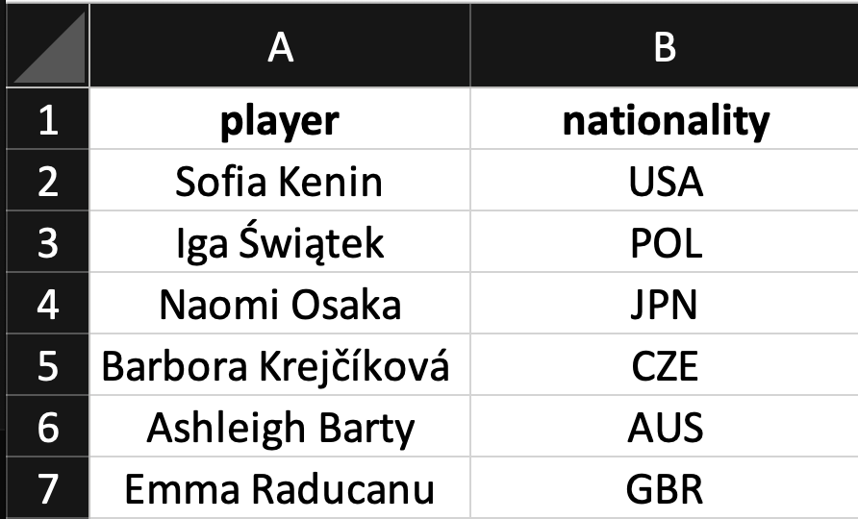
Third Normal Form (3NF)
We can fix the problem of duplication by creating three different tables. Now we only have information that is directly about the unit of observation on each table with no duplication.
These tables are in Third Normal Form (3NF).
unit of observation: tournament
unit of observation: tournament x year
unit of observation: player
T. ARNOLD

Slide 6
Second Normal Form?
You may wonder why we skipped 2NF. It does exist as an intermediate form. The type of duplication in the tournament_country is called a functional dependency whereas the duplication in winner_nationality is a transitive dependency. 2NF only requires that we remove the first type.
unit of observation: tournament x year
T. ARNOLD

Slide 7
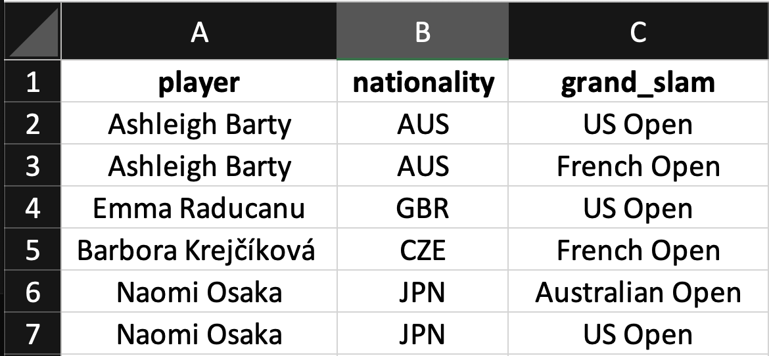
Wide vs. Long
Consider the two following datasets, which contain the same information. Both are in 3NF, but have different units of observation. The second format is longer than the first; the first is wider than the second. We will come back to this concept soon.
unit of observation: player
unit of observation: tournament x player
T. ARNOLD

Slide 8
How to Organize Data
Here are my general rules for how to collect data in terms of these concepts:
Always respect 1NF when collecting data.
Following 3NF is nice, but you can break this in the interest of
simplicity, particularly when doing the initial data collection.
Try to think of how you can make the dataset longer rather than
wider.
In the upcoming classes we will see how two-table and pivot data verbs help us deal with these concepts.
T. ARNOLD

