Slide 1

Introduction to Data Science
Welcome!
Today we are going to get all of the administrative details. Here is a quick outline:
– give a brief overview of the course material
– go through the syllabus
– tell you a bit about myself
– install software
– answer any additional questions
T. ARNOLD

Slide 2
Data Science
What exactly is data science?
Data science is an interdisciplinary field concerned with drawing knowledge from data and communicating those results to various audiences. Data science needs to be learned by doing data science.
By the end of the semester, you will feel confident collecting and analyzing datasets from a variety of fields. You will be able to use these skills to address data-driven problems in a wide range of application domains.
T. ARNOLD

Slide 3
Course Sequence
MATH 209
or
CSMC 150
MATH 289
MATH 389
This course assumes you have some experience using code to manipulate data. It makes no assumptions about your knowledge of any specific programing language or knowledge of statistical inference.
The class is designed as a year-long sequence paired with MATH 389; I strongly suggest taking both during the same academic year if possible.
T. ARNOLD

Slide 4
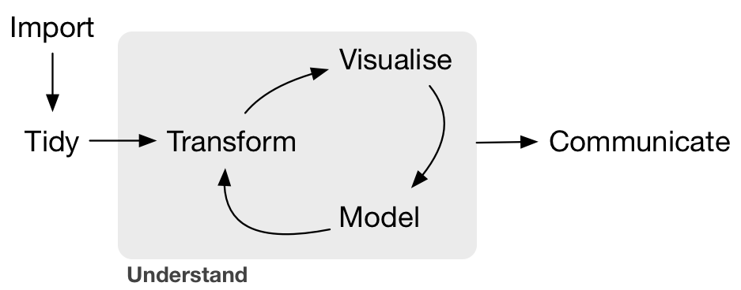
Data Science Pipeline
Grolemund & Wickham R4DS Illustration
T. ARNOLD

Slide 5
Data Science Pipeline
Focus of MATH 289
Grolemund & Wickham R4DS Illustration
T. ARNOLD

Slide 6
Data Science Pipeline
Grolemund & Wickham R4DS Illustration
Focus of MATH 389
T. ARNOLD

Slide 7


Programming
There are several different programming languages for data science. By far the two most popular are R and Python.
We will be using R this semester but will learn a version that is easily adapted to other languages such as Python.
In the last week I will demo the use of Python and JavaScript based on the the class material.
T. ARNOLD

Slide 8
Course Topics
I like to think of this course are organized around several different languages of data science. These are more formal ways of thinking about how to work with different parts of the DS pipeline.
The languages we will focus on this semester are:
— the grammar of graphics
— relational algebra
— functional programming
— APIs
— regular expressions
— XPath expressions
— geographic information systems (GIS)
T. ARNOLD

Slide 9
Class Structure
Most course meetings are organized as follows:
— notes: introduction to a new topic (usually, < 15 minutes)
— classwork: answer questions in the form of an R notebooks
— homework: finish left-over classwork and any posted readings
All materials can be found on the course website.
T. ARNOLD

Slide 10
Syllabus
See syllabus posted on the course website.
T. ARNOLD

Slide 11







About Me
- From New England: born in Maine, school in MA, ME, CT
- Moved to Richmond in 2016
- Research on large text and image datasets in linguistics and cultural studies
T. ARNOLD

Slide 12





About Me
- Lots of industry experience in DS:
- IBM (Healthcare)
- Travelers (Insurance)
- DARPA (social media)
- AT&T (location analytics)
- Telperian (pharmaceuticals)
- Own two Shih-Tzus, Sargent and Roux
T. ARNOLD

Slide 13
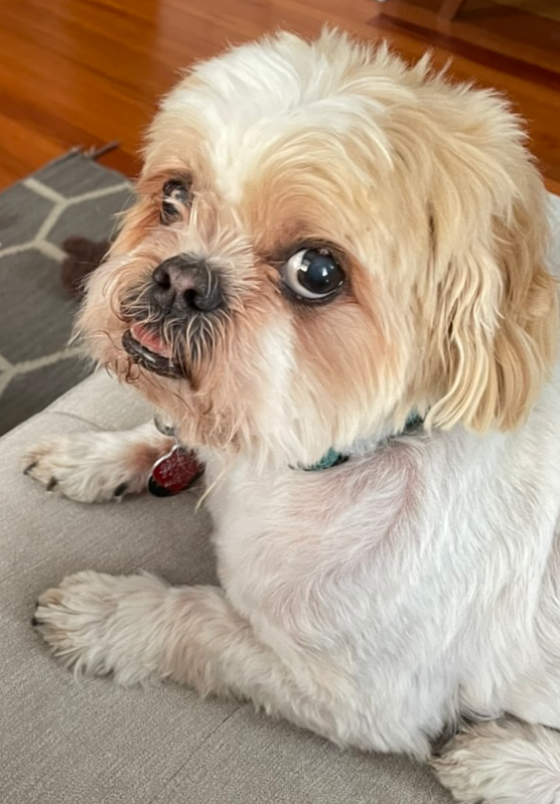
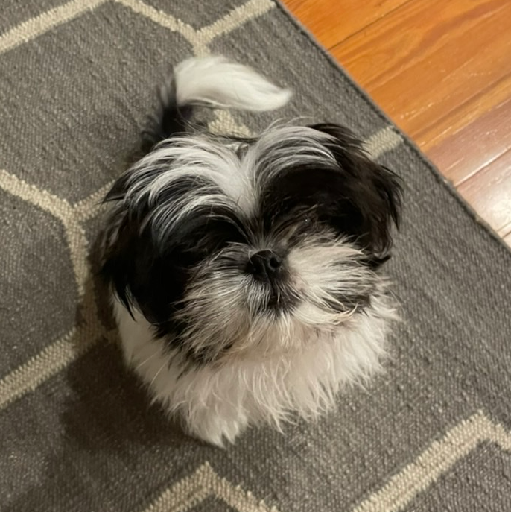
About Me
- I have two Shih-Tzus: Roux and Sargent
- Roux is often in my office; please come say hello
T. ARNOLD

