Slide 1

Regular Expressions
As you read, regular expressions (or regex) provide a language for describing a search pattern that will match patterns in a string. They can get very complex, but usually we only need relatively simple regular expressions for data science applications.
\A start of string
\Z end of string
\w match word character (note: lowercase w)
\W match any non-word character (note: uppercase W)
. any character (other than new line)
[ ] match any (single) character inside bracket
[ ]* match 0 or more characters inside bracket
[ ]+ match 1 or more characters inside bracket
[^ ] match any number of character NOT inside bracket
0-9 numeric digits
a-z lowercase letters
A-Z uppercase letters
[note: you will need to write two slashes in R]
[note: these must be used inside brackets]
T. ARNOLD

Slide 2
Example #1
How would you describe the following regex query?
[\w]+ing
T. ARNOLD

Slide 3
Example #2
How would you describe the following regex query?
"[^"]+"
T. ARNOLD

Slide 4
stringi
The stringi package is probably my favorite R package—at least, my favorite R package that I did not create! It provides an amazing amount of fast functionality that almost always just works as I expect it to. All functions start with the prefix “stri_” and most accept either a regex OR fixed string search pattern (the latter turns out to be very helpful in a lot of cases).
As an example, here is an example of a regular expression that counts the number of words (from the latin alphabet) with capital letters:
stri_count(input, regex = "[A-Z][\\w-']+")
T. ARNOLD

Slide 5
Using Regular Expressions
There are several commons things we can do once we are able to match a pattern in a string, all supported by the R stringi package:
stri_count count the number of time the pattern occurs
stri_detect does pattern occur at least once?
stri_extract_all extract all occurances of the pattern
stri_extract_first extract the first occurances of the pattern
stri_replace_all replace all occurances of the pattern with a fixed string
stri_split split string into substrings, using patterns as the split
There are also some related stringi functions that do not take a regular expression as an input:
stri_length how many characters are in the string
stri_sub take a substring by position
stri_trans_toupper convert to uppercase
stri_trans_tolower convert to lowercase
stri_trans_totitle convert to title case
T. ARNOLD

Slide 6
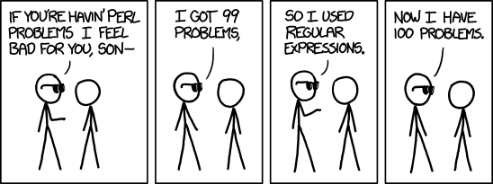
Regular Expressions
https://xkcd.com/1171/
T. ARNOLD

Slide 7
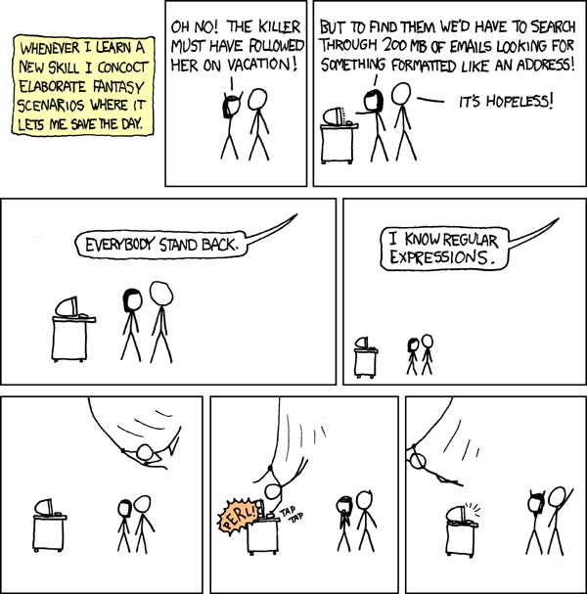
https://xkcd.com/208/
T. ARNOLD

