Slide 1

1. Intro to Grammar of Graphics
T. ARNOLD

Slide 2
Grammar of Graphics
Data visualizations are made up of layers. Each layer consists of three parts:
data tabular dataset associated with the layer
geom graphical element associated with each observation
aesthetics mappings from properties of the plot that
(aes) associate features in the dataset with elements of
the geometry
Complex plots can be constructed by putting together multiple layers.
T. ARNOLD

Slide 3
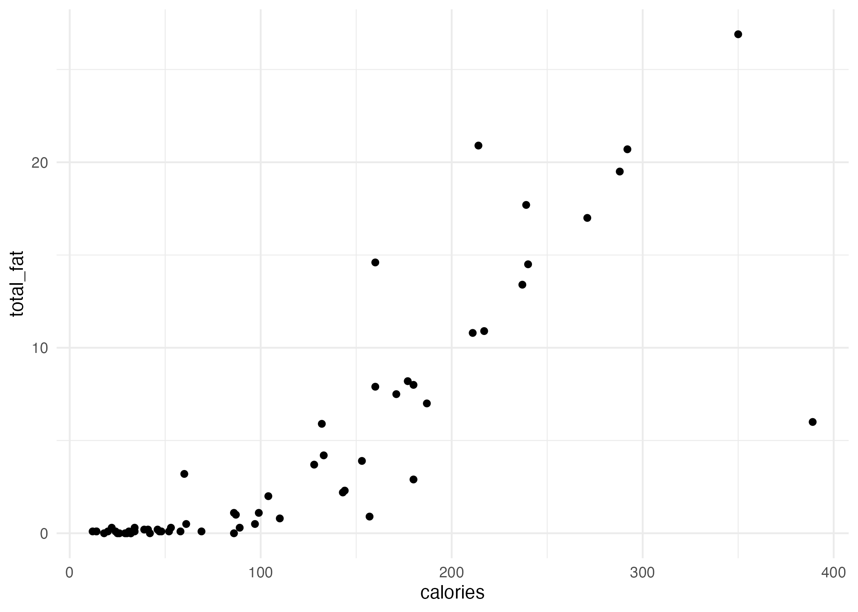
Scatter Plot Example
data: food
geom: point
aes: { x: calories, y: total_fat }
each observation in the food dataset is represented by a point
T. ARNOLD

Slide 4
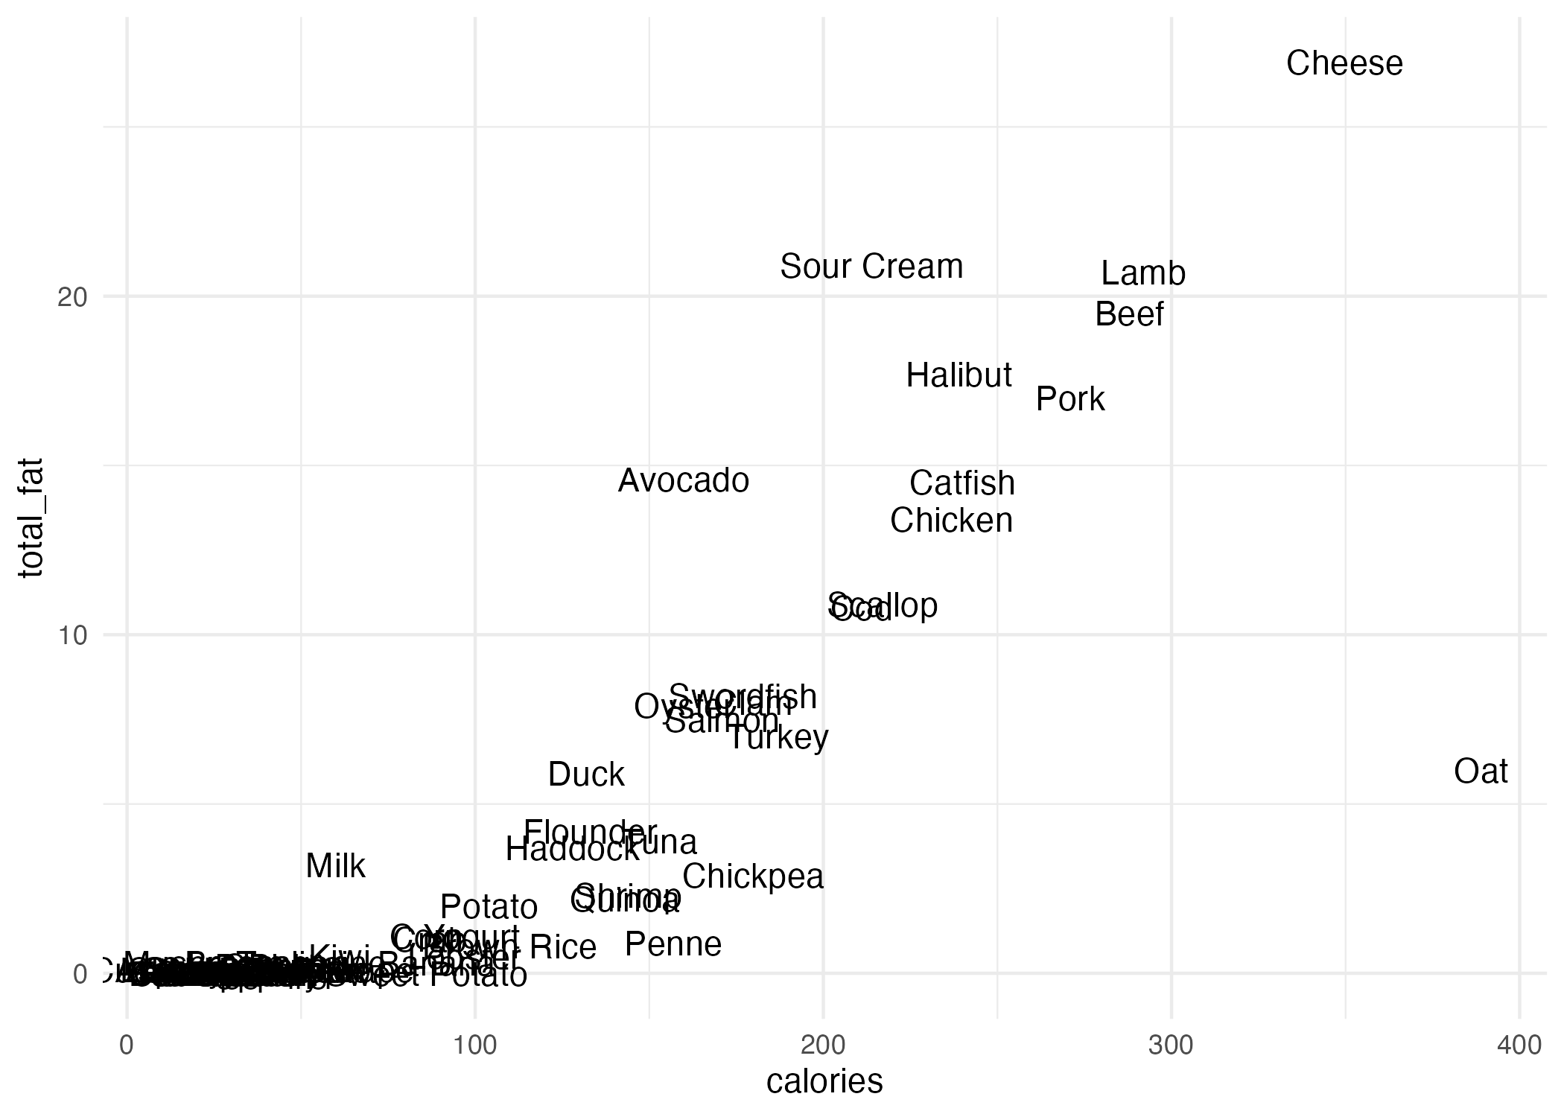
Text Plot Example
data: food
geom: text
aes: { x: calories,
y: saturated_fat
label: item }
each observation in the food dataset is represented by a textual label
T. ARNOLD

Slide 5
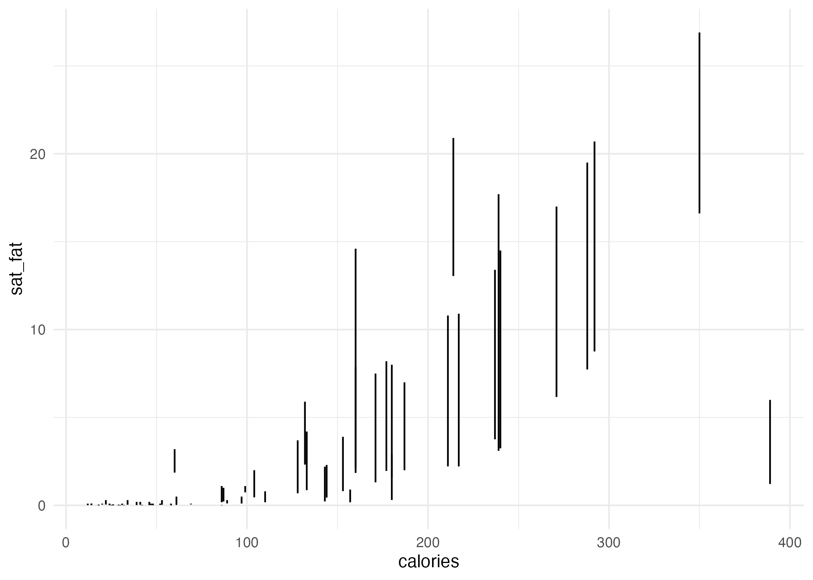
Segment Plot Example
data: food
geom: segment
aes: { x: calories,
y: saturated_fat
xend: calories,
yend: total_fat }
each observation in the food dataset is represented by a vertical line segment
T. ARNOLD

Slide 6
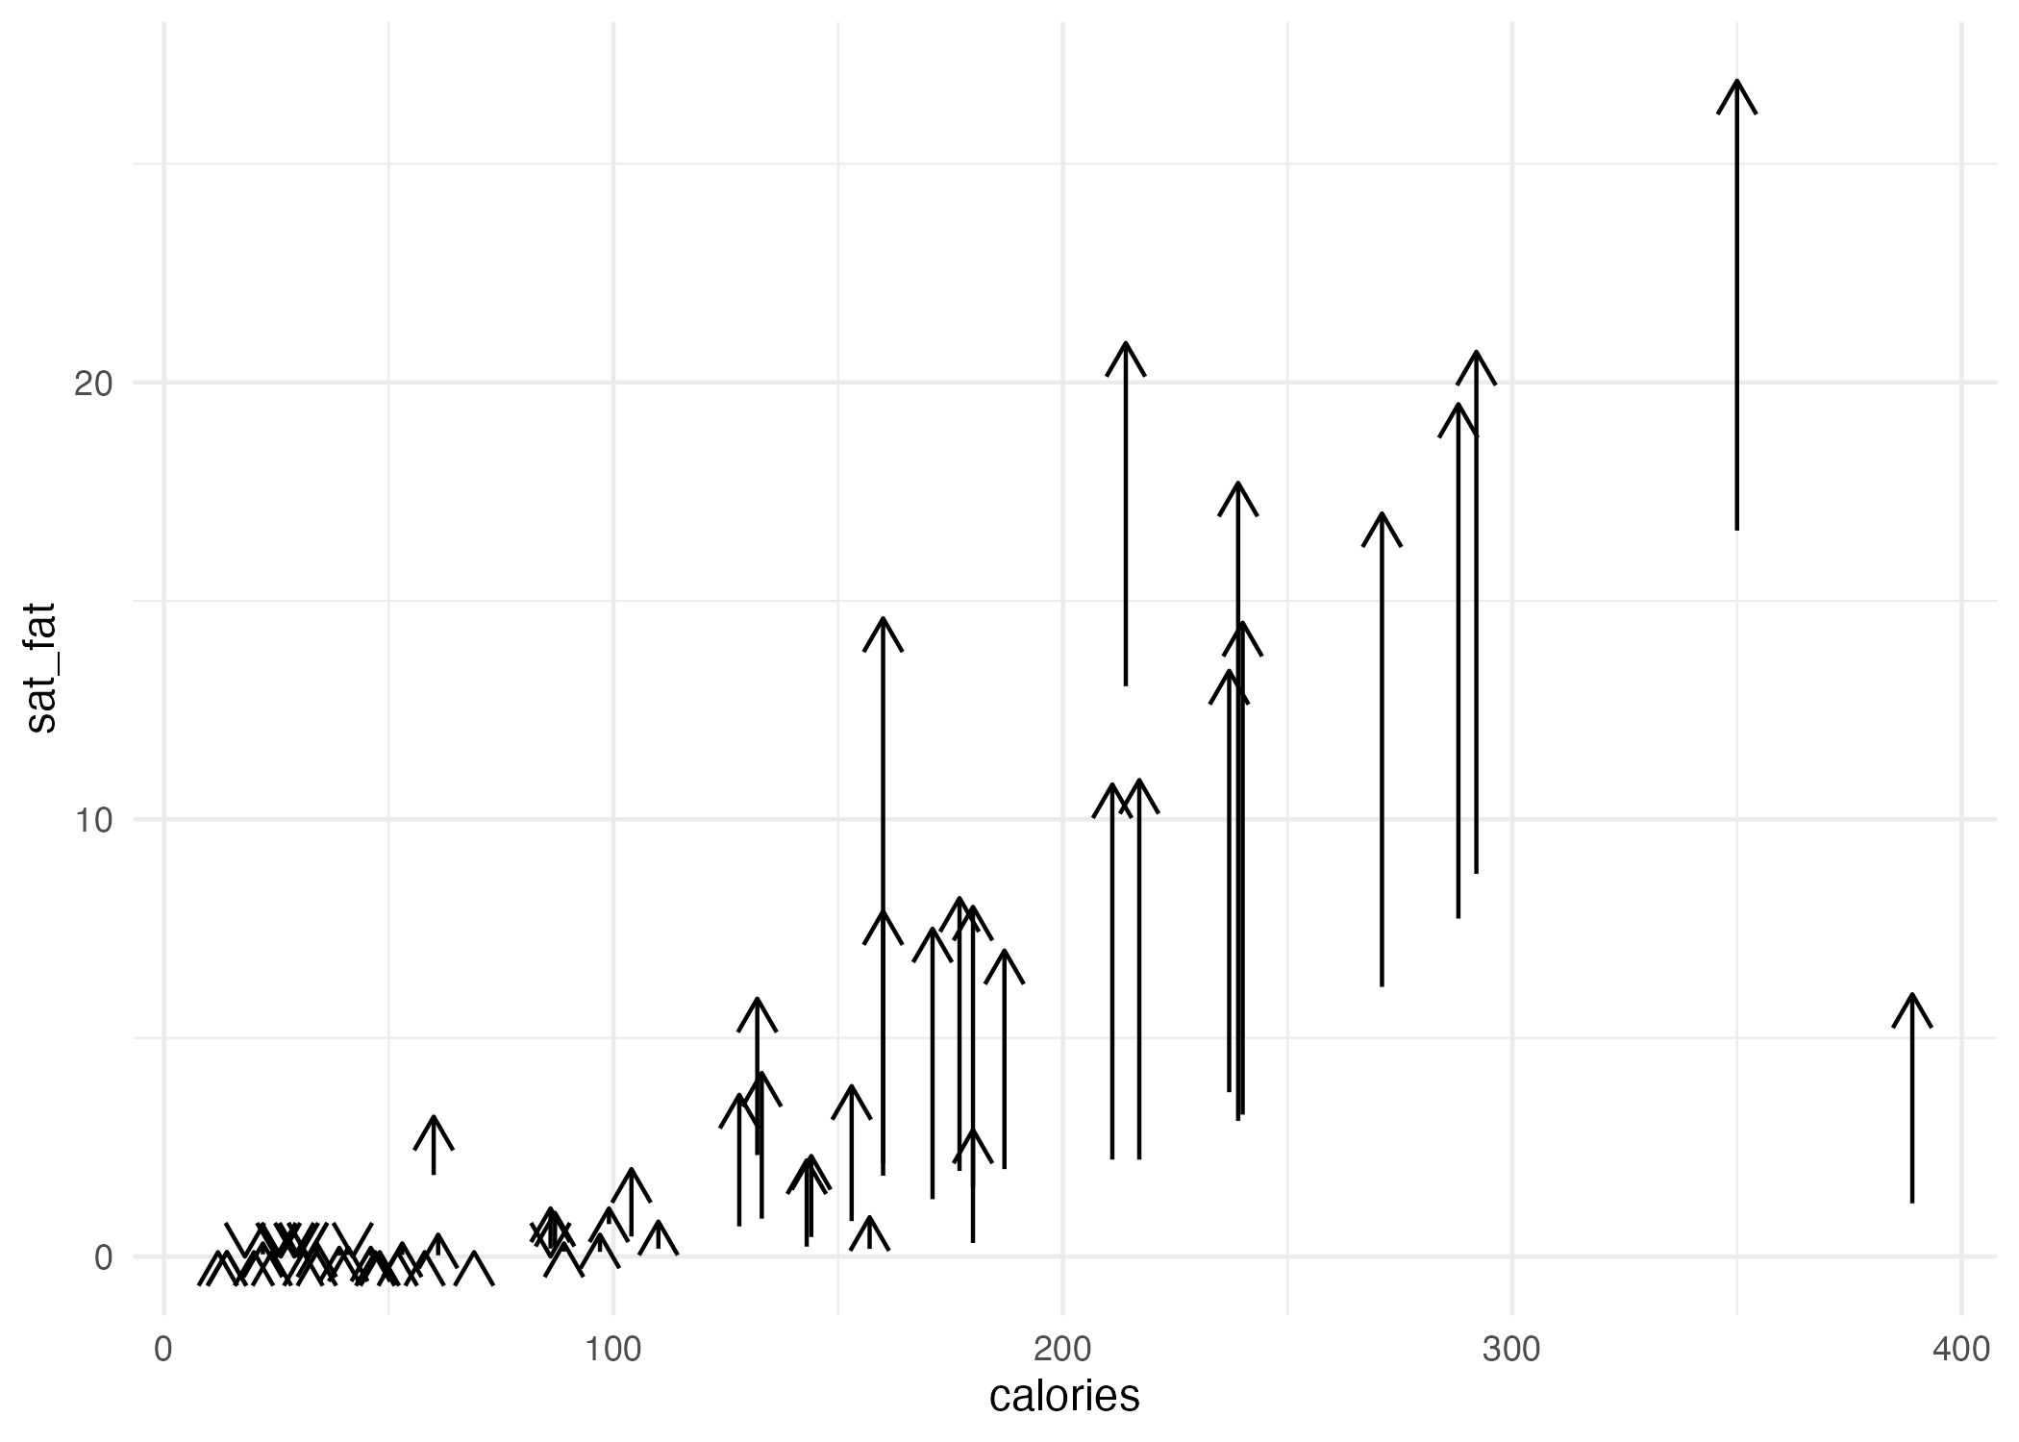
Arrow Plot Example
data: food
geom: arrow
aes: { x: calories,
y: saturated_fat
xend: calories,
yend: total_fat }
each observation in the food dataset is represented by a vertical line segment plus an arrow!
T. ARNOLD

Slide 7
Syntax
data: food
geom: point
aes: { x: calories, y: total_fat }
food %>%
ggplot() +
geom_point(aes(x = calories, y = total_fat))
data: food
geom: text
aes: { x: calories,
y: saturated_fat
label: item }
food %>%
ggplot() +
geom_text(aes(x = calories, y = total_fat,
label = item))
T. ARNOLD

Slide 8
2. Fixed Aesthetics
T. ARNOLD

Slide 9
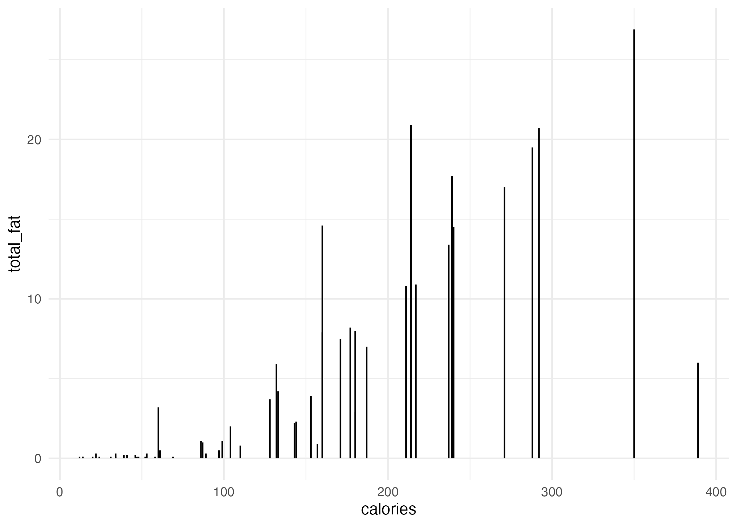
Fixed Aesthetics
data: food
geom: segment
aes: { x: calories,
y: 0,
xend: calories,
yend: total_fat }
we can map an aesthetic to a fixed value rather than a feature
we will see even better examples of why this is useful next time!
T. ARNOLD

Slide 10
Fixed Aesthetic Syntax
data: food
geom: segment
aes: { x: calories, y: 0, xend: calories, yend: total_fat }
food %>%
ggplot() +
geom_segment(aes(x = calories, xend = calories, yend = total_fat), y = 0)
fixed aesthetics go OUTSIDE the aes function
but inside the geom_* function
T. ARNOLD

