Slide 1

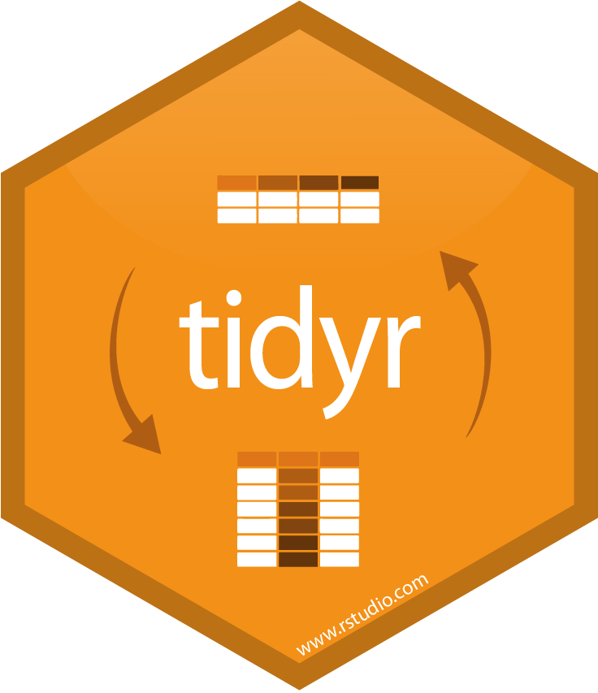

Data Verbs
Data verbs are functions that take one or more tabular datasets and return a new dataset. They are designed to always accept the dataset(s) as the first arguments to make them easy to use in pipes. Verbs correspond to a theoretical model called relational algebra, which describes for how transformations occur within a database.
Most verbs come from one of two R packages:
T. ARNOLD

Slide 2
Data Verbs
While there are dozens of verbs provided by these packages, most are just slight variations of each other. We will focus on learning ten core verbs, from which everything else is easily derived:
filter()
slice()
select()
arrange()
mutate()
summarize()
left_join()
semi_join()
pivot_wider()
pivot_longer()
[one-table verbs]
[two-table verbs]
[pivots]
T. ARNOLD

Slide 3
FILTER / SLICE
A
1
A
B
3
B
⇒
A
1
A
B
2
C
B
2
C
A
7
D
%in%
between()
<, >, <=, >=, !=, ==
T. ARNOLD

Slide 4
ARRANGE
A
1
A
A
1
A
B
3
B
⇒
A
7
D
B
2
C
B
2
C
A
7
D
B
3
B
desc()
T. ARNOLD

Slide 5
SELECT
A
1
A
A
A
B
3
B
⇒
B
B
B
2
C
B
C
A
7
D
A
D
T. ARNOLD

