Slide 1

Data Antipatterns
An antipattern is an example of something that you should not do. In the notes you saw several examples of how to collect and organize data. Here, we will see several examples of things you should strongly avoid doing in your own work ...
T. ARNOLD

Slide 2
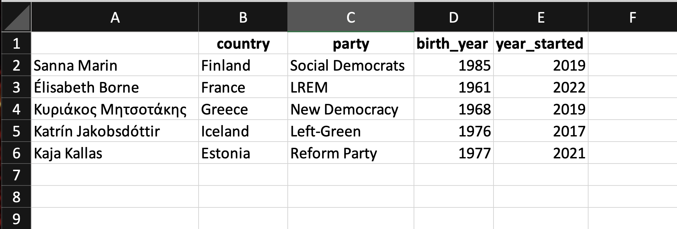
Antipattern #1
What is the issue here and how could we fix it?
T. ARNOLD

Slide 3
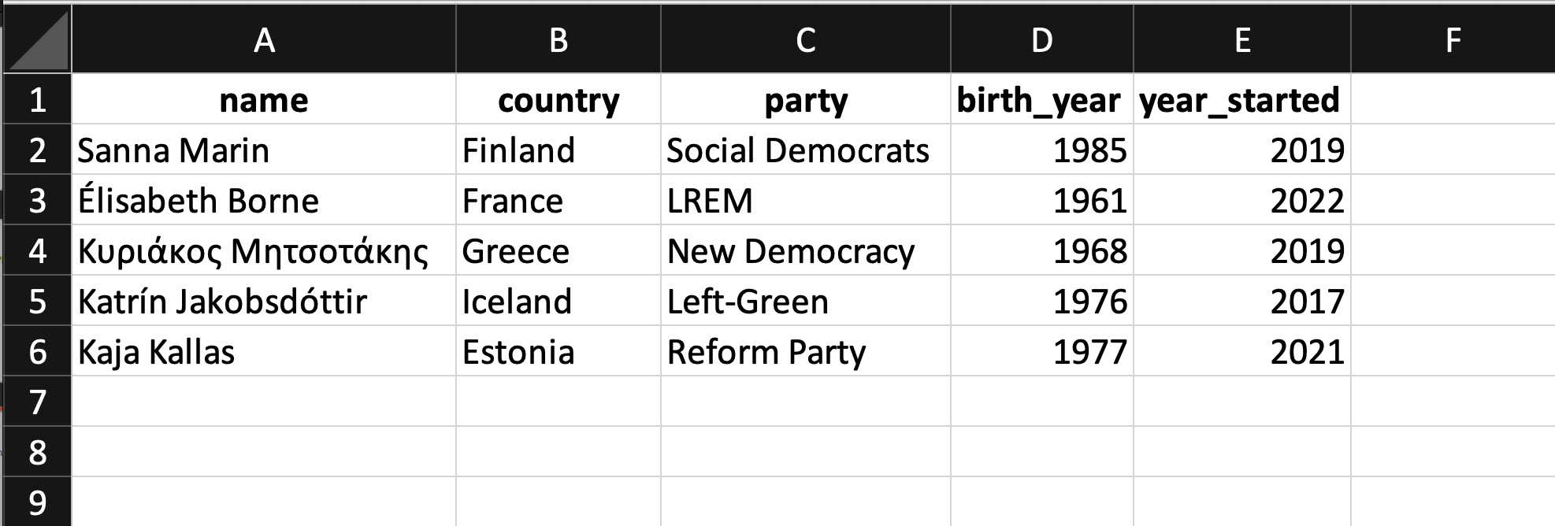
Antipattern #1 : Solution
Problem: The first column does not have a name.
Solution: Add column name.
T. ARNOLD

Slide 4

Antipattern #2
What is the issue here and how could we fix it?
T. ARNOLD

Slide 5
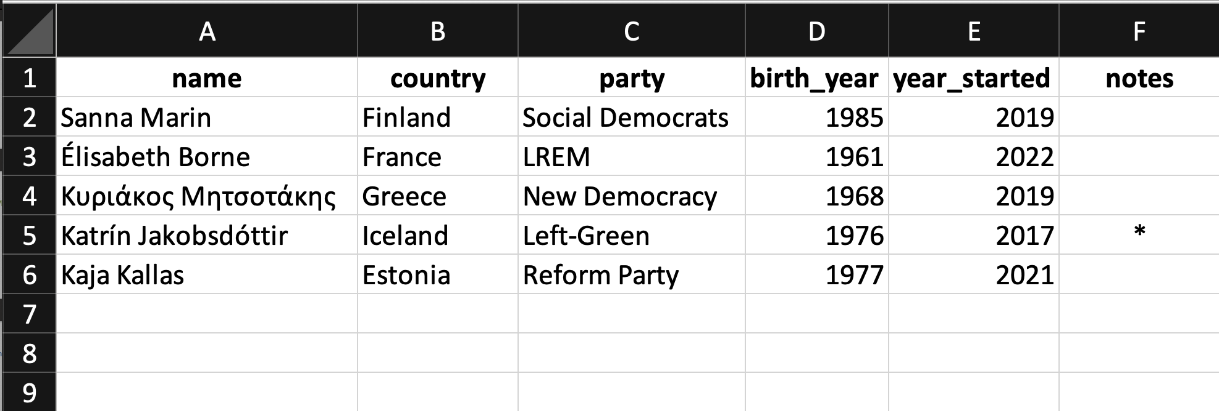
Antipattern #2 : Solution
Problem: A numeric variable has a non-numeric element (here a *).
Solution: Include a notes column to contain the special information.
T. ARNOLD

Slide 6
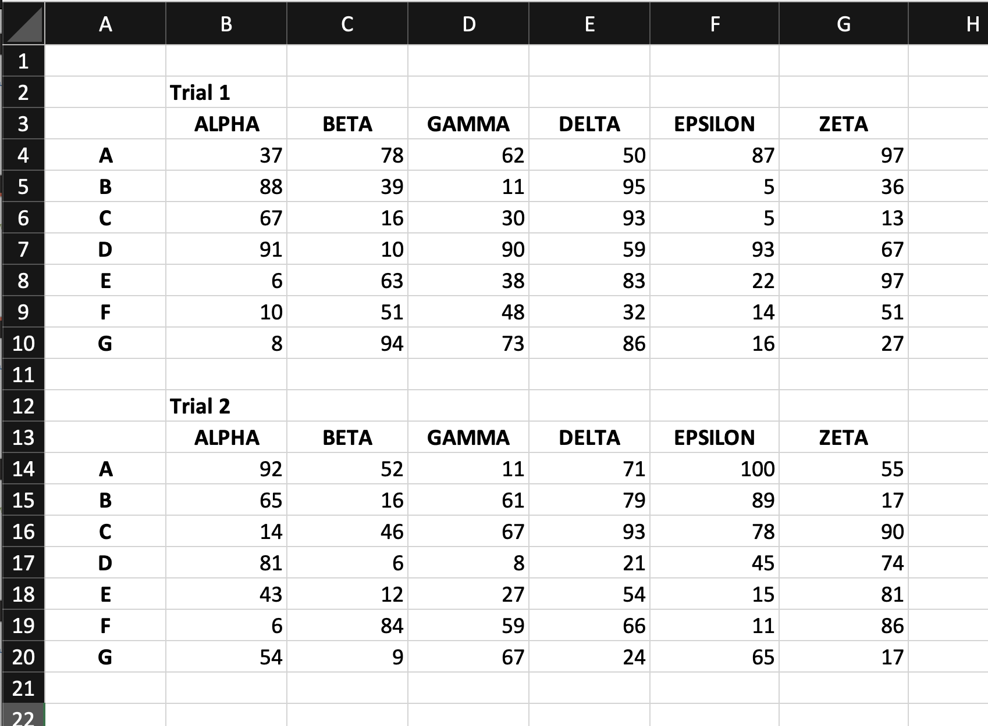
Antipattern #3
What is the issue here and how could we fix it?
T. ARNOLD

Slide 7
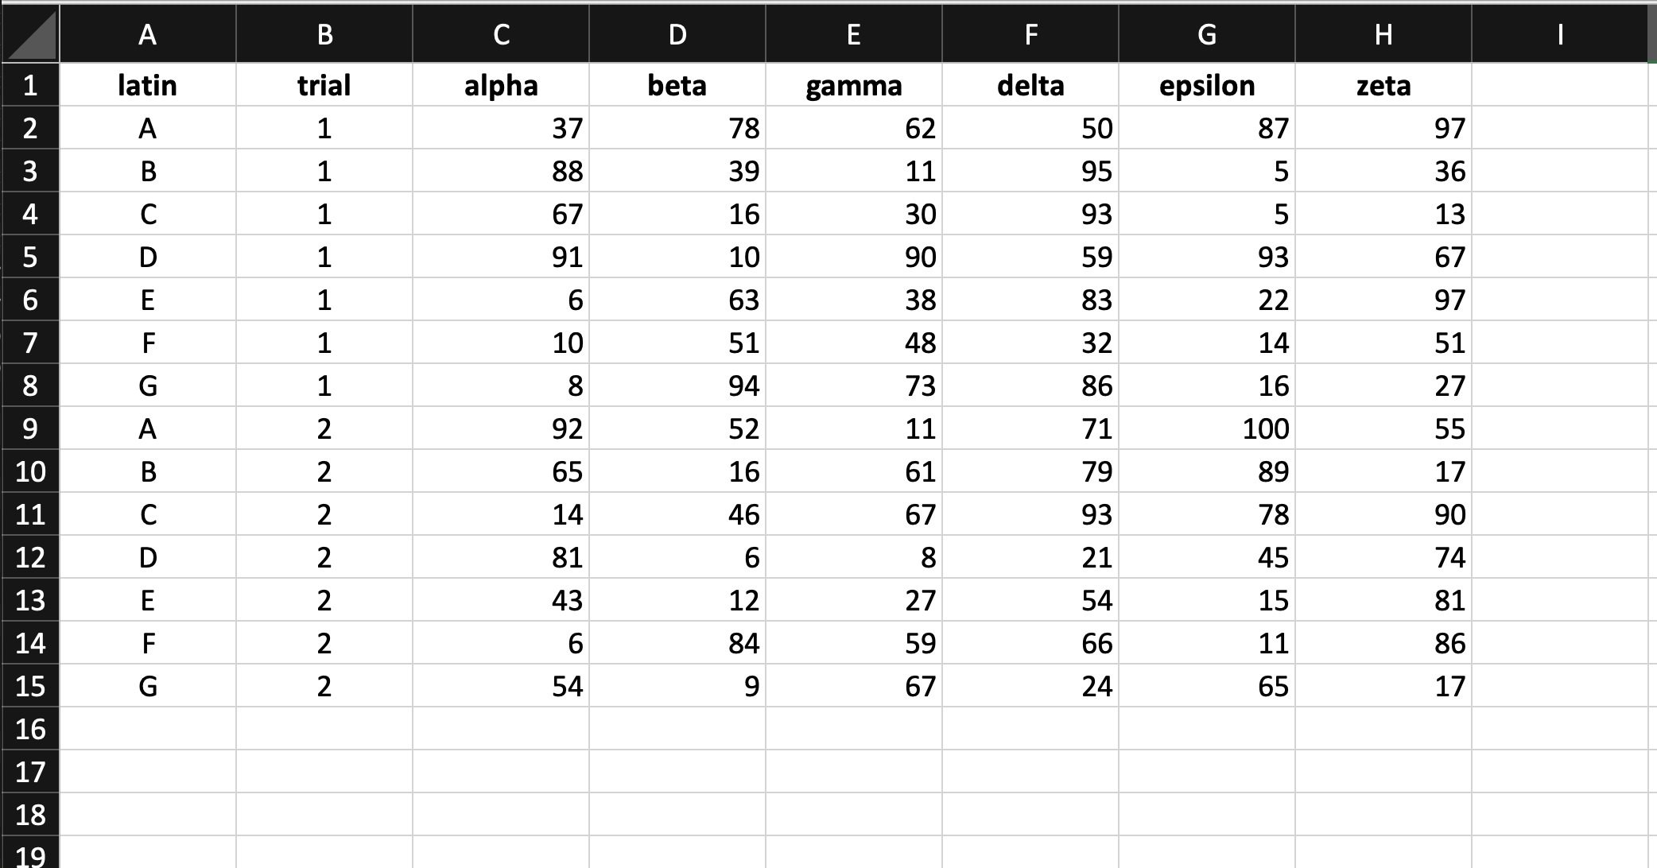
Antipattern #3 : Solution
Problem: Two tables on one sheet.
Solution: Combine into a single table, adding a column for the trial.
T. ARNOLD

Slide 8
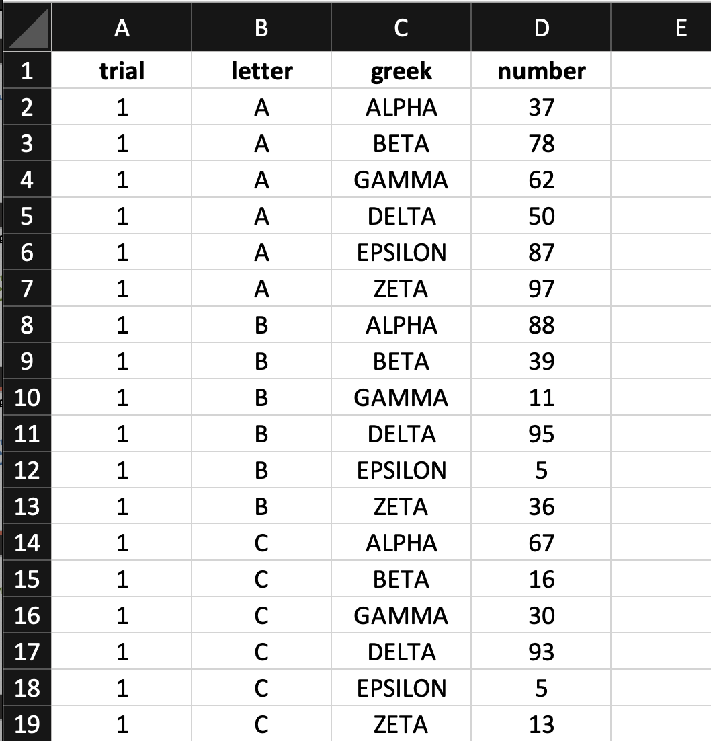
Antipattern #3 : Solution
Another Solution: Create a longer format for the data with one measurment on each row.
Note: This is format is preferred for reasons we will see when learning about data pivots in a future set of notes.
T. ARNOLD

Slide 9
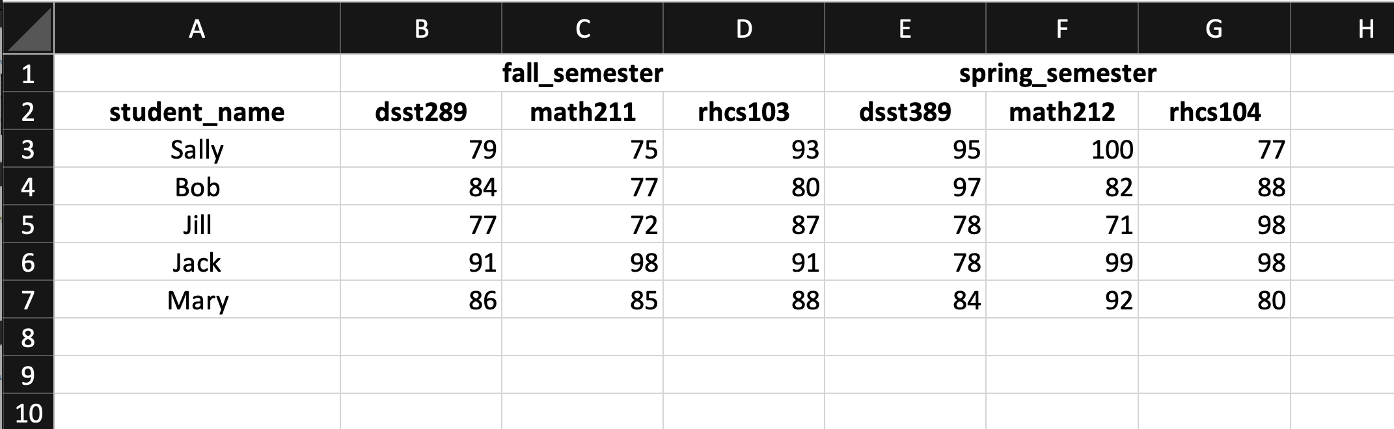
Antipattern #4
What is the issue here and how could we fix it?
T. ARNOLD

Slide 10
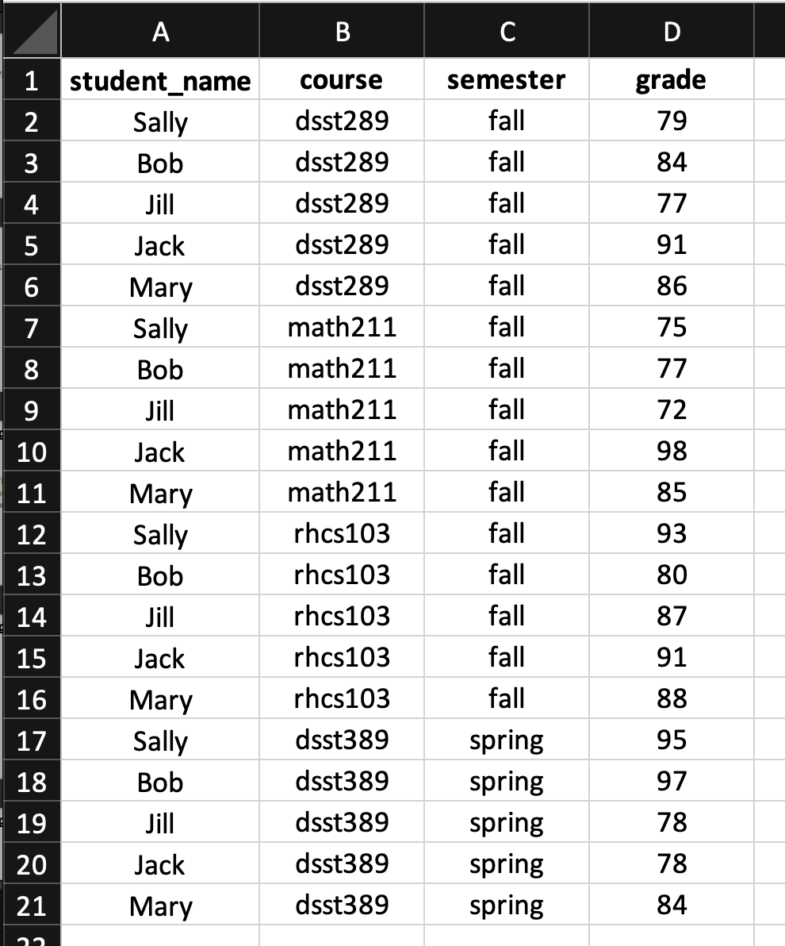
Antipattern #4 : Solution
Problem: Hierarchical column names.
Solution: Spread data into more rows and fewer columns so that the metadata about the original features become full features in the new data.
T. ARNOLD

Slide 11
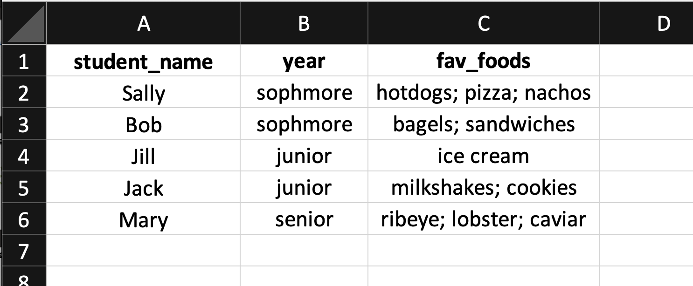
Antipattern #5
What is the issue here and how could we fix it?
T. ARNOLD

Slide 12
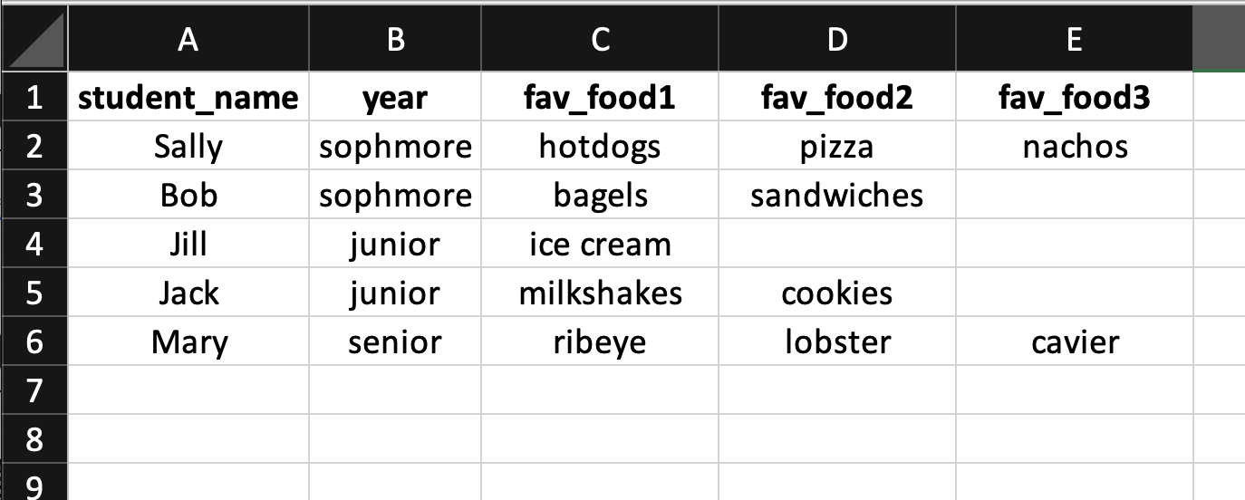
Antipattern #5
Note: Why is this is not a good solution? Think about using data formated like this to determine the most frequently listed favorite food from a large dataset. It turns out it is quite complicated with the tools we have available to us!
Problem: Multiple values in one cell.
Bad Solution: Create new numbered columns.
T. ARNOLD

Slide 13
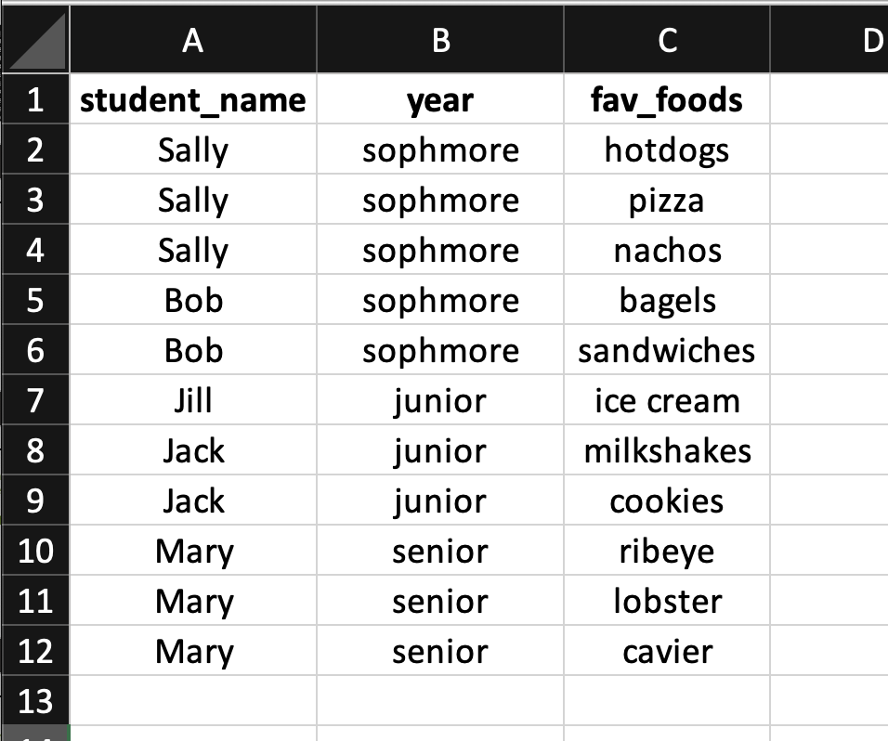
Antipattern #5 : Solution
Problem: Multiple values in one cell.
Solution: Expand data to include one row for each item.
T. ARNOLD

Slide 14
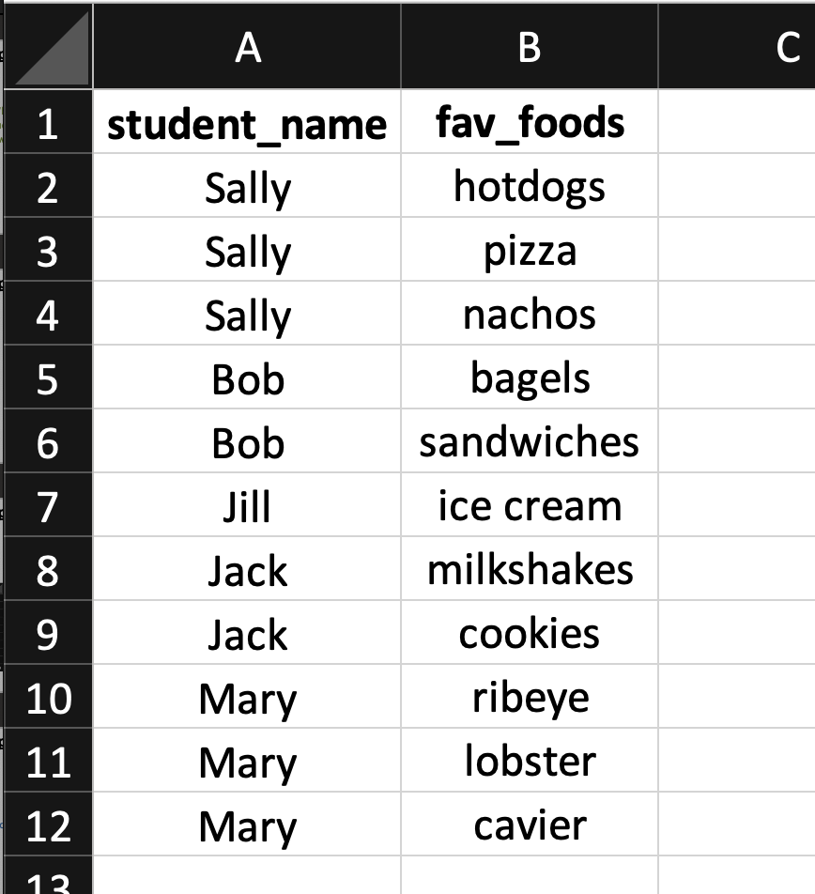
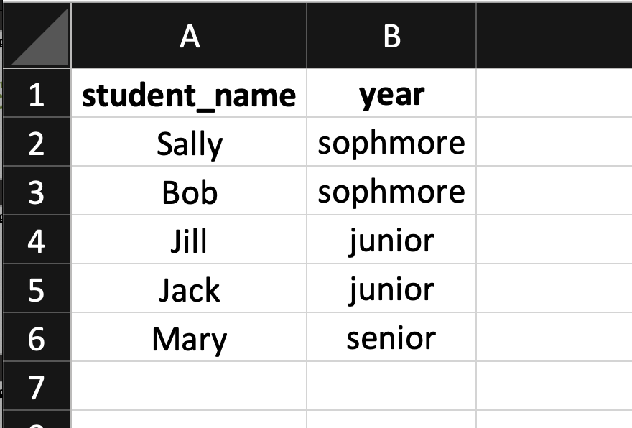
Antipattern #5
Note: This is format is preferred for reasons we will see when learning about data normalization in a future set of notes.
Another Solution: Same as before, but create a second table to avoid repeating information.
T. ARNOLD

