Slide 1
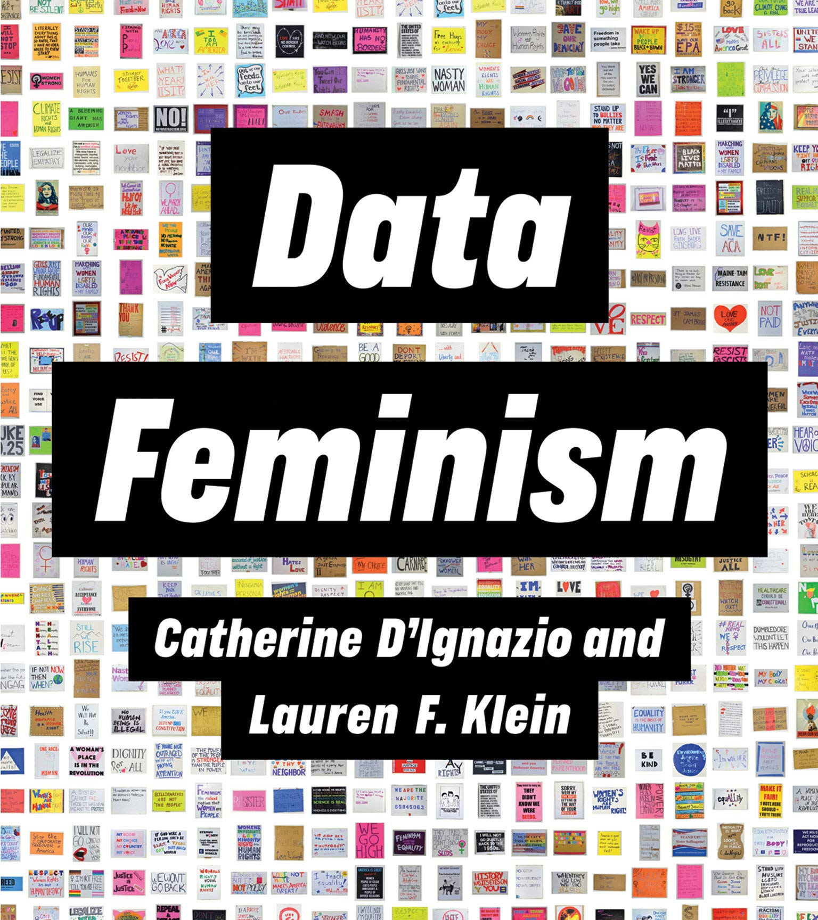

Data Feminism
D’Ignazio and Klein describe Data Feminism as:
“A way of thinking about data, both their uses and their limits, that is informed by direct experience, by a commitment to action, and by intersectional feminist thought. The starting point for data feminism is something that goes mostly unacknowledged in data science: power is not distributed equally in the world.”
T. ARNOLD

Slide 2
Data Feminism: Four Actions*
DATA IS A STRUCTURE OF POWER
1. Align work with your values to affect positive change in the world.
DATA IS NEVER NEUTRAL OR OBJECTIVE
2. Reflect, align with values, and document all the decisions made when creating data.
3. Integrate a diverse range of sources; combine qualitative + quantitative analyses.
DATA SCIENCE REQUIRES MANY PARTICIPANTS
4. Surface all the people that contribute to our work as data scientists.
* Note that this is a very opinioned and partial distillation of the original ideas.
T. ARNOLD

Slide 3
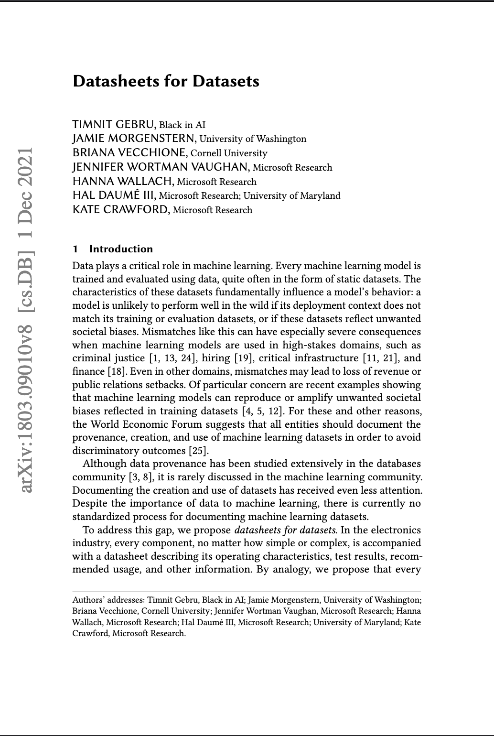
Datasheets
Datasheets are a proposal to pair datasets with a file that: “documents its motivation, composition, collection process, recommended uses, and so on. Datasheets for datasets have the potential to increase transparency and accountability within the machine learning community, mitigate unwanted societal biases in machine learning models, facilitate greater reproducibility of machine learning results, and help researchers and practitioners to select more appropriate datasets for their chosen tasks.”
T. ARNOLD

Slide 4
Datasheets: Sections
Metadata
Motivation
Composition
Narrative
Distribution
Attributions
References
Notes
Two sections removed/renamed because they were specific to machine learning applications.
Three sections were added to better align with ideas from Data Feminism.
T. ARNOLD

