Slide 1
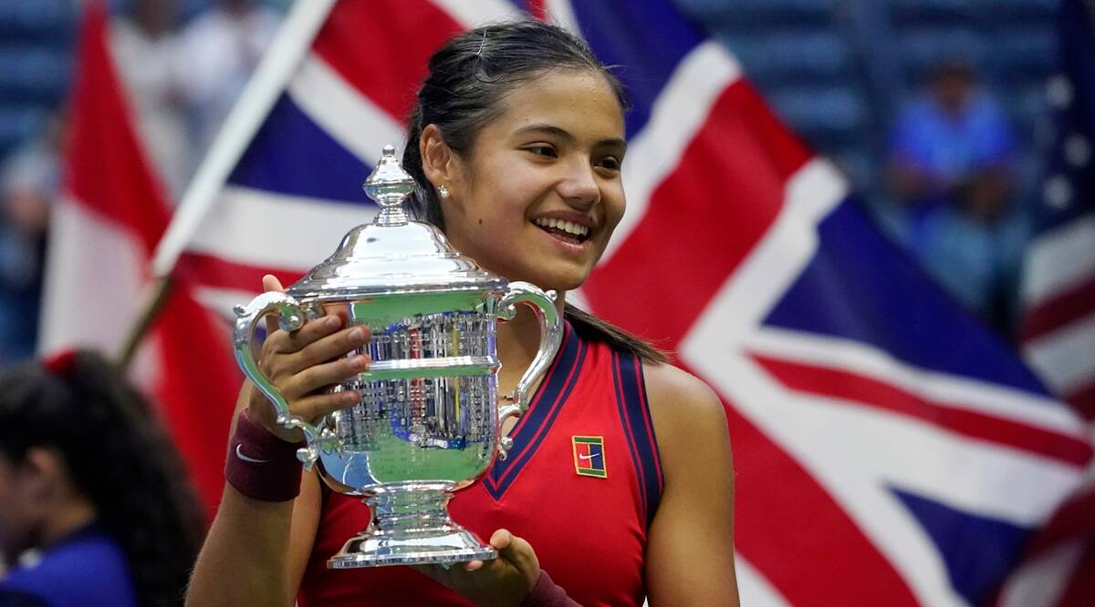
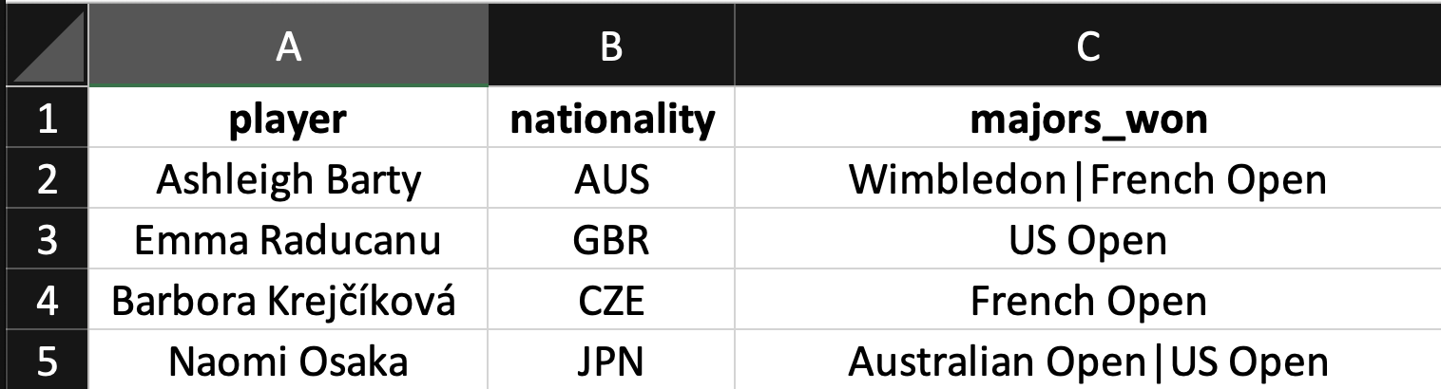

An Example
Consider the following dataset showing four female tennis players. Notice that the last column is trying to put multiple pieces of information in one value.
unit of observation: Player
T. ARNOLD

Slide 2
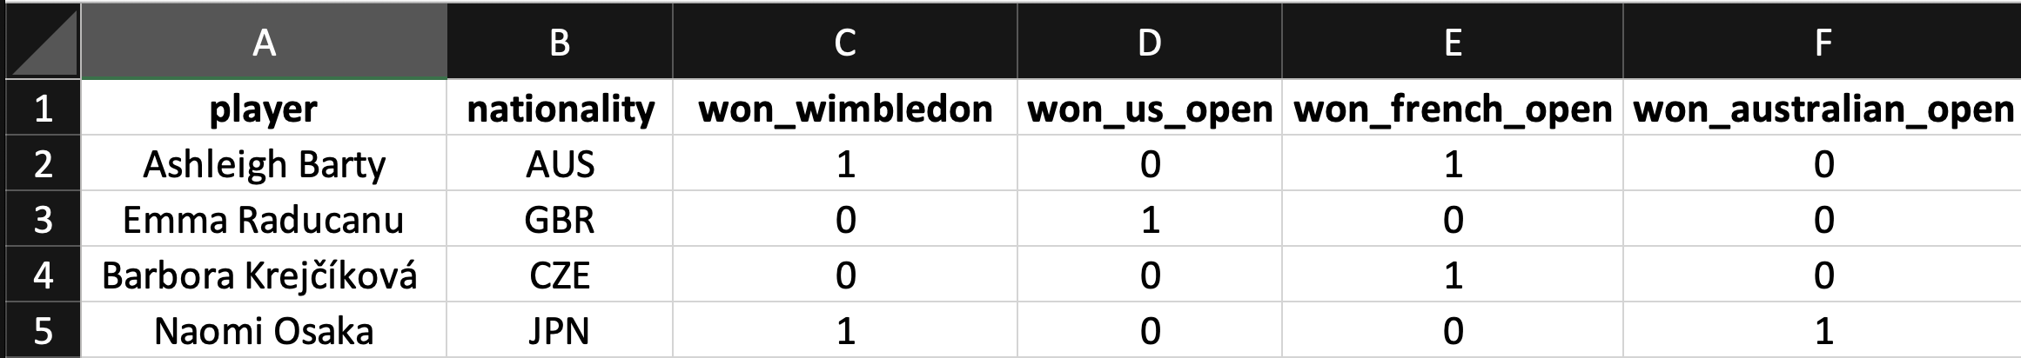
First Normal Form (1NF)
Here is an alternative that only has one piece of information in each cell. This table is said to be in the First Normal Form (1NF).
1NF requires that the data be in a tabular format with only one individual piece of information in each cell. Here is one way to do that using the same unit of observation (note that a long format might be better for many kinds of analysis).
unit of observation: Player
T. ARNOLD

Slide 3

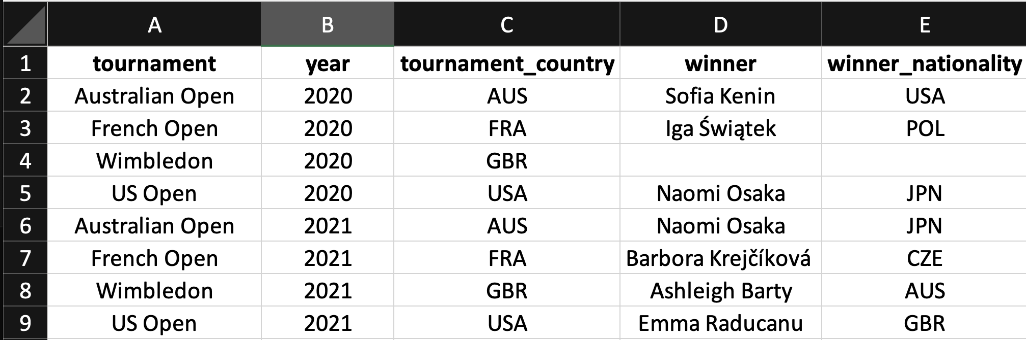
Another Example
Here is another example of a similar dataset. This one gives information about each Grand Slam itself. It is in 1NF but notice that it duplicates information.
unit of observation: tournament x year
T. ARNOLD

Slide 4
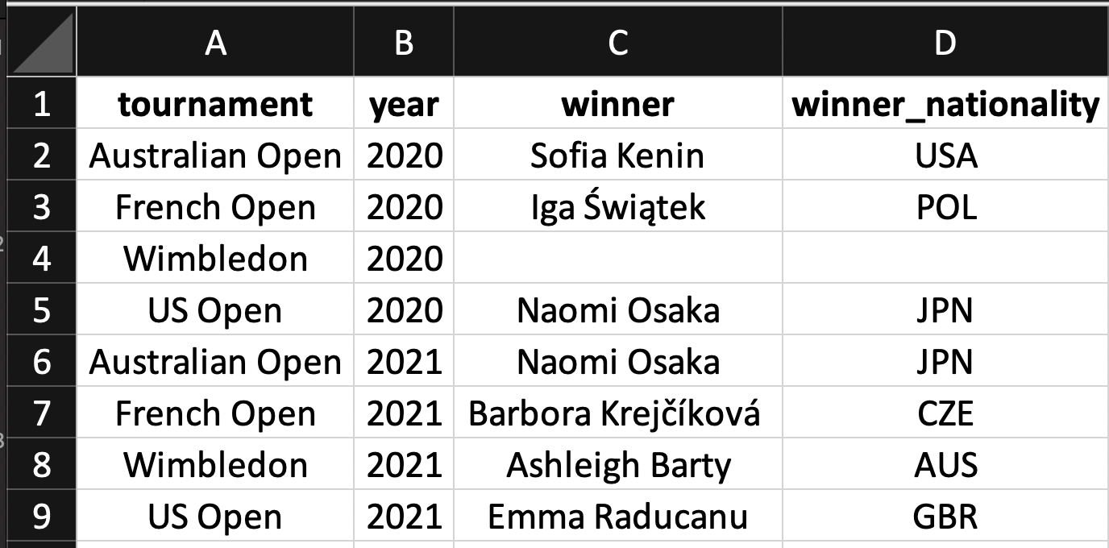
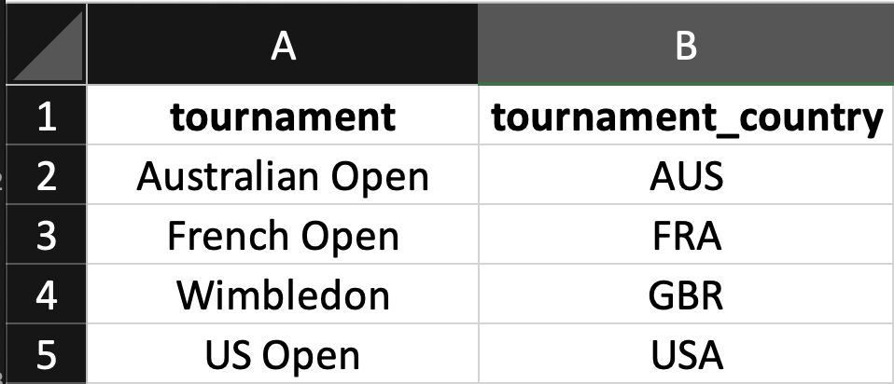
Second Normal Form (2NF)
We can fix the some problems of duplication by creating two different tables. Namely, we want all of the information in the table to relate to the unit of observation. All of the columns should be part of a candidate key or defined by the entire candidate key. The data is now follows the rules for the second normal form (2NF).
unit of observation: tournament x year
unit of observation: tournament
T. ARNOLD

Slide 5
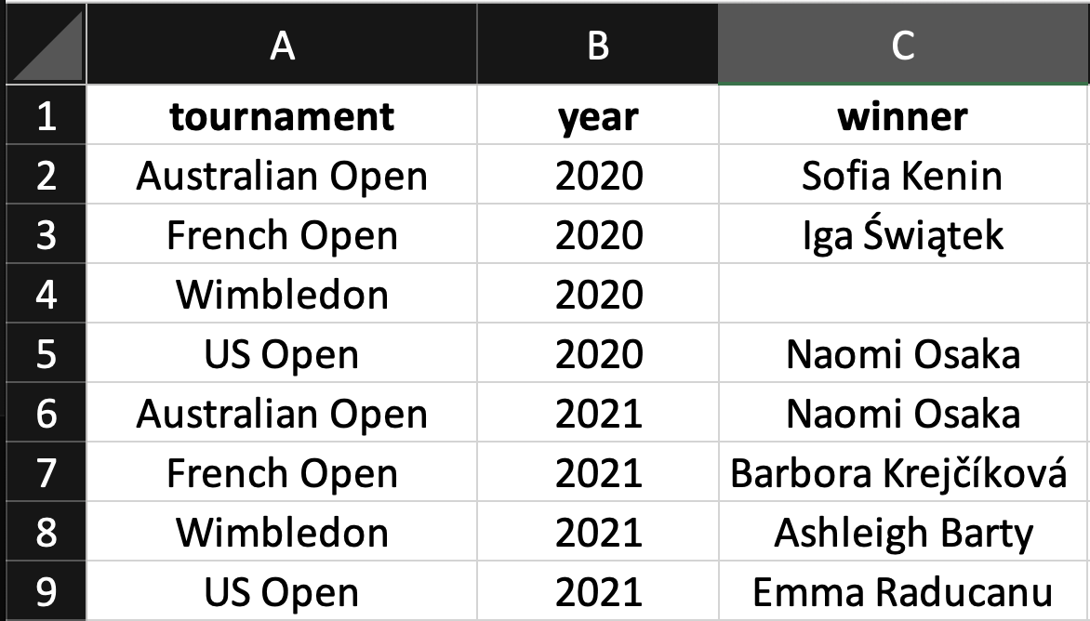
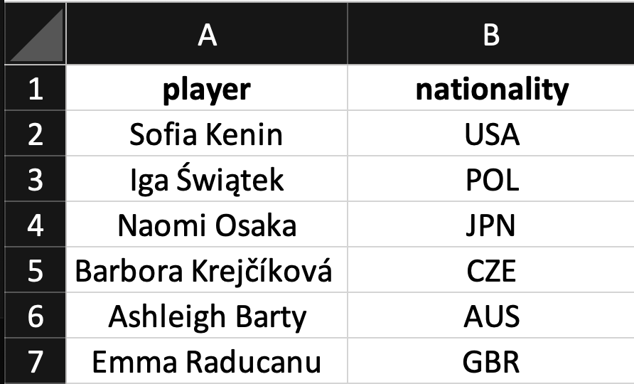
Third Normal Form (3NF)
There is still a kind of duplication in the previous dataset because the winner nationality is a function of the winner name. Putting the tables into the third normal form, or 3NF, requires fixing this dependency as well.
unit of observation: tournament
unit of observation: player
unit of observation: tournament x year
T. ARNOLD

