Slide 1
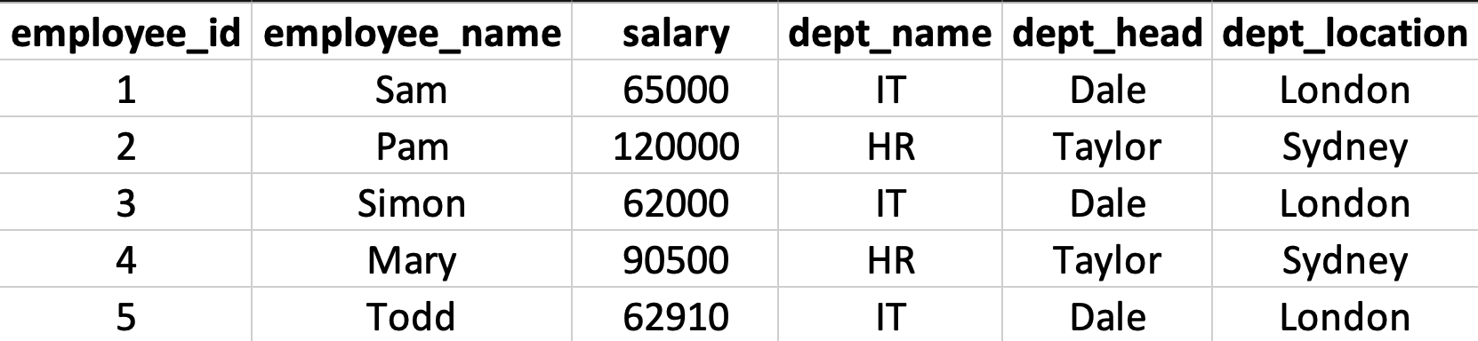

Example #1
What is/are the candidate key(s) in the following table? What is the strongest normal form respected by the table?
T. ARNOLD

Slide 2
Example #1
Candidate keys are: {employee_id} and {employee_name}
The table is in 2NF. All of the features outside the candidate keys depend on the entire key, but there is a transitive dependency from dept_name => dept_head and dept_name => dept_location
T. ARNOLD

Slide 3
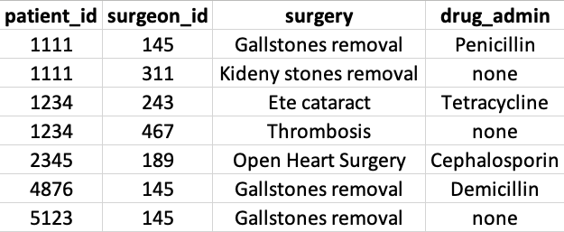
Example #2
What is/are the candidate key(s) in the following table? What is the strongest normal form respected by the table?
T. ARNOLD

Slide 4
Example #2
Candidate key is: {patient_id, surgeon_id}
The table is in 3NF. All of the features outside the non-candidate keys depend on the entire key, and none of them are functionally dependent on other features.
T. ARNOLD

Slide 5
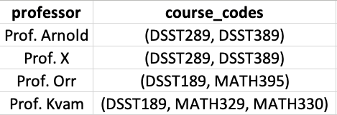
Example #3
What is/are the candidate key(s) in the following table? What is the strongest normal form respected by the table?
T. ARNOLD

Slide 6
Example #3
Candidate key is: {professor}
The table is in 0NF. There is more than one value is a cell, which breaks even the 1NF rules. Note that the rules are cumulative; it does not matter that it results the 2NF and 3NF rules.
T. ARNOLD

Slide 7
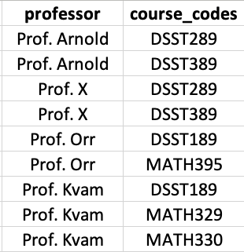
Example #4
What is/are the candidate key(s) in the following table? What is the strongest normal form respected by the table?
Note: This is the way to fix the 1NF issue with the Example 3 table.
T. ARNOLD

Slide 8
Example #4
Candidate key is: {professor, course_codes}
The table is in 3NF. Note: when the candidate key consists of all the columns, 1NF always implies 3NF.
T. ARNOLD

Slide 9
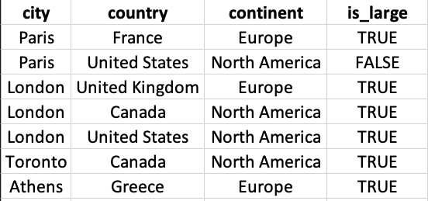
Example #5
What is/are the candidate key(s) in the following table? What is the strongest normal form respected by the table?
T. ARNOLD

Slide 10
Example #5
Candidate key is: {city, country}
The table is in 1NF because continent depends only on country, a proper subset of the first candidate key and country depends on a proper subset of the second candidate key.
T. ARNOLD

Slide 11
Data Feminism
List the four principles of Data Feminism as described on the class slides. A single sentence for each is sufficent.
T. ARNOLD

Slide 12
Data Feminism
DATA IS A STRUCTURE OF POWER
1. Align work with your values to affect positive change in the world.
DATA IS NEVER NEUTRAL OR OBJECTIVE
2. Reflect, align with values, and document all the decisions made when creating data.
3. Integrate a diverse range of sources; combine qualitative + quantitative analyses.
DATA SCIENCE REQUIRES MANY PARTICIPANTS
4. Surface all the people that contribute to our work as data scientists.
T. ARNOLD

