Slide 1

Tibbles
T. ARNOLD

Slide 2
Tibble / Data Frame
The type of R object that we will use to store tabular data is called a tibble, a special type of the more generic data frame.
Tibbles are what are created with functions with read_csv, passed around in many complex pipes (%>%), and fed into modelling and visualisation functions.
It will be useful to create tibbles inline in R, without reading from a CSV, both for short examples/exercises as well as later when doing doing scraping.
T. ARNOLD

Slide 3
Creating a Tibble
We will create a tibble uses the functions tibble() and c() (combine) to manually build a dataset with named features. Here is an example that describes the political divisions within five countries:
country_div <- tibble(
country = c("USA", "Canada", "France", "Germany", "China"),
division = c("state", "province", "département", "federated state", "province"),
number = c(50, 10, 101, 16, 23)
)
Once we run this code, we can use country_div just like any other dataset.
NOTE: values of character features must be in quotes; and be careful of
all the commas
T. ARNOLD

Slide 4
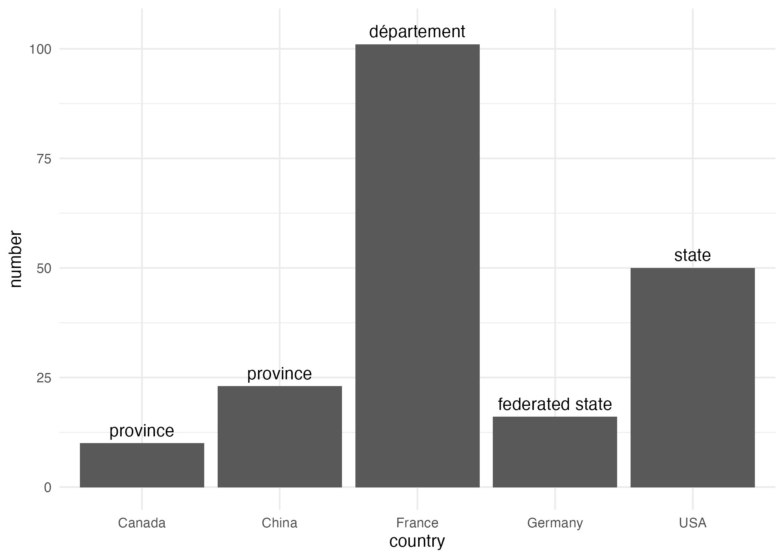
Tibble + Plot = Fun !
the col geom produces one bar for each row of the dataset
country_div %>%
ggplot() +
geom_col(aes(x = country, y = number)) +
geom_text(aes(x = country, y = (number + 3), label = division))
you can apply functions and mathematical operations to features before passing them to aesthetics
T. ARNOLD

