Slide 1

Introduction to Data Science
T. ARNOLD

Slide 2
Course Wrap-Up
Today we are going to discuss a few final closing thoughts about the course:
1. data science in the wild
2. data science minor
3. SQL and Python
4. evaluations
I will be brief so that we have plenty of time to work on the final project.
T. ARNOLD

Slide 3
1. Data Science in the Wild
T. ARNOLD

Slide 4

Data Science in the Wild
I encourage you to use the techniques in this class in future endeavors. This may be as soon as a course next semester, or it may be a job several years down the road.
I suggest keeping two things in mind:
1. We covered the basics in the first 8 weeks, and
these will cover most use-cases. Do not get
overwhelmed by the more advanced stuff.
2. The most important thing to keep in mind are the
class notes about creating data. If you make the
basic data well, it is easy to use ggplot2 + dplyr.
T. ARNOLD

Slide 5
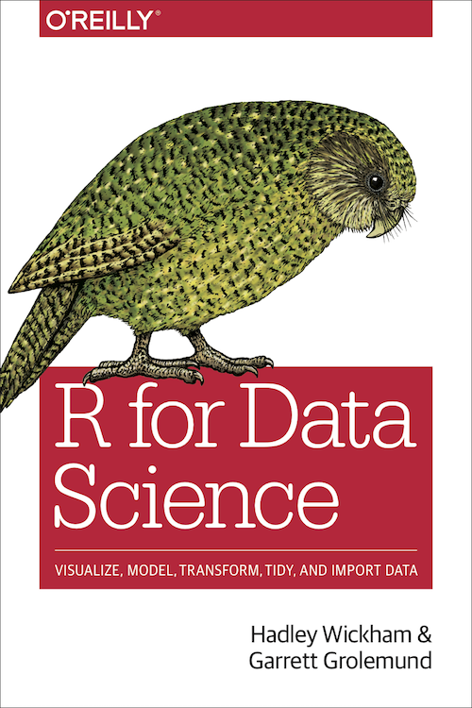
Getting Help
If you are trying to get help with R, or just data science in general, here are a few sources of help:
1. our course website (it should still be up)
2. The R for Data Science book
3. R package vignettes
4. GitHub issues
5. ROpenSci and the R Journal
T. ARNOLD

Slide 6
2. DS Minor
T. ARNOLD

Slide 7
Data Science and Statistics Minor: Structure
A total of six credits.
BIOL 336
CHEM 301, 314, 315
Intro
Data Science
Statistical Learning
Intro Statistics
CMCS 325, 327
MATH 209
MATH 289 => DSST 289
MATH 389
GEOG 260, 360, 365
Data and Society
or
BIOL 320; CHEM 300; PSYC 200; RHCS 245
MATH 329, 330
RHCS 345
PSYC 300, 343
INTRODUCTION (1)
CORE COURSES (3)
ELECTIVES (2)

Slide 8
3. SQL and Python
T. ARNOLD

Slide 9


What We Have Learned
I warned you all at the start of the semester that this course can often feel like we are just learning the programming language R, while in fact we are learning more general concepts from various fields of data science.
As a way of giving a course recap and to illustrate this, let’s look at two other popular languages for data analysis. This is not a complete introduction to them, but a good starting point.
T. ARNOLD

Slide 10
Structured Query Language (SQL)
A language for manipulating data from a data base. Closely linked to the data verbs from dplyr.
SELECT calories, sugar FROM food WHERE food_group = "fruit" ORDER BY sugar ;
food %>%
filter(food_group == "fruit") %>%
select(calories, sugar) %>%
arrange(sugar)
SELECT mu AS avg(calories) FROM food GROUP BY food_group ;
food %>%
group_by(food_group) %>%
summarize(mu = mean(calories))
T. ARNOLD

Slide 11
Python
A language very similar to R, particularly when you use the popular pandas library and Python notebooks.
import numpy as np
import pandas as pd
from plotnine import ggplot, geom_point, geom_text, aes
dt = pd.read_csv('notes/data/food.csv')
dt <- read_csv("notes/data/food.csv")
(ggplot(dt, aes('calories', 'sugar', color='factor(food_group)')) +
geom_point())
dt %>% ggplot(aes(calories, sugar)) + geom_point()
T. ARNOLD

Slide 12
Python (cont.)
dt[dt['food_group'] == 'vegetable']
filter(dt, food_group == 'vegetable')
dt['calories2'] = dt['calories'] * 2
mutate(dt, calories2 = calories * 2)
dt[['fiber', 'food_group']]
select(dt, fiber, food_group)
dt.sort_values('calories')
arrange(dt, calories)
T. ARNOLD

Slide 13
Python
A language very similar to R, let’s see it compares.
T. ARNOLD

Slide 14
4. Course Evaluations
T. ARNOLD

Slide 15
Course Evaluations
Finally, I ask that you finish today by taking a few minutes to fill out the course evaluations. These are helpful as we think about how this class evolves under the new data science minor.
T. ARNOLD

