Slide 1
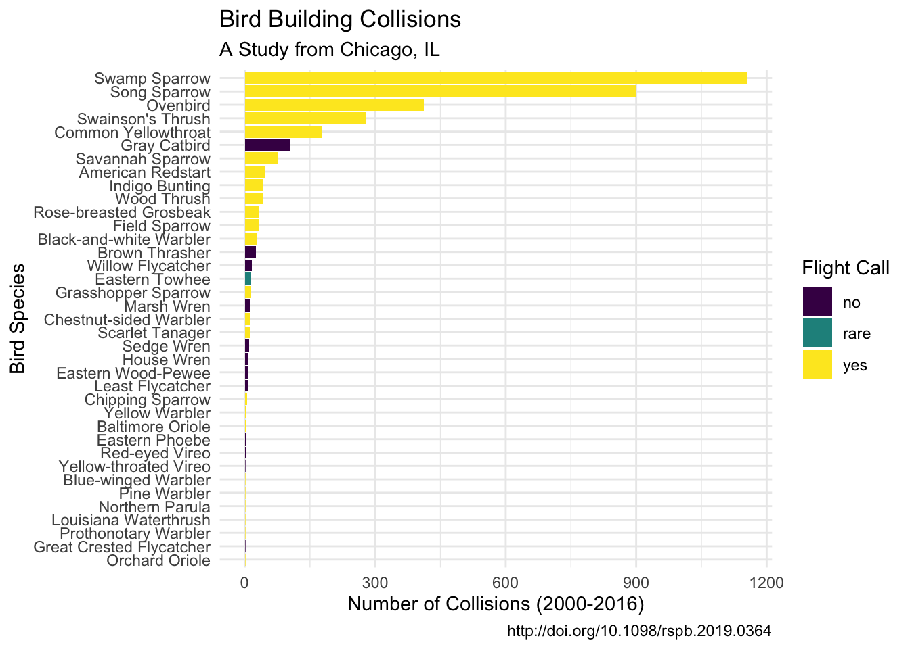
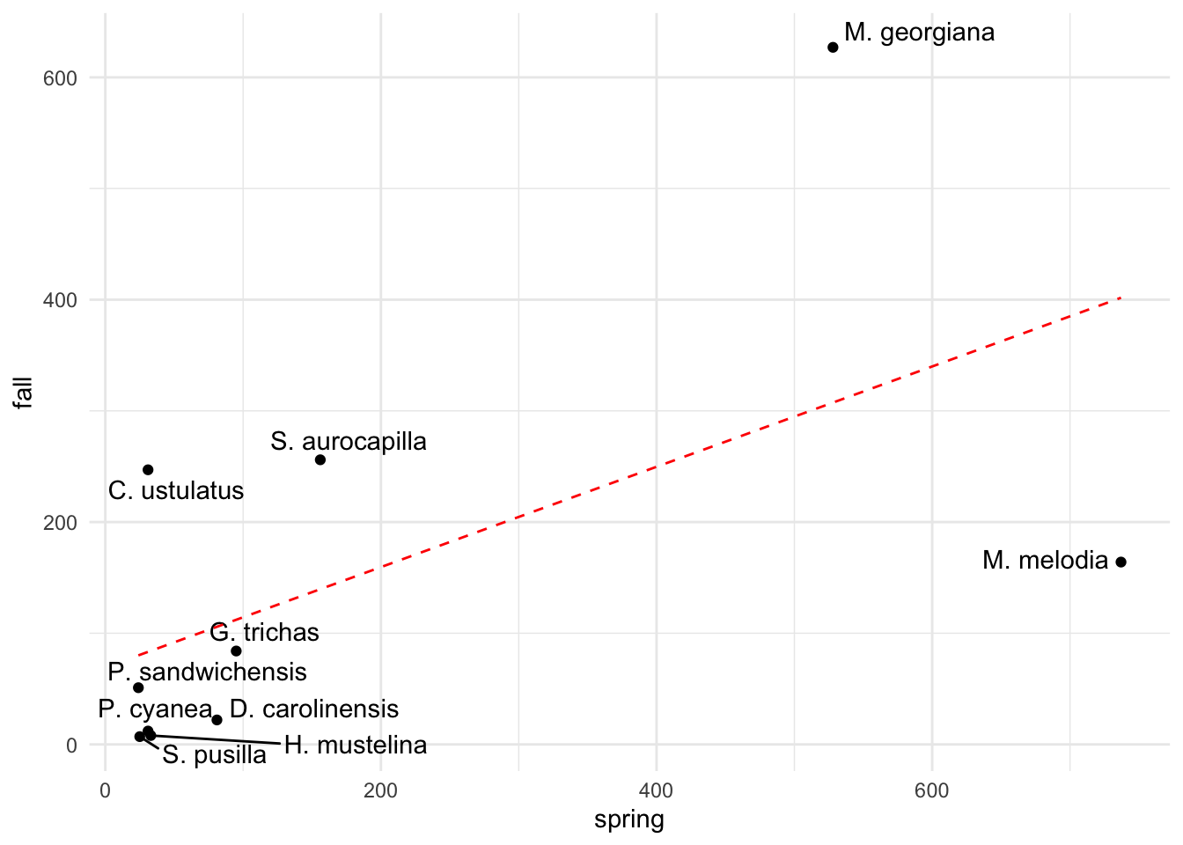
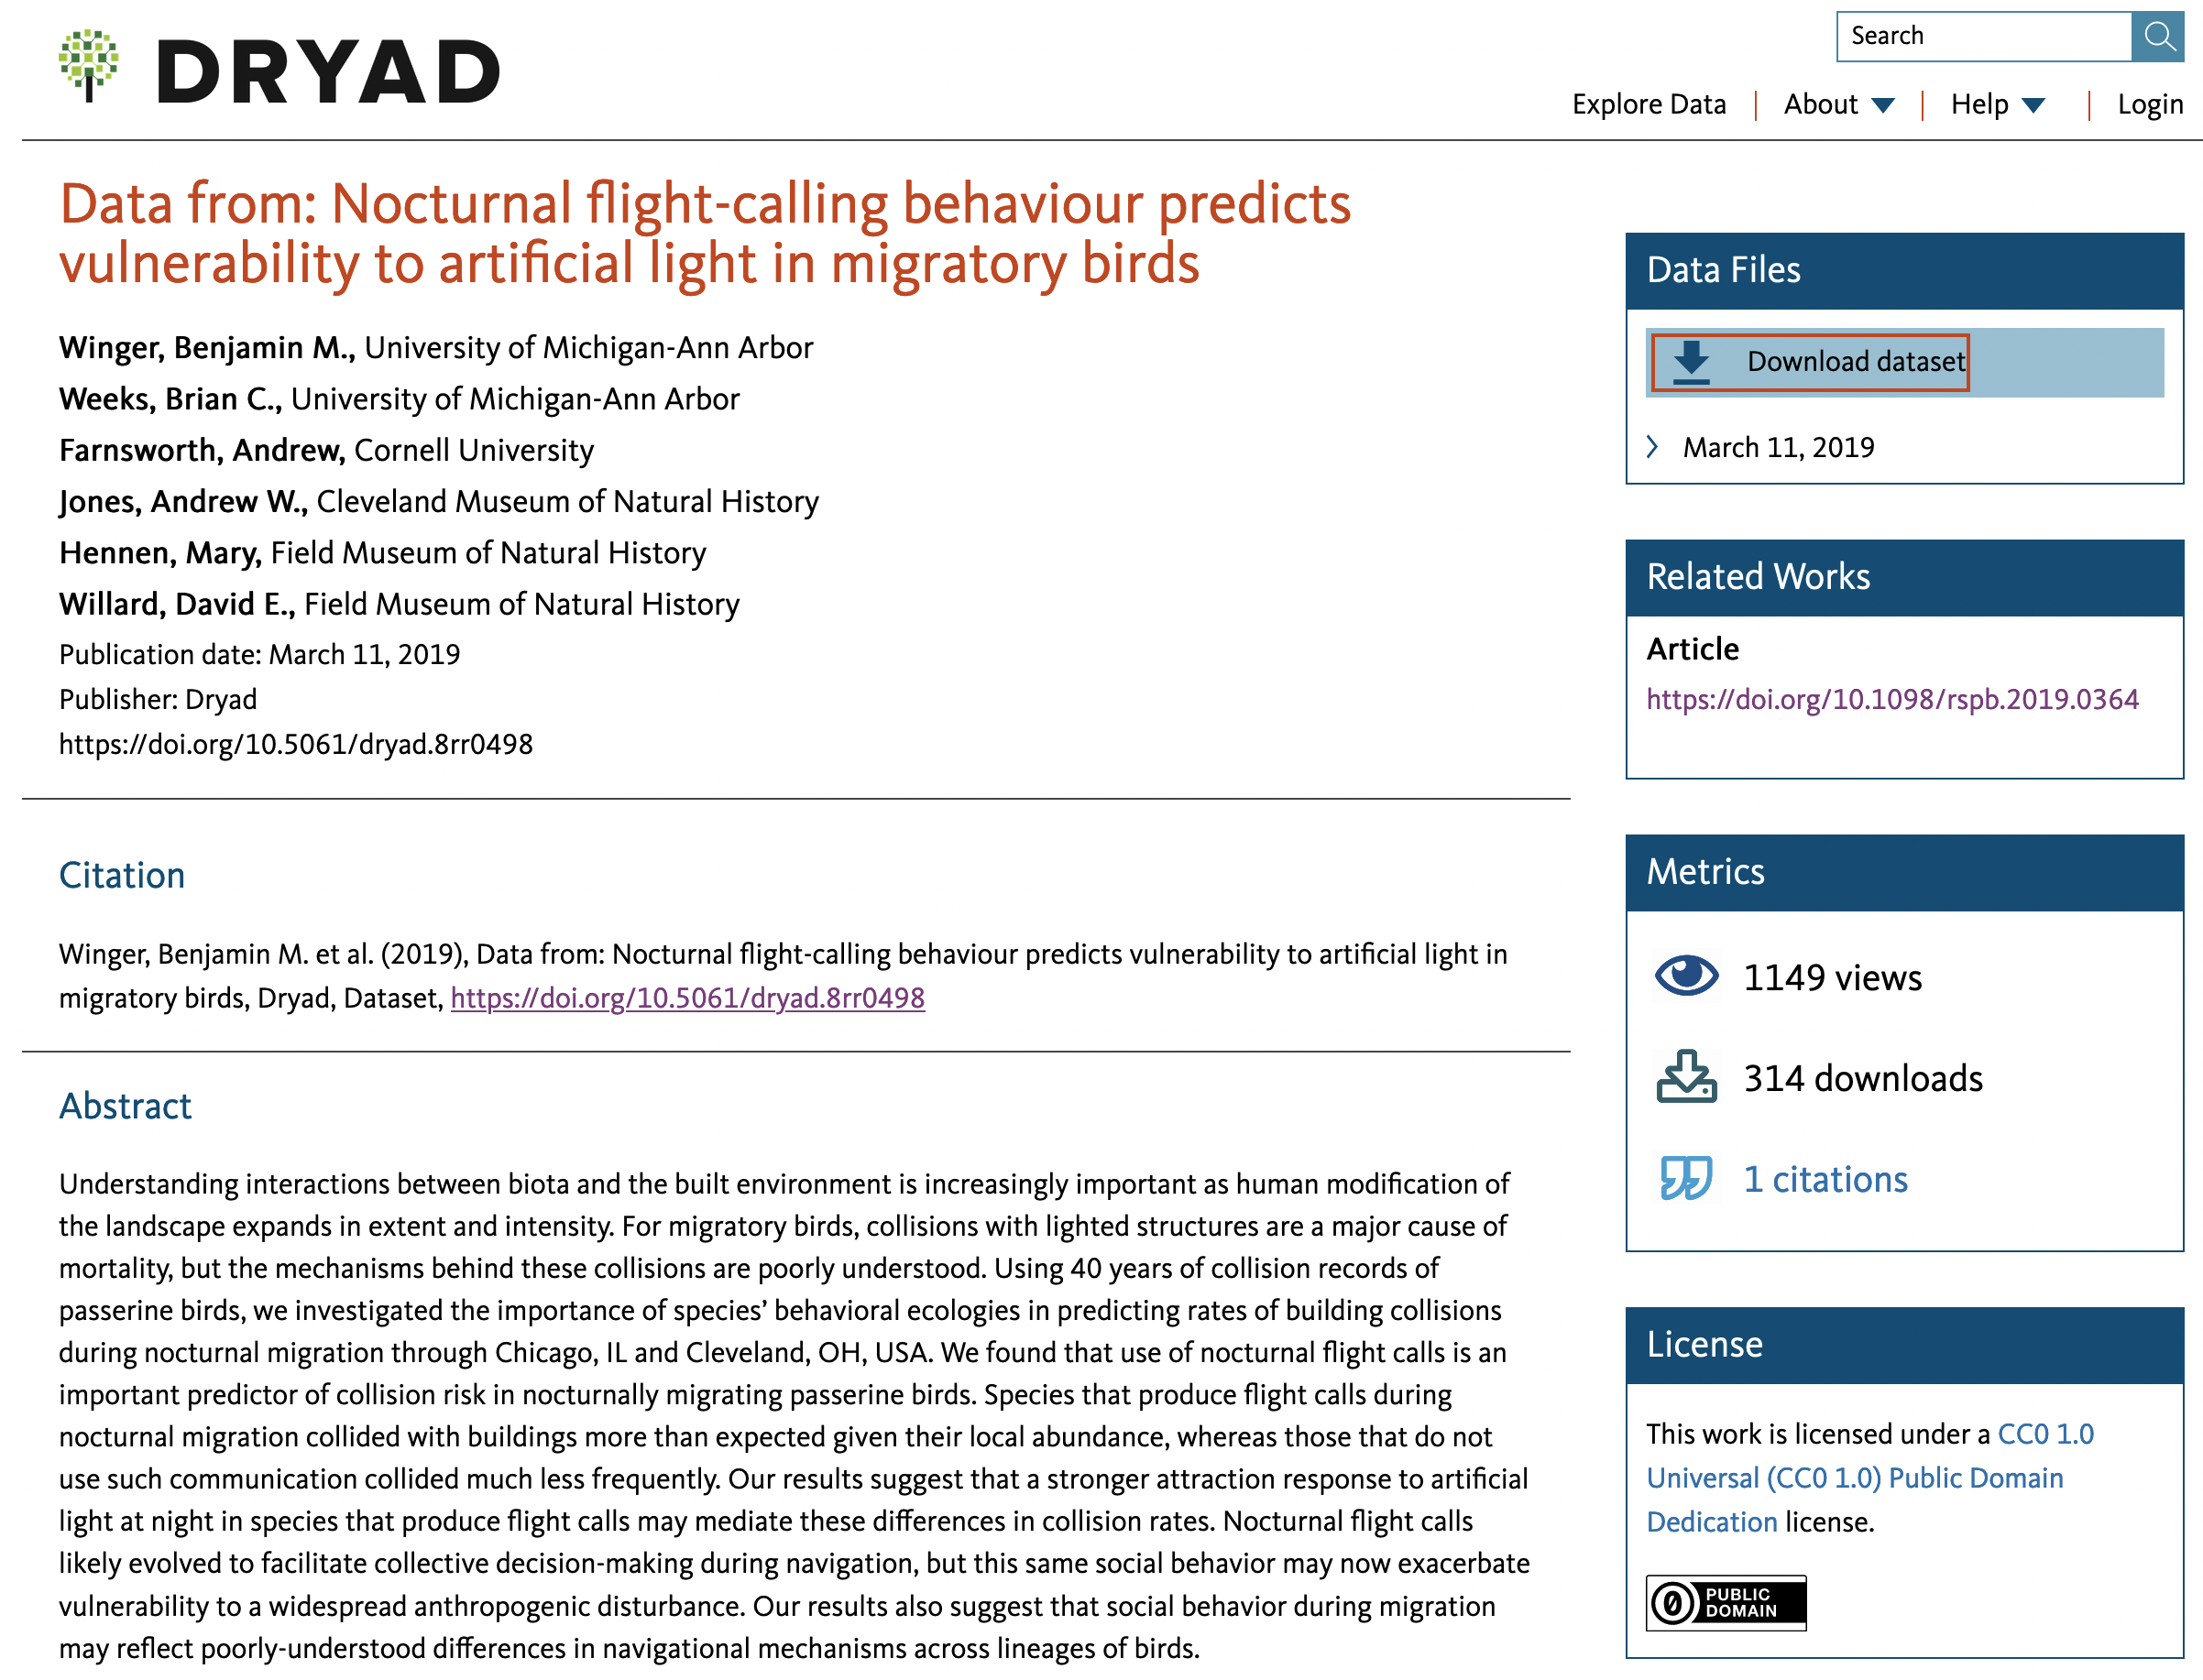
Nocturnal flight-calling behaviour predicts vulnerability to artificial light in migratory birds
Data Source Website
Data Visualization
The data are available from the DRYAD data repository as an easily downloadable zip file containing three csv files. These could be read into R using read_csv without any modifications.
If your data was more complex, you might use more space to describe your work loading it into R.
These are plots that I took from the exam. The right one should have included proper axis labels and a title, whereas the on the left doesn’t need to repeat the citation information that is included again below.
Winger, Benjamin M. et al. (2019), Data from: Nocturnal flight-calling behaviour predicts vulnerability to artificial light in migratory birds, Dryad, Dataset, https://doi.org/10.5061/dryad.8rr0498
Project by Taylor Arnold

