Slide 1

Introduction to Data Science
Welcome!
T. ARNOLD

Slide 2
Introduction to Data Science
Today we are going to get all of the administrative details dealt with. Here is a quick outline:
1. syllabus
2. course content
3. introductions
4. install course materials
There should be plenty of time for questions throughout the class.
T. ARNOLD

Slide 3
1. Syllabus
T. ARNOLD

Slide 4
2. Course Content
T. ARNOLD

Slide 5
Data Science?
This semester we will learn and practice a series of methods for organizing, collecting, visualizing, manipulating, and exploring different kinds of data. We are focused on the creation and application of methods, rather than theoretical or foundational questions.
This is not a mathematics course, nor will it resemble a traditional introductory statistics class. We will spend the entire semester writing code to apply data science concepts.
T. ARNOLD

Slide 6


Programming
There are several different programming languages for data science. By far the two most popular are R and Python.
We will be using R this semester but will learn a version that is easily adapted to other languages such as Python.
No specific experience with R or Python is expected!
T. ARNOLD

Slide 7
An Example
If you are not familiar with the kinds of tasks that are common in data science and exploratory data analysis, an example can be very helpful.
Here is a slightly dated but still the best concise example I know of:
https://www.youtube.com/watch?v=Z8t4k0Q8e8Y
T. ARNOLD

Slide 8
3. Introductions
T. ARNOLD

Slide 9







About Me
- From New England: born in Maine, school in MA, ME, CT
- Moved to Richmond in 2016
- Research on large text and image datasets in linguistics and cultural studies
T. ARNOLD

Slide 10





About Me
- Lots of industry experience in DS:
- IBM (Healthcare)
- Travelers (Insurance)
- DARPA (social media)
- AT&T (location analytics)
- Telperian (pharmaceuticals)
T. ARNOLD

Slide 11
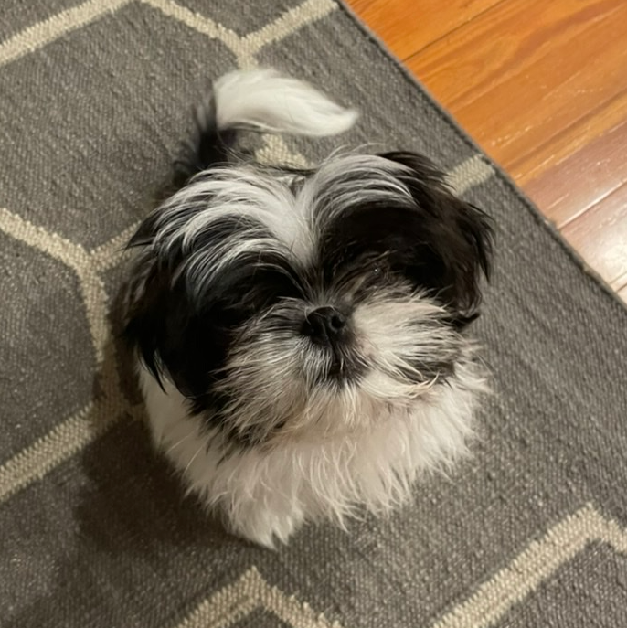
About Me
I have a dog named Roux. He is often in my office; please come say hello!
T. ARNOLD

Slide 12
You?
How does your name show up in BannerWeb? Do you have a different preferred name? Is there anything else I should know about the pronunciation of your name or your preferred pronouns?
Please give a brief 2-3 sentence introduction.
What other statistics or data sciences courses have you taken at UR?
In one sentence, why are you taking this class?
Anything else I should know? At a minimum, please let me know if you have a DAN or are involved in any UR sports teams or other official organizations that may cause you to miss class
T. ARNOLD

Slide 13
4. Course Setup
T. ARNOLD

Slide 14
Installing Course Software
We need to install three different components for this semester:
1. The R Programming Language
2. The RStudio IDE
3. A set of R Packages and data
All of these components are open-source and available for all modern operating systems. You may have trouble, however, if you have an older OS and have not updated it recently.
Even if you already have R installed, I suggest doing a fresh update for the semester.
T. ARNOLD

Slide 15
1. Installing the R Language
To install R, go to https://cran.r-project.org/ and select your operating system. Then:
macOS => click on R-4.3.2.pkg and follow instructions
Windows => click on base followed by "Download R"
For Linux, either install from source or use your favorite package manager.
You need to install R before anything else, but we will never actually open it directly. So feel free to remove and shortcuts or links that are created during installation.
T. ARNOLD

Slide 16
2. Installing RStudio
To install RStudio, follow the following link and download either the dmg (macOS) or exe (Windows):
https://posit.co/download/rstudio-desktop/
Note: On macOS, you need to drag the RStudio icon into your Applications directory after downloading.
T. ARNOLD

Slide 17
3. Install R Packages
Finally, download and unzip the "materials.zip" file from the class website. We will use this directory throughout the semester, so put it somewhere you will remember it.
Then, open the setup.Rmd file in RStudio, and click the green play buttons (see next slide).
Make sure to put this folder somewhere for the semester. You will need it!
T. ARNOLD

Slide 18
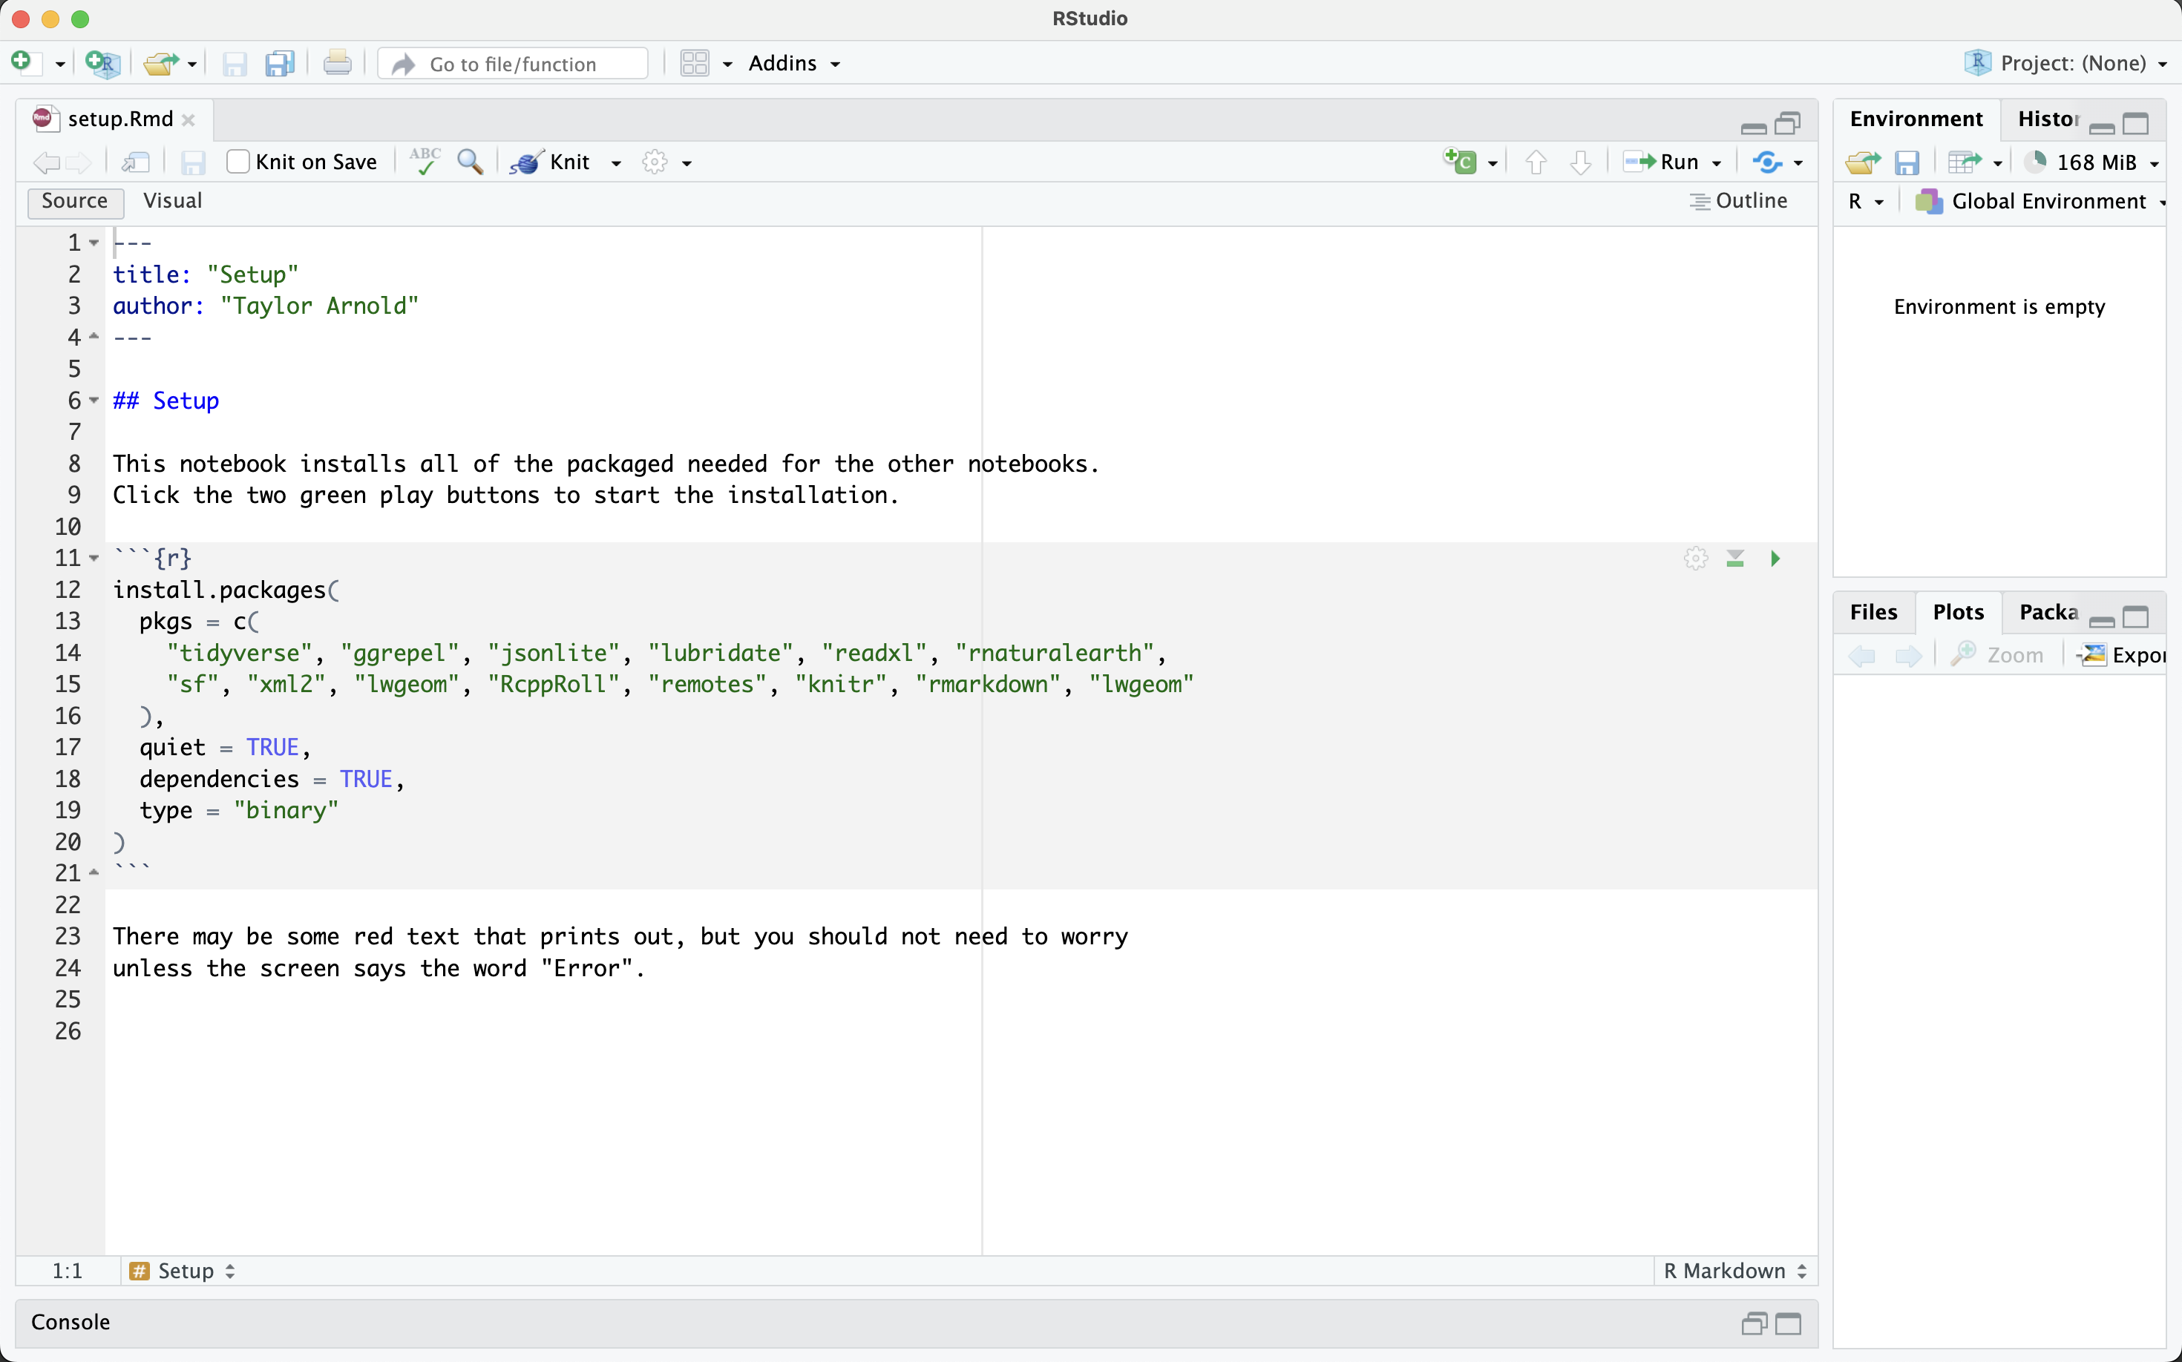
3. Install R Packages
Click here
T. ARNOLD

Slide 19
For the Semester
You should plan on bringing a laptop with a working version of R, RStudio, and all of the installed packages to each class meeting. If that is or becomes an issue, just let me know and we will find a solution.
Note that if you are having computer issues, particularly during an exam, it is always possible to use the lab computers in Jepson as a back-up. They have R and RStudio installed, but not all of the class R packages. Simply start from Step 3 in these notes before getting started.
T. ARNOLD

