Slide 1

Installing Course Software
We need to install three different components for this semester:
1. The R Programming Language
2. The RStudio IDE
3. A set of R Packages and data
All of these components are open-source and available for all modern operating systems. You may have trouble, however, if you have an older OS and have not updated it recently.
Even if you already have R installed, I suggest doing a fresh update for the semester.
T. ARNOLD

Slide 2
1. Installing the R Language
To install R, go to https://cran.r-project.org/ and select your operating system. Then:
macOS => click on R-4.1.2.pkg and follow instructions
Windows => click on base followed by "Download R"
For Linux, either install from source or use your favorite package manager.
You need to install R before anything else, but we will never actually open it directly. So feel free to remove and shortcuts or links that are created during installation.
T. ARNOLD

Slide 3
2. Installing RStudio
To install RStudio, follow the following link and download either the dmg (macOS) or exe (Windows):
https://www.rstudio.com/products/rstudio/download/#download
Note: On macOS, you need to drag the RStudio icon into your Applications directory after downloading.
T. ARNOLD

Slide 4
3. Install R Packages
Finally, download and unzip the "materials.zip" file from the class website. We will use this directory throughout the semester, so put it somewhere you will remember it.
Then, open the setup.Rmd file in RStudio, and click the green play buttons (see next slide).
T. ARNOLD

Slide 5
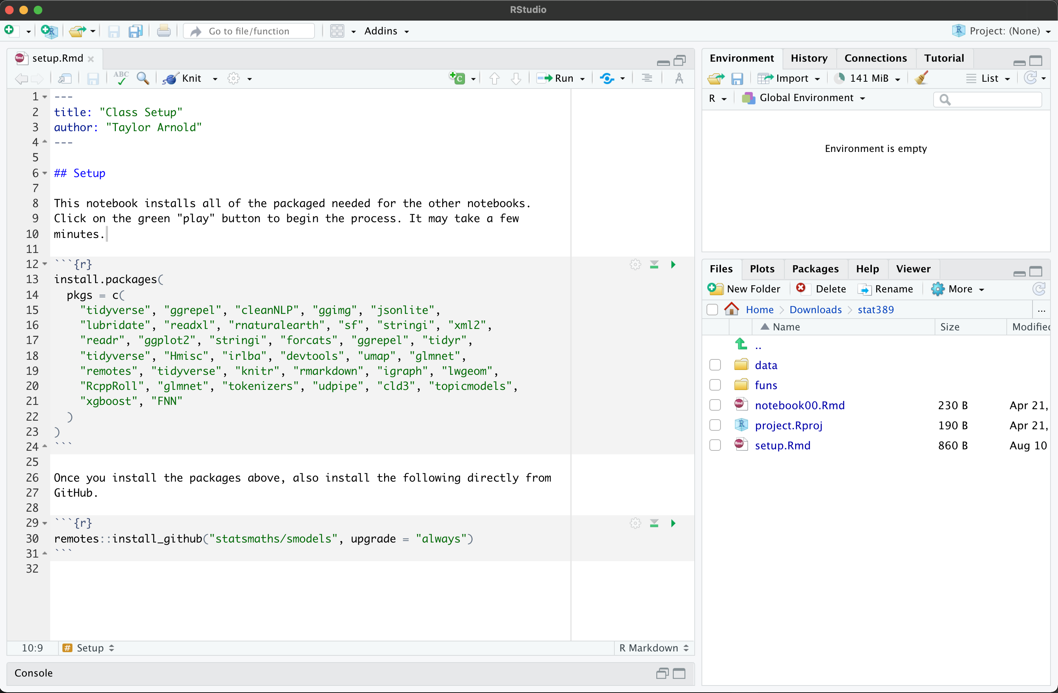
3. Install R Packages
Click here
Then, click here
T. ARNOLD

Slide 6
For the Semester
You should plan on bringing a laptop with a working version of R, RStudio, and all of the installed packages to each class meeting. If that is or becomes an issue, just let me know and we will find a solution.
Note that if you are having computer issues, particularly during an exam, it is always possible to use the lab computers in Jepson as a back-up. They have R and RStudio installed, but not all of the class R packages. Simply start from Step 3 in these notes before getting started.
T. ARNOLD

