Slide 1

Logistic Regression
Last time we introduced the logistic regression method for building a classification algorithm from training data.
In summary, we model the probability of being one of the two classes (orange, in the example) is a transformation of a linear combination of the feature variables X and Y.
We then classify the predicted class based on whether the probability is greater than 0.5
Probability(⬤) = F(a + b × X + c × Y)
T. ARNOLD

Slide 2
More Variables
We can easily extend our model to include more feature variables by adding them along with a new constant.
While we lose the ability to make simply, pretty visualizations of the classification task, most of the same general concepts hold.
For example, with three dimensions, the model creates a classification plane in three dimensions that partitions the three dimensional space into two halves.
Probability(⬤) = F(a + b × X + c × Y + d × Z)
T. ARNOLD

Slide 3
Too Many Variables
In theory we can include as many features as we want. Adding up to a dozen or two is usually fine.
However, once we start adding a larger number of features, it becomes too easy to find a set of model parameters that can seperate the two classes in the training data but is unable to work well on the validation data.
The phenomenon of matching the training data in a way that does not generalize to new data is called overfitting. It’s hard to define a precise way, but you’ll start to understand the concept through looking at examples.
T. ARNOLD

Slide 4
Working with Many Variables
Fortunately, there is a solution to making logistic regression feasible when we have a large number of features.
In a standard logistic regression we find the set of parameters that maximizes how well the data fits the parameters. Specifically, we want to maximize the probability of observing the data we found assuming the modelling probabilities are correct.
Logistic Regression =>
[
]
Maximise
Fit
T. ARNOLD

Slide 5
Penalized Logistic Regression
In penalized logistic regression, we instead maximize the fit of the data minus a measurement of the complexity of the model.
We use a parameter λ > 0 to control the relative tradeoff between fitting the training data well and not having a model that is overly complex.
Penalized Logistic Regression =>
[
]
Maximise
Fit
– λ × Complexity
T. ARNOLD

Slide 6
Elastic Net
There are several different varieties of penalized regression, which depend on the way that we measure the complexity of a model.
The most important for us this semester is a penalized regression method called the elastic net. It has a few sub-varieties, but in its simpliest form, the measure of complexity it given by the sum of the absolute value of the non-intercept model parameters.
Complexity =>
|b| + |c| + |d|
T. ARNOLD

Slide 7
Elastic Net
It should be clear that using this complexity measurement will have parameters that are smaller than those from the standard logistic regression.
The amazing thing, which is not immediately clear, is that the elastic net method will often set some of the model parameters exactly the zero. This is called the parsimonious or model selection property.
Complexity =>
|b| + |c| + |d|
T. ARNOLD

Slide 8
Elastic Net: Applications
In addition to being a good overall method for predictive modelling, the elastic net is also useful for identifying features that are most related to a specific respose.
For example, this technique is often used in bioinformatics. For example, one might collect data about the genes of 50 patients who repond well to a theraputic treatement and 50 patients who responded poorly. Then, we could use the elastic net method to predict treatement outcomes based on the tens of thousands of features from the genes. The genes that have non-zero parameters are those that might be responsible for whether the treatment works.
In this class, we will mostly be doing text prediction where the features are the number of times a particular word is used. There are a large number of words, but the elastic net will identify the small set of words that are important for identifying a particular category.
T. ARNOLD

Slide 9
Finding the Tuning Parameter
When using the elastic net, how can we find a good value of the parameter λ ? If we want to just make good predictions, we can use a technique called cross validation. This is an important technique in machine learning, so let’s take a moment to understand how it works.
In cross validation, we start by randomly partitioning the training data into groups that are called folds. We will illustrate using an example with three folds:
training data
Fold 1
Fold 2
Fold 3
T. ARNOLD

Slide 10
Cross Validation
training data
Fold 1
Fold 2
Fold 3
Now, we fit a collection of elastic net models with different values for λ using all the training data except for the data in the first fold.
Then, we use each of these models to predict how well they perform on the held-out data in the first fold.
T. ARNOLD

Slide 11
Cross Validation
training data
Fold 1
Fold 2
Fold 3
Then, we repeat the process but now determine all the model parameters using all the training data except for the observations found in fold 2.
These model are then used to predict the values in fold 2.
T. ARNOLD

Slide 12
Cross Validation
training data
Fold 1
Fold 2
Fold 3
Finally, we do this all again for the data in fold 3.
When we are done, we have a measurement of how well each particular value of lambda is able to predict the held-out data in each of the folds.
T. ARNOLD

Slide 13
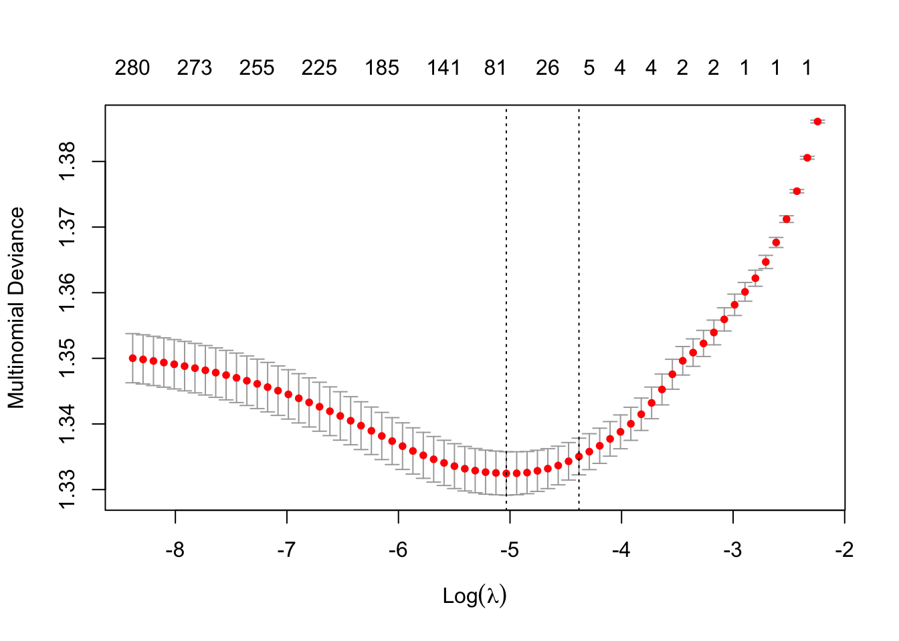
Cross Validation
Typically, when we are done we have a curve that looks something like this. The bars give confidence intervals from each of the folds.
Classification Error
λ
T. ARNOLD

Slide 14
Cross Validation
Notice that the best prediction is usually somewhere in the middle, with a balance between fit and complexity.
“1se” model; typically just as good but many fewer non-zero parameters
value predicted to be the “best”
Classification Error
models overfit to the training data
λ
not as predictive, but good for identifying the strongest variables
T. ARNOLD

Slide 15
Elastic Net: Summary
The elastic net will be our most important method for building predictive models this semester. It allows us to do classification with a large number of variables, is able to produce some of the most predictive models in many application domains, and produces interpretable models.
One thing to keep in mind, that is easy to forget, is that the elastic net is a method for producing a linear prediction of probabilities. The only thing that is different is the way that we pick the parameters in the logistic model. Once choosen, the model works exactly the same way.
Probability(⬤) = F(a + b × X + c × Y + d × Z)
T. ARNOLD

Slide 16
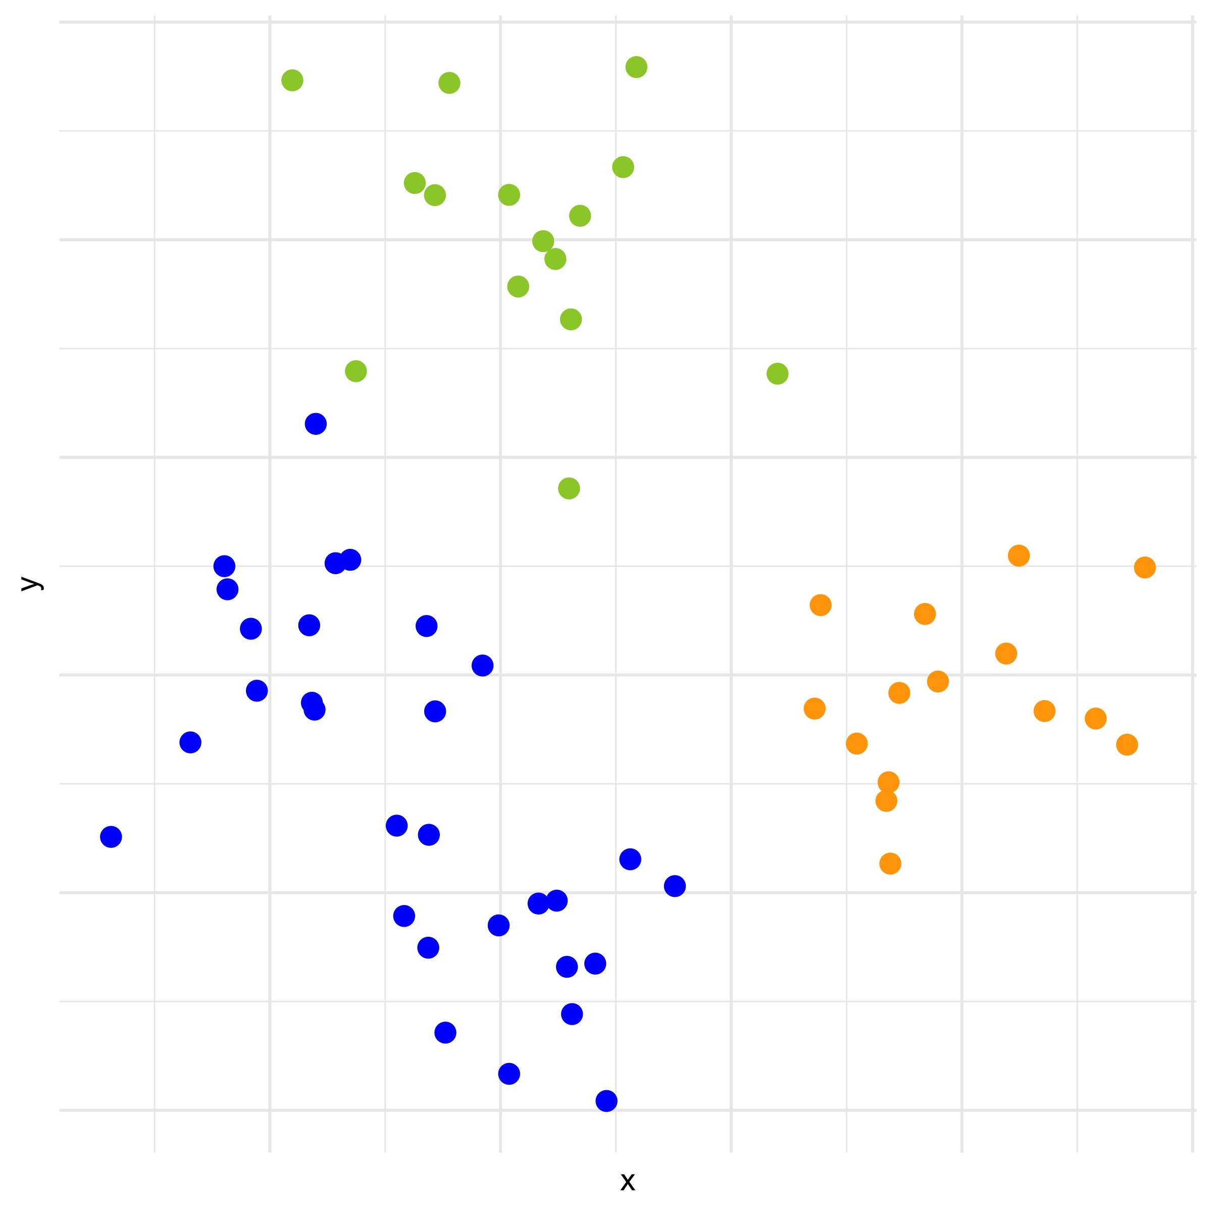
Multiclass Prediction
There is one final tweak to the elastic net model that we will need. So far we have only considered the case where there are two classes. Often, though, we will want to consider a prediction task where there are three or more classes.
T. ARNOLD

Slide 17
Multiclass Prediction
The solution is to build one logistic regression model for each class. Prediction is then done using the maximum label probability for each point.
Probability(⬤) = F(a + b × X + c × Y)
Probability(⬤) = F(d + e × X + f × Y)
Probability(⬤) = F(g + h × X + i × Y)
T. ARNOLD

Slide 18
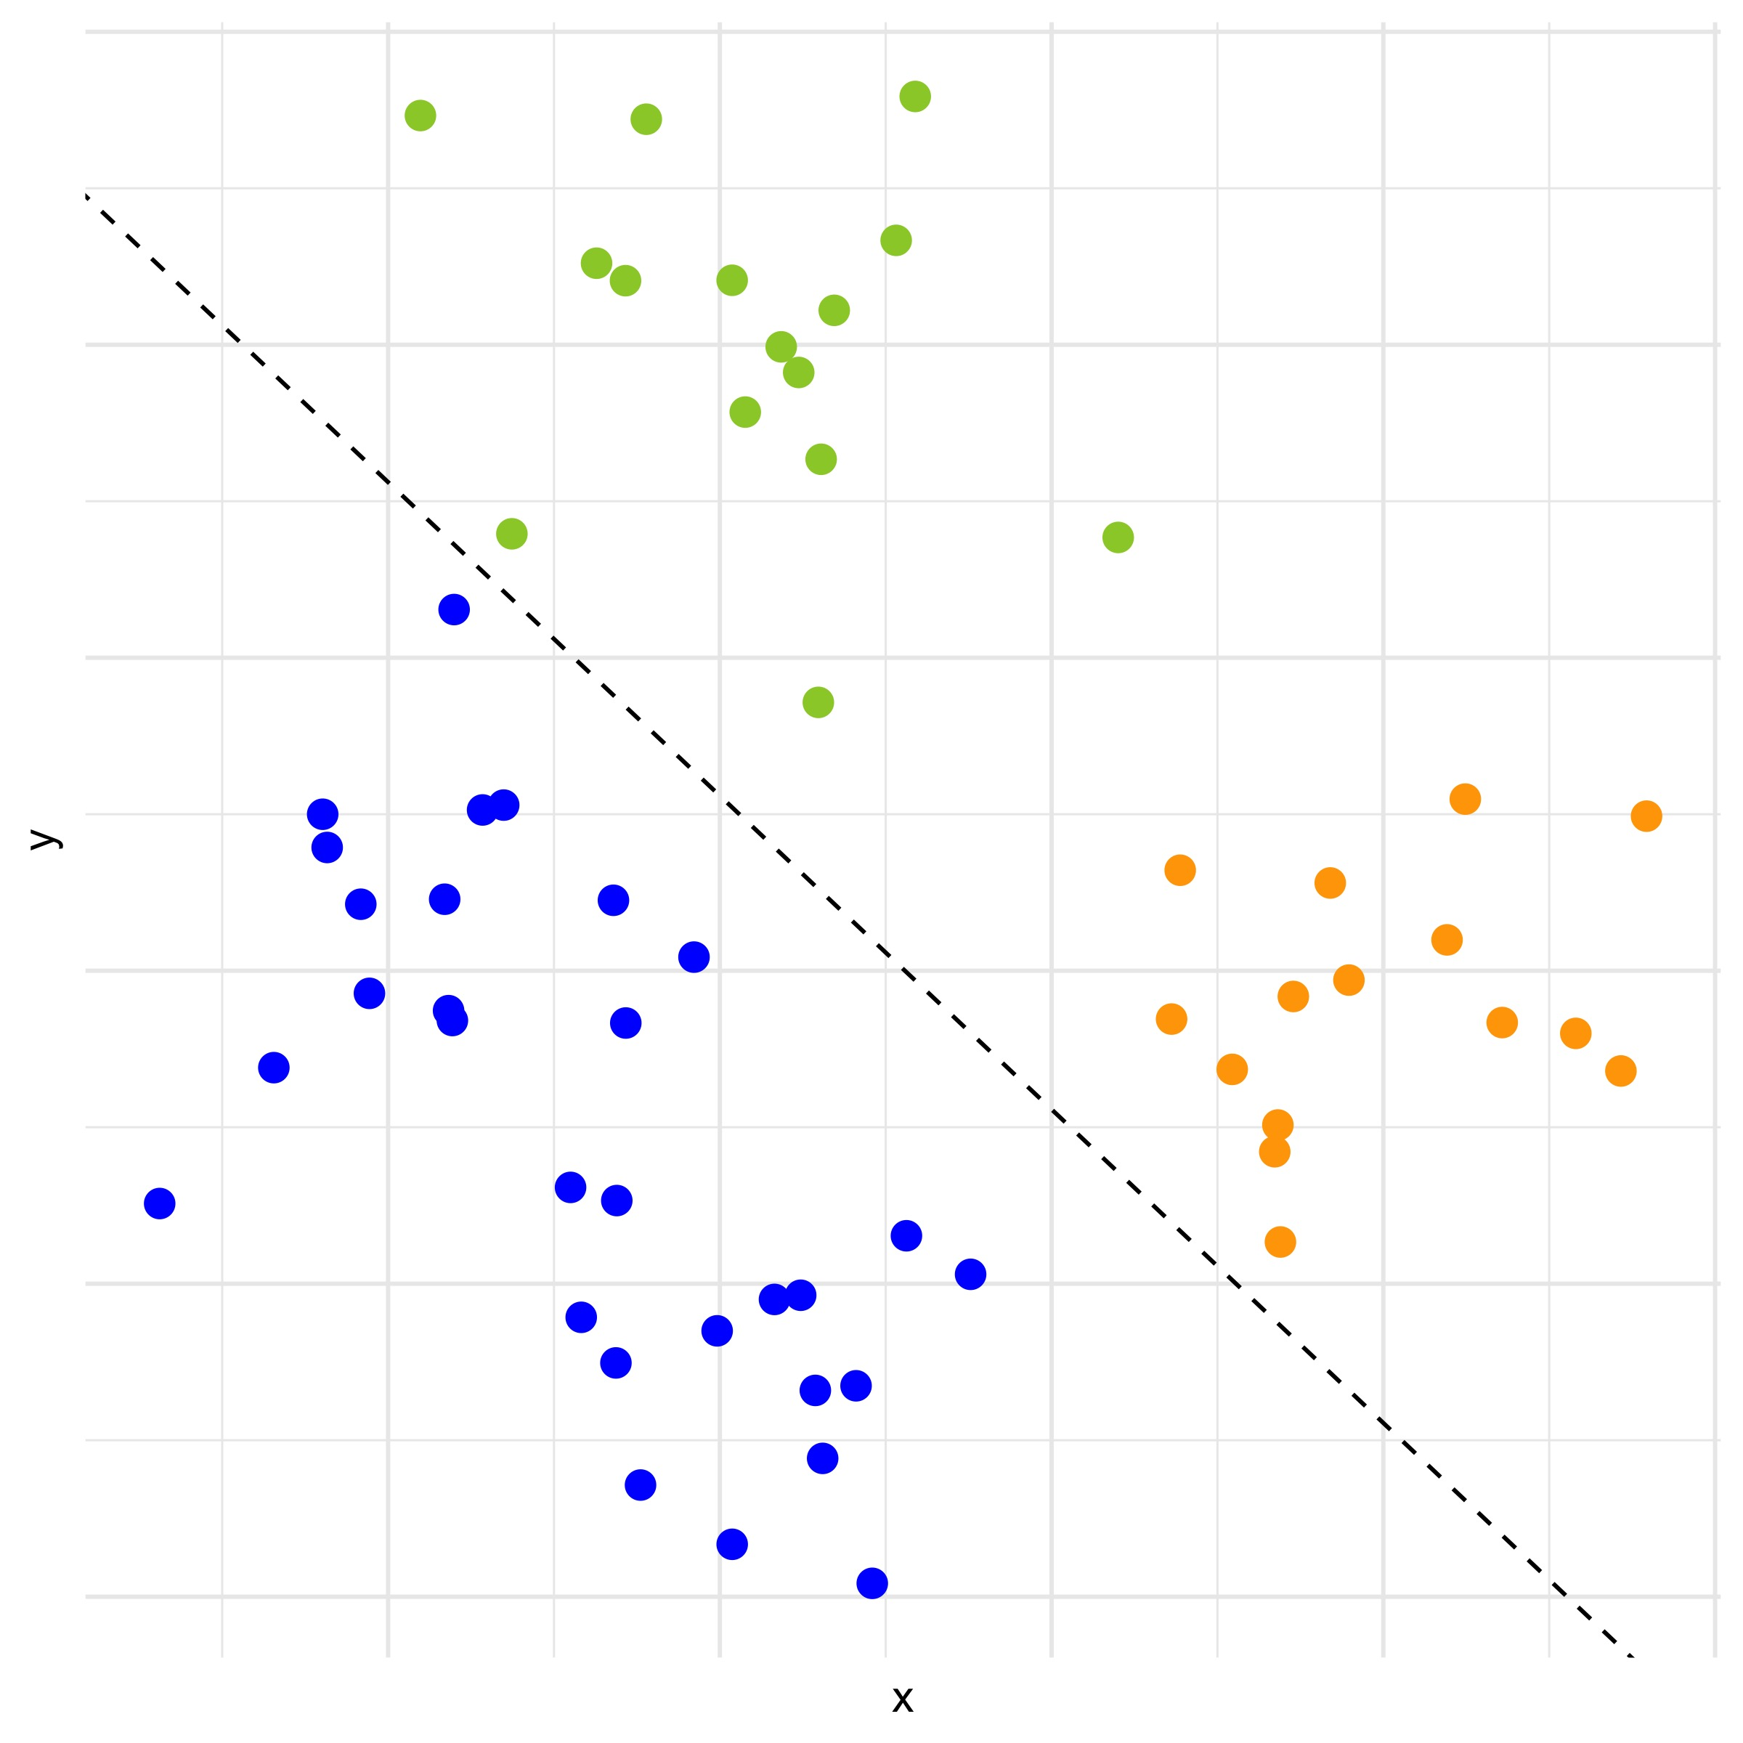
Multiclass Prediction
Here is a line for the blue class (the blue class is below the line):
Probability(⬤) = F(a + b × X + c × Y)
T. ARNOLD

Slide 19
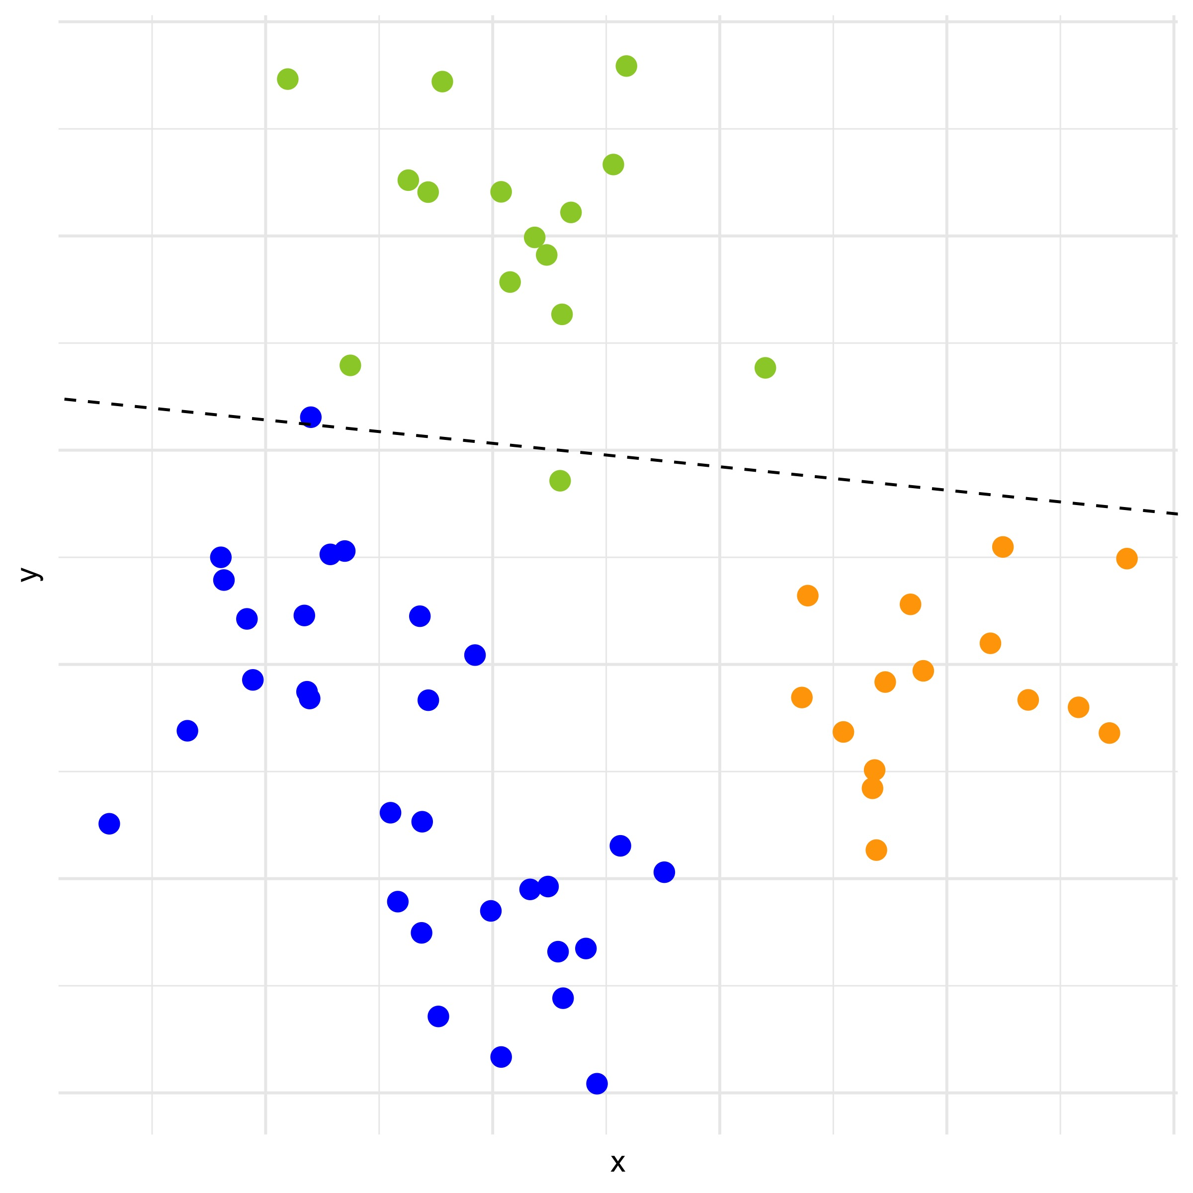
Multiclass Prediction
Here’s one for the green class:
Probability(⬤) = F(d + e × X + f × Y)
T. ARNOLD

Slide 20
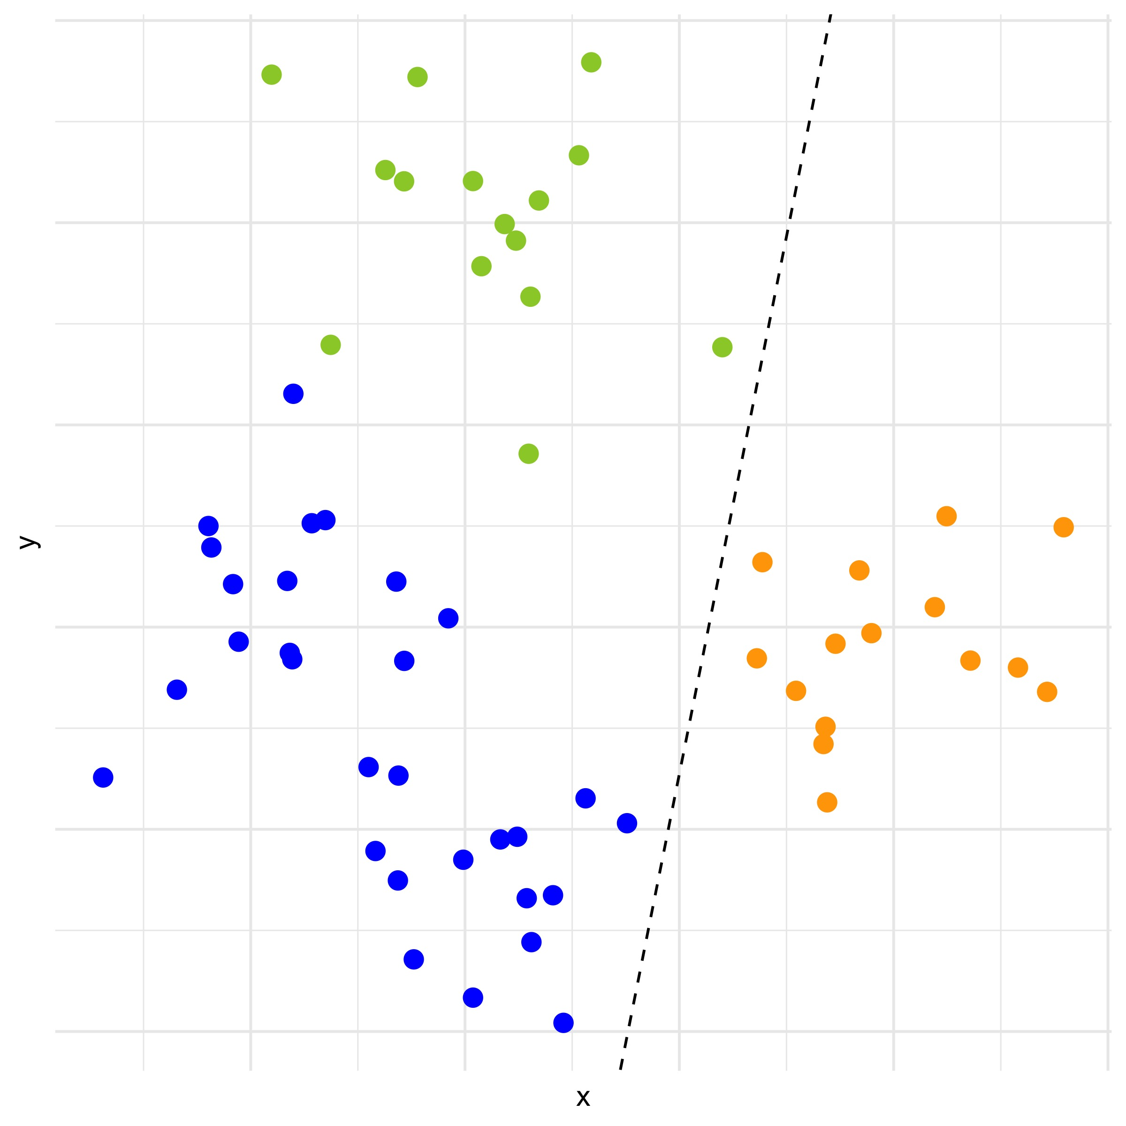
Multiclass Prediction
And finally, one for the orange group.
Probability(⬤) = F(g + h × X + i × Y)
T. ARNOLD

Slide 21
Multinomial Regression
This method is called multinomial regression, in contrast to logistic regression.
Going forward, we will always use multinomial regression, and therefore use the term elastic net without referring to whether we are doing logistic or multinomial classification.
T. ARNOLD

