Slide 1

DSST389: Statistical Learning
T. ARNOLD

Slide 2
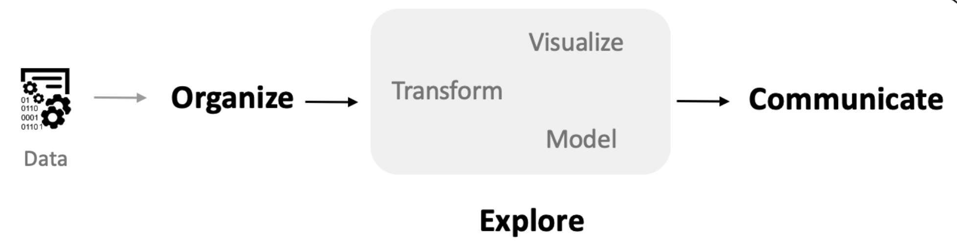
Data Science Pipeline
A standard, highly abstract diagram showing the flow of information when doing data science work.
T. ARNOLD

Slide 3
DSST 289
In our Intro to Data Science course, we focused most heavily on the interior parts of the pipeline.
grammar of graphics w/ ggplot2
1NF, 2NF, etc.
verbs; pivots; joins
T. ARNOLD

Slide 4
DSST 389
For this class, we focused on the end of the pipeline while continuing to practice the interior methods.
putting the pieces together in a cohesive way
predictive models, clustering, dim. reduction
T. ARNOLD

Slide 5
DSST 389
We also focus on the explore step as a whole and in the final project collecting data from an external API (a bit of a review for those in the Fall 2021 version of 289).
Web-based API, JSON, XML
putting all of these explore parts together requires creativity and patience
T. ARNOLD

Slide 6




Projects
T. ARNOLD

Slide 7
ML Concepts
Core Concepts
– error rates
– train/validation split
– cross-validation
– confusion matrix
– overfitting
Some Other Metrics
– false positive rate
– ROC curves / AUC
– Top-k error rate
– test/holdout error
– gain/lift
T. ARNOLD

Slide 8
Supervised Models
Core Techniques
– linear regression
– logistic regression
– elastic net
– k-nearest neighbors
– decision trees
– gradient boosted trees
Others You May See
– support vector machines
– additive models
– Bayesian models
– structural equation models
– kernel techniques
T. ARNOLD

Slide 9
Unsupervised Models
Core Techniques
– principal components
– UMAP
– k-means
– hierarchical clustering
Some Others You May See
– neural network embedding
– spectral clustering
The choice of distance metric as a large effect on unsupervised models. We used Euclidean and TF-IDF. Many other techniques will modify the distance function but use a classical technique on the modified data
T. ARNOLD

Slide 10
Text-Specific Techniques
Core Techniques
– tokenization
– lemmatization
– POS tagging
– N-grams
– Topic Models
– KWiC
– G-scores
Some Others You May See
– stochastic processes
– word2vec
– recurrent neural networks
– transformers (i.e., GPT-4)
T. ARNOLD

Slide 11
Data Creation
Core Concepts
– APIs and HTTP
– Web Scraping
– XML & Xpath
– JSON & map functions
– iteration
Some Others You May See
– regular expressions
– functional programming
– authentication
– cookies
We only covered the basics of HTTP, XML, and JSON. You’ll have enough to get started and can use other tutorials and documentation if you need to do something more complicated.
T. ARNOLD

Slide 12
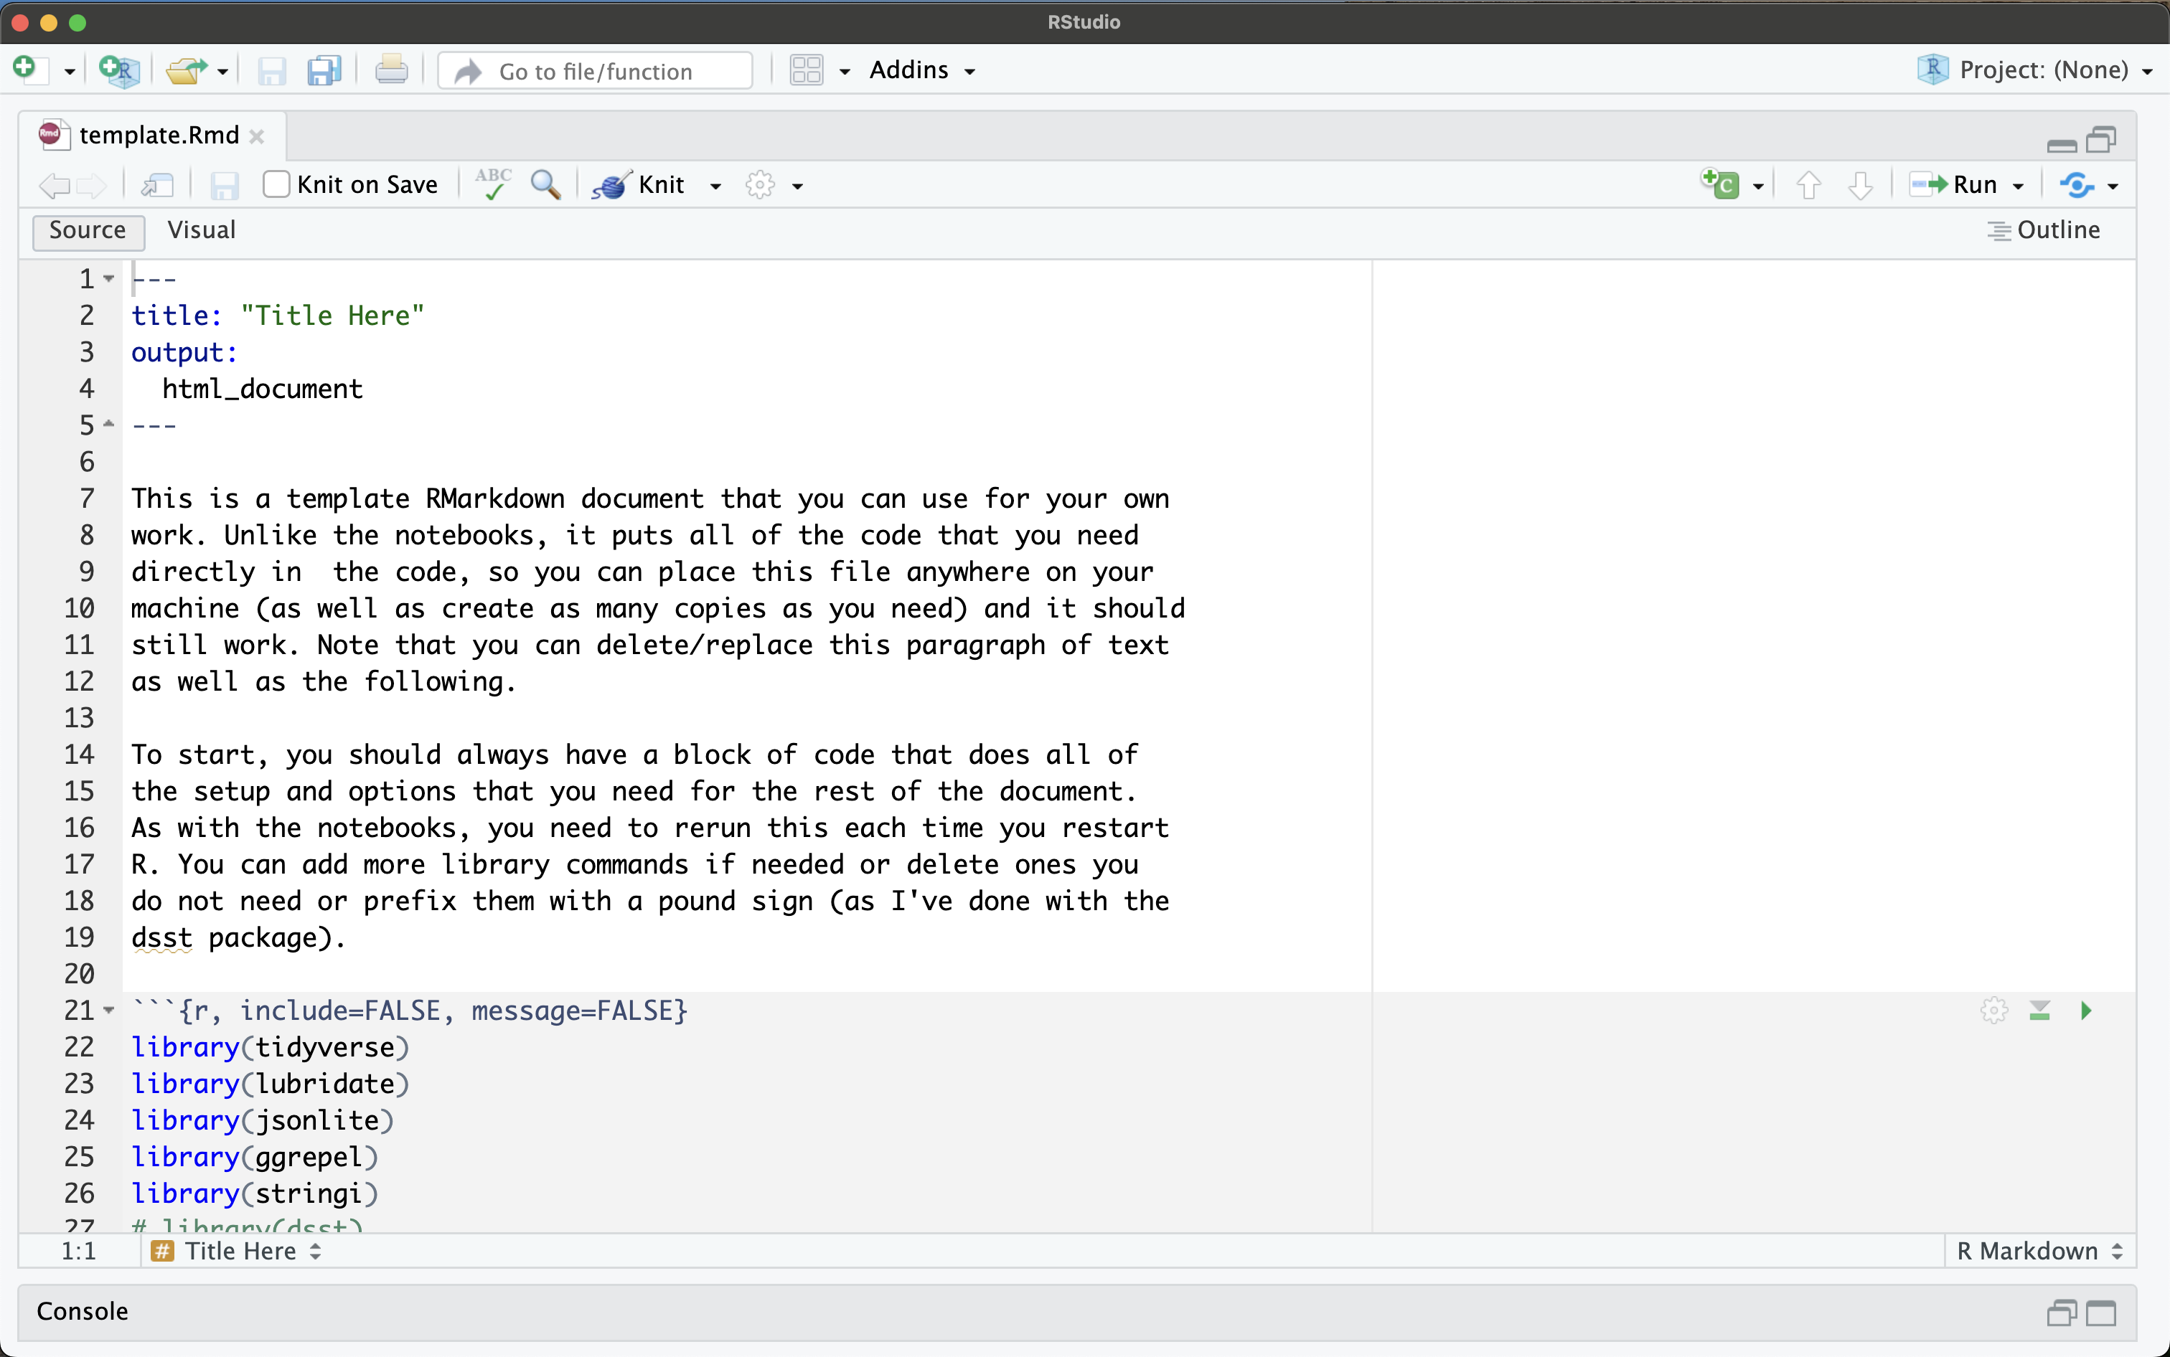
On Your Own
I have included a template file that you can get in our class notes. You can copy and use this file to run any code from class independently of the rest of the class setup.
The class notes will also remain online indefinitely in case you want to return to them.
T. ARNOLD

Slide 13
DSST389: Statistical Learning
T. ARNOLD

Slide 14
DSST389: Statistical Learning
DSST389: Advanced Data Science
T. ARNOLD

