Slide 1

Clustering, rethought
In the previous unit, we introduced methods for clustering analysis. K-means puts each document into one of k different clusters. This is clean but lacks nuiance; a document can only be in a single cluster.
Hierarchical clustering allows for a bit more variety. We can say that at one level docs A + B and docs C + D make two different clusters, but farther up the tree these combine to create a larger 4 document cluster.
When documents get longer, as in Project 4, these can still both be too restrictive.
T. ARNOLD

Slide 2
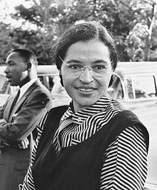
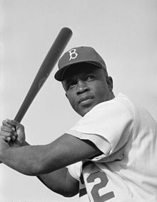
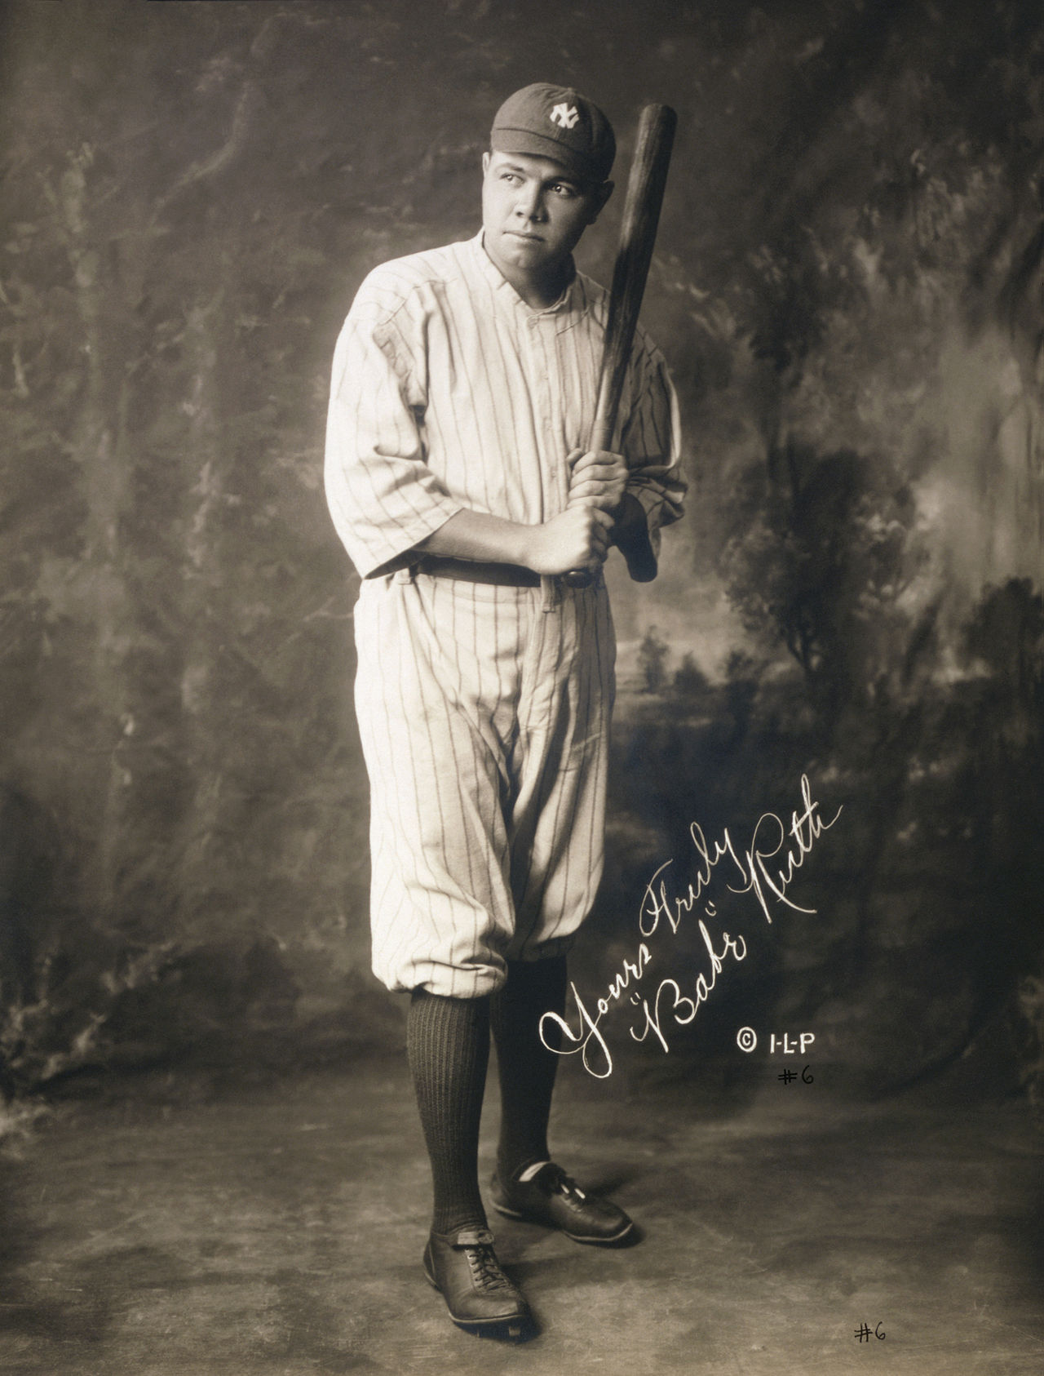
Example
Consider the three following Wikipedia pages. Which two pages would you combine to create the first cluster in a hierarchical clustering model?
Rosa Parks
Jackie Robinson
Babe Ruth
T. ARNOLD

Slide 3
Example
Consider the three following Wikipedia pages. Which two pages would you combine to create the first cluster in a hierarchical clustering model?
The trick is that there is really no right answer here.
Rosa Parks
Jackie Robinson
Babe Ruth
T. ARNOLD

Slide 4
Themes
Baseball
Civil Rights
Here is an alternative!
Rosa Parks
Jackie Robinson
Babe Ruth
T. ARNOLD

Slide 5
Themes
Baseball
Civil Rights
Here is an alternative!
Rosa Parks
0%
100%
Jackie Robinson
50%
50%
Babe Ruth
100%
0%
T. ARNOLD

Slide 6
Themes
But how to describe the themes? More probabilities!
bat
activist
boycott
segregation
ball
homerun
Baseball
3%
0%
0%
0%
2%
1%
…
…
Civil Rights
0%
1%
1%
2%
0%
0%
T. ARNOLD

Slide 7
Topic Models
Putting this all together, we can describe a topic model by two matrices (grids of numbers) describing how documents are distributed over topics and topics are distributed over words.
K topics
L words
N documents
K topics
T. ARNOLD

Slide 8
Aside: LSI
One way to find a topic model is to consider the (matrix) product of the two matricies and to try to find values that best approximate the TF-IDF matrix. This is called LSI, or latent semantic indexing.
Up to some scaling factors, the green and blue matrices will actually be the first K principal components of the TF-IDF matrix (the blue is the invert = TRUE version for the words).
The technique has some nice applications, but does not produce interpretable topics.
L words
K topics
L words
≈
TF-IDF scores
N
docs
N documents
X
K
T. ARNOLD

Slide 9
Latent Dirchlet Allocation
The actual technique we will use is a Bayesian method called LDA (latent Dirchlet allocation). The idea is that we find the values for the matrices that maximize the probability of observing the actual data.
Let’s see how to do this in R!
K topics
L words
N documents
K topics
T. ARNOLD

