Slide 1
Chapter 8
Fundamental Sampling distributions and data descriptions
Random Sampling
Some Important Statistics
Sampling Distributions of Mean
Sampling Distributions of Variance
T-Distribution

Slide 2
Random sampling

Slide 3
Recall: statistical inference
Population
Collect Data
(Randomly)
Sample
Make guess about a parameter
(Statistical Inference)

Slide 4
Example
A Pew Research article investigated Americans’ attitudes towards guns.
They conducted a survey of 3,930 Americans and asked each person whether or not they owned a gun.
Population: All Americans
3,930 Americans
Sample:
Inference!

Slide 5
Parameters and Statistics
Parameter
  Number describing a Population
  Fixed, unknown
Statistic
  Number describing a Sample
  Random, observable

Slide 6
Example
Pew Research wants to know what percent of all Americans own guns.
Percent of All Americans with guns is a parameter.
Percent of 3,930 Americans sampled with guns is a statistic.
Population: All Americans
3,930 Americans
Sample:
Inference!

Slide 7
Sampling
Non-random (convenience) sampling methods are often biased.
  Statistics from non-random samples either consistently overestimate or underestimate the true population parameters.
Random sampling
  Each unit in the population has an equal probability of being selected for the sample

Slide 8
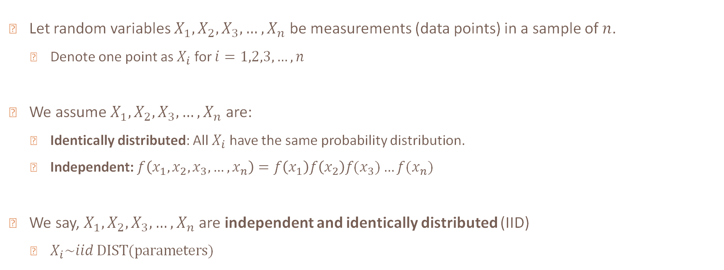
Random sampling
Let random variables $X_{1},X_{2},X_{3},…,X_{n}$ be measurements (data points) in a sample of $n$.
  Denote one point as $X_{i}$ for $i=1,2,3,…,n$
We assume $X_{1},X_{2},X_{3},…,X_{n}$ are:
  Identically distributed: All $X_{i}$ have the same probability distribution.
  Independent: $f\left(x_{1},x_{2},x_{3},…,x_{n}\right)=f\left(x_{1}\right)f\left(x_{2}\right)f(x_{3})…f(x_{n})$
We say, $X_{1},X_{2},X_{3},…,X_{n}$ are independent and identically distributed (IID)
  $X_{i}\sim iid DIST(parameters)$

Slide 9
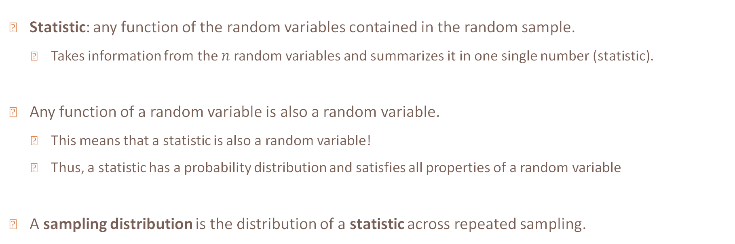
statistics
Statistic: any function of the random variables contained in the random sample.
  Takes information from the $n$ random variables and summarizes it in one single number (statistic).
Any function of a random variable is also a random variable.
  This means that a statistic is also a random variable!
  Thus, a statistic has a probability distribution and satisfies all properties of a random variable
A sampling distribution is the distribution of a statistic across repeated sampling.

Slide 10
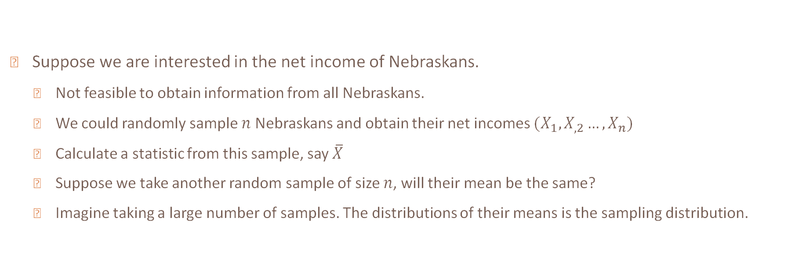
Example
Suppose we are interested in the net income of Nebraskans.
  Not feasible to obtain information from all Nebraskans.
  We could randomly sample $n$ Nebraskans and obtain their net incomes $(X_{1},X_{,2}…,X_{n})$
  Calculate a statistic from this sample, say $\overline{X}$
  Suppose we take another random sample of size $n$, will their mean be the same?
  Imagine taking a large number of samples. The distributions of their means is the sampling distribution.

Slide 11
Example
Population: All Nebraskans
$125,000
$160,000
$95,000
$134,000
$110,000
$145,000
$105,000
90,000
100,000
110,000
120,000
130,000
140,000
150,000
160,000
170,000
Average Net Income

Slide 12
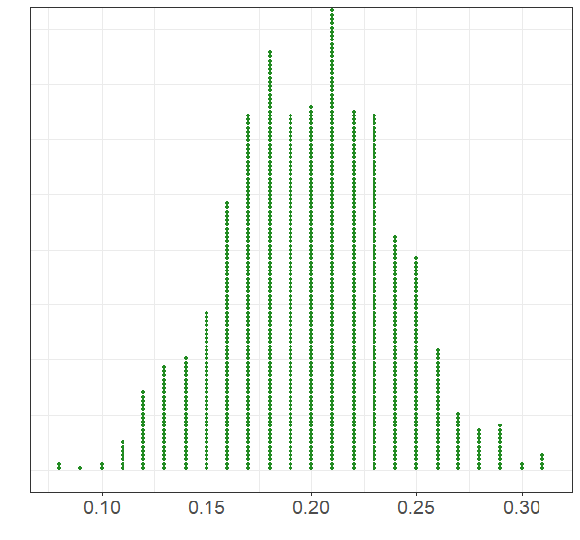

Sampling distribution of many percent's
$$\hat{p}$$

Slide 13
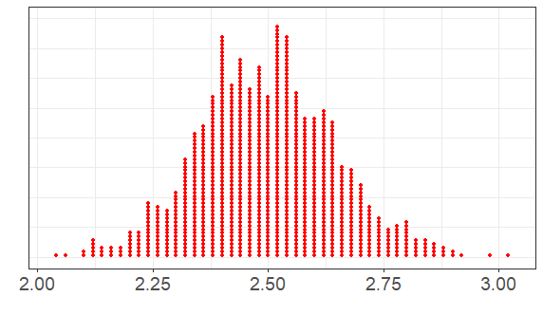

Sampling distribution of many means
$$\overline{x}$$

Slide 14
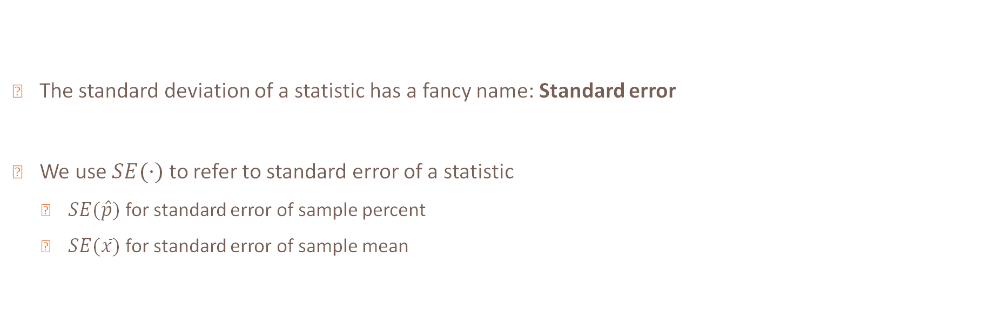
Standard error
The standard deviation of a statistic has a fancy name: Standard error
We use $SE(⋅)$ to refer to standard error of a statistic
  $SE(\hat{p})$ for standard error of sample percent
  $SE(\overline{x})$ for standard error of sample mean

Slide 15
Good statistics
Are unbiased (on average, equal to their population version)
Precise (small standard errors)

Slide 16

Sampling Distribution of $\overline{X}$
Let $X_{i}\sim iid N(μ,σ^{2})$. Consider $\overline{X}=\frac{\sum_{i=1}^{n}{X_{i}}}{n}$. Find $E[\overline{X}]$ and $Var(\overline{X})$

Slide 17
Example 1
If a sample of size of 144 is drawn from a normal distribution with mean 130 and variance 20, what is the distribution of the sample mean? (specify the values of the parameter(s))

Slide 18
Sampling Distributions Activity
Go to the Sampling Distributions webpage at http://onlinestatbook.com/stat_sim/sampling_dist/index.html
Click begin
Steps
  Select Normal Distribution for your parent population
  Select N = 2
  Click animate, click animate again, and again…
  Click 10,000
  Increase N to 25 and repeat
  What do you notice about the mean and standard deviation of your parent population and sampling distributions?
Repeat steps above by changing the parent population to Uniform, Skewed, and Custom
What happens as you change your parent population? What changes as N increases?

Slide 19
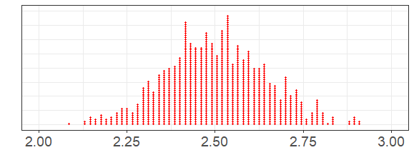
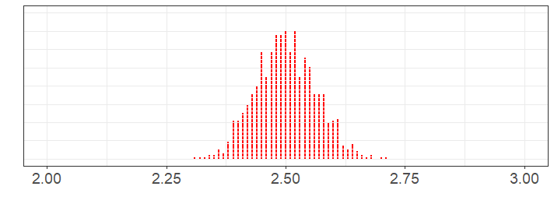
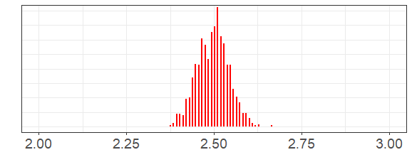
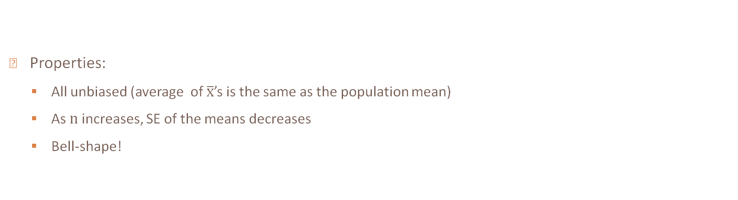
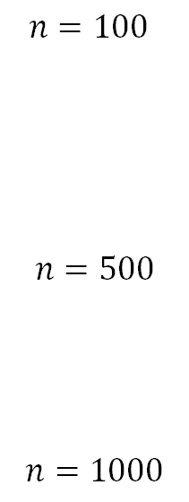
Sampling Distribution of $\overline{X}$
$n=100$
$$n=500$$
$$n=1000$$
Properties:
  All unbiased (average of $\overline{x}$’s is the same as the population mean)
  As $n$ increases, SE of the means decreases
  Bell-shape!

Slide 20
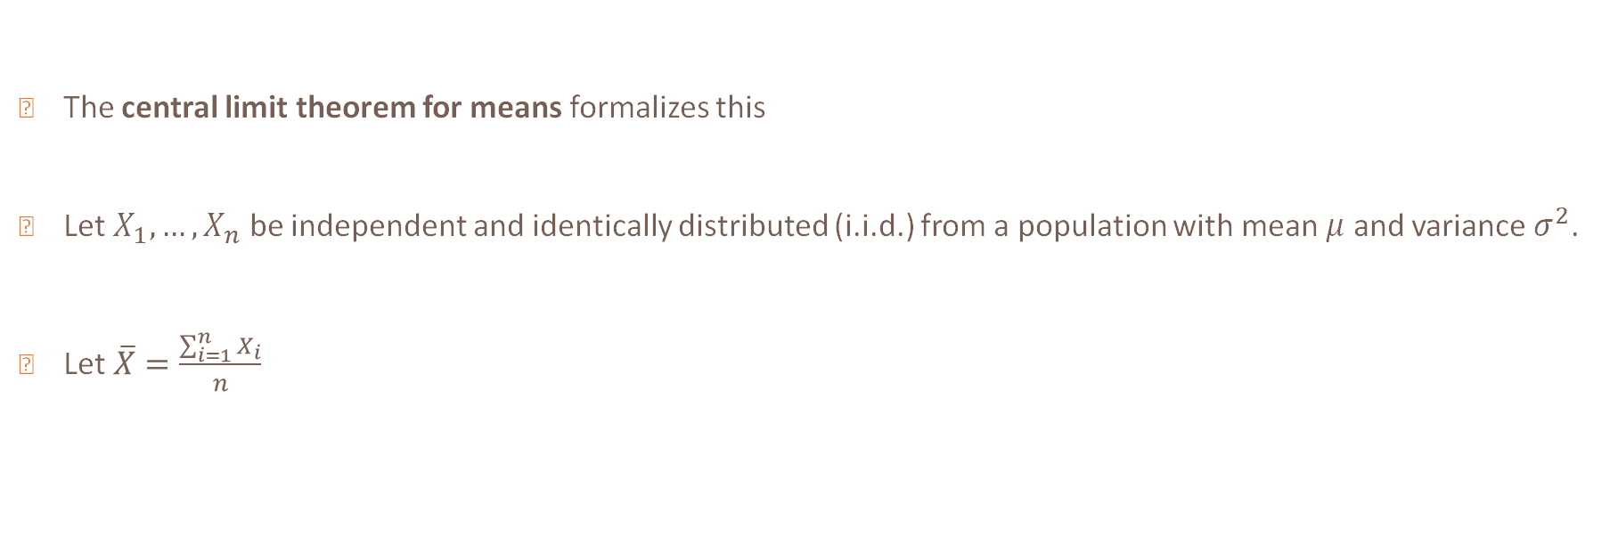
Central limit theorem
The central limit theorem for means formalizes this
Let $X_{1},…,X_{n}$ be independent and identically distributed (i.i.d.) from a population with mean $μ$ and variance $σ^{2}$.
Let $\overline{X}=\frac{\sum_{i=1}^{n}{X_{i}}}{n}$

Slide 21
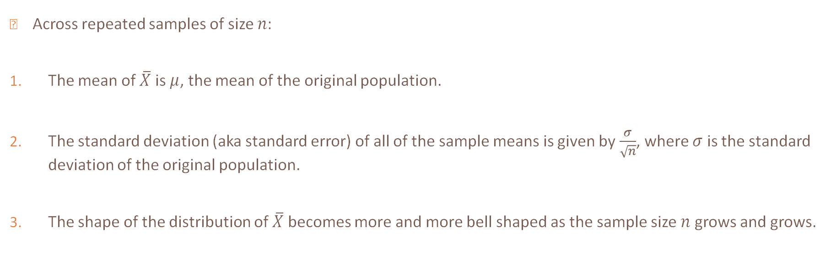
Central limit theorem
Across repeated samples of size $n$:
The mean of $\overline{X}$ is $μ$, the mean of the original population.
The standard deviation (aka standard error) of all of the sample means is given by $\frac{σ}{\sqrt{n}}$, where $σ$ is the standard deviation of the original population.
The shape of the distribution of $\overline{X}$ becomes more and more bell shaped as the sample size $n$ grows and grows.

Slide 22
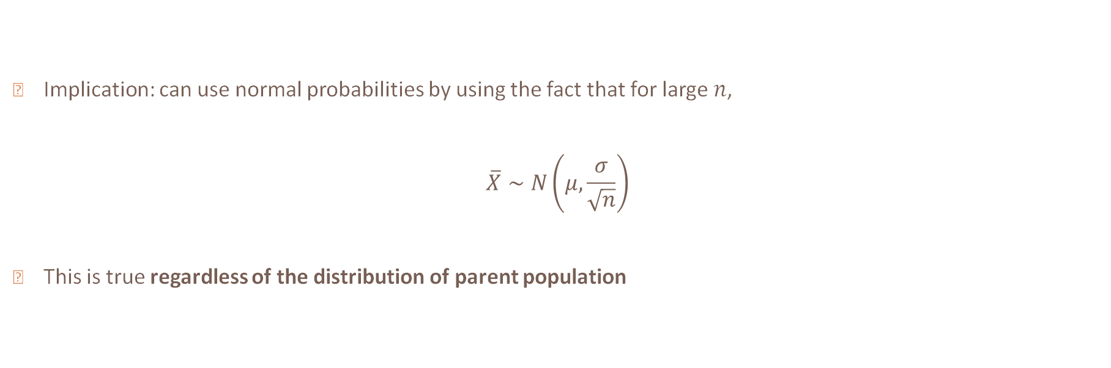
Implication of CLT
Implication: can use normal probabilities by using the fact that for large $n$,
$$\overline{X}∼N\left(μ,\frac{σ}{\sqrt{n}}\right)$$
This is true regardless of the distribution of parent population

Slide 23
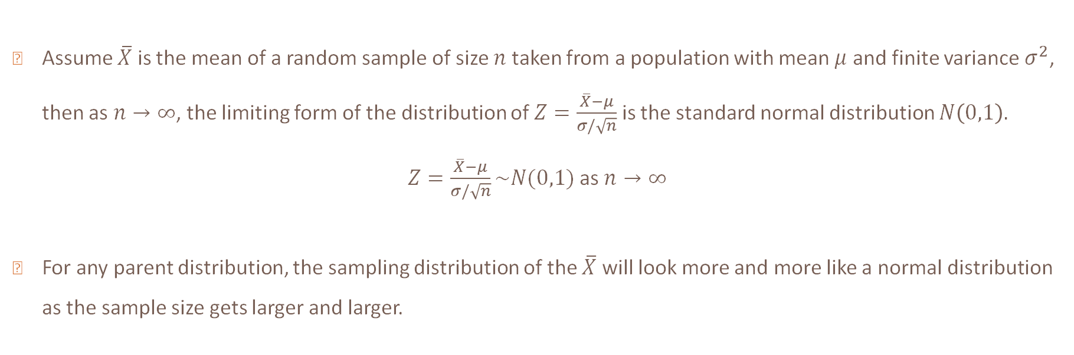
CLT Formal definition
Assume $\overline{X}$ is the mean of a random sample of size $n$ taken from a population with mean $μ$ and finite variance $σ^{2}$, then as $n→∞$, the limiting form of the distribution of $Z=\frac{\overline{X}−μ}{σ/\sqrt{n}}$ is the standard normal distribution $N\left(0,1\right).$
$Z=\frac{\overline{X}−μ}{σ/\sqrt{n}}\sim N(0,1)$ as $n→∞$
For any parent distribution, the sampling distribution of the $\overline{X}$ will look more and more like a normal distribution as the sample size gets larger and larger.

Slide 24
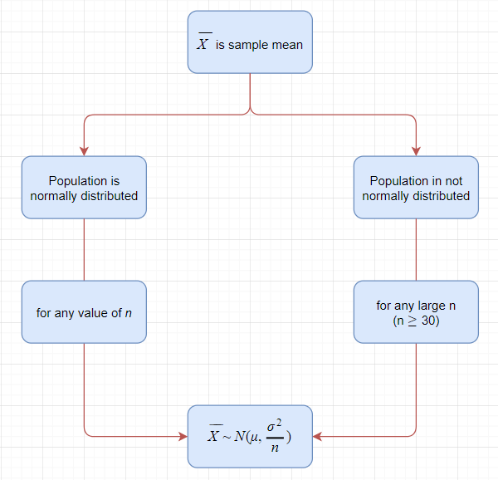

Slide 25
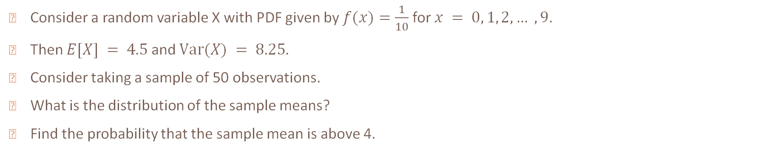
Example 2
Consider a random variable X with PDF given by $f(x)=\frac{1}{10}$ for $x = 0, 1, 2, … ,9$.
Then $E[X] = 4.5$and $Var(X) = 8.25$.
Consider taking a sample of 50 observations.
What is the distribution of the sample means?
Find the probability that the sample mean is above 4.

Slide 26
Central limit theorem
Across repeated samples of size $n$:
The mean of $\overline{X}$ is $μ$, the mean of the original population.
The standard deviation (aka standard error) of all of the sample means is given by $\frac{σ}{\sqrt{n}}$, where $σ$ is the standard deviation of the original population.
The shape of the distribution of $\overline{X}$ becomes more and more bell shaped as the sample size $n$ grows and grows.

Slide 28
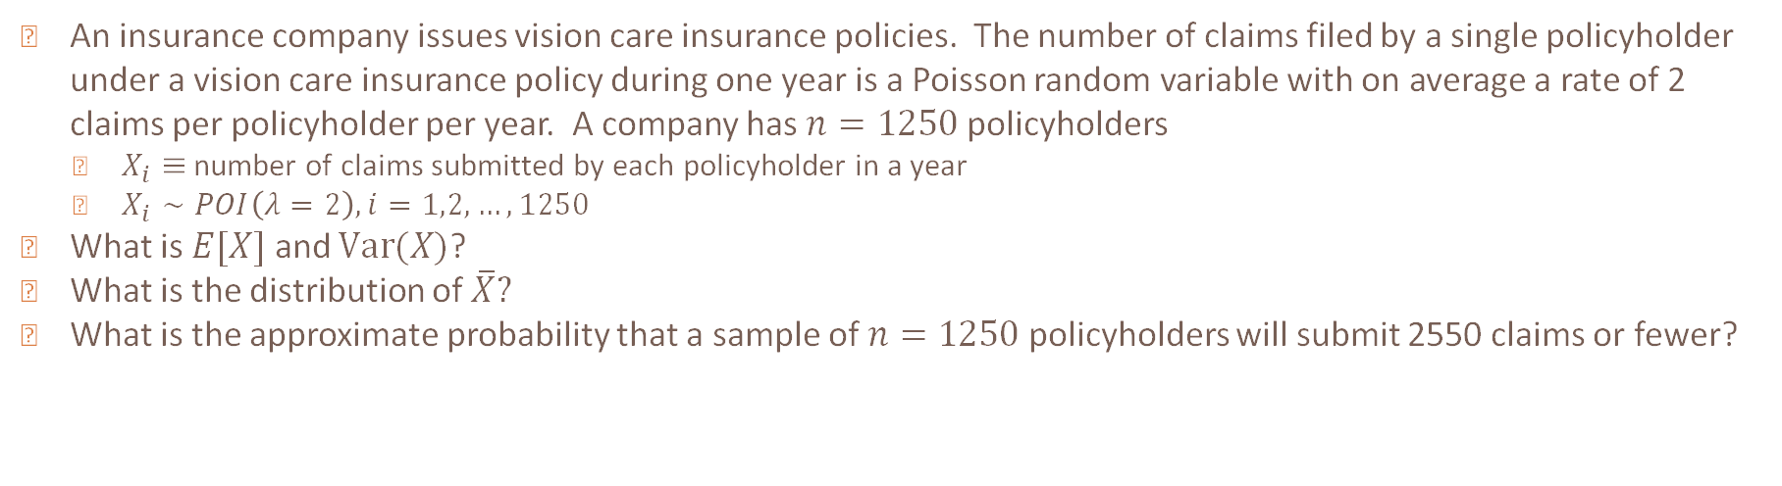
Example 3
An insurance company issues vision care insurance policies. The number of claims filed by a single policyholder under a vision care insurance policy during one year is a Poisson random variable with on average a rate of 2 claims per policyholder per year. A company has $n=1250$ policyholders
  $X_{i}≡$ number of claims submitted by each policyholder in a year
  $X_{i}∼POI\left(λ=2\right), i=1,2,…,1250$
What is $E[X]$ and $Var(X)$?
What is the distribution of $\overline{X}?$
What is the approximate probability that a sample of $n=1250$ policyholders will submit 2550 claims or fewer?

Slide 29
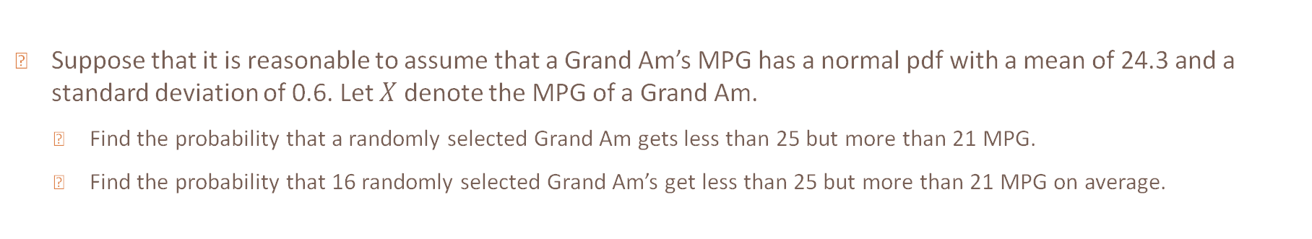
Example 4
Suppose that it is reasonable to assume that a Grand Am’s MPG has a normal pdf with a mean of 24.3 and a standard deviation of 0.6. Let $X$ denote the MPG of a Grand Am.
  Find the probability that a randomly selected Grand Am gets less than 25 but more than 21 MPG.
  Find the probability that 16 randomly selected Grand Am’s get less than 25 but more than 21 MPG on average.

Slide 30
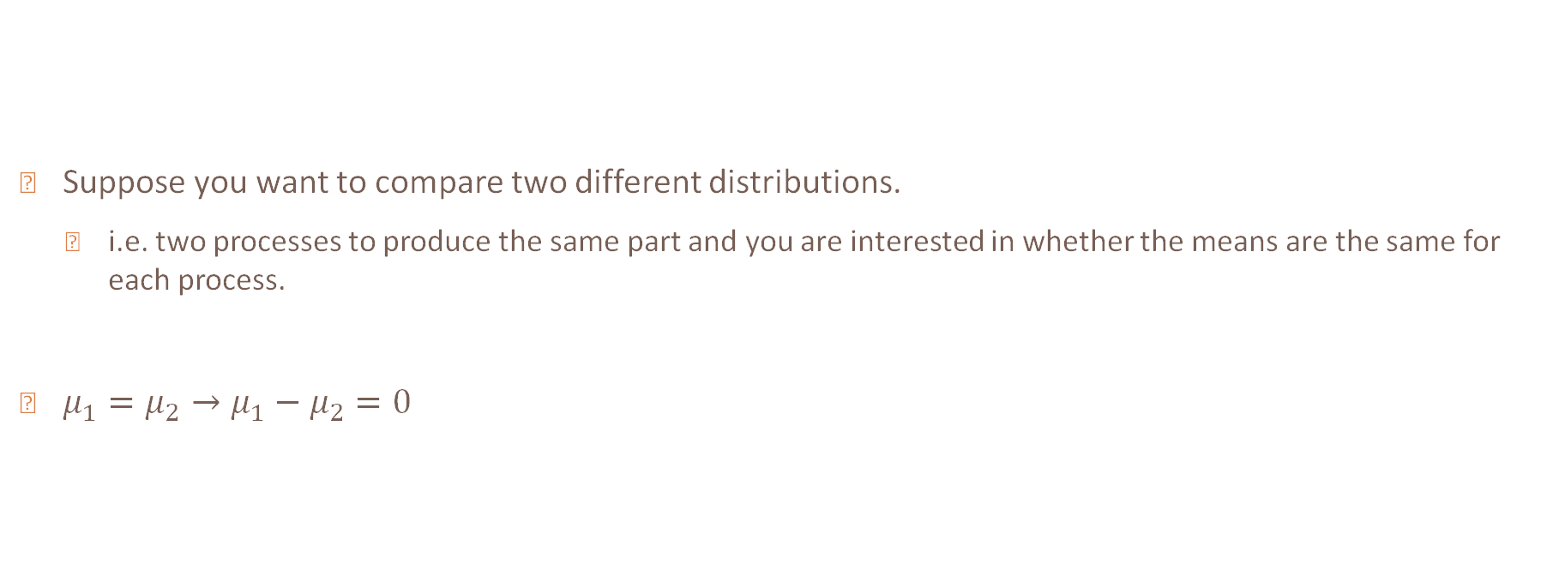

Sampling distribution of ${\overline{X}}_{1}−{\overline{X}}_{2}$
Suppose you want to compare two different distributions.
  i.e. two processes to produce the same part and you are interested in whether the means are the same for each process.
$μ_{1}=μ_{2}→μ_{1}−μ_{2}=0$

Slide 31
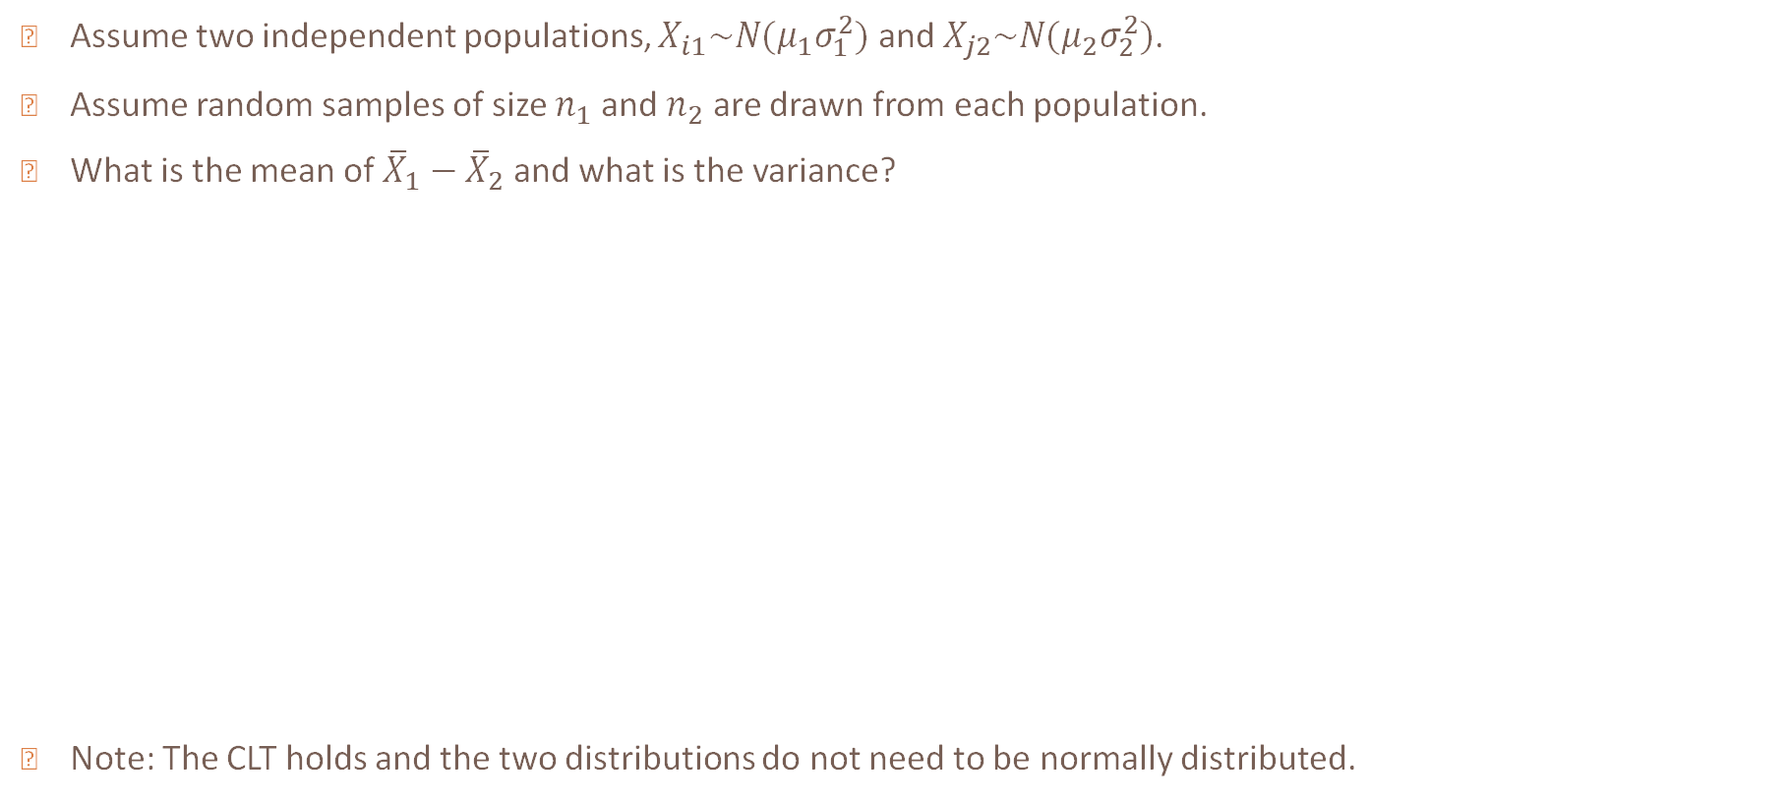
Sampling distribution of ${\overline{X}}_{1}−{\overline{X}}_{2}$
Assume two independent populations, $X_{i1}\sim N(μ_{1}σ_{1}^{2})$ and $X_{j2}\sim N(μ_{2}σ_{2}^{2})$.
Assume random samples of size $n_{1}$ and $n_{2}$ are drawn from each population.
What is the mean of ${\overline{X}}_{1}−{\overline{X}}_{2}$ and what is the variance?
Note: The CLT holds and the two distributions do not need to be normally distributed.

Slide 32
Example 5
The television picture tubes of manufacturer A have an expected lifetime of 6.5 years and a standard deviation of 0.9 year, while those of manufacturer B have an expected lifetime of 6.0 years and a standard deviation of 0.8 year. What is the probability that a random sample of 36 tubes from manufacturer A will have a mean lifetime that is at least 1 year more than the mean lifetime of a sample of 49 tubes from manufacturer B?

Slide 33
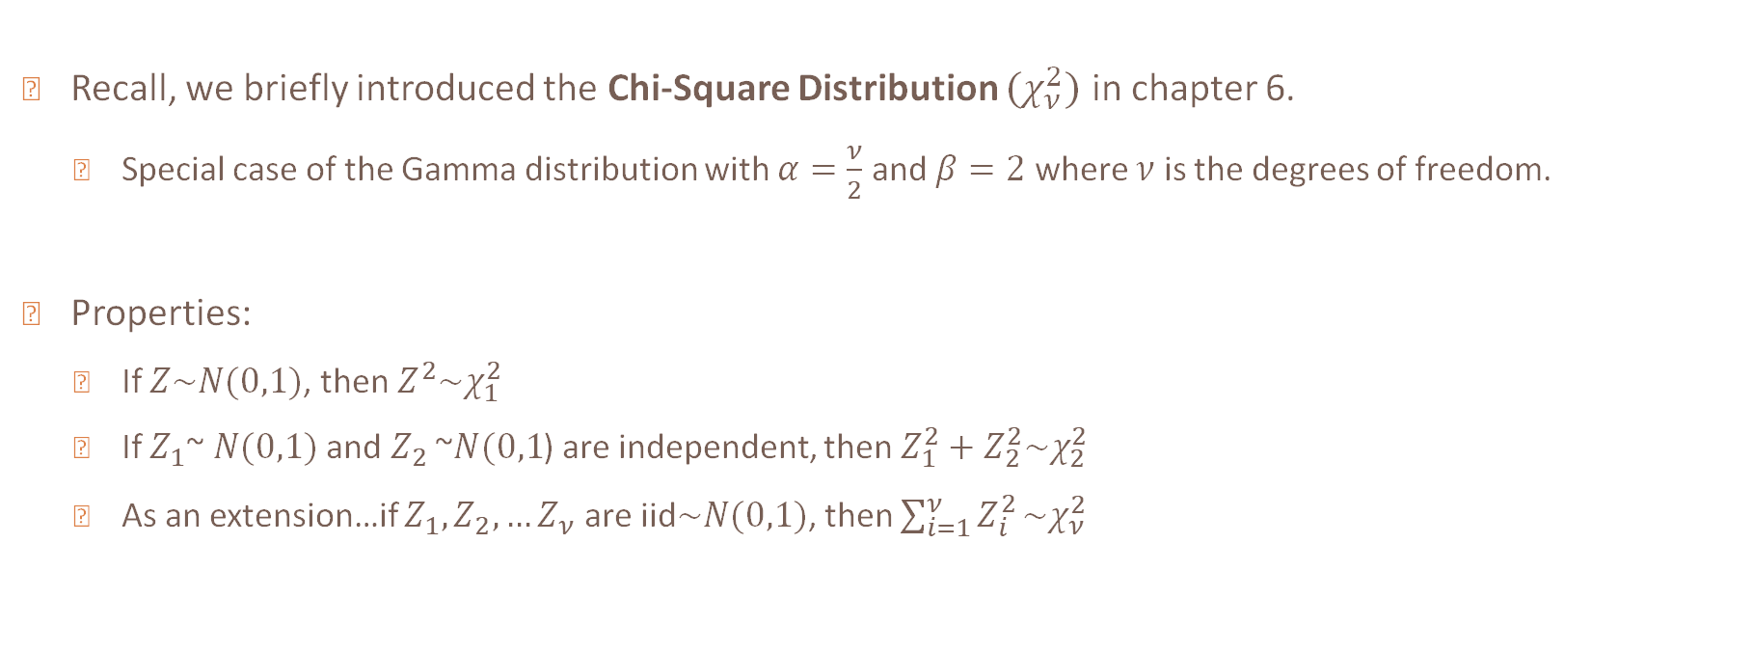
Chi – Square distribution
Recall, we briefly introduced the Chi-Square Distribution $(χ_{ν}^{2})$ in chapter 6.
  Special case of the Gamma distribution with $α=\frac{ν}{2}$ and $β=2$ where $ν$ is the degrees of freedom.
Properties:
  If $Z\sim N(0,1)$, then $Z^{2}\sim χ_{1}^{2}$
  If $Z_{1}$~ $N(0,1)$ and $Z_{2}$ ~$N(0,1$) are independent, then $Z_{1}^{2}+Z_{2}^{2}\sim χ_{2}^{2}$
  As an extension…if $Z_{1},Z_{2},…Z_{ν}$ are iid$\sim N(0,1)$, then $\sum_{i=1}^{ν}{Z_{i}^{2}}\sim χ_{ν}^{2}$

Slide 34
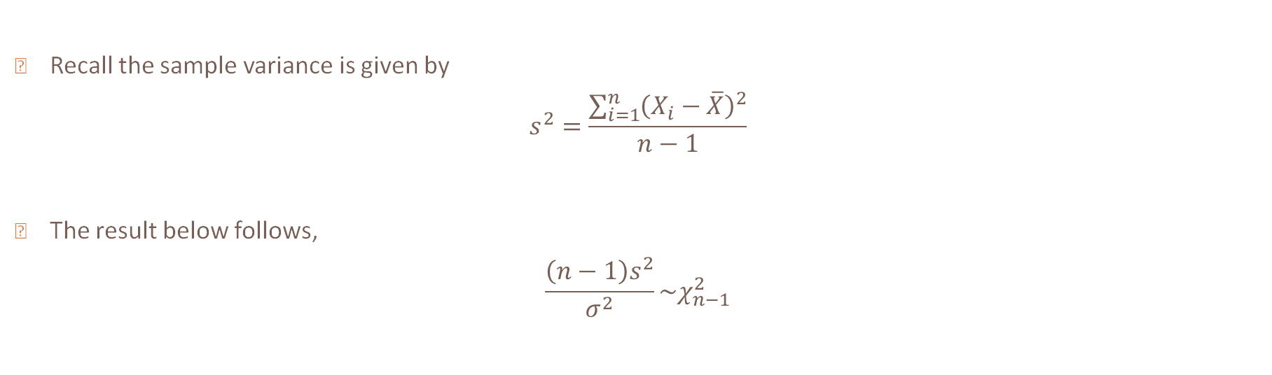

Sampling distribution of $s^{2}$
Recall the sample variance is given by
$$s^{2}=\frac{\sum_{i=1}^{n}{{\left(X_{i}−\overline{X}\right)}^{2}}}{n−1}$$
The result below follows,
$$\frac{\left(n−1\right)s^{2}}{σ^{2}}\sim χ_{n−1}^{2}$$

Slide 35
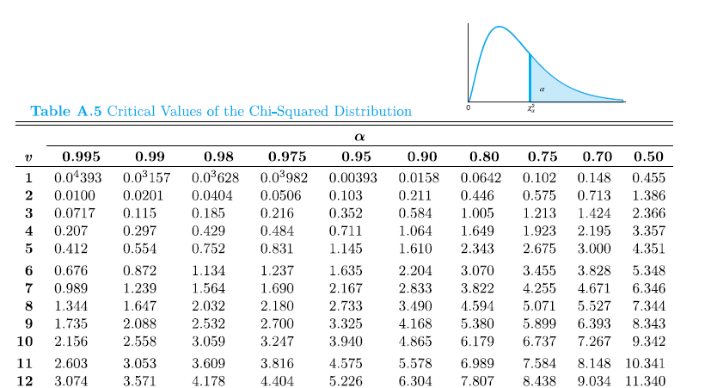
Chi-square table
The chi-square table gives the quantile $c$ such that $P\left(χ_{ν}^{2}>c\right)=p$
Find probability
Find degrees of freedom

Slide 36
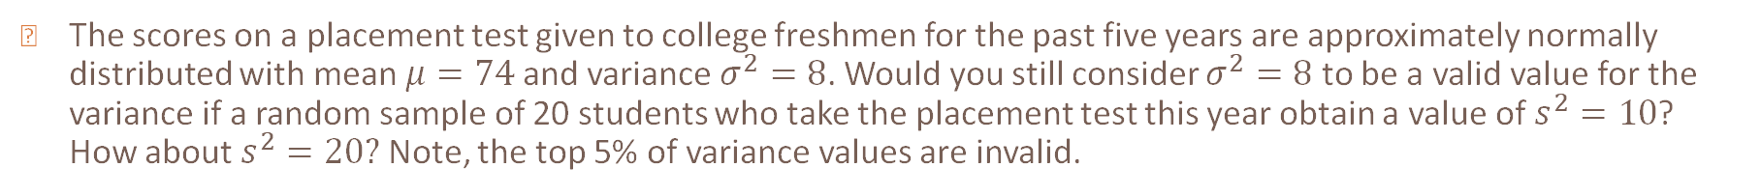
Example 6
The scores on a placement test given to college freshmen for the past five years are approximately normally distributed with mean $μ=74$ and variance $σ^{2}=8$. Would you still consider $σ^{2}=8$ to be a valid value for the variance if a random sample of 20 students who take the placement test this year obtain a value of $s^{2}=10$? How about $s^{2}=20?$ Note, the top 5% of variance values are invalid.

Slide 37
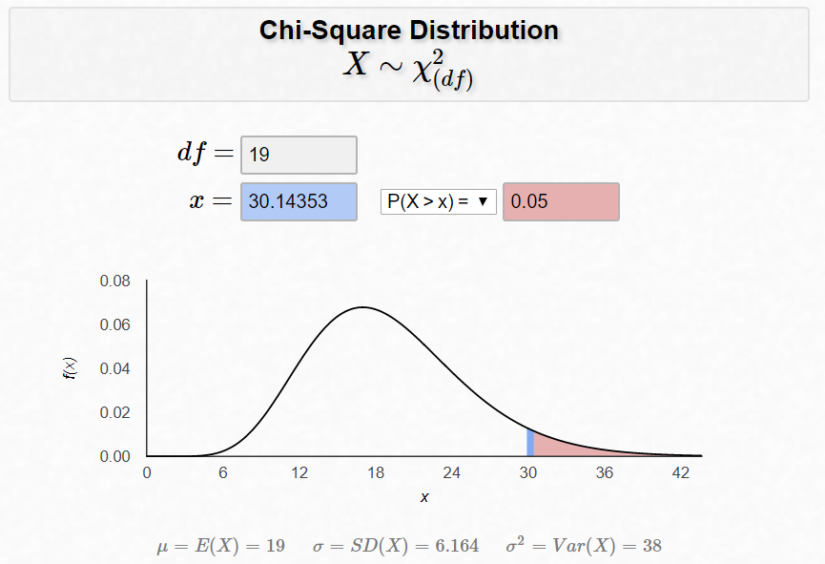
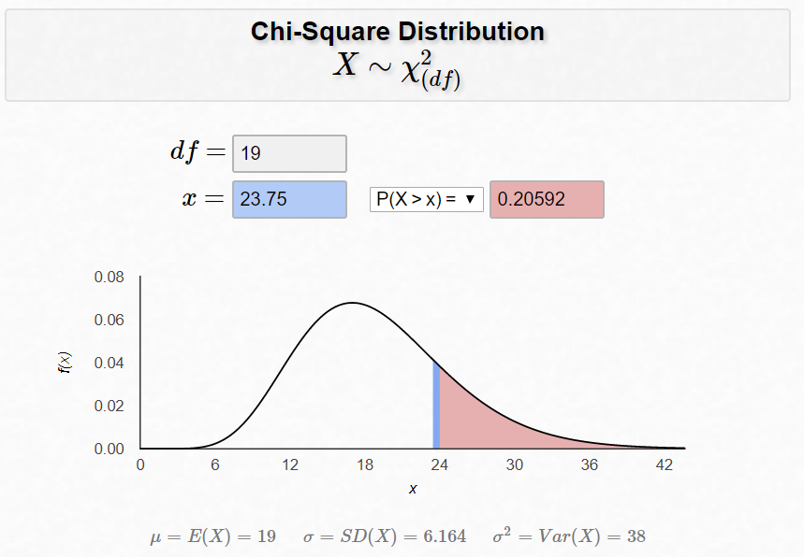
Technology

Slide 38
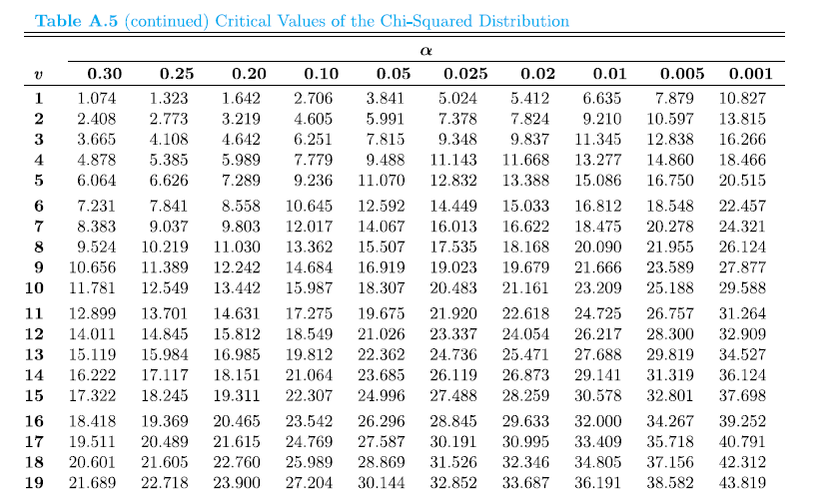

Slide 39
In-class
The time (in hours) that a technician requires to perform preventive maintenance on an air-conditioning unit is governed by the exponential distribution with mean 1 hour. Your company has a contract to maintain 70 of these units in an apartment building. You must schedule technicians’ time for a visit to this building. Is it safe to budget an average of 1.1 hour for each unit? Or should you budget an average of 1.25 hours?

Slide 40
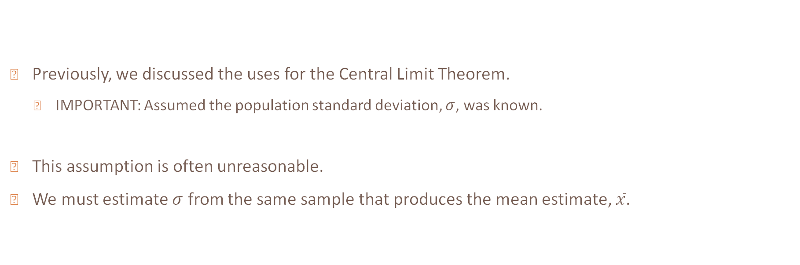
T – distribution
Previously, we discussed the uses for the Central Limit Theorem.
  IMPORTANT: Assumed the population standard deviation, $σ$, was known.
This assumption is often unreasonable.
We must estimate $σ$ from the same sample that produces the mean estimate, $\overline{x}$.

Slide 41
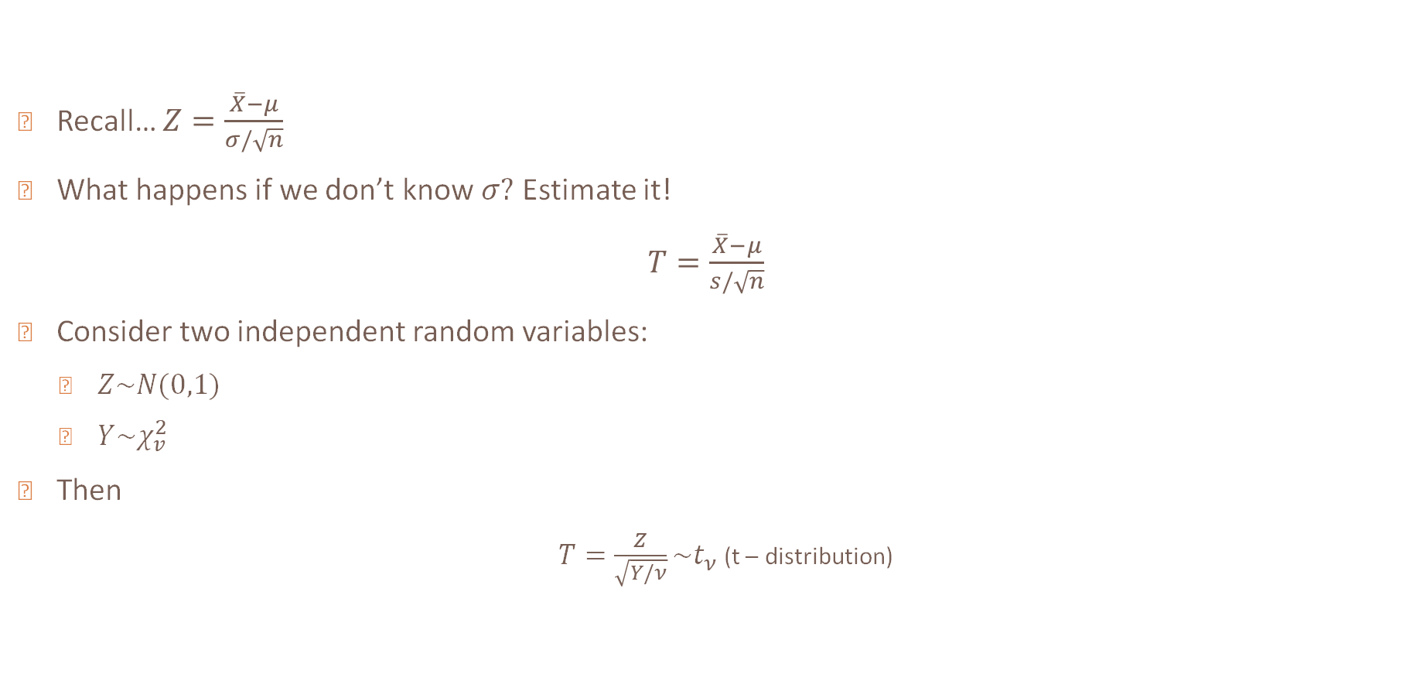
T – Distribution
Recall… $Z=\frac{\overline{X}−μ}{σ/\sqrt{n}}$
What happens if we don’t know $σ?$ Estimate it!
$T=\frac{\overline{X}−μ}{s/\sqrt{n}}$
Consider two independent random variables:
  $Z\sim N(0,1)$
  $Y\sim χ_{v}^{2}$
Then
  $T=\frac{Z}{\sqrt{Y/ν}}\sim t_{ν}$ (t – distribution)

Slide 42
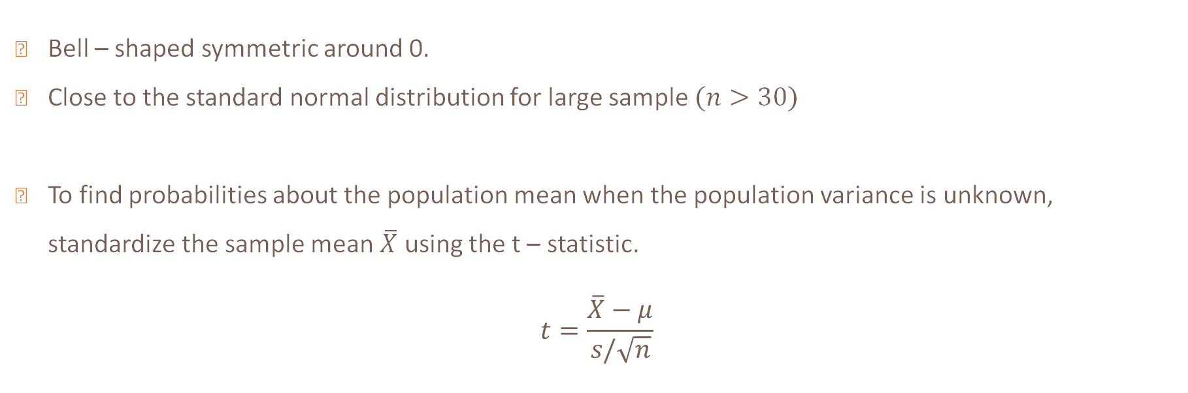
T - distribution
Bell – shaped symmetric around 0.
Close to the standard normal distribution for large sample $(n>30)$
To find probabilities about the population mean when the population variance is unknown, standardize the sample mean $\overline{X}$ using the t – statistic.
$$t=\frac{\overline{X}−μ}{s/\sqrt{n}}$$

Slide 43
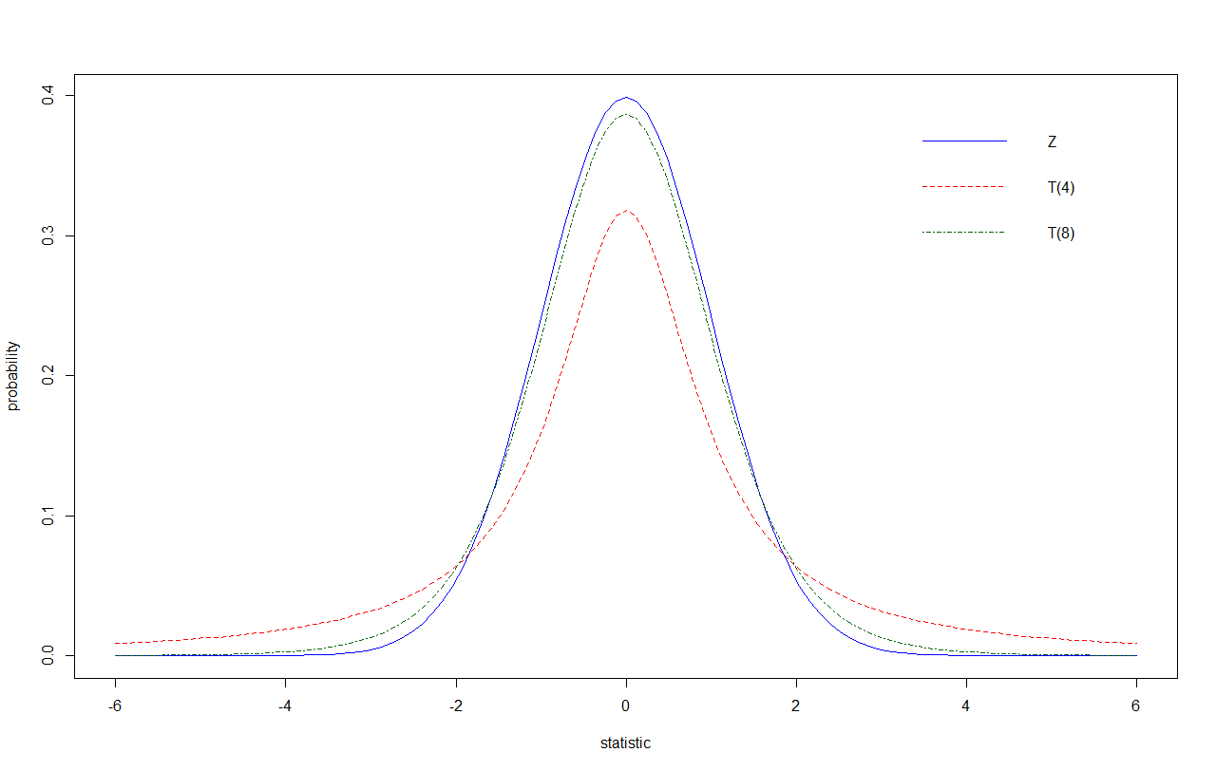

Slide 44
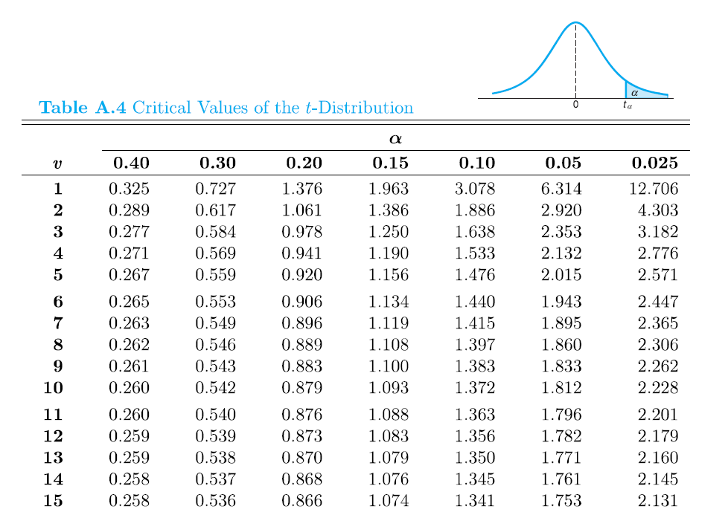
Gives positive critical values, $t$, such that $P\left(T>t\right)=α$
Note that $P(T > t) = P(T <−t)$
Find probability
Find degrees of freedom

Slide 45
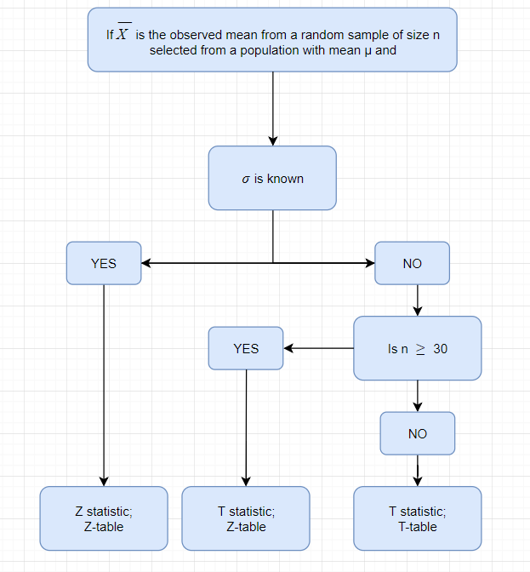

Slide 46
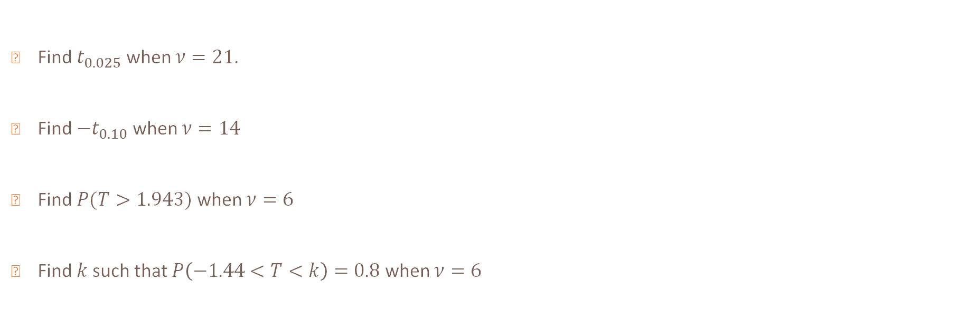
Example 7
Find $t_{0.025}$ when $ν=21$.
Find $−t_{0.10}$ when $ν=14$
Find $P(T>1.943)$ when $ν=6$
Find $k$such that $P\left(−1.44<T<k\right)=0.8$ when $ν=6$

Slide 47
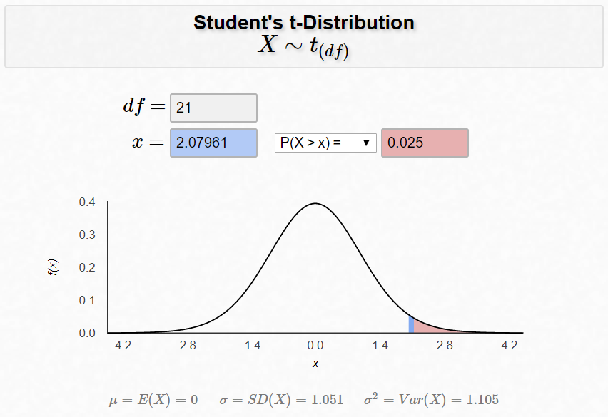
Technology

Slide 48
Example 8
It is known that HW scores follow a normal distribution with mean 80. Given a random sample of 15 HW scores with a sample standard deviation of 5, what is the probability that the average HW score is at least 82?

Slide 49
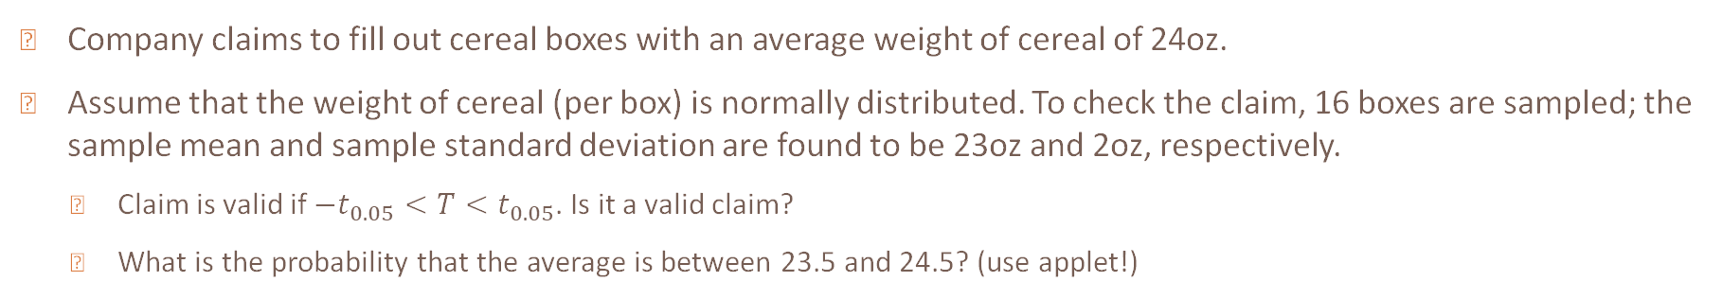
Example 9
Company claims to fill out cereal boxes with an average weight of cereal of 24oz.
Assume that the weight of cereal (per box) is normally distributed. To check the claim, 16 boxes are sampled; the sample mean and sample standard deviation are found to be 23oz and 2oz, respectively.
  Claim is valid if $−t_{0.05}<T<t_{0.05}$. Is it a valid claim?
  What is the probability that the average is between 23.5 and 24.5? (use applet!)

Slide 50
Example 10
An insurance company knows that in the entire population of millions of apartment owners, the mean expected annual loss from damage is $75 with a standard deviation of $300. The distribution of losses is strongly right skewed (i.e. most policies have $0 losses) but a few have large losses. If the company sells 10,000 policies, can it safely base its rates on the assumption that its average loss will be no greater than $85

Slide 51
In-class
It is known that a certain engine is expected to perform at 20 MPG. A random sample of 100 engines is chosen and with the sample variance computed to be 1. Find the probability that, on average, the chosen engines will perform less than 21 MPG.

