Slide 1
Orange Theory Data Analysis
Jon Zimmerman
XX/XX/2020

Slide 2
What is Orange Theory?
Orange Theory is a 60 minute, full-body workout, focused on training endurance, strength and power.¹
This is a High Intensity Interval Training (HIIT) workout, which alternates between short periods of intense exercise and long recovery periods.
Studios are split into three stations: treadmills, rowing machines, and weight training. Members cycle between these stations over the course of a session at the instruction of a coach.
Each member wears a heart rate monitor during the workout to track statistics throughout the class.
Notes:
https://www.orangetheoryfitness.com/faq

Slide 3
How does the heart rate monitor track performance?
Calories Burned
Amount of Time Spent in each of the five designated heart rate zones:
Gray: <=60% of your max heart rate (resting heart rate zone)
Blue: Between 61 and 70% of your max heart rate (warm-up period zone)
Green: Between 71 and 83% of your max heart rate (challenging, but do-able zone)
Orange: Between 84 and 91% of your max heart rate (uncomfortable, fat-burning zone)
Red: >=92% of your max heart rate (uncomfortable, “all-out” effort zone)
Notes:
First class → Max Heart Rate is assigned through a formula that accounts for member’s age
After 20 classes → you can readjust your max heart rate to your actual Max HR from any of the previous 20 classes

Slide 4
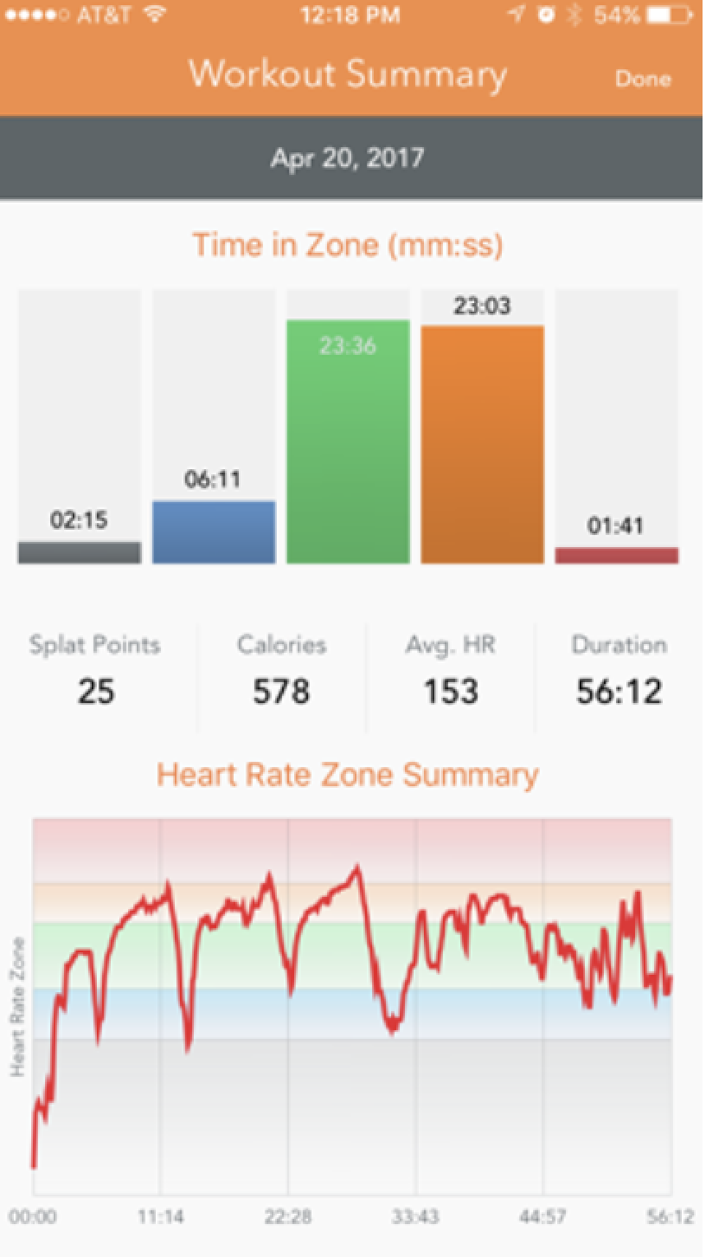
How does the heart rate monitor track performance?
Splat Points = Time Spent in Orange Zone + Time Spent in Red Zone
Ideally, you want to earn >=12 splat points per class
Earning 12 splat points or more will achieve the Excess Post-Exercise Oxygen Consumption (EPOC) or after-burn effect.
This results in an increased metabolic rate for up to 36 hours after the workout, which leads to higher calorie burn after, not just during the workout¹
Notes:
https://www.orangetheoryfitness.com/faq

